Slide 1

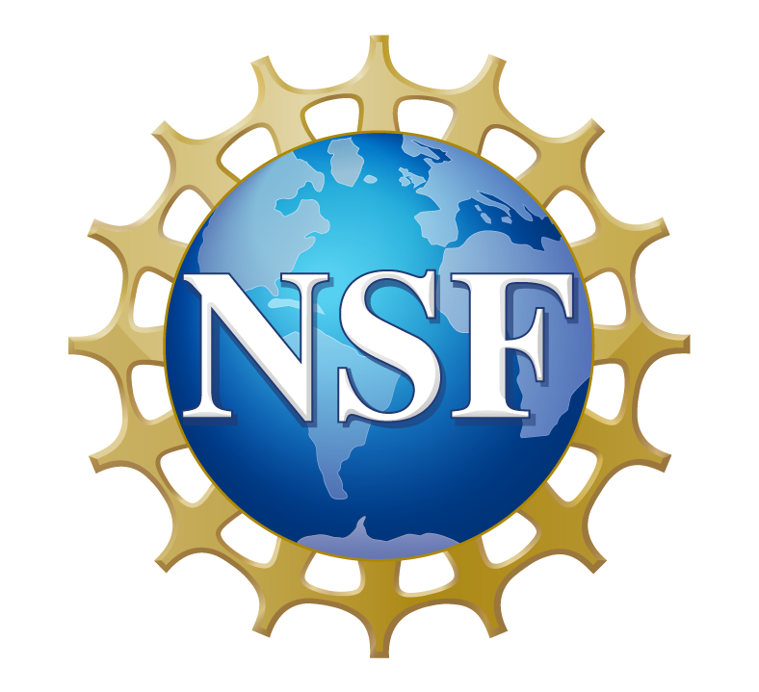
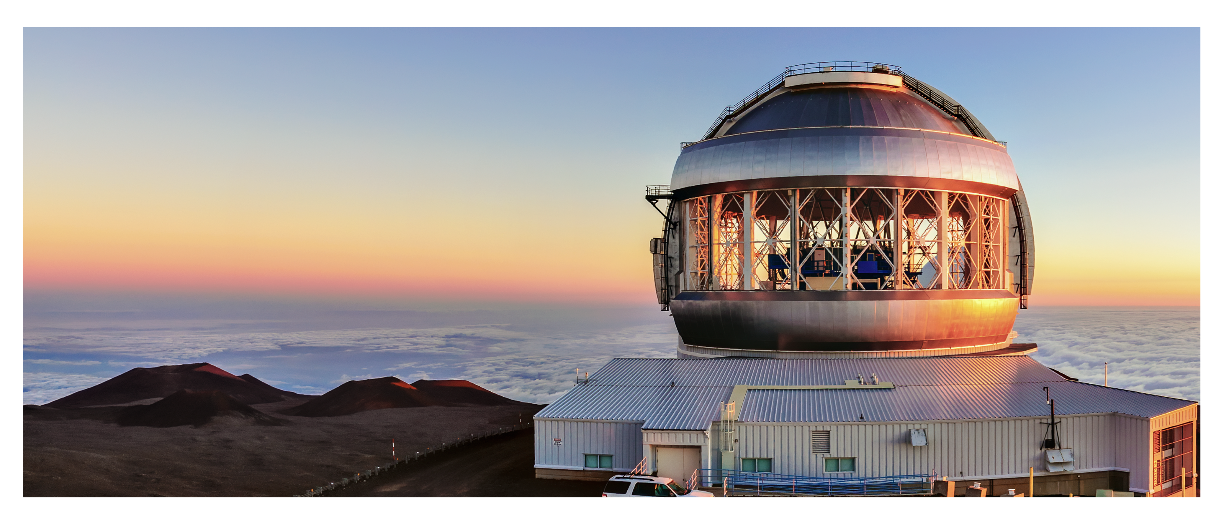

Gemini North, part of Gemini Observatory, in Maunakea, HI

Slide 2
Share your story using these customizable social media templates. Social media posts will be used as reference material and/or shared via NSF channels. When using this template please do not exceed the 60-character maximum. Your participation is voluntary.

Slide 3
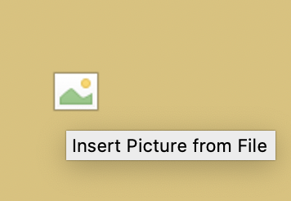
Replacing Images
Images can easily be replaced in the layout by clicking the image icon (Figure 1), selecting a photo from your device and then clicking Insert.
NOTE for NSF Staff: If you need assistance verifying copyright and permissions, please contact OLPA image research.
Figure 1

Slide 4
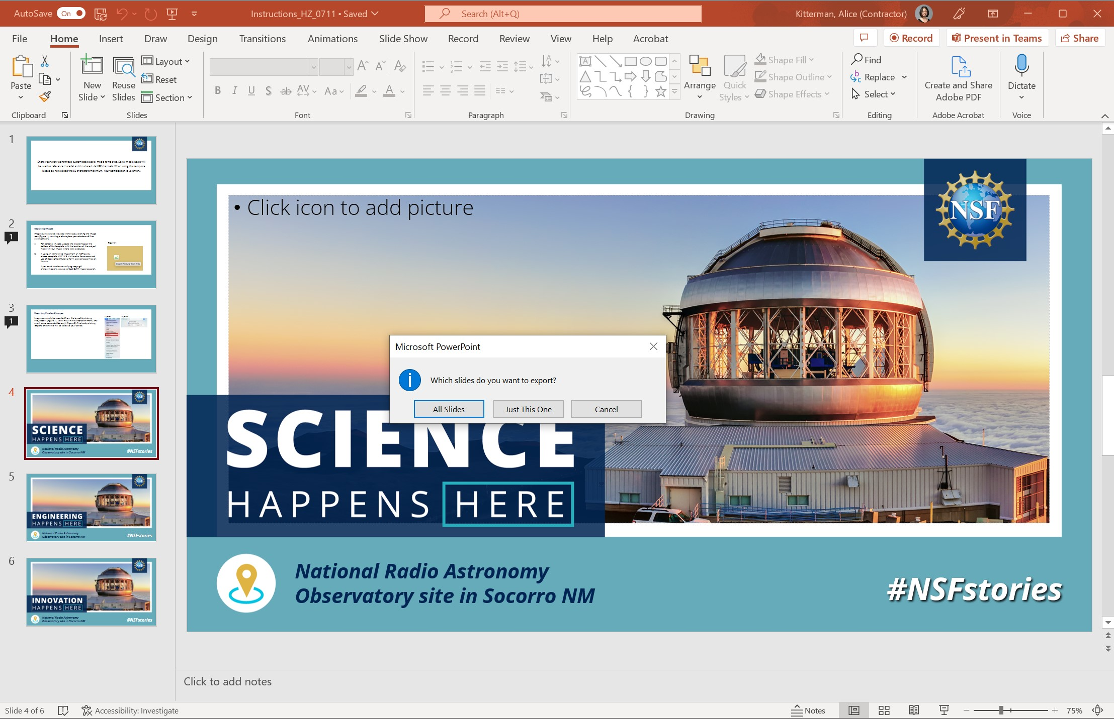
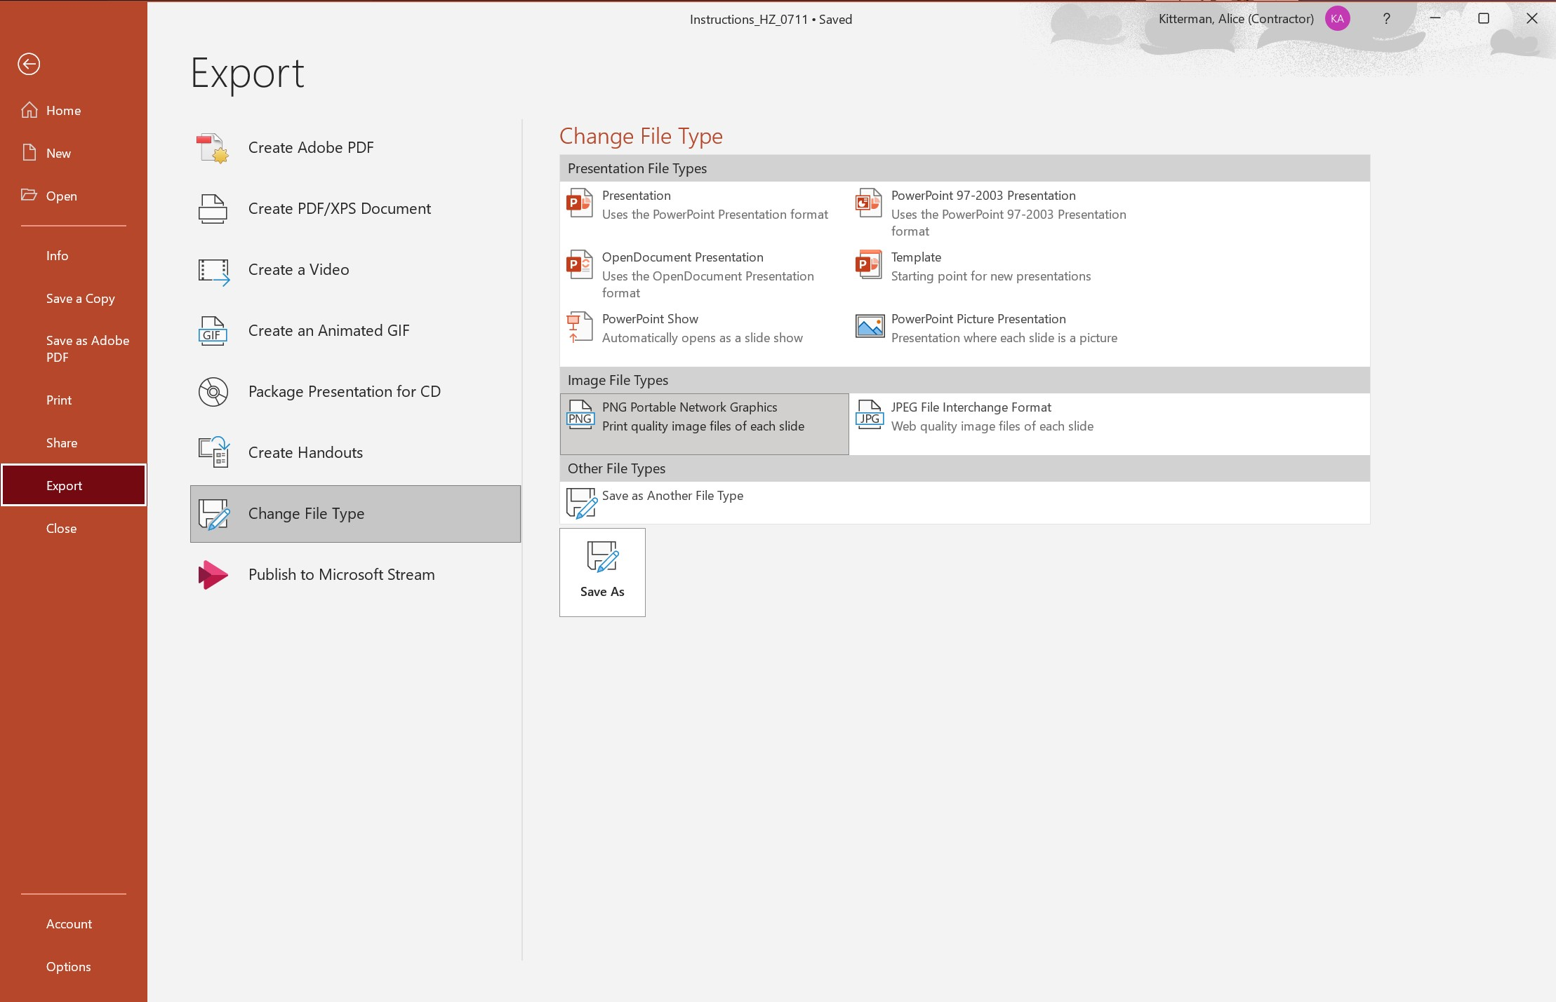
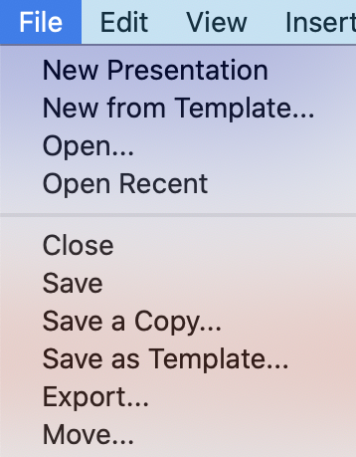
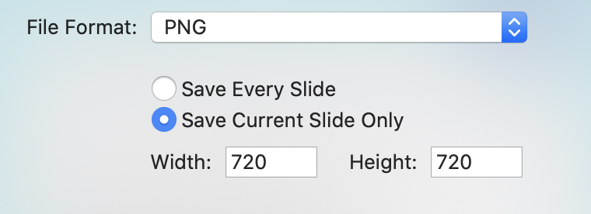
Exporting Finalized Images
Images can easily be exported from the layout by clicking File, Export (Figures 2a and 2b). Select ‘Change File Type’ and select PNG in the drop-down menu. Select ‘save current slide only’ (Figures 3a and 3b). Finalize by clicking ’Export’ and the file will be saved to your device.
Figure 3a, PC
Figure 2a, PC
Figure 2b, Mac
Figure 3b, Mac

Slide 5
National Radio Astronomy
Observatory site in Socorro, NM

Slide 6

National Radio Astronomy
Observatory site in Socorro, NM

Slide 7

National Radio Astronomy
Observatory site in Socorro, NM

