Slide 1
Frontiers in Research and Education in Computing:
A View from the National Science Foundation
Jeannette M. Wing
Assistant Director
Computer and Information Science and Engineering
and
President’s Professor of Computer Science
Carnegie Mellon University
AT&T Labs
Florham Park, NJ
June 10, 2009

Slide 2
NSF

Slide 3
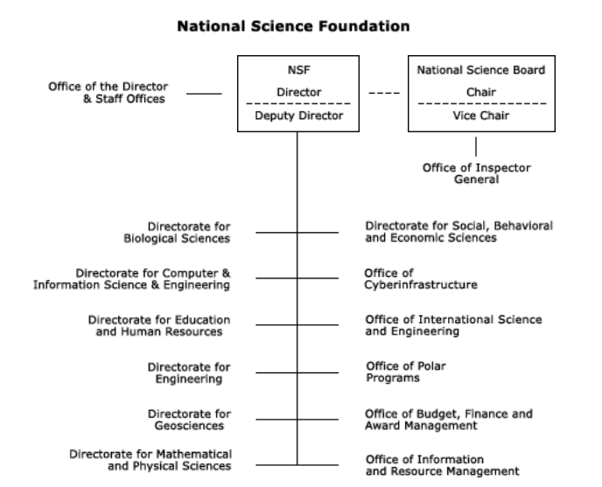

Slide 4
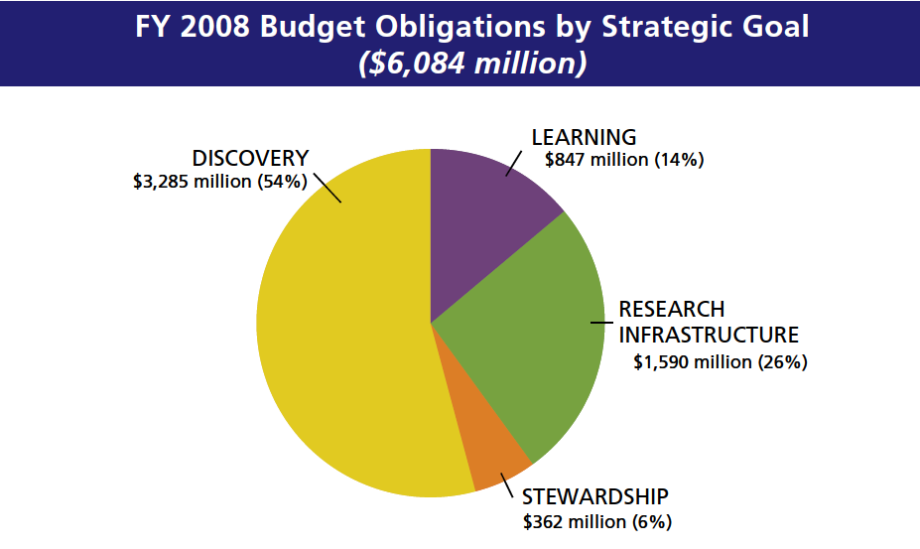

Slide 5
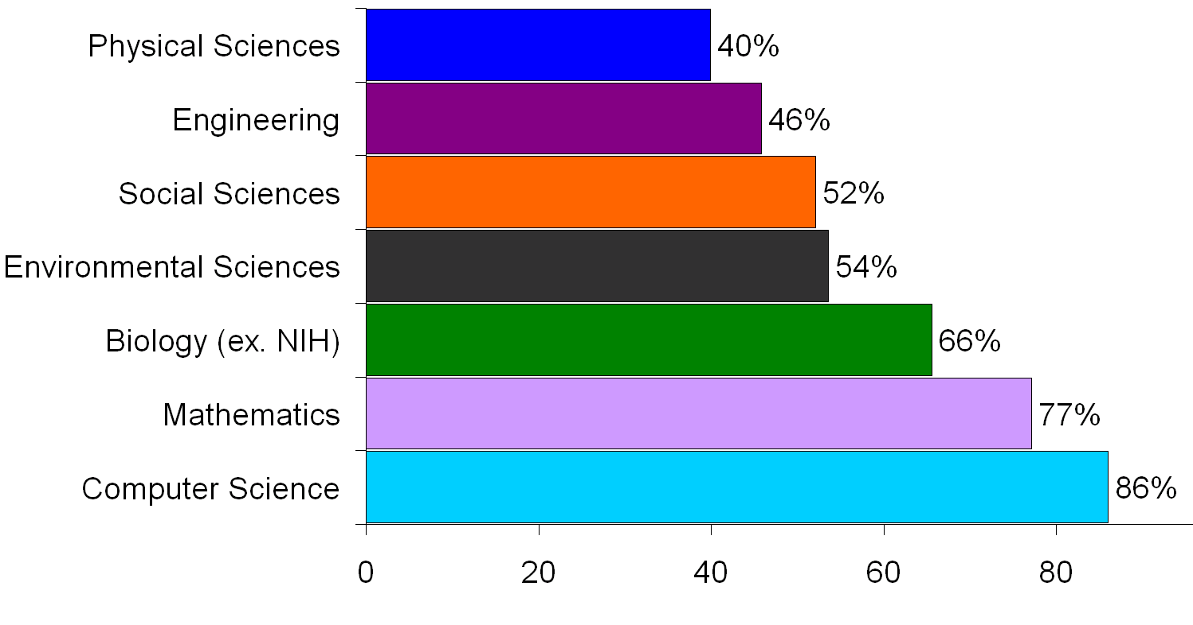
Stewardship for the Field
NSF support as a percent
of total federal support
of academic basic research

Slide 6
CISE

Slide 7
Core and Cross-Cutting Programs
CCF
CNS
IIS
Core
Core
Core
Algorithmic F’ns
Communications &
Information F’ns
Software &
Hardware F’ns
Computer Systems
Network Systems
Infrastructure
Education & Workforce
Human-Centered
Information Integra-
tion & Informatics
Robust Intelligence
Cross-Cutting
Cyber-Physical Systems
Data-intensive Computing
Network Science and Engineering
Trustworthy Computing
Plus many many other programs with other NSF directorates and other agencies
Notes:
Small December up to $500,000
Medium October FY09 August FY10 $500,001 up to $1,200,000
Large December $1,200,000 up to $300,000,000

Slide 8
CISE FY08-FY10 Research Initiatives
Continued from FY08
  Cyber-enabled Discovery and Innovation
  Expeditions
  Multicore Chip Design and Architecture
New/Enhanced FY09 Initiatives
  Data-Intensive Computing
  Cyber-Physical Systems (joint with ENG)
  Network Science and Engineering
  Trustworthy Computing
New FY10 Initiative
  Socially Intelligent Computing

Slide 9
Continued from FY08

Slide 10
CDI: Cyber-Enabled Discovery and Innovation
Paradigm shift
  Not just computing’s metal tools (transistors and wires) but also our mental tools (abstractions and methods)
It’s about partnerships and transformative research.
  To innovate in/innovatively use computational thinking; and
  To advance more than one science/engineering discipline.
FY08: $48M invested by all directorates and offices
  1800 Letters of Intent, 1300 Preliminary Proposals, 200 Final Proposals, 36 Awards
Computational Thinking for Science and Engineering
Notes:
~650 Data to Knowledge, 500 Understanding Complexity, < 200 Virtual Organizations
90 PDs (~35 from CISE) and 6 (4 from CISE) admin staff across the agency helped

Slide 11
Range of Disciplines in CDI Awards
Aerospace engineering
Atmospheric sciences
Biochemistry
Biophysics
Chemical engineering
Communications science and engineering
Computer science
Geosciences
Linguistics
Materials engineering
Mathematics
Mechanical engineering
Molecular biology
Nanocomputing
Neuroscience
Robotics
Social sciences
Statistical physics
… advances via Computational Thinking

Slide 12
Range of Societal Issues Addressed
Cancer therapy
Climate change
Environment
Visually impaired
Water

Slide 13
Expeditions
Bold, creative, visionary, high-risk ideas
Whole >> Σ part _{i}
Solicitation is deliberately underconstrained
  Tell us what YOU want to do!
  Response to community
    Loss of ITR Large, DARPA changes, support for high-risk research, large experimental systems research, etc.
FY08: 4 awards, each at $10M for 5 years
  122 LOI, 75 prelim, 20 final, 7 reverse site visits
i
Notes:
$10M for five year ($2M/year)

Slide 14
4 Awards
Computational Sustainability
  Gomes, Cornell, Bowdoin College, the Conservation Fund, Howard University, Oregon State University and the Pacific Northwest National Laboratory
Intractability
  Arora, Princeton, Rutgers, NYU, Inst for Adv. Studies
Molecular Programming
  Winfrey, Cal Tech, UW
Open Programmable Mobile Internet
  McKeown, Stanford

Slide 15
Multicore Chip Design and Architecture
“Beyond Moore’s Law” (but hardware focus)
Joint with ENG and Semiconductor Research Corporation (SRC)
$6M, 15-19 awards

Slide 16
New and Enhanced FY09

Slide 17
Drivers of Computing
Society
Science
Technology
Notes:
And finally, some science drivers. Here is a list of fundamental questions in computing that I have recently started. It’s really meant to be suggestive of the kinds of scientific questions that underlie the research challenges of our field.
I am going to use these questions to frame the three presentations you are about to hear.

Slide 18
Data Intensive Computing

Slide 19
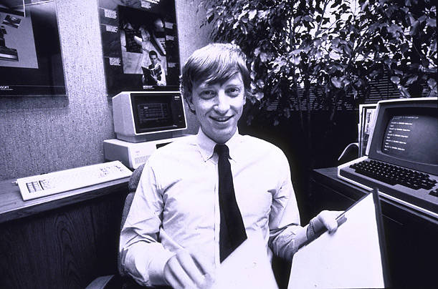
How Much Data?
NOAA has ~1 PB climate data (2007)
Wayback machine has ~2 PB (2006)
CERN’s LHC will generate 15 PB a year (2008)
HP is building WalMart a 4PB data warehouse (2007)
Google processes 20 PB a day (2008)
“all words ever spoken by human beings” ~ 5 EB
Int’l Data Corp predicts 1.8 ZB of digital data by 2011
640K ought to be enough for anybody.
Slide source: Jimmy Lin, UMD

Slide 20
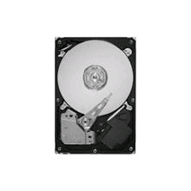
Convergence in Trends
Drowning in data
Data-driven approach in computer science research
  graphics, animation, language translation, search, …, computational biology
Cheap storage
  Seagate Barracuda 1TB hard drive for $90
Growth in huge data centers
Data is in the “cloud” not on your machine
Easier access and programmability by anyone
  e.g., Amazon EC2, Google+IBM cluster, Yahoo! Hadoop

Slide 21
Data-Intensive Computing
Sample Research Questions
Science
  What are the fundamental capabilities and limitations of this paradigm?
  What new programming abstractions (including models, languages, algorithms) can accentuate these fundamental capabilities?
  What are meaningful metrics of performance and QoS?
Technology
  How can we automatically manage the hardware and software of these systems at scale?
  How can we provide security and privacy for simultaneous mutually untrusted users, for both processing and data?
  How can we reduce these systems’ power consumption?
Society
  What (new) applications can best exploit this computing paradigm?

Slide 22
Cyber-Physical Systems

Slide 23
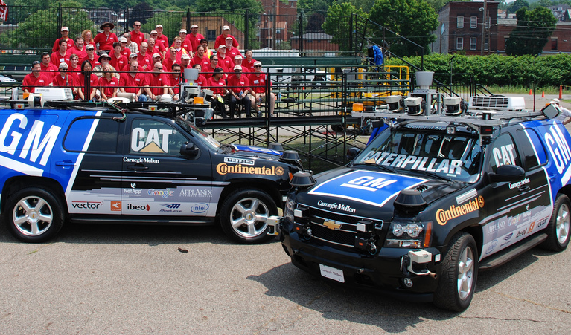

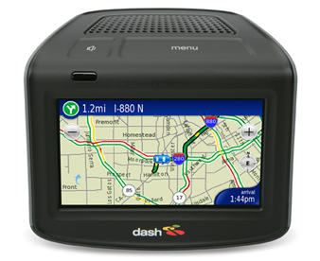
A BMW is “now actually a network of computers”
  [R. Achatz, Seimens, Economist Oct 11, 2007]
Smart Cars
Credit: PaulStamatiou.com
Cars drive themselves
Smart parking
Lampson’s Grand Challenge:
Reduce highway traffic deaths to zero.
  [Butler Lampson, Getting Computers to Understand, Microsoft, J. ACM 50, 1 (Jan. 2003), pp 70-72.]
Credit: Dash Navigation, Inc.
Dash Express:
Cars are nodes in a network

Slide 24
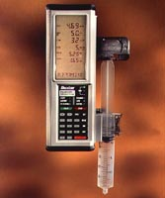
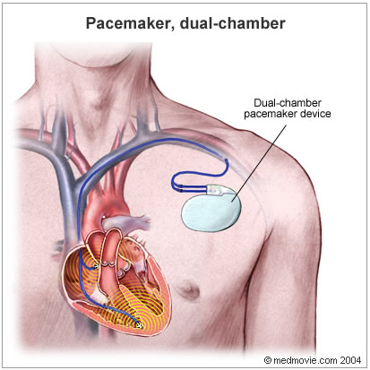
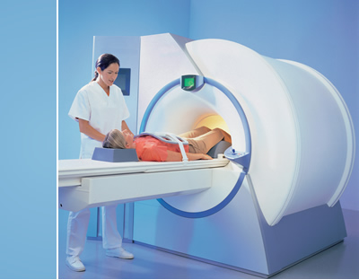
Embedded Medical Devices
Credit: Baxter International
infusion pump
pacemaker
scanner
Credit: Siemens AG
IBM Research
24
Jeannette M. Wing

Slide 25
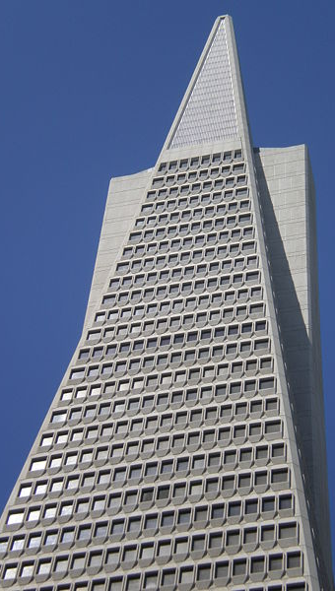
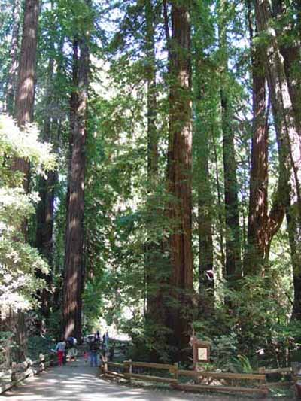
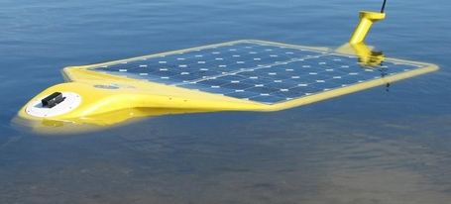
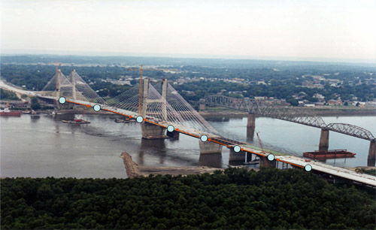
Sensors Everywhere
Credit: Arthur Sanderson at RPI
Hudson River Valley
Credit: MO Dept. of Transportation
Sonoma Redwood Forest
smart buildings
IBM Research
25
Jeannette M. Wing
smart bridges

Slide 26
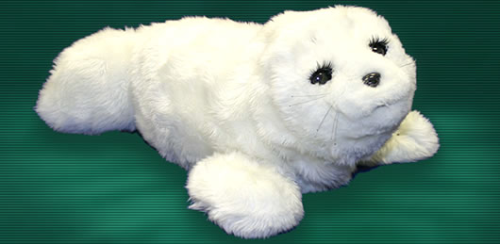
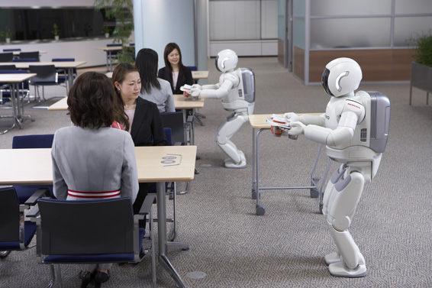

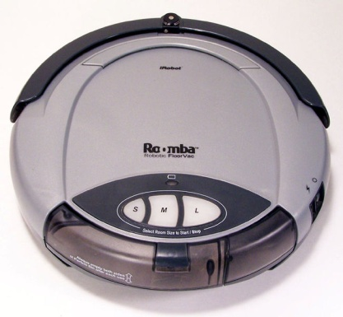
Robots Everywhere
Credit: Paro Robots U.S., Inc.
At home: Paro, therapeutic robotic seal
Credit: Carnegie Mellon University
Credit: Honda
At home/clinics: Nursebot, robotic assistance for the elderly
At work: Two ASIMOs working together in coordination to deliver refreshments
At home: iRobot Roomba vacuums your house

Slide 27
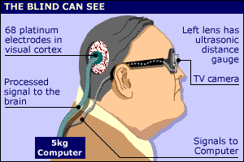
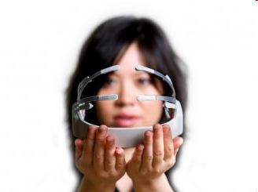

Assistive Technologies for Everyone
brain-computer interfaces of today
Credit: Dobelle Institute
memex of tomorrow
Credit: Emotiv
IBM Research
27
Jeannette M. Wing
Credit: Paramount Pictures

Slide 28
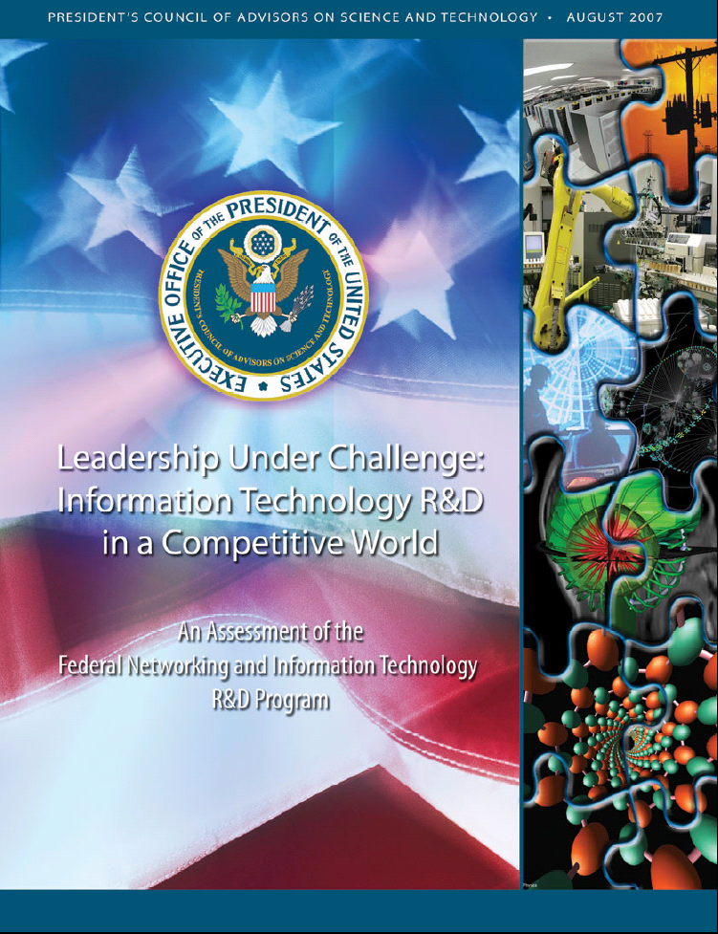
U.S Broader Research Agenda and Priorities
Dan Reed and George Scalise, editors
August 2007
Credit: http://www.ostp.gov/pdf/nitrd_review.pdf

Slide 29
U.S Broader Research Agenda and Priorities
Dan Reed and George Scalise, editors
August 2007
#1 Priority: Cyber-Physical Systems
  Our lives depend on them.
Credit: http://www.ostp.gov/pdf/nitrd_review.pdf

Slide 30

Cyber-Physical Systems
Sample Research Challenges
Science
Co-existence of Booleans and Reals
  Discrete systems in a continuous world
Reasoning about uncertainty
  Human, Mother Nature, the Adversary
Technology
Intelligent and safe digital systems that interact with the physical world
  Self-monitoring, real-time learning and adapting
Society
Systems need to be unintrusive, friendly, dependable, predictable, …

Slide 31
Enhanced Initiatives

Slide 32



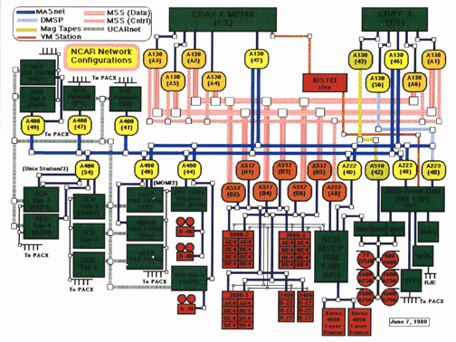




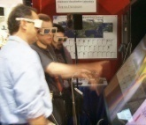


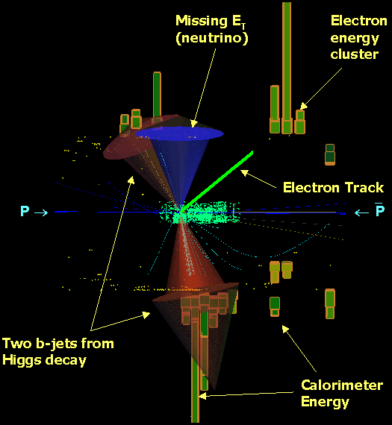

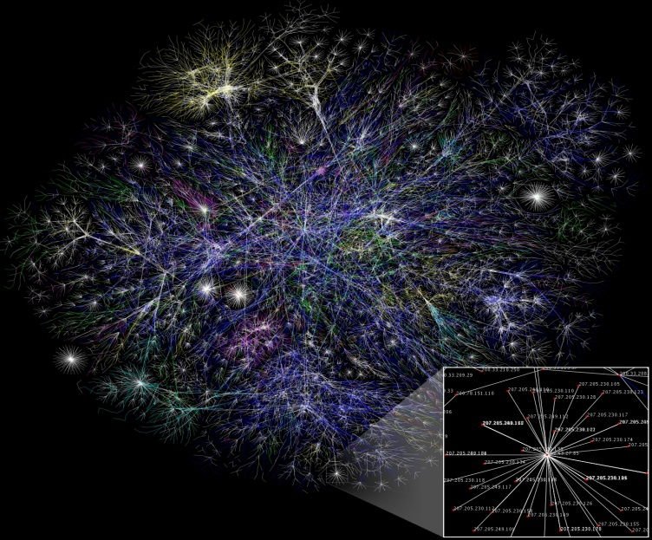



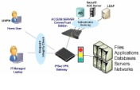
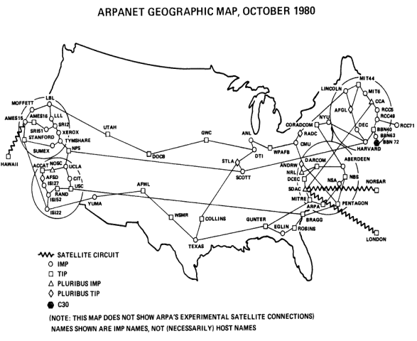

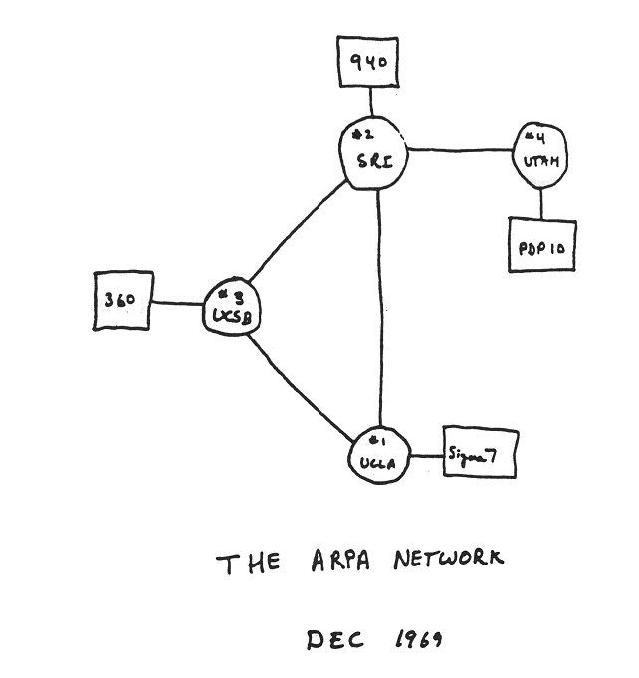


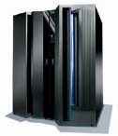



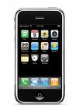

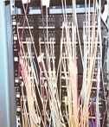
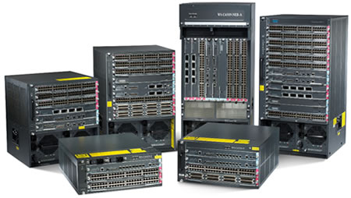

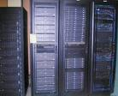

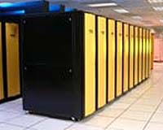
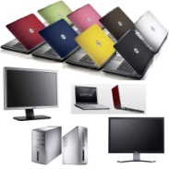
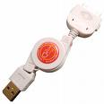
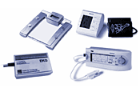
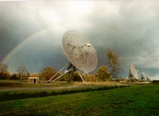
Our Evolving Networks are Complex
1970
1980
1999
Notes:
The networks that we have created and that have evolved over the decades are complex.
For example, the Internet is complex. Here is a picture of the ARPANET in 1970. Here it is in 1980. Twenty years later, it is too complex to draw, let alone understand, model, or predict its behavior. The Internet is computer science’s gift to society, but ironically we cannot even describe it.
We interpret networks at multiple layers of abstraction. Below, we are concerned with new technologies: in the beginning we communicated via phone lines, modems, and cables underground and now we have a proliferation of communication media and a proliferation of devices, sensors, and actuators.
Above, we are concerned with new kinds of social uses of our computers and networks: from the days when people shared a terminal, to today where we have a multitude of applications, from the good to the bad. Examples of the good are on-line banking, social networks, and open courseware that already enables tens of millions of people, including tens of thousands of high school students, to learn from famous professors. Examples of the bad are spam, worms and viruses, and distributed denial of service.
I’ve shown pictures of the past and the present. What about the future? I believe that if we understand the complexity of our networks better then we can evolve them in ways that can unleash unimaginable creativity and innovation—from new technologies, to new applications, to new users—and hopefully at the same time improve the overall security of our networked systems.
32

Slide 33


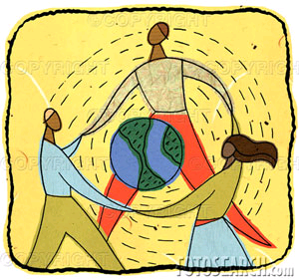
Our Evolving Networks are Complex
1970
1980
1999
Notes:
The networks that we have created and that have evolved over the decades are complex.
For example, the Internet is complex. Here is a picture of the ARPANET in 1970. Here it is in 1980. Twenty years later, it is too complex to draw, let alone understand, model, or predict its behavior. The Internet is computer science’s gift to society, but ironically we cannot even describe it.
We interpret networks at multiple layers of abstraction. Below, we are concerned with new technologies: in the beginning we communicated via phone lines, modems, and cables underground and now we have a proliferation of communication media and a proliferation of devices, sensors, and actuators.
Above, we are concerned with new kinds of social uses of our computers and networks: from the days when people shared a terminal, to today where we have a multitude of applications, from the good to the bad. Examples of the good are on-line banking, social networks, and open courseware that already enables tens of millions of people, including tens of thousands of high school students, to learn from famous professors. Examples of the bad are spam, worms and viruses, and distributed denial of service.
I’ve shown pictures of the past and the present. What about the future? I believe that if we understand the complexity of our networks better then we can evolve them in ways that can unleash unimaginable creativity and innovation—from new technologies, to new applications, to new users—and hopefully at the same time improve the overall security of our networked systems.
33

Slide 34

Our Evolving Networks are Complex
1970
1980
1999
Notes:
The networks that we have created and that have evolved over the decades are complex.
For example, the Internet is complex. Here is a picture of the ARPANET in 1970. Here it is in 1980. Twenty years later, it is too complex to draw, let alone understand, model, or predict its behavior. The Internet is computer science’s gift to society, but ironically we cannot even describe it.
We interpret networks at multiple layers of abstraction. Below, we are concerned with new technologies: in the beginning we communicated via phone lines, modems, and cables underground and now we have a proliferation of communication media and a proliferation of devices, sensors, and actuators.
Above, we are concerned with new kinds of social uses of our computers and networks: from the days when people shared a terminal, to today where we have a multitude of applications, from the good to the bad. Examples of the good are on-line banking, social networks, and open courseware that already enables tens of millions of people, including tens of thousands of high school students, to learn from famous professors. Examples of the bad are spam, worms and viruses, and distributed denial of service.
I’ve shown pictures of the past and the present. What about the future? I believe that if we understand the complexity of our networks better then we can evolve them in ways that can unleash unimaginable creativity and innovation—from new technologies, to new applications, to new users—and hopefully at the same time improve the overall security of our networked systems.
34

Slide 35
Network Science and Engineering
Fundamental Question: Is there a science for understanding the complexity of our networks such that we can engineer them to have predictable behavior?
Deepen and broaden research agenda of original GENI concept
Subsumes CISE’s past networking programs: SING, FIND, NGNI

Slide 36
Network Science and Engineering
Sample Research Challenges
Understand the complexity of large-scale networks
Network science and engineering researchers
Science
- Understand emergent behaviors, local–global interactions, system failures and/or degradations
- Develop models that accurately predict and control network behaviors
Technology
Develop new architectures, exploiting new substrates
Distributed systems and substrate researchers
- Develop architectures for self-evolving, robust, manageable future networks
- Develop design principles for seamless mobility support
- Leverage optical and wireless substrates for reliability and performance
- Understand the fundamental potential and limitations of technology
Enable new applications and new economies, while ensuring security and privacy
Society
Security, privacy, economics, AI, social science researchers
- Design secure, survivable, persistent systems, especially when under attack
- Understand technical, economic and legal design trade-offs, enable privacy protection
- Explore AI-inspired and game-theoretic paradigms for resource and performance optimization
Notes:
The field of computing has science drivers, technology drivers, and societal drivers. Network science and engineering is no different. For all three drivers, there are fundamental challenges that face us if we are to make progress in answering the question stated earlier. Let’s use these three interacting sets of drivers to frame a research agenda for network science and engineering. I’ll start with the science drivers.
The scientific challenge is to understand the complexity of networked systems. We do not have theories of our networks such that we understand their emergent properties. We do not have formal models of our networks such that we can assert any guarantees of reliability or survivability, especially in the presence of disruptive events or malicious attacks. We do not have models of our networks such that we can accurately predict their performance; for example Poisson models and heavy-tail distribution models are unrealistic or overly simplistic.
The technology drivers come from new communication substrates such as wireless and optical. These new substrates change the physical characteristics of the network, suggesting new network architectures, where the goal is not just simply optimizing the transmission of a packet from one host to another. For example, because of increased bandwidth and large distances between nodes we already view the network not just as a communication medium but as a storage medium. Technology drivers also come from new devices. The ubiquity of mobile computing and communication devices, for example, is forcing us to rethink our networks in truly fundamental ways, to include at the very least the human dimension of what networks are.
Moreover, new theories and new architectures enable new societal uses of the network—creating new opportunities such as virtual worlds and new challenges such as ensuring the security and privacy of users and their data.
For your interest, I’ve included in small font, a sampling of fundamental challenges for each of these three drivers.
The research communities active in addressing these intellectual challenges are correspondingly listed on the right. Indeed one of the opportunities in developing a research agenda for network science and engineering, is ambitiously to ignite a diverse range of communities to work together and look at networked systems from a holistic viewpoint—it’s not enough to invent a new theory, a new architecture, or a new application without understanding the implications it has for all aspects of the networked system.
I would like to emphasize the expanse of these intellectual challenges. I am talking not just about networks as the invisible infrastructure that we all take for granted today, but about networks of people and organizations that creatively use the invisible infrastructure in unforeseen ways.
To calibrate the rapid growth in societal impact of the Internet, let me give you some concrete examples: Mosaic, the first browser, was created in 1993 and Google was founded in 1998, less than ten years ago. Google is known for search but it makes its money on ads; who would have guessed? (As as aside: remember that Mosaic and Google, like other browsers and search engines, were born out of NSF/CISE-funded research projects in universities.) Within just the past four years, we have seen the creation and influence of social networks embraced by the younger generation: SecondLife, FaceBook, and YouTube. We are also seeing old institutions remake themselves, including the print media like newspapers and the music recording industry. More sobering, in April of this year we witnessed the first cyber attack on a nation—Estonia—by a well-organized group in Russia. And just three weeks ago, the US company Seagate reported that hard drives sold in Taiwan contained Trojan Horses planted by subcontractors in China so that any information stored on those tainted hard drives was automatically uploaded to websites in Beijing. We did not anticipate any of these phenomena—good and bad—nor did we anticipate how they have completely changed the way in which people and organizations interact with each other.
It is the expanse of all these intellectual challenges that necessitates including not just researchers in computer and information science and engineering, but researchers in economics and the social sciences.

Slide 37
Network Science and Engineering
Sample Research Challenges
Understand the complexity of large-scale networks
Network science and engineering researchers
Science
- Understand emergent behaviors, local–global interactions, system failures and/or degradations
- Develop models that accurately predict and control network behaviors
Technology
Develop new architectures, exploiting new substrates
Distributed systems and substrate researchers
- Develop architectures for self-evolving, robust, manageable future networks
- Develop design principles for seamless mobility support
- Leverage optical and wireless substrates for reliability and performance
- Understand the fundamental potential and limitations of technology
Enable new applications and new economies, while ensuring security and privacy
Society
Security, privacy, economics, AI, social science researchers
- Design secure, survivable, persistent systems, especially when under attack
- Understand technical, economic and legal design trade-offs, enable privacy protection
- Explore AI-inspired and game-theoretic paradigms for resource and performance optimization
Notes:
The field of computing has science drivers, technology drivers, and societal drivers. Network science and engineering is no different. For all three drivers, there are fundamental challenges that face us if we are to make progress in answering the question stated earlier. Let’s use these three interacting sets of drivers to frame a research agenda for network science and engineering. I’ll start with the science drivers.
The scientific challenge is to understand the complexity of networked systems. We do not have theories of our networks such that we understand their emergent properties. We do not have formal models of our networks such that we can assert any guarantees of reliability or survivability, especially in the presence of disruptive events or malicious attacks. We do not have models of our networks such that we can accurately predict their performance; for example Poisson models and heavy-tail distribution models are unrealistic or overly simplistic.
The technology drivers come from new communication substrates such as wireless and optical. These new substrates change the physical characteristics of the network, suggesting new network architectures, where the goal is not just simply optimizing the transmission of a packet from one host to another. For example, because of increased bandwidth and large distances between nodes we already view the network not just as a communication medium but as a storage medium. Technology drivers also come from new devices. The ubiquity of mobile computing and communication devices, for example, is forcing us to rethink our networks in truly fundamental ways, to include at the very least the human dimension of what networks are.
Moreover, new theories and new architectures enable new societal uses of the network—creating new opportunities such as virtual worlds and new challenges such as ensuring the security and privacy of users and their data.
For your interest, I’ve included in small font, a sampling of fundamental challenges for each of these three drivers.
The research communities active in addressing these intellectual challenges are correspondingly listed on the right. Indeed one of the opportunities in developing a research agenda for network science and engineering, is ambitiously to ignite a diverse range of communities to work together and look at networked systems from a holistic viewpoint—it’s not enough to invent a new theory, a new architecture, or a new application without understanding the implications it has for all aspects of the networked system.
I would like to emphasize the expanse of these intellectual challenges. I am talking not just about networks as the invisible infrastructure that we all take for granted today, but about networks of people and organizations that creatively use the invisible infrastructure in unforeseen ways.
To calibrate the rapid growth in societal impact of the Internet, let me give you some concrete examples: Mosaic, the first browser, was created in 1993 and Google was founded in 1998, less than ten years ago. Google is known for search but it makes its money on ads; who would have guessed? (As as aside: remember that Mosaic and Google, like other browsers and search engines, were born out of NSF/CISE-funded research projects in universities.) Within just the past four years, we have seen the creation and influence of social networks embraced by the younger generation: SecondLife, FaceBook, and YouTube. We are also seeing old institutions remake themselves, including the print media like newspapers and the music recording industry. More sobering, in April of this year we witnessed the first cyber attack on a nation—Estonia—by a well-organized group in Russia. And just three weeks ago, the US company Seagate reported that hard drives sold in Taiwan contained Trojan Horses planted by subcontractors in China so that any information stored on those tainted hard drives was automatically uploaded to websites in Beijing. We did not anticipate any of these phenomena—good and bad—nor did we anticipate how they have completely changed the way in which people and organizations interact with each other.
It is the expanse of all these intellectual challenges that necessitates including not just researchers in computer and information science and engineering, but researchers in economics and the social sciences.

Slide 38
Trustworthy Computing
Trustworthy = reliability, security, privacy, usability
Deepen and broaden Cyber Trust
Three emphases for FY09
  Foundations of trustworthy
    Models, logics, algorithms, metrics
  Privacy
  Usability

Slide 39
New for FY10

Slide 40




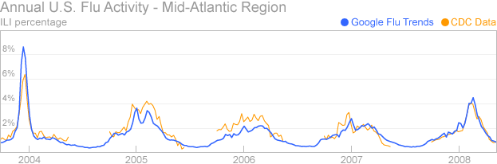






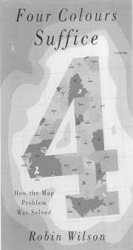
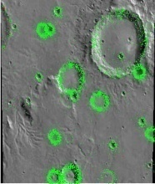





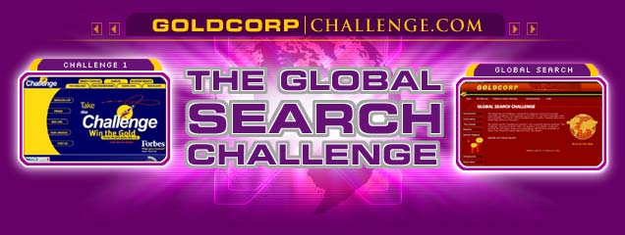




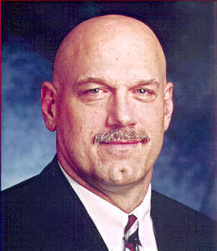


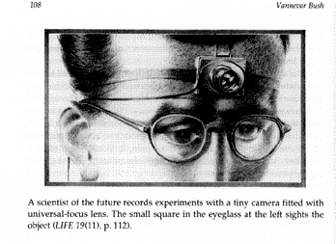
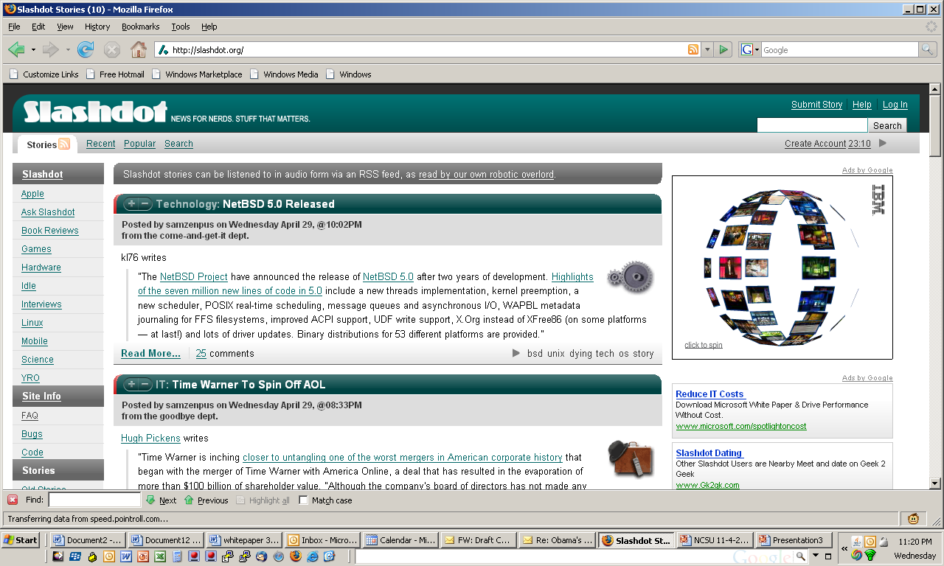
Clickworkers
Collaborative Filtering
Collaborative Intelligence
Collective Intelligence
Computer Assisted Proof
Crowdsourcing
eSociety
Genius in the Crowd
Human-Based Computation
Participatory Journalism
Pro-Am Collaboration
Recommender Systems
Reputation Systems
Social Commerce
Social Computing
Social Technology
Swarm Intelligence
Wikinomics
Wisdom of the Crowds

Slide 41
Clickworkers
Collaborative Filtering
Collaborative Intelligence
Collective Intelligence
Computer Assisted Proof
Crowdsourcing
eSociety
Genius in the Crowd
Human-Based Computation
Participatory Journalism
Pro-Am Collaboration
Recommender Systems
Reputation Systems
Social Commerce
Social Computing
Social Technology
Swarm Intelligence
Wikinomics
Wisdom of the Crowds
Socially Intelligent Computing

Slide 42
Others
Joint with other directorates and offices
  CISE + BIO + SBE + MPS: Computational Neuroscience (with NIH)
  CISE + EHR: Advanced Learning Technologies
  CISE + ENG: Cyber-Physical Systems, Multi-core (with SRC)
  CISE + MPS: FODAVA (with DHS), MCS
  CISE + OCI: DataNet
  OCI + CISE + ENG + GEO + MPS: PetaApps
  Creative IT (co-funding with other directorates)
Activities with other agencies, e.g., DARPA, DHS, IARPA, NGA, NIH, NSA
Partnerships with companies
  Google+IBM, HP+Intel+Yahoo!: Data-Intensive Computing
  SRC: Multi-core
Research infrastructure: CRI, MRI
…
Please see website www.cise.nsf.gov for full list.

Slide 43
Research Ideas in the Works

Slide 44
IT and Energy and Environment
IT as part of the problem and IT as part of the solution
IT as a consumer of energy
  2% (and growing) of world-wide energy use due to IT
IT as a helper to solve problems
  Direct: reduce energy use, recycle, repurpose, …
  Indirect: e-commerce, e-collaboration, telework -> reduction travel, …
  Systemic: computational models of climate, species, … -> inform science and inform policy
Broader context: Sustainability, Energy, Climate Change, Economy, Human Behavior
Notes:
Organization of Economic Co-Operation and Development (OECD)

Slide 45



Computational Economics
Computer Science influencing Economics
Economics influencing Computer Science
Automated mechanism design underlies electronic commerce,
e.g., ad placement, on-line auctions, kidney exchange
Internet marketplace requires revisiting Nash equilibria model
Use intractability for voting schemes to circumvent impossibility results
- Emphasis on foundational aspects (e.g., algorithms, game theory)
but clearly contributions/participation from AI (multi-agents) and systems communities
(and hence overlaps a bit with Human-Computer Intelligence and NetSE)

Slide 46
Education

Slide 47
Education
Challenge to Community: What is an effective way of teaching (learning) computational thinking to (by) K-12?
Computational Thinking for Everyone
  National Academies Computer Science and Telecommunications Board (CSTB)
    Workshops on CT for Everyone (last week)
    Collaborating with Board on Science Education
  Internal working group at NSF
    CISE, EHR, SBE, OCI, MPS

Slide 48
CISE Education Programs
CPATH
  Goal: Revisiting undergraduate computer science curricula
  FY08-09: Enlarge scope to include outreach to K-12
  FY09: More focus on computational thinking, not just curricula models/frameworks.
Broadening Participation in Computing
  Focus: Women, underrepresented minorities, people with disabilities
  Award types: Alliances and Demo Projects
  FY08: Special projects on image of computing
  FY09: Re-envisioning the Computer Science AP exam

Slide 49
C.T. in Education: Community Efforts
ACM-Ed
Computing
Community
CRA-E
CSTA
NSF
College Board
Rebooting
Computational
Thinking
National Academies
workshops
CSTB “CT for Everyone” Steering Committee
Marcia Linn, Berkeley
Al Aho, Columbia
Brian Blake, Georgetown
Bob Constable, Cornell
Yasmin Kafai, U Penn
Janet Kolodner, Georgia Tech
Larry Snyder, U Washington
Uri Wilensky, Northwestern
K-12
BPC
CPATH
AP

Slide 50
Federal Picture:
NITRD

Slide 51
What is NITRD?
Networking and Information Technology Research and Development
Established by High-Performance Computing Act 1991
Co-chairs: Chris Greer (NC0) and Jeannette Wing (NSF)
Agencies (in order of investment): NSF, DARPA, OSD and DoD, NIH, DOE/SC/NE/FE, NSA, NASA, NIST, AHRQ, DOE/NNSA, NOAA, EPA, NARA
8 Program Component Areas

Slide 52
FY08 Budget Estimate: $3.341B
FY09 Budget Request: $3.548B
Science and Technology Policy Institute, Briefing to PCAST, January 2007

Slide 53
FY08 Estimates and FY09 Requests by Agency

Slide 54
NITRD as Percent of Total R&D FY09 Request
NIH 1.8%
DOE 4.7%
NSF 21%
DARPA 17.4%
Notes:
NSF 21%
DARPA 17.3%
NIH 1.78%
DOE 4.7%

Slide 55
International

Slide 56
Science and Technology Policy Institute, Briefing to PCAST, January 2007

Slide 57
Science and Technology Policy Institute, Briefing to PCAST, January 2007
Notes:
Plum, maroon, cyan

Slide 58
Science and Technology Policy Institute, Briefing to PCAST, January 2007

Slide 59
China: Annual Budget of NSFC
Unit: 100 million Yuan
NSFC budget has increased at an annual rate of over 20%. The budget for 2006-2010 will be doubled compared with that from 2001-2005, reaching 20-30B Yuan (3- 4.5B US$).
80 ➔ 5300 (million Yuan)
12 ➔ 795 (M US$)

Slide 60
Last Word:
The Future of Computing is Bright!

Slide 61



Drivers of Computing
7A’s
Anytime Anywhere
Affordable
Access to Anything by Anyone Authorized.
Society
Science
Technology
What is computable?
P = NP?
(How) can we build complex
systems simply?
What is intelligence?
What is information?
J. Wing, “Five Deep Questions in Computing,” CACM January 2008

Slide 62





































Drivers of Computing
7A’s
Anytime Anywhere
Affordable
Access to Anything by Anyone Authorized.
Society
Science
Technology
What is computable?
P = NP?
(How) can we build complex
systems simply?
What is intelligence?
What is information?
J. Wing, “Five Deep Questions in Computing,” CACM January 2008

Slide 63
Thank You!

Slide 64
Credits
Copyrighted material used under Fair Use. If you are the copyright holder and believe your material has been used unfairly, or if you have any suggestions, feedback, or support, please contact: jsoleil@nsf.gov
Except where otherwise indicated, permission is granted to copy, distribute, and/or modify all images in this document under the terms of the GNU Free Documentation license, Version 1.2 or any later version published by the Free Software Foundation; with no Invariant Sections, no Front-Cover Texts, and no Back-Cover Texts. A copy of the license is included in the section entitled “GNU Free Documentation license” (http://commons.wikimedia.org/wiki/Commons:GNU_Free_Documentation_License)
The inclusion of a logo does not express or imply the endorsement by NSF of the entities' products, services or enterprises

