Slide 1

OFFICE OF SCIENCE
Office of High Energy Physics Report to the AAAC
October 13, 2011
Kathleen Turner
Office of High Energy Physics
Office of Science, U.S. Department of Energy

Slide 2
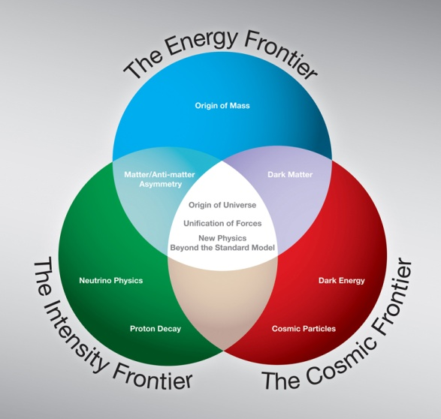
HEP Strategic Plan (based on 2008 P5 report)
The High Energy Physics program’s mission is to understand how our universe works at its most fundamental level. To enable discoveries, HEP supports
theoretical and experimental research in both elementary particle physics
and fundamental accelerator science and technology.
Progress in achieving the mission goals requires advancements at the
Energy, Intensity and Cosmic Frontiers
The U.S. should have a strong, integrated research program at all three frontiers.
At lower funding levels, cannot maintain leadership at all 3 frontiers
HEP at its core is an accelerator-based experimental science.
Support accelerator and detector R&D to develop new technologies
that are needed by the field
that benefit the nation

Slide 3
Office News
Jim Siegrist has joined the office as the new Associate Director (started 10/1/11)
Lali Chatterjee has moved to our office to serve as the Computational HEP program manager
Simona Rolli has joined the office to serve as the Theory program manager

Slide 4
Program & Budget Status

Slide 5
High Energy Physics Budget (dollars in thousands)
Description | FY 2010 | FY 2011 Request | FY 2011 Actual | FY 2012 Request | FY12 vs FY11
Proton Accelerator-Based Physics | 438,369 | 439,262 | 438,855 | 411,207 | -27,648
Electron Accelerator-Based Physics | 30,212 | 24,707 | 24,454 | 22,319 | -2,135
Non-Accelerator Physics | 97,469 | 88,539 | 90,067 | 81,852 | -8,215
Theoretical Physics | 68,414 | 69,524 | 68,050 | 68,914 | +864
Advanced Technology R&D | 156,347 | 189,968 | 154,152 | 171,908 | +17,756
Construction | 0 | 17,000 | 0 | 41,000 | +41,000
Total, High Energy Physics | 790,811 | 829,000 | 775,578 | 797,200 | +21,622
Office of Science | 4,964,040 | 5,121,437 | 4,857,665 | 5,418,863 | +561,198
The FY12 Request includes SBIR/STTR of approximately $19M, which has already been removed from FY10 and FY11 Actuals. Therefore the real FY12 request is a reduction of approximately $2M from FY11 and $12M from FY10.
FY12 – We are currently in a Continuing Resolution
House mark: $797.2M
Senate mark: $780.2M

Slide 6
Funding Trends
HEP is now between the HEPAP/P5 “A” and “B” scenarios.
Funding FY 2009-2011: Program workforce and scope largely preserved – implementation slow
Funding FY 2012 Target: Workforce will be downsized and the program de-scoped; cannot maintain leadership program at all 3 frontiers
Scenario B (FY07 + COL)
Scenario A (FY08 + COL)

Slide 7
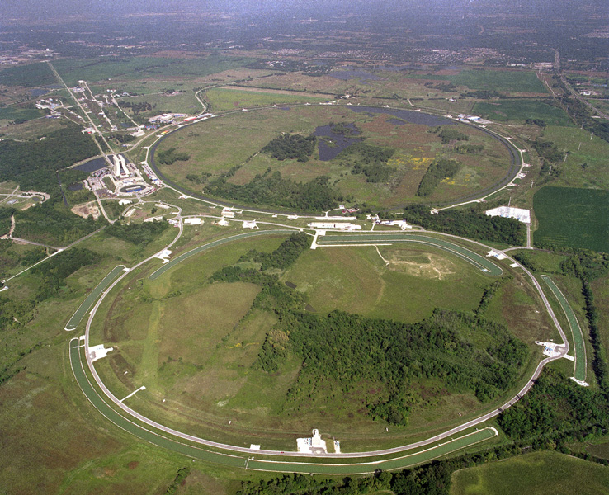
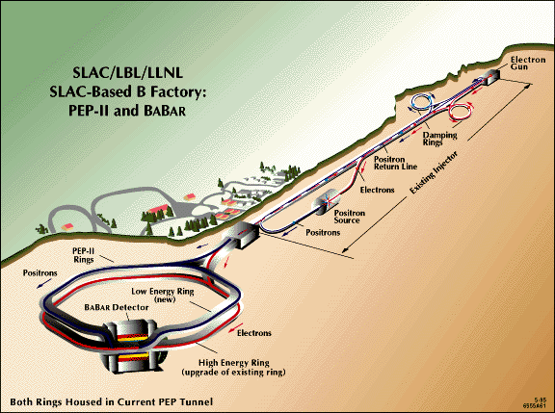
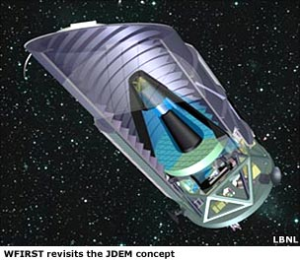
Recent Major Shifts
In the 90’s, the fraction of the HEP budget devoted to projects was ~ 20% but declined to < 5% in 2006. Our strategy is to work to increase this back to 20%.
With flat funding HEP has to end programs to start new ones (Mu2e, LSST, LBNE).
Premature shutdown of B-factory (FY 2008)
Ended funding for JDEM (FY 2011) & only doing one major dark energy experiment (LSST)
Shutdown of the Tevatron (end of FY 2011).
Tevatron
Main Injector

Slide 8
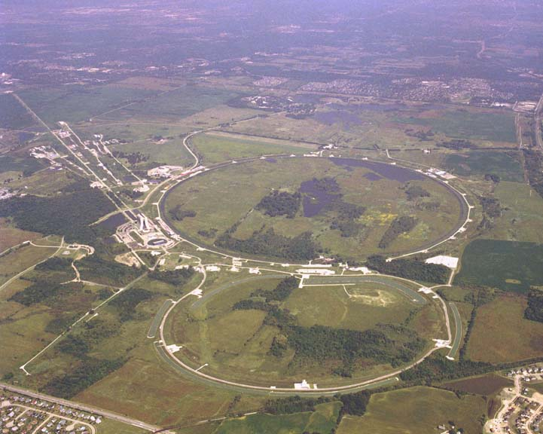
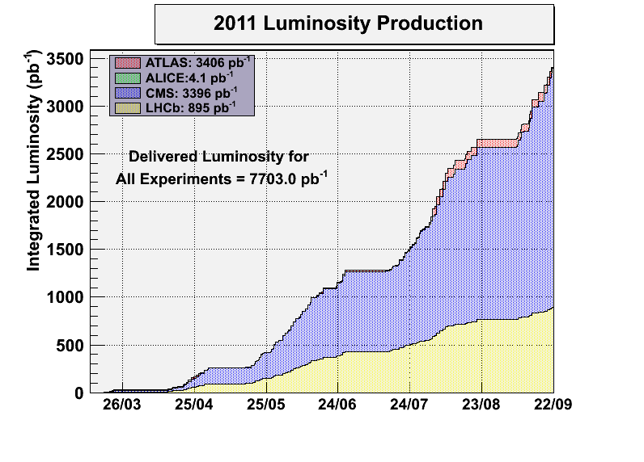
Energy Frontier - Status
Fermilab Accelerator Operations
Operation of the Fermilab Tevatron completed on Sept 30, 2011 after 30 years of operations.
Funding continues to complete the CDF and Dzero data analyses
The neutrino beam lines continue running to support the neutrino program.
CERN Large Hadron Collider (LHC) Program
Excellent Performance in 2011.
CMS and ATLAS each have ~ 4.7fb⁻¹ now.
New results on the Standard Model Higgs exclude a large part of the allowed mass region.
LHC will shutdown in 2013 for repairs to the magnets that will allow 14 TeV operation.
Extensive detector maintenance planned.

Slide 9
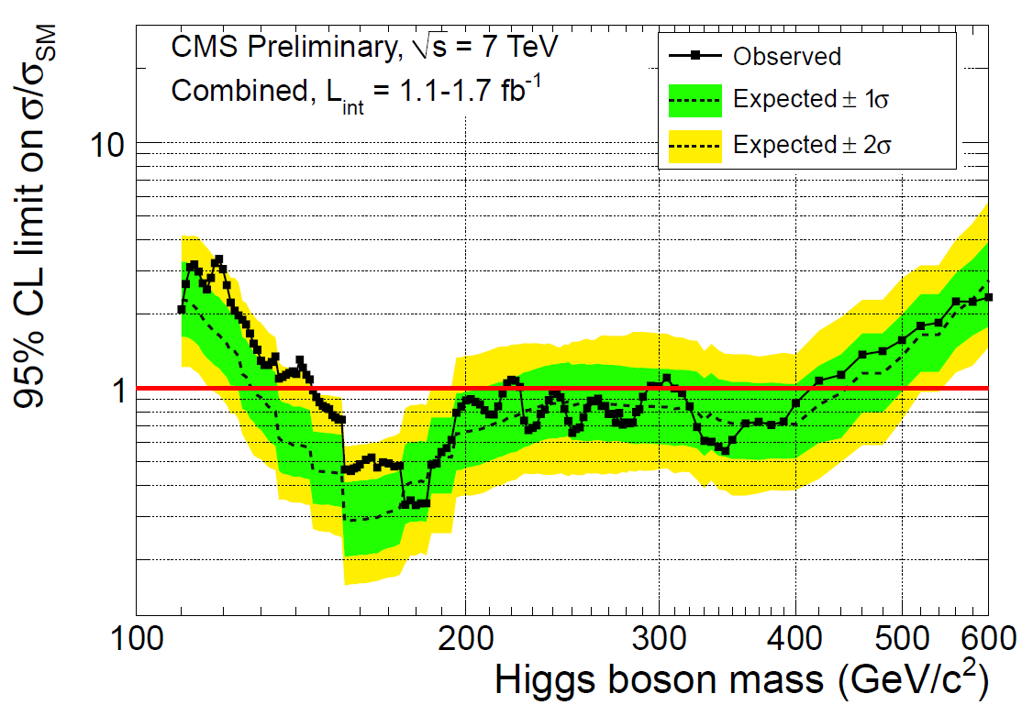
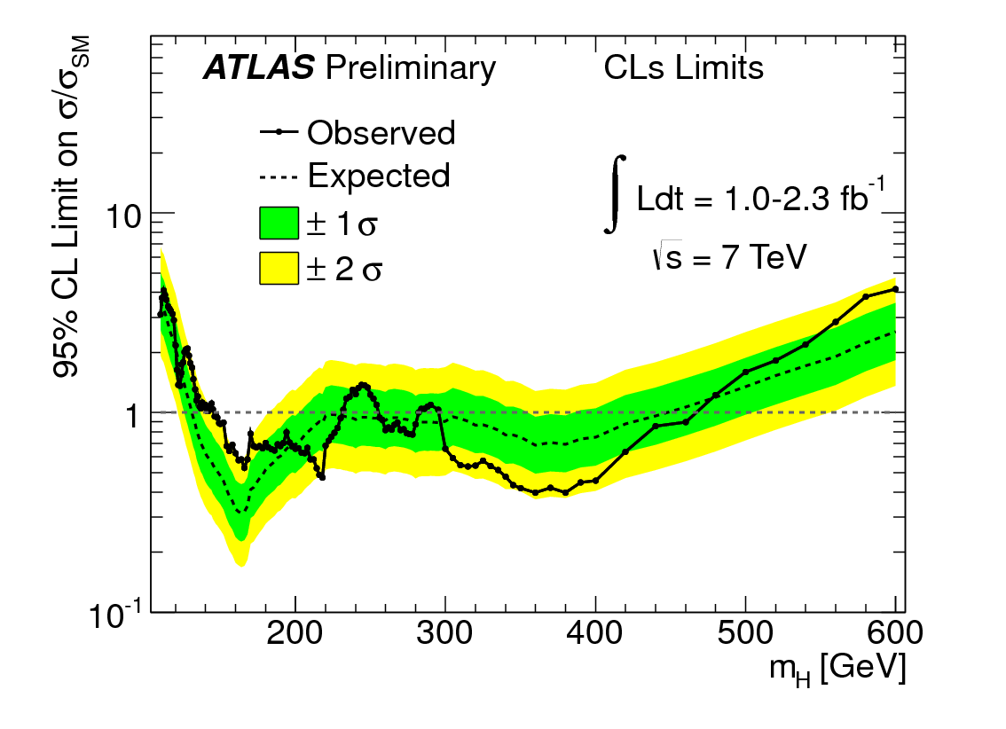
Energy Frontier: LHC Search for the Higgs
ATLAS excluded: 146-232, 256-282, 296-466
CMS excluded: 145-216, 226-288, 310-400

Slide 10
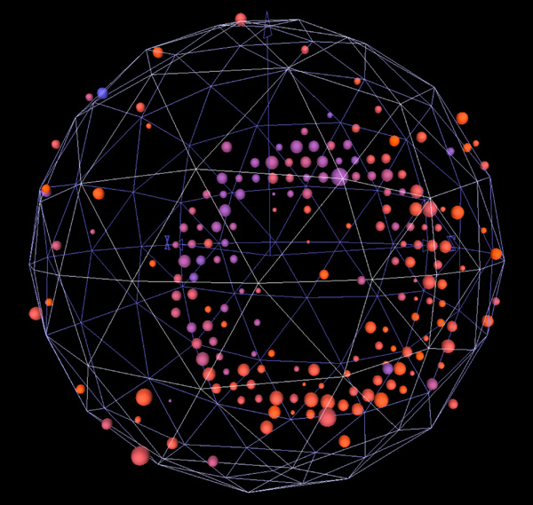
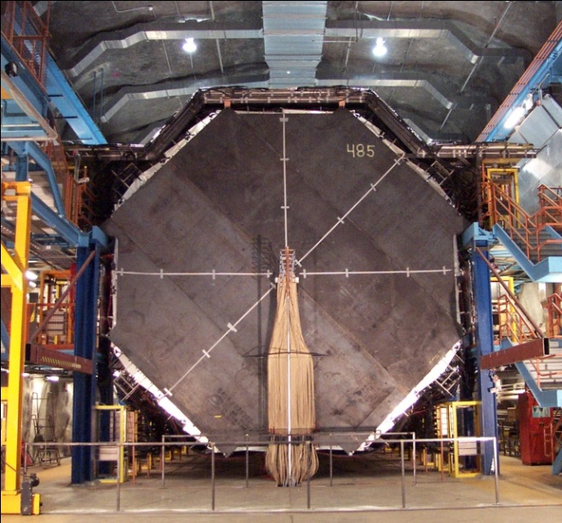
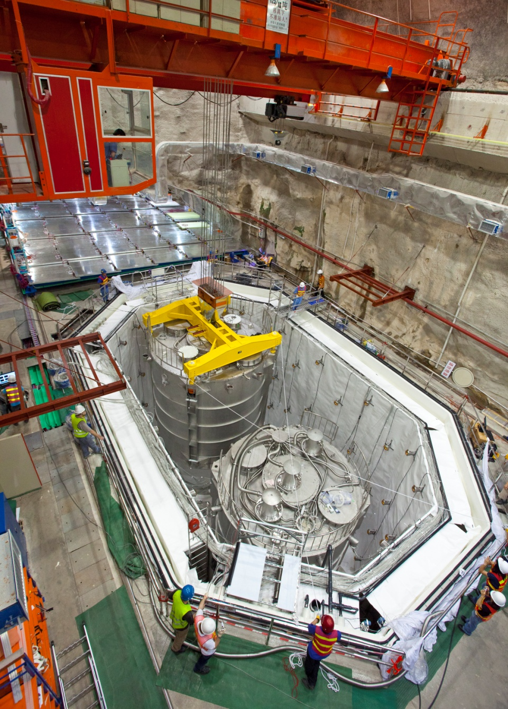
Intensity Frontier – Current experiments
Fermilab and Minnesota
MINOS, MiniBooNE and MINERvA continue operations.
MINOS is planning to install atomic clocks to see if they can reproduce the OPERA results
The NOvA project will install the first detector modules and do the required accelerator upgrades in FY 2012; completion in FY 2013.
MINIBOONE EVENT
MINOS FAR DETECTOR
China
The Daya Bay Reactor Neutrino Experiment is being built in partnership with China.
First antineutrino detectors completed and being installed now
Initial commissioning in 2011 and full operations in 2012
Daya Bay

Slide 11
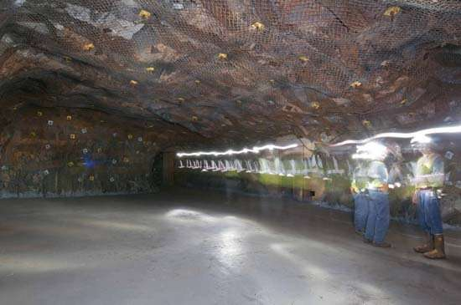
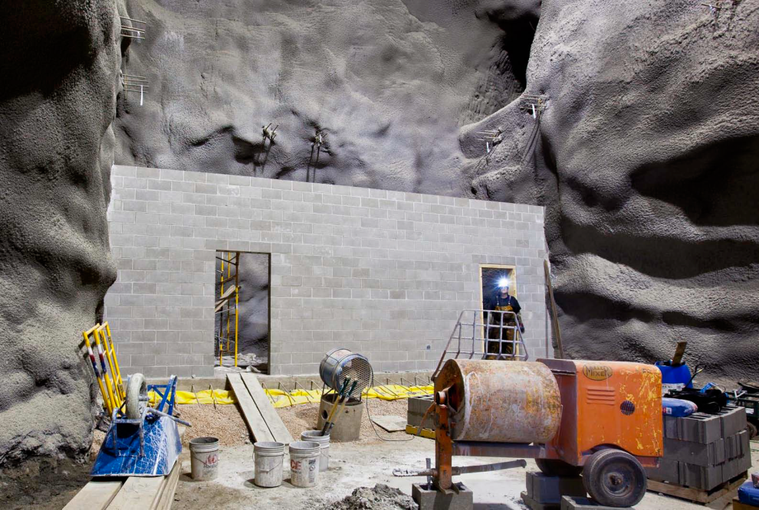
Intensity Frontier: LBNE, DUSEL and Homestake
DOE Office of Science has an interest in three experiments that had been planned for DUSEL.
Long Baseline Neutrino Experiment (LBNE)
Dark Matter
Neutrinoless Double Beta Decay
Dec. 2010 - The National Science Board declined to continue supporting DUSEL
May 2011 - NRC study report found all 3 science areas to be “extremely important” and noted that US leadership would result an on-shore program based on underground science, and it would be complementary to the off-shore accelerator program
June 2011 – report from DOE review of cost-effective options for science at Homestake
Don’t know costs well enough yet to make a decision.
A technology choice for LBNE will be made ~ Dec. 2011
Co-locating all 3 would benefit all of them.
Davis Cavern refurbishment
supported by South Dakota
Floor completed
Walls coated and clean room being built.
The FY 2012 request includes $15 million to keep the Homestake Mine viable while decisions are made. (HEP $10 M, NP $5 M)
Funding cannot be provided during the CR. A DOE and NSF high-level agreement was made for NSF to provide funding for pumping the mine until the CR is lifted.

Slide 12
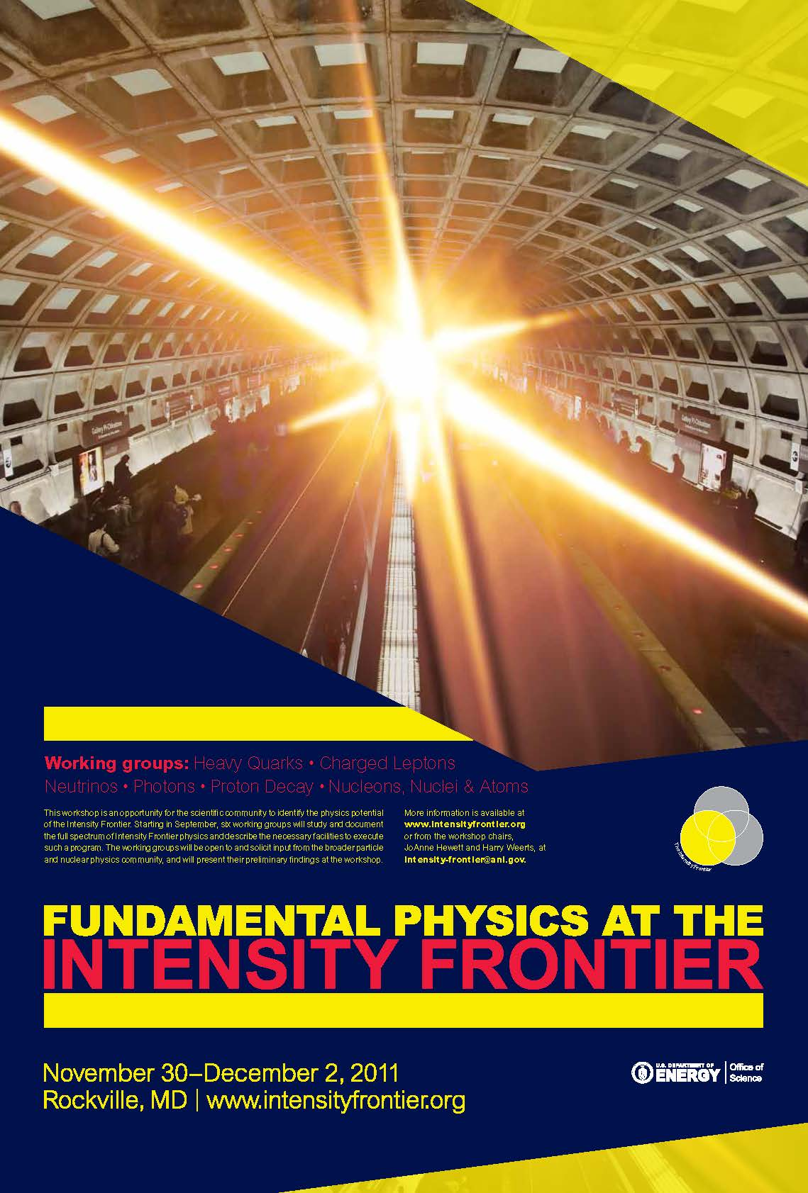
Intensity Frontier – Future Program
FY12 funding request for new experiments
Have to wait until CR is lifted
Mu2e - charged lepton flavor violation experiment
LBNE – next generation neutrino oscillation studies
MicroBooNE - low energy neutrino cross sections
Intensity Frontier Workshop in Rockville, MD on Nov 30-Dec 2
OHEP requested that JoAnne Hewett and Harry Weerts organize and lead a workshop to:
identify the most exciting opportunities to carry out experiments on the intensity frontier for our future planning
determine which experiments can be done with current facilities and technology which will require new facilities or new technology to reach their full potential.

Slide 13
Cosmic Frontier

Slide 14

Nobel Prize
Congratulations to:
Saul Perlmutter
Adam Riess
Brian Schmidt
…on their 2011 Nobel Prize in Physics “for the discovery of the accelerating expansion of the Universe through observations of distant supernovae.”

Slide 15
Cosmic Frontier - Recent Activities
The Cosmic Frontier - Program Guidance
Oct. 2009 - Received guidance from HEPAP (PASAG)
Recommended an optimized program over the next 10 years in 4 funding scenarios
Defined Prioritization Criteria for Contributions to Particle Astrophysics Projects
The science addressed by the project is necessary
Particle physicist participation is necessary
Scale matters, particularly for projects at the boundary between particle physics and astrophysics.
Programmatic issues
Dark matter & dark energy remain the highest priorities
Dark energy funding shouldn’t compromise US leadership in dark matter
These should not completely zero out other activities
Pursue at least 2 technologies for the direct detection of dark matter
HAWC and VERITAS-upgrade recommended in any funding scenario; can only do Auger-North and AGIS/CTA in higher funding scenarios
15

Slide 16
Cosmic Frontier: Program Guidance
August 2010 - Received guidance from Astro2010
Recommendations to DOE as part of a coordinated ground/space-based Dark Energy program with NSF and NASA:
The optimistic (doubling) funding profile allows investment in:
LSST (partner with NSF)
WFIRST (contribute to NASA mission)
At lower funding level
LSST is recommended as the priority because DOE role is critical
Other identified opportunities
2nd priority ground based
contributions to NSF mid-scale experiments
e.g. BigBOSS, CMB, HAWC experiments, etc.
4th priority ground-based
NSF & DOE contribute as a minor partner to a European-led CTA ground-based gamma-ray observatory

Slide 17
Cosmic Frontier Budget
The Cosmic Frontier is a subset of the Non-Accelerator Research funding line.
Cosmic Frontier Funding (in $K) | FY10 actual | FY11 actual | FY12 Request | FY12 under CR
Research | 55161 | 57112 | 52419 | 54427
Grants Research | 11674 | 11975 | 15385 | 12030
Lab Research | 34145 | 36091 | 37034 | 34770
Exp Ops & Commissioning | 9342 | 9046 |  | 7627
Projects | 20155 | 17652 | 14000 | 14000
MIE's | 10110 | 5900 | 1500 | 7000
MIE - DES | 8610 | 4000
MIE - SuperCDMS Soudan | 1500
MIE - LSST |  | 1900 |  | 5500
MIE - HAWC |  |  | 1500 | 1500
Small + R&D | 10045 | 11752 | 12500 | 7000
TOTAL | 75316 | 74764 | 66419 | 68427
There is a decrease in project funding as DES and SuperCDMS-Soudan complete.
LSST and HAWC become MIE’s in FY12: HAWC starts fabrication; LSST still in R&D

Slide 18
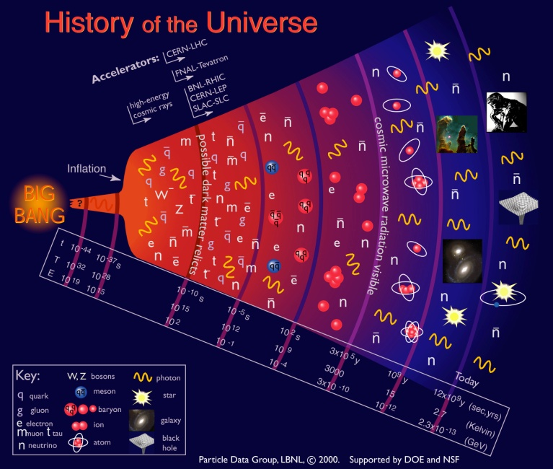
Cosmic Frontier – science thrusts
Dark energy
Dark matter
High Energy Cosmic & Gamma rays
CMB and Other
DOE partners with NSF and/or NASA on most of the experiments.
Most are international collaborations.

Slide 19
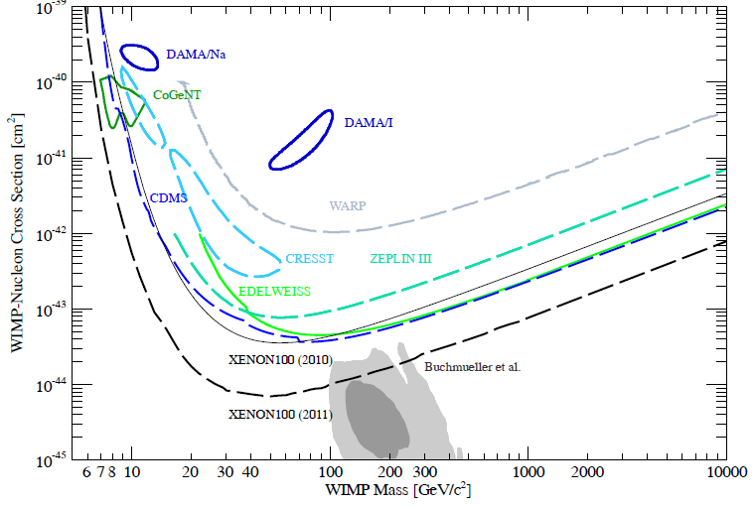
Direct-Detection Dark Matter – Current
WIMP and Axion direct-detection experiments
Many creative approaches: Technologies include cryogenic germanium detectors, liquid xenon, liquid argon, and bubble chambers.
Working in partnership with NSF-PHY on current efforts and planning future
Current “Generation 1” (G1) experiments being funded:
SuperCDMS-Soudan: Ge detectors, at Soudan mine
LUX-350: Liquid Xe, Homestake mine
COUPP 60: Bubble Chamber, at SNOLAB
DarkSide-50: Liquid Ar, at Gran Sasso
ADMX: Axion detector, at U. Washington
XENON-100: Liquid Xe, at Gran Sasso
Other efforts (DAMIC, DMTPC, …)

Slide 20
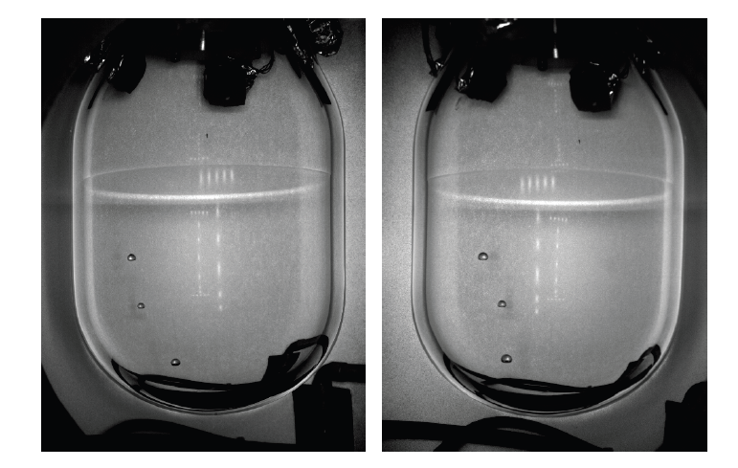
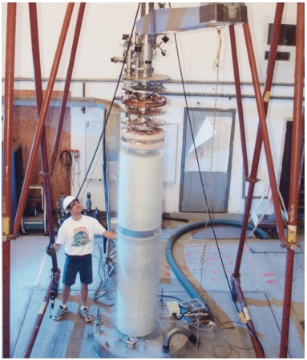
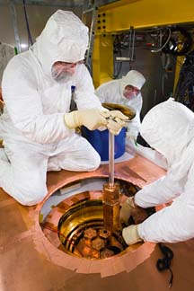
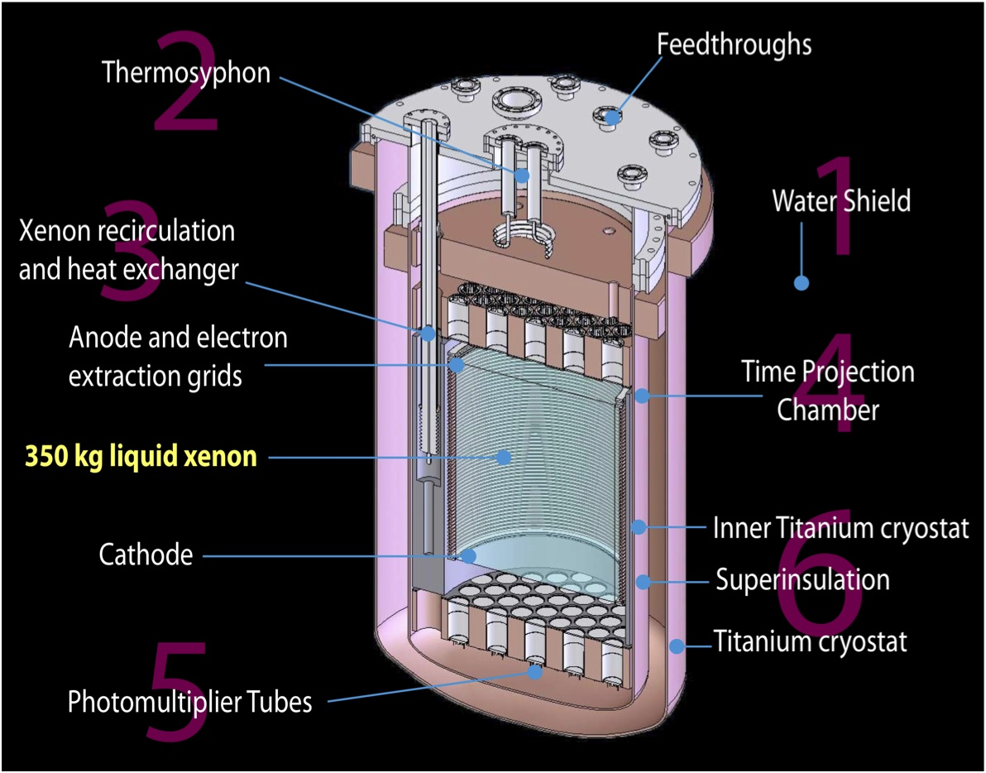
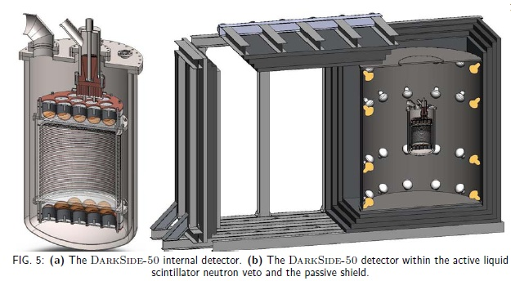
Direct-Detection Dark Matter – Current
Cryogenic Dark Matter Search (CDMS) at Soudan mine - germanium detectors
COUPP Bubble Chamber – Fermilab, SNOLab
Axion Dark Matter eXperiment (ADMX) Phase-2a at U.Washington
Large Underground Xenon (LUX) detector – Sanford Lab, Homestake mine
DarkSide-50 – Dual-Phase liquid argon TPC at LNGS Gran Sasso

Slide 21
Direct-Detection Dark Matter - Future
Technology choices will need to be made going forward in the next phases → G2 , G3
Now planning process for G2 experiments
~10x greater sensitivity than G1
Most if not all of the above G1 collaborations are planning G2 versions
DOE update on planning for G2:
Anticipate that solicitation for R&D for G2 experiments will be announced within a few months, with proposals due 3-4 months after the announcement.
Working towards a schedule of selecting experiment(s) in late FY 2012 or FY 2013 that will then move to the next stage in development
Will be done in coordination with NSF; also will need global coordination

Slide 22
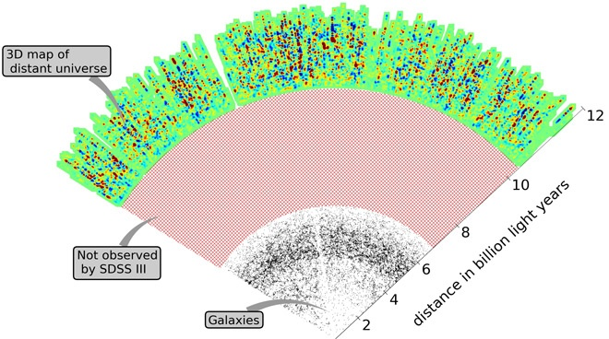
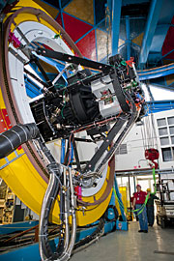
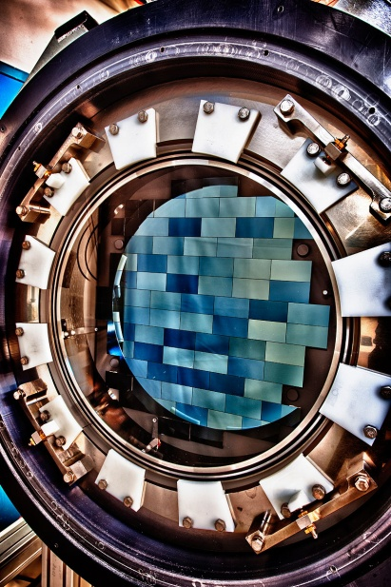
Dark Energy - Current
Operating:
Baryon Oscillation Spectroscopic Survey (BOSS) – on SDSS III
Supernova Cosmology Project, Nearby Supernova Factory + involvement in a few other supernova surveys
Fabrication:
Dark Energy Survey (DES) - finishing fabrication in 2011 and then installing and commissioning; start taking data at the end of FY 2012.
BOSS - Has shown that they can use quasars to explore large scale structure at high z
DES – Telescope simulator and completed imager

Slide 23
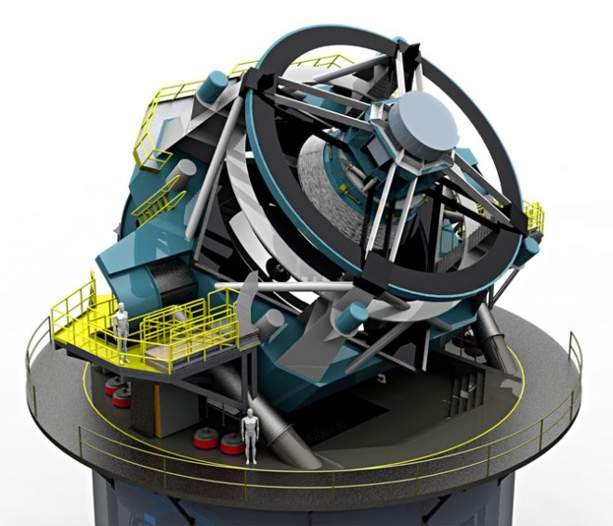
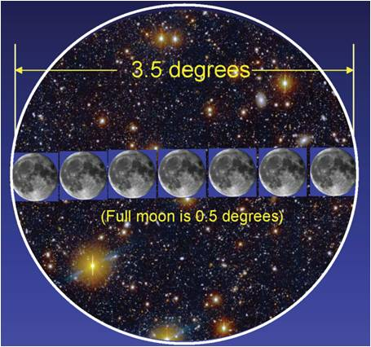
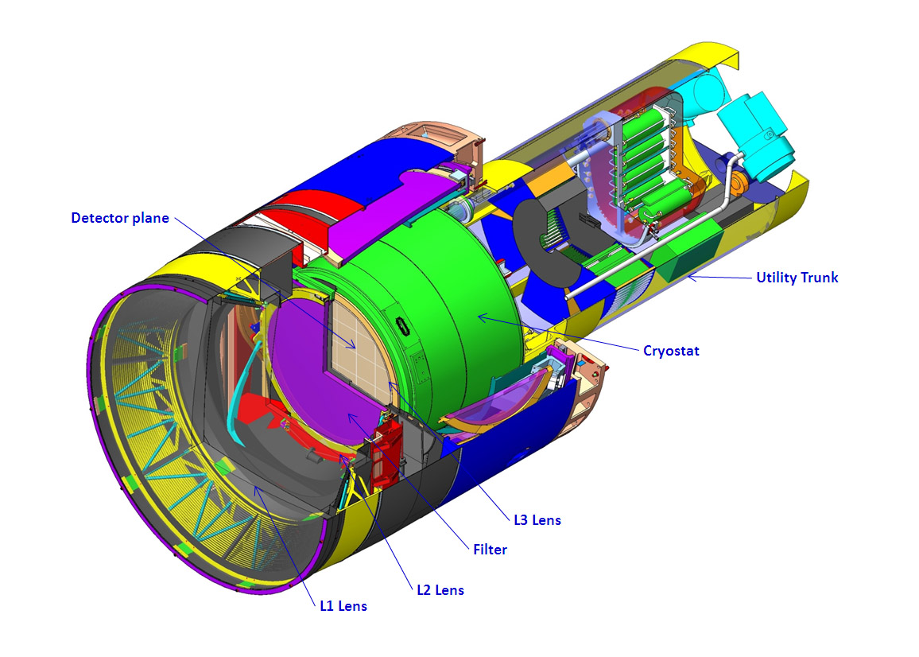
Dark Energy - LSST
LSST – Large Synoptic Survey Telescope
Stage IV dark energy experiment using all 4 methods
HEP is coordinating project planning with NSF
Holding regular meetings of the Joint Oversight Group (JOG)
Working on an MOU
DOE will be responsible for the camera
June 2011 - Mission Need Statement signed for a “Stage IV” experiment and Critical Decision 0 (CD-0) approved
Nov. 2011 - A “Lehman” review of the camera project, in preparation for requesting CD-1 approval, will be held at SLAC
FY 2012 - funding is provided for LSST R&D
HEP Planning assumes that LSST camera project fabrication start will be approved in FY 2013.

Slide 24
Dark Energy – Future Possibilities
BigBOSS
Primary method is Baryon Acoustic Oscillations (BAO): Fluctuations in the early universe imprinted on galaxy distributions.
Proposal is to fabricate a new 5000 fiber spectrograph covering a 3-degree field to mount on an existing telescope
NOAO reviewed and accepted the proposal for the Stage IV experiment on the Mayall telescope at Kitt Peak in late 2010.
A proposal has been submitted to DOE
Plan a December 2011 review of the science case and R&D effort
Depending on outcome and potential funding availability, we would then approach NSF for discussions
Space-based Dark Energy:
JDEM R&D has been closed out.
Several of our scientists are participating on the WFIRST SDT. We have no current plans for participation in WFIRST.
Several of our scientists joined the Euclid science team in August 2011 (no hardware contributions are planned). Euclid was approved to move forward for development by ESA in October 2011.

Slide 25
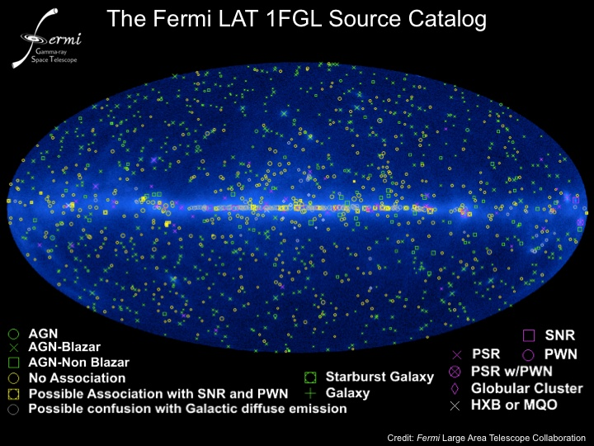
Cosmic-ray, Gamma-ray – Current, Future
Operating
Pierre Auger in Argentina – R&D efforts on radio and microwave detection
VERITAS in Arizona
Fermi Gamma-ray Space Telescope
Alpha Magnetic Spectrometer (AMS)
R&D, Fabrication
High Altitude Water Cherenkov (HAWC) in
Mexico – DOE, NSF, Mexico
FY11 R&D
FY12 – “baseline” review scheduled for Nov. 2011
Fabrication can start when CR is lifted
Future Possibilities
Proposal for R&D phase has been submitted for
contributions to Europe-led Cherenkov Telescope Array
OHEP-related science – indirect detection of dark matter, Lorentz-invariance tests
Deciding how to review
2012 Panofsky prize to Bill Atwood (SLAC →
UCSC) "for his leading work on the design, construction,
and use of the Large Area Telescope on the Fermi Gamma-ray
Satellite, enabling numerous new results in gamma-ray
astrophysics and fundamental physics.“
Atwood and Peter Michelson and FGST/LAT team
won the 2011 Bruno Rossi Prize
25

Slide 26
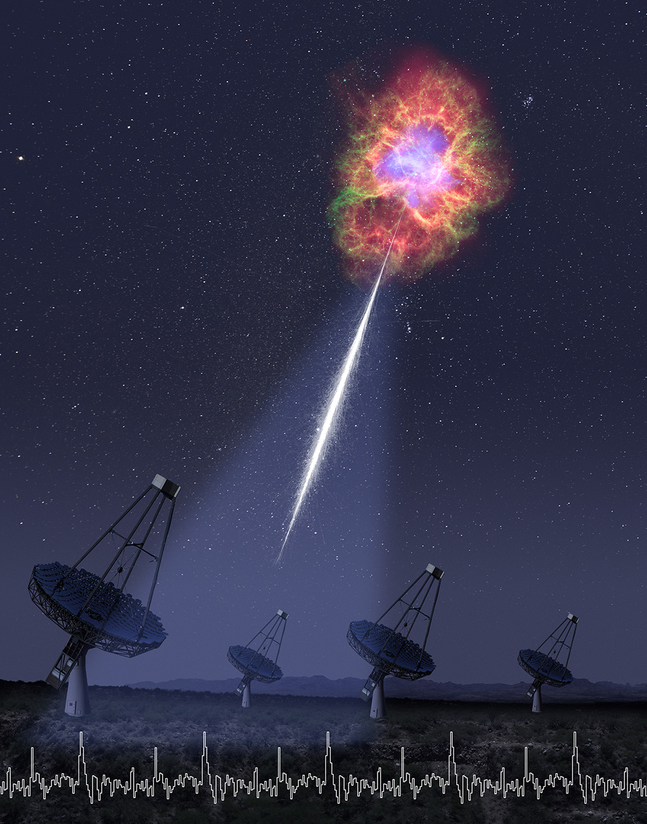
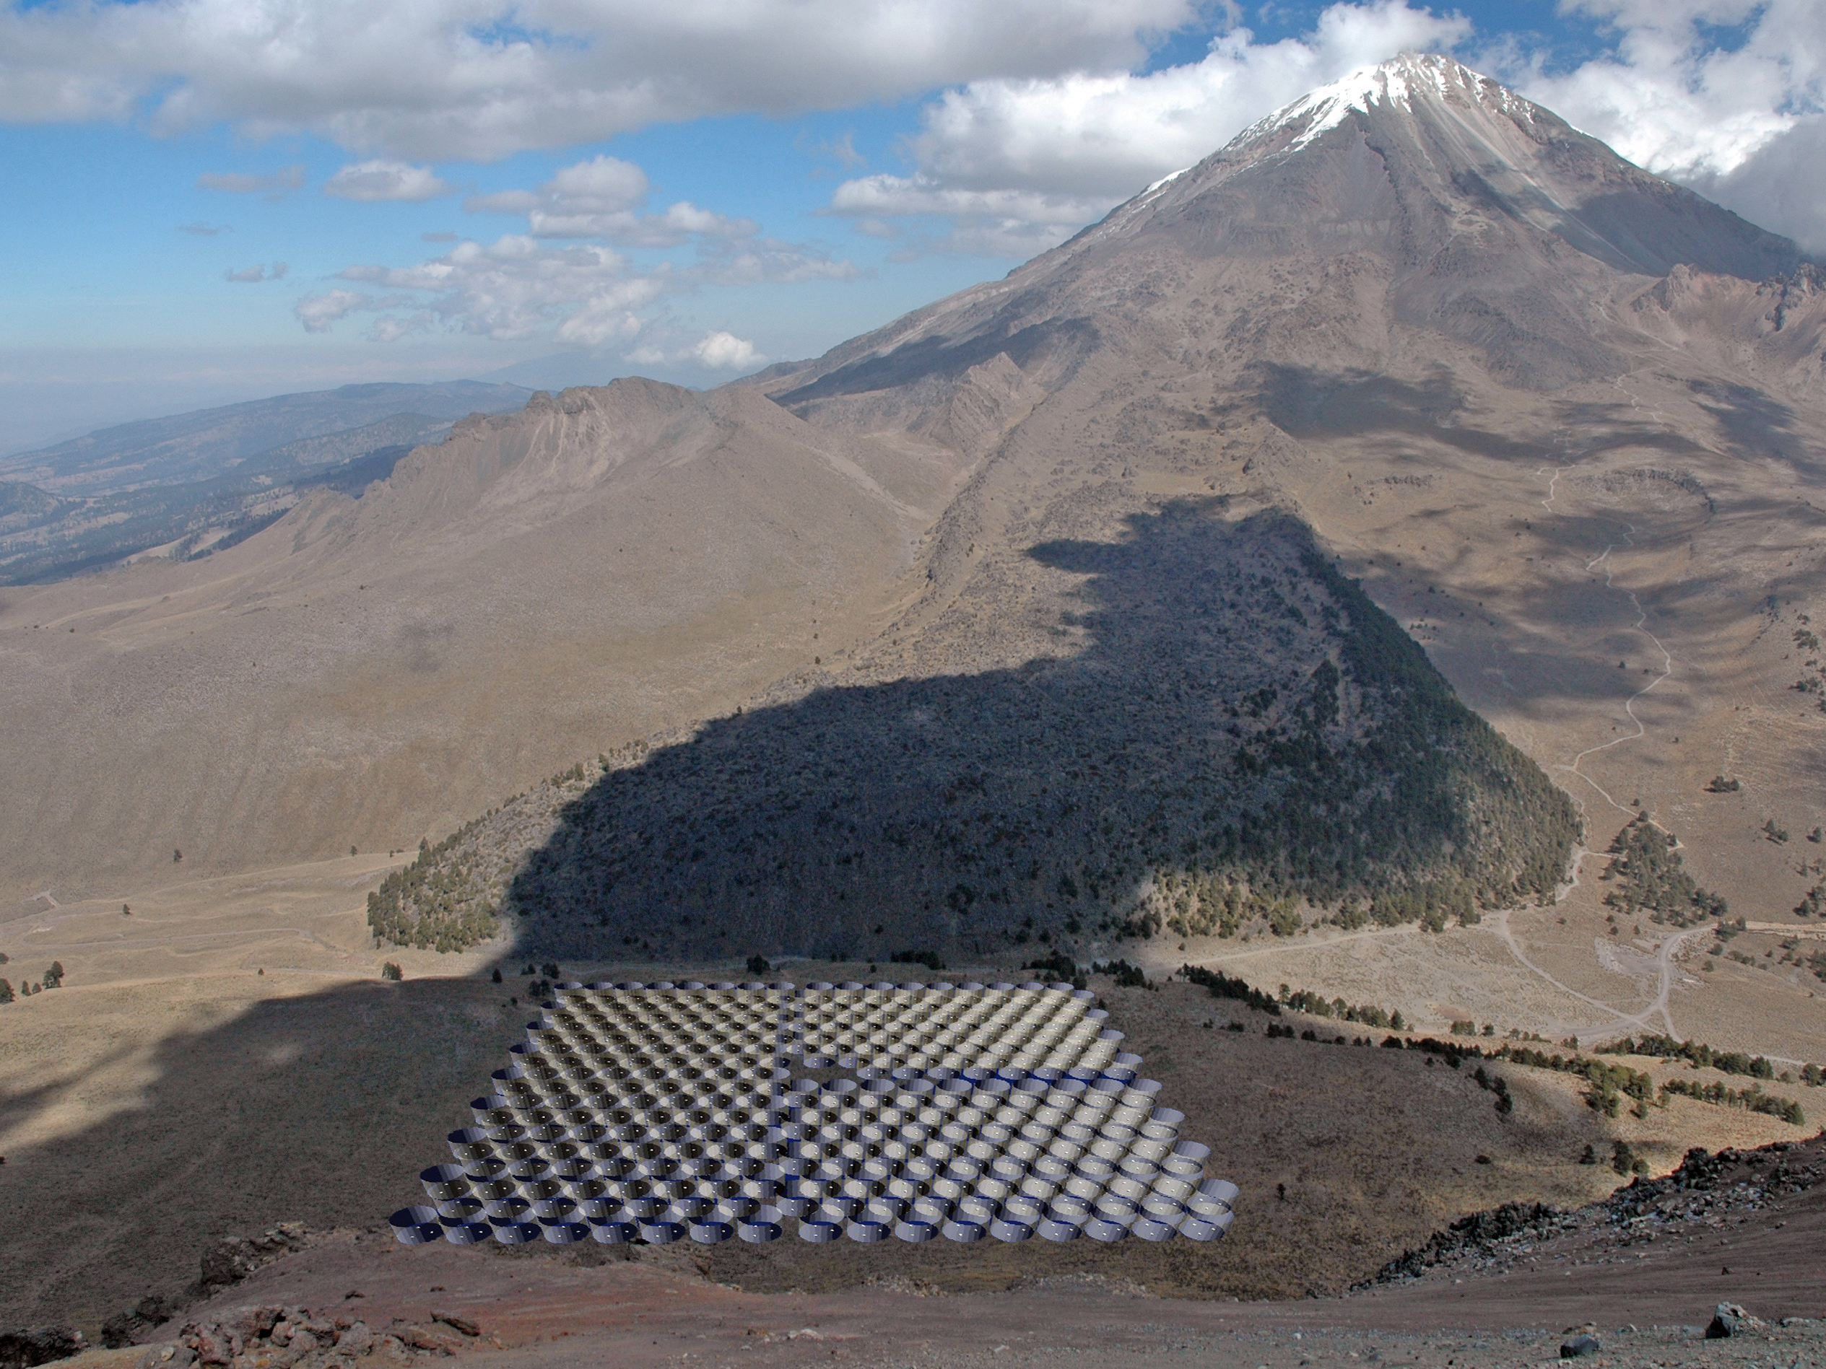
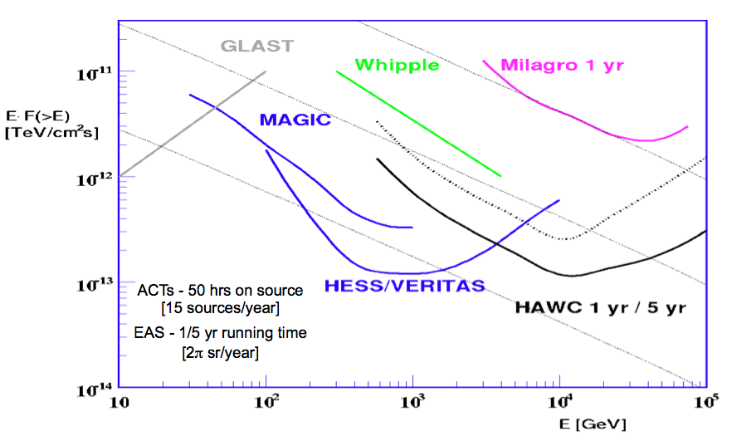
Cosmic-ray, Gamma-ray - Current
HAWC – the 7-tank prototype array is complete and being commissioned
Science Magazine: unexpected VERITAS
detection of pulsed (periodic) gamma-ray emission
from the Crab Pulsar between 150 GeV and 40 GeV.

Slide 27

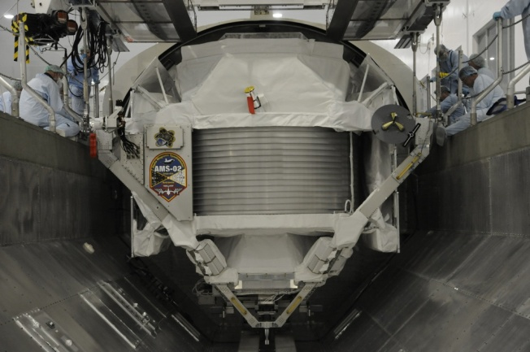
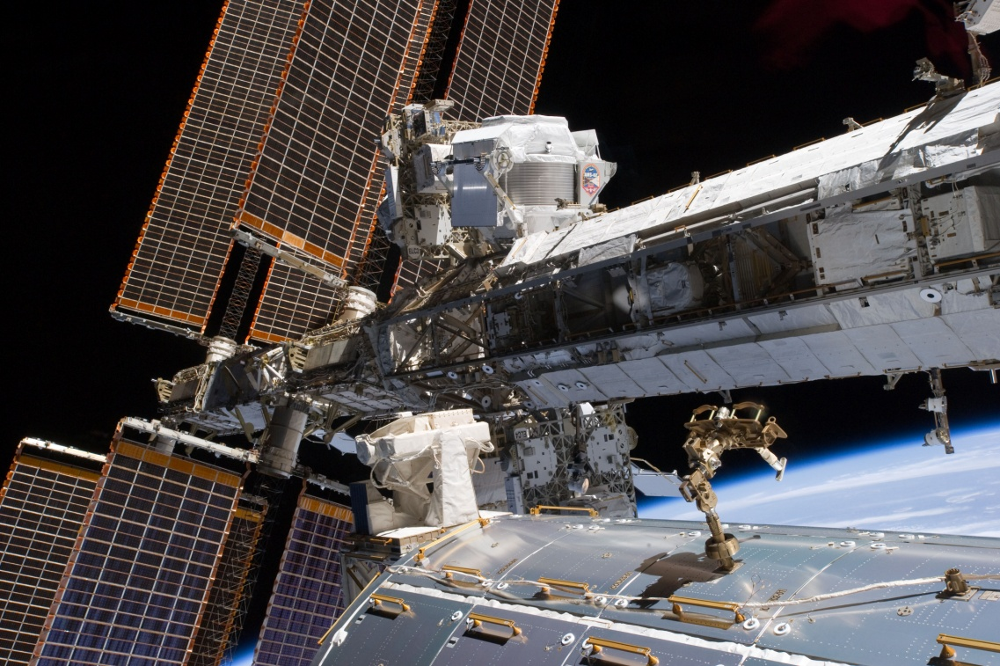
AMS
Launched on May 16, 2011, (Endeavor, STS-134) and installed on Space Station
Science goal of searches for antimatter in space, searches for dark matter, and searches for other new forms of matter like strange quark matter (strangelets)
Will open up new vistas in high energy particle astrophysics.
It is a DOE HEP-led large, international collaboration, although most of the total cost for the instrumentation was provided by foreign collaborators
NASA is the lead in providing ISS laboratory, Shuttle mission, and associated infrastructure

Slide 28
AMS – results
AMS is performing as expected and has collected and has collected more than 6 billion cosmic ray events since installation.
42 GeV carbon
20 GeV Electron

Slide 29
Cosmic Frontier – other efforts
Cosmic Microwave Background:
HEP has small research efforts on a few experiments
HEP making hardware contribution to South Pole Telescope
ESA/NASA Planck mission – HEP has MOU with NASA to provide computing resources at NERSC in Berkeley for data processing and analysis
Holographic Interferometry:
Aaron Chou won an Early Career award to develop the Holometer experiment at
Fermilab – will provide direct experimental access to the Planck scale and probe the the
microscopic quantum nature of space and time.

Slide 30
Computational HEP Program
Groups from the DOE labs and their university partners have formed a collaboration to address the
computational challenges relating to DOE HEP Cosmic Frontier Research
Includes leveraging DOE and other high performance computing resources
The National Energy Research Scientific Computing Center (NERSC)
The Innovative & Novel Computational Impact on Theory and Experiment (INCITE) program
The ASCR Leadership Computing Challenge (ALCC) program
NSF, NASA, and NNSA Computers
DOE Office of Science Scientific Discovery through Advanced Computing (SciDAC ) program (Research)
The Collaboration recently convened a planning meeting in September
Purpose -- To identify key challenges, and possible consolidation of resources for computing at the
DOE HEP Cosmic Frontier. Topics included:
Cosmological simulations and analysis
Targeted to structure formation probes of dark energy, dark matter, inflation, and neutrinos
Capability support and value added for cosmological surveys (BOSS, DES, LSST, --)
Dark Energy probes/methods

Slide 31
Cosmic Frontier - Recent Activities
The Cosmic Frontier - Program Management
DOE-HEP Cosmic Frontier program is planning a review process to start in
spring 2012 – based on recommendations from Committee of Visitors
Will accomplish the necessary oversight of efforts and funds
Will allow longer range planning of the program
~ March to May, we will have 2 reviews of projects
- If appropriate, do these in partnership/coordination with NSF for joint projects
Review of Current Projects – R&D, Fabrication
For all experiments, we will continue to have monthly or quarterly reports and discussions to agencies
as appropriate
Standard panel review - Projects below MIE limit ($2M equipment, $5M total project cost)
- Panel review of each experiment/effort’s Project Execution Plan - status of technical, cost, schedule, management
Individual reviews - Projects above MIE limit but below the “Lehman” limit of $20M
- Will have individual R&D and “baseline” review before moving to process 1(e.g. HAWC)
Lehman reviews - Projects above the $20M “Lehman” limit
- May choose to have independent review of the pre-conceptual R&D phase, science (e.g. BigBOSS) before moving to Lehman review process
31

Slide 32
Cosmic Frontier - Recent Activities
The Cosmic Frontier - Program Management
Review of Operating Experiments – may do this every 2 or 3 years
For all experiments, we will continue to have monthly or quarterly reports & discussions to agencies as
appropriate
Individual panel review - Projects above the “Lehman” limit:
Prior to the operating phase, we plan an independent review of their Project Operations Plan – science plan, data collection schedule, technical aspects, cost, schedule, management
After they move into operations, they can move into the standard operations review below
Standard Operations panel review – projects below “Lehman” limit or ones above after their initial operations plan has been reviewed and approved
Starting now, ask each experiment to provide a Project Operations Plan
For experiments within their agreed-upon operating phase:
- Panel reviews the status of science results, data collection, technical ops, cost, schedule, management
For experiments nearing the end of their operating phase:
Panel reviews their status and proposal for continued operations in terms of science case and cost, schedule
32

Slide 33
Cosmic Frontier - Recent Activities
The Cosmic Frontier - Program Coordination
Particle Physics is a global field
We coordinate and partner with NSF and NASA and international agencies – regular meetings, joint oversight, etc.
In Astro-Particle Physics, internationally we participate in:
OECD Global Science Forum
Astro-Particle Physics Working Group - A 2-year study of global coordination and planning of astro-particle physics experiments (report Dec. 2010)
A follow on, Astro-Particle International Forum (APIF) started in spring 2011 – continued coordination and planning
33

Slide 34
BACKUPS

Slide 35
Cosmic Frontier - Recent Activities
AAAC March 2011 Report Findings – p.1
The new NRC Astro2010 decadal survey report: New Worlds, New Horizons (NWNH), is a culmination of unprecedented community effort. The report represents the nationwide consensus of the most critical and promising future directions in astrophysics and astronomy. For the first time independent assessment of cost and technical maturity of all proposed projects was included in the decision making process.
The many ongoing NASA, NSF and DOE science breakthroughs and successes in astrophysics and astronomy are the result of successful agency stewardship of previous decadal surveys. That is, the decadal process really works, and it is important to maintain the priorities and balance given in NWNH.
Budgetary constraints may severely delay the implementation of many of the NWNH recommended projects. Continued budgetary constraints have the potential to damage current U.S. worldwide leadership in astronomy and astrophysics.
We highly commend the initial response of the agencies to NWNH, given the budgetary constraints. Especially welcome are NASA’s plans for the midscale Explorer program, NSF’s plan for midscale innovation projects, the NASA Tech Fellows program, and NASA’s Wide-Field Infrared Survey Telescope (WFIRST) plans.
*We commend the interagency actions by the NSF and DOE with respect to the Large Synoptic Survey Telescope (LSST), which we find to be consistent with the recommendations of NWNH.
35

Slide 36
Cosmic Frontier - Recent Activities
AAAC March 2011 Report Findings – p. 2
*Rising Above the Gathering Storm warns that the Nation must do a better job in training the next generation of scientists and engineers in order to remain competitive. Astronomy has a role to play in this regard, because it is a mind-opening field, a gateway, in which exciting discoveries can attract young people to STEM (science, technology, engineering, and mathematics) careers.
*As noted in the AAAC letter of October 22, 2010, the Committee remains concerned about the potential impacts of the anticipated JWST cost increases and schedule delays on the NWNH recommended major space activities for the decade.
*NWNH called for the formulation of a Decadal Survey Implementation Advisory Committee (DSIAC) to provide strategic advice on decadal report-related issues and to monitor the progress on achieving the recommendations. While the AAAC over the years has adopted a role as shepherd over the decadal results, its charge is primarily to be a tactical committee, whose role is to advise on issues related to projects that cut across more than one agency. AAAC is available to work with a newly formed DSIAC as needed.
*The Committee finds that interagency cooperation plays a key role in the astronomy research program and will continue to do so through the next decade. The agencies have identified opportunities for joint activities from the priorities recommended in the NWNH program, but the Committee notes that in many cases activities may be limited by the tight fiscal environment.
36

Slide 37
OHEP Trends
Ramp up ILC, SRF, and some accounting changes.
Trading projects for more research
In the late 90’s the fraction devoted to projects was about 20%.
This fraction reached a minimum around 2006.
The projects started since then are coming to completion.
The HEP Committee of Visitors recommended projects should be ~20% of the budget.

Slide 38
Major Recommendations of P5
The panel recommends that the US maintain a leadership role in world-wide particle physics. The panel recommends a strong, integrated research program at the three frontiers of the field: the Energy Frontier, the Intensity Frontier and the Cosmic Frontier.
The panel recommends support for the US LHC program, including US involvement in the planned detector and accelerator upgrades. (highest priority)
The panel recommends a world-class neutrino program as a core component of the US program, with the long-term vision of a large detector in the proposed DUSEL and a high-intensity neutrino source at Fermilab.
The panel recommends funding for measurements of rare processes to an extent depending on the funding levels available… (Mu2e)
The panel recommends support for the study of dark matter and dark energy as an integral part of the US particle physics program.
The panel recommends a broad strategic program in accelerator R&D, including work …, along with support of basic accelerator science.

Slide 39
P5 Funding Scenarios
The implementation of the plan has evolved and reacted to funding constraints and changing circumstances.
The P5 report provided advice on 3 funding scenarios:
A: a constant level of effort from the FY 2008 level
Cannot play a leadership role in on all three frontiers.
B: a constant level of effort from the FY 2007 level
Can play a leadership role on all three frontiers.
C: doubling the budget over 10 years from the FY 2007 level
World class at all three frontiers with more timely results, greater impact, and more efficiency.
We are now at Scenario A
We can only do 1 dark energy experiment and are losing leadership on the Cosmic Frontier.

Slide 40
PASAG – Dark Matter Recommendations
Scenario A
Maintain world-leading program by supporting 2 next-generation (G2) experiments and SuperCDMS-SNOLab
Not able to do a third-generation (G3) experiment this decade which may mean loss of world leadership
Scenario B
Maintain world-leading program by supporting 2 G2 experiments and SuperCDMS-SNOLab
Start a G3 experiment this decade.
A broad G2 program is higher priority than a 2nd G3 experiment
Scenario C & D
World-leading program with support of 2 G2 experiments and SuperCDMS-SNOLab, followed by 2 G3 experiments.
40

Slide 41
PASAG – Dark Energy Recommendations
Scenario A
Not possible to have major hardware and science contributions to any large project -- participation supported only in very limited areas
Scenario B
May have just enough funding for significant participation in 1 large project but there are risks since costs are uncertain; fast start may not be possible
Scenario C
A world-leading program is enabled, with coordinated experiments in space and on the ground
Significant HEP role in 1 large experiment plus a moderate-scale project and/or substantial role in 2nd large project. Project start may need to be pushed out due to funding profile
Scenario D
Funding would allow major roles in 2 large experiments
41

Slide 42
PASAG - Recommendations
High Energy Cosmic Particle Recommendations
Scenario A
Effort is severely curtailed in order to preserve viable program in dark matter & energy
VERITAS upgrade & HAWC should be a priority.
Auger-North & AGIS are not possible
Scenario B
VERITAS upgrade, HAWC and a reduced but leading role in an AGIS that is merged with CTA
Auger-North is not possible
Scenario C & D
A world-leading program is enabled. VERITAS upgrade, HAWC and a reduced but leading role in an AGIS that is merged with CTA, along with leadership of Auger-North
Cosmic Microwave Background Recommendations
Scenario A, B, C, D
QUIET-II should be supported along with other small investments that meet prioritization criteria.
42

Slide 43
Accelerator R&D Significant Changes
The FY 2012 budget for Accelerator R&D is essentially flat
Advanced Plasma Accelerator Facilities
FACET, the beam driven wakefield accelerator test facility at SLAC had completed its user-assisted commissioning and is ready for CD-4. (Budget request includes $6 million to operate it in FY 2012 .)
BELLA, the laser-driven wakefield accelerator test facility at LBNL will be completed in FY 2012 (Budget request includes $2 million to operate it in FY 2012 )
L’OASIS—the little brother of BELLA continues to produce exciting results, including energy tuning, observation of first light from its undulator. The staging experiment to demonstrate a two-stage LPA will be carried out in FY 2012.
The Muon Accelerator Program (MAP) has been officially established at Fermilab to consolidate the R&D activities previously conducted under two separate programs (NFMCC and MCTF)
The ILC R&D program continues its ramp-down in FY 2012.
ART prioritizes the remaining R&D that was planned for the ILC Global Design Effort to maximize its impact.
The Superconducting RF program continues to ramp down as it completes developing SRF infrastructure at Fermilab.

