Slide 1
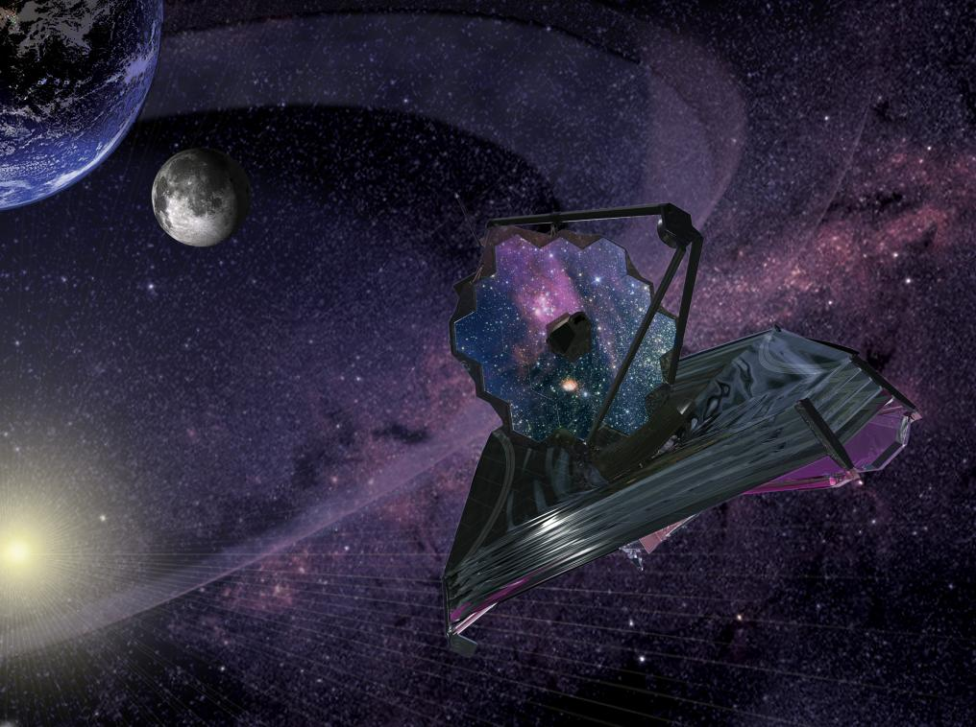
Astronomy
and the
James Webb
Space Telescope
John Mather
JWST Senior Project Scientist
AAAC Oct 13 2011

Slide 2
JWST Science Updates
4 (original) major themes: first light, galaxy assembly, star & planet formation, evolution of planetary systems
2011 Conference: Frontier Science Opportunities with the JWST – many new ideas!
Dark energy – Nobel; plans for JWST
Dark matter – mapping it with JWST
Galaxy formation – compare with simulations
Chilly stars (< 300 K) – WISE Y dwarfs
Lonely planets (microlensing) – JWST in clusters

Slide 3
More connections
Herschel: D/H in a comet matches Earth oceans – JWST can find many more
Soummer et al: pulled 3 planets out of HST archives of HR8799 –JWST too
TESS and FiNESSE selected for Explorer studies – finders for JWST
ALMA first light

Slide 4
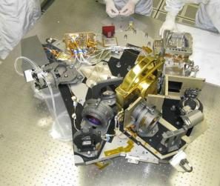




The James Webb Space Telescope
JWST Instruments
The Near Infrared Camera (NIRCam)
Visible and near infrared camera (0.6 – 5 micron)
2.2 x 4.4 arcmin field of view, diffraction limited
Coronographs
The Near Infrared Spectrograph (NIRSpec)
Multi-object dispersive spectrograph (1 – 5 micron)
- 3.4 x 3.4 arcmin field of view with 0.1 arcsec pixels
R = 1000 and 2700 gratings and R = 100 prism
IFU over 3 x 3 arcsecond region
The Mid Infrared Instrument (MIRI)
Mid-infrared camera and slit spectrograph (5 – 28 microns)
1.9 x 1.4 arcmin imaging field of view with 0.11 arcsec pixels
R = 100 slit spectrograph (5 – 10 micron) and IFU (R = 3000)
Coronographs
NIRCam
The Tunable Filter Imager (TFI) → NIRISS
- Infrared imager and slitless spectrograph
- 2.2 x 2.2 arcmin field of view
The Fine Guidance Sensor (FGS)
2.4 x 2.4 arcmin imager for target acquisition
Rapid readout of subarray for ACS control
Ensures 95% probability of finding a guide star anywhere in sky
NIRSpec
Notes:
1.) Picture on the left is the NIRCam engineering test unit. The instrument has two identical modules.
2.) Picture on the right is a single exposure 2.2’ x 4.4’ exposure. The two wavelengths are observed simultaneously via dichroics

Slide 5
The James Webb Space Telescope
JWST Science Themes – The Quest for Origins
1.) The End of the Dark Ages
Discover the first stars, protogalaxies, supernovae, and black holes
Follow the Universe’s ionization history across cosmic time
2.) The Assembly and Evolution of Galaxies
Track the merger of protogalaxies
Study the effects of black holes on their surroundings
Map the evolution of dark matter, stars, and metals through galaxy growth
3.) The Birth of Stars and Planetary Systems
Unveil newborn stars and planets in dusty clouds
Reveal the dependency of star formation to environment
Measure how chemical elements are produced and recirculated
Complete the stellar and substellar inventory
Measure the IMF to below the H-burning limit, in different environments
4.) The Origins of Life
Study the formation of planets
Measure the composition of atmospheres, probe for liquid water
Complete the census of the outer solar system
JWST Science summarized in 15 JWST Science White Papers
http://www.stsci.edu/jwst/science/whitepapers

Slide 6
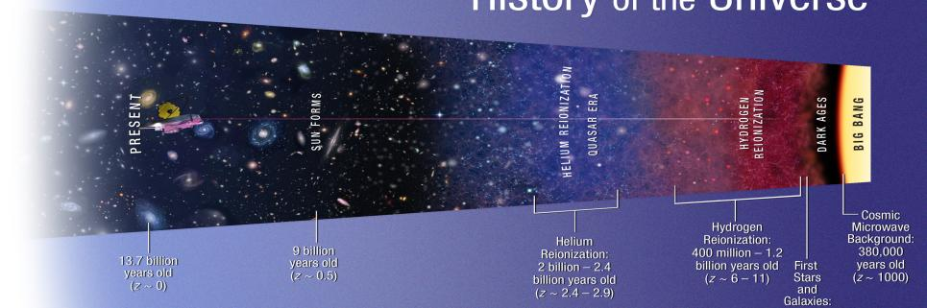
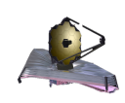
The James Webb Space Telescope
JWST Science Themes – The End of the Dark Ages
JWST Questions
1.) What are the first galaxies?
2.) When did reionization occur?
3.) What is the Universe’s reionization history?
4.) What sources caused reionization?
HUBBLE’S LIMIT

Slide 7
More great ideas
Measure H0 to 1.3% (JWST+GAIA)
  To constrain Dark Energy and neutrinos
Disentangle AGN and star-formation
Study the galaxy feedback cycle
  Demographics of star formation & stellar mass vs. morphology redshift & environment
  Evolution of Black-hole vs. bulge mass relation
  Kinematics & abundances from spectra
  Dust formation and destruction
  H2 formation and destruction
Dissect tidal disruption events
  A dime a dozen by the time of JWST
Harry Ferguson chart – Frontiers conference

Slide 8
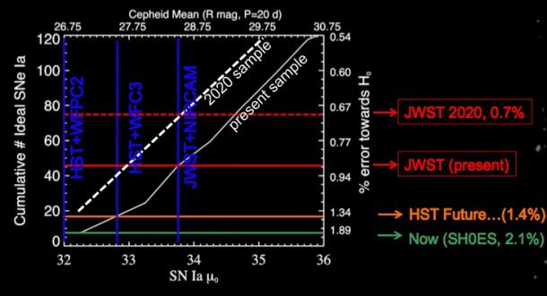
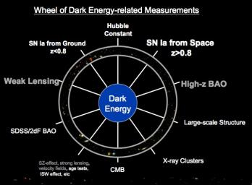
The James Webb Space Telescope
Dark Energy and Dark Matter: The acceleration parameter of the Universe
1.) Leverage multiple techniques to minimize systematic errors.
2.) wide field surveys will find targets.
3.) Measure very distant supernovae (standard candles?)
4.) SNe rest frame IR light curves – may be better standard candles?
5.) directly measure effects of dark matter from distorted geometry of distant
objects, masses of galaxies and clusters to high-z, rotation curves, etc…
6.) Map cosmic archeology at high-z (prior to acceleration, formation of clusters).
7.) Measure Cepheid variables in galaxies with known maser distances.
JWST will constrain Dark Energy through exquisite measurements of H_{O}

Slide 9
More great ideas
Can we find Pop III Pair-Instability Supernovae?
  May need help from lensing
  Challenging to confirm
Search for the first galaxies
  May need help from lensing
  How do we know we have found them?
    Lack of [OIII]? Strong HeII?
Use strong lensing (50 or so) to
  constrain dark-matter substructure
  test density profiles
  dissect AGN
Harry Ferguson chart – Frontiers conference

Slide 10
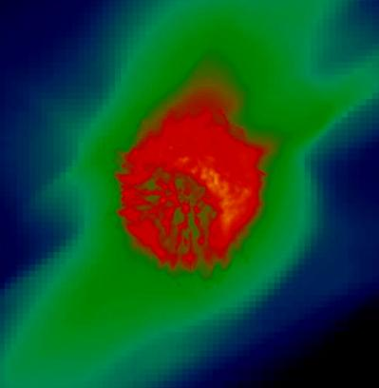


Finding the First Cosmic Explosions
with JWST
Daniel Whalen
McWilliams Fellow
Carnegie Mellon University
Dan Whalen chart – JWST Frontiers

Slide 11
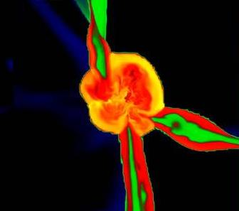
Birthplaces of
Primordial Stars
~ 200 pc
10⁵ - 10⁶ M_{sol}
halos at z ~ 20
Dan Whalen chart – JWST Frontiers

Slide 12
Properties of the First Stars
thought to be very massive (25 - 500 solar masses)
due to inefficient H₂ cooling
form in isolation (either one per halo or in binaries)
T_{surface} ~ 100,000 K
extremely luminous sources of ionizing and LW photons
(> 10⁵⁰ photons s⁻¹)
2 - 3 Myr lifetimes
no known mechanisms for mass loss -- no line-driven winds
Dan Whalen chart – JWST Frontiers
Notes:
12

Slide 13
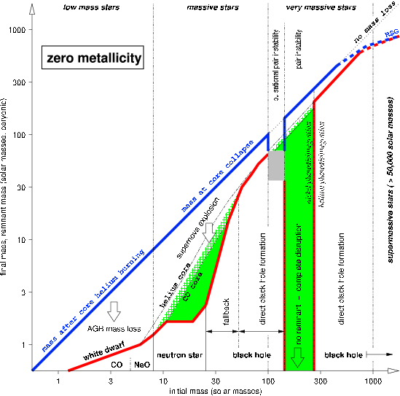
Final Fates of the First Stars
Heger & Woosley 2002, ApJ 567, 532
Dan Whalen chart – JWST Frontiers
Notes:
13
type ii / hypernovae: remnant
PISN: no remnant

Slide 14
Conclusions
PISN will be visible to JWST out to z ~ 10 ; strong lensing may
enable their detection out to z ~ 15 (Holz, Whalen & Fryer 2010
ApJ in prep)
dedicated ground-based followup with 30-meter class telescopes
for primordial SNe spectroscopy
discrimination between Pop III PISN and Pop III CC SNe will be
challenging but offers the first direct constraints on the Pop III IMF
complementary detection of Pop III PISN remnants by the SZ effect
may be possible (Whalen, Bhattacharya & Holz 2010, ApJ in prep)
Dan Whalen chart – JWST Frontiers
Notes:
14

Slide 15
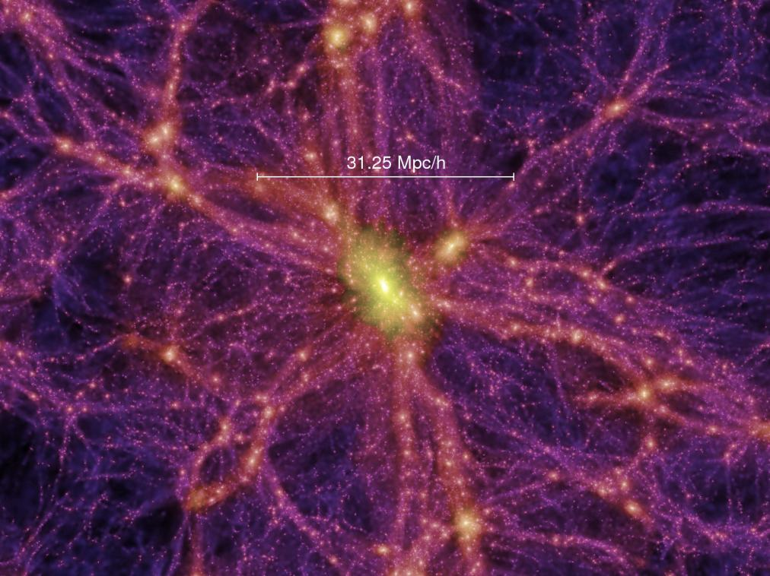
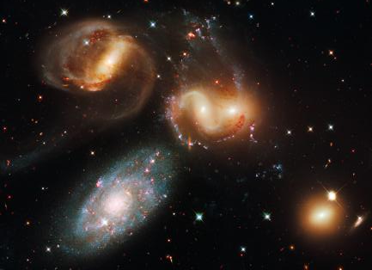
The James Webb Space Telescope
JWST Science Themes – The Assembly and Evolution of Galaxies
JWST Questions
1.) Where and when did the hubble sequence form?
2.) Do hierarchical formation models and global scaling relations
explain diverse galaxy morphologies and their cosmic evolution?
3.) How did the heavy elements form?
4.) What role do ULIRGs and AGN play in galaxy evolution?

Slide 16
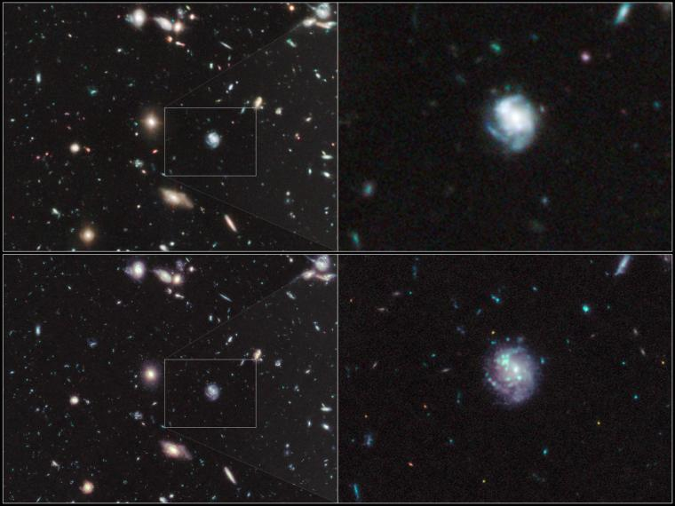
The James Webb Space Telescope
JWST Science Themes – The End of the Dark Ages
The Hubble UDF
(F105W, F125W, F160W)
Simulated JWST
JWST sees much deeper, has higher angular resolution than Hubble

Slide 17
Outline
Three birds:
  Is there dark matter substructure?
  Which comes first: the galaxy or the black hole?
  Are dark matter density profiles universal?
One stone:
  Observations of multiply-imaged QSOs
    MIRI imaging
    NIRSPEC spectroscopy
Tommaso Treu chart – JWST Frontiers

Slide 18
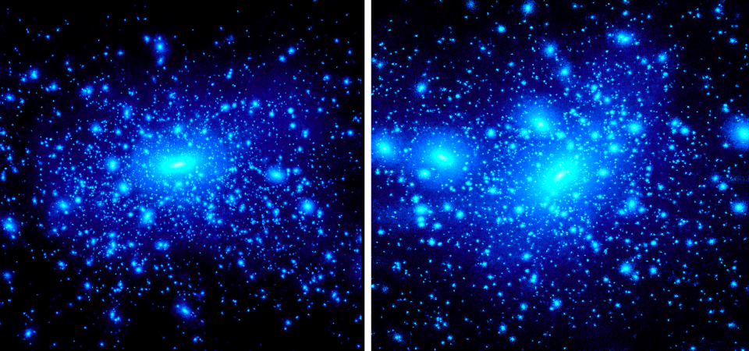
Theory
Cluster
Galaxy
Kravtsov 2010
Tommaso Treu chart – JWST Frontiers
Notes:
18

Slide 19
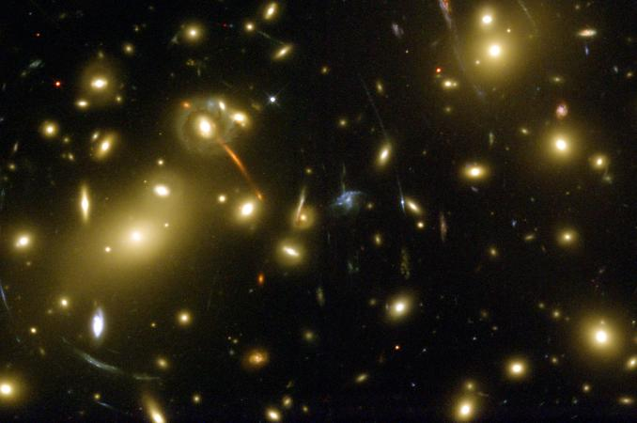
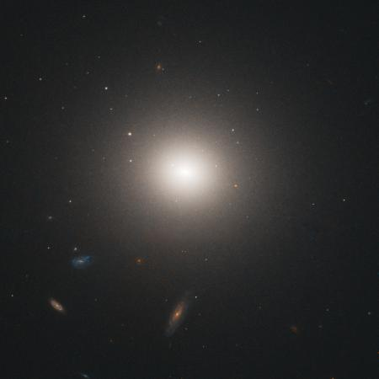
Observations
Cluster
Galaxy
Tommaso Treu chart – JWST Frontiers
Notes:
19

Slide 20
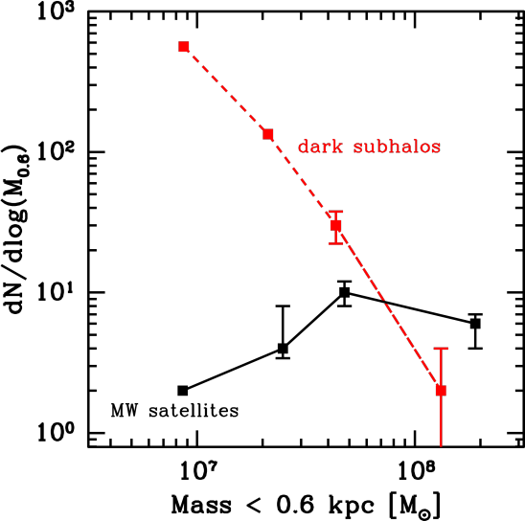
Milky Way Satellites
Theory
Number of satellites
Observations
Strigari et al. 2007
Tommaso Treu chart – JWST Frontiers
Notes:
20

Slide 21
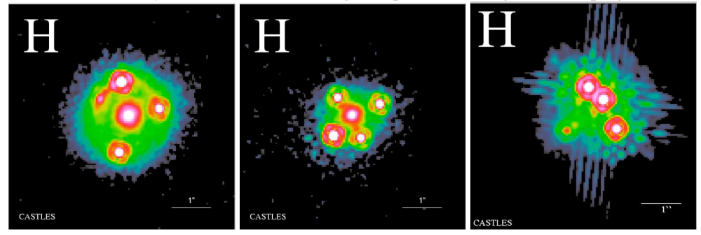
One stone: gravitationally lensed QSOs
Tommaso Treu chart – JWST Frontiers

Slide 22
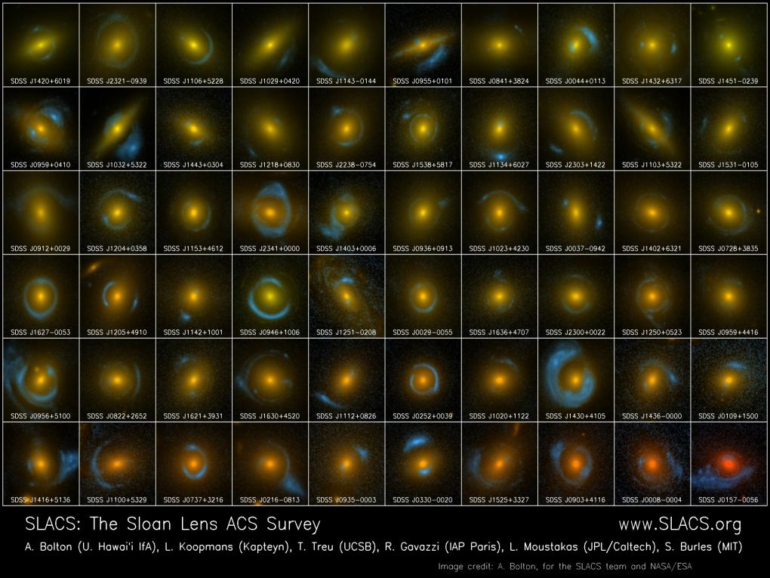
Strong lensing is rare (1/1000 galaxy):
It’s hard to find large samples!!

Slide 23
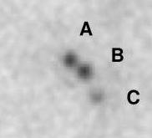
State of the art vs JWST
Sensitivity at 11μms:
D ~0.2-0.3mJ:
  Undetected by Subaru
  S/N~40-60 in 28s of MIRI
B 10mJ:
  S/N~5 in 3.1 hrs of Subaru
  S/N~700 in 28s of MIRI
Flux (mJ) | MIRI Exptime (S/N=10)
0.02 | 100s
0.006 | 1000s
0.002 | 9500s
?
Chiba et al. 2005; 3.1hrs of Subaru
Tommaso Treu chart – JWST Frontiers
Notes:
23

Slide 24
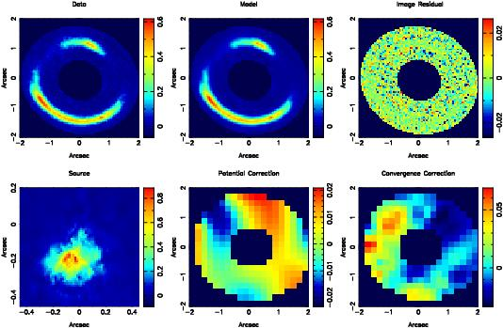
Direct detection of a dark substructure
Tommaso Treu chart – JWST Frontiers
Vegetti et al 2010
Notes:
TMT WIRC will go to vis, but not 1st light.
24

Slide 25
Conclusions
JWST observations of gravitationally lensed QSOs can solve three open problems
  Are there dark satellites around galaxies?
    MIRI imaging of lensed dusty torus
  Which comes first, black hole or host spheroid?
    NIRSPEC spectroscopy of lensed QSO hosts
  Are dark matter density profiles universal?
    NIRSPEC spectroscopy of lensed QSO hosts
    NIRSPEC spectroscopy of foreground deflector
BIG TASK FOR THE NEXT 5 YEARS IS FINDING TARGETS
Tommaso Treu chart – JWST Frontiers

Slide 26
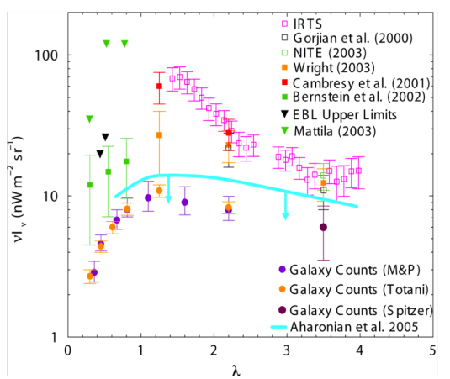
The Extragalactic Background:
Are we missing something?
Bock et al. 2006
At face value, the integrated extragalactic background light suggests a major source of energy in the near-IR
- early energetic galaxy formation?
- bad subtraction of zodiacal foreground?
Harry Ferguson chart – Frontiers conference

Slide 27


Mid-Infrared Observation of High Redshift Galaxy Evolution
Alexandra Pope (UMass Amherst)
JWST Workshop – STScI Baltimore
June 8, 2011
Notes:
-”understanding the assembly of galaxies” one of the main science goals of JWST
-what we learned from Spitzer, pose good questions for JWST
- Also think about where we will be at in 2017-1018 with other other IR/submm facilities

Slide 28
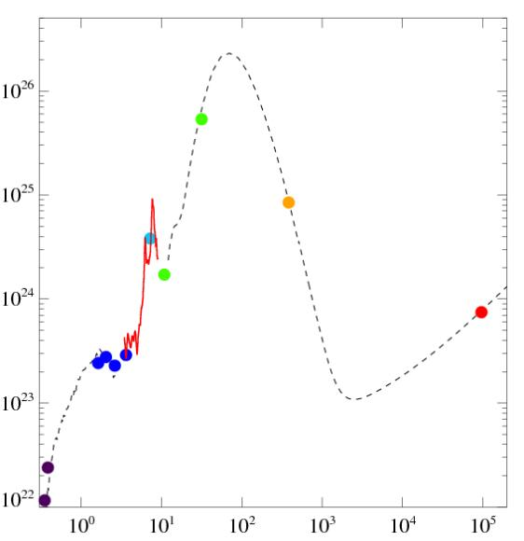
Spectral energy distribution (SED) of high redshift submillimeter galaxies (SMGs)
Herschel
Circa 2011: Well sampled SED for ULIRGs z~1-3
Spectroscopy can provide a probe of the underlying radiation field
Mid-IR spectroscopy is sensitive to dust which is dominating the SFRD
MIPS
SCUBA
Luminosity density (WHz⁻¹)
IRS
VLA
IRAC
HST
Rest Wavelength (μm)
Alexandra Pope chart – JWST Frontiers

Slide 29
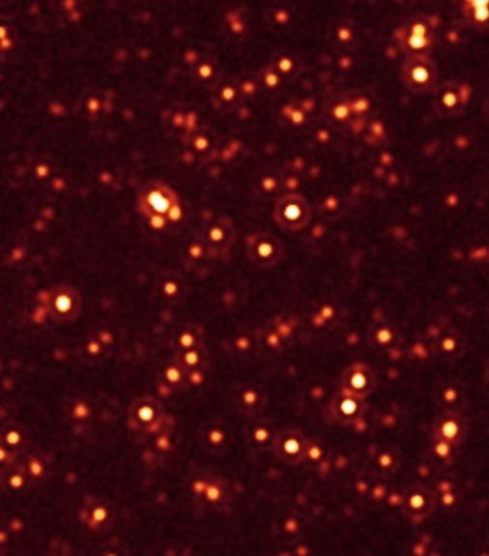
Deep Spitzer MIPS 24μm surveys
Secure detections* account for 70% of the 24μm background (Papovich+04, Chary+04)
  e.g. Counterparts to submillimeter galaxies (SMGs) out to z~4 (Pope+06)
  e.g. Detect warm dust in 2/3 of LBGs (Reddy+08)
  * Reach the confusion limit at ~60μJy (5σ, Dole+2004)
Alexandra Pope chart – JWST Frontiers
Spitzer GOODS Legacy Survey

Slide 30
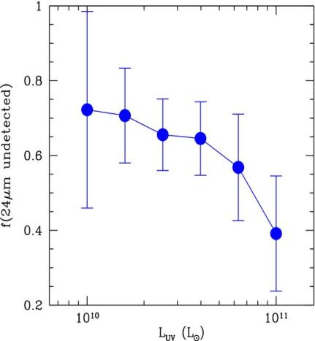
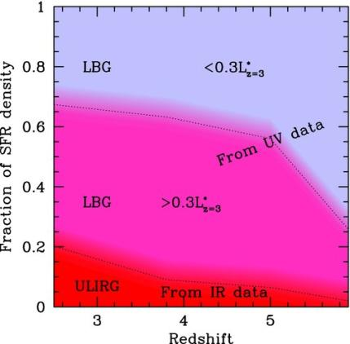
Many star forming galaxies still missing from deep 24μm surveys
Reddy et al. 2010
Bouwens et al. 2009
Alexandra Pope chart – JWST Frontiers

Slide 31
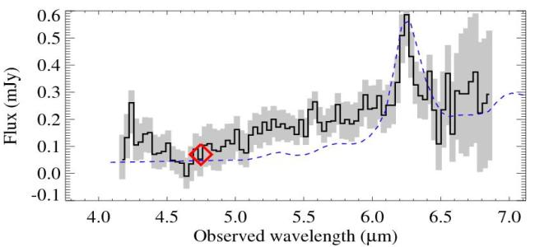
JWST/MIRI spectra of z>4 galaxies?
Spitzer/IRS saw PAHs out to z~4
JWST/MIRI will see the 6.2μm PAH out to z~3.5 and the 3.3μm PAH out to z~7 – track down the earliest dust and learn how it formed
24 hr Spitzer IRS spectrum of the z=4 SMG GN20
Riechers et al. in preparation
Alexandra Pope chart – JWST Frontiers

Slide 32
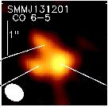
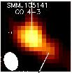
What if SMGs are really powered by AGN?
SMGs have sizes of :
~0.6 arcsec ~5kpc (Engel+10, Younger+08)
JWST/MIRI has a resolution of 0.3 arcsec at 10μm – we can try to resolve the 3.3μm PAH emission in galaxies at z<2
Compare to distribution of large dust grains as traced by ALMA
Alexandra Pope chart – JWST Frontiers

Slide 33
Synergy with Herschel, ALMA and other (sub)mm facilities
We need to plan JWST program that will complement other capabilities and facilities circa 2017/2018:
    Herschel will have provided a statistic samples of high redshift ULIRGs
    ALMA will be underway “detecting molecular gas in Milky Way like galaxies out to z~3” – but on smaller targeted samples
    Large single dish (sub)mm telescopes (LMT, CCAT) can provide statistical samples of LIRGs – only probing the cold dust
Alexandra Pope chart – JWST Frontiers

Slide 34
Summary
We have learnt a lot from Spitzer – this puts us in a great position to plan innovative projects for JWST
Several key areas where still have a lot to learn about dust in high redshift galaxies:
    Directly detect dust in the galaxies which dominate the SFRD
    Understand the detailed composition of dust at high redshift which constrains the production mechanisms
    Relative heating of dust from starbursts and AGN activity
JWST together with ALMA will be a powerful duo for attacking these problems
Alexandra Pope chart – JWST Frontiers
Notes:
But first, what we know from Spitzer

Slide 35
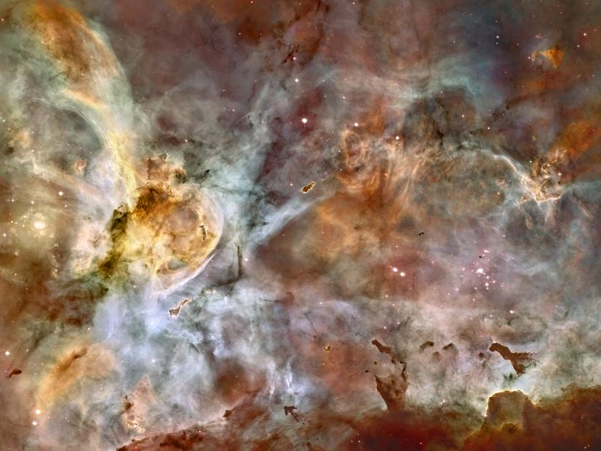
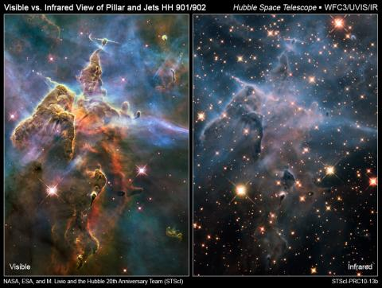
The James Webb Space Telescope
JWST Science Themes – The Birth of Stars and Planetary Systems
The power of high-res ir imaging
(Hints from WFC3)
The Carina Nebula
Notes:
Environment – massive stars produce winds and radiation; disrupt SF or cause it?
Inventory - boundary b/w smallest brown dwarfs and planets is yet unknown; imaging will measure it and spectroscopy will yield fundamental properties (masses, composition).
Point out that IR imaging will penetrate through the dust and reveal hidden stellar nurseries.
Follow up spectroscopy will provide detailed properties for young stars, insights into the IMF.
Something interesting: note the color of the red star in the top-right of the IR panel…its barely seen in the optical plane.

Slide 36
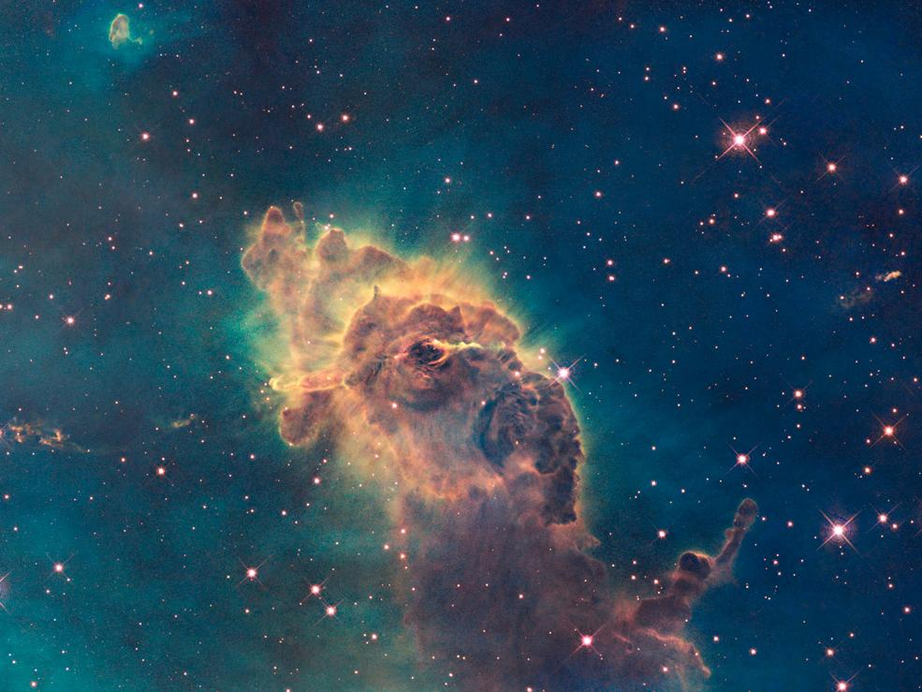
The James Webb Space Telescope
JWST Science Themes – The Birth of Stars and Planetary Systems
- Lifting the Curtain on Star Formation (optical)
Notes:
Just another nice example of why IR observations are so powerful – young star and its jet are revealed when you can see past the dust.
Could stress here that WFC3/IR barely pushes the IR, JWST will fully explore it and offer unprecedented overlapping spectroscopy.

Slide 37
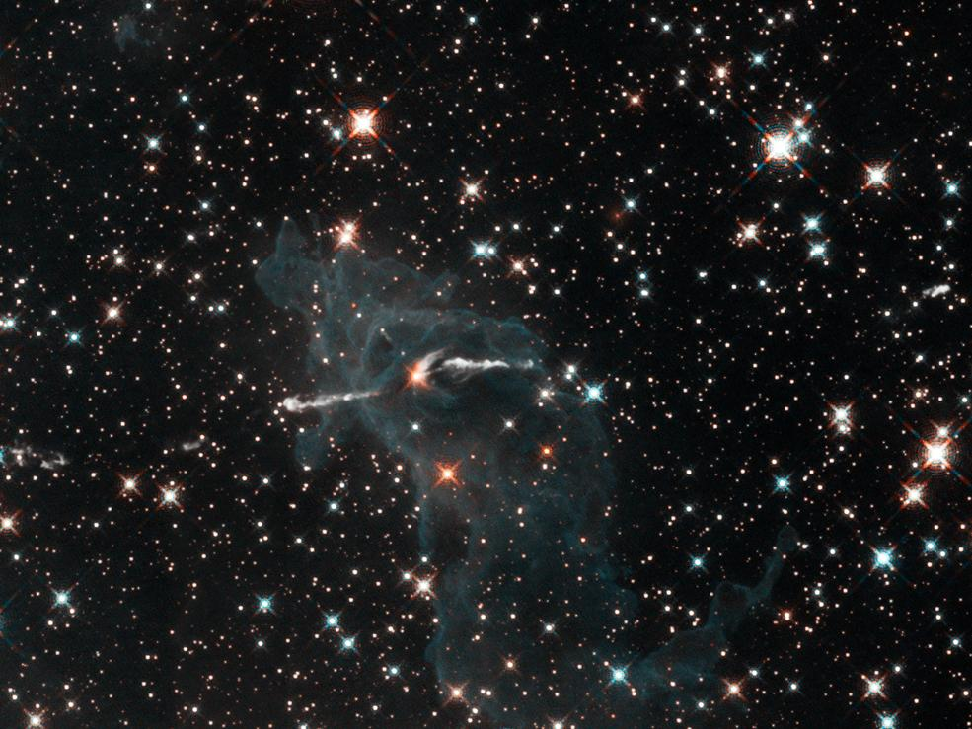
The James Webb Space Telescope
JWST Science Themes – The Birth of Stars and Planetary Systems
- Lifting the Curtain on Star Formation
JWST Questions
1.) How do clouds collapse and form stars and planets?
2.) How does environment affect star formation?
3.) How does feedback from star formation affect environment, and trigger
new star formation?
4.) How are chemical elements produced and recirculated?
5.) What is the stellar and substellar IMF, to and beyond the H-burning limit?
6.) How does the IMF depend on environment (age, metallicity, binarity)?
Notes:
Just another nice example of why IR observations are so powerful – young star and its jet are revealed when you can see past the dust.
Could stress here that WFC3/IR barely pushes the IR, JWST will fully explore it and offer unprecedented overlapping spectroscopy.

Slide 38
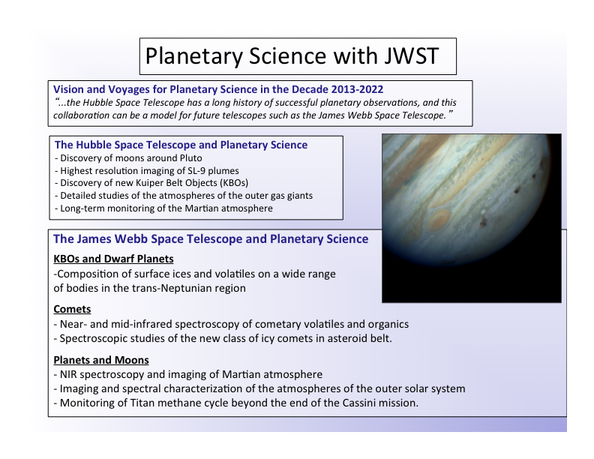
Jon Lunine chart – JWST Webinar

Slide 39
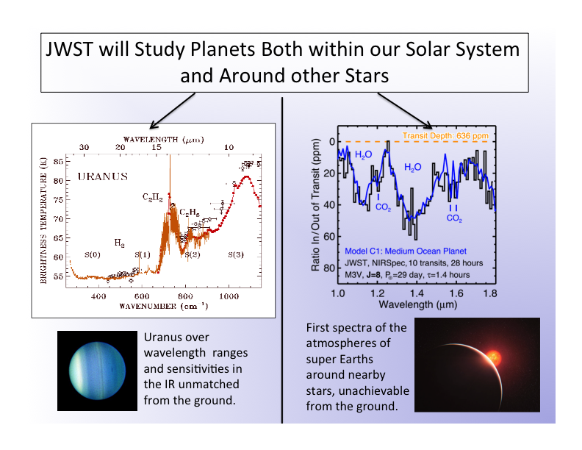
Jon Lunine chart – JWST Webinar

Slide 40
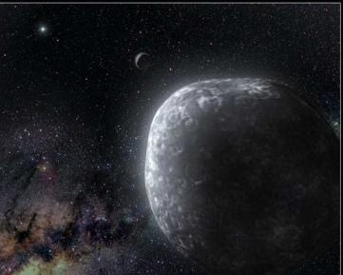
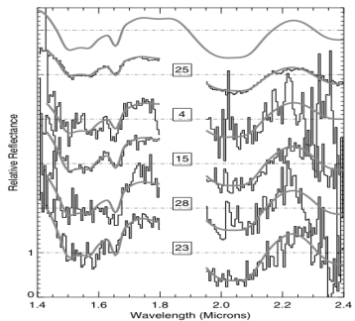
The James Webb Space Telescope
The Outer Solar System
1.) NIRSpec will measure IR spectra for all known
Kuiper Belt Objects (KBOs).
2.) Spectral features from water ice will be mapped
at redder wavelengths than currently possible,
revealing surface mineralogy.
3.) The Chemical compositions of these objects will
provide clues to the nature of the solar nebula.
This in turn provides insights on the early
formation and evolution of the solar system.
Artist’s impression of a binary KBO
NIRC spectra of water ice features in Haumea collision family objects

Slide 41
If JWST launched tomorrow, we have great ideas
What causes the rotational modulation of the spectrum of Uranus?
Why is Neptune’s stratosphere hotter than Uranus’s?
Observe solar systems forming from proto-planetary disks
  Gravitational effects
  Chemistry and transport of water and organics
  Find a molten proto-earth afterglow?
Study known exoplanets
  Orbital constraints
  Direct imaging
  Sizes, atmospheres & thermal structure from transits & eclipses
  Tricky observing strategy decisions – need to prioritize what to do early
Harry Ferguson chart – Frontiers conference

Slide 42
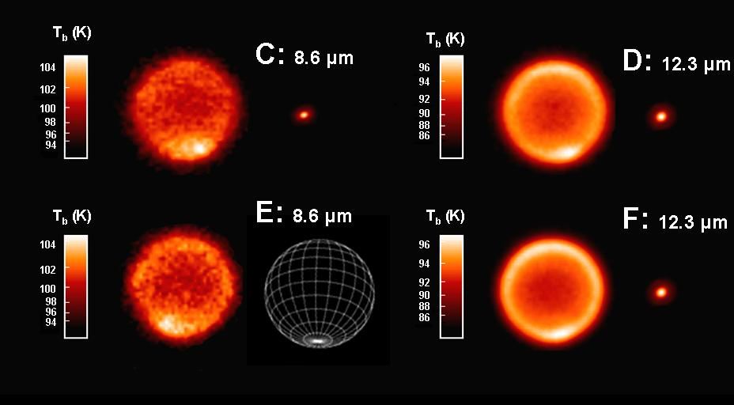
Neptune’s Stratospheric Emission
CH₄ C₂H₆
Heidi Hammel chart – Frontiers conference
Δt =6.83 hrs Δt =2.25 hrs
O MIRI resolution O

Slide 43
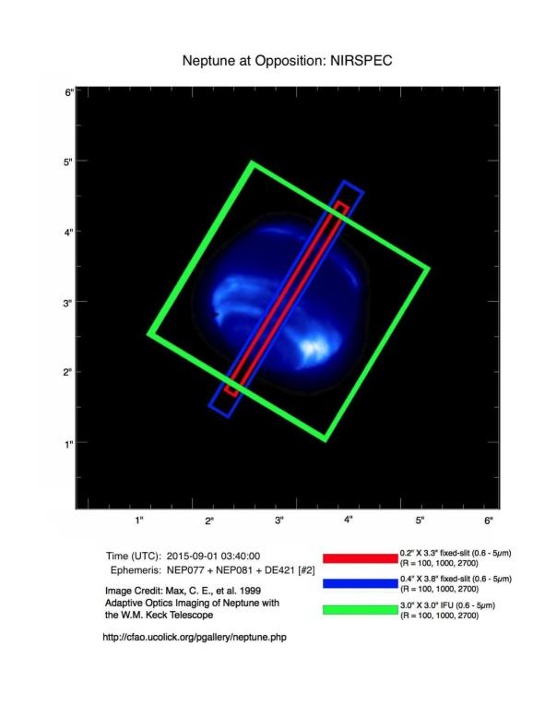
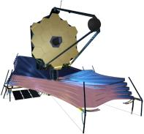
Neptune with JWST/NIRSPEC
Heidi Hammel chart – Frontiers conference

Slide 44
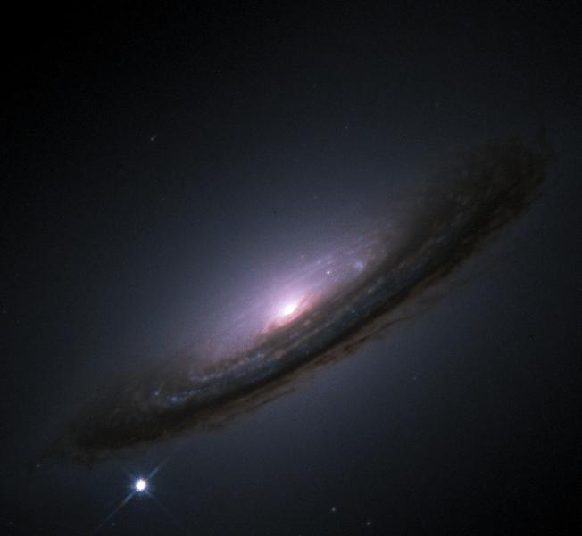
The James Webb Space Telescope
Transient Objects
1.) Explore the nature of exotic transients through increased sensitivity and
resolution (GRBs, Sne, tidal disruption events, unknown objects, …).
2.) Measure the nature of Dark Energy through IR light curves of SNe.
3.) Measure the SNe rate at high-z and probe its connection with the star
formation rate and galaxy morphology.

Slide 45
The James Webb Space Telescope
Specific JWST Science Efficiencies
Solar System – JWST/MIRI spectroscopy of gas giants will resolve temperature sensors and shed light
on underlying driving dynamics.
Debris Disks – JWST/MIRI will provide sensitivity and resolution to map the 10 and 20 micron silicate
emission features generated by circumstellar dust graints (<2 hours).
Exoplanets – JWST/NIRSpec will measure phase curves of exoplanets around nearby M dwarfs
(< 1 hour) and characterize water features in the atmospheres of “ocean planets”.
Stars and Star Clusters – JWST/NIRCam will measure the stellar mass function down to the hydrogen
burning limit in stellar populations out to 25 kpc (<3 hours).
Galaxy Evolution – JWST spectroscopy of star forming galaxies allows calculation of escape fraction
and contributions to ionization budget.
First Objects – JWST will resolve ambiguities from Hubble and Spitzer in fitting SEDs by spectroscopically
characterizing early systems at z = 9, and characterizing stellar contributions to z > 10. First
explosions will be seen through a time rise of radiation as the fireball expands and cools.
Dark Energy – JWST/NIRCam sensitivity will enable high precision measurements of the Hubble constant
and characterize departures from a flat Universe. A 1% error in Ho can be achieved in a
few hundred hour survey with JWST.

Slide 46

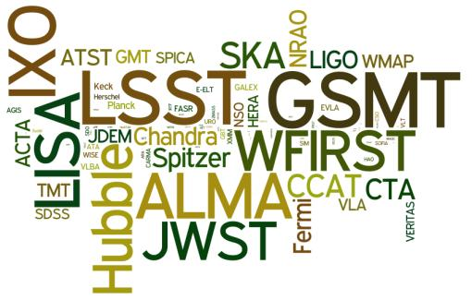
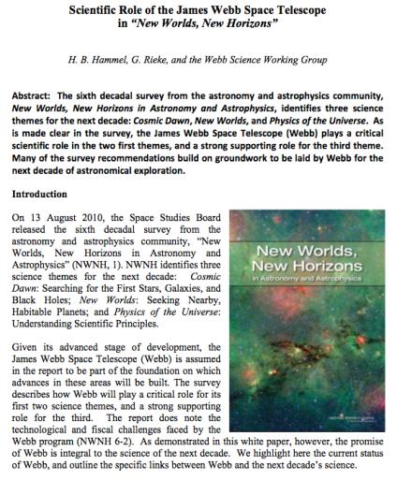
The James Webb Space Telescope
Synergy Between Future Facilities
JWST is an essential component
of the 2010 Decadal Survey
Notes:
The wordle shows how many times the different missions were mentioned in NWNH.
- JWST is almost mentioned as many times as LSST and WFIRST, despite not being a formal part of the Decadal Survey’s priorities!

Slide 47




The James Webb Space Telescope
Visit JWST at:
- The Space Telescope Science Institute (STScI): http://www.stsci.edu/jwst/
- NASA Goddard Space Flight Center (GSFC): http://www.jwst.nasa.gov/
- European Space Agency (ESA): http://sci.esa.int/science-e/www/area/index.cfm?fareaid=29
- Canadian Space Agency (CSA): http://www.asc-csa.gc.ca/eng/satellites/jwst/default.asp
- Northrop Grumman: http://www.as.northropgrumman.com/products/jwst/index.html
- JWST Observer Facebook: http://www.facebook.com/pages/JWST-Observer/103134319723237
- flickr: http://www.flickr.com/photos/nasawebbtelescope/
Twitter: @auraJWST
STScI Frontiers Webcast archive: https://webcast.stsci.edu/webcast/archive.xhtml
- JWST Public Website: http://webbtelescope.org/webb_telescope/
- JWST Public Facebook: http://www.facebook.com/webbtelescope
- Twitter: @NASAWebbTelescp
- Youtube: http://www.youtube.com/user/NASAWebbTelescope
- Newsletter at STScI: https://blogs.stsci.edu/newsletter/
- Newsletter at GSFC: http://www.jwst.nasa.gov/newsletters.html

Slide 48
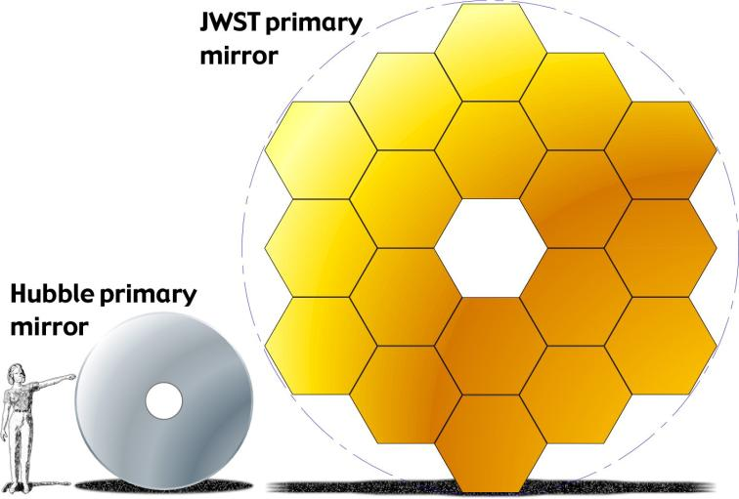
The James Webb Space Telescope
JWST
6.5 meters
Hubble
2.4 meters
Spitzer
0.85 meters
Light Gathering Power
JWST = 25 m² ; Hubble = 4.5 m² ; Spitzer = 0.6 m²

Slide 49
The James Webb Space Telescope
HST
Light gathering power
(Mirror Area)
JWST
Spitzer
0.1 microns
1 microns
10 microns
100 microns
Wavelength
Light Gathering Power
JWST = 25 m² ; Hubble = 4.5 m² ; Spitzer = 0.6 m²
Notes:
A comparison for just optical and near-IR great observatories.
- Stress that key element of a telescope is the light gathering power, which scales with the area of the primary mirror, not the diameter.

Slide 50


The James Webb Space Telescope
Diffraction Limits of Hubble, Spitzer, and JWST at various wavelengths
(Minimum angular separation of a source that can be resolved)
JWST (D = 6.5 M)
NIRCam @ 2 μm = 0.063’’
NIRCam @ 4 μm = 0.126’’
MIRI @ 10 μm = 0.317’’
MIRI @ 20 μm = 0.635’’
Diffraction Limits
Spitzer (D = 0.8 M)
IRAC @ 3.6 μm = 0.93”
IRAC @ 8.0 μm = 2.06”
MIPS @ 24 μm = 6.18”
Hubble (D = 2.4 M)
ACS @ 0.5 μm = 0.043’’
WFC3 @ 1.6 μm = 0.138’’
Best sampling demands a pixel size that is slightly finer than nyquist limit (λ/2D)
(i.e., ~2 pixels should sample the diffraction limits given above)
But, Hubble pixels are 0.04 – 0.05” at <1 μm and 0.13” at >1 μm
Spitzer pixels are 1.2” at <8 μm and 2.55” at 24 μm
Hubble can not fully sample diffraction limit at optical or IR wavelengths
Spitzer only reaches diffraction limit at λ > 24 microns
JWST NIRCam has two modules, with pixel size 0.0317” at <2.5 μm and 0.0648 at >2.5 μm
JWST MIRI has pixel size of 0.11 arcsec
JWST optimally samples the diffraction limit at 2 μm, 4 μm, and 7+ μm

