Slide 1


NSF Programs and Budget Update
Division of Astronomical Sciences
Jim Ulvestad
Division Director, AST
October 13, 2011

Slide 2
Outline
Research and Facility Highlights
Response to 2011 AAAC Report
Budget Outlook
Status of NWNH Response

Slide 3
2011 Nobel Prize in Physics
Discovery of accelerating universe/Dark Energy
Saul Perlmutter, Adam Riess, Brian Schmidt
Numerous individual investigator grants to Bob Kirshner at Michigan and Harvard in 80s/90s
Riess and Schmidt funded as Harvard grad students
Various other grants to co-investigators
NSF Center for Astroparticle Physics: UC Berkeley
Key supernova discoveries and identifications at Blanco 4m telescope at CTIO (NOAO)
Supporting observations/follow-up at KPNO, Gemini
Also Keck spectroscopy “pre-TSIP”

Slide 4
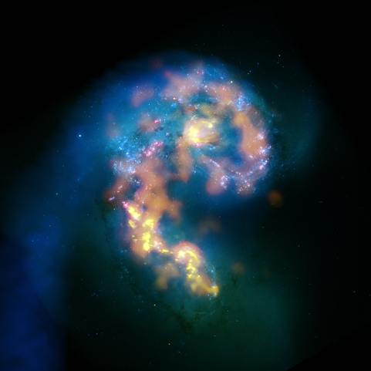
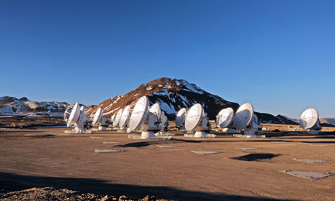
ALMA
Antennae, NGC 4038/9
HST
Science observations started on 30 Sept.
112 projects selected from over 900 proposals for observation in Cycle 0
44 antennas now in Chile with 27 accepted; current delivery rate is ~2/month
Final North American deliverables (antennas and receivers) on course for ~Sept 2012
VLA HI
ALMA Bands 3,6,7
Brodwin et al. 2010, ApJ, 721, 90

Slide 5
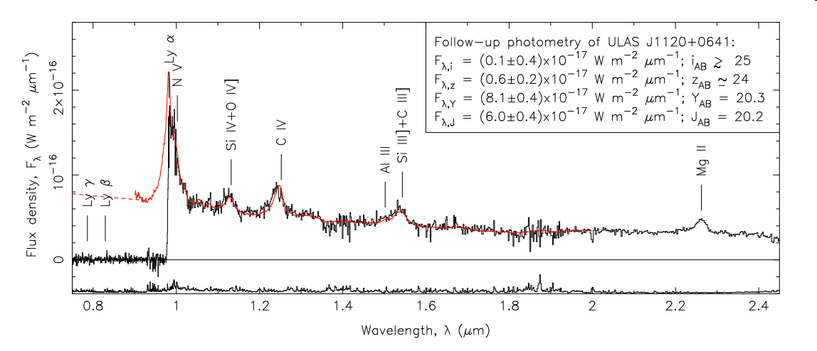
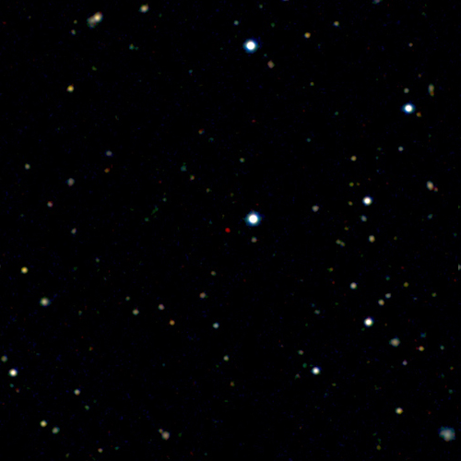
Gemini: ULAS J1120+0641 at z=7.085
GNIRS + VLT spectrum of most distant QSO yet discovered. Massive black holes existed when universe was 750 MY old. IR-optimized Gemini was key to this discovery.
QSO is the red object in the center of the frame.
Mortlock et al. 2011, Nature, 474, 616

Slide 6
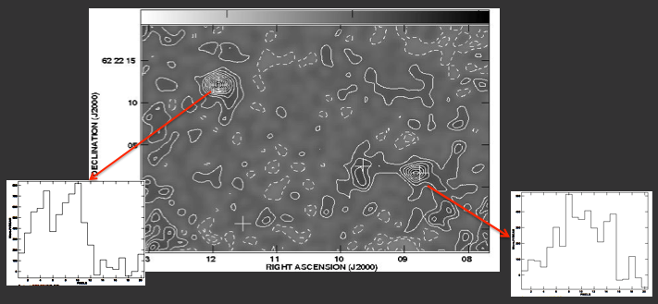
EVLA: Forming Cluster in Early Universe
EVLA finds 10¹⁰-10¹¹ M_{sun} of gas from CO observations of 3 galaxies at z=4.05
34 papers with first EVLA science in ApJL special issue, September 2011
EVLA completion expected on time and on budget in 2012
2″ size, apparent ordered rotation
Carilli et al. 2011, ApJ, 739, L33

Slide 7
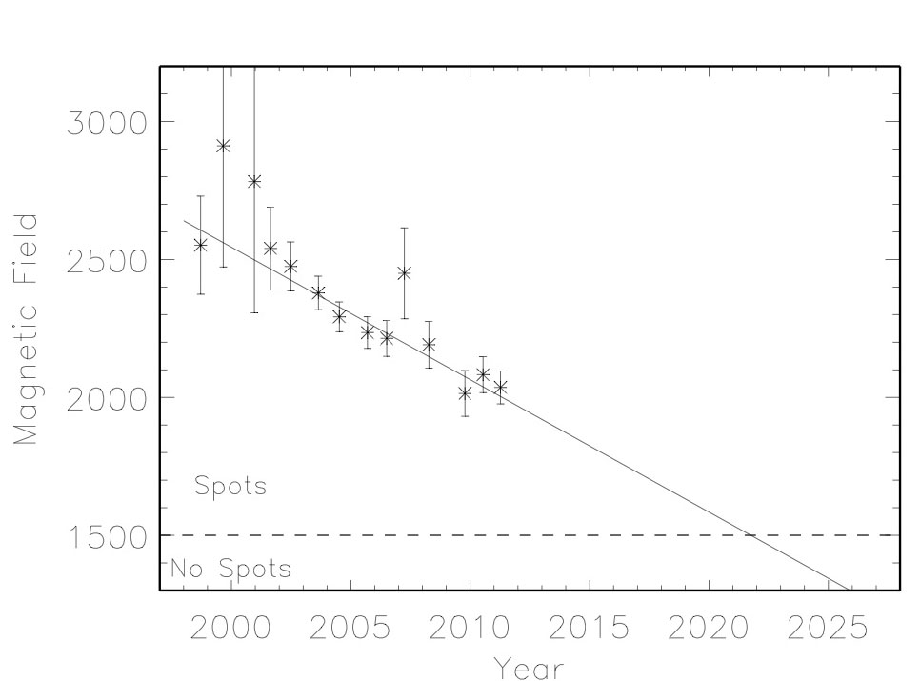
Is the Sun Going into Hibernation?
Lack of “rush to the poles” of coronal emission. (Altrock, USAF Coronal Studies Program at NSO Sac Peak.)
East-to-west subsurface flow, like a jet stream in the solar interior, that is a harbinger of the next solar cycle (Cycle 25; we are currently in 24) has not appeared. (Hill et al., NSO GONG).
Mean umbral field in monotonic decline. See figure on right. (Penn et al., NSO, using McMath/Pierce and Dunn telescopes).
When the umbral field equals the photospheric field, sunspots will disappear!
Is this the onset of a new Maunder Minimum? Time will tell.
A good demonstration of the importance of long-term, stable synoptic data collection and curation.

Slide 8
Other Facility News
ATST environmental appeal in final stages
Still aiming for end of commissioning in late 2018
Arecibo transferred to new managing organization (SRI International) on October 1, 2011
Funding partnership among NSF/AST, NSF/AGS, NASA
Dark Energy Survey at NOAO/CTIO 4m (Blanco) telescope scheduled to start in September 2012
NSF/DOE collaboration on telescope/camera
105 nights/yr for 5 yr; camera available for community
BigBOSS under discussion; possible execution at 4m Mayall telescope at NOAO/KPNO
NSF funding dependent on mid-scale competition

Slide 9
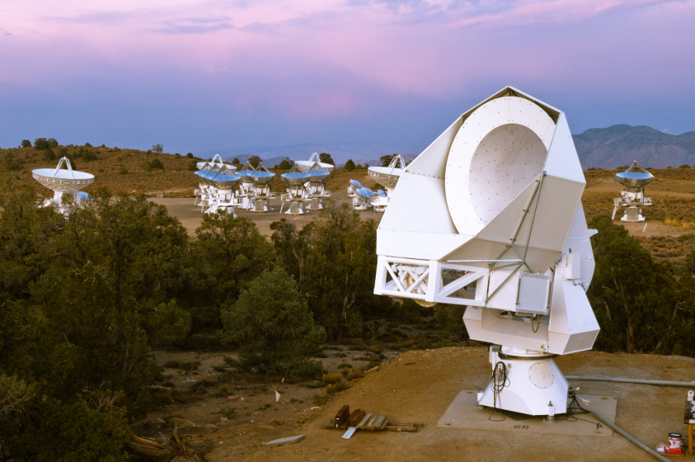
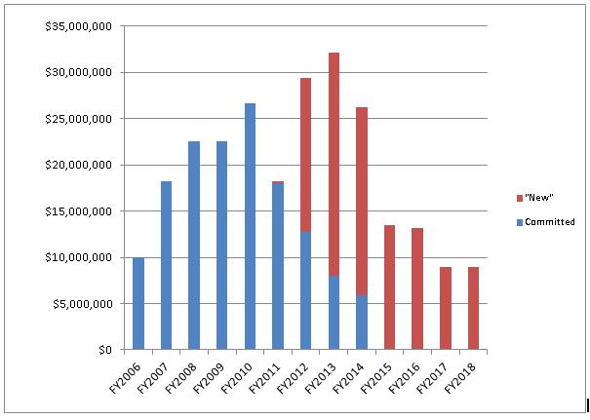
Mid-Scale Instrumentation
Currently supporting
PAPER
POLARBEAR
ACTPOL
SDSS-III
VAO
HETDEX
LSST D&D
CCAT D&D
? DESDM, TSIP, ReSTAR, GSMT ?
No new starts in FY12
POLARBEAR
30M
Some known desires
Recent
2006
2018

Slide 10
South Pole Astronomy
Primarily supported by NSF Office of Polar Programs (OPP), with (very) minor shared AST funding
South Pole Telescope, BICEP2, SPIDER2, etc.
Funding for Particle Astrophysics, primarily IceCube operations and science, shared 50/50 with PHY
In constrained budget environment, with IceCube in full operations, maintenance of South Pole astronomy program will be a challenge
Balance/tradeoff against other AST mid-scale projects?

Slide 11
Response to 2011 AAAC Report Findings
F2. Maintain priorities/balance of NWNH: Yes
F3: Budgetary constraints: See below
F4. Commend NSF plan for midscale innovation projects: High priority, constrained by funding
F5. Interagency interactions on LSST: PDR passed, CD process under way; see separate talk
F6. Astronomy potential for engagement of young people: Outreach suffers in funding crunches
F8. DSIAC: Still under discussion. See below
F9. Interagency: LSST, DES, TCN (separate talk)

Slide 12
Budget Outlook

Slide 13
FY 2011 and 2012 NSF Budgets
NSF & AST | NSF R&RA | %/prior yr | AST | %/prior
FY10 Approp. | $5.62B | 0.0% | $246.5M | 0%
FY11 Request | $6.02B | (+8.0%) | $251.8M | +2%
FY11 Approp. | $5.56B | -0.9% | $236.6M | -4%
FY12 Request | $6.25B | +12.4% | $249.1M | +5%
FY12 H. App. mk. | $5.60B | +0.7% | --- | ---
FY12 S. App. mk. | $5.44B | -2.2% | --- | ---
MREFC | MREFC | %/prior yr | Comment
FY10 Approp. | $117.3M | 0.0% | Low due to ARRA
FY11 Request | $165.2M | (+8.0%) | Mostly OOI; NEON start
FY11 Approp. | $117.1M | 0.0% | Pegged at FY10 level
FY12 Request | $224.7M | +91.8% | Mostly OOI, NEON
FY12 H. App. mk. | $100.0M | -14.6% | Slows down all projects
FY12 S. App. mk. | $117.1M | 0.0% | Option: +$100M from R&RA

Slide 14
FY 2012/2013 Budget Outlook
All signals are that AST budget will continue downward trend
OMB memo to agencies asks for 5% and 10% reductions in FY 2013 requests:
http://www.whitehouse.gov/sites/default/files/omb/memoranda/2011/m11-30.pdf
Cumulative budget changes are already significant and having long-term impact

Slide 15
AST Response to Budget Shortfalls
No new unsolicited mid-scale proposals will be funded in FY 2012
May need to be prepared to take significant action shortly after release of President’s budget to Congress in Feb 2012
Would need action quickly to accommodate 2013 budget request that follows OMB guidance
Types of action that may be required
Divestment of individual facilities
Restructuring observatory operations

Slide 16
Status of NWNH Response

Slide 17
Simple Budget Calculation
NWNH assumed 4% increase in purchasing power per year
For 2% inflation, AST budget in FY 2012 would have been $246M × (1.06)² = $277M
If FY 2011 trend continues in FY 2012, AST budget will be $246M × (0.96)² = $227M
$50M/yr shortfall relative to NWNH, when ALMA ops ramp is maximum ($13M increase from FY10 to FY12)
If same trends continue through FY 2014, shortfall relative to NWNH will be >$100M/yr in 2 yr from now

Slide 18
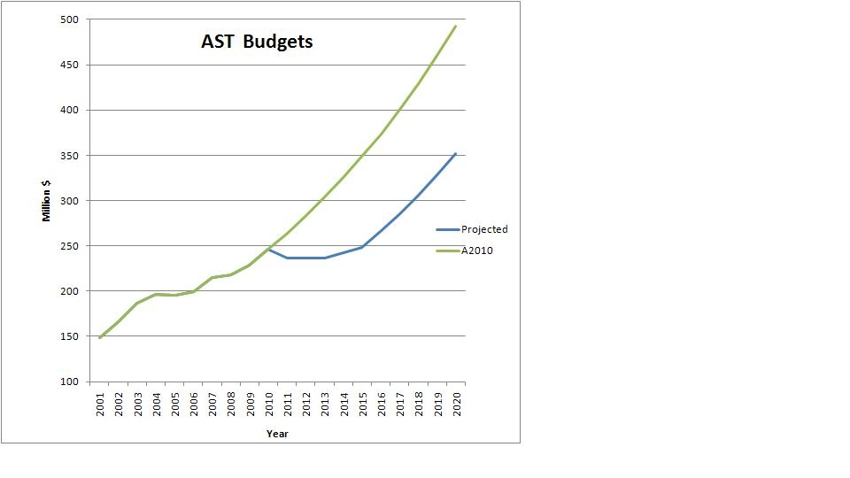
A More “Optimistic” Scenario
NWNH “doubling” budget for AST, assuming 3%/yr inflation
Δ > $100M/yr
Optimistic AST ops budget; flat until FY13, then rises with inflation through FY15, then resumes “doubling” path

Slide 19
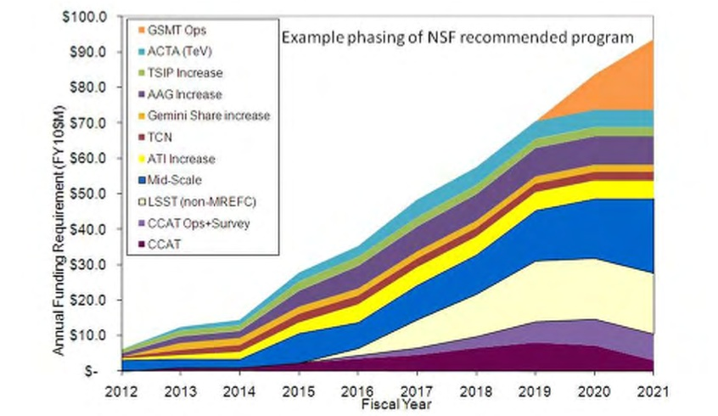
NWNH “Existence Proof” Ramp
> $100M gap for “optimistic” case implies that none of this can be done without extensive reductions in current programs
GSMT Ops
AAG
Mid-Scale
LSST Ops
CCAT

Slide 20
NWNH Actions—Large Programs
Continuing LSST D&D funding, aiming for possibility of MREFC start in FY 2014 or later
Increased D&D and required operations funding both will require significant funding reallocation
See separate NSF/DOE presentation
Mid-Scale Innovations Program
No visible budget wedge in AST, discussions ongoing about more general MPS program
GSMT selection solicitation under consideration
Would have stringent conditions: No MREFC funding possible before 2020, no ops funding before 2023
ACTA: No wedge, possible proposal opportunity if Mid-Scale program is initiated

Slide 21
GSMT Summary
Had planned solicitation for federal GSMT partnership
Put on hold in March pending FY 2011 budget
FY 2011 budget, and committee marks for FY 2012 budget, make it very unlikely that a federal GSMT investment is possible this decade
NSF met with GMT and TMT Boards (jointly) in August to inform them of this outlook
Possible NWNH response is to issue solicitation for very small amount of NSF partnership funding
Pro: Shows interest from NSF
Pro: Enables early engagement in partnership
Con: No federal money feasible before 2020
Con: Solicitation can set up unachievable expectations

Slide 22
NWNH Plans—Medium/Small
CCAT Design and Development proposal funded
No apparent construction wedge in 2014/2015
Small programs
None of the recommended increases (AAG, ATI, TCN, Gemini, TSIP) fit in budget scenarios
Recommended AAG increase for entire decade was 17%, but number of AAG proposals increased ~17% from FY 2010 to FY 2011
Redirecting some funding to Theory and Computation Networks may be possible, at expense of other grant programs (see later presentation on TCN)

Slide 23
NWNH Plans—Other Items
OIR System
Gemini/NOAO consolidation is non-trivial
Gemini governance and renewal of international agreement after 2015 are also in play
Advanced Technology Solar Telescope
Portfolio review is being given the assumption that ATST will stay within MPS/AST
Impact on operations budget and structure of grants program
DSIAC
Significant charter overlap with AAAC
Agency and NRC discussions are ongoing
Since there presently is no funding wedge for NSF to follow ANY NWNH recommendations without substantial divestment of current capabilities, the possible role of DSIAC is more elusive

Slide 24
Why do a Portfolio Review?
NWNH advised: “If …budget is truly flat…there is no possibility of implementing …the recommended program…without…enacting the recommendations of the first 2006 senior review and/or …a second more drastic…review before mid-decade.” (p. 240)
Not a repeat of Senior Review, which was confined to facilities.
Examine balance across entire portfolio of activities AST supports.
Maximize progress on central science questions (Ch. 2 of NWNH), balancing recommendations for new facilities, instrumentation and program enhancements with capabilities enabled by existing facilities and programs.
See separate talk by Tom Statler

Slide 25
Backups

Slide 26
Principles for Budget Decisions
Protect high priority facilities with international and interagency commitments, notably the scheduled increase for ALMA Operations and the US contribution to Gemini Ops;
Maintain a robust individual investigator program to enable a broad base of astronomical research across the country;
Expedite movement of facilities to a very strong service orientation, with de-emphasis of internal scientific and development activities, in order to maintain extant diverse observational capabilities and competitiveness for the US astronomy community;
Initiate significant long-term reductions in existing facilities in order to enable operation of the newest generation of NSF astronomy facilities, such as ALMA, as well as (future) ATST and LSST;
To the extent possible, defer the divestment of major observing capabilities until after the report of the MPS/AST Portfolio Review, scheduled to be completed in summer 2012.

