Slide 1
Office of High Energy Physics Program and Budget Status AAAC meeting February 23, 2011
Glen Crawford
Director, Research and Technology Division
Office of High Energy Physics
DOE Office of Science

Slide 2
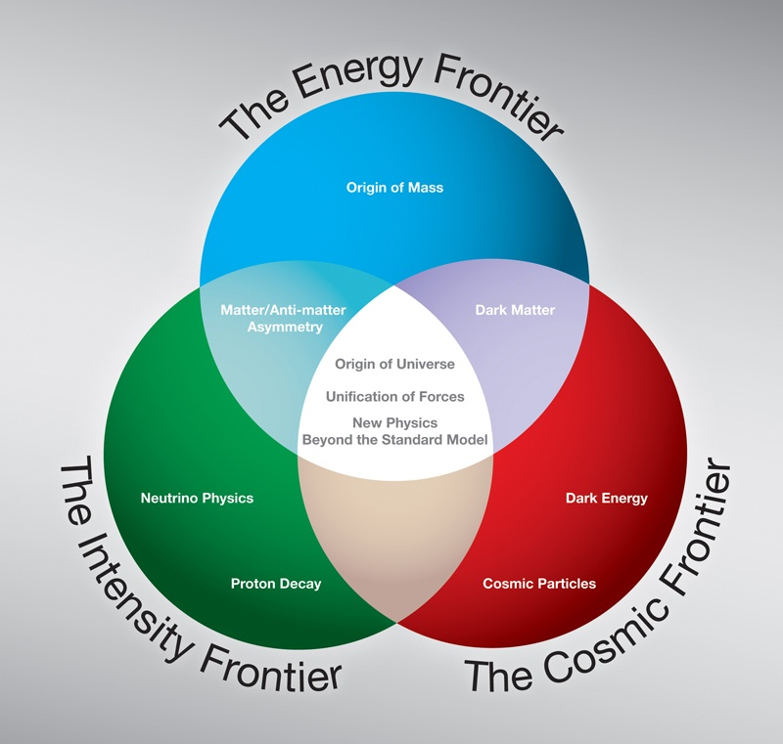
High Energy Physics Program - Scientific Frontiers
The Energy Frontier, powerful accelerators are used to create new particles, reveal their interactions, and investigate fundamental forces;
The Intensity Frontier, intense particle beams and highly sensitive detectors are used to pursue alternate pathways to investigate fundamental forces and particle interactions by studying events that occur rarely in nature; and
The Cosmic Frontier, ground and space-based experiments and telescopes are used to make measurements that will offer new insight and information about the nature of dark matter and dark energy, to understand fundamental particle properties and discover new phenomena.
The major elements of DOE’s plan are to:
Exploit the capabilities of the Tevatron and LHC at the Energy Frontier to make discoveries
Implement a world-class Intensity Frontier program at Fermilab
Address compelling high-impact scientific opportunities at the Cosmic Frontier
Develop accelerator technologies needed by Nation and for a U.S. leadership role in particle physics

Slide 3
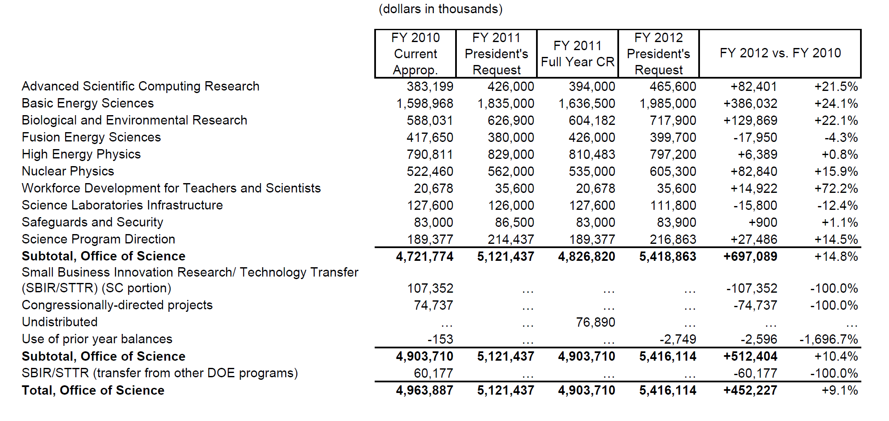
Office of Science budget

Slide 4
Office of High Energy Physics (HEP) program
The Scientific Challenges:
Determine the origins of mass in terms of the fundamental particles and their properties
Exploit the unique properties of neutrinos to discover new ways to explain the diversity of particles
Discover new principles of nature, such as new symmetries, new physical laws, or unseen extra dimensions of space-time
Explore the “dark” sector that is 95% of the Universe (Dark Matter and Dark Energy)
Invent better and cheaper accelerator and detector technologies to extend the frontiers of science and benefit society
FY 2012 Highlights:
Support for U.S. researchers at the LHC
Research, design, and construction for NOvA, LBNE, and Mu2e experiments as part of a program of high energy physics at the intensity frontier
Research in accelerator technologies including superconducting radio frequency and plasma wakefield acceleration.
U.S. participation in international collaborations pursuing dark matter, dark energy and neutrino physics; the Reactor Neutrino Experiment in China and the Dark Energy Survey in Chile begin operations in FY 2012; the DOE scope on the High Altitude Water Cherenkov (HAWC) experiment begins fabrication

Slide 5
FY12 - High Energy Physics Budget Request
Description | B&R | FY 2010 | FY 2011 Request | FY 2011 Feb | FY 2012 Request | FY12 vs FY10
Proton Accelerator Based Physics | KA11 | 438,369 | 439,262 | 441,823 | 412,707 | -25,662
Research | KA1101 | 125,743 | 130,299 | 130,419 | 127,696 | 1,953
Facilities | KA1102 | 312,626 | 308,963 | 311,404 | 285,011 | -27,615
Electron Accelerator-Based Physics | KA12 | 30,212 | 24,707 | 24,707 | 22,319 | -7,893
Research | KA1201 | 15,263 | 14,927 | 14,927 | 13,069 | -2,194
Facilities | KA1202 | 14,949 | 9,780 | 9,780 | 9,250 | -5,699
Non-Accelerator Physics | KA13 | 97,469 | 88,539 | 88,539 | 81,852 | -15,617
Research | KA1301 | 97,469 | 88,539 | 88,539 | 81,852 | -15,617
Projects | KA130103 | 30,828 | 22,060 | 20,860 | 14,000 | -16,828
Theoretical Physics | KA14 | 68,414 | 69,524 | 68,024 | 68,914 | 500
Research | KA1401 | 68,414 | 69,524 | 68,024 | 68,914 | 500
Advanced Technology R&D | KA15 | 156,347 | 189,968 | 181,968 | 171,908 | 15,561
Accelerator Science | KA1501 | 37,617 | 50,010 | 50,761 | 46,291 | 8,674
Accelerator Development | KA1502 | 93,522 | 93,736 | 84,985 | 80,972 | -12,550
Other Technology R&D | KA1503 | 25,208 | 46,222 | 46,222 | 44,645 | 19,437
SBIR/STTR | KA150304 | 0 | 20,027 | 20,027 | 19,164 | 19,164
Construction | 39KA | 0 | 17,000 | 0 | 39,500 | 39,500
Total, High Energy Physics |  | 790,811 | 829,000 | 805,061 | 797,200 | 6,389
5

Slide 6
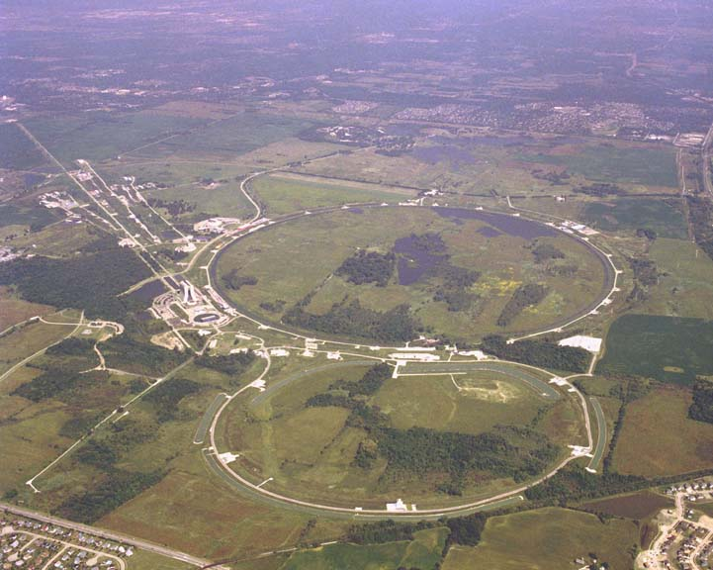
The Energy Frontier
The Tevatron at FNAL has been running extremely well. Experiments now significantly limit the allowed values of the Standard Model (SM) Higgs Boson. These limits will continue to improve, ruling out a larger range of SM Higgs masses.
The LHC is also running extremely well. LHC is expected to discover or rule out the Higgs Boson across the entire SM mass range by the end of 2012.
An extended Tevatron run was considered. Though shutdown was planned after FY
2011, the High Energy Physics Advisory Panel (HEPAP) was asked to advise the Office
of Science on extension of operations. In light of potential impacts on the rest of the
HEP program, particularly the Intensity Frontier activities, HEPAP recommended that
the Tevatron run be extended for three years only if additional funds could be
secured.
The FY 2012 President’s Request does not include running the Tevatron beyond 2011.

Slide 7
The Intensity Frontier
The Intensity Frontier uses intense particle beams to uncover properties of
neutrinos & observe rare processes that point to new paradigms of physics.
The U.S. is poised to make significant advances at the Intensity Frontier.
The FY 2012 budget request builds on unique capabilities at Fermilab and supports associated research in Intensity Frontier physics.
Rare Processes
The Mu2e experiment will search for the conversion of a muon to an electron in the field of a nucleus.
Neutrino Physics
More detailed measurements of mixing in neutrinos and other elementary particles could
reveal differences between matter and antimatter and discover new physics.
MINOS – operations continue
NuMIOff-Axis Electron Neutrino Experiment (NOvA) – Funds are requested to continue construction in FY 2012. Operations are planned to being in 2013.
MicroBooNe
Long Baseline Neutrino Experiment (LBNE) – LBNE should be sensitive to differences between neutrinos and antineutrinos to test our assumptions about the symmetries between matter and antimatter and will deliver more precise measurements of neutrino mixing.

Slide 8
Deep Underground Science and Engineering Laboratory (DUSEL)
The FY2012 Request includes $15 M ($10 M in HEP and $5M in NP) to maintain
the viability of DUSEL, including dewatering and maintaining security, while DOE
assesses options for an underground research program.
DOE has plans for Long Baseline Neutrino, Dark Matter, and Double Beta Decay
experiments.
A DOE assessment will identify options to carry out the planned research
program in a cost effective way, including an alternatives analysis for the
location of individual experiments.
The DOE assessment will seek input from the DOE, NSF, and the DUSEL
Stakeholder communities as well as the Sanford Laboratory in Lead, South
Dakota.

Slide 9
Cosmic Frontier - Recent Activities
The Cosmic Frontier
Oct. 2009 - Received guidance from HEPAP (PASAG)
Recommended an optimized program over the next 10 years in 4 funding scenarios
Defined Prioritization Criteria for Contributions to Particle Astrophysics Projects
Dark matter & dark energy remain the highest priorities
Dark energy funding shouldn’t compromise US leadership in dark matter
Should not completely zero out other activities; HAWC and VERITAS-upgrade recommended in any funding scenario
August 2010 - Received guidance from Astro2010
Recommendations to DOE as part of a coordinated ground/space-based Dark Energy program:
The optimistic (doubling) funding profile allows investment in:
LSST – DOE should partner with NSF
WFIRST – DOE should contribute
At lower funding level:
LSST is recommended as the priority because DOE role is critical
Other identified opportunities:
2nd priority ground based - contributions to NSF mid-scale experiments
e.g. BigBOSS, CMB, HAWC experiments, etc.
4th priority ground-based - NSF & DOE contribute as a minor partner to a European-led CTA ground-based gamma-ray observatory
Oct. 2010 - OECD Global Science Forum Astroparticle Physics Working Group
A 2-year study of global coordination and planning of astro-particle physics experiments
→ recommended annual agency-level meeting to coordinate program (starting Spring 2011)
9

Slide 10
Cosmic Frontier – Guidance DOE HEP Considerations
Budgetary scenarios:
Our current projections tend towards the lower funding amounts
Do not have the same profile as assumed by Astro2010.
DOE OHEP Objectives:
Contributions to select, high impact experiments with discovery potential
that address particle-astrophysics goals
where DOE HEP researchers and investments can play a significant role in and make significant contributions (PASAG recommended criteria)
Achieve earliest, best, and most cost-effective U.S. dark energy and dark matter science results
Partnerships with NASA and NSF and international collaborators as appropriate
Priorities
Dark matter – direct detection experiments are a priority (not part of Astro2010 study)
Maintain a leading U.S. role in dark energy research (Astro2010 recommendation)
Other opportunities for contribution as funding permits
10

Slide 11
Particle Astrophysics - Budget
 | FY 2010 | FY 2011 CR | FY 2012 Request
TOTAL | 75,581 | 70,802 | 65,919
Research | 55,753 | 54,002 | 52,419
Univ/Grants Research | 16,478 | 14,444 | 15,385
National Lab Research | 35,505 | 32,608 | 30,582
Exp. Operations | 3,500 | 6,950 | 6,452
Current Projects | 10,110 | 4,000 | 1,500
DES | 8,610 | 4,000
SuperCDMS | 1,500
HAWC |  |  | 1,500
Future Projects R&D | 9,718 | 12,800 | 12,000
There is a decrease in project funding as DES and SuperCDMS complete. HAWC starts fabrication in FY12. LSST and dark matter experiments are in an R&D phase before starting MIEs.
11

Slide 12
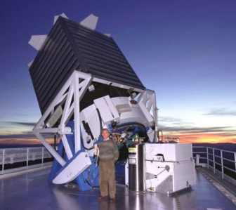
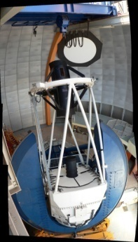
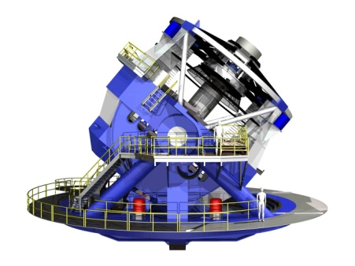
Cosmic Frontier - Dark Energy
BOSS
DOE is funding operations for several supernovae studies:
Supernova Cosmology Project, Nearby Supernova Factory, QUEST
Baryon Oscillation Spectroscopic Survey (BOSS)
Primary survey on SDSS-II
DOE, NSF-AST partner on the operations, which started Aug. 2009
Dark Energy Survey (DES)
DOE & NSF-AST partnership for new camera and data management system on the Blance telescope in Chile
FY11: fabrication completes and integration/installation starts
FY12: start data-taking
Large Synoptic Survey Telescope (LSST)
Aug. 2010 – Astro2010 recommended as top ground-based priority facility
HEP and AST are working to coordinate our schedules and funding
Agency Joint Oversight Group (JOG) set up; having biweekly meetings
Paperwork for CD-0 (mission need) approval is in process
Future
DOE HEP is supporting several people that were selected for the WFIRST Science Definition Team.
Depending on available funds and priorities in the program, HEP may consider efforts on future dark energy experiments – ground or space
DES
LSST

Slide 13
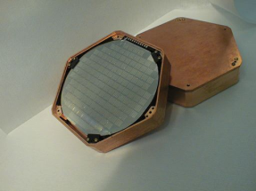
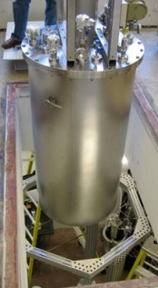
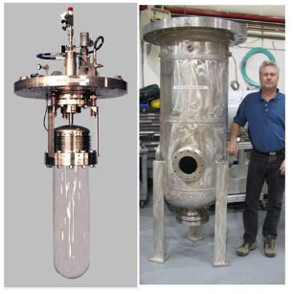
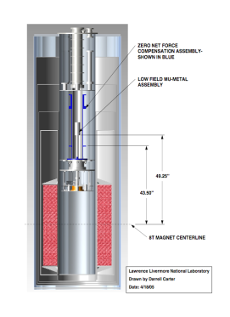
Cosmic Frontier:
Dark Matter (direct detection) experiments
Partnerships: All but ADMX are DOE/NSF partnerships. There are a few more that are mainly NSF-funded but with small DOE contributions (DMTPC, Xenon).
Future: We are working closely with NSF-PHY to coordinate reviews and funding of new efforts.
CDMS (Cryogenic Dark Matter Search)
SuperCDMS-Soudan fabrication 2009-2011 w/iZip detectors
LUX-350 (Large Underground Xenon) at Sanford Lab
Fabrication 2008-10; now commissioning on the surface
COUPP (Chicago Observatory for Underground Particle Physics)
COUPP-4 operating at SNOLab
COUPP-60 commissioning, operating at FNAL w/plans to go to SNOLab
ADMX (Axion Dark Matter eXperiment)
ADMX-I operations 2007-2009
Proposed Future Experiments: funds available for R&D and small fabrication – most collaborations are planning the next phase.
CDMS
VERITAS
LUX
COUPP-60
FGST
DES
COUPP
13
ADMX
Notes:
13

Slide 14
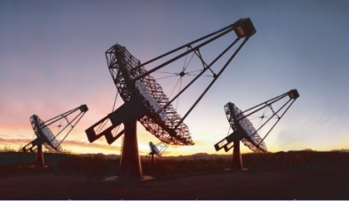
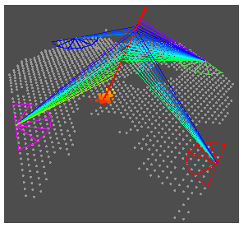
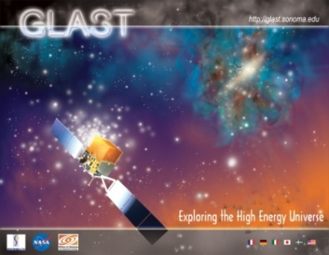
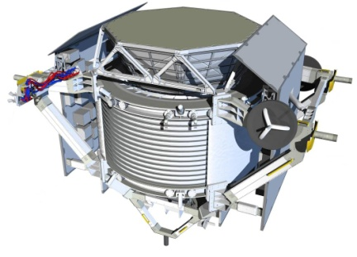
Cosmic Frontier:
High Energy Cosmic-ray and Gamma-ray experiments
VERITAS (Very Energetic Radiation Imaging Telescope Array System)
DOE, NSF and Smithsonian Partnership
Status: Data-taking started in 2007 at Whipple Observatory in Arizona
VERITAS-upgrade – NSF funded as an MRI in early 2010
Pierre Auger
Large international collaboration; DOE and NSF are US partners; Fermilab hosts the Project Office
Status: full operations started in 2008 in Argentina
Not participating in Auger North given current budget projections
FGST (Fermi Gamma-ray Space Telescope)
DOE partnered with NASA on Large Area Telescope (LAT); launched June 2008
SLAC hosted the LAT fabrication Project Office and now hosts the LAT Instrument Science Operations Center
Named one of the 10 top science breakthroughs of 2009 by Science Magazine.
AMS (Alpha Magnetic Spectrometer)
Large international collaboration; DOE funds the spokesman, Sam Ting
Status: NASA plans to launch on the Shuttle on April 19, 2011
HAWC (High Altitude Water Cherenkov) observatory
DOE and NSF partnership w/contributions from Mexico
R&D in FY2011; Fabrication start in FY2012
Future:
Will consider contributions to CTA-US in the future as appropriate.
VERITAS
COUPP-60
DES
FGST
Pierre Auger – Argentina
AMS
Notes:
14

Slide 15
Cosmic Frontier - Other Efforts
Cosmic Microwave Background (CMB)
Small research and R&D efforts on a few experiments where we could make targeted contributions
Planck – updating the MOU with NASA to provide computing resources at NERSC for analysis
Other
Theory/modeling/simulations in support of experiments

