Slide 1


NSF AST Budget Status
Division of Astronomical Sciences
Jim Ulvestad
Division Director, AST
May 6, 2011

Slide 2
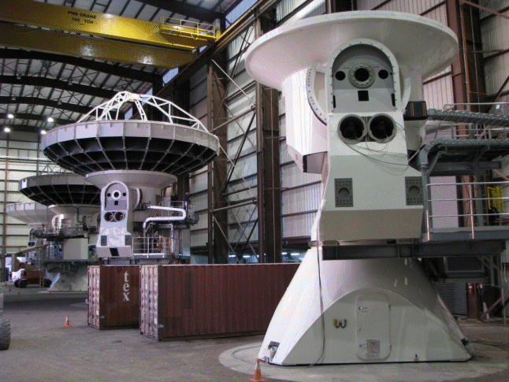
ALMA Status
41 antennas in Chile
Early science call out; first observations late 2011

Slide 3
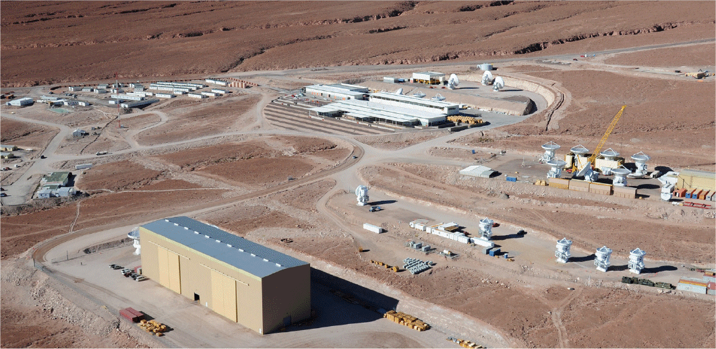
ALMA Status
41 antennas in Chile
Early science call out; first observations late 2011

Slide 4
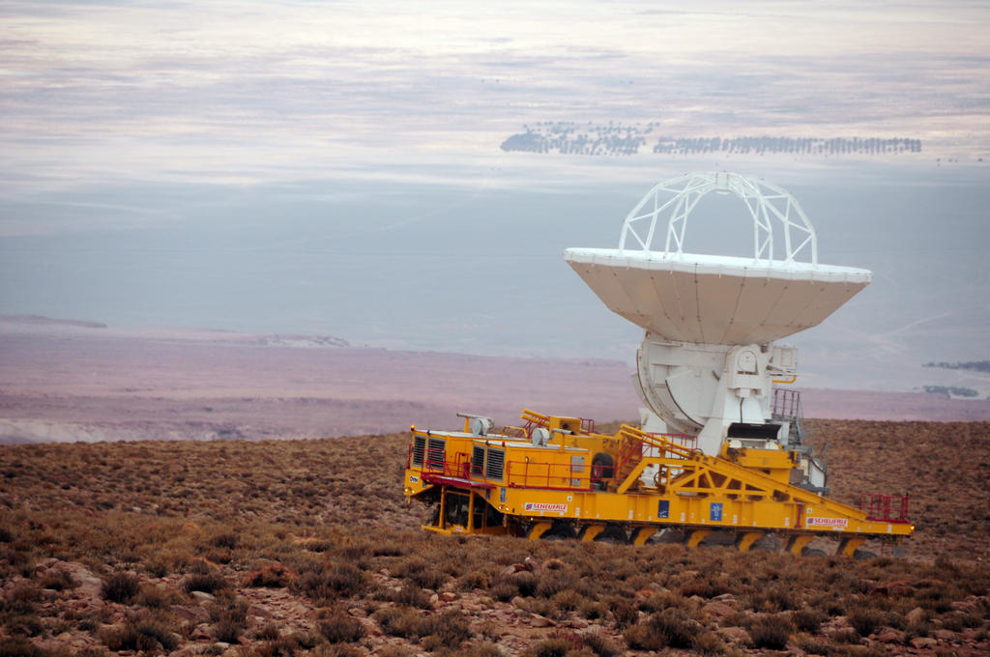
ALMA Status
41 antennas in Chile
Early science call out; first observations late 2011

Slide 5
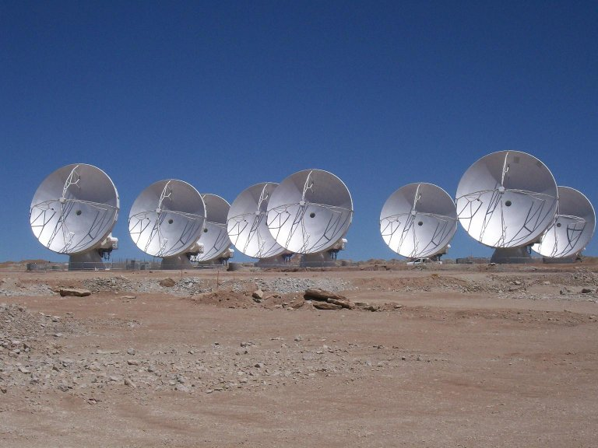
ALMA Status
41 antennas in Chile
Early science call out; first observations late 2011

Slide 6
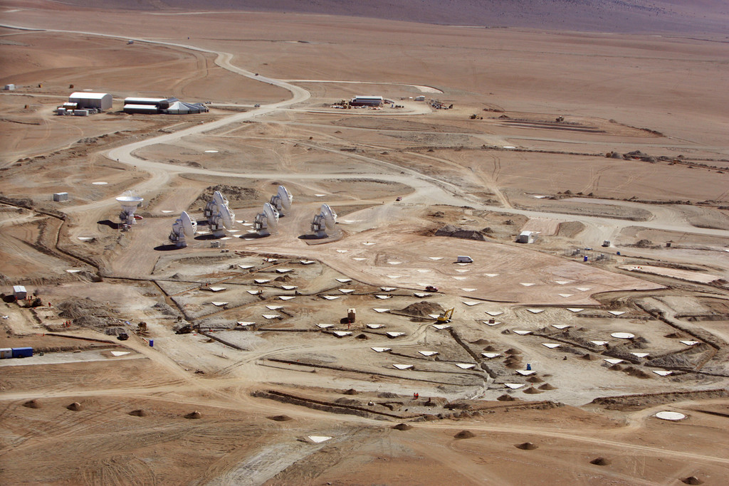
ALMA Status
41 antennas in Chile
Early science call out; first observations late 2011

Slide 7
Other Highlights
LSST moving toward approval for Preliminary Design Review
  Approval needed by June to avoid slipping from FY14 to FY15 for earliest possible MREFC start
Gemini Observatory Director stepping down; Interim Director will be in place on May 18
  Gemini renewal proposal reviewed in March, for time frame from mid-2012 through 2015
  Gemini governance tiger team met in March
  Gemini Board meeting next week, reviewing transition plan, management transition, governance

Slide 8
Realities of FY 2011 and 2012 Budgets
 | NSF R&RA | %/FY10 | AST | %/FY10
FY10 Omnibus | $5.62B | 0.0% | $245.7M | 0.0%
FY11 Request | $6.02B | (+8.0%) | $251.8M | (+2.5%)
FY11 Approp. | $5.56B | -0.9% | ??? | -xx%
FY12 Request | $6.25B | (+12.4%) | $249.1M | (+1.4%)
FY12 Approp. | ??? | ??? | ??? | ???
MREFC line was cut from $165M in FY11 request to $117M in appropriation (=FY10). This will stretch out projects currently in the MREFC plan, so there may be no funding wedge available for LSST until later than desired.

Slide 9
Sample Budget Scenarios for Astro2010
1: FY11=0.95*FY10, then 2.5%/yr (or flat?)
2: FY11&12=request, then flat
3: FY11&12=request, then 2.5%/yr
4: FY11&12=request, then 4.5%/yr
5: FY11&12=request, then 6.5%/yr

Slide 10
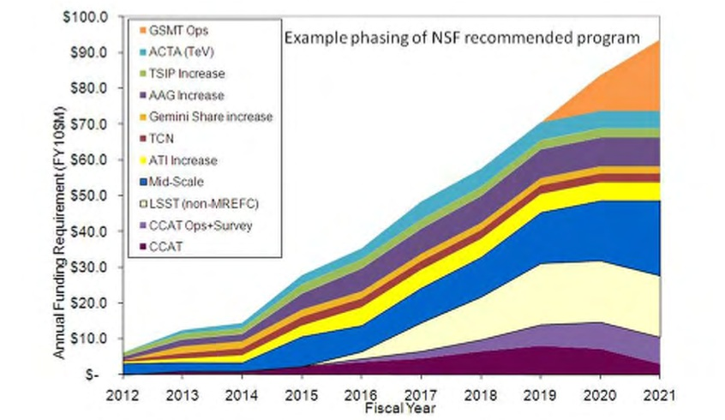
Astro2010 Ramp + Budget Scenarios
5
4
3

Slide 11
AST Portfolio Review
NWNH advised: “If …budget is truly flat…there is no possibility of implementing …the recommended program…without…enacting the recommendations of the first 2006 senior review and/or …a second more drastic…review before mid-decade.” (p. 240)
AST portfolio review will Not be a repeat of Senior Review, which was confined to facilities.
Examine balance across entire portfolio of activities AST supports.
Enable progress on central science questions (Ch. 2 of NWNH), balancing recommendations for new facilities & instrumentation with capabilities of existing facilities & programs.

