Slide 1
Trends in Science and Engineering:
A View from the National Science Foundation
Jeannette M. Wing
Assistant Director
Computer and Information Science and Engineering
National Science Foundation
The Third US-China Computer Science Leadership Summit
Beijing University, Beijing, China
14-15 June 2010

Slide 2
A New Administration

Slide 3
Science and Research Informs Policy
It talks science and research:
  We’ll restore science to its rightful place, and wield technology’s wonders…. [President Obama, Inaugural Address, January 20, 2009]
  Science is more essential for our prosperity, our security, our health, our environment, and our quality of life than it has ever been before. And if there was ever a day that reminded us of our shared stake in science and research, it’s today. [President Obama, speech at the National Academy of Sciences (NAS), April 27, 2009]
And it talks evidence-based policy:
  …to ensure that federal policies are based on the best and most unbiased scientific information [President Obama, NAS]

Slide 4
Administration Priorities
Scientific interests
  Economy: innovation, jobs, prosperity, growth
  Energy: Obama’s Sputnik
  Health: biomedical and IT
  Security
  Broadband, including spectrum: http://www.broadband.gov/
  STEM Education: K-12 through life-long
Cross-cutting
  High-risk, high-return
  Multi-disciplinary
  Young investigators
  “Open innovation” model
  Accountability and transparency
→
→
→
→
→
→

Slide 5
NSF

Slide 6
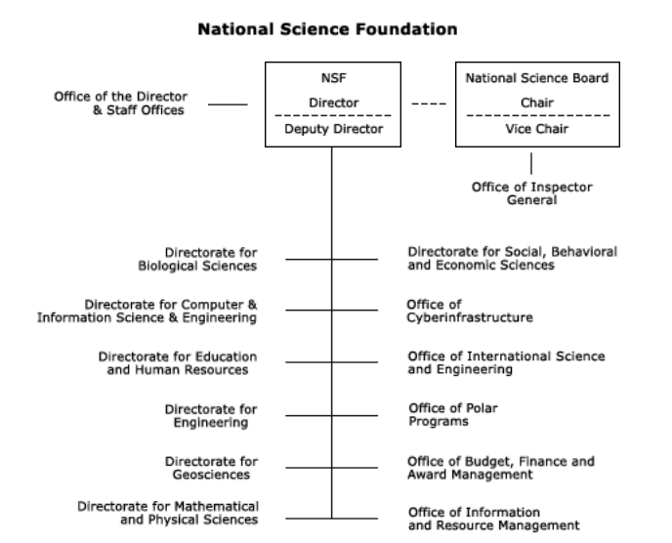

Slide 7
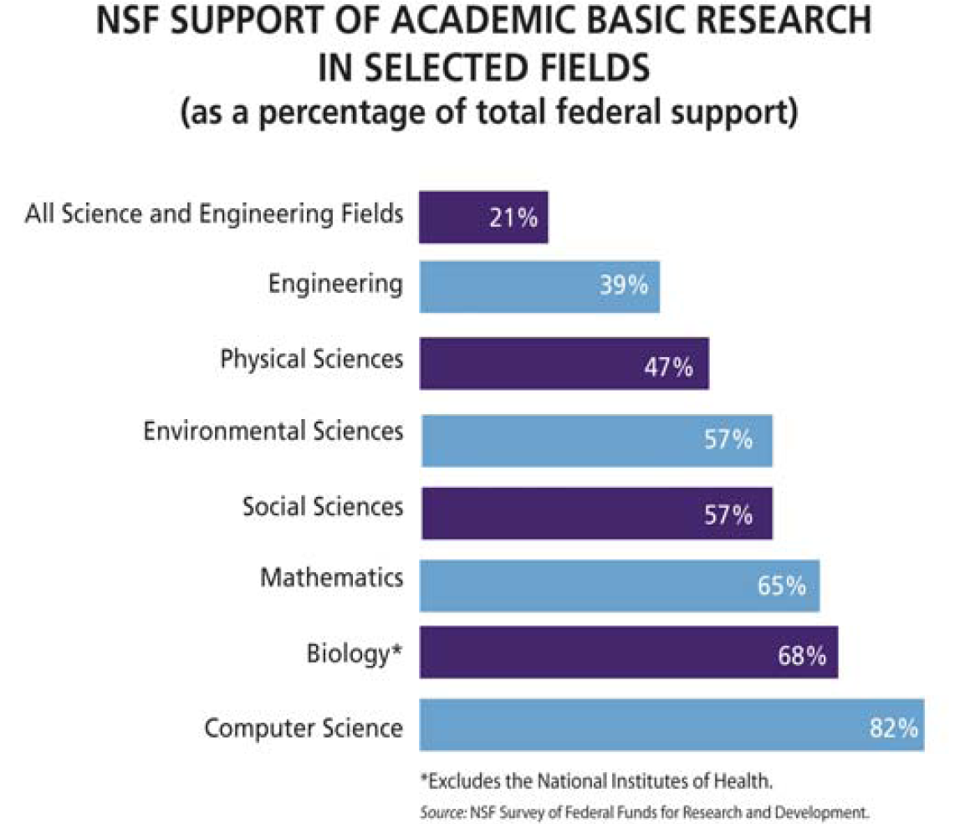

Slide 8
NSF FY 2011 Request to Congress
(Dollars in Millions)
Request over FY 2010 Estimate
FY 2011 Amount Percent
BIO $ 767.81 $ 53.27 7.5%
CISE $ 684.51 $ 65.68 10.6%
ENG (Excl SBIR) $ 682.81 $ 64.65 10.5%
GEO $ 955.29 $ 65.65 7.4%
MPS $1,409.91 $ 58.07 4.3%
SBE $ 268.79 $ 13.54 5.3%
OCI $ 228.07 $ 13.79 6.4%
NSF Total $7,424.40 $551.89 8.0%
CISE $ 684.51 $ 65.68 10.6%

Slide 9
Center-Scale Programs

Slide 10
Center Programs
Science and Technology Centers
  Center for Embedded Networked Sensing, Estrin, UCLA
  Team for Research in Ubiquitous Secure Technology (TRUST), Sastry, UC Berkeley, CMU, Cornell, Mills, San Jose State, Stanford, Vanderbilt
  …
Engineering Research Centers
Materials Research Science and Engineering Centers
Nano-scale Science and Engineering Centers
Centers for Analysis and Synthesis
Centers for Chemical Innovation
Science of Learning Centers
Industry/University Cooperative Research Program
→

Slide 11
2010 Science and Technology Centers
Science of Information
  Szpankowski, Purdue, Bryn Mawr, Howard, MIT, Princeton, Stanford, Berkeley, UCSD, UIUC
  What is Information? – One of our fields “Deep Questions” [Wing, CACM 2008]
  Core of CCF/CIF
BEACON, Goodman, MSU, UT/Austin, UW, NCSU, U of Idaho
  Computational Methods to Study Evolution
Energy Efficient Electronics Science, Yablonovitch, Berkeley+ …
  Millivolt electronic switch as successor to transistor
Integrated Cellular Systems, Kamm, MIT+ …
  Engineer clusters of living cells or “biological machines”
Dark Energy Biosphere, Edwards, USC+ …

Slide 12
Expeditions
Bold, creative, visionary, high-risk ideas
Whole >> Σ part _{i}
Solicitation is deliberately underconstrained
  Tell us what YOU want to do!
  Response to community
    Loss of ITR Large, DARPA changes, support for high-risk research, large experimental systems research, etc.
~ 3 awards, each at $10M over 5 years
  FY08 122 LOI, 75 prelim, 20 final, 7 reverse site visits, 4 awards
  FY09 48 prelim, 20 final, 7 reverse site visits, 3 awards
  FY10 23 prelim, 16 final, …
i
Notes:
$10M for five year ($2M/year)

Slide 13
FY08-FY09 Awards
FY08 Awards
  Computational Sustainability
    Gomes, Cornell, Bowdoin College, the Conservation Fund, Howard University, Oregon State University and the Pacific Northwest National Laboratory
  Intractability
    Arora, Princeton, Rutgers, NYU, Inst for Adv. Studies
  Molecular Programming
    Winfrey, Cal Tech, UW
  Open Programmable Mobile Internet
    McKeown, Stanford
FY09 Awards (funded with ARRA)
  Customized Computing Technology
    Cong, UCLA
  Modeling Tools for Disease and Complex Systems
    Clarke, CMU, NYU, Cornell, SUNY Stony Brook, University of Maryland
  Robotic Bees
    Wood, Harvard
→
→
→

Slide 14
Societal Grand Challenges

Slide 15
SEES: Science, Engineering, and Education for a Sustainable Well-Being
Sustainability = energy, environment, climate, economics
$765.50M NSF
CISE Interests
  Direct (CCF, CNS): energy-intelligent computing to optimize energy-computational performance in computing & communications systems
  Indirect (CNS, IIS): advances in computing to reduce energy consumption in other sectors, e.g., Smart Grid, Smart Home, Smart Transportation
  Foundational (CCF): energy as a third resource, along with time and space, to measure algorithmic complexity and system performance
  Systemic (CCF, IIS): algorithms and software for climate modeling, economic and social incentives

Slide 16
Smart Health
It’s more than electronic health records
It’s more than digitizing current data and processes
What are the computing research challenges such that we can transform healthcare delivery and wellness management of all individuals?
Modeling, decision making, discovery, visualization, summarization, data availability, smart sensing, telemetry, actuation for patient monitoring, robotics and vision for diagnosis and surgery, deployment (software integration), security and privacy, …
CISE AD co-chairs with ONC NITRD Health IT Planning Group
  FDA, NIST, NIH, NLM, NSF, ONC, VA
  ARRA Section 13202(b) – NITRD Strategic Plan for Health IT
Working with ENG and SBE within NSF
OSTP support

Slide 17
CTE: Cyberlearning Transforming Education
CISE + EHR + SBE: $41.28M total
Advanced learning technologies to enhance learning
- Anytime, Anywhere Learning
- Personalized Learning
- (Cyber)Learning about (Cyber)Learning
It’s a research program: Fundamental knowledge about learning to inform new cyber tools and techniques
Assessment and evaluation is a challenge

Slide 18
CDI: Cyber-Enabled Discovery and Innovation
Paradigm shift
  Not just computing’s metal tools (transistors and wires) but also our mental tools (abstractions and methods)
It’s about partnerships and transformative research.
  To innovate in/innovatively use computational thinking; and
  To advance more than one science/engineering discipline.
Investments by all directorates and offices
  FY08: $48M, 1800 Letters of Intent, 1300 Preliminary Proposals, 200 Full Proposals, 36 Awards
  FY09: $63M+, 830 Preliminary Proposals, 283 Full Proposals, 53+ Awards
  FY10: 320 Full Proposals, … holding panels now ….
  FY11 President’s Request: > $100M
Computational Thinking for Science and Engineering
Notes:
~650 Data to Knowledge, 500 Understanding Complexity, < 200 Virtual Organizations
90 PDs (~35 from CISE) and 6 (4 from CISE) admin staff across the agency helped

Slide 19
Range of Disciplines in CDI Awards
Aerospace engineering
Astrophysics and cosmology
Atmospheric sciences
Biochemistry
Biomaterials
Biophysics
Chemical engineering
Civil engineering
Communications science and engineering
Computer science
Cosmology
Ecosystems
Genomics
Geosciences
Linguistics
Materials engineering
Mathematics
Mechanical engineering
Molecular biology
Nanocomputing
Neuroscience
Proteomics
Robotics
Social sciences
Statistics
Statistical physics
Sustainability
…
… advances via Computational Thinking

Slide 20
Range of Societal Issues Addressed
Cancer therapy
Climate change
Environment
Visually impaired
Water

Slide 21
Summary of Trends
Small to Medium to Large to X-Large (Center-Scale) Science
Collaborations
Multidisciplinary
Societal Grand Challenge Problems
International
…
Interagency
Big Data
Cyberinfrastructure, not just large instruments
…

Slide 22
Thank You!

Slide 23
Credits
Copyrighted material used under Fair Use. If you are the copyright holder and believe your material has been used unfairly, or if you have any suggestions, feedback, or support, please contact: ciseitsupport@nsf.gov
Except where otherwise indicated, permission is granted to copy, distribute, and/or modify all images in this document under the terms of the GNU Free Documentation license, Version 1.2 or any later version published by the Free Software Foundation; with no Invariant Sections, no Front-Cover Texts, and no Back-Cover Texts. A copy of the license is included in the section entitled “GNU Free Documentation license” (http://commons.wikimedia.org/wiki/Commons:GNU_Free_Documentation_License)
The inclusion of a logo does not express or imply the endorsement by NSF of the entities' products, services or enterprises.

