Slide 1
The Importance of Broader Impacts at NSF
BIRDS
Jeannette M. Wing
Assistant Director for Computer and Information Science and Engineering
National Science Foundation
June 22, 2010

Slide 2
Why Are You Here?
Three CISE Committee of Visitors reports, one per division, in 2009.
  “How should we evaluate broader impacts?”
  “How should we evaluate how reviewers evaluate broader impacts?”
  “Why don’t you just get rid of this criterion since no one understands it anyway?”
So, this summit is to help you
  To understand the intent and importance of broader impacts
  To inspire you to think of ways your research can have broader impact and thus write meaningful (to you and the reviewers) broader impacts statements.

Slide 3
History
1997: Four merit review criteria merged into two
  Intellectual Merit
    Intrinsic scientific merit
    Soundness of team’s approach
  Broader Impacts
    Utility or relevance of project
    Effect on the infrastructure of science and engineering
2002: NSF announced that any proposal that did not address both Intellectual Merit and Broader Impacts would be returned without review.

Slide 4
Goal: Connect Science to Society
Why?
Intellectual reasons
  Better public understanding of science and engineering
  Better public appreciation of research, its purpose and impact
  Inspire the young to enter science and engineering
Pragmatic reasons
  Taxpayer dollars fund your research
    We – NSF and who NSF funds (i.e., you) – are accountable to Congress and the public
NSF continually needs to explain what basic research is and the importance of science and engineering to society, the economy, and the well-being of the nation.

Slide 5
Importance: Recent Attention by Many
National Science Board
  Report due 2011
Media
  “Science for the Masses”, Nature, May 2010
    “No agency has gone as far as the US NSF…”
    “The criterion was established to get scientists out of their ivory towers and connect them to society” A. Bement, former NSF Director
    “By not tracking broader-impacts activities, the NSF undervalues its true contribution to society” M. Roberts, Univ. Colorado, Boulder

Slide 6
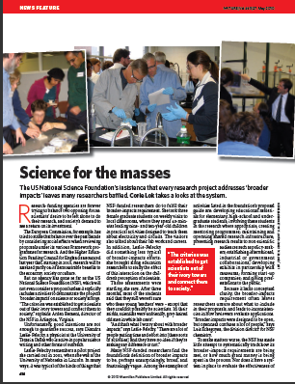
Importance: Recent Attention by Many
National Science Board
  Report due 2011
Media
  “Science for the Masses”, Nature, May 2010
    “No agency has gone as far as the US NSF…”
    “The criterion was established to get scientists out of their ivory towers and connect them to society” A. Bement, former NSF Director
    “By not tracking broader-impacts activities, the NSF undervalues its true contribution to society” M. Roberts, Univ. Colorado, Boulder

Slide 7
Importance: Attention by Congress
America COMPETES Reauthorization Act of 2010, passed by House on May 28, 2010
Section 214(a) Goals - The Foundation shall apply a Broader Impacts Review Criterion to achieve the following goals:
  (1) Increased economic competitiveness of the United States.
  (2) Development of a globally competitive STEM workforce.
  (3) Increased participation of women and underrepresented minorities in STEM.
  (4) Increased partnerships between academia and industry.
  (5) Improved pre-K-12 STEM education and teacher development.
  (6) Improved undergraduate STEM education.
  (7) Increased public scientific literacy.
  (8) Increased national security.

Slide 8
Importance: Attention by Congress
Section 214 (b) Policy- Not later than 6 months after the date of enactment of this Act, the Director shall develop and implement a policy for the Broader Impacts Review Criterion that--
  (1) provides for educating professional staff at the Foundation, merit review panels, and applicants for Foundation research grants on the policy developed under this subsection;
  (2) clarifies that the activities of grant recipients undertaken to satisfy the Broader Impacts Review Criterion shall--
    (A) to the extent practicable employ proven strategies and models and draw on existing programs and activities; and
    (B) when novel approaches are justified, build on the most current research results;
  (3) allows for some portion of funds allocated to broader impacts under a research grant to be used for assessment and evaluation of the broader impacts activity;
  (4) encourages institutions of higher education and other nonprofit education or research organizations to develop and provide, either as individual institutions or in partnerships thereof, appropriate training and programs to assist Foundation-funded principal investigators at their institutions in achieving the goals of the Broader Impacts Review Criterion as described in subsection (a); and
  (5) requires principal investigators applying for Foundation research grants to provide evidence of institutional support for the portion of the investigator's proposal designed to satisfy the Broader Impacts Review Criterion, including evidence of relevant training, programs, and other institutional resources available to the investigator from either their home institution or organization or another institution or organization with relevant expertise.

Slide 9
NSF Broader Impacts Website
my italics
Advance discovery and understanding while promoting teaching, training, and learning
Broaden participation of under-represented groups
Enhance infrastructure for research and education
Broaden dissemination to enhance scientific and technological understanding
Benefits to society

Slide 10
Selected Representative Examples
Develop educational materials for elementary, high-school and undergraduate students
Involve elementary, high-school and undergraduate students in the research where appropriate
Create mentoring programs
Maintain and operate shared research infrastructure
Establish international, industrial or government collaborations
Form start-up companies
Present research results to non-scientific audiences such as policy-makers
Give presentations to the public
Develop exhibits in partnership with museums

Slide 11
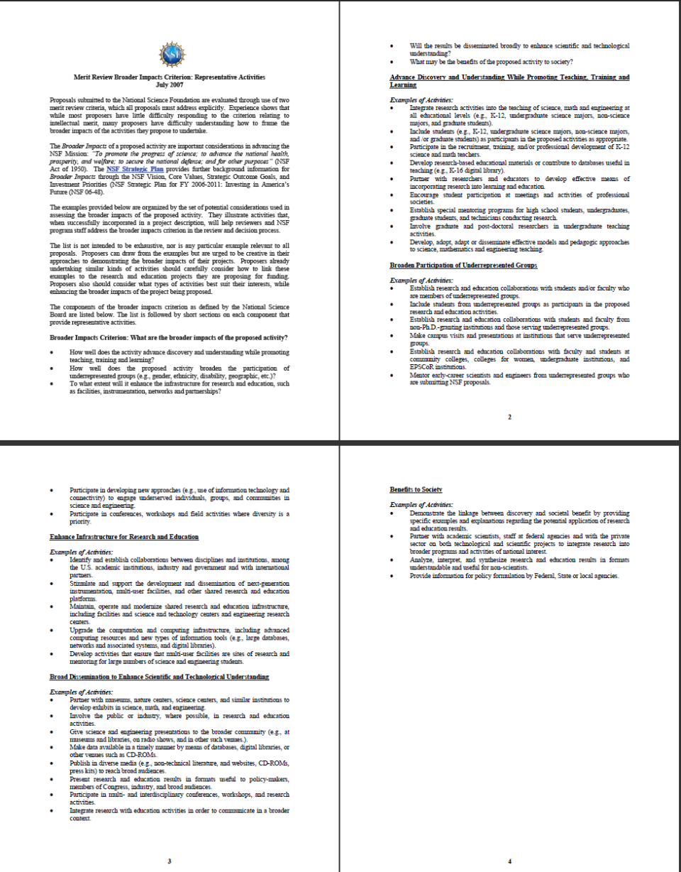
Selected Representative Examples
Develop educational materials for elementary, high-school and undergraduate students
Involve elementary, high-school and undergraduate students in the research where appropriate
Create mentoring programs
Maintain and operate shared research infrastructure
Establish international, industrial or government collaborations
Form start-up companies
Present research results to non-scientific audiences such as policy-makers
Give presentations to the public
Develop exhibits in partnership with museums
http://www.nsf.gov/pubs/2007/nsf07046/nsf07046.jsp

Slide 12
Challenges
Some broader impacts seem to take more effort than others. Do I get more credit for that?
How should reviewers evaluate broader impacts statements?
How much should broader impacts count compared to intellectual merit?
How should NSF monitor progress of broader impacts statements?
  How are PIs held accountable to their current and past statements?
How does one measure the success of a broader impacts activity?
What is the cost of broader impacts and where should it come from? Line item in budget? Separate program?
Who should be responsible? The PI? The University? NSF?

Slide 13
FY11 Funding Opportunities
CISE core (CCF, CNS, IIS) and cross-cutting research program solicitations posted June 11
  Cross cuts: Smart Health and Well-being, Network Science and Engineering, Trustworthy Computing
CISE + X programs
  Cyber-Physical Systems (with ENG)
  Social-Computational Systems (with SBE)
  Interface between Computer Science and Economics (with SBE)
  Software for Sustained Innovation Institutes (with OCI) (S^2I^2)
  … [Please see website www.cise.nsf.gov ] …
CISE education program (coming this summer)
  Long and fat pipeline: K-16 x Diversity of all dimensions
NSF foundation-wide activities in FY11 Budget Request
  Science, Engineering and Education for Sustainability (SEES)
  Cyberlearning Transforming Education (CTE)
  Cyber-enabled Discovery and Innovation (CDI)
  Science and Engineering Beyond Moore’s Law (SEBML)
Increase in Graduate Research Fellowships and CAREER awards

Slide 14
Thank You!

