Slide 1

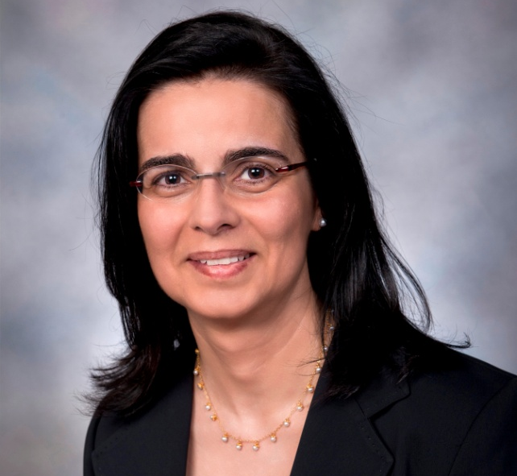
CISE DISTINGUISHED LECTURE SERIES
Thursday, October 13 at 3:30pm, Room 110
Motion Planning for Physical Systems
Prof. Lydia E. Kavraki
Rice University
Lydia E. Kavraki is the Noah Harding Professor of Computer Science and Professor of Bioengineering at Rice University. Her research contributions are in the area of robotics, computational structural biology and bioinformatics. Kavraki is one of the authors of the robotics textbook titled "Principles of Robot Motion" published by MIT Press. Kavraki is the recipient of numerous awards including an NSF CAREER award, a Sloan Fellowship, and the 2000 ACM Grace Murray Hopper Award. She is a Fellow of the ACM, AAAI, and AIMBE.
Over the last decade, the development of robot motion planning algorithms to solve complex geometric problems has not only contributed to advances in industrial automation and autonomous exploration, but also to a number of diverse fields such as graphics animation and computational structural biology.
This talk will discuss the state of the art of sampling-based motion planning with emphasis on work for systems with increased physical realism. Recent advances in planning for hybrid systems will be described, as well as the challenges of combining formal logic and planning for creating safe and reliable robotic systems that can interact with humans. The talk will also demonstrate how the experience gained through robotics planning has led to algorithmic tools for analyzing the flexibility and interactions of molecules for the discovery of new medicines.
Talks held at 4201 Wilson Blvd. Questions: Contact Dawn Patterson at dpatters@nsf.gov

