Slide 1

OFFICE OF SCIENCE
Office of High Energy Physics Report to the AAAC
February 10, 2012
Kathleen Turner
Office of High Energy Physics (HEP)
Office of Science (SC), U.S. Department of Energy (DOE)

Slide 2
HEP PROGRAM - STATUS
HEP PROGRAM - CONSIDERATIONS
COSMIC FRONTIER
-- PROGRAM BUDGET & PLANNING
-- PROGRAM STATUS
-- PROGRAM MANAGEMENT
2

Slide 3
HEP PROGRAM - STATUS

Slide 4
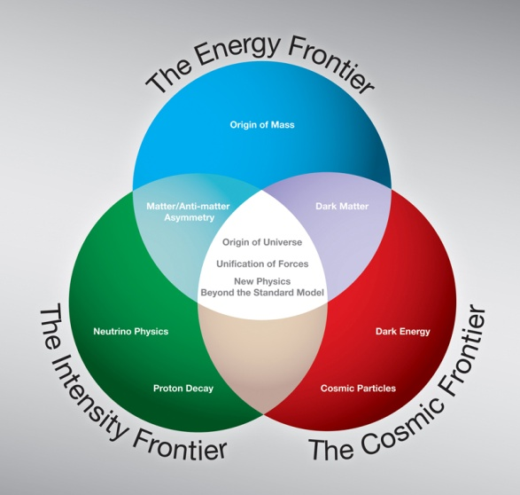
HEP Strategic Plan (based on 2008 P5 report)
The High Energy Physics program’s mission is to understand how our universe works at its most fundamental level. To enable discoveries, HEP supports
  theoretical and experimental research in both elementary particle physics
  and fundamental accelerator science and technology.
Progress in achieving the mission goals requires advancements at the
  Energy, Intensity and Cosmic Frontiers
  The U.S. should have a strong, integrated research program at all three frontiers.
  At lower funding levels, cannot maintain leadership at all 3 frontiers
HEP at its core is an accelerator-based experimental science.
  Support accelerator and detector R&D to develop new technologies
    that are needed by the field
    that benefit the nation
Community task force is providing input on promising accelerator R&D → will be followed by strategic planning exercise.

Slide 5
High Energy Physics Budget
(dollars in thousands)
Description | FY 2010 Actual | FY 2011 Actual | FY 2012 Approp
Proton Accelerator-Based Physics | 438,369 | 438,855 | 421,594
Electron Accelerator-Based Physics | 30,212 | 24,454 | 23,025
Non-Accelerator Physics¹ | 97,469 | 90,067 | 84,062
Theoretical Physics | 68,414 | 68,050 | 66,777
Advanced Technology R&D | 156,347 | 154,152 | 167,402
Construction (Line Item) | 0 | 0 | 28,000
Total, High Energy Physics | 790,811 | 775,578 | 790,860
Office of Science | 4,964,040 | 4,857,665 | 4,873,500
Footnote 1: The Non-accelerator Physics subprogram includes all of the Cosmic Frontier and the non-accelerator part of the Intensity Frontier experimental research, operations, R&D, small experiment fabrication and MIE fabrication projects. The Theoretical Physics subprogram includes Cosmic Frontier theoretical research.
The FY12 budget includes SBIR/STTR of approximately $20M, which has already been removed from FY10 and FY11 Actuals. Therefore the real FY12 request is a reduction of approximately $5M from FY11 and $12M from FY10.

Slide 6
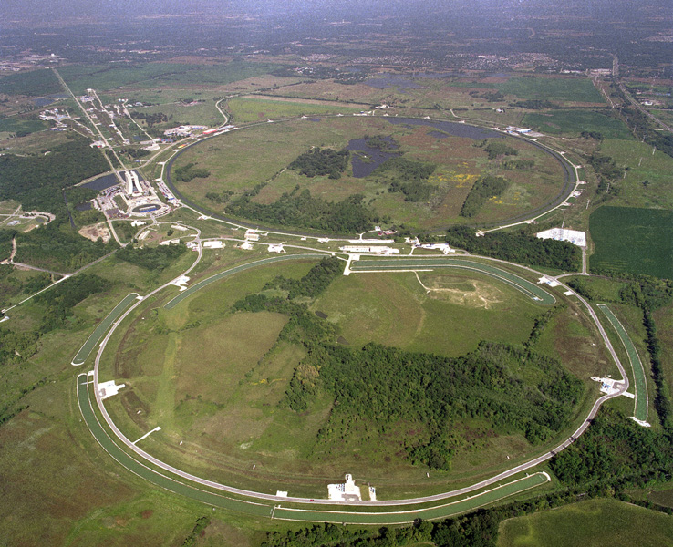
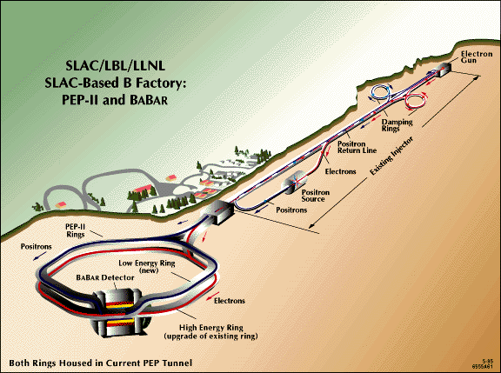
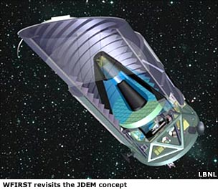
Recent Major Shifts
We are working to increase the fraction of the budget devoted to projects back up to ~ 20%.
Programs have ended in order to start new ones:
  Mu2e, LSST, LBNE
Shutdown of the Fermilab Tevatron (end of FY 2011)
  - accelerator complex continues operations in support of neutrino experiments
Premature shutdown of B-factory (FY 2008)
Ended R&D funding for JDEM (FY 2011) & only participating in one major dark energy experiment (LSST)
Tevatron
Main Injector

Slide 7
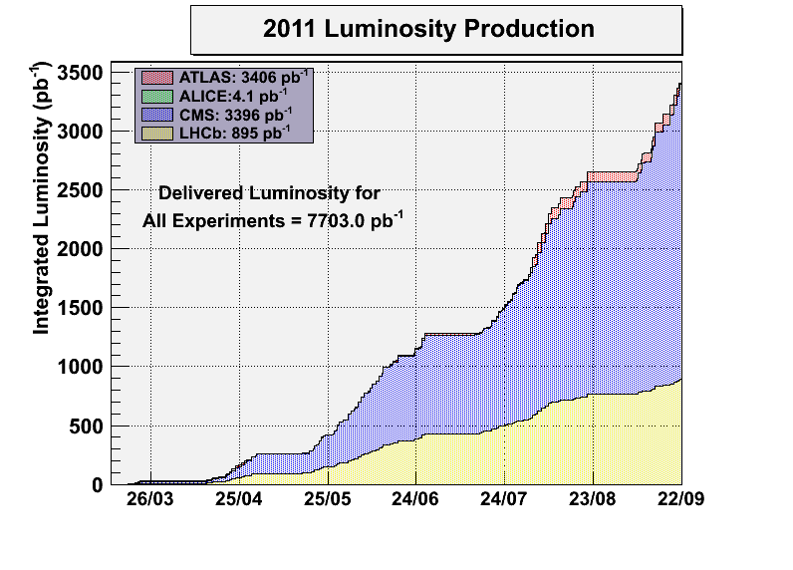
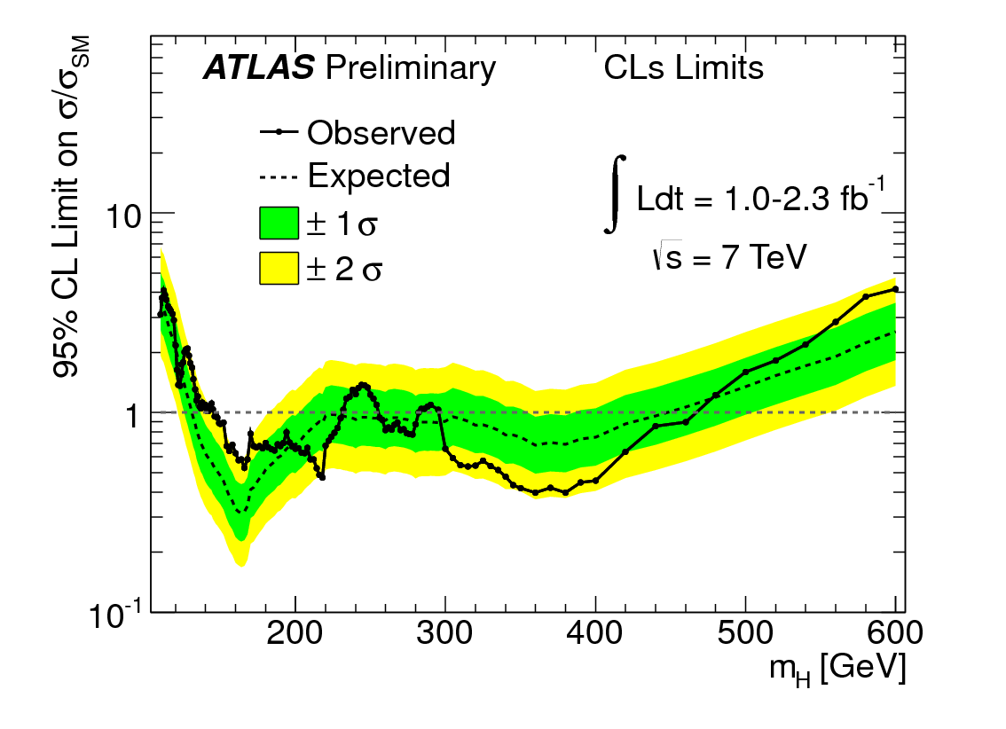
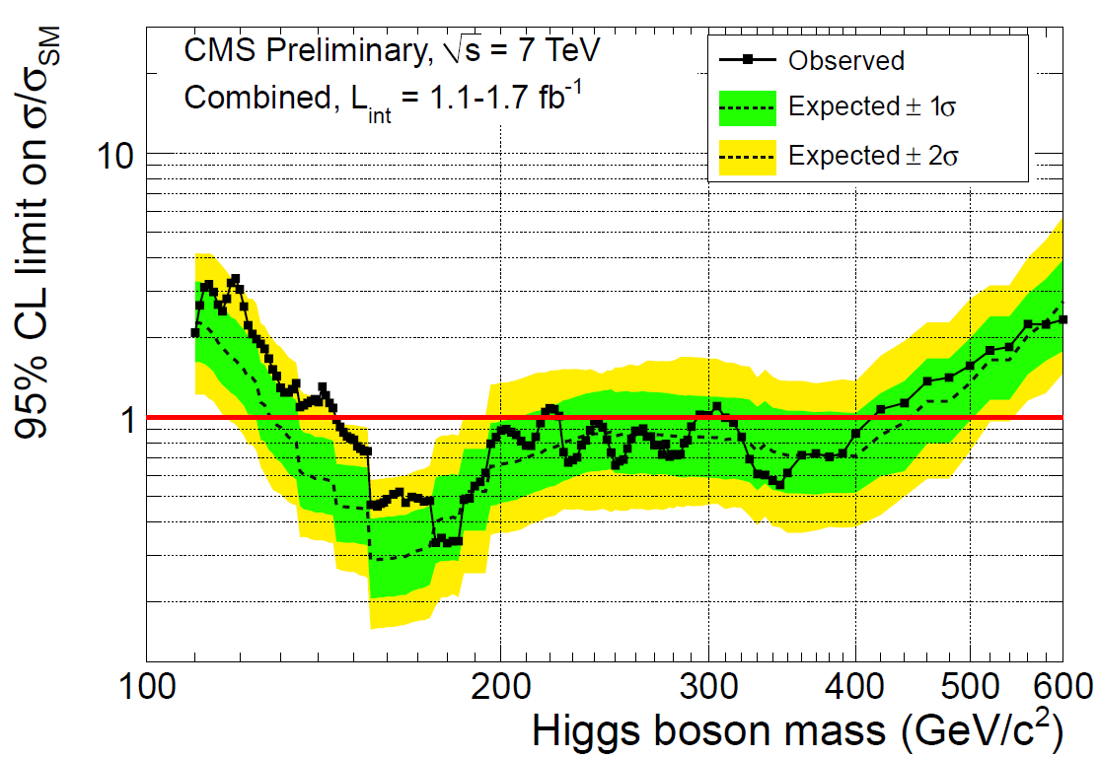
Energy Frontier - Status
Fermilab Tevatron: Operations ended
Large Hadron Collider (LHC) at CERN
DOE made contributions to the accelerator and detectors (ATLAS and CMS)
LHC has now operated for 2 years; excellent performance in 2011.
  CMS and ATLAS each have ~ 4.7fb⁻¹ now.
New results on the Standard Model Higgs exclude a large part of the allowed mass region; expect Standard Model Higgs will be seen or excluded by the end of 2012.
LHC will shutdown in 2013 for “Phase I” improvements
  Extensive detector maintenance planned.
  Upgrades to the detectors being planned to support the high data rates and radiation levels
  HEP is working with CERN and the ATLAS and CMS collaborations to develop a plan for US-HEP contributions to the upgrade
ATLAS excluded: 146-232, 256-282, 296-466
CMS excluded: 145-216, 226-288, 310-400

Slide 8
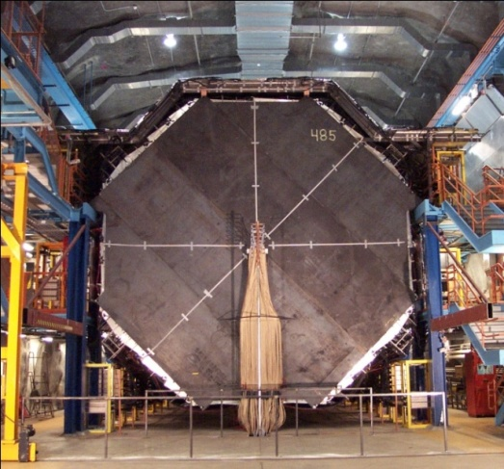
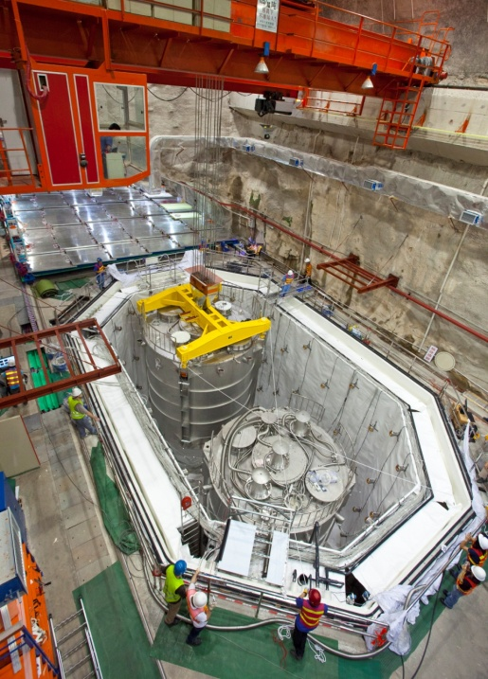
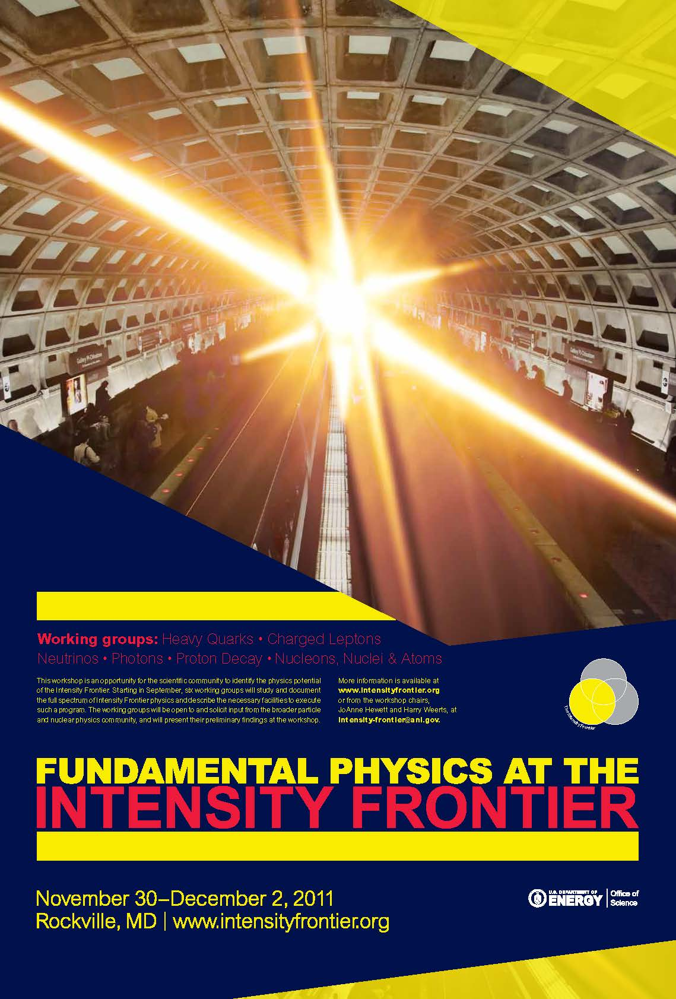
Intensity Frontier – Status
Neutrino Experiments
Fermilab and Minnesota
MINOS, MiniBooNE and MINERvA continue operations.
The NOvA project starts detector installation & does accelerator upgrades in FY12
MicroBooNE started fabrication in FY12
China
Daya Bay Reactor Neutrino Experiment - partnership with China.
Detector installation is near completion; commissioning started; full operations in 2012
New Projects – Mu2e and LBNE
Both have CD-0 approval (mission need)
CD-1 preparations underway
Path Forward
Intensity Frontier community workshop held in Dec. 2011
to develop the science case and identify opportunities for the program
report due in February
HEP is developing an Intensity Frontier Implementation Plan
based on community input; plan due in summer 2012
MINOS FAR DETECTOR
Daya Bay

Slide 9
Underground Science
DOE Office of Science (SC) and NSF had developed a partnership model for a program at a Deep Underground Science and Engineering Lab (DUSEL), planned for the Homestake Mine in South Dakota.
  NSF – steward of the DUSEL facility
  NSF – steward the dark matter experiment
  DOE HEP – steward the Long Baseline Neutrino Experiment (LBNE)
  DOE NP – steward the neutrinoless double beta decay experiment
Dec. 2010 - The NSB terminated support for DUSEL
May 2011 – NRC study found underground science areas to be “extremely important”
June 2011 – DOE review of options for underground science; hinges on LBNE
– costs need to be better understood; need technology choice
  FY 2012 Appropriations bill:
  DOE to provide a detailed project plan and updated cost estimate by 4/1/12, before Congress will consider construction approval
  The FY 2012 budget includes $15 million to keep the Homestake Mine viable while decisions are made. (HEP $10 M, NP $5 M). Note: NSF covered the costs until the Continuing Resolution was lifted.
Office of Science Director, Dr. Bill Brinkman, plans to decide by March whether or not to proceed with LBNE at Homestake to meet the Congressional deadline
LAr has been chosen for LBNE technology; refined cost estimate available soon

Slide 10
HEP PROGRAM - CONSIDERATIONS
10

Slide 11
HEP program – strengths & model
DOE Office of Science:
Provide science leadership and support to enable significant advances in science areas.
Model to enable the work:
Lab environment with a variety of resources needed
  Job is to build and operate facilities to do research; develop new projects – all phases
Lab infrastructure, including computing facilities (NERSC, SCiDAC program etc)
Long term support for participation in all phases
Encourage collaborations with expertise in required areas to make significant advances
Partnerships as needed to leverage additional science and expertise
Include speculative science (e.g. led to dark energy discovery)
DOE model has been very successful:
See http://science.energy.gov/about/honors-and-awards/doe-nobel-laureates/
11

Slide 12
HEP program – how it operates
→ Independently planning program to make significant advances in science
Energy & Intensity Frontier
We design & build the accelerator facilities to do our science
We operate the facilities to do the experiments
Science Collaboration active throughout all phases – science and construction activities
Cosmic Frontier
We do experiments! Design and build instrumentation and other resources (e.g. computing), operations, research activities.
For dark energy experiments, we need to use telescope facilities belonging to other agencies.
Need to understand what fraction of the experiment is directly related to HEP science – leads to level of our participation
Priority is significant contributions to facilities/experiments & supporting collaboration with necessary expertise, resources to go from design to data analysis, including science studies/planning.
12

Slide 13
HEP program – interagency/international partnerships
Decision to do an Interagency project
Partnerships between agencies and other offices within agencies can provide necessary or additional resources → provide opportunity for increased science
While all government agencies follow the same rules, there are differences in the
details!
Differences in how each agency and science community works can add overhead to experiment & needs to be taken into account
  Processes for planning/deciding on projects, managing/funding projects, funding research, etc
  HEP emphasis on collaboration leading the science from the start – different than other communities
  Need to ensure data and science analysis return when working between fields
13

Slide 14
HEP program
– considerations for funding projects/experiments
Many Cosmic Frontier experiments have a much broader science program than what is
of interest to the HEP program → we make contribution at an appropriate level
Follow PASAG criteria:
Significantly advance HEP science goals
Visible/leadership contributions
HEP community brings needed expertise or instrumentation etc to the table
Partnerships as needed
In practice:
- We fund Collaborations of scientists with associated technical personnel and other expertise to make big advances in our science areas.
- Science planning expected all along process and to end up with coordinated data analysis by a collaboration (1 precision result rather than 100 independent results)
14

Slide 15
HEP program – funding practices for research
DOE-HEP traditions grew up from scientists that design, build, operate, analyze experiments.
Typically, collaborations are formed and scientists build a grass-roots effort to move a project
forward. Competition among projects overseen by HEPAP. Peer reviews and program planning reflects these traditions.
We support
Research efforts (scientists) on R&D, experiment design, fabrication,
data-taking, analysis activities
Considerations:
- Activity in direct support of our science/experiment and priorities
- % time on this effort → Assume 2 months summer support and support of their group “buys” their full research time throughout the entire year
Long term commitment to our experiment/science
To optimize science return, emphasis is on:
→Teams of scientists with responsibilities on Collaboration for our projects (i.e. not just
end-user)
Not a priority: Might be our science, but working on another agency’s project or own small experiment, or using data but not supporting the Collaboration
15

Slide 16
COSMIC FRONTIER – PROGRAM BUDGET & PLANNING

Slide 17
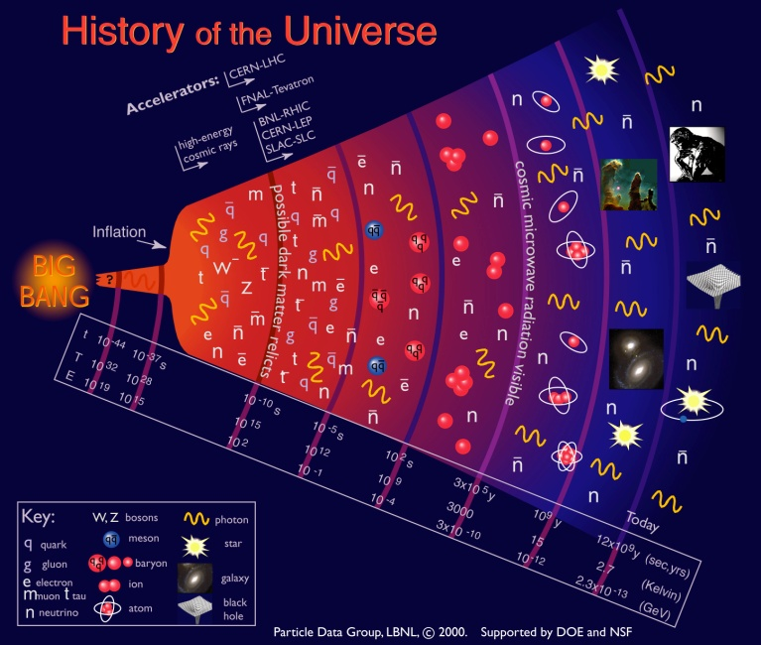
Cosmic Frontier
  Science Thrusts →
  Dark energy
  Dark matter
  High Energy Cosmic & Gamma rays
  CMB and Other
17

Slide 18
Cosmic Frontier - Recent Activities
Cosmic Frontier - Program Guidance
  FACA panels – official advice:
  High Energy Physics Advisory Panel (HEPAP) – reports to DOE and NSF; provides the primary advice for the program
  Astronomy and Astrophysics Advisory Committee (AAAC) – reports to NASA, NSF and DOE on areas of overlap
  Oct. 2009 - HEPAP (PASAG)
  Recommended an optimized program over the next 10 years in 4 funding scenarios
  Dark matter & dark energy remain the highest priorities; but don’t zero out everything else
  We also get input from the National Academy →
    August 2010 - Astro2010
    Recommendations to DOE:
    The optimistic (doubling) funding profile allows investment in: LSST and WFIRST
    At lower funding level →LSST is recommended as the priority because DOE role is critical
    Other identified opportunities:
        2nd priority ground based - contributions to NSF mid-scale experiments
        4th priority ground-based – contribute (w/NSF) as a minor partner to European-led CTA ground-based gamma-ray observatory
18

Slide 19
Cosmic Frontier: Program Planning & Priorities
  Principles & Objectives
Balanced program, with staged implementation
Follow PASAG → Prioritization Criteria for Contributions to Particle Astrophysics Projects
Contributions to select, high impact experiments:
    That directly address HEP science goals
    That will make a visible or leadership contribution
    For which the HEP community brings something to the table – instrumentation, collaborations, analysis techniques etc.
Priority for Direct-detection Dark Matter (PASAG: multiple technologies at next step) & Dark Energy (Astro2010: LSST)
HAWC and VERITAS-upgrade (PASAG)
Particle Physics is a global field: Cooperative multi-agency & international development & coordination as appropriate (not necessarily joint funding)
In Astro-Particle Physics, internationally we participate in OECD Global Science Forum: Astro-Particle International Forum (APIF) started in spring 2011 – continued coordination and planning

Slide 20
Cosmic Frontier Budget
Cosmic Frontier Funding (in $K) | FY10 actual | FY11 actual | FY12 current
Research | 55161 | 57112 | 54347
Grants Research | 11674 | 11975 | 12110
Lab Research | 34145 | 36091 | 34610
Exp Ops & Commissioning | 9342 | 9046 | 7627
Projects | 20155 | 17652 | 14000
MIE - DES | 8610 | 4000
MIE - SuperCDMS Soudan | 1500
MIE - LSST |  | 1900 | 5500
MIE - HAWC |  |  | 1500
Small fabrication + R&D | 10045 | 11752 | 7000
TOTAL | 75316 | 74764 | 68347
There is a decrease in project funding as DES and SuperCDMS-Soudan complete.
LSST and HAWC become MIE’s in FY12: HAWC starts fabrication; LSST still in R&D (doesn’t have fabrication-start approval in FY12)

Slide 21
COSMIC FRONTIER
- PROGRAM STATUS

Slide 22
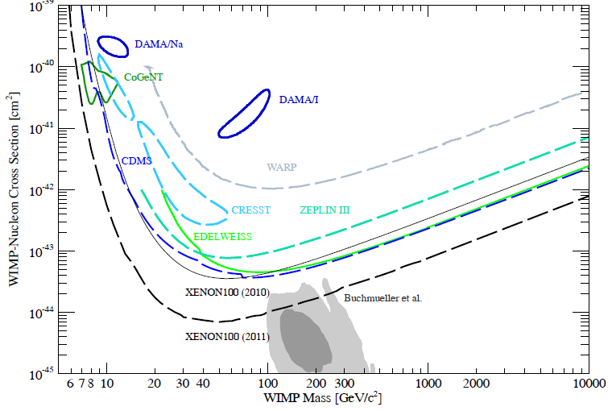
Direct-Detection Dark Matter – Current program
Current “Generation 1” (DM-G1) experiments funded by HEP:
  ADMX: Axion detector, at UWash - FY12 fabrication, commissioning; FY13/14 operations
  COUPP 60: Bubble Chamber at Fermilab now - FY12 move to SNOLab, commissioning; FY13 operations
  DarkSide-50: Liquid Ar, at Gran Sasso - FY12 fabrication, commissioning; FY13/14 operations
  LUX-350: Liquid Xe, Homestake mine - FY12 installation & commissioning; FY13 operations underground
  SuperCDMS-Soudan: Ge detectors, at Soudan mine - FY12 commissioning, operations; FY13/14 operations
  XENON-100: Liquid Xe, at Gran Sasso - FY12 data analysis
  Also: R&D/research efforts (DAMIC, DMTPC, …) and Research funding only for efforts on miniCLEAN.
  Searching for WIMPs and AXIONs
  Many creative approaches: Technologies include cryogenic germanium detectors, liquid xenon, liquid argon, bubble chambers and resonant cavities
  We are working in partnership with NSF-PHY on current efforts and in coordinating future plans.

Slide 23
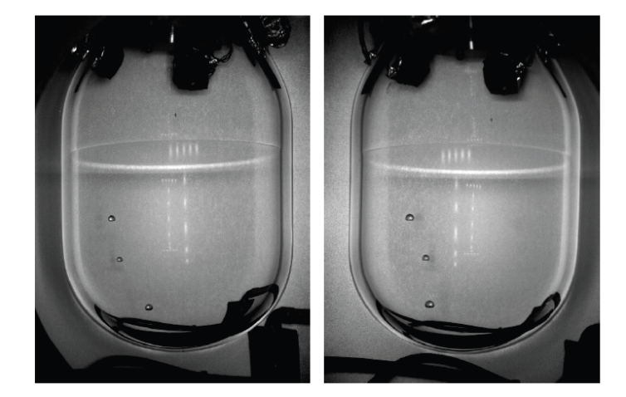
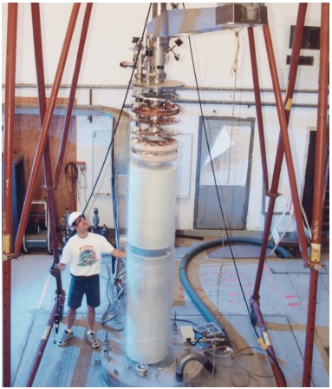
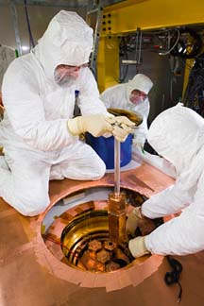
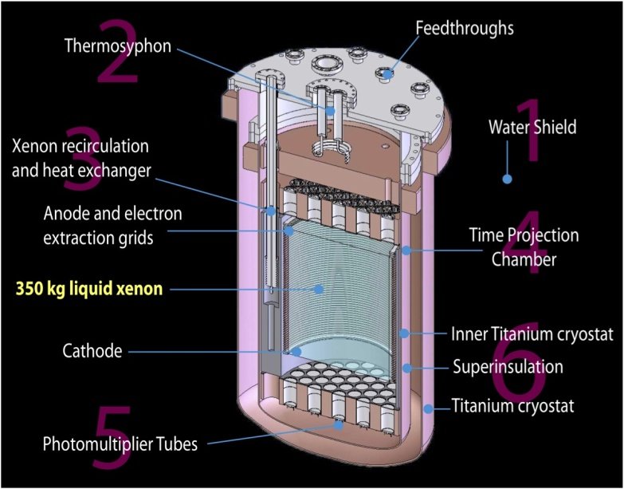
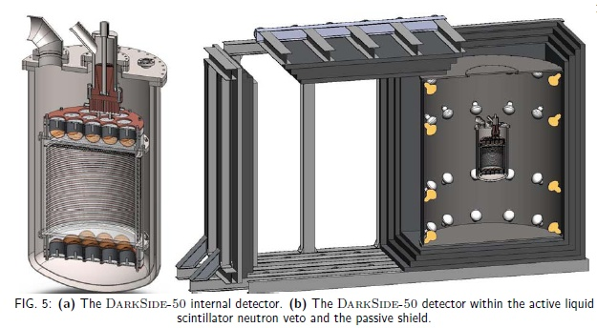
Direct-Detection Dark Matter – Current
Cryogenic Dark Matter Search (CDMS) at Soudan mine - germanium detectors
COUPP Bubble Chamber – Fermilab, SNOLab
Axion Dark Matter eXperiment (ADMX) Phase-2a at U.Washington
Large Underground Xenon (LUX) detector – Sanford Lab, Homestake mine
DarkSide-50 – Dual-Phase liquid argon TPC at LNGS Gran Sasso

Slide 24
Direct-Detection Dark Matter - Future
DM-G2 experiments (in coordination w/NSF)
~10x greater sensitivity than G1
Most if not all of the above G1 collaborations are planning G2 versions
Technology choices will need to be made; we can’t fund all current collaboration to go to next phase
DOE DM-G2 process:
Solicitation for FY13 R&D for G2 experiments will be announced soon, with proposals due 3-4 months later.
We anticipate further selection after this phase and then project start no earlier than FY14
DM-G3 experiments (also global coordination expected)
G3 R&D and planning continues at a low level
Dark Matter – program planning
HEP planning a coordinated strategy for dark matter research
-- Need information on coordination and complementarity of different methods of dark matter detection: direct detection, indirect using gamma-ray experiments, LHC
→ Planning a community workshop in August 2012; announcement coming

Slide 25
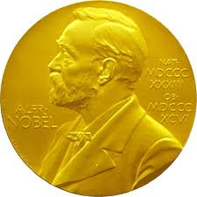
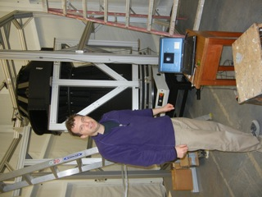
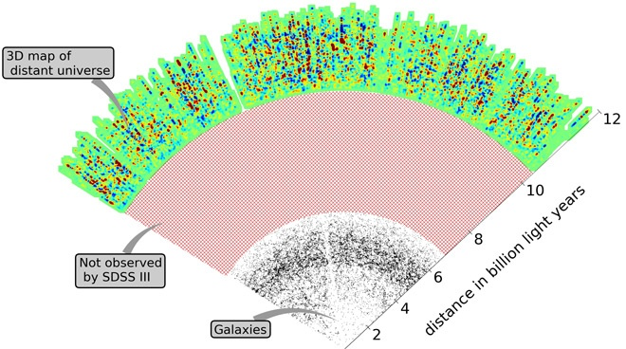
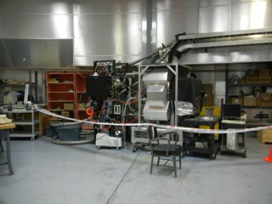
Dark Energy – Current program
  Program of experiments w/ all methods: supernovae, baryon acoustic oscillations, galaxy clustering, weak lensing, etc.
  HEP provides support for research (scientists) and operations during data-taking phase
  Current experiments:
  Analysis of current data sets (mainly SDSS-II) – small research efforts continue to help plan our future experiments
  Supernova Cosmology Project, Nearby Supernova Factory, Palomar Transient Factory, QUEST – operations continue
  Baryon Oscillation Spectroscopic Survey (BOSS) on SDSS-III – operations continue through FY14
  Dark Energy Survey (DES) – camera (Fermilab) delivered to NOAO in Chile; FY12 integration, commissioning, installation; start 5 year operations late FY12
  - Pre-operations review planned for May
DES Imager in Coude room in Blanco Dome
DES - Peter Doel and the fully assembled corrector on the rotary table for the alignment check
BOSS - Has shown that they can use quasars to explore large scale structure at high z

Slide 26
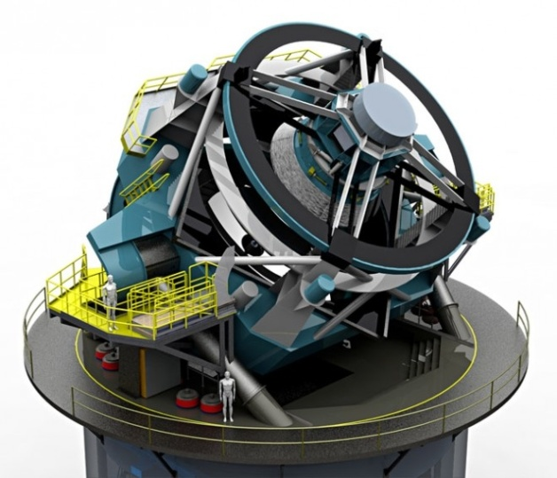
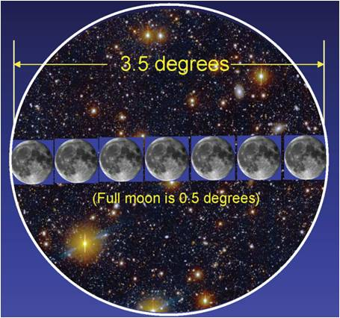
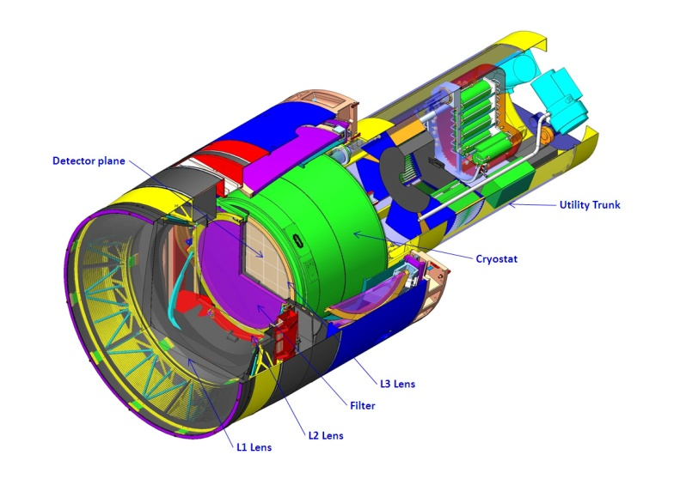
Dark Energy - Planned
  LSST – Large Synoptic Survey Telescope
    HEP is coordinating project planning with NSF
      Holding regular meetings of the Joint Oversight Group (JOG); Working on an MOU
    DOE responsible for the camera; NSF responsible for telescope facility and data management system
    June 2011 - Mission Need Statement signed for a “Stage IV” experiment; Critical Decision 0 (CD-0) approved; costs now accrue towards MIE total project cost
    Nov. 2011 - successful “Lehman” review of the camera project; in preparation for requesting CD-1 approval
    Feb 2012 – CD-1 approval meeting scheduled for mid-Feb.
    FY 2012 – continued funding is provided for LSST R&D
    HEP Planning assumes that LSST camera project MIE fabrication start will be approved in FY 2013
    -- Fabrication activities can then start after CD2/3a approved

Slide 27
Dark Energy – Future planning
LSST is our priority for the next experiment to be developed.
Pro-actively developing a balanced, robust dark energy program in HEP – investigating options
Near term and low cost options
Move forward using multiple methods
What facilities are required and how do we obtain access to do our experiments? Current examples:
    Pay for telescope time
    Contribution to operations
    Provide instrumentation/other in exchange for operating/telescope time
  Current low-level Research efforts (no current plan for participation in the projects)
  WFIRST NASA Science Definition Team – several scientists participating
  ESA Euclid space mission – scientists from several DOE labs have joined the Science Collaboration
  - LBNL group was asked to join in exchange for their help in mission design
  Future experimental possibilities:
  BigBOSS – LBNL is leading a collaboration scientists in science planning and technical R&D; current plan is to provide instrumentation for survey on Mayall at Kitt Peak
  - successful December 2011 science/R&D review; now investigating options for facility access
  - Other options: ground supernova surveys, BOSS-upgrade, spectroscopic survey in the south, etc

Slide 28
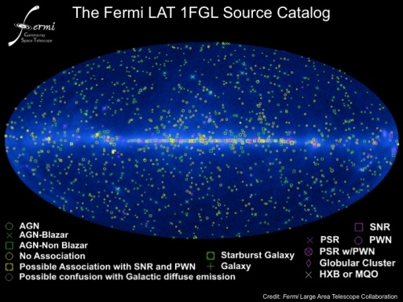
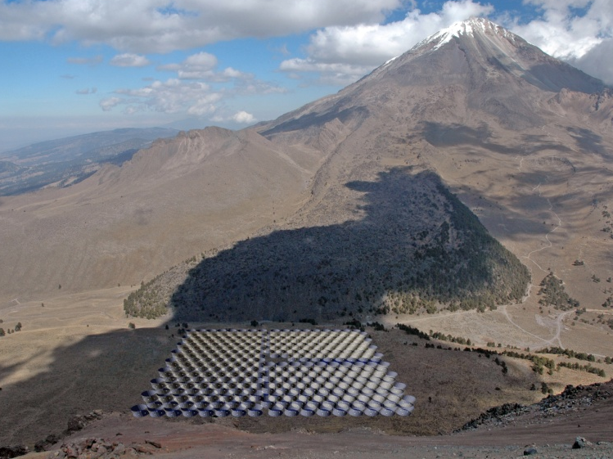
High Energy Cosmic-ray, Gamma-ray - Current
Pierre Auger cosmic ray observatory in Argentina
FY12/13: HEP participation (led by Fermilab) in operations & analysis continues at least through FY13; collaboration planning to request extending; small R&D efforts on radio and microwave detection of UHECR
VERITAS – 4 telescope gamma-ray array in Arizona
FY12: NSF-funded upgrade complete, operations & analysis continues; collaboration requesting to continue operations through FY17
Fermi Gamma-ray Space Telescope (FGST) – FY12/13 operations and analysis; collaboration proposing to NASA senior review & DOE to continue through at least FY15
- HEP will continue supporting the Instrument Science Operations Center (ISOC) at SLAC if NASA Senior Review recommends to extend the operations
Alpha Magnetic Spectrometer (AMS) – launched May 2011; FY12/13/14 operations & analysis
High Altitude Water Cherenkov (HAWC) in Mexico – Joint DOE/NSF Baseline review in Dec. 2011 was successful; finalizing Project Execution Plan for baseline approval now; FY12-14 fabrication; FY15 operations
- DOE, NSF and Mexico partnerhip
2012 Panofsky prize to Bill Atwood "for his leading work on the design, construction, and use of the Large Area Telescope on the Fermi Gamma-ray Satellite, enabling numerous new results in gamma-ray astrophysics and fundamental physics.“
HAWC array - model
28

Slide 29

AMS – Alpha Magnetic Spectrometer
Launched on May 16, 2011, (Endeavor, STS-134) and installed on Space Station
AMS is performing as expected and has collected and has collected more than 6 billion cosmic ray events since installation.
42 GeV carbon
20 GeV Electron

Slide 30
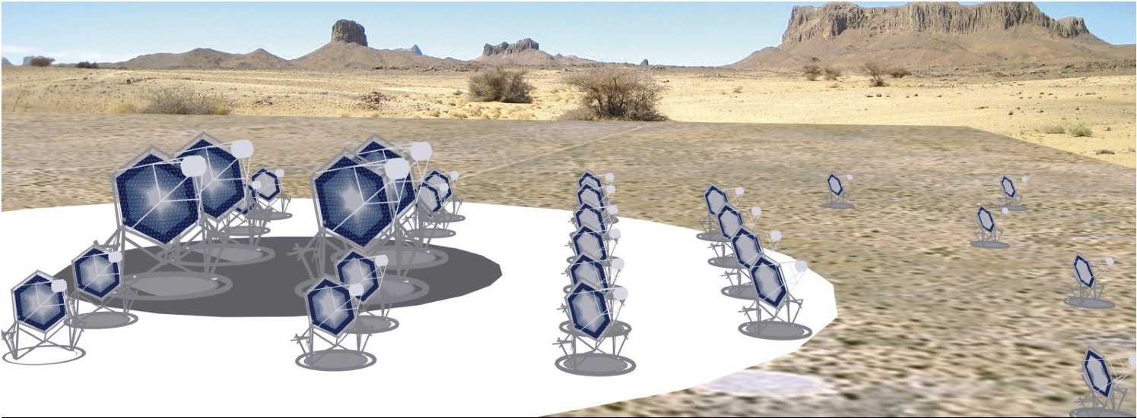
High Energy Cosmic-ray, Gamma-ray – Future Possibilities
  Cherenkov Telescope Array (CTA)
  Europe-led next generation gamma-ray experiment
  Proposed OHEP-related science: indirect detection of dark matter & Lorentz-invariance tests
  US-collaboration (ANL, SLAC, Universities) submitted proposal for R&D program leading to fabrication with several possible contributions: telescopes, electronics, focal plane
  FY12: science studies and low-level R&D; also investigating other options for different levels of contribution and at different stages
30

Slide 31
Cosmic Frontier – other efforts
Cosmic Microwave Background:
  HEP making hardware contribution to South Pole Telescope
  Several ANL Divisions worked together to design next-generation transition edge sensors
  ESA/NASA Planck mission – HEP has MOU with NASA to provide computing resources at NERSC in Berkeley for data processing and analysis
Holographic Interferometry:
Holometer experiment at Fermilab in fabrication – will provide direct experimental
access to the Planck scale and probe the microscopic quantum nature of space and
time.

Slide 32
Related efforts - Computational Cosmology Collaboration
DOE Laboratories
Collaboration forming and proposing efforts:
Core modeling, simulation capability for HEP Cosmic Frontier Computing
Planned as ‘one-point contact’ for scientists, projects, and theory
Overlapping Themes: Cosmological Probes, Simulations, Middleware/Tools, ‘Discovery Science’
Initial topics: weak lensing, the Ly-alpha forest, clusters, galaxy surveys, neutrino constraints, inflation and non-Gaussianity, and baryonic effects
Capabilities: Frameworks and codes like HACC (Hardware/Hybrid Accelerated Cosmology Code), ART (Adaptive Refinement Tree), others
Resources: Leadership Class Computers and synergies with DOE SciDAC Institutes and projects, DPLTA (Data Preservation and Long-term Analysis) and OSG (Open Science Grid) efforts within HEP communities
Connections to DOE Cosmic Frontier Experiments
Computing at the Cosmic Frontier Workshop Report (coming soon)

Slide 33
COSMIC FRONTIER
- PROGRAM MANAGEMENT

Slide 34
Cosmic Frontier - Recent Activities
Cosmic Frontier - Program Management
    Oversight of R&D, Fabrication Projects:
    Projects over the limit for “Lehman” review (> $20M) – have independent Lehman reviews
    (HEP office may review them prior to Lehman process; e.g. BigBOSS review in Dec. 2011)
    Projects below the official “Lehman” review limit ($20M):
    Don’t have time/manpower to have a separate review of each so plan joint annual panel review of all projects that are in R&D, Fabrication phases → June 2012
    Review status of technical, cost, schedule, management aspects
    Review their project execution plan & baseline (if applicable)
    Caveat:
    May have an individual review if the project is above the MIE limit $5M (but below $20M) before moving to joint panel review process (e.g. HAWC)
34

Slide 35
Cosmic Frontier - Recent Activities
Cosmic Frontier - Program Management
    Oversight of Operating Experiments:
    Don’t have time/manpower to have a separate review of each so plan bi-annual (or tri-annual) joint panel review of all operating experiments → July 2012
    Review status of technical operations, cost, schedule, management, analysis & computing aspects, etc.
    Review their project operations plan (if applicable)
    Review of their case for extended operations (if applicable) – science case, cost, schedule etc.
    Caveat:
    For larger experiments (e.g. DES), prior to the operating phase, we plan an individual panel review of their Project Operations Plan and readiness; after this they move into standard joint review process above
    For all experiments, we will continue to have monthly or quarterly reports & discussions to agencies and JOGs as appropriate
35

Slide 36
Cosmic Frontier - Recent Activities
Cosmic Frontier – Schedule
Feb 13 – FY13 budget request released
March 12-13 – HEPAP meeting
May – panel pre-operations review of DES
June – panel review of all current projects (below Lehman process)
July – panel review of all operating experiments
Aug – Dark Matter workshop
36

