Slide 1


NSF/AST Programs & Budget Update
AAAC
Jim Ulvestad
February 10, 2012

Slide 2
Outline
Brief Facility and Science News
Budget Outlook & Astro2010 Status
Meta-issues

Slide 3
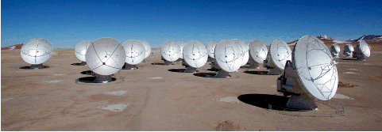
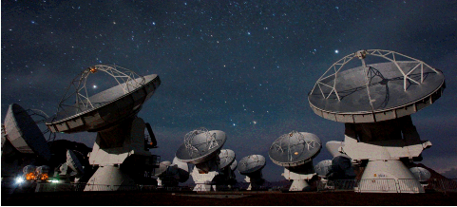
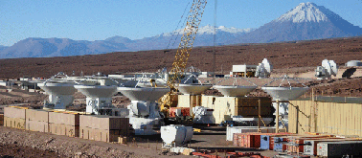
ALMA
Early Science started on 30 September
  Cycle 0 likely to be extended as observing efficiency is low and construction has priority
  Data taken for >30 projects
  First science paper on preprint server
54 antennas now in Chile with 35 accepted; delivery rate is ~2/month
Final North American deliverables (antennas and receivers) on course for ~Sept 2012
  NCE issued for integration of final NA & EU antennas and receivers
Inauguration in March 2013
Notes:
Early Science execution stats and antenna deliveries as of mid-January.

Slide 4

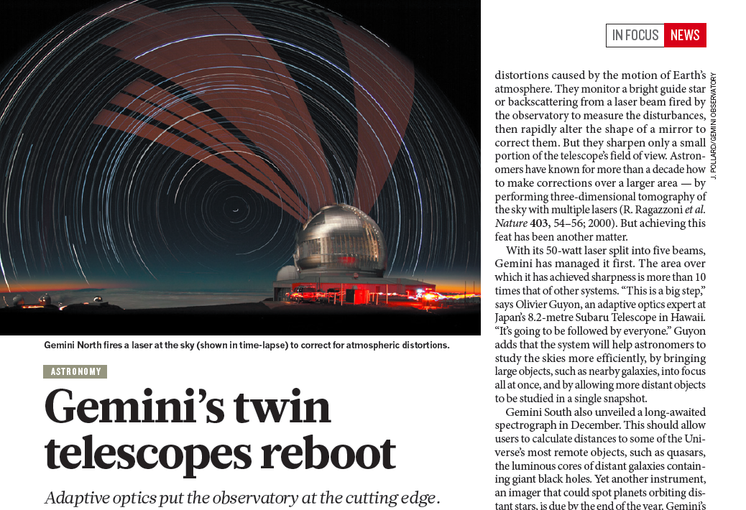
Gemini Instrument Progress
Multi-conjugate Adaptive Optics and laser constellation

Slide 5
More on Facilities
EVLA re-named Karl G. Jansky VLA, dedication in March 2012, completion at end of 2012
Gemini status and progress
  Multi-conjugate Adaptive Optics (GEMS), GPI, Flamingos-2+, GMOS CCDs
  US share grows from 50% to 63% in 2013 (UK withdrawal)
Dark Energy Survey at CTIO to begin in late CY 2012
Advanced Technology Solar Telescope (ATST) still awaiting permission to break ground on Haleakala
  Discussions with GEO about home for ATST/NSO
Many upcoming management competitions

Slide 6
Budget Outlook & Astro2010 Status

Slide 7
Budget Macro-Trends, Last 20 Years-I
Several major facilities came on line 1993-2002
  VLBA (1993); GBT (2000); Gemini (1999, 2002)
  Facility ops costs were ~65% of AST budget in 2000-2002
AST budget doubled in 2000-2010 decade
  No new facilities became operational after 2002, so grants programs expanded significantly
    Expanded AAG and ATI budgets/awards dramatically
    Began Astronomy & Astrophysics Postdoctoral Fellowships
    Started PAARE
    Huge mid-scale expansion (SDSS, CBI, NVO, ACT, etc.)
  Initiated TSIP & ReSTAR
  Started D&D for LSST, GSMT, and SKA

Slide 8
Budget Macro-Trends, Last 20 Years-II
NSF astronomy community now supported at a very healthy level
  Attempted to keep research awards on pace with demand
  Facility ops costs were ~53% of AST budget in 2008
  Major facility infrastructure renewal through ARRA
This decade, new major facilities (ALMA, EVLA, ATST) are coming on line
  Simultaneously, budget is stagnant/decreasing
    Increasing pressure on facility O&M costs (up $4M in FY12)
  Facility fraction of AST budget ~56% and headed upward
  Little/no room for starting Astro2010 recommendations

Slide 9
FY 2011 and 2012 NSF Budgets
NSF & AST | NSF R&RA | %/prior yr | AST | %/prior
FY10 Approp. | $5.62B | +9.1% | $246.5M | +8%
FY11 Request | $6.02B | +7.1% | $251.8M | +2%
FY11 Approp. | $5.56B | -0.9% | $236.6M | -4%
FY12 Request | $6.25B | +12.4% | $249.1M | +5%
FY12 Approp. | $5.72B | +2.9% | $234.5M | -1%
Stay tuned for President’s budget REQUEST on 13 February
  Pay attention to spending requests for new NSF initiatives as well as bottom line for AST
  Each of AST FY11/12 approps was $15M below request

Slide 10
Budget Bottom Line—Expectations and Aspirations Cannot be Met
All possible scenarios have 2015 AST purchasing power less than 2010
Committed operating costs for facilities coming on line increase by ~$30M from 2010 to 2015
Cannot cover existing programs and commitments, let alone respond to Astro2010 recommendations
After accounting for inflation, estimated shortfall will be 15-20% of total AST budget of ~$230M by 2015, without considering ANY of the Astro2010 recommendations
Portfolio review is working with these constraints, and report is expected this summer

Slide 11
AST Response to Budget Shortfalls
Planning for constrained budgets since 2010, by forward-funding actions, reducing outyear commitments, and program cuts
  Managed to protect AAG and ATI in FY 2011, but they will be cut in FY 2012
No new mid-scale projects started in FY 2012
Stay tuned for FY 2013
Portfolio Review: see separate presentation

Slide 12
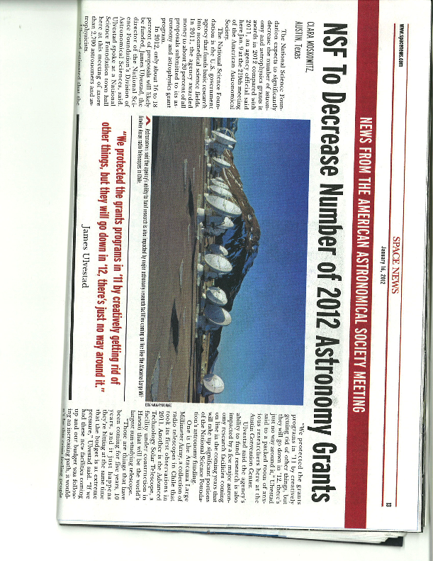
Facilities/Grants Balance

Slide 13
Astro2010 Status
LSST being presented to MREFC panel as part of process to seek permission for a possible FY14 start
  If started in FY 2014, planned date for beginning of operations is October 2021
  BUT, there is little room for FY14 starts in MREFC line
Mid-scale: plan, but no funding
GSMT: solicitation for partner planning, no construction funding until at least 2020, if then
CCAT: D&D funded, no construction wedge available
TSIP: see meta-issues
Gemini: $2M increase in FY 2012 mandated by Congress

Slide 14
Meta-Issues

Slide 15
Community Health: Astronomer “Bubble”?
Replacement rate for faculty and national labs requires training 2-4 PhDs per faculty member over ~30-35 yr career
  In flat-budget scenario, graduating far more PhDs than there are careers in research astronomy
  Most grant funding is from NASA, so NSF can’t solve
See McDaid article in Jan/Feb AAS Newsletter
What is the appropriate NSF response in the facility/mid-scale/grants balance?
  Support older facilities to produce students?
What is the responsibility of the university community in faculty incentives and promotion policies, and in the signals being sent to students?

Slide 16
Mid-scale, TSIP, ReSTAR & Univ. Radio Obs.
Programs with some/many similar objectives
  Telescope access, university instrumentation expertise, mid-scale science
  Can they be combined in some way?
Can university observatories be healthy without long-term federal commitments?
  Differences between OIR and RMS systems?
Astro2010 recommendations assumed operations costs of candidate long-term Mid-Scale Innovations projects were covered
  Examples: BigBOSS (cost of running Mayall 4m), NanoGrav (cost of running Arecibo and GBT), HERA, FASR

Slide 17
Strategic and Tactical Question(s)
Given a highly constrained budget, what do we want US ground-based (and space-based) astronomy to look like in 2020-2025?
  What is the US research community that can be supported?
  How is astronomy research going to be conducted in the US?
    How do we think about “going observing” at a telescope, and what is the role of NSF in continuing to support this interactive capability?
How do we get there?
  For much of this decade, we will be engaged in a transition that is very challenging for the US astronomy community

Slide 18
Backup Slides

Slide 19
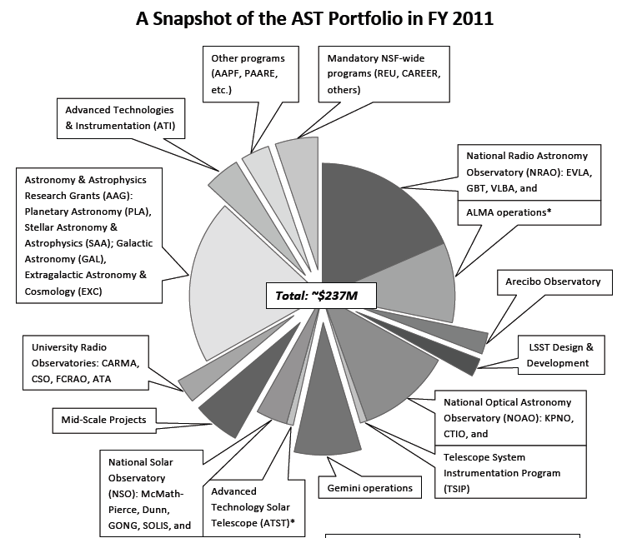

Slide 20
LSST
Passed Preliminary Design Review in Sept. 2011
Now in process of being presented to MREFC panel as part of process to ask for inclusion for a possible FY 2014 new start
  Concerns about details of NSF/DOE MOU, ops funding
If started in FY 2014, planned date for beginning of operations is October 2021
  BUT, previous MREFC reductions mean that there is little/no room for new starts in FY 2014 MREFC line

Slide 21
Midscale Innovations Program (MSIP)
AST has a draft plan for proceeding on MSIP
  However, this plan requires funding, which is not available in a flat-budget scenario
  Further comments in “meta-issues”
CCAT: 3-yr Design & Development funding (combined with private funding) intended to bring CCAT to near construction readiness
  No wedge apparent for construction funding at that point

Slide 22
Giant Segmented Mirror Telescope
Solicitation issued December 30, 2011, entitled “Partnership Planning for a Giant Segmented Mirror Telescope”
  $0.25M/yr for 5 yr, for planning for the possibility of an eventual public/private GSMT partnership
  Includes constraint that no federal funding for construction or operations is possible until after 2020
  No commitment to eventual funding is made or implied by this solicitation, and explicit acknowledgement of the Astro2010 priorities is included

Slide 23
“Small”/Other Recommendations
Increases in general (AAG) and instrumentation (ATI) grants programs not possible unless/until portfolio review recommends substantial facility divestment
TSIP: see meta-issues
Gemini: $2M increase in FY 2012 mandated by Congress, but no additional shares available
Theory & Computation Network: separate talk
Gemini/NOAO consolidation: highly unlikely due to perceived difficulty of conducting real competition
CAA/DSIAC: proposal under review

