Slide 1

OFFICE OF SCIENCE
Office of High Energy Physics (HEP)
Report to the AAAC
11 May 2012
Kathleen Turner
Office of High Energy Physics (HEP)
Office of Science (SC), U.S. Department of Energy (DOE)

Slide 2
High Energy Physics Budget
(dollars in thousands)
Description | FY 2010 Actual | FY 2011 Actual | FY 2012 Approp | FY 2013 Request | FY 2013 vs FY 2012
Proton Accelerator-Based Physics | 438,369 | 438,855 | 421,594 | 411,532 | -10,062
Electron Accelerator-Based Physics | 30,212 | 24,454 | 23,025 | 29,146 | +6,121
Non-Accelerator Physics | 97,469 | 90,067 | 84,062 | 97,425 | +13,363
Theoretical Physics | 68,414 | 68,050 | 66,850 | 68,522 | +1,672
Advanced Technology R&D | 156,347 | 154,152 | 167,329 | 149,896 | -17,433
Construction (Line Item) | 0 | 0 | 28,000 | 20,000 | -8,000
Total, High Energy Physics | 790,811 | 775,578 | 790,860 | 776,521 | -14,339
Office of Science | 4,964,040 | 4,857,665 | 4,873,634 | 5,001,156 | +127,522
Notes:
The Non-accelerator Physics subprogram includes all of the Cosmic Frontier and the non-accelerator part of the Intensity Frontier experimental research, operations, R&D, small experiment fabrication and MIE fabrication projects. The Theoretical Physics subprogram includes Cosmic Frontier theoretical research.
The FY12 & FY13 budgets includes SBIR/STTR of approximately $20M, which has already been removed from FY10 and FY11 Actuals. Therefore the real FY12 and FY13 amounts are a reduction of approximately $5M and $19M relative to FY 2011.
The FY 2012 appropriation is reduced by $840,000 for the High Energy Physics share of the DOE-wide $73,300,000 rescission for contractor pay freeze savings. The FY 2013 budget request reflects the FY 2013 impact of the contractor pay freeze.

Slide 3
Major Changes & Issues in FY2013
Support for ILC R&D efforts ends
  5 year R&D plan successfully completed; no project on near horizon
  Plan to continue involvement with international planning at very low level
LBNE construction not included in FY 2013 budget request
  Office of Science Director (Bill Brinkman) notified Fermilab in March that DOE cannot support LBNE in its current design - due to cost.
  Brinkman asked Fermilab to investigate alternative, staged approach, with science results at each stage
  Fermilab is leading these studies and will report in July
Homestake mine
  In the President’s request, the Homestake mine dewatering effort is maintained to support early science (LUX and Majorana Demonstrator)
  -- Senate markup has recommended increased support
Lack of new facilities for science threatens the future of the program
  To exert leadership we need not only to fully exploit current research infrastructure but also to develop new facilities and infrastructure.
  Opportunities at the Cosmic Frontier:
    LSSTcam – FY13 request for approval of MIE fabrication start
    Dark Matter detection – FY13 request includes increase in R&D funding to support DM-G2 efforts

Slide 4
Cosmic Frontier Budget
Cosmic Frontier Funding (in $K) | FY10 actual | FY11 actual | FY12 current | FY13 request
Research | 55161 | 57112 | 54347 | 52771
Grants Research | 11674 | 11975 | 12110 | 12551
Lab Research | 34145 | 36091 | 34610 | 34855
Exp Ops & Commissioning | 9342 | 9046 | 7627 | 5365
Projects | 20155 | 17652 | 14000 | 26463
MIE – DES | 8610 | 4000
MIE - SuperCDMS Soudan | 1500
MIE - LSST |  | 1900 | 5500 | 10000
MIE - HAWC |  |  | 1500 | 1500
Small fabrication + R&D | 10045 | 11752 | 7000 | 14963
TOTAL | 75316 | 74764 | 68347 | 79234
FY12: There is a decrease in project funding as DES and SuperCDMS-Soudan complete.
LSST and HAWC become MIE’s in FY12: HAWC starts fabrication; LSST still in R&D
FY13: Requesting fabrication-start approval for LSST and funding starts to ramp up. Funds provided for Dark Matter R&D (solicitation for Generation-2 experiments out soon)

Slide 5
High Energy Physics Community - Program Planning
The APS Division of Particles and Fields has initiated a long-term planning assessment of High Energy Physics. →following taken from the DPF email on 5/3/12
The long-term planning exercise is anchored by two meetings:
* A Community Planning Meeting (CPM2012), at Fermilab, October 11-13, 2012,
* A Community Summer Study (CSS2013), at Snowmass, June 2-22, 2013.
Ten prominent members of the community have kindly agreed to serve as conveners representing:
* Energy Frontier: Raymond Brock (Michigan State U), Michael Peskin (SLAC)
* Intensity Frontier: JoAnne Hewett (SLAC), Harry Weerts (Argonne)
* Cosmic Frontier: Jonathan Feng (UC Irvine), Steve Ritz (UC Santa Cruz)
* Instrumentation: Marcel Demarteau (Argonne), Howard Nicholson (Mt. Holyoke)
* Facilities: William Barletta (MIT), Murdock Gilchriese (LBNL)
The next step is for the coveners to setup subgroups – will be done by end of June.
Send in suggestions (subgroup topics, sub-convener names, interactions between frontiers, ...)
Participation from the high-energy physics community, and from members of our sister APS divisions, DAP, DPB, and DNP, are essential for success.
→We anticipate that this long-term planning process will trigger an independent process of review and prioritization solicited by the funding agencies.
The DOE-HEP Cosmic Frontier program managers (Kathy Turner, Michael Salamon) and NSF-PHY have already has had 1st phone call with Feng/Ritz and plan continued coordination of efforts.

Slide 6
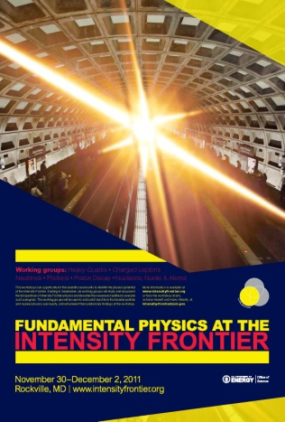
Current/Recent Agency efforts will feed into DPF process
Intensity Frontier - Intensity Frontier community workshop held in Dec. 2011
to develop the science case and identify opportunities for the program – report out soon
HEP Intensity Frontier Implementation Plan – summer 2012; will feed into DPF process
Cosmic Frontier
Dark Matter
HEP planning a coordinated strategy for dark matter research
→Need information on coordination and complementarity of different methods of dark matter particle detection: direct detection, axions, indirect using gamma-ray experiments, LHC
Planning a community workshop ~ Nov. 2012; announcement coming
This will be done under the leadership of DPF & will fold into the overall community planning at Snowmass in summer 2013
Dark Energy
HEP will pro-actively develop a balanced, robust dark energy program
start with development of coordinated science program, including science reach of our current experiments (LSST included) and possible areas for the future
then can describe near term and low cost options to move forward using multiple methods
investigate facilities/options/partnerships for doing the experiments
We are setting up a small task force to write a white paper on the science case and reach of our current experiments, with possibilities areas to investigate going forward – will feed into DPF process.

Slide 7
Direct-Detection Dark Matter program
Dark Matter Generation 2 (DM-G2) experiments (in coordination w/NSF)
~10x greater sensitivity than G1
Most if not all of the above G1 collaborations are planning G2 versions
Technology choices will need to be made; we can’t fund all current collaboration for next phase
DOE DM-G2 process:
Solicitation for FY13 R&D for G2 experiments has been announced
  proposals due early July
  review ~ Aug/Sept
We anticipate further selection after this phase and then project fabrication start no earlier than FY14
DM-G3 experiments (also global coordination expected)
G3 R&D and planning continues at a low level

Slide 8
Dark Energy Program
  Current program:
  BOSS, DES, supernova surveys
  Current low-level research efforts (no current plan for participation in the projects)
  WFIRST NASA Science Definition Team – several scientists participating
  ESA Euclid space mission – scientists from several DOE labs have joined the Science Collaboration
  - LBNL group was asked to join in exchange for their help in mission design
  LSST is the priority for the next HEP dark energy project to be developed – see later talk
  Future experimental possibilities:
  BigBOSS – LBNL is leading a collaboration scientists in science planning and technical R&D; current plan is to provide instrumentation for survey on Mayall at Kitt Peak
  - successful December 2011 science/R&D review; now investigating options for facility access
  - Other options: ground supernova surveys, BOSS-upgrade, spectroscopic survey in the south, etc

Slide 9
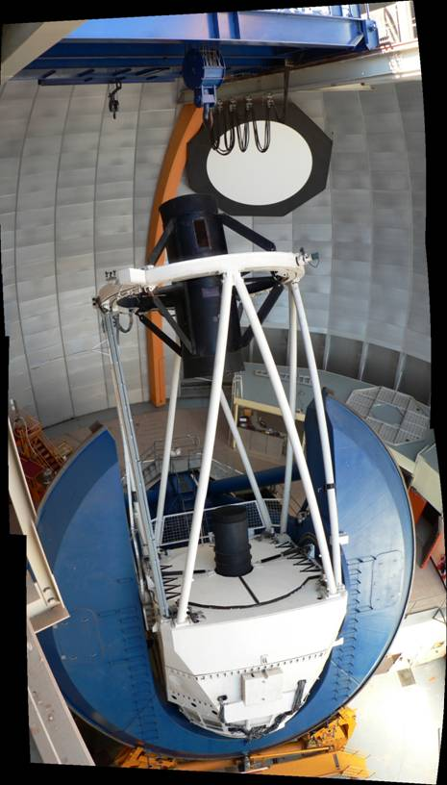
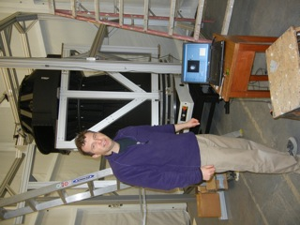
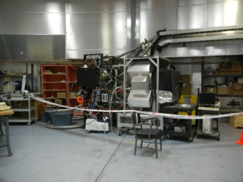
Dark Energy Survey (DES)
  DOE-HEP – responsible for Dark Energy Camera (DECam) fabrication
  NSF Astronomy (NSF-AST) – telescope facility (CTIO in Chile) and data management system (DESDM)
  Status: DECam and all associated instrumentation has been delivered to Chile
  Now working in integration, commissioning, installation
  Start 5 year operations late FY 2012
  Methods will be weak lensing, galaxy clusters, supernovae, large scale structure including BAO
  HEP held an external review of pre-operations status/planning on May 2-3; the 3 labs and project are preparing responses.
DES - Peter Doel and the fully assembled corrector on the rotary table for the alignment check
DES Imager in Coude room in Blanco Dome

Slide 10
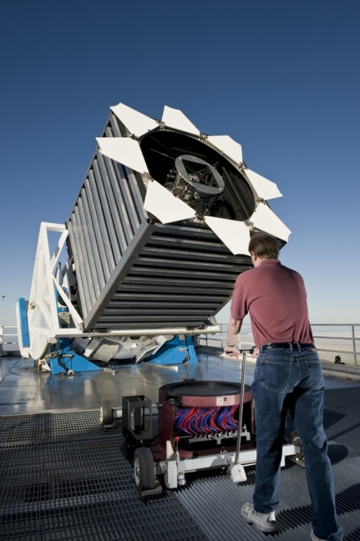
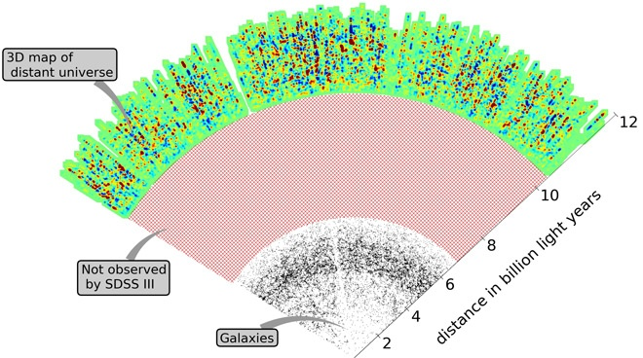
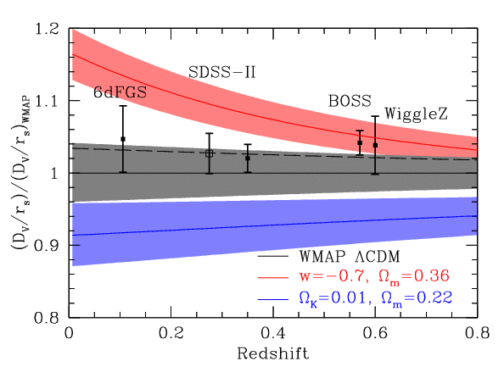
Baryon Oscillation Spectroscopic Survey (BOSS) on SDSS-III
  Partnership: DOE, NSF-AST, Sloan Foundation
  DOE-HEP supported the upgrade of instrumentation & participates in data-taking operations and analysis, which continues through FY 2014
March 2012: Definitive detection of BAO Peak at 6.7 sigma
SDSS-II at z=0.35
BOSS at z=0.57
BOSS - Has shown that they can use quasars to explore large scale structure at high z

Slide 11
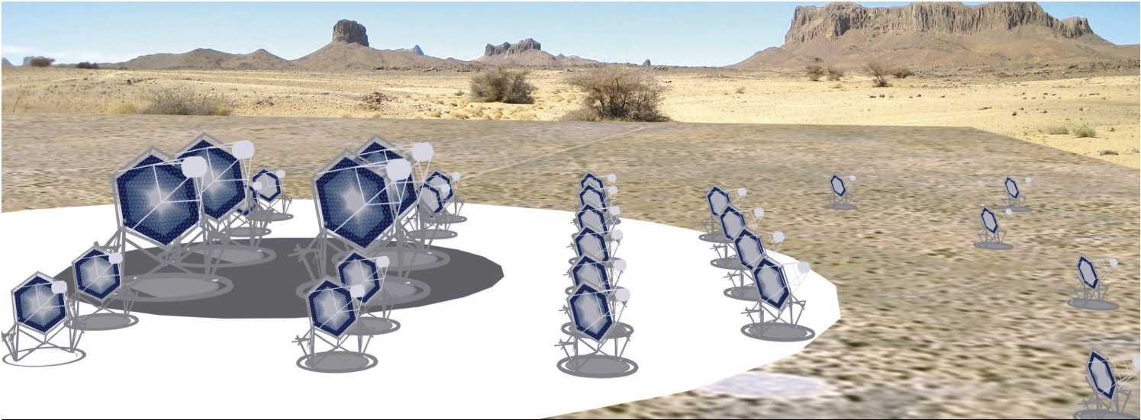
High Energy Cosmic-ray, Gamma-ray program
  Current efforts: Auger, VERITAS, AMS, FGST – all continue operations
FGST -- NASA Senior Review: “Fermi operations are extended through FY16, with a 10 percent per year reduction starting in FY14. All FY15-FY16 decisions are for planning purposes and will be revisited in the 2014 Senior Review”
HEP plans continued support the Instrument Science Operations Center (ISOC) at SLAC through at least FY 2014; will revisit further operations
  Future possibilities: Cherenkov Telescope Array (CTA)
  Next generation gamma-ray experiment
  Proposed HEP-related science: indirect detection of dark matter & Lorentz-invariance tests
  US-collaboration submitted proposal for R&D program leading to fabrication with several possible contributions: 36 mid-size telescopes, electronics, focal plane for dark matter science
  FY12: science studies and low-level R&D; collaboration also investigating other options for different levels of contribution and at different stages
11

Slide 12
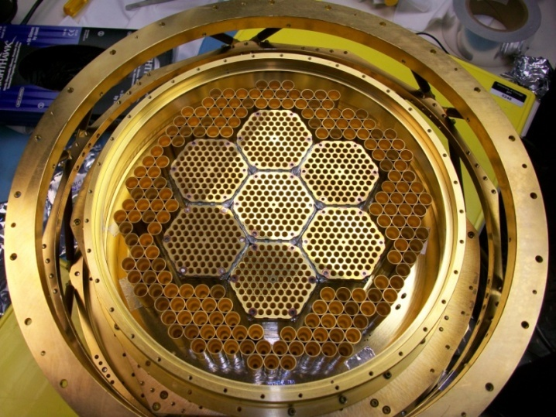
CMB – South Pole Telescope
The HEP program has contributed instrumentation and is supporting scientists to work on
SPTpol – CMB polarization measurements
- First light in Jan. 2012)
- Related science: Inflation, neutrinos, dark energy w/DES
The inner 7 hex-shaped modules in the150 GHz array were made by NIST
Outer 100 GHz array was contributed by Argonne National Lab (ANL)
- Every detector has its own individual horn, which couples light to two detectors, each sensitive to two different types of polarization.
Expecting proposal for future upgrade:
collaboration wants to increase # pixels, and utilize
superconducting microstrip detectors

Slide 13
Cosmic Frontier - Recent Activities
Cosmic Frontier - Program Management
    Oversight of Fabrication Projects & Operating Experiments:
    Interagency Joint Oversight Groups (JOG) – have regular phone calls or meetings between agencies and with project teams to discuss status and issues
    ➔ Have official JOG for DES, VERITAS, LSST
    Review of Operating Experiments:
    ~ August/September 2012 – starting bi-annual panel review of operating experiments
    Review status of operations, budget, data-processing, etc.
    Review science status and plans for the future
    For experiments that don’t already have an agreed-upon operations phase, we will use this as an opportunity to set the schedule.
13

