Slide 1

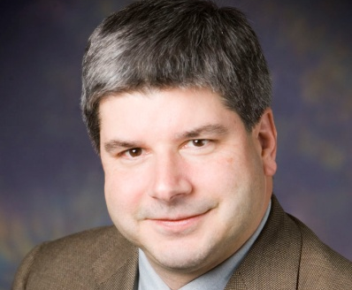
CISE DISTINGUISHED LECTURE SERIES
Wednesday, February 15 at 10am in Rm. 110
Making Sound Design Decisions using Quantitative Security Metrics
Prof. William H. Sanders
University of Illinois at Urbana-Champaign
Making sound security decisions when designing, operating, and maintaining a complex system, such as the power grid cyber infrastructure, is a challenging task. Analysts need to be able to understand and predict how different factors affect the overall system security. To provide insight on system security and aid decision-makers, we propose the ADversary VIew Security Evaluation (ADVISE) method to quantitatively evaluate the strength of a system's security. Our approach is to create an executable state-based security model of a system.
This talk describes the system and adversary characterization data that are collected as input for the executable model. It also describes the simulation algorithms for adversary attack behavior and the computation for the probability that an attack attempt is successful. A power grid distribution-side case study illustrates how to analyze system security using the ADVISE method. A tool is currently under development to facilitate automatic model generation and simulation. The ADVISE method aggregates security-relevant information about a system and its adversaries to produce a quantitative security analysis useful for holistic system security decisions.
William H. Sanders is a Donald Biggar Willett Professor of Engineering and the Director of the Coordinated Science Laboratory at the University of Illinois at Urbana-Champaign. He is a Fellow of the IEEE and the ACM, a past Chair of the IEEE Technical Committee on Fault-Tolerant Computing, and past Vice-Chair of the IFIP Working Group 10.4 on Dependable Computing. Dr. Sanders's research interests include secure and dependable computing and security and dependability metrics and evaluation, with a focus on critical infrastructures. He is currently the Director and PI of the DOE/DHS Trustworthy Cyber Infra-structure for the Power Grid (TCIPG) Center. He is also a member of the NIST Smart Grid Advisory Committee.
Talk held at 4201 Wilson Blvd. Questions: Contact Cynthia Jackson at cjackson@nsf.gov

