Slide 1
Plutonium-238 for Solar System Exploration Status
Leonard A. Dudzinski
Program Executive NASA Headquarters, Washington, DC
Presentation to
NASA Astronomy and Astrophysics Advisory Committee
November 30, 2012

Slide 2
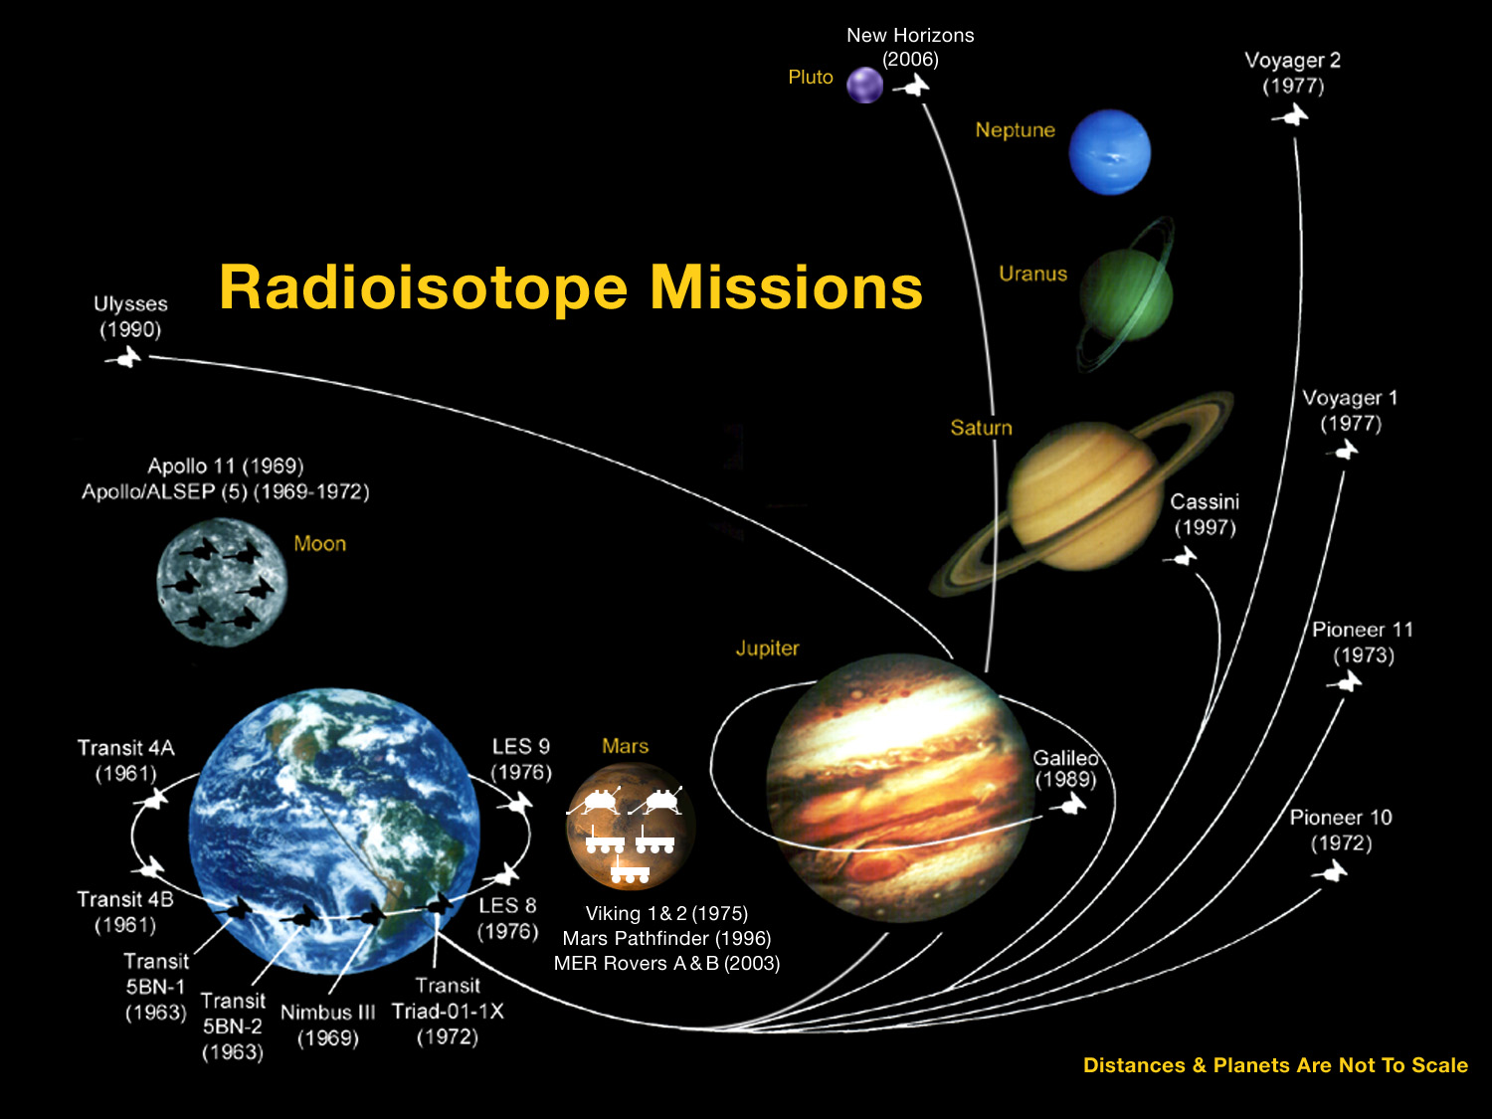

51 years and counting…
46 RTGs were used safely in 27 missions since 1961
10 Earth orbit missions (Transit, Nimbus, LES)
8 planetary missions(Pioneer, Voyager, Galileo, Ulysses, Cassini, New Horizons)
6 on lunar surface missions (Apollo ALSEP)
3 on Mars surface missions (Viking 1 & 2, MSL Curiosity)
300 RHUs were used safely in 10 missions since 1969
6 planetary missions(Pioneer 10 & 11, Voyager 1 & 2, Galileo, Cassini)
1 on lunar surface missions (Apollo 11)
3 on Mars surface missions (Pathfinder, MER A & B)
MSL Curiosity (2011)

Slide 3
NASA Radioisotope Power Systems Program Program Goal
Ensure the availability of power for the exploration of the solar system in environments where conventional solar or chemical power generation is impractical or impossible.
The targeted mission sets are in the Flagship, New Frontiers, Mars, and Discovery Programs
Program can support all NASA missions
The HQ RPS Program Executive is the NASA lead for ensuring the supply of Plutonium-238 to NASA missions

Slide 4
Radioisotope Power System Applications in Near Term Planetary Missions
Evolving SMD RPS Mission Planning Set post Decadal Survey
 | Projected Launch Year | Power Reqmnt (W_{e}) | RPS Type (Flight + Spare) | Pu-238 Availability
Mars Science Lab | 2011 | 100 | 1 MMRTG
Juno (New Frontiers 2) | 2011 | No RPS Requirement
Discovery 12 | 2016 - 17 | 200 - 300 | 2 ASRG
Osiris-REX (NF3) | 2016 | Directed non-RPS
Solar Probe | 2019 | Directed non-RPS
Mars 2018 (TBD)† | 2018 | 100 - 150 | 1 ASRG or MMRTG*+Spr
Discovery 13 | 2020 - 21 | 200 - 300 | 2 ASRG
Mars 2020 (TBD)† | 2020 | 100 - 150 | 1 ASRG or MMRTG*+Spr
New Frontiers 4 | 2022 - 23 | 300 - 500 | 4 ASRG + Spare
Discovery 14 | 2024 - 25 | 200 - 300 | 2 ASRG
Europa or Uranus or Other† | 2020 - 25 | 500 - 1000 | 4 ASRG or MMRTG + Spr
New Frontiers 5 | 2028 - 29 | 300 - 500 | 4 ASRG + Spare
Large Directed
Mars
New Frontiers
Lunar
Discovery
Other
Operational
On its way
Not Selected
In Development
In Development
In Discussion
In Discussion
† If funded
6 year-cadence New Frontier mission opportunities would likely require 500 W_{e} RPS
Every Discovery mission opportunity will have an RPS option
Radioisotope heater units may be required on these and other missions
Other science, exploration, and demo missions not yet identified may also require RPS

Slide 5

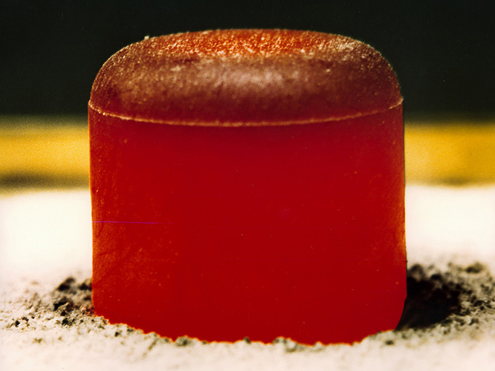
Bottom Line
²³⁸Pu is essential for space exploration
“Unless and until a new source of Pu-238 is established, the restricted supply Pu-238 will increasingly limit both the quality and quantity of U.S. space science in many mission areas, and continued U.S. leadership in these areas will be at risk”
National Research Council report: “Radioisotope Power Systems: An Imperative for Maintaining U.S. Leadership in Space Exploration”, 2009
HFIR fuel core at ORNL

Slide 6
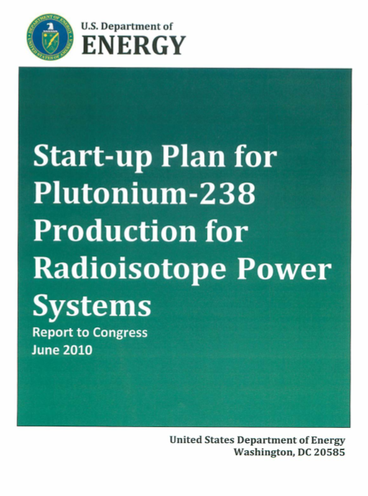
Pu-238 Domestic Production Status
NASA Authorization Act of 2010 authorized NASA to fund DOE efforts in Pu-238 Production under a reimbursable agreement.
DOE has begun a multi-phase Plutonium-238 Supply Project consistent with the published Start-up Plan to achieve full-scale production late in the decade.
Phase I efforts to be completed by December 2012.
Project planning, NEPA assessment, analysis of project alternatives, cost and schedule estimate
Technology demonstration efforts will achieve by the end of 2013:
A qualified neptunium-237 target for irradiation in the High Flux Isotope Reactor (target currently in reactor)
A qualified process for post-irradiation target processing
A qualified Pu-238 product
A project plan for scale-up to full-scale production at 1.5-2.0 kg/year
PPBE FY15 will take into account NASA fully funding Pu-238 production

Slide 7
Plutonium Supply Project
Presentation by DOE

