Slide 1

OFFICE OF SCIENCE
Office of High Energy Physics (HEP) Program Status
AAAC Meeting
November 30 – December 1, 2012
Kathleen Turner
Office of High Energy Physics
Office of Science, U.S. Department of Energy
Cosmic Frontier program managers: Michael Salamon, Jim Stone, Kathleen Turner

Slide 2
HEP Program
Intro
Budget & Planning
Execution & Guidance
Frontier status
Cosmic Frontier
Guidance
Considerations & Model
Status & Plans
Budget
Reviews
Going Forward

Slide 3
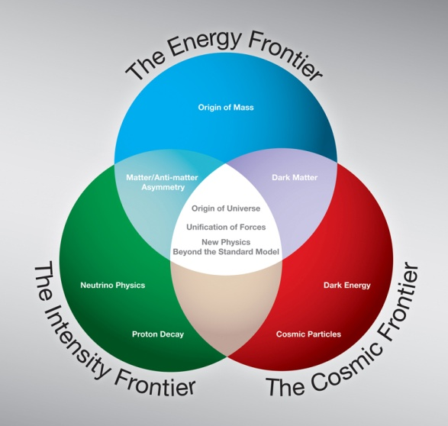
HEP Strategic Plan (based on 2008 P5 report)
The High Energy Physics program’s mission is to understand how our universe works at its most fundamental level. To enable discoveries, HEP supports
  theoretical and experimental research in both elementary particle physics
  and fundamental accelerator science and technology.
Progress in achieving the mission goals requires advancements at the
  Energy, Intensity and Cosmic Frontiers
  The U.S. should have a strong, integrated research program at all three frontiers.
  At lower funding levels, cannot maintain leadership at all 3 frontiers
HEP at its core is an accelerator-based experimental science.
  Support accelerator and detector R&D to develop new technologies
    that are needed by the field
    that benefit the nation

Slide 4
HEP Program
Experiment
Theory
Simulation
The Energy Frontier
Origins of Mass
Matter/Anti-matter
Asymmetry
Dark matter
Neutrino Physics
Proton Decay
The Intensity
Frontier
Dark energy
Cosmic Particles
The Cosmic
Frontier
Origin of Universe
Unification of Forces
New Physics
Beyond the Standard Model
Along Three Paths
Accelerators
Detectors
Computing
Physics Frontiers
  Enabled by
  Advanced Technologies

Slide 5
HEP Program Model
DOE Office of Science: We are a science mission agency
Provide science leadership and support to enable significant advances in specific science areas
Lab environment with a variety of resources needed to design, build, operate facilities/projects selected for the Program
Lab infrastructure, including computing facilities (NERSC, SCiDAC program etc)
Encourage scientific teams/collaborations with expertise in required areas to participate in all phases, leading to the science results.
Partnerships as needed to leverage additional science and expertise
Include speculative science (e.g. led to dark energy discovery)
Energy & Intensity Frontier: Design, build, operate facilities to do experiments
Cosmic Frontier: We do experiments! Design and build instrumentation & bring other resources (e.g. computing), operations, research activities; use other agency’s facilities (e.g. telescopes) when needed.
Model has been very successful:
See http://science.energy.gov/about/honors-and-awards/doe-nobel-laureates/
5

Slide 6
High Energy Physics Budget
(dollars in thousands)
Description | FY 2012 Budget Authority | FY 2013 Request | FY 2013 vs FY 2012
Energy Frontier | 159,997 | 160,736 | -739
Intensity Frontier | 283,675 | 280,743 | +2,932
Cosmic Frontier | 71,940 | 84,946 | -13,006
Theoretical Physics | 66,965 | 65,018 | +1,947
Advanced Technology R&D | 157,106 | 141,588 | +15,518
Accelerator Stewardship | 2,850 | 2,900 | -50
SBIR/STTR | 20,327 | 20,590 | -263
Construction (Line Item) | 28,000 | 20,000 | -8,000
Total, High Energy Physics | 790,860 | 776,521 | -14,339
Office of Science | 4,873,634 | 5,001,156 | +127,522

Slide 7
Budget details
Lack of new facilities for science threatens the future of the program
→ Need to fully exploit current research efforts but also develop new facilities and experiments to maintain a healthy & leadership program.

Slide 8
HEP – going forward
New investments are needed to continue US leadership in well defined research areas.
Possibilities for future funding growth are weak. Must make do with what we have.
Research funding will decrease at ~2% a year for the next several years to increase the fraction of the HEP budget for new projects.
Going Forward it is important that we:
- Increase the fraction of the HEP budget for new projects.
- Have a balanced program with staged implementation and science
Recently finished projects - Critical Decision 4 (CD-4) approved
  Daya Bay, Dark Energy Survey, and FACET - fabrication complete
  BELLA – will complete soon
New opportunities:
    LSST camera – FY13 budget requests Major Item of Equipment (MIE) fabrication start
Five new MIE’s received CD-0 “Mission Need” approval in September 2012
-- all are $20M-40M range
  Energy Frontier: ATLAS Detector Upgrade; CMS Detector Upgrade
  Intensity Frontier: New Muon g−2 Experiment
  Cosmic Frontier: Second-generation Dark Matter Experiments (DM-G2) & Midscale Dark Energy Spectroscopic Instrument (DESI)

Slide 9
Program Guidance & Input
  FACA panels – official advice:
  High Energy Physics Advisory Panel (HEPAP)
    – reports to DOE and NSF; provides the primary advice for the program
  Astronomy and Astrophysics Advisory Committee (AAAC)
    – reports to NASA, NSF and DOE on areas of overlap
  Other:
  The APS Division of Particles and Fields (DPF) has started a community-led science planning process to help develop science plans for all the Frontiers in the next year.
  -- Lay out current strengths, capabilities & opportunities for the science program
  -- Community meetings ongoing; “Snowmass” summer study in Minneapolis July/August
  -- See http://www.snowmass2013.org -- all inputs are welcome!
  National Academies of Sciences
  Example: Astro2010 (August 2010)
  Specific studies:
  Example: Dark Energy science group - Science case for a HEP dark energy program developed by a task force at HEP request (Rocky Kolb, chair). This was seen as a good model for the different science areas.
9

Slide 10
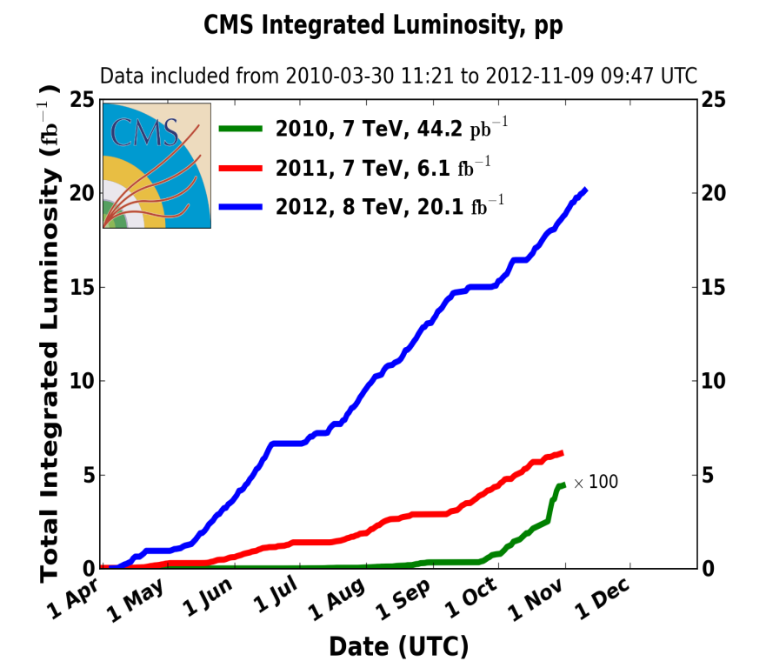
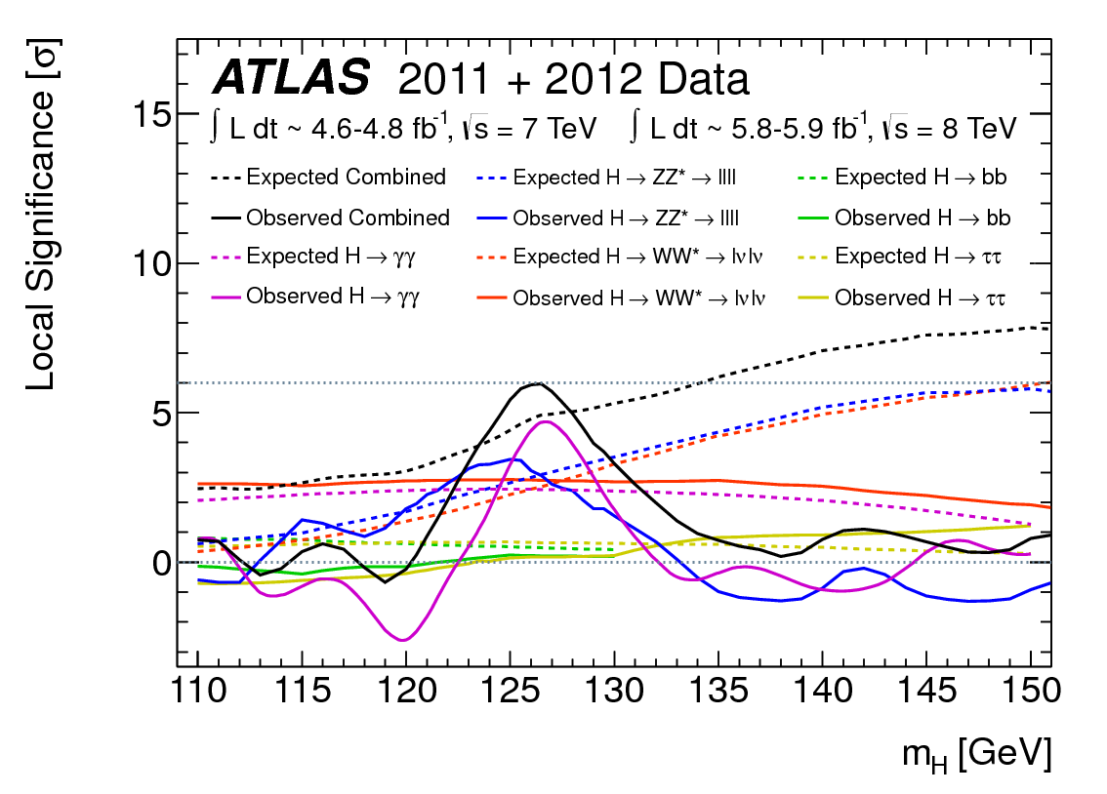
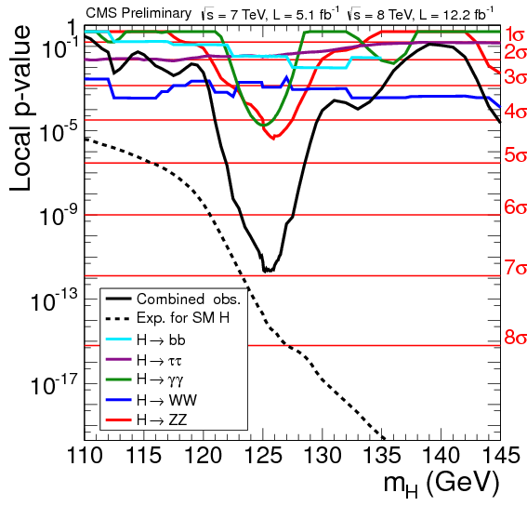
Energy Frontier Status
Projected by end-2012: ~25 fb⁻¹ per CMS & ATLAS
Fermilab Tevatron (DØ and CDF)
Operations ended at the end-of-FY11
Large Hadron Collider (LHC) at CERN
DOE made significant contributions to the accelerator and detectors (ATLAS and CMS)
LHC will shutdown during 2013-2014 for “Phase-0” improvements: maintenance, detector consolidation and upgrades
Working with experiments to develop plan for contributions to “Phase-1” upgrades (scheduled in 2018)
Major Results:
A Higgs Boson-like particle has been observed at CERN by both experiments
in several decay modes
Mass ~ 126 GeV/c² with > 5 σ signals
Experiments are now shifting from a search-based to a measurement-based Higgs program to address if particle is consistent with Standard Model Higgs
ATLAS Observed Result
(July 2012)
CMS Observed Result
(as of HCP 2012)

Slide 11
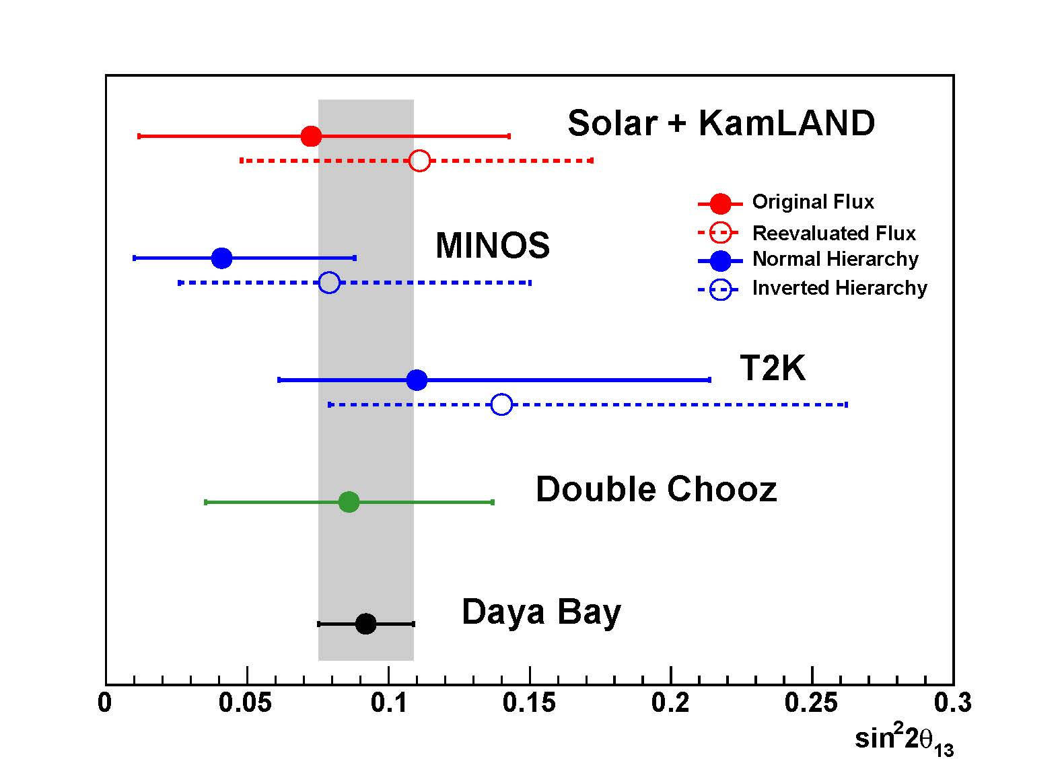
Intensity Frontier Status
Current program: Minerva, Nova, T2K, MicroBoone, Daya Bay, EXO-200
-- Nova and MicroBoone will complete construction in FY 2014
Planned program of major projects --- construction not approved yet
  Belle-II (CD-1 approved)
  Mu2e to explore charged lepton mixing (CD-1 approved July)
  LBNE to make definitive measurements of neutrino properties (CD-1 being planned)
      10 kton liquid argon detector on the surface at Homestake
      New neutrino beamline at Fermilab
      Provides the foundation for a long-term world-leading neutrino program
  Muon g-2 conceptual design
Recent Major Results:
Daya Bay reactor neutrino experiment definitively shows that the unmeasured neutrino mixing is large (of order 10%); very valuable info for LBNE redesign

Slide 12
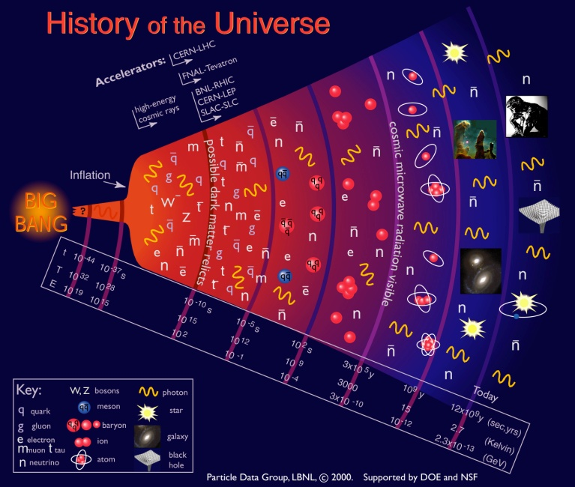
Cosmic Frontier

Slide 13
Cosmic Frontier – Guidance & Planning
  FACA panels – official advice to the Government:
  HEPAP
  Astronomy and Astrophysics Advisory Committee (AAAC)
  FACA subpanels provide targeted advice →
  For the Cosmic Frontier, we are following HEPAP’s Particle Astrophysics Science Assessment Group (PASAG) 2009 report:
  - Recommended an optimized program over the next 10 years in 4 funding scenarios
  - Dark matter & dark energy remain highest priorities; don’t zero out everything else
  Prioritization Criteria - Make contributions to select, high impact experiments:
  That directly address HEP science goals
  That will make a visible or leadership contribution
  With HEP community contributions: instrumentation, collaborations, analysis techniques etc.
  Other input:
  Astro2010 – National Academies “Decadal Survey” of Astronomy/Astrophysics, New World New Horizons (2010 report)
  We consider the recommendations to DOE for their scientific value & options for our program --
    Large projects - LSST was recommended as priority for DOE because role is critical
    2nd priority ground based - contributions to NSF mid-scale experiments
    4th priority ground based - contribute (w/NSF) as a minor partner to European-led CTA
13

Slide 14
Cosmic Frontier – Program Model
Science Mission-driven – We develop and support a specific portfolio of projects
At the Cosmic Frontier, the emphasis is on doing experiments and getting results
using PASAG criteria
partnerships or use other agency’s facilities when needed (e.g. we don’t build telescopes)
Model is to make significant contributions to facilities/experiments selected for the program & support a science collaboration to carry it the experiment and provide the science results.
Facilities: Many Cosmic Frontier experiments use facilities which have a much broader science program than the interests of HEP program → we make project contributions at an appropriate level & support research efforts for our science interests.
Interagency projects: Partnerships between agencies and other offices within agencies can provide necessary or additional resources leading to opportunities for increased science.
While all government agencies follow the same rules, there are differences in the details which need to be taken into account to ensure data and science analysis return
Processes for planning/deciding on projects, managing/funding projects, funding research, etc
HEP emphasis on collaboration for coordinated science planning & analysis.
14

Slide 15
Cosmic Frontier – Research Model
PASAG Criteria can also be applied to research efforts on projects in the program:
Effort will significantly advance HEP science goals
Researchers will make significant/visible/leadership impact & contributions
In practice, we typically support teams/collaborations of scientists with the necessary expertise and responsibilities to take experiments from design to data analysis.
-- Science planning is expected throughout all phases to end up with coordinated data analysis by a collaboration (1 precision result rather than 100 independent results)
Peer reviews and program planning reflect these traditions. Consider:
Is the activity in direct support of our science/experiment and priorities?
For experiments with broad science program, what efforts are needed to support our science interests?
What are the priority efforts needed now for a particular experiment?
What are the commitments and responsibilities of the researcher (% of their time on the effort)?
Typically, HEP-supported researchers make long term commitments to our experiment/science – he/she has specific commitments to our projects/experiments that may include analyzing data with one experiment while planning the next one.
Need to make sure that projects in our program are adequately supported before supporting or adding to research efforts for other programs.
15

Slide 16

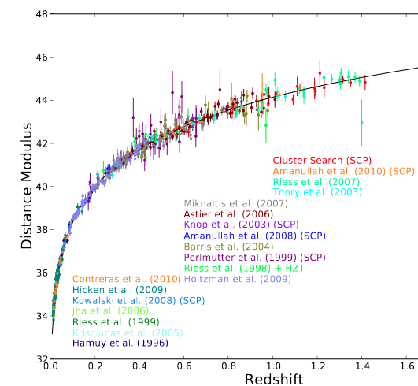
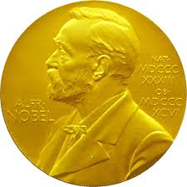
Cosmic Frontier – Program Status & Plans
Program “thrusts”
  Discover (or rule out) the particle(s) that make up Dark Matter
  Advance understanding of the physics of Dark Energy
  Understanding the high energy universe: Cosmic-rays, Gamma-rays
  Other efforts
  2011 Nobel Prize awarded for the measurement of the acceleration of the Universe: Perlmutter, Schmidt, and Riess.

Slide 17
Dark Energy
  ➔Balanced, staged program of experiments w/ all methods: supernovae, BAO, galaxy clustering, weak lensing, etc.
  Current Experiments
  Analysis of current data sets (mainly SDSS-II)
  – research efforts continue to inform future planning
  Supernova surveys: Supernova Cosmology Project, Nearby Supernova Factory, Palomar Transient Factory, QUEST – operations continue
  BOSS (on SDSS-III)
  Dark Energy Survey (DES)
  Science effort, but no “project” plans:
  WFIRST NASA Science Definition Team – several scientists participating
  Euclid (ESA/NASA) space mission – several HEP-funded scientists have joined or are proposing to join the science collaboration

Slide 18
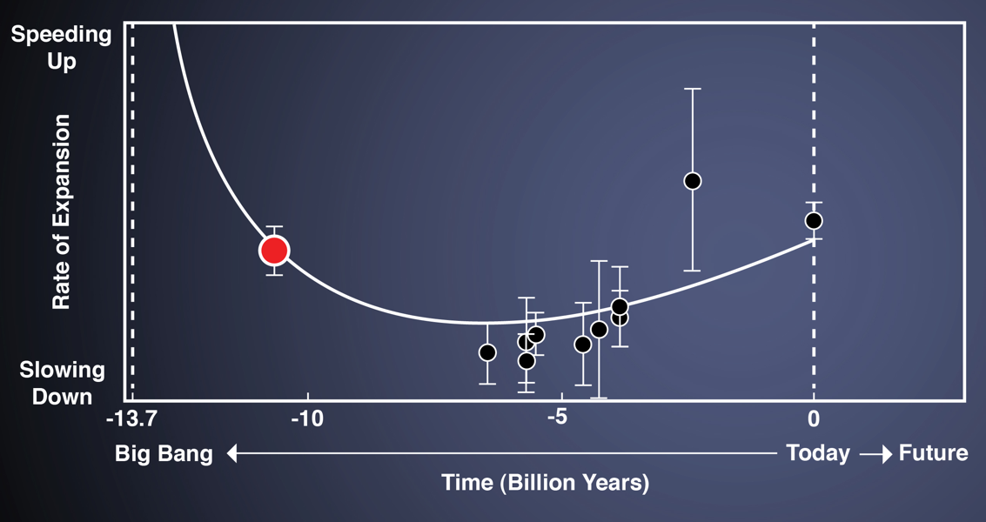
Baryon Oscillation Spectroscopic Survey (BOSS)
BOSS mapping 3-D positions of 1.5 million galaxies + line-of-sight to 160,000 quasars using the Lyman-alpha forest.
5-year survey of 10,000 deg2 completes in 2014; all data made public in a freely-available, user-friendly database.
Funded by DOE, NSF, the Sloan Foundation, and contributions private and foreign institutions.
SDSS-II at z=0.35
BOSS at z=0.57
BAO from BOSS Lyman-alpha forest
BAO from
BOSS galaxies
April 2012: 1.7% distance measure at z=0.55 consistent with Einstein’s Λ
- Supersedes all previous BAO results combined
Nov 2012: 3% distance measure at z=2.3 from newly-demonstrated Lyman-alpha technique from distant quasars

Slide 19
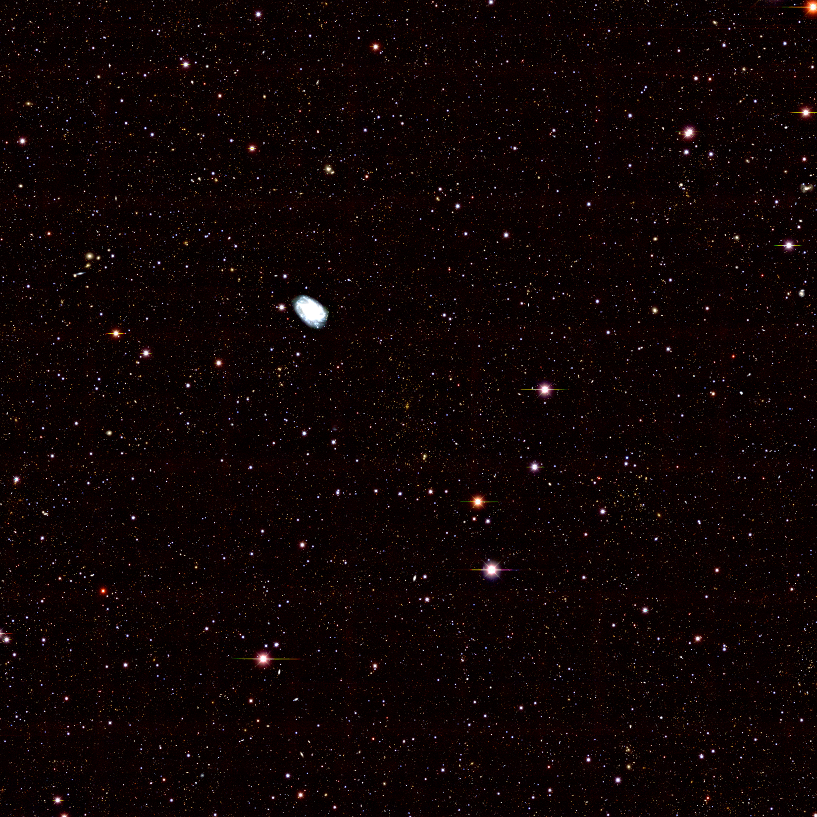
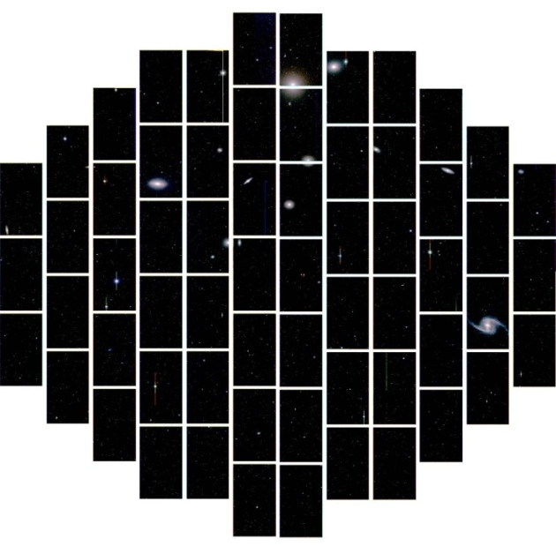
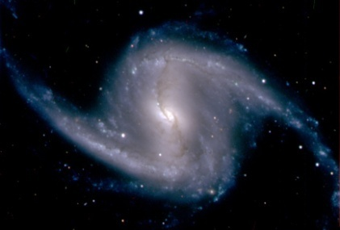
Dark Energy Survey (DES)
  Fornax cluster with close-up of the galaxy NGC 1365
DES – first light
  DOE/NSF partnership with private and foreign contributions
  HEP supported fabrication of the Dark Energy camera (DECam), managed by Fermilab, which was installed on Blanco telescope in Chile
  First Light on 9/12/12!
  Start 5 year operations in December 2012.
  DECam image of a 1 sq deg. region in g,r,z filters to depth of the DES survey; image is centered on an SPT cluster at z=0.3

Slide 20
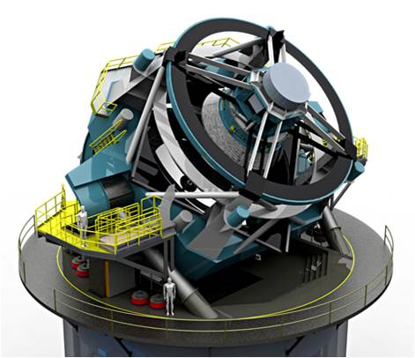
Next Steps : Dark Energy
Developing program in coordination with NSF-AST
Large Synoptic Survey Telescope (LSST)
Moving forward on LSST as the priority for the next HEP dark energy project to be developed
  NSF is lead-agency, responsible for telescope & data management; DOE responsible for the camera
    DOE Critical Decision 1 (CD-1) approved for LSST-camera in Feb. 2012
    FY 2013 Budget Request has MIE funding for LSST-camera project (long lead items in FY2013)
    DOE-HEP planning assumes NSF-AST will request funding for construction in FY 2014 Budget Request
    LSST DOE/NSF Joint Oversight Group meets biweekly

Slide 21
Next Steps : Dark Energy
“Rocky-III” (summer 2012) – HEP community dark energy science plan
  Want to pro-actively developing a balanced, robust dark energy program in HEP - With near term and low cost options, using multiple methods
  First step was to look at the science reach of current and planned projects; then to identify key missing components and opportunities for reaching full “Stage-IV” levels
- The science case for a HEP dark energy program developed by a task force at HEP request (Rocky Kolb, chair). Their Aug. 2012 report identified key missing components and opportunities in progressing to a stage IV program with multiple methods:
    There is compelling case for an advanced wide-field spectroscopic survey, which would enable dark-energy information at the Stage IV level through the techniques of Baryon Acoustic Oscillations and Redshift Space Distortions. A spectroscopic survey would produce Important dark-energy science results in the period between the completion of the Stage III Dark Energy Survey (DES) photometric project and the arrival of results from the Stage IV LSST photometric project.
Mid-scale Dark Energy Spectroscopic Instrument experiment
Critical Decision 0 (CD-0) for MS-DESI experiment was signed 9/18/12
-- We are talking regularly with NSF about possible opportunities and models for the experiment.
Coordination Dark Energy program
  Collecting info from experiments about their assets & needs to optimize the dark energy efforts; Tradeoffs possible - operations costs, data policies, etc.

Slide 22
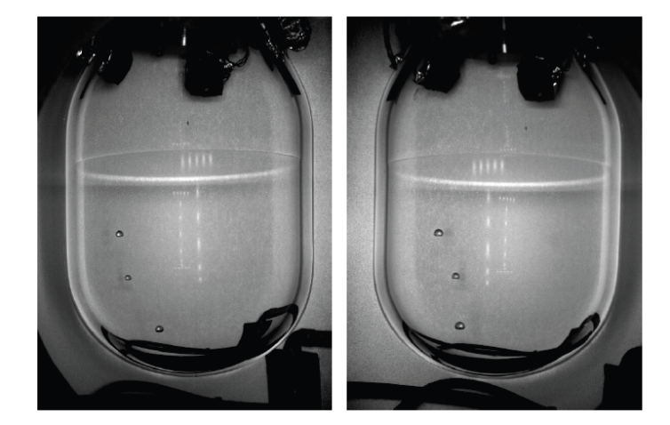
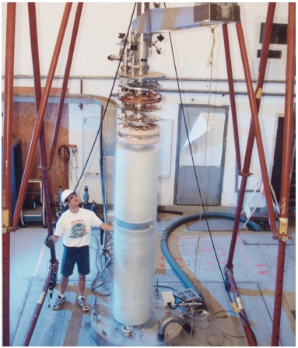
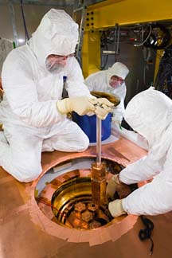
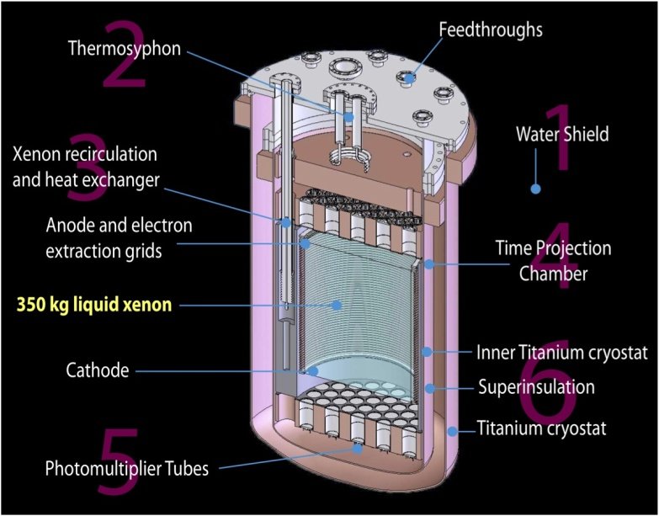
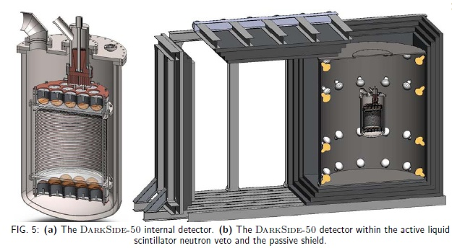
Direct-Detection Dark Matter – Current “Generation 1” (DM-G1)
Cryogenic Dark Matter Search (CDMS) at Soudan mine - germanium detectors
COUPP Bubble Chamber – Fermilab, SNOLab
Axion Dark Matter eXperiment (ADMX) Phase-2a at U.Washington
Dark Matter TPC (DMTPC)
Large Underground Xenon (LUX) detector – Sanford Lab, Homestake mine – now underground!
DarkSide-50 – Dual-Phase liquid argon TPC at LNGS Gran Sasso

Slide 23
Next Steps : Cosmic Frontier – Dark Matter
  ➔Balanced, staged program of experiments w/multiple technologies in the near term.
  - Developing program in coordination with NSF-PHY
  Have a path forward for next phase of direct detection dark matter experiments
Direct Detection Dark Matter Generation 2 (DM-G2) experiments
Technology choices will need to be made
  - we can’t fund all current collaborations to go to next phase
Proposals for FY13 R&D funding went through a Comparative Review held in September – results out soon
  Anticipate further selection after this phase - Will downselect which projects move to fabrication phase in ~ a year - project start no earlier than FY14
  Critical Decision 0 (CD-0) for DM-G2 experiment(s) was signed 9/18/12.
DM-G3 experiments (expect to need global coordination)
G3 R&D and planning continues at a low level

Slide 24
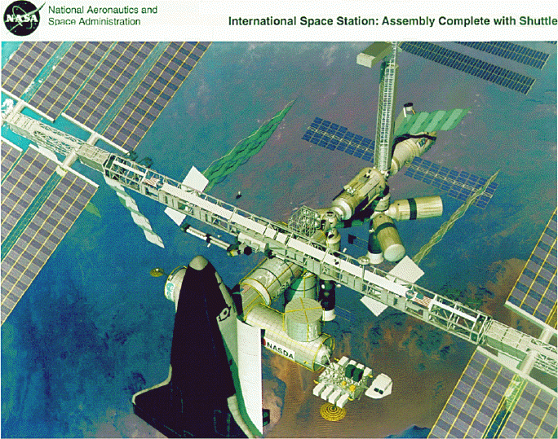
High Energy Cosmic-ray, Gamma-ray experiments
  ➔Experiments measuring properties of high energy cosmic-rays & gamma rays; can also explore acceleration mechanisms and do indirect searches for dark matter candidates.
Pierre Auger - cosmic ray observatory
VERITAS – gamma-ray array
Fermi Gamma-ray Space Telescope
HAWC – gamma ray array
Cherenkov Telescope Array (CTA):
Astro2010 recommended US contribution to CTA in higher budget scenarios (4th on list of ground-based experiments) and that funding be split approximately 2/3 NSF and 1/3 DOE.
DOE/HEP recently gave guidance to the US collaboration:
Following the Astro2010, we consider NSF to be in the lead for considering the project.
We have no funding identified for a contribution to CTA in the foreseeable future and therefore don’t plan to fund R&D towards it.
Alpha Magnetic Spectrometer (AMS) on the International Space Station – launched May 2011; operations & analysis continues
24

Slide 25
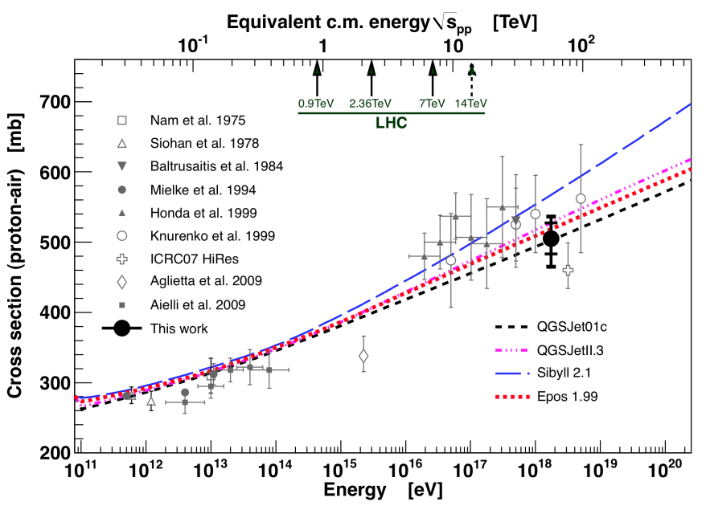
Pierre Auger Observatory
  Science: observe, understand and characterize the Ultra High Energy (UHE) cosmic rays and probe
  particle interactions at UHE.
  Observatory: installed over a 3000 km² site in Argentina with 24 fluorescence telescopes & 1600
  surface Cherenkov detectors
  Enhancements: 3 high elevation fluorescence telescopes, 60 infill detectors, muon counter array.
  Collaboration & Partnership: Large international collaboration of 18 countries, 463 collaborators
  Fermilab hosts the Project Office; plans to ramp down management responsibilities and
  collaboration is investigating new model.
  Publications: As of end 2012: 36 full-authored papers,
  Operations Status: Data taking started in 2004. Full array completed in 2008; Plan to run through to at least 2015.
  Future: Collaboration is doing R&D for enhancements and future detection techniques which
  may extend the lifetime of the Observatory.
Proton-air cross section measured at center-of-mass 57 TeV (2012).
25

Slide 26
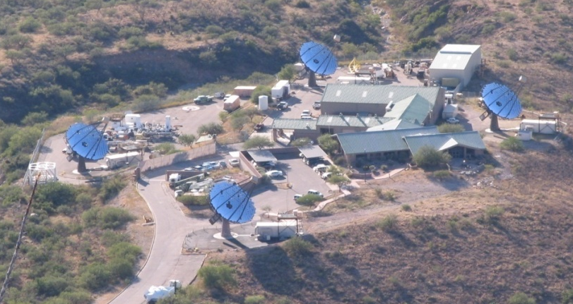
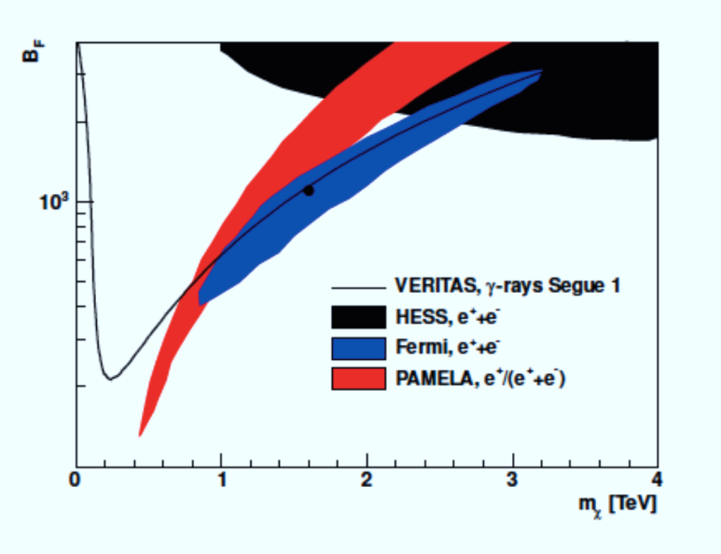
VERITAS
(Very Energetic Radiation Imaging Telescope Array System)
Four 12-meter Cherenkov telescope high energy (100 GeV to 30 TeV) gamma-ray array at Whipple observatory in Arizona
Collaboration/Partnership: ~100 scientists from US
(DOE,NSF,SAO), Canada, Ireland, UK.
Current Status of experiment:
Operating since Fall 2007
NSF-funded upgrade complete summer 2013
Collaboration requesting to continue operations through FY17
Recent Highlights:
Discovery of new, unexpected VHE emission from Crab Pulsar
VERITAS DM limits from dwarf galaxy Segue 1
Limits on boost factor in leptophillic
DM models (region above line excluded);
arVix:1202.2144, accepted in PRD.
26

Slide 27
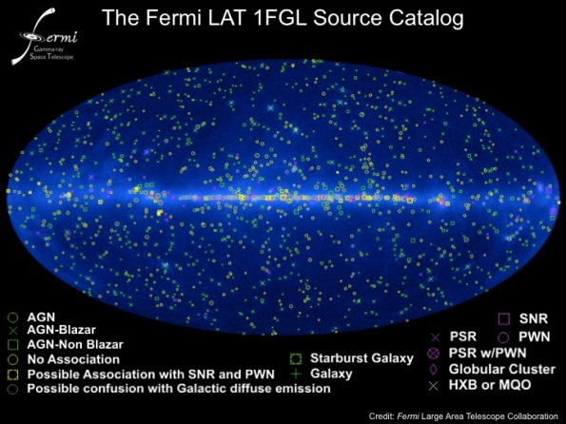
Fermi Gamma-ray Space Telescope (FGST)
DOE, NASA and 4 international partners on Large Area Telescope; NASA leads the mission
HEP plans continued support for the Instrument Science Operations Center (ISOC) at SLAC
through at least FY 2014 (same as NASA’s current approval) – will revisit extending to FY2016
Recent highlights include:
Collaboration update at Fermi Symposium (October 2012) on the ~135 GeV bump in the spectrum from the Galactic Center region and elsewhere:
  -- systematics under careful investigation; more statistics will answer the question.
  -- upgrade of event reconstruction and analysis (“Pass 8”) in 2013 will further improve instrument performance
first blind search detection of a millisecond pulsar
  - Science Express 1229054 online 25 October 2012
measurement of cosmic extragalactic background light
  - Science 30 November 2012: 1190-1192
search for dark matter in gamma-ray lines
  - Phys Rev D 86, id. 022002, July 2012
27

Slide 28
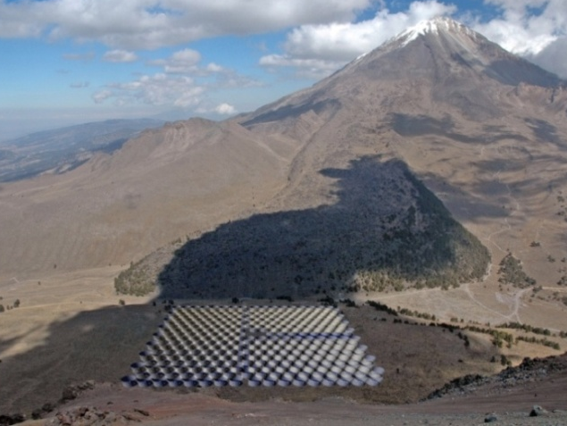
High Altitude Water Cherenkov (HAWC)
Gamma Ray Observatory
Extensive Air Shower Detector composed of 250-300 Water Cherenkov Detectors (WCD)
located at 13500’ in Mexico
Collaboration: 150 scientists from US and Mexico
Partnership: US (DOE, NSF) and Mexico (CONACyT)
Status:
- Project fabrication 2011-2014
- 30 WCD array completed in Sept. 2012, Engineering data run is underway
- Full operations in August 2014
Cosmic-ray skymap from one day of HAWC 30 data demonstrating the HAWC reconstruction and analysis

Slide 29
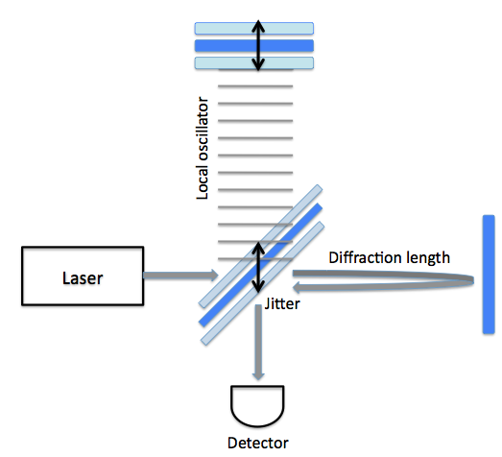
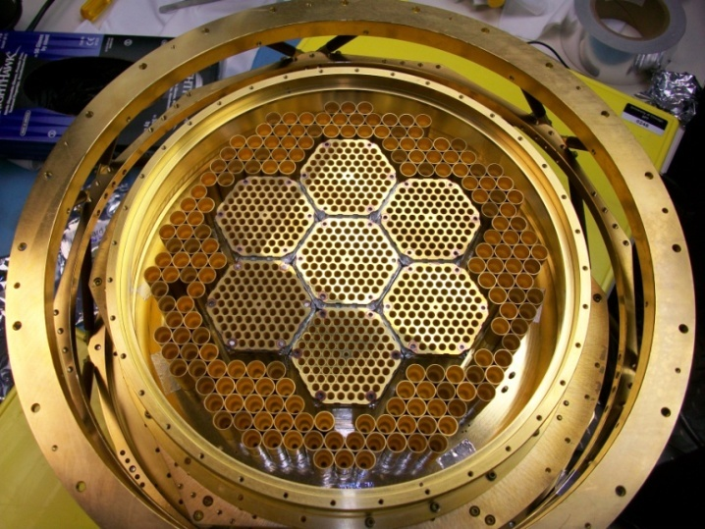
Cosmic Frontier – Other experiments
South Pole Telescope polarization (SPTpol)
- CMB polarization experiment
HEP provided support for outer-ring detector fabrication and is supporting operations for ANL activities.
Correlated position noise in interferometers
Holometer – Holographic
Interferometry experiment at FNAL
Commissioning now

Slide 30
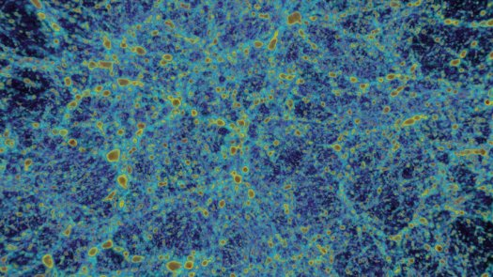
Cosmic Frontier – Related efforts
Computational Cosmology
SciDAC-3 (Scientific Discovery through Advanced Computing) DOE award to Cosmic Frontier
Computational Collaboration at DOE Labs (2012 for 3 Years): Computation-Driven Discovery for
the Dark Universe PI: S. Habib
ESA/NASA Planck mission: First comprehensive simulations run at DOE NERSC Facility generating
35TB of data – used to validate ongoing analysis of the real Planck data in preparation for their
release in January 2013. POC: J. Borrill, LBNL
Allocations at NERSC: Both DES and LSST planning on using NERSC for simulations and analysis
Cosmological simulation code HACC (S. Habib, ANL et al)
- Finalist for Gordon Bell Prize at SuperComputing 2012
- Received NERSC Pilot Project award
HEP Theory Program
funds Cosmic Frontier related theory efforts; typically not directly in support of experiments in the program
30

Slide 31
Cosmic Frontier (Experimental) Program - Funding
Cosmic Frontier Funding (in $K) | FY12 actual | FY13 plan
Research – university | 11,815 | 11,925
Research – lab | 34,937 | 35,315
Experimental Operations | 7,415 | 7,545
Future project R&D | 3,100 | 3,359
Small project fabrication | 2,538 | 0
MIE – LSST | 5,500 | 10,000
MIE – HAWC | 1,500 | 1,500
DM-G2 R&D | 0 | 7,000
TOTAL | 66,805 | 76,644

Slide 32
Cosmic Frontier – Program reviews
    Sept. 2012 - Cosmic Frontier Experimental Operations Review:
    -- Panel review of operating, or about-to-start operating experiments; plan to do this ~ biannually
Reviewed each experiment individually (i.e. didn’t rank/prioritize against each other)
For experiments that don’t already have an agreed-upon operations phase, we will use this as an opportunity to set the operations budget & schedule
Results will inform program planning since we will need to ramp down some experiments in the next few years to make room for new projects.
    Nov. 2012 – Cosmic Frontier Comparative Grant Review
-- Panel review of all grants up for renewal in FY13 as well as new proposals
FY13 demand is over twice the available funding; Hard choices will have to be made!
Reminder: Research planned to decrease ~ 2%/year for next few years
    Jan. 2013 (Office of Science program) - Review of Early Career proposals
    -- HEP usually awards ~ 10/year
    Late FY13 – Cosmic Frontier Comparative Lab Research Program Review
    -- Panel review held every 3 years to comparatively review our major lab research programs – ANL, BNL, FNAL, LBNL, SLAC
32

Slide 33
Cosmic Frontier – Going Forward
Dark Matter:
-- Path for direct detection dark matter experiments is clear
- Comparative review of DM-G2 efforts in FY13, leading to future project start
- Plan for other methods of detection developing under leadership of DPF/Snowmass process
Dark Energy:
-- Pro-actively developed science plan for balanced, staged program from BOSS, DES→LSST and MS-DESI
Investigating access to facilities needed for MS-DESI
Further development of science plan through DPF/Snowmass process
Other areas:
-- Science case and role of other particle astrophysics areas needs to be better articulated through DPF/Snowmass process
DPF Community Summer Study (2012-2013 -- Snowmass on the Mississippi)
  →Develop and communicate the science plans and strategies for the HEP/Particle physics program.

Slide 34
Cosmic Frontier – Future Planning & Optimization
Results of the DPF/Snowmass process will inform future planning & optimization
Lead with science goals and articulate how they address HEP goals
Develop a science plan with decision tree/points
Balance & Optimization
Between Cosmic thrusts; will need to decrease support for one area if we are to expand into another.
Experiments directly-aligned with goals or provide input/contributions to goals
Supporting theory, simulation, computational efforts
Coordination of background and other R&D studies to support entire program.
Multiple technologies/methods? Phase space covered and how far do we go with each?
Balance of speculative efforts with ones that guarantee results
Domestic and off-shore
Methods, technologies
Overlaps: Other experiments already planned or existing that also do this science?
Optimization: Enhance all our efforts to leverage most science from the program.

Slide 35
Cosmic Frontier – Summary
Have path forward for next steps in Dark Matter & Dark Energy
Will further develop and optimize program starting with input from the DPF/Snowmass process.
Lots of results coming out or expected soon in all areas. Future is looking bright!!

Slide 36
Discussion points

Slide 37
AAAC Report – March 2012
Findings/Recommendations for DOE/HEP
Finding:
The Large Synoptic Survey Telescope (LSST), the top-ranked large ground-based facility in NWNH, is on the path to being started, with an active NSF/DOE Joint Oversight Group (JOG) to synchronize the approval, review and funding processes. The AAAC applauds NSF and DOE for their coordinated activities and finds that it is very important that these activities remain synchronized as the project proceeds (§2.2).
Finding:
The AAAC is concerned about declining levels of funding for technology development within NASA, NSF, and DOE. Maintaining technology development is essential to enable the discoveries that will take place in future decades, and to maintain the technical leadership of the U.S. (§2.8).
Finding:
Interagency coordination and interactions on a number of joint projects including the LSST,
the Theory and Computation Networks (TCN), Fermi and the Dark Energy Survey (DES) are
good. The AAAC is pleased with the level of such cooperation (§3).
Text:
International cooperation on Euclid represents an initial step to achieving advances in dark energy research – a key scientific frontier identified in NWNH. NASA engagement with Euclid likely will have derivative implications regarding interagency cooperation between two predominate sources of dark energy research support, the DOE and the NSF, that warrants future consideration by the AAAC. The AAAC noted that the success of the Euclid mission depends in part on complementary ground-based observations from projects such as LSST and the Dark Energy Survey (DES). The NRC report points out that collaborative processing and analyses of the combined ground-based and space-based datasets in the areas of overlap could position the U.S. community for leadership in their scientific exploitation.

Slide 38
AAAC Report – March 2012
Findings/Recommendations for DOE (not HEP)
Finding:
The AAAC expresses its continuing concern that U.S. inventories of mission critical
consumables including Plutonium-238, Helium-3, and Helium-4, which enable a range of astrophysics research as well as commercial and national security endeavors, are depleting rapidly (§4.2).
Text:
The AAAC urges that, in consultation with Congress, prompt action be taken and appropriate budgetary resources be identified through cooperative coordination between DOE, NASA, and, if applicable, other federal agencies (e.g., the National Security Agency, Department of Homeland Security), to enable the Pu-238 project production restart, sufficient availability of Helium-3, and a standard procedure to capture Helium-4. All three actions are necessary to assure the viability of future astrophysical observations and experiments.

Slide 39
AAAC Panel – discussion points & questions
The committee is wondering whether there are any major DOE astrophysics projects, not in the OHEP portfolio, that they don’t hear about.
They are aware that dark energy projects deliver a lot of other extragalactic science as well, and would like to understand (a) whether that somehow alters OHEP’s mission to study dark energy exclusively, and (b) whether it encourages a community effort to wrap extragalactic science in a dark energy cloak to make it more fundable by DOE.
In the broader context, they would like to better understand where the roles and missions of the agencies are bounded and where they overlap, and especially how this may be evolving.
The Committee has provided a list of topics on which they would like to have information and discussion beyond the usual presentation:
(all agencies) Response to findings and recommendations of 2012 AAAC report;
(all agencies) How agencies can contribute to providing open community access to facilities;
(NASA) Status of Pu-238 and associated technologies (Jim Green gave an update at the DPS meeting last week that the audience found very informative; I assume he’d be able to provide Paul with details if needed);
(DOE) Astrophysics done at DOE labs but not directly supported by OHEP;
(DOE) How large projects (impacting a wide range of science questions) map onto the DOE/OHEP mission to study only dark energy.

