Slide 1


NSF/AST Programs & Budget Update
AAAC
Jim Ulvestad
November 30, 2012

Slide 2
Outline
Budget/Division Primer
Science and Telescope News
Status of 2012 AAAC Report Issues
Additional Division News
Portfolio Review & Budget Outlook
AST Issues
Polar Astronomy

Slide 3
Budget/Division Primer

Slide 4
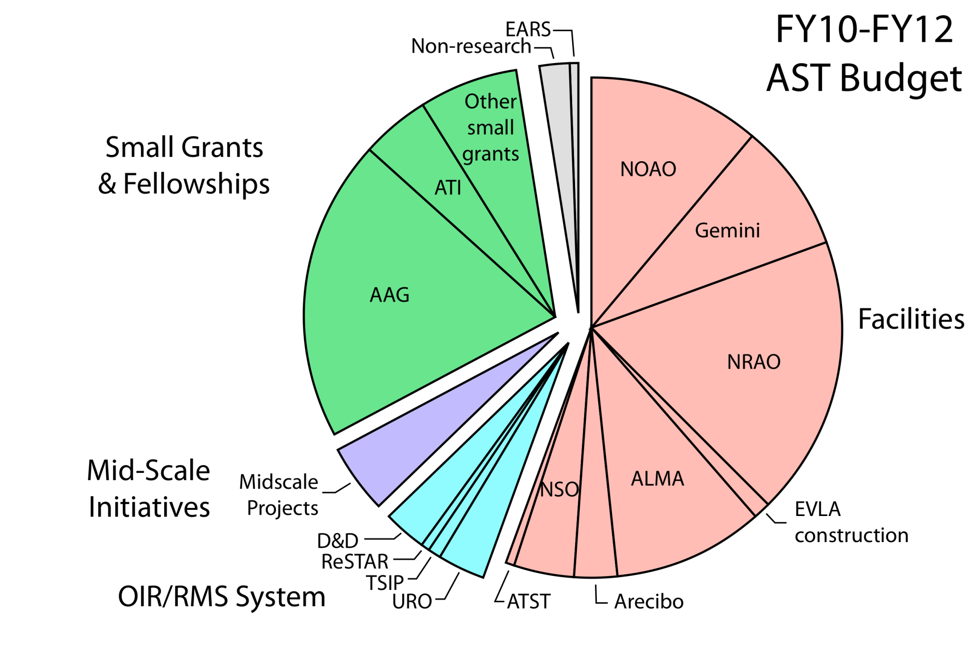
PR Fig. 3.1
(Avg=$238M)
Slated for major growth this decade

Slide 5
Science and Telescope News

Slide 6
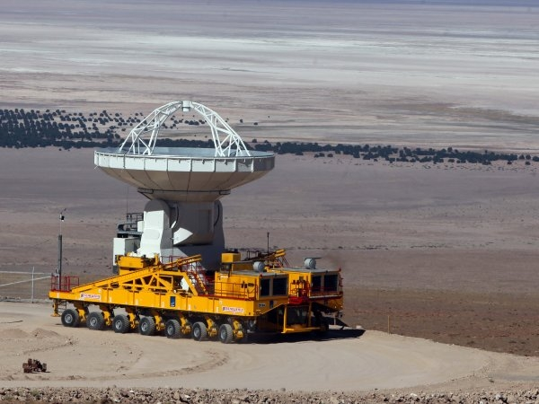
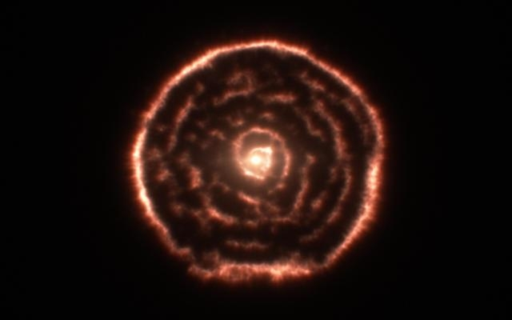
ALMA Status
112 early-science projects selected from ~900 Cycle 0 proposals; 85% of observations completed
196 high-priority projects selected from 1133 Cycle 1 proposals
64/66 antennas in Chile; 57 accepted
Inauguration in March, 2013
Gas spiral around R Sculptoris caused by interplay between AGB star thermal pulses and stellar companion
Last of 25 NA antennas accepted
Maercker et al. 2012, Nature, 490, 232

Slide 7
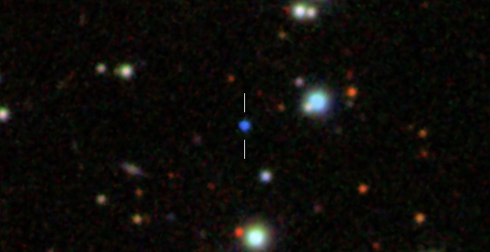
First visible-light evidence for gravitational waves from white-dwarf binary
WD binary has 13-minute orbit
General Relativity predicts gravitational waves to radiate energy from system, causing stars’ orbits to shrink.
Team measured this effect, with eclipses happening 6 seconds sooner than expected in one year.
The white-dwarf binary SDSS J0651+2844. Image credit: The Sloan Digital Sky survey. Hermes et al. 2012, ApJ, 761, L1-L15.
Binary system will be useful for future searches of gravitational waves, and exploring tidal heating effects on compact objects and planetary systems.
Observations made by McDonald, Gemini-N and MMT Observatories.
Supported by AST-0909107/Montgomery and AST-1008734/Szkody (SAA).

Slide 8
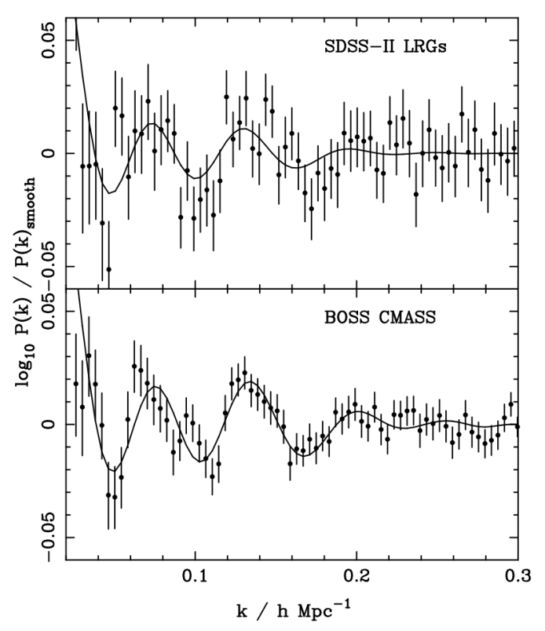
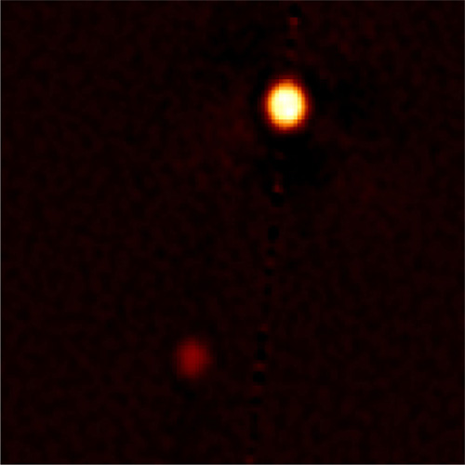
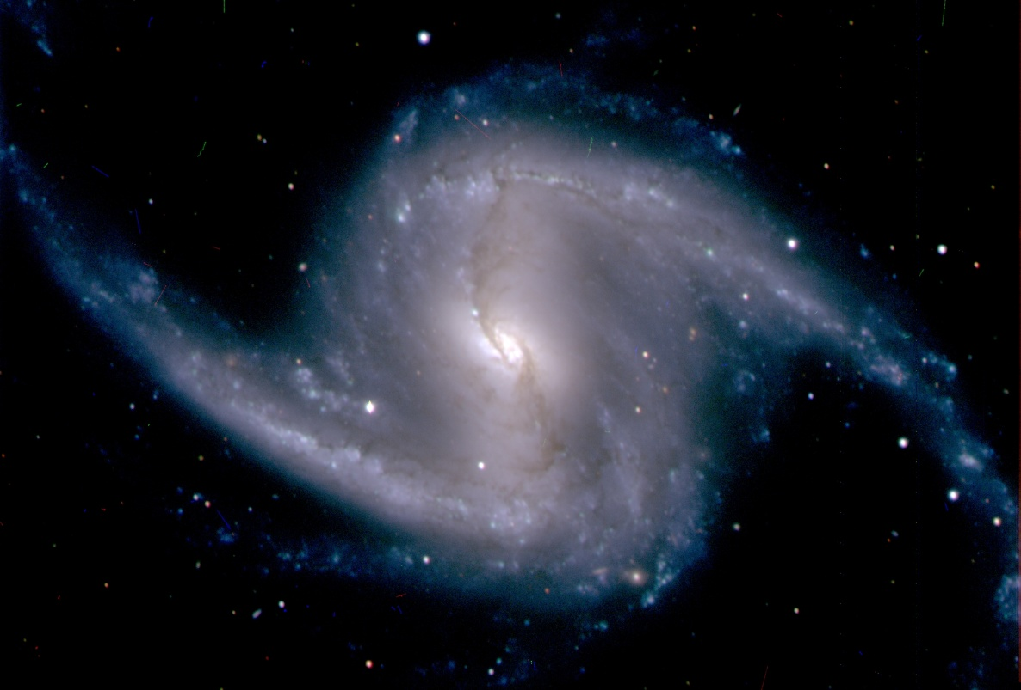
More Recent Results
BAO measured with SDSS-III BOSS
Pluto-Charon image with Gemini-N; highest resolution ground-based image of system (Howell et al. 2012, PASP, 124, 920)
Anderson et al. 2012, astro-ph/1203.6594
DECam First Light image
Gemini/NSF/NASA/AURA
Dark Energy Survey Collaboration

Slide 9
Status of 2012 AAAC Report Issues

Slide 10
2012 AAAC Issues-I
2011 Nobel Prize: Facilitated by balance among AST programs. Striving to maintain balance, as recommended by Portfolio Review.
Budget constraints on decadal survey recommendations: See specific issues below.
LSST: Advanced to MREFC readiness queue, with formal National Science Board approval to request funding for LSST construction in future budget request.
Assuming an FY 2014 start, survey could start late in CY 2021. See earlier presentation.
Midscale: High priority in the Division, planning for a possible solicitation in FY 2013.
Ability to issue solicitation will depend on FY 2013 budget resolution and FY 2014 budget request.

Slide 11
2012 AAAC Issues-II
Research (AAG) and Instrumentation (ATI) grants
AAG success rate in FY 2012 was 14.7%.
ATI success rate in FY 2012 was 20%.
Expect rates to go lower in FY 2013.
Portfolio Review Report released August 16.
Commend the committee for an outstanding report that remained true to the decadal survey science priorities.
General AST response document issued in late August.
Cannot publish detailed implementation plan because of many stakeholders, nature of budget preparation process.
“No decisions have been made yet.”
Proceeding to gather additional information about divestment options and opportunities for facilities.

Slide 12
2012 AAAC Issues-III
Technology development concerns
See previous comments about midscale and ATI.
GSMT solicitation
Review conducted, moving toward making an award, participating in TMT Collaborative Board.
Gemini future (post-2015)
All partners will remain in, except Australia wishes to purchase time on annual basis.
US gains two Board members in 2013, one will be NOAO Director.
New international agreement under development.
Complex instrumentation remains a challenge.

Slide 13
2012 AAAC Issues-IV
VAO, survey teams, national observatory archives
Plan to conclude current VAO effort in 2014, with transition of protocols, standards, and tools to maintenance mode, and will entertain proposals for future development.
Committee on Astronomy and Astrophysics
First meeting held, PR follow-on studies being discussed.
Interagency cooperation
LSST; see previous comments.
NSF/NASA solicitation on Theoretical and Computational Astrophysics Network has been issued.
Fermi Gamma-ray Space Telescope continues cooperation agreement with NSF facilities.
Dark Energy Survey science program beginning soon.
ALMA & EVLA progressing well. For Gemini, see previous slide.

Slide 14
Additional Division News

Slide 15
Division News--Personnel
Dana Lehr continues as Acting Deputy Division Director; expect permanent Deputy on-board in March.
Tom Gergely (spectrum management) and Jeff Pier (NOAO, MRI) retiring in December/January.
Rotation ended for Scott Fisher, Don Terndrup, soon for Katharina Lodders.
Dan Evans recently started as new rotator; Ilana Harrus begins as new permanent program officer in February.
Seeking another rotator soon, plus more in late 2013/early 2014.

Slide 16
Division News--Miscellaneous
Advanced Technology Solar Telescope has had its Conservation District Use Permit reaffirmed by Hawaii Board on Land and Natural Resources.
Court hearing on injunction was yesterday (Thursday), and injunction was denied.
Potential to start excavation within days.
Ongoing discussions with DOE regarding their Mid-scale Dark-Energy Spectroscopic Instrument (MS-DESI).

Slide 17
Portfolio Review & Budget Outlook

Slide 18
Basic PR Recommendations
At either assumed budget level, recommended current-facility portion of the portfolio is the same
Driven by facility complexity, dangers of over-optimism
At lower level, facilities/grants/mid-scale are all at ~75% of FY10-12 level (i.e., maintain present balance)
At higher level, restore funds to grants and midscale, invest in more new NWNH-recommended facilities later
Merge dedicated programs (e.g., University Radio Observatories, optical instrumentation) into midscale
Facility recommendations
Priority 1 (Fund): ALMA, ATST, VLA, LSST (operations start in 2020), CTIO, Gemini-S, Dunn Solar Telescope (until ~2017)
Priority 2 (Continue to fund now, revisit if budget does badly): Arecibo, SOAR, Solar synoptic, Gemini-N
Priority 3 (Divest expeditiously): McMath-Pierce Solar Telescope, federal (NOAO) telescopes on Kitt Peak, Green Bank Telescope (NRAO), Very Long Baseline Array (NRAO)

Slide 19
Community Response to Portfolio Review
Generally positive statements from AAS, AAS President.
Responses also issued by AURA and AUI/NRAO.
General tenor of community responses
Some general acceptance that choices need to be made, but not by divesting the facility that a particular community member is most interested in.
Concern concentrates on facilities, with little focused concern about the potential impact on grants and midscale.
Open-access concerns from both OIR and RMS observers.
General statements that budget scenarios were too pessimistic, and apparent lack of community recognition of the national and international economic climate.

Slide 20
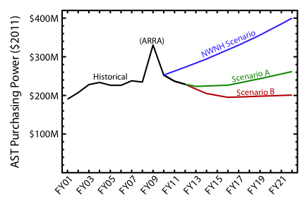
Portfolio Review Budget Scenarios
Pres. Req.
Seq.
PR Fig. 3.3
Committee Figure 3.3 is annotated here by budget ranges for FY13, ranging from the President’s Request level to an 8.2% across-the-board sequestration
Recent AST budget requests and appropriations:
Year | FY11 | FY12 | FY13
Request | $251.8M | $249.1M | $244.6M
Approp. | $236.8M | $234.6M | ???

Slide 21
NSF Response to PR Report
NSF response document issued on August 31.
NSF must decide on nature of divestments near the end of CY 2013 in order to realize significant savings by FY 2017.
No decisions have been made by NSF; discussions within NSF will lead to future Presidential budget requests, which are then subject to action by Congress.
Divesting a telescope does not need to imply closing a site.
Emphasize principle of divestment in a responsible manner
Includes sites that host non-AST tenants.
Agree with Committee assessment that failure to act on their recommendations will reduce grants program four-fold in Scenario B by FY16-17.
Resulting grants success rate would be in 3%-4% range.
This success rate would essentially end NSF research funding of the U.S. astronomy community.
Committee found this risk unacceptable.

Slide 22
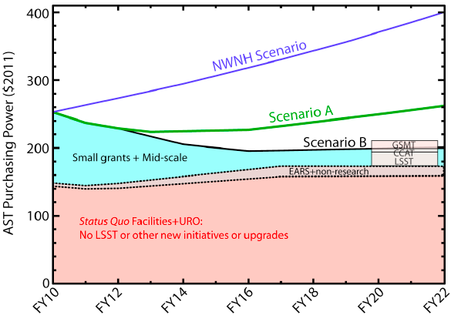
Impact of Maintaining Status Quo
PR Fig. 3.4

Slide 23
AST Issues

Slide 24
Recompetitions
(Re-)competitions of national facility management
Competitions of management follow National Science Board policy.
Competition planning and activities underway for management and operation of NRAO/ALMA, NOAO, and Gemini, all to be completed in 2015.
Dear Colleague Letters issued (NRAO) or upcoming.
Solicitations in Q2 and Q3 of 2013 are likely.
Potentially complex interactions with Portfolio Review recommendations

Slide 25
Additional Key Issues
Budget uncertainty, Congressional direction.
NSF staff workload.
Complex, upcoming management competitions.
Rapid transition to virtual merit-review panels.
Deferral of decisions on PR facility recommendations will exacerbate pressure on grant/midscale funding.
Yet those facilities given lower priority by the Portfolio Review are valued by parts of the community and represent significant science and training opportunities.
Inability to make progress on human-capital issues discussed by decadal surveys and Portfolio Review, in constrained budget scenarios.
What steps, if any, should agencies take to address perceived overproduction of PhD’s relative to stable, long-term positions in astronomy?
What is the OIR “system” of the future?

Slide 26
Polar Astronomy
Presentation by Vladimir Papitashvili follows.

