Slide 1
Astronomy and Astrophysics in Antarctica Resent Discoveries and Results
Interagency Astronomy and Astrophysics Advisory Committee Meeting
November 30, 2012
Vladimir Papitashvili, Program Director
Antarctic Astrophysics & Geospace Sciences
NSF/Office of Polar Programs

Slide 2
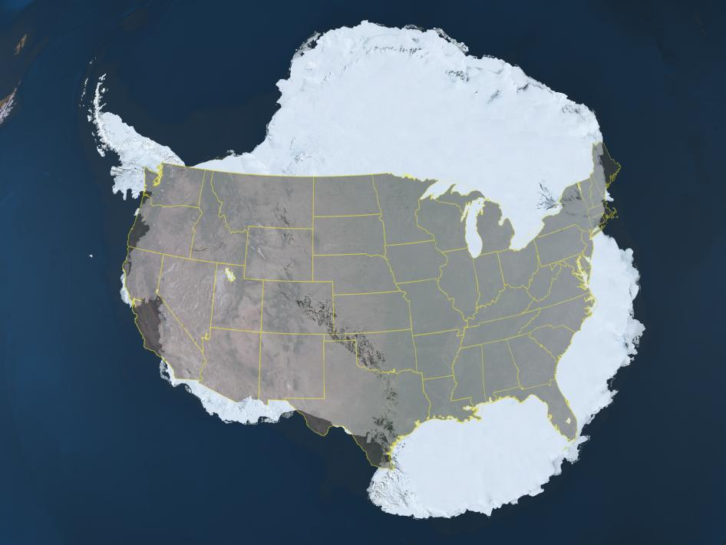
Palmer x
South Pole
x
VA / NSF
x
Denver, ASC
x
LAX / PTH
x
McMurdo
x

Slide 3
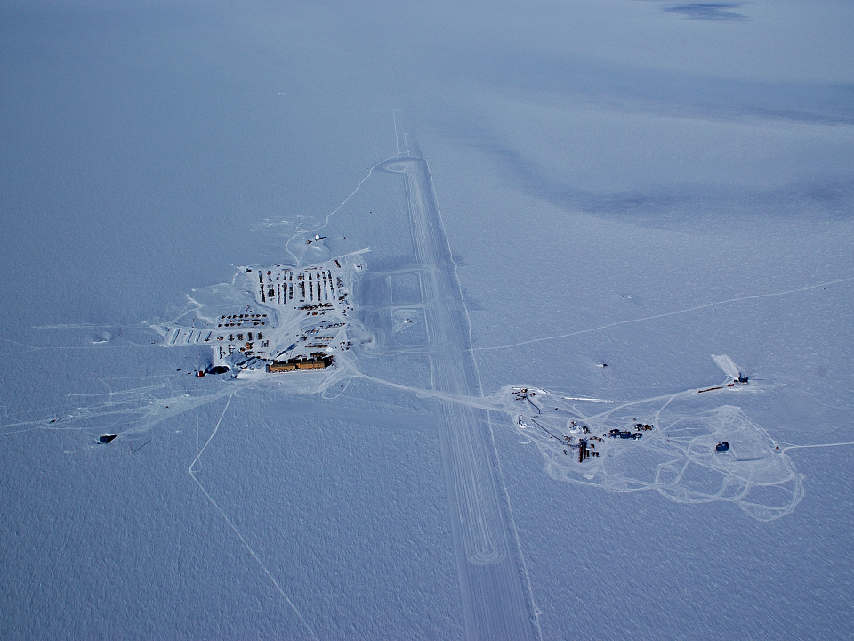
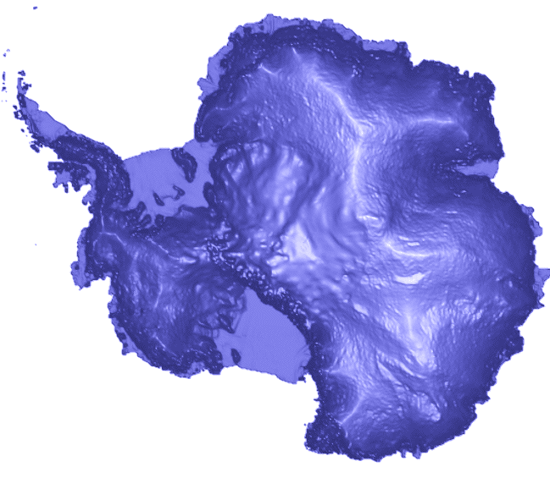
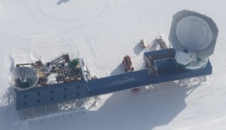
U.S. Amundsen-Scott South Pole Station
2.9 km elevation above sea level
Where are we ?
Snow runway
IceCube area
IceCube Lab
Elevated Station
Geographic South Pole
DSL with BiCEP2& SPT
MAPO with SPUD/Keck array
As of November 2012

Slide 4
NSF/OPP Antarctic Astronomy & Astrophysics
IceCube Neutrino Observatory (MREFC Project completed; M&O and science are underway) PI: Francis Halzen, Univ. of Wisconsin-Madison, and IceCube Collaboration of 39 institutions
South Pole Telescope (SPT) (10-m dish sub-mm telescope) PI: John Carlstrom, Univ. of Chicago, and SPT collaboration of seven institutions
Gravitational Wave Background (small aperture) Telescopes BiCEP 2 and SPUD/Keck receivers array PIs: John Kovac (Harvard University), Clem Pryke (University of Minnesota), Chao-Lin Kuo (Stanford University), and Jamie Bock (Caltech/JPL)
HEAT – TeraHertz Robotic Telescope at Ridge A (4.1 km elevation) PIs: Craig Kulesa (University of Arizona) and Michael Ashley (University of New South Wales, Australia)
NASA Long-Duration Balloon Program at McMurdo

Slide 5
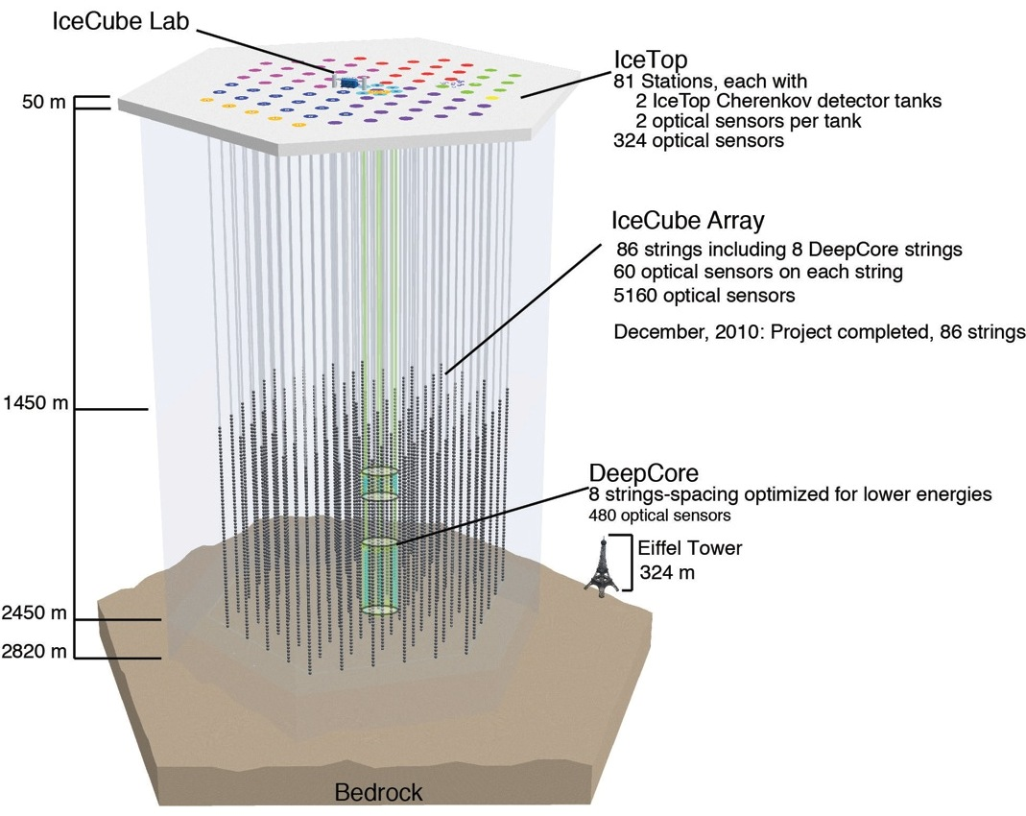
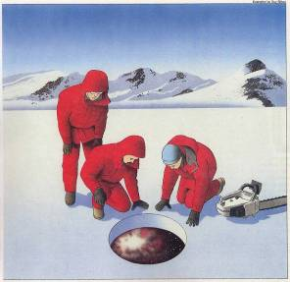
IceCube Neutrino Observatory
(jointly supported by NSF's OPP/ANT and MPS/PHY)
Recent Accomplishments
Univ. of Wisconsin successfully completed the ice drilling and deployment of all 86 strings in December 2010
ICNO operations and scientific research are fully underway
New window on the Universe is now open!
ν → μ
ν
IceCube occupies a volume of one cubic kilometer. Here all 86 strings of optical modules are depicted deployed deep in the South Pole’s ice sheet. The IceTop modules are deployed at the snow surface, comprising an array of sensors to detect cosmic ray air showers. This surface array is used to veto some IceCube muon detections and to conduct research on high-energy cosmic rays.
Notes:
5

Slide 6
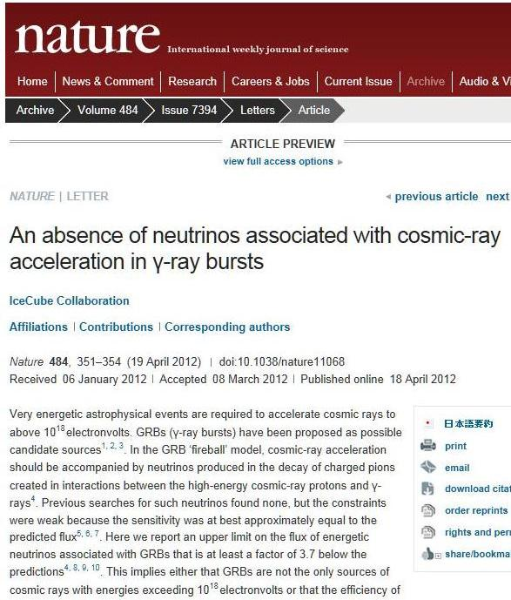
IceCube Collaboration Recent Results
NSF Press Release 12-073 (May 2012)
The IceCube Collaboration reported about a search for neutrinos possibly emitted from 300 gamma ray bursts (GRBs) that occurred between May 2008 and April 2010 and detected by the SWIFT and Fermi satellites.
It was found that an upper limit on the flux of energetic neutrinos associated with GRBs is at least a factor of 3.7 below the model prediction.
Nathan Whitehorn (NSF-funded postdoctoral fellow at the Univ. of Wisconsin-Madison), lead author of the publication in Nature):
This result represents a coming-of-age of neutrino astronomy. The South Pole’s IceCube Neutrino Observatory was able to rule out 15 years of predictions and has begun to challenge one of only two major possibilities for the origin of the highest-energy cosmic rays, namely gamma-ray bursts and active galactic nuclei.”

Slide 7
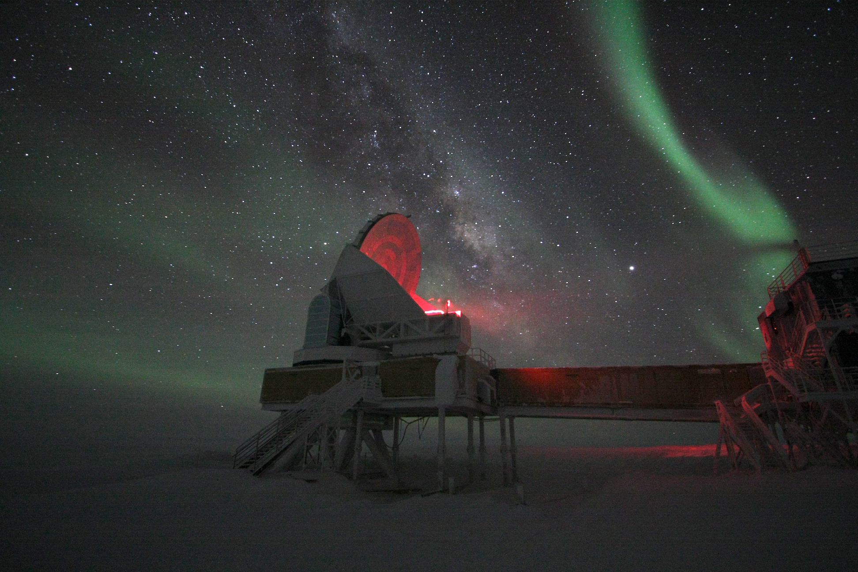
South Pole Telescope, Aurora, and Milky Way
Recommended in the 2001 Astrophysics Decadal Survey as a moderate initiative (<$50M)
Funded in August 2002 - First light in February 2007 - right on the budget ($18M) and schedule!
First light: February 17, 2007
Confirmed viability of the CMB/SZE observing strategy and completed five years-long survey of 2500 sq. degrees of the sky in November 2011
Discovered over 500 massive galaxy clusters in the distant early Universe
NSF Press Release 12-066 (May 2012):
South Pole Telescope Provides New Insights Into Dark Energy and Neutrinos
SPT has now switched to CMB polarization measurements searching for imprints of the primordial, Inflationary gravitational waves and understanding gravitational lensing
Photo: Keith Vanderlinde
Notes:
7

Slide 8
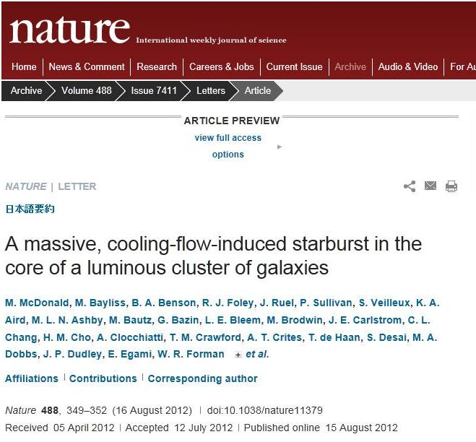
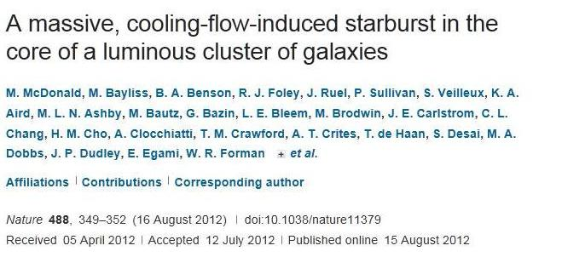
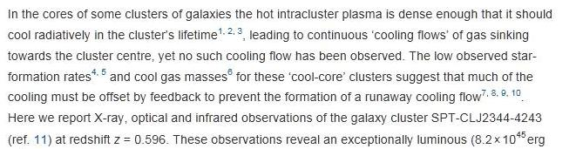
+26 papers published (or in press) by the SPT team in ApJ since 2009 … seven more are under review
J. E. Carlstrom
SPT-CLJ2344-4243

Slide 9
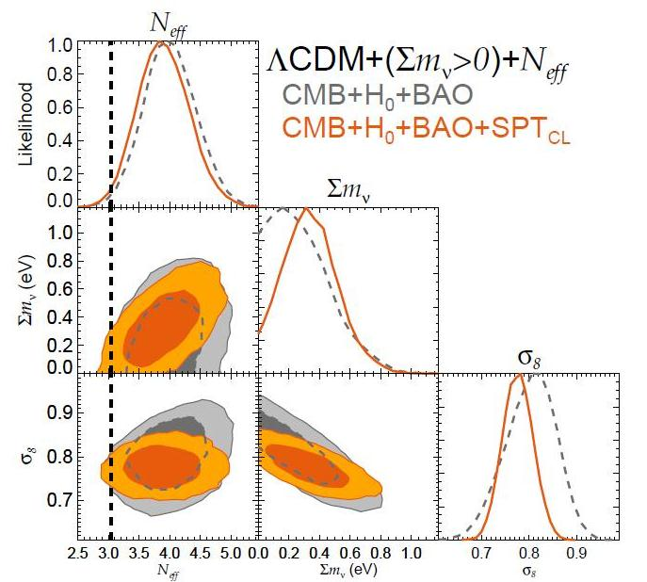
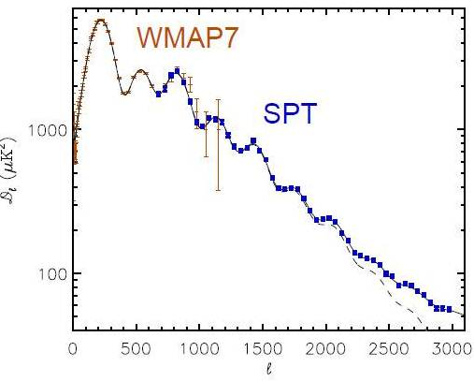
Benson et al., under review, ApJ, 2012
Story et al., submitted to ApJ, October 2012
Cosmological Constrains from SPT/SZE Survey: neutrinos effective number and total mass
A Measurement of the CMB Damping Tail from the SPT/SZE Survey
!!! Vieira et al., Nature, submitted, Nov 28, 2012 !!!

Slide 10
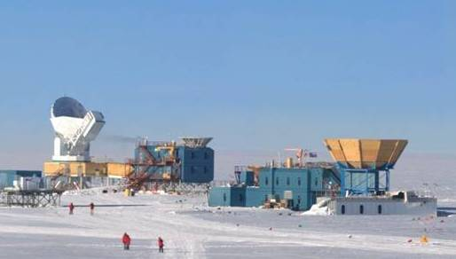
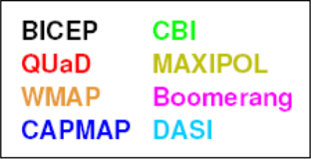
Inflationary Gravitational Waves Background
studies with 30-cm aperture telescopes
BiCEP 1&2
SPUD/Keck
In 2005, the CMB Interagency Task Force set a target to detect the CMB polarization B-mode if r ~ 0.02
BiCEP-1 has the best published results to date (Chiang et al. ApJ 711, 1123, 2010):
The measured CMB polarization E-mode spectrum was consistent with expectations from a ΛCDM model, and the B-mode spectrum was consistent with zero
The tensor-to-scalar ratio derived from the BiCEP-1 B-mode spectrum observations was r = 0.02^{+0.31}_{-0.26} or r < 0.72 at 95% confidence
This was the first meaningful constraint on the Inflationary Gravitational Wave Background (IGWB) from B-modes – and still the best!
BiCEP-2 is finishing its 3-rd observing year with sensitivity 10x higher than BiCEP-1
BiCEP-1 two-year data
Lensing bump
-1
Inflationary Gravitational Waves bump
B-mode limits published so far (previous generation experiments)
Notes:
10
This is the BICEP telescope at the South Pole.
I’ll be talking about it and a series of telescopes which will succeed it
designed to search as deeply as possible, and as quickly as possible, for signature of Inflation in degree-scale CMB polarization

Slide 11
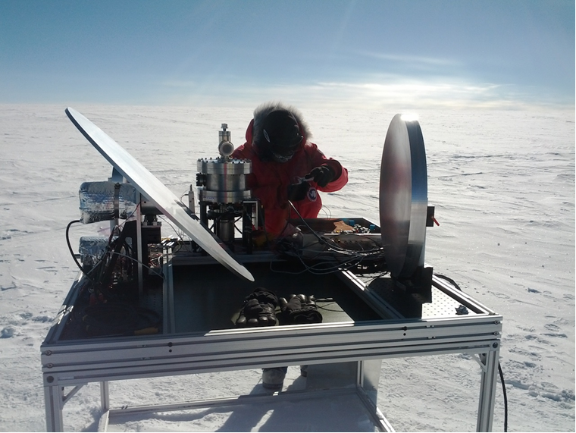
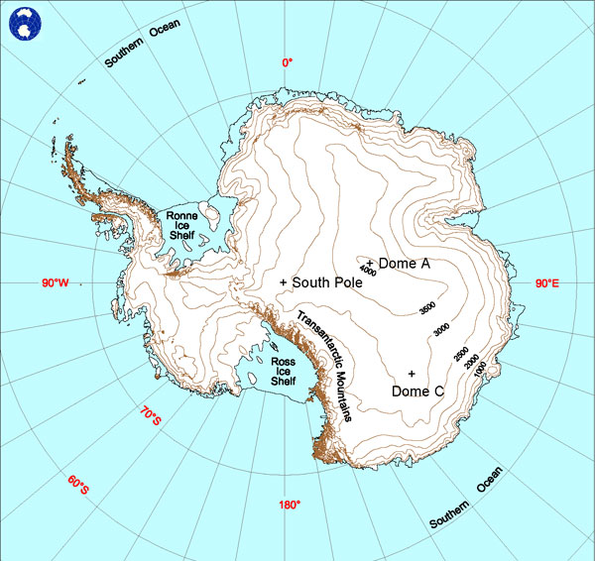
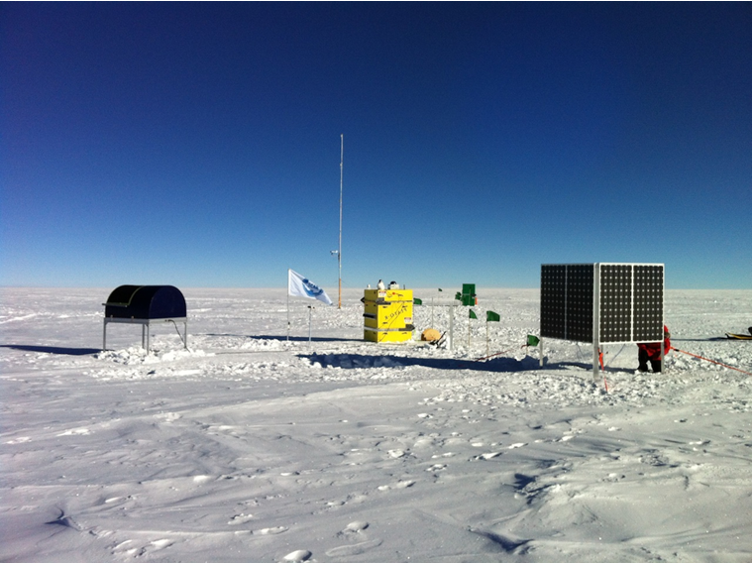
HEAT - TeraHertz Robotic Telescope at Ridge A, Antarctica
Joint project between the U.S. (Univ. of Arizona; HEAT telescope ) and Australian (U. of New South Wales, PLATO-R power module) scientists
HEAT at Ridge A
Funded by NSF and Commonwealth of Australia in July 2010 through June 2014
Deployed by the U.S. Antarctic Program at Ridge A (East Antarctic Plateau, 4.1 km elevation) in January 2012
Ridge A – 200 km south of Chinese station Kunlun at Some A
Ridge A site
PLATO-R operated successfully 127 days since installation and well into austral winter (Jan 21 – May 27, 2012) until it had run out of
diesel fuel stored on-site. Then PLATO-R has revived on October 25 by solar photovoltaic panels: http://mcba11.phys.unsw.edu.au/~plato-r/
HEAT PLATO-R Solar Panels

Slide 12
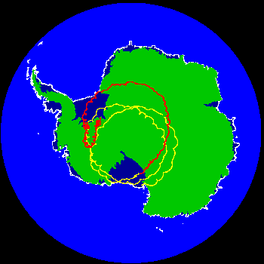
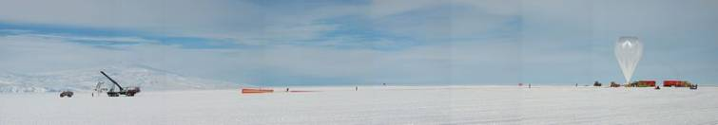
Long-Duration Ballooning
from McMurdo, Antarctica
August 1988 – First MoA signed between NASA and NSF
- One LDB launch every other year beginning in Jan 1990
- 22 long-duration balloon payloads flown from McMurdo
between 1990 and 2003 (~1.7 flights per year)
Sep 2003 – Second MoA signed between NASA and NSF
(expired March 31, 2009)
- Two launches per years beginning in December 2003
- 15 long-duration balloon payloads flown from McMurdo
between 2003 and 2009 (~2.5 flights per year)
April 2009 – Third MoA signed between NASA and NSF
(expiring March 31, 2014)
- Three launches per years, including Super-Pressure Balloons
- 10 balloon payloads flown between 2009 and 2012;
- 3 more will be flown in December 2012 – January 2013
FY09 - SPB Flight Tracks
Total 47 LDB and SPB launches over 22 years (50 after 2012/13 season)

