Slide 1


DOE Plans for Restarting Domestic Pu-238 Production
Rebecca Onuschak
Federal Program Director for Pu-238 Production
DOE Office of Space and Defense Power Systems
November 30, 2012

Slide 2
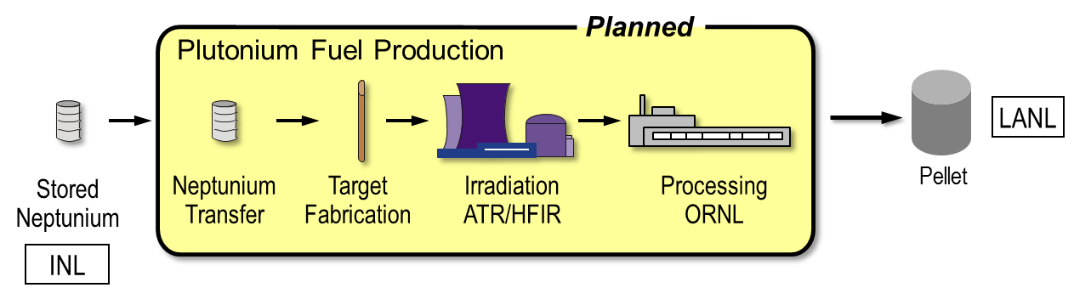
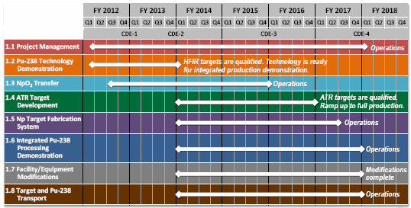
DOE plans to achieve 1.5 kg/yr production capability by 2018
ORNL has begun technology demonstration to develop capability to make Pu-238 for DOE
The project is broken into subprojects

Slide 3
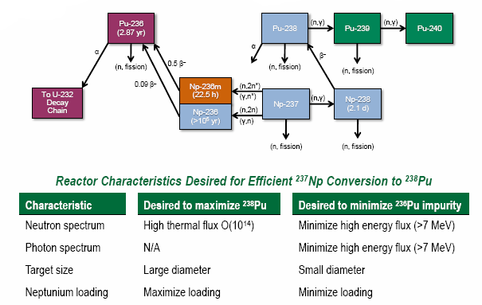
Plutonium-238 is Produced in a Nuclear Reactor via Neutron Capture and Beta Decay

Slide 4
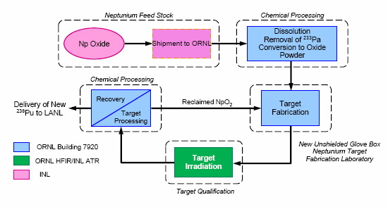
Production can be restarted without new facilities

Slide 5
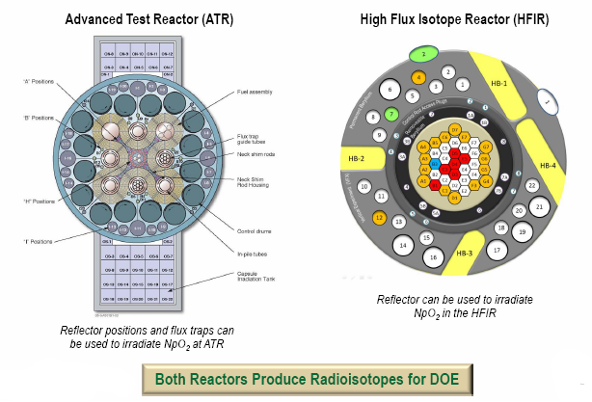
Two existing DOE reactors

Slide 6
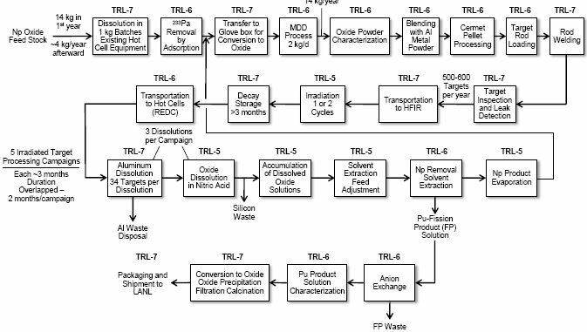
High-TRL methods are key to approach

Slide 7
First Steps (underway now)
Review past NEPA analysis to ensure current approach remains the best option and that impacts are understood
Demonstrate key technologies that need to be re-established and/or adjusted for the current approach
Historical production process:
  Was designed for reactors that no longer operate
  Used facilities and infrastructure supported by weapons activities
Current approach:
  Will use existing research reactors and facilities
  Must be lean enough to “pay its own way” (no weapons production infrastructure on which to depend)

Slide 8
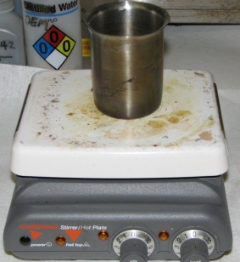
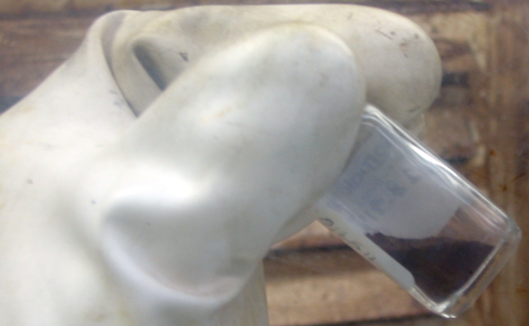
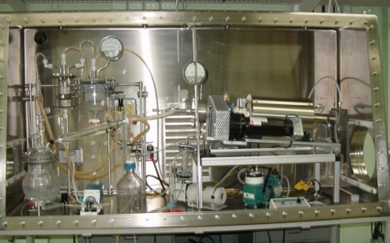
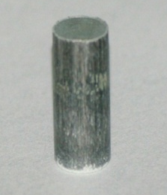
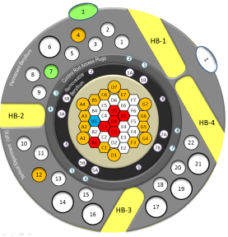
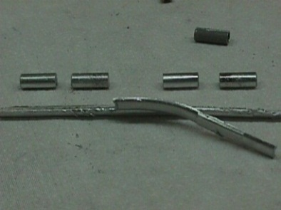
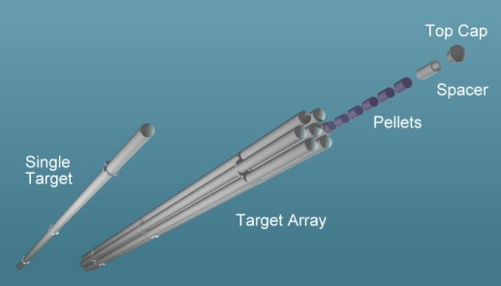
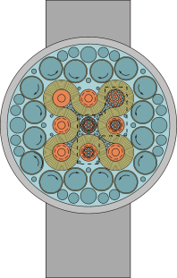
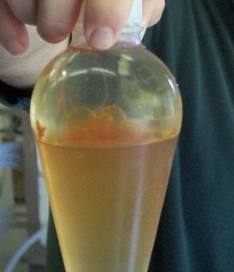
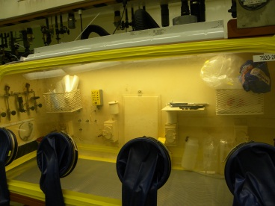
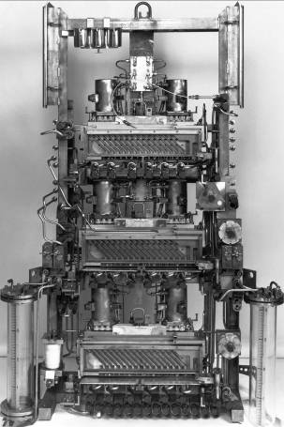
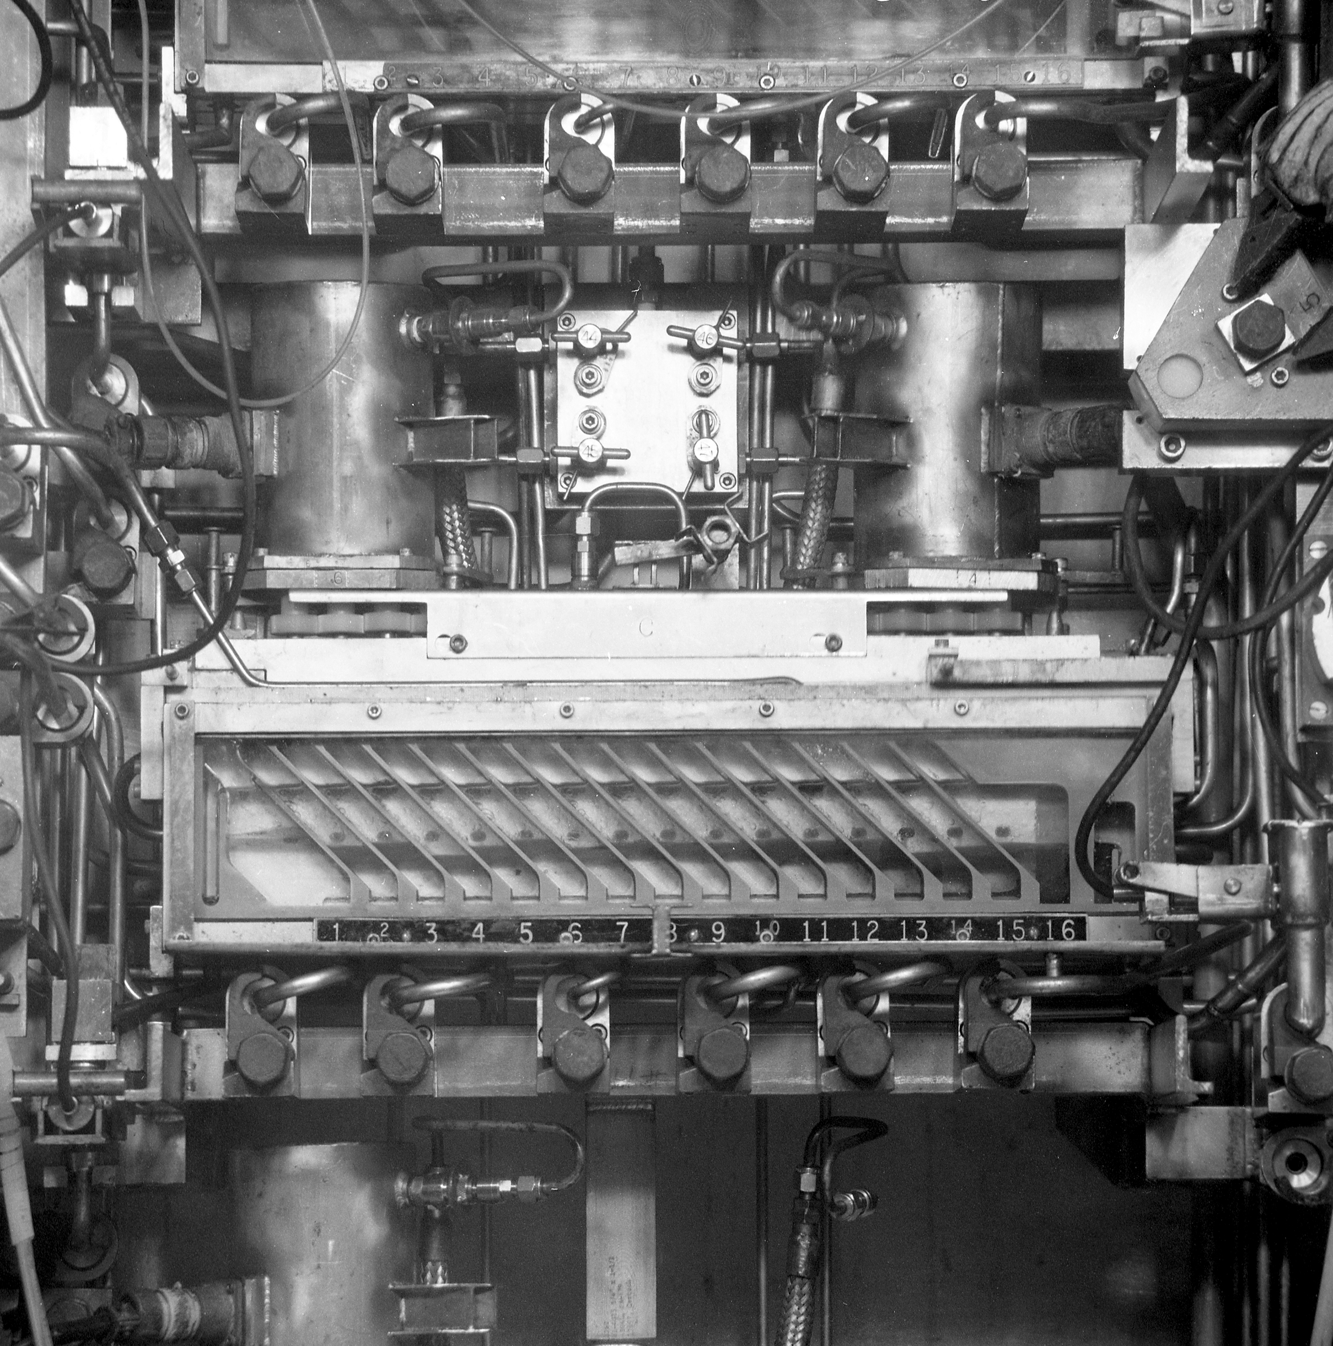
Development work will adjust processes to use existing research reactors
Neptunium Conversion to Oxide
Target Fabrication, Irradiation, and Post-Irradiation Examination
Chemical Separations
2011-044A RMW

Slide 9
Existing capabilities need scale-up
Process Step | Current Technology Using Existing Equipment | Proposed 2 kg/year | Issues to be Addressed During Development
Target Fabrication | < 100/year (hot cell and glovebox) | > 200-600/year (glovebox) | Production target design
Dissolution (caustic) | 4 kg Al/batch (upper limit) | 4 kg Al/batch | Process controls to ensure safe operation at maximum throughput
Dissolution (acid) | 1-2 kg/batch heavy metal (HM) as used nuclear fuel (UNF) | 2 kg HM as irradiated Np/Pu per batch | Dissolution of actual irradiated target material (small batches)
Solvent extraction | 1-4 kg UNF | 2 Kg Np/Pu /batch | Np valence state adjustment; Np extraction behavior; effects of high specific activity 238Pu on solvents.
Anion exchange | 200 gm Pu/batch | 200 gm 238Pu/batch | Effect of high specific activity 238Pu on existing process chemistry

Slide 10
Existing capabilities scale-up (continued)
Process Step | Current Technology Using Existing Equipment | Proposed 2 kg/year | Issues to be Addressed During Development
Oxalate Precipitation | 35 gm/batch using ²⁴²Pu | 80 gm/batch ²³⁸Pu | Effect of high specific activity ²³⁸Pu on existing process chemistry
16O | SRS/LANL Technology exists (not implemented at ORNL) | 2 kg/year | Methods for safe process operation and control; ensure minimal back reaction
Shipping | ~ 75-200 gm ²⁴²Pu/shipment ~ 8 gm ²³⁸Pu/shipment | ~ 200-600 gm ²³⁸Pu/shipment | Increase capacity per shipment for ²³⁸Pu shipments
Modified direct denitration | 0.1 - 1.0 kg/hour based on U | 100-200 gm/hour of Np | Demonstrate process chemistry for MDD based on Np
Pa removal | ~ 100 gm Np total (for previous test target work) | ~ 14 kg Np/year | Scale up from ~100 gm to ~14 kg/yr.

Slide 11
Path to Full-Scale Production
Complete NEPA Documentation; finalize project alternative selection | Spring 2013
Qualify targets for HFIR; begin integrated process demonstration | Fall 2013
Ship first Pu-238 sample material to LANL (confirms product quality) | Fall 2014
Qualify targets for ATR; begin ramp-up to full production | Fall 2016
Turnover to Operations | Fall 2017
DOE and NASA are moving forward with a realistic, low-risk plan to address this critical supply issue

Slide 12
Acknowledgment
The majority of the content presented here, including all of the graphics, was provided by Dr. Robert Wham of the Oak Ridge National Laboratory.

