Slide 1

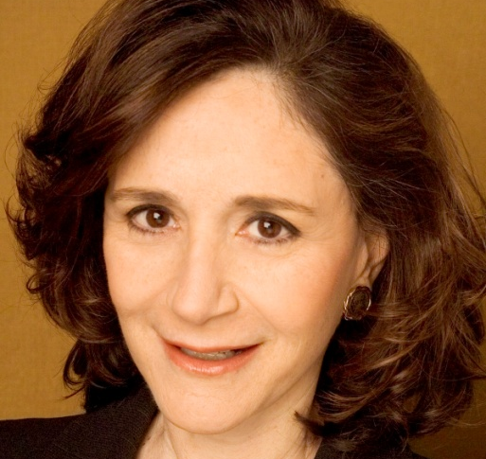
CISE DISTINGUISHED LECTURE SERIES
Wednesday, April 4 at 2pm in Rm. 110
Alone Together:
Technology as the Architect of Our Intimacies
Prof. Sherry Turkle, MIT
Technology proposes itself an architect of our intimacies. And these days, technology offers us substitutes for direct face-to-face connection with people in a world of machine-mediated relationships on networked devices. As we instant message, e-mail, text, and Twitter, technology redraws the boundaries between intimacy and solitude. As we instant message, e-mail, text, and Twitter, technology redraws the boundaries between intimacy and solitude. We talk of getting “rid” of our e-mails, as though these notes were so much excess baggage. Besides, it takes too long; across the generations, we would rather text than talk.
The world of our connections comes with so many bounties. But we begin to see that some things are amiss: sometimes we are too busy communicating to think, too busy communicating to create, and paradoxically, too busy communicating to connect with the people who matter. This has implications for children as they grow up, for grownups as they form relationships, and for institutions as they try to do their work.
The goals of this presentation is to sketch out the most important challenges facing both individuals and institutions as we face the new challenges of our digital age and to provide new tools for thinking through and addressing these issues. It is time to start a new kind of conversation – in our families, in our places of business, in our political institutions.
Sherry Turkle is the Abby Rockefeller Mauzé Professor of the Social Studies of Science and Technology at MIT and the founder and director of the MIT Initiative on Technology and Self. Prof. Turkle has published eight books, including “Alone Together: Why We Expect More from Technology and Less from Each Other.” Prof. Turkle writes on the "subjective side" of people's relationships with technology, is an expert on mobile technology, social networking, and sociable robotics. She has been named "woman of the year" by Ms. Magazine and among the "forty under forty" who are changing the nation by Esquire.
Talks held at 4201 Wilson Blvd. Questions: Contact Amanda Shea at ashea@nsf.gov

