Slide 1


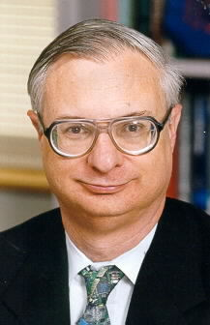
Virtual Coaches in Healthcare:
A Vision of the Future
Thurs, Sept 20, 10am (Rm. 110)
Daniel P. Siewiorek
Director of the Quality of Life Technology Center, CMU
CISE DISTINGUISHED LECTURE SERIES
Daniel P. Siewiorek is the Buhl University Professor of Electrical and Computer Engineering and Computer Science at Carnegie Mellon University. He is the Director of the Quality of Life Technology Center, an NSF ERC in collaboration with the University of Pittsburgh. Previously he served as head of CMU’s Human Computer Interaction Institute. His research interests span human interaction with intelligent systems, mobile and ubiquitous computing, and system reliability. He has designed or been involved with the design of nine multiprocessors, over two-dozen commercial computers, and over 20 generations of mobile systems. He has written nine textbooks and is a recipient of major awards from AAEE, IEEE, and ACM. He is a Fellow of IEEE, ACM, and AAAS, and a member of the National Academy of Engineering.
With health care costs raising astronomically and the number of aging increasing, there are not enough economic or human resources in the way of care givers to meet society’s needs. A confluence of technologies including miniature electronics, digital communications, human-computer interaction, robotics, and machine learning makes possible the creation of intelligent assistants that monitor and communicate with users, understand their needs and goals, and compensate for diminished capabilities as we age or suffer a disability. This talk will highlight the research challenges in creating virtual coaches that monitor user activities providing reminders and advice to reach personal and caregiver goals.
Talks held at 4201 Wilson Blvd, Arlington, VA 22230 Questions: Contact Dawn Patterson at dpatters@nsf.gov

