Slide 1


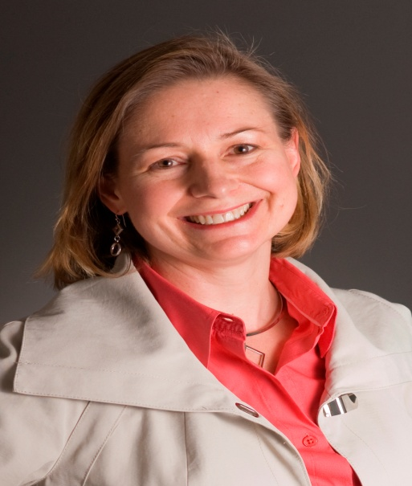
Inventing the Future of Technology with Emotion
Wednesday, October 10th, 2012 , 10am (Rm. 110)
Rosalind Picard, Sc.D, FIEEE
Professor, MIT Media Lab &
Co-Founder, Chief Scientist, Chairman Affectiva, Inc.
CISE DISTINGUISHED LECTURE SERIES
Affective computing was originally envisioned to make computers emotionally intelligent, e.g., recognizing if they’ve annoyed you, and responding in a way that doesn’t escalate your frustration. Over the years we’ve created dozens of technologies in an effort to provide tools that comfortably and respectfully recognize and respond to human emotion – and some of them succeed. Successful affective technologies do not merely make machines intelligent, they also help people be smarter – especially for those of us who face challenges processing emotional information, whether because of having autism, having limited vision, or having other impediments to understanding emotion. Along the way I have encountered big surprises. I will share stories of things learned and will attempt some (risky) live demonstrations.
Dr. Rosalind Picard is a Professor at the MIT Media Lab. She holds degrees in Electrical Engineering and Computer Science from Georgia Tech and MIT and is a fellow of the IEEE. She has authored or co-authored over 200 scientific articles in signal processing, computer vision, pattern recognition, machine learning, and affective computing. Dr. Picard wrote the book Affective Computing, which helped give rise to a field by that name.
Picard is also co-founder, chief scientist, and chairman of Affectiva, Inc., supported by an NSF SBIR, which has commercialized two of the technologies she will show.
Talks held at 4201 Wilson Blvd, Arlington, VA 22230 Questions: Contact Jasmine Young at jyoung@nsf.gov

