Slide 1


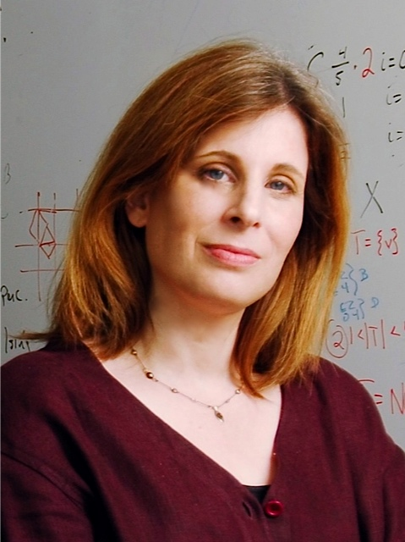
Sampling Random Structures and Phase Transitions Wednesday, March 20,2013,10:30am (Rm. 110) Dana Randall, PhD Professor, Georgia Tech
CISE DISTINGUISHED LECTURE SERIES
Sampling algorithms using Markov chains arise in many areas of computation, engineering, and science. The idea is to perform a random walk among the elements in a large state space so that samples chosen from the stationary distribution are useful for the application. In order to get reliable results efficiently, we require the chain to be rapidly mixing, or quickly converging to equilibrium. Often there is a parameter of the system (typically related to temperature or fugacity) so that at low values many natural chains converge rapidly while at high values they converge slowly, requiring exponential time. This dichotomy is often related to phase transitions in the underlying models. In this talk we will explain this phenomenon, giving examples form the natural and social sciences, including magnetization, lattice gasses, colloids, and models of segregation.
Dr. Dana Randall is the Advance Professor of Computing and an Adjunct Professor of Mathematics at Georgia Tech. She is a Fellow of the American Mathematical Society, a National Associate of the National Academies, and holds degrees in Computer Science and Mathematics from Harvard University and U.C. Berkeley. Her research on randomized algorithms and sampling has helped create an interdisciplinary field bridging computer science, discrete probability and statistical physics. Dr. Randall currently serves on the Board of Governors of the Institute for Mathematics and its Applications, the Executive Board of DIMACS, the Editorial Board of the AMS, and the Steering Committee of the SIAM/ACM Symposium on Discrete Algorithms.
Talks held at 4201 Wilson Blvd, Arlington, VA 22230 Questions: Contact Jeannette Pitt-Simpkins at jpittsim@nsf.gov

