Slide 1

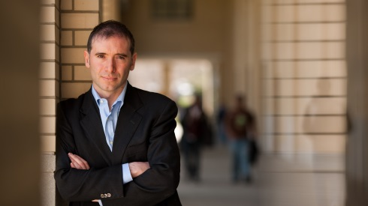
W ashington
A rea
T rustworthy
C omputing
H our
18th WATCH:
An Experiment in Hiring Discrimination via Online Social Networks
Alessandro Acquisti
Carnegie Mellon University
THURSDAY Sept 26th, Noon, Room 110
Abstract
Anecdotal evidence and self-report surveys suggest that U.S. firms are using Web 2.0 and social networking sites to seek information about prospective hires. However, little is known about how the information they find online actually influences their hiring decisions. We present two controlled experiments of the impact that information posted on a popular social networking site by job applicants can have on employers' hiring behavior. In two studies (a survey experiment and a field experiment) we measure the ratio of callbacks that different job applicants receive as function of their personal traits. The experiments (a survey experiment and a field experiment) focus on sensitive traits that are either unlawful or risky for U.S. employers to enquire about during interviews, but which can be inferred from applicants' online presences. Both the results from the survey experiments and those from the field experiment provide evidence of potential hiring discrimination via social networking sites.
Speaker
Alessandro Acquisti is an associate professor at the Heinz College, Carnegie Mellon University (CMU) and the co-director of CMU Center for Behavioral and Decision Research. He investigates the economics of privacy. His studies have spearheaded the application of behavioral economics to the analysis of privacy and information security decision making, and the analysis of privacy and disclosure behavior in online social networks. Alessandro has been the recipient of the PET Award for Outstanding Research in Privacy Enhancing Technologies, the IBM Best Academic Privacy Faculty Award, multiple Best Paper awards, and the Heinz College School of Information's Teaching Excellence Award. He has testified before the U.S. Senate and House committees on issues related to privacy policy and consumer behavior. Alessandro's findings have been featured in national and international media outlets, including the Economist, the New York Times, the Wall Street Journal, the Washington Post, the Financial Times, Wired.com, NPR, and CNN. His 2009 study on the predictability of Social Security numbers was featured in the "Year in Ideas" issue of the NYT. Alessandro holds a PhD from UC Berkeley, and Master degrees from UC Berkeley, the London School of Economics, and Trinity College Dublin. He has held visiting positions at the Universities of Rome, Paris, and Freiburg (visiting professor); Harvard University (visiting scholar); University of Chicago (visiting fellow); Microsoft Research (visiting researcher); and Google (visiting scientist). He has been a member of the National Academies' Committee on public response to alerts and warnings using social media.
About the WATCH series:
Transforming today’s trusted but untrustworthy cyberinfrastructure into one that can meet society’s growing demands requires both technical advances and improved understanding of how people and organizations of many backgrounds perceive, decide to adopt, and actually use technology. WATCH aims to provide thought-provoking talks by innovative thinkers with ideas that illuminate these challenges and provide signposts toward solutions. The series is jointly organized by NSF’s Computer Science and Engineering (CISE) and Social, Behavioral, and Economic (SBE) Directorates and sponsored by the CISE Secure and Trustworthy Cyberspace (SaTC) Program. Talks will be recorded and made available over the Internet.
Thursday, Sept 26, 2013
NSF Stafford I Room 110, Noon
Public Invited
Questions/comments about WATCH?
Contact Keith Marzullo kmarzull@nsf.gov

