Slide 1
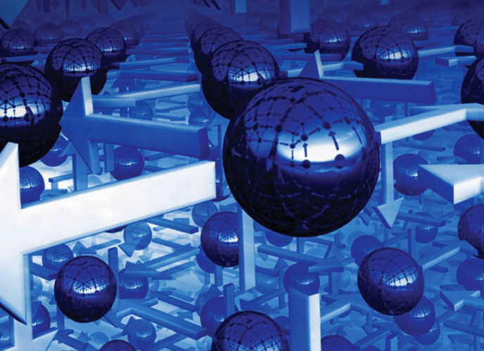

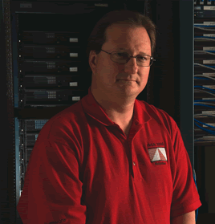
21st Century
Computer Architecture
Wednesday, Dec 18, 2013, 10am (Rm. 110)
Mark D. Hill, Ph.D.
Gene M. Amdahl Professor of Computer Sciences and
Electrical & Computer Engineering
University of Wisconsin-Madison
FY14 CISE DISTINGUISHED LECTURE SERIES
Dr. Mark D. Hill is the Gene M. Amdahl Professor of Computer Sciences and Electrical & Computer Engineering at the University of Wisconsin-Madison, where he also co-leads the Wisconsin Multifacet project. His research interests include parallel computer system design, memory system design, computer simulation, deterministic replay and transactional memory. He earned a Ph.D. from the University of California, Berkeley. He is an ACM Fellow, a Fellow of the IEEE, co-inventor on 30+ patents, and ACM SIGARCH Distinguished Service Award recipient. Hill's 30-year career has been largely supported by NSF.
This talk—suitable for a wide CS audience—has two parts. The first part will discuss possible directions for computer architecture research, including architecture as infrastructure, energy first, impact of new technologies, and cross-layer opportunities. This part is based on a 2012 Computing Community Consortium (CCC) whitepaper effort led by Hill. The second part of the talk is an example of the cross-layer research advocated in the first part. Analysis shows that many “big-memory” server workloads, such as databases, in-memory caches, and graph analytics, pay a high cost for page-based virtual memory: up to 50% of execution time wasted. Via small changes to the operating system (Linux) and hardware (x86-64 MMU), this work reduces execution time these workloads waste to less than 0.5%. The key idea is to map part of a process’s linear virtual address space with a new incarnation of segmentation, while providing compatibility by mapping the rest of the virtual address space with paging.
Talks held at 4201 Wilson Blvd, Arlington, VA 22230 Questions: Contact Cherrelle Dike at cdike@nsf.gov.

