Slide 1


S-STEM (17-527) NSF Scholarships in Science, Technology, Engineering, & Mathematics Information Materials
1
Overview of the
Solicitation
Notes:
Welcome! This is the first in a series of presentations on the S-STEM solicitation. These presentations will cover long standing characteristics of the S-STEM program as well as a few details that have changed recently. Each presentation will be hosted by a different program officer on the S-STEM team.

Slide 2
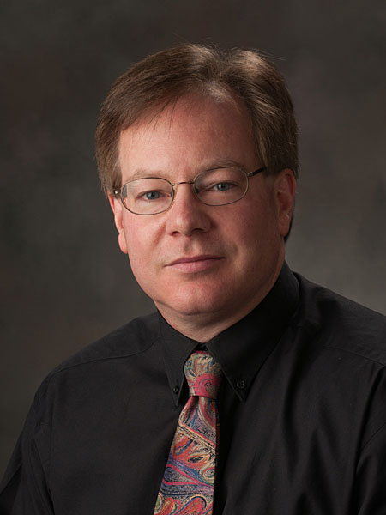
S-STEM Presentations
Presenter Kevin Lee
Methodology
Part I: Presentations (7) Available
Part II: Q & A Sessions
Notes:
My name is Kevin Lee and I am a co-lead of the S-STEM program. This is my third year as part of the S-STEM team. My disciplinary expertise is in physics and astronomy and I am an NSF rotator from the University of Nebraska.
Our goal in these informational materials is to communicate characteristics of the S-STEM program to prospective investigators and these presentations are part 1 of our effort to do so. Part 2 will consist of Webinar question and answer teleconference sessions. So these materials function in a “flipping the classroom” mode. Investigators will be asked to view the presentations first at their convenience and formulate the questions they wish to ask in the teleconference Q & A sessions at a later date. This approach allows us to provide these presentations soon after the release of the new solicitation and you can get started on your preparations to submit a proposal immediately rather than wait for a scheduled webinar session. Hopefully we have successfully anticipated many of the questions you will likely have regarding the new solicitation and handled them in the presentations.

Slide 3
Presentation Series
1) Overview of the S-STEM Program
2) Track 1: Institutional Capacity Building
3) Track 2: Design and Development: Single Institution
4) Track 3: Design and Development: Multi-Institutional Consortia
5) Information for New PIs and Common Problems
6) Project Description
7) Merit Review Criteria
Notes:
Here is an outline of the seven part series.
We will start with an overview of the S-STEM program (this presentation).
We will then look at the different categories of proposals that can be submitted to S-STEM and the scope of each.
We will then move on to proposal preparation. There is one presentation designed for new PIs that will focus on the basics and common problems; and one describing a project description for S-STEM to help all investigators see the “big picture” of an S-STEM proposal.
We will close with an overview of the Merit Review Process with an emphasis on how it applies to the S-STEM program.
Many investigators will want to view all 7 presentations sequentially to get a complete perspective. However, it may not be necessary to view all 7.

Slide 4
Overview of the S-STEM Program Presentation1 Outline
What hasn’t changed
S-STEM Overall Purpose
What has changed
Motivations
60/40 split
Strands and Types
Notes:
Here is an outline of the content of this particular presentation.
We will first focus on the purpose, long-time characteristics, and tremendous benefits of the S-STEM program – things that will be familiar to many of you.
We will then move on to what has changed recently and the underlying motivations for these changes and set the stage for the 6 presentations that follow this one. We will particularly focus on the much broader range of program elements that can now be funded.

Slide 5
S-STEM Program: Core Purpose
To improve the STEM workforce by increasing
# of students who graduate with STEM degrees
# of students entering the STEM workforce
Provides Scholarships
Academically Talented
Low-income students with demonstrated financial need
Funded by H-1B visa fees
Notes:
The overarching purpose of the S-STEM program has remained constant. We are focused on providing scholarships to academically talented low-income students with demonstrated financial need to improve the STEM workforce with the intent of ensuring that the United States is competitive in the global workplace.
There are still three criteria for awarding scholarships to students.
Students must be academically talented (or have the potential to become so).
Students must be low-income and demonstrate financial aid needs as determined by your financial aid office evaluating a student’s FAFSA or GAANN form.
Students must be U.S. citizens and nationals of the United States (as defined in section 101(a) of the Immigration and Nationality Act), aliens admitted as refugees under section 207 of the Immigration and Nationality Act, or aliens lawfully admitted to the United States for permanent residence.
Note that the funding mechanism for S-STEM is different than for most other NSF programs. It is funded by H-1B visa fees. Corporations pay a visa fee to bring in a high-tech worker from another country and those funds are then used to further development of our own pool of high-tech workers.

Slide 6
The S-STEM Program: Recent Changes
Funding
At least 60% of the funds must be used for scholarships
Up to 40% of funds may be used for other things – support structures, research, recruitment, etc.
Why the change?
Scholarships are not enough
Many more support structures are now possible
A more systematic determination of what support structures are effective will benefit the STEM education community.
Notes:
The solicitation specifies that at least 60% of the funds must be used for student scholarships. This allows more funds to go into supporting high quality curricular and co-curricular activities, and studies on the recruitment and retention of students, and the effectiveness of support structures.
So what is the motivation behind this? Providing students with scholarship support helps then overcome financial obstacles in their path to obtaining a STEM degree. However research has shown that scholarships alone are not sufficient to ensure that low-income academically talented students with demonstrated financial need complete degrees. It has become clear that scholarships along with participation in academic and student support activities result in retention and graduation in STEM fields. The additional funds allow PIs to provide more academic and student services support. They also will enable S-STEM awardees to gather systematic information and disseminate the “lessons learned” about how and what support structures or factors affect student outcomes in different circumstances.
The S-STEM program makes it possible for PIs to implement and adapt high-quality and effective curricular and co-curricular activities for recruiting and support structures to tackle unique challenges at their schools. It allows for the adaptation of effective programmatic elements and encourages PIs to study the effects of their implementation and disseminate that information to the broader community. All projects must be knowledge-generating!

Slide 7
Goals of the Program
1. To increase the recruitment, retention, student success, and graduation (and transfer) of low-income academically talented students in STEM.
2. To implement and study models, effective practices, and/or strategies that contribute to success in STEM.
3. To contribute to the implementation and sustainability of effective curricular and co-curricular activities in STEM education.
Notes:
There are three major goals for the S-STEM program:
To increase the recruitment, retention, student success, and graduation (including student transfer) of low-income academically talented students with demonstrated financial need who are pursuing associate, baccalaureate, and graduate degrees in STEM, and subsequently enter the STEM workforce or graduate study.
2. To implement and study models, effective practices, and/or strategies that contribute to understanding the factors of supportive curricular and co-curricular activities that affect recruitment, retention, student success, academic/career pathways, and/or degree attainment (including student transfer) in STEM of low-income academically talented students with demonstrated financial need.
3. To contribute to the implementation and sustainability of effective curricular and co-curricular activities (e.g. curriculum, professional, and workforce development activities) for low-income academically talented students with demonstrated financial need, pursuing undergraduate or graduate STEM education.

Slide 8
S-STEM Proposal Categories
Track I: S-STEM Institutional Capacity Building
Capped at 650k for maximum duration of 5 years
Track 2: Design and Development: Single Institution
Capped at 1M for maximum duration of 5 years
Track 3: Design and Development: Multi-Institutional Consortia
Capped at 5 M for maximum duration of 5 years
Notes:
The solicitation specifies three different kinds of proposals that can be submitted.
Track 1 is entitled S-STEM Institutional Capacity Building. These proposals are capped at 650k for a maximum duration of 5 years. At least 60% of the funds must support scholarships for low-income academically talented students with demonstrated financial need. Projects are still expected to implement effective practices, and use that information to learn, and to disseminate findings to the broader community. Projects are encouraged to use data analytics to discover academic and career pathways.
Track 2 is entitled S-STEM Design and Development for single institutions. These projects are capped at 1M for a maximum duration of 5 years and should implement and test effective high quality curricular and co-curricular activities. Activities are expected to increase the recruitment, retention, student success, and graduation (including student transfer) of low-income academically talented students with demonstrated financial need who are pursuing associate, baccalaureate, and graduate degrees in STEM. It is expected that these projects will study attempts to address a well-documented institutional need or concern (in a manner consistent with what is already known from educational research).
Track 3 is entitled S-STEM Design and Development for Multi-Institutional consortia and are capped at 5M for a maximum duration of 5 years. It is expected to involve several institutions implementing scholarship programs and collaborating on the implementation and study of a common set of academic or student support services. The actual amount of funding requested should reflect the number of schools involved, the number of scholarships awarded, and the complexity of the academic and student support service questions explored.

Slide 9
Expected Student Outcomes
1) Receive a degree in one of the STEM disciplines supported by the S-STEM program;
2) Transfer from an associate to a baccalaureate degree program or from an undergraduate to a graduate program; or
3) Successfully overcome one or more of an institution's self-identified attrition points
Notes:
The outcomes that scholarship recipients are expected to achieve by the end of the S-STEM scholarship award period include:
1) Receive an associate, baccalaureate, or graduate degree in one of the STEM disciplines supported by the S-STEM program; or
2) Transfer from an associate degree program to a baccalaureate degree program or from an undergraduate
program to a graduate program in one of the STEM disciplines supported by the S-STEM program; or
3) Successfully overcome one or more of an institution's self-identified attrition points which have been described in the institution's proposal.

Slide 10
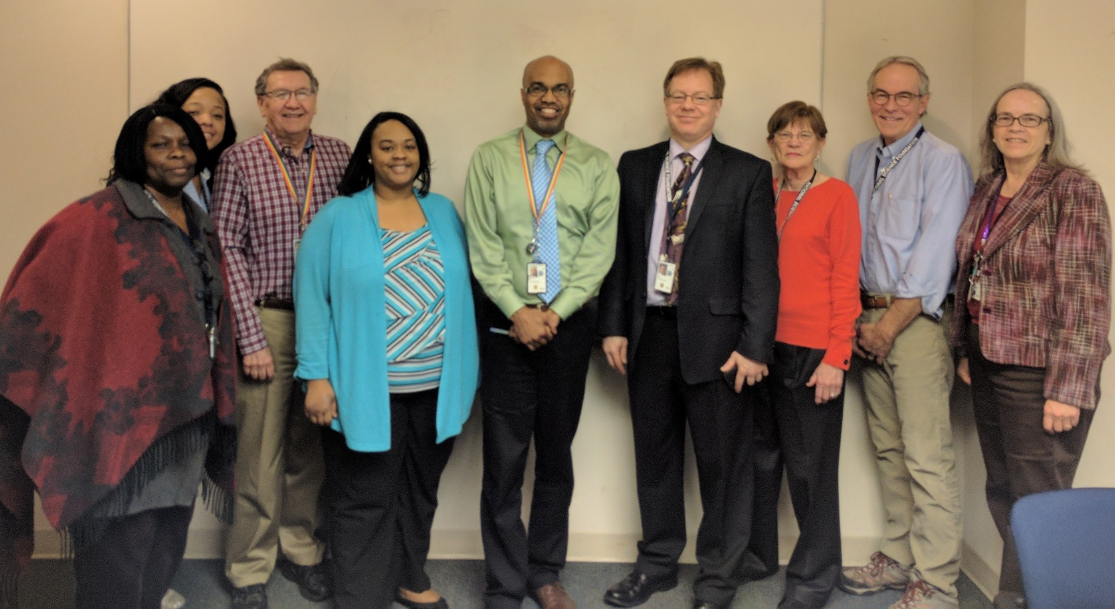
Thank you
NSF S-STEM Team
Abby Ilumoka, Jaimia Goodwin, John Haddock, Nabriya Horton, Ron Buckmire
Kevin Lee, Liz Teles, Chuck Sullivan, Stephanie August
Not Pictured: Ellen Carpenter, Karen Crosby, Connie Della-Piana, Tom Higgins, Ece Yaprak
Notes:
We hope this presentation has been useful in helping you to plan your S-STEM proposal. On behalf of the NSF and the entire S-STEM team we thank you for your time and interest. For more information, please consult the S-STEM solicitation or the links on the next slide.

Slide 11
Additional Information
NSF Proposal & Award Policies & Procedures Guide
https://www.nsf.gov/pubs/policydocs/pappg17_1/
Common Guidelines for Education Research and Development
http://www.nsf.gov/pubs/2013/nsf13126/nsf13126.pdf
NSF Merit Review Overview
http://nsf.gov/bfa/dias/policy/merit_review/
Solicitation, FAQs, and Webinar Resources on the S-STEM program website:
https://www.nsf.gov/funding/pgm_summ.jsp?pims_id=5257
Notes:
Here are links to a collection of resources on NSF proposal submission and the S-STEM program in particular.

