Slide 1


S-STEM (NSF 17-527) NSF Scholarships in Science, Technology, Engineering, & Mathematics Information Materials
2
DELETE
Track 1: S-STEM Institutional Capacity Building
Notes:
Welcome! This is the second in a series of short presentations on the new S-STEM solicitation that was released in June. This presentation will address proposals to Track 1 of the SSTEM program. This track is called “Institutional Capacity Building”.

Slide 2
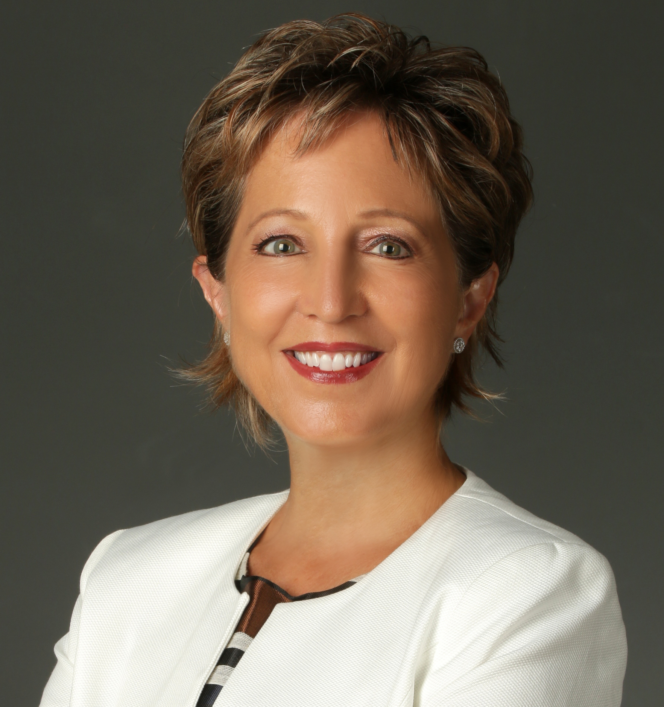
S-STEM Presentation
Presenter : Ece Yaprak, Ph.D.
Notes:
Hi, this is Ece Yaprak. I am a Program Officer working on the S-STEM program. My background is in Engineering. I am in the NSF Division of Undergraduate Education from Wayne State University.
I will be conducting this presentation on some aspects of the S-STEM program . The presentation describes material that appears in NSF 17-527, the S-STEM solicitation or NSF 17-1, the NSF Proposal & Award Policies & Procedures Guide.

Slide 3
S-STEM Program Goals
To increase the recruitment, retention, student success, and graduation (including student transfer) of low-income academically talented students who are pursuing associate, baccalaureate, or graduate degrees in STEM and enter the STEM workforce or graduate study.
To implement and study models, effective practices, and/or strategies that contribute to understanding of factors that affect recruitment, retention, student success, academic/career pathways, and/or degree attainment in STEM of low income academically talented students.
To contribute to the implementation and sustainability of effective curricular and co-curricular activities for low-income academically talented students pursuing undergraduate and graduate STEM education
Notes:
The goals of the S-STEM program are:
To increase the recruitment, retention, student success, and graduation (including student transfer) of low-income academically talented students with demonstrated financial need who are pursuing associate, baccalaureate, or graduate degrees in STEM and enter the STEM workforce or graduate study.
To implement and study models, effective practices, and/or strategies that contribute to understanding of factors … that affect recruitment, retention, student success, academic/career pathways, and/or degree attainment (including student transfer) in STEM of low income academically talented students with demonstrated financial need.
To contribute to the implementation and sustainability of effective curricular and co-curricular activities (e.g., curriculum, professional, and workforce development activities) for low-income academically talented students with demonstrated financial need, pursuing undergraduate and graduate STEM education

Slide 4
Track 1: Key Parameters
$650,000 total over a maximum duration of 5 years.
At least 60% of total amount requested must be requested for scholarships
(FAFSA, GAANN, eligible)
Implementation and Investigation of academic and student support activities.
Invites proposals focused on S-STEM disciplines
Requires STEM faculty mentors and a cohort experience.
Notes:
Let’s begin by describing some key parameters for the SSTEM Track 1 Institutional Capacity Building proposals. Institutions may request up to $650,000 over a maximum duration of 5 years.
At least 60% of the total amount request must be used for scholarships given to low-income students with demonstrated financial need and academic talent or potential.
Financial need is determined by the FAFSA form for undergraduates and the GAANN for graduate students.
In addition to providing scholarships, projects will implement and investigate academic and student support activities.
Projects must involve specific STEM disciplines that are listed in the S-STEM solicitation.
Projects are required to have STEM faculty mentors and a cohort experience for students.

Slide 5
Track 1 – Who should consider applying to this strand?
Focus: Institutional Capacity Building
Institutions that have limited experience with designing and conducting NSF-funded research and implementation activities.
Examples
Institutions who have not been funded by NSF.
Institutions with limited NSF funding experience.
Notes:
Next what are the types of institutions that should consider applying to Track 1? The institutional capacity building track is intended for institutions that have limited experience with designing and conducting NSF-funded projects -- such as the type of projects described in the other track, that is Track 2.
Examples of institutions that might be appropriate applicants to S-STEM track 1 include:
Institutions who have not been funded by the NSF in the past. Or institutions with limited NSF funding.
This is what is intended by institutional capacity building, providing a way for institutions with limited NSF grant experience to join the S-STEM community of practice.

Slide 6
Purpose of projects
Provide scholarships.
Increase recruitment, retention, student success and completion of STEM degrees, and subsequent entry into the workforce or graduate studies.
Improve the implementation and understanding of evidence-based academic and student support activities for NSF S-STEM Scholars and other academically talented students pursuing STEM degrees.
Develop and test strategies for systematically exploring student academic and career pathways in STEM in ways that are congruent with the context of the institution.
Establish new collaborative partnerships and infrastructure.
Notes:
What is the purpose of SSTEM Track 1 Institutional Capacity Building projects?
First of all to provide scholarships to low-income STEM students with academic talent and demonstrated financial need.
Projects should increase recruitment, retention, student success, completion of STEM degrees and entry into the workforce or graduate studies.
Projects improve the implementation and understanding of evidence-based academic and student support activities for NSF S-STEM scholars and other academically talented students, especially other low-income students, pursuing STEM degrees. In other words, projects should implement and contribute knowledge about existing effective practices.
Improve STEM career pathways. Projects should develop and test strategies for improving student academic and career pathways in STEM. These pathways should be consistent with the context or situation at a given institution. In other words, the pathways should make sense based on the type of institution and the current institutional goals. They should establish ecosystems of academic and student support that foster student success and contribute to the national goal of increasing student retention and graduation in STEM. They should help the S-STEM community and others learn about what is working and for what types of students.
Establish partnerships and infrastructure. The projects should establish new partnerships and infrastructure to help build institutional capacity to address the current project goals and expanded goals for subsequent S-STEM projects. In other words, improve the foundation and capacity to the S-STEM community by creating and establishing new collaborations and new arrangements.

Slide 7
Project Team
Led by a team of STEM faculty who are currently teaching in S-STEM disciplines
The Principal Investigator must be a faculty member currently teaching in a S-STEM discipline.
A STEM administrator.
A member who may be an institutional, educational, discipline-based educational, or social science researcher.
Notes:
For S-STEM Type 1 proposals the project management team should consist of at least these three individuals. The Principal Investigator should be a faculty member currently teaching in one of the STEM disciplines. The STEM disciplines considered are listed in the solicitation. The STEM disciplines included in the S-STEM program are: biological sciences (except medicine and other clinical fields); physical sciences including physics, chemistry, astronomy, and materials science; the mathematical sciences; computer and information sciences; geosciences; engineering ; and technology areas associated with these fields.
The team should also include a STEM administrator as a co-Principal Investigator. This could be an administrator whose responsibilities include STEM subjects in addition to other duties. An example would be a Director of Admissions, or a Director of Student Services.
The third required member of the management team should be a co-Principal Investigator with a background in institutional research, education, social science or discipline-based education research. The education researcher co-PI can be from the same institution as the PI and the STEM administrator OR the education research co-PI can be from an institution or organization that is different from the institution that is submitting the proposal.

Slide 8
Project Plans
Recruitment and selection of NSF S-STEM Scholarship recipients.
Meet NSF S-STEM program eligibility criteria
Meet institution’s eligibility criteria
Is acceptable to encourage applications from members of underrepresented groups (e.g., gender, race, ethnicity, geographic areas, first generation, etc.) in STEM fields
Assist any student who meets eligibility criteria
Academic and student support activities must support student success, retention, (transfer), graduation in STEM and entry into the STEM workforce or graduate studies.
Notes:
In reviewing project plans, it is expected that projects will recruit and provide scholarships to qualified low income academically talented students who demonstrate financial need.
Recipients will meet program eligibility criteria and the criteria set by the institution.
Projects will implement academic and student support activities that have been found to foster student success, retention, transfer, graduation in STEM, and entry into the STEM workforce or graduate studies.

Slide 9
Project Plans (Continued)
Findings from these types of projects shall be used to improve local implementation of academic and student supports, provide an understanding of student success (e.g., effects of project activities on student outcomes),
Inform any future proposals for S-STEM Design and Development Strand.
Notes:
What is the expected purpose or goal of S-STEM Track 1 Institutional Capacity Building proposals? What are PIs expected to envision in their project plans?
In reviewing project plans, it is expected that findings from Track 1 projects will be used to improve implementation of academic and student support at the institution.
Projects will provide an understanding of student success. In other words, Track 1 projects will study the effects of project activities on student outcomes.
A Track 1 Institutional capacity building project is expected to inform future proposals by the PI team or institution to the other tracks of S-STEM, the Design and Development Tracks.

Slide 10
Project Plans (Continued)
PIs are encourage to work with offices of institutional research or similar offices.
And/Or contact researchers whose interests are in understanding undergraduate/graduate STEM education or workforce development.
PIs are encouraged to review the S-STEM Program FAQs (When available on program website).
PIs are encouraged to review the Common Guidelines for Education Research and Development (NSF 13-126).
Notes:
Continuing with project plans …
PIs are encouraged to work with their offices of institutional research or other similar offices to make use of existing infrastructure and expertise to gather data relevant to the goals of the S-STEM project.
Another option for PIs is to contact educational researchers whose interests are in understanding undergraduate or graduate STEM education and workforce development. These researchers can serve as co-investigators on the planned S-STEM project.
The program also has developed a set of Frequently Asked Questions that may be helpful. FAQs will be located on the program webpage when available.
The Department of Education, Institute for Educational Sciences and the Education and Human Resources Directorate at NSF developed the Common Guidelines for Education Research and Development. This document describes expectations for research studies. PIs are encouraged to review the Common Guidelines when planning projects.

Slide 11
Data Analytics
The program encourages projects to consider utilizing data analytics to examine patterns in institutional student data that describe and predict the successful completion of student academic and career paths.
Notes:
Another suggested source of information useful to an S-STEM project is through the use of Data Analytics.
Data Analytics methods can allow the project team to discern patterns in institutional student data that describe and predict the successful completion of student academic degree programs and entry into STEM career paths.

Slide 12
Use of funds – Track 1
Scholarships for low-income academically talented students with demonstrated financial need.
Support of implementation of high quality extant curriculum and other professional and workforce development activities.
Implementation and investigation of evidence-based academic and student support activities to determine their effectiveness in recruiting, retaining, and graduating students in STEM.
Support for project evaluation and management.
Notes:
What are funds to be used for in an S-STEM Track 1 Institutional Capacity Building Project?
Scholarships to low-income academically talented students with demonstrated financial need.
Funds should also be requested to support implementation and testing of evidence-based academic and student support activities to determine their effectiveness.
Fund should support investigation of the effectiveness of project activities in increasing recruitment, retention, student success and retention, and graduation and in what ways.
Funds should also support project evaluation and project management.

Slide 13
Expected Outcomes: Scholarship Recipients
Receive an associate, baccalaureate, or graduate degree in one of the STEM disciplines supported by the S-STEM program;
Transfer from an associate degree program to a baccalaureate degree program or from an undergraduate program to a graduate program in one of the STEM disciplines supported by the S-STEM program; or
Successfully overcome one or more of an institutions’ self-identified attrition points which have been described in the proposal.
Notes:
It is expected that scholarship recipients will achieve at least one of the following by the end of the scholarship award period.
Receive an associate, baccalaureate, or graduate degree in one of the STEM disciplines supported by the S-STEM program;
Transfer from an associate degree program to a baccalaureate degree program or from an undergraduate program to a graduate program in one of the STEM disciplines supported by the S-STEM program; or
Successfully overcome one or more of an institutions’ self-identified attrition points which have been described in the proposal.

Slide 14
Track 1: Institutional Capacity Building
$650,000 for a maximum duration of 5 years.
At least 60% of total amount requested must be requested for scholarships for low-income academically talented students
Increase recruitment, retention, student success, (transfer), and completion of STEM degrees by low-income talented students with demonstrated financial need, and entry into the workforce or graduate studies.
Develop and test strategies for student success.
Establish new collaborative partnerships and infrastructure.
Notes:
This brings us to the end of this webinar about SSTEM Track 1: Institutional Capacity Building projects. Before closing let us summarize just a few key points.
SSTEM Track 1 Institutional Capacity Building projects can request up to $650,000 for a maximum duration of 5 years.
At least 60% of total amount requested must be requested for scholarships for low-income academically talented students with demonstrated financial need.
A major goal is to increase the recruitment, retention, student success and completion of STEM degrees, by low-income talented students with demonstrated financial need. And support eventual entry into nations’ STEM workforce.
Track 1 projects will also be developing and testing strategies for student success and establishing new collaborative partnerships and infrastructure. This capacity building effort will support future proposals by the PI team or institution to the Design and Development tracks.

Slide 15
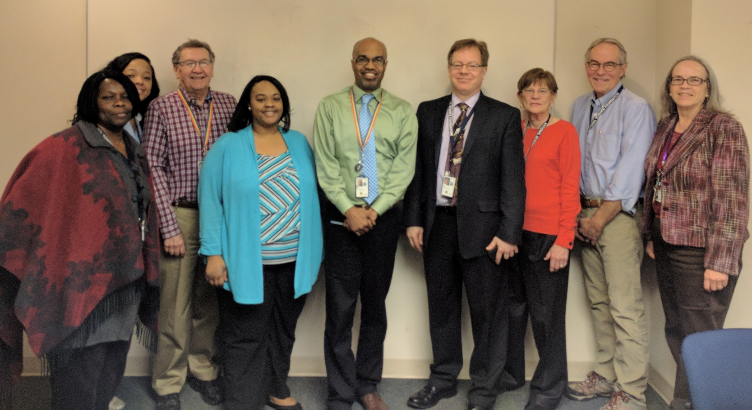
Thank you
NSF S-STEM Team
Abby Ilumoka, Jaimia Goodwin, John Haddock, Nabriya Horton, Ron Buckmire
Kevin Lee, Liz Teles, Chuck Sullivan, Stephanie August
Not Pictured: Ellen Carpenter, Karen Crosby, Connie Della-Piana, Tom Higgins, Ece Yaprak
Notes:
We hope this presentation has been useful in helping you to plan your S-STEM proposal. On behalf of the NSF and the entire S-STEM team we thank you for time and interest. For more information, please consult the S-STEM solicitation or the links on the next slide.

Slide 16
Additional Information
NSF Proposal & Award Policies & Procedures Guide
http://https://www.nsf.gov/pubs/policydocs/pappg17_1/
Common Guidelines for Education Research and Development
http://www.nsf.gov/pubs/2013/nsf13126/nsf13126.pdf
NSF Merit Review Overview
http://nsf.gov/bfa/dias/policy/merit_review/
Solicitation, FAQs, and Webinar Resources on the S-STEM program website:
https://www.nsf.gov/funding/pgm_summ.jsp?pims_id=5257
Notes:
Here are links to a collection of resources on NSF proposal submission and the S-STEM program in particular.

