Slide 1


S-STEM (NSF 17-527) NSF Scholarships in Science, Technology, Engineering, & Mathematics Information Materials
4
Track 3
Design and Development
Multi-Institution
Notes:
Welcome! This is the fourth in a series of presentations on the new S-STEM solicitation that was released in December 2016. This presentation will address proposals to Track 3 entitled “Design and Development – Multi Institution Consortia”.

Slide 2
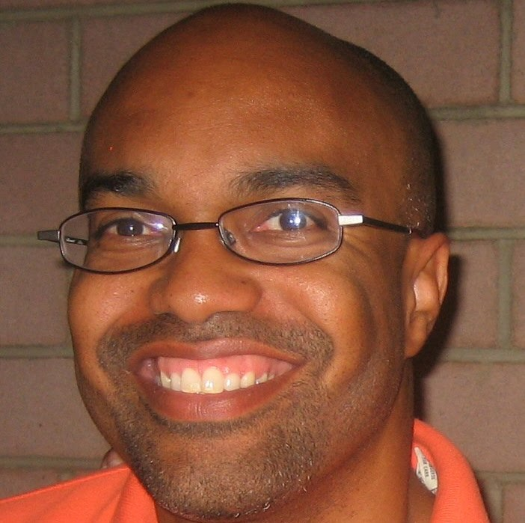
S-STEM Presentation
Ron Buckmire
Notes:
Hi, this is Ron Buckmire. I am a permanent Program Officer for mathematics education in NSF’s Education and Human Resources Directorate. My background is in applied mathematics. I am in the Division of Undergraduate Education as the Program Lead for the S-STEM (Scholarships in STEM) program.
I will be conducting this presentation on some aspects of the S-STEM program. The presentation describes material that appears in NSF 17-527, the S-STEM solicitation or NSF 17-1, the NSF Proposal & Award Policies & Procedures Guide.

Slide 3
S-STEM Program Goals
To increase the recruitment, retention, student success, and graduation (including student transfer) of low-income academically talented students … who are pursuing associate, baccalaureate, or graduate degrees in STEM and enter the STEM workforce or graduate study.
To implement and study models, effective practices, and/or strategies that contribute to understanding of factors … that affect recruitment, retention, student success, academic/career pathways, and/or degree attainment in STEM of low income academically talented students …
To contribute to the implementation and sustainability of effective curricular and co-curricular activities … for low-income academically talented students … pursuing undergraduate and graduate STEM education
Notes:
The goals of the S-STEM program are:
To increase the recruitment, retention, student success, and graduation (including student transfer) of low-income academically talented students with demonstrated financial need who are pursuing associate, baccalaureate, or graduate degrees in STEM and enter the STEM workforce or graduate study.
To implement and study models, effective practices, and/or strategies that contribute to understanding of factors that affect recruitment, retention, student success, academic/career pathways, and/or degree attainment (including student transfer) in STEM of low income academically talented students with demonstrated financial need.
To contribute to the implementation and sustainability of effective curricular and co-curricular activities (e.g., curriculum, professional, and workforce development activities) for low-income academically talented students with demonstrated financial need, pursuing undergraduate and graduate STEM education

Slide 4
Track 3 Projects Expectations
Establish scholarship programs for low-income academically talented students with demonstrated financial need.
Provide strong academic and student support.
Such as: high-quality extant curriculum, professional, and workforce development activities.
Increase student success, retention, and degree attainment in STEM (including student transfer, if appropriate).
Implement/adapt and study effective curricular and co-curricular activities and professional development activities
Contribute to understanding the effect of evidence-based practices on student outcomes.
Notes:
This presentation will focus on S-STEM Track 3 proposals
What are the Expectations of S-STEM Track 3 proposals?
They are expected to establish scholarship programs for low-income academically talented students with demonstrated financial need and provide academic and student support.
This academic and student support can take the form of implementation of (1) high quality extant curricular efforts and (2) other professional and/or workforce development activities.
Projects should increase retention, student success and graduation rates (and transfer rates, if appropriate) in STEM fields.
Projects should also contribute to understanding the effect of evidence-based practices (such as recruitment, student success, retention, graduation, and transfer in STEM including cognitive and non-cognitive factors).

Slide 5
Track 3 Features
Focus on multi-institutional efforts - may request up to:
$5.0 million total for a maximum duration of 5 years
At least 60% of the total requested amount must support scholarships for low-income academically talented students with demonstrated financial need.
Implementation and investigation of a common set of high-quality curricular and/or co-curricular activities.
Proposals focused on STEM disciplines included in the S-STEM program.
Notes:
An important feature of Track 3 awards is the amount and duration of the awards. The multi-institutional efforts may request up to 5 million dollars for a 5-year period.
5 million is the total amount split between the consortia members.
At least 60% of the total request must support scholarships for academically talented STEM students with demonstrated financial need.
The effort provides technical assistance, infrastructure, and processes to support implementation and investigation of a common set of effective practices
The STEM disciplines included in the S-STEM program are: biological sciences (except medicine and other clinical fields); physical sciences including physics, chemistry, astronomy, and materials science; the mathematical sciences; computer and information sciences; geosciences; engineering ; and technology areas associated with these fields

Slide 6
Multi-Institutional Consortia
(a) Built around a common interest in one or more evidence-based educational practice(s) and/or student support(s)
(b) Have a common interest in student transfer and/or articulation.
Notes:
S-STEM submissions to Track 3 are proposals submitted by consortia or collaborations of multiple institutions.
What is the basis for these multi-intuition consortia?
Two types of consortia are envisioned:
The first type of collaborations are built around a common interest in one or more evidence-based educational practice or practices or student support. The collaborating institutions share a common interest in developing a program around a study of a particular evidence-based educational practice.
OR collaborations can be structured around a common interest in studying student transfer or articulation between the collaborating institutions.

Slide 7
Track 3 seeks to:
Leverage S-STEM funds with institutional efforts and infrastructure.
Increase and understand
Recruitment
Retention
Student Success
Degree Attainment in STEM
Emphasis on low income academically talented students with demonstrated financial need
Notes:
It is expected that Design & Development: Multi-Institutional Consortia projects will leverage SSTEM funds in combination with existing institutional efforts and existing student support infrastructure.
In addition to providing scholarships, SSTEM projects will increase and understand the implementation and adaptation of high quality extant curricular and co-curricular materials and practices for improving recruitment, retention, student success and degree attainment (and transfer, if appropriate) in STEM Fields.
Projects will have an emphasis on low income academically talented students with demonstrated financial need like all S-STEM projects.

Slide 8
Expectations
Increase the quality of the STEM workforce or graduate studies in STEM.
Have strong STEM faculty commitment and involvement.
Notes:
Projects should increase the quality of the STEM workforce.
And have strong STEM faculty commitment and involvement.

Slide 9
Expectations
Implement or adapt and study
A common set of effective high quality curricular and co-curricular activities and professional development.
Activities tailored to students, STEM faculty, and different types of institutional contexts.
Informed by the Common Guidelines for Education Research and Development (NSF 13-126)
Notes:
Elaborating on expectations:
In addition to scholarships, the SSTEM program supports projects that will implement, adapt, and study a common set of effective curricular, co-curricular, and professional development activities that are tailored to students, faculty, and different types of institutional contexts.
The Department of Education, Institute for Educational Sciences and the Education and Human Resources Directorate at NSF developed the Common Guidelines for Education Research and Development. This document describes expectations for research studies. PIs are encouraged to review the Common Guidelines when planning projects.

Slide 10
Expectations
Focus on cognitive or non-cognitive aspects of student experiences and success
Research experiences, internships, participation in student cohorts, the mentor/mentee relationship.
Increase implementation and understanding of a common set of evidence-based practices and strategies on student outcomes.
Notes:
Topics of study might focus on cognitive or non-cognitive aspects of student experiences.
Experiences might include research experiences, internships, participation in student cohorts, or the mentor/mentee relationship.
Projects will increase implementation and understanding of a common set of evidence-based practices and strategies on student outcomes.

Slide 11
Expectations for Track 3
Develop, implement, examine, or validate models, effective practices or strategies or factors common to the institutions involved that affect recruitment, student success, retention, learning, degree attainment and entry into the STEM workforce or graduate studies (including transfer)
Establish strong technical assistance, infrastructure, and processes.
Notes:
Projects should contribute to the implementation and understanding of models, effective practices or strategies, or common factors that affect recruitment, student success, retention, learning, degree attainment and entry into the workforce or graduate studies (including transfer between 2-year and 4-year institutions) or undergraduate and graduate studies in STEM.
Projects must establish strong technical assistance, infrastructure, and processes to ensure success.

Slide 12
Expected Outcomes: Scholarship Recipients
Receive an associate, baccalaureate, or graduate degree in one of the STEM disciplines supported by the S-STEM program;
Transfer from an associate degree program to a baccalaureate degree program or from an undergraduate program to a graduate program in on of the STEM disciplines supported by the S-STEM program; or
Successfully overcome one or more of an institutions’ self-identified attrition points which have been described in the proposal.
Notes:
It is expected that scholarship recipients will achieve at least one of the following by the end of the scholarship award period.
Receive an associate, baccalaureate, or graduate degree in one of the STEM disciplines supported by the S-STEM program;
Transfer from an associate degree program to a baccalaureate degree program or from an undergraduate program to a graduate program in one of the STEM disciplines supported by the S-STEM program; or
Successfully overcome one or more of an institutions’ self-identified attrition points which have been described in the proposal.

Slide 13
Program encourages
Consideration of utilizing data analytics
Examine patterns in institutional student data
Describe and predict successful completion of student academic and career pathways.
Partnerships with offices of institutional research, offices of financial aid and offices of admissions.
Notes:
Projects are asked to consider using data analytics to examine patterns in student data that describe and predict the successful completion of student academic pathways.
A source of institutional data is an institution’s office of institutional research.

Slide 14
Project Teams
These types of projects are managed by project teams composed of:
Faculty members currently teaching in an S-STEM discipline(s),
STEM administrators,
Educational, discipline-based educational, or social science researchers.
Notes:
For S-STEM Track 3 proposals the project management team should consist of at least these three individuals. The Principal Investigator could be a faculty member currently teaching in one of the STEM disciplines. The team should also include a STEM administrator as a co-Principal Investigator. This could be an administrator whose responsibilities include STEM subjects in addition to other duties. An example would be a Director of Admissions, or a Director of Student Services.
The third required member of the management team could be a co-Principal Investigator or Lead PI with a background in institutional research, education, social science or discipline-based education research. The education research co-PI can be from the same institution as the PI and STEM administrator OR they can be from a different institution.

Slide 15
Principal Investigator (PI)
PI must be either:
a faculty member currently teaching in one of the S-STEM disciplines or
an institutional, educational, discipline-based educational, or social science researcher.
Notes:
For multi-institutional consortia the Principal Investigator must be either a faculty member currently teaching in one of the S-STEM disciplines or an institutional researcher, and education researcher, a social science researcher or a discipline-based education researcher.

Slide 16
Use of funds – Track 3
Scholarships for low-income academically talented students with demonstrated financial need.
Implementation of requirement for S-STEM faculty mentors and cohort experience.
Support for high-quality extant professional and workforce development activities.
Implementation and investigation of a common set of evidence based academic and student support activities to determine their effectiveness in recruiting, retaining, and graduating students in STEM.
Technical assistance, infrastructure, and processes to support implementation and investigation of a common set of effective practices.
Support for evaluation and management.
Notes:
What are funds to be used for in an S-STEM Track 3 project?
Use of funds is described in detail in the solicitation, however in general terms, funds …
Support scholarships to support low-income academically talented students who demonstrate financial need
Can support a common set of high-quality extant curriculum, professional, and workforce development activities
Funds also should be requested to support implementation and testing of common set of evidence-based academic and student support activities to determine their effectiveness for …
Recruiting, retaining, and graduating students in STEM, as well as
Helping students to be successful in transferring, joining the workforce, or pursuing advanced degrees in STEM
Providing technical assistance, infrastructure, and processes to support implementation and investigation of a common set of effective practices
Funds also support project evaluation and project management.

Slide 17
Caution
The level of funding requested should be based on the focus, scope, and size of the effort.
Possible to request less than $5M.
Notes:
A note of caution here. The level of funding should be based on the focus, size and scope of the proposed effort. The total request must be carefully and well-justified.
It is possible to request less than the maximum of 5 million dollars.

Slide 18
Track 3 Design and Development: Multi-Institutional Consortia
Multi Institution Consortia
Up to $5M for 5 years.
At least 60% of total amount requested must be requested for scholarships for low-income academically talented students with demonstrated financial need.
Increases in recruitment, retention, student success and completion of STEM degrees by talented students with demonstrated financial need, and entry into the workforce.
Implementation/adaptation and testing a common approaches for student success
Contributions to STEM undergraduate education knowledge base.
Encouraged to focus on cognitive and non-cognitive aspects of student experiences and success.
Implement and study a common set of effective practices.
Notes:
This brings us to the end of this presentation about S-STEM Track 3 Design and Development: Multi-Institutional Consortia projects. Before closing let us summarize just a few key points.
Track 3 proposals are proposals from a multi institution consortia.
Projects can request up to $5 million for 5 years. It is possible to request less time and less money.
At least 60% of the total amount requested must be budgeted for scholarships (direct student support).
A major goal is to increase the recruitment, retention, student success and completion of STEM degrees, by low-income academically talented students with demonstrated financial need. Another goal is to support these students’ eventual entry into nations’ STEM workforce.
Track 3 projects will also test strategies for student success and contribute to the STEM education knowledge base.
These projects will contribute to the knowledge base on a common set of effective practices that affect recruitment, student success, retention, and graduation in STEM, including cognitive and non-cognitive factors.

Slide 19
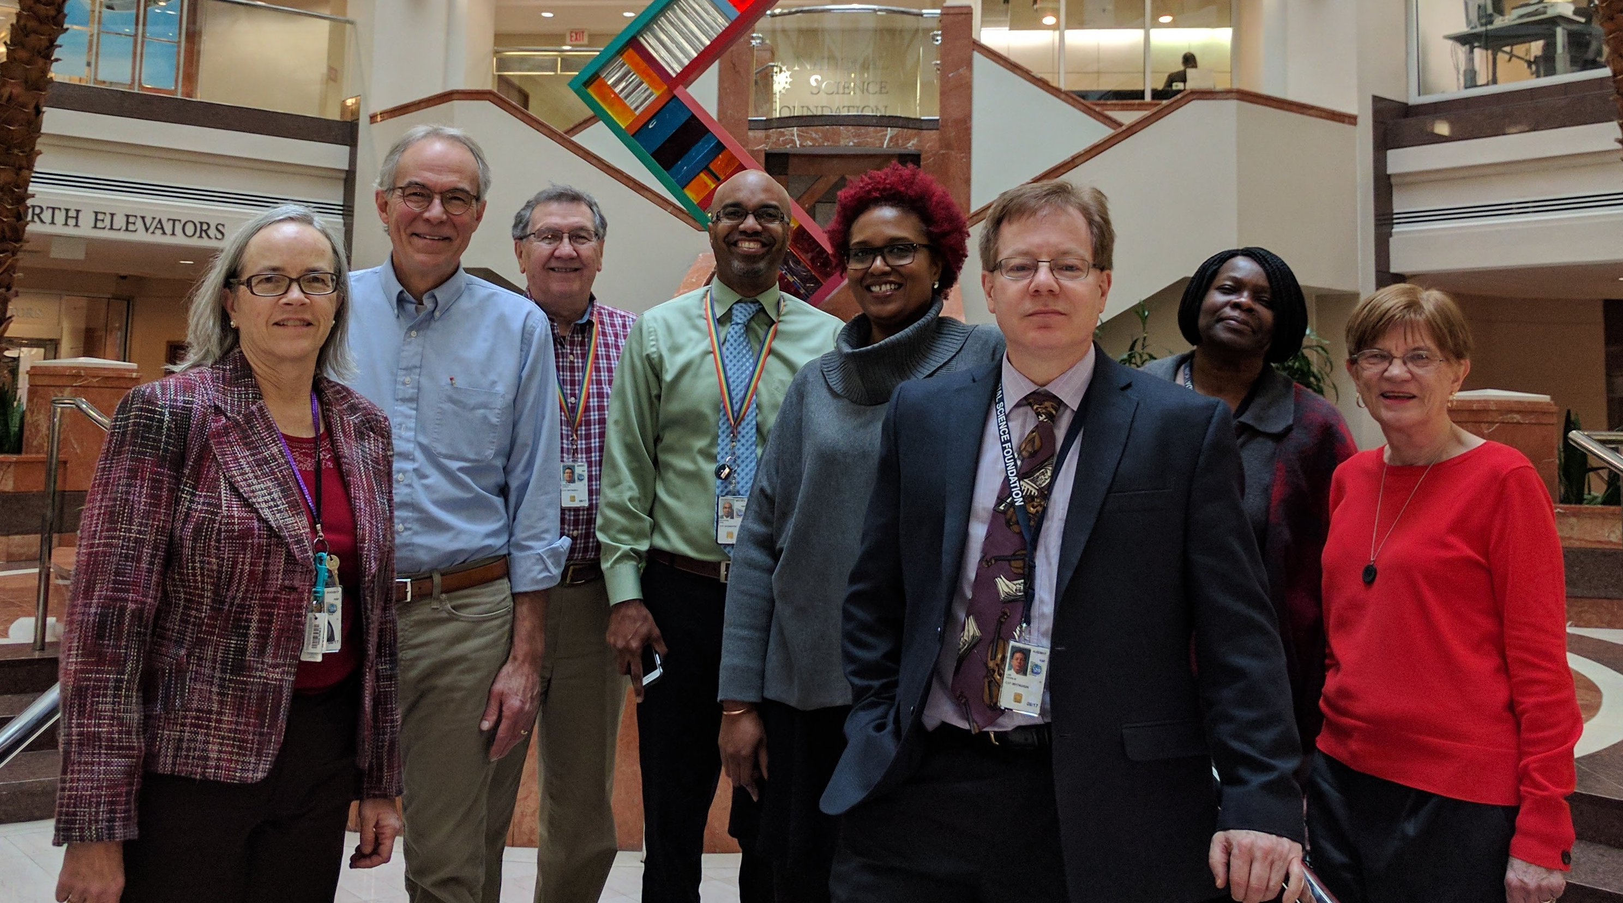
Thank you
NSF S-STEM Team
Stephanie August, Chuck Sullivan, John Haddock, Ron Buckmire
Karen Crosby, Kevin Lee, Abby Ilumoka, Liz Teles
Not Pictured: Jaimia Goodwin, Nabriya Horton, Ellen Carpenter, Connie Della-Piana, Tom Higgins, Ece Yaprak
Notes:
We hope this presentation has been useful in helping you to plan your S-STEM proposal. On behalf of the NSF and the entire S-STEM team we thank you for time and interest. For more information, please consult the S-STEM solicitation or the links on the next slide.

Slide 20
Additional Information
NSF Proposal & Award Policies & Procedures Guide
http://https://www.nsf.gov/pubs/policydocs/pappg17_1/
Common Guidelines for Education Research and Development
http://www.nsf.gov/pubs/2013/nsf13126/nsf13126.pdf
NSF Merit Review Overview
http://nsf.gov/bfa/dias/policy/merit_review/
Solicitation, FAQs, and Webinar Resources on the S-STEM program website:
https://www.nsf.gov/funding/pgm_summ.jsp?pims_id=5257
Notes:
Here are links to a collection of resources on NSF proposal submission and the S-STEM program in particular.

