Slide 1


S-STEM (NSF 17-527) NSF Scholarships in Science, Technology, Engineering, & Mathematics Information Materials
5
Suggestions for New Principal Investigators
Notes:
Welcome! This is the fifth in a series of presentations on recent S-STEM solicitation, NSF 17-527. This presentation will provide suggestions for new principal investigators.

Slide 2
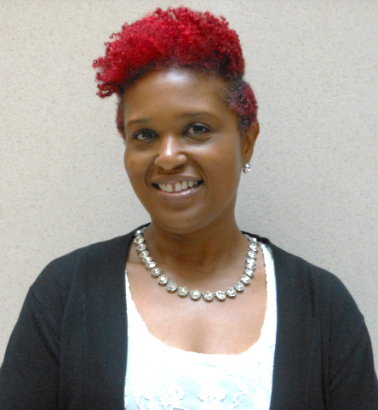
S-STEM Presentation
Karen Crosby
Notes:
Hi, this is Karen Crosby. I am a Program Officer working on the S-STEM program. My background is in Engineering. I am in the NSF Division of Undergraduate Education from Southern
University, Baton Rouge, Louisiana. I am a member of the Department of Mechanical Engineering there and my background is specifically in material science.
I will be conducting this presentation on some aspects of the S-STEM program. The presentation describes material that appears in NSF 17-527, the S-STEM solicitation or NSF 17-1, the NSF Proposal & Award Policies & Procedures Guide.

Slide 3
S-STEM Goals
Increase the recruitment, retention, student success, and graduation (including student transfer) of students with demonstrated financial need who are pursuing associate, baccalaureate, graduate degrees in STEM and enter the STEM workforce or graduate study.
Implement and study models, effective practices, and/or strategies that contribute to understanding the factors of supportive curricular and co-curricular activities that affect recruitment, retention, student success, academic/career pathways, and/or degree attainment (including student transfer) in STEM.
Contribute to the implementation and sustainability of effective curricular and co-curricular activities (e.g., curriculum, professional, and workforce development activities) in undergraduate or graduate STEM education.
Notes:
First a quick overview of the goals of S-STEM
Increase the recruitment, retention, student success, and graduation (including student transfer) of students with demonstrated financial need who are pursuing associate, baccalaureate, graduate degrees in STEM and enter the STEM workforce or graduate study.
Implement and study models, effective practices, and/or strategies that contribute to understanding the factors of supportive curricular and co-curricula activities that affect recruitment, retention, student success, academic/career pathways, and/or degree attainment (including student transfer) in STEM.
Contribute to the implementation and sustainability of effective curricular and co-curricular activities (e.g., curriculum, professional, and workforce development activities) in undergraduate or graduate STEM education

Slide 4
Thanks!
Thanks for your willingness to help with achieving the goals of the S-STEM program.
Clear need
Help low income, academically talented students with demonstrated financial need to be successful in STEM
Appreciate willingness to devote time and effort to the S-STEM program.
Notes:
Thank you for your willingness to submit proposals and join the nationwide effort to achieve the goals of the S-STEM program. Currently, there is a clear need to help low income, academically talented students, with demonstrated financial need to be successful in STEM careers. We appreciate you devoting time and effort to the S-STEM program.

Slide 5
Audience
Has limited familiarity with NSF proposals and the proposal process.
Has little to no prior experience with S-STEM.
Notes:
The intended viewers for this presentation are those who are somewhat unfamiliar with submitting NSF proposals and have NO prior experience with S-STEM.
This presentation segment is intended to complement not replace the other S-STEM presentations in this series

Slide 6
Presentation Agenda
Common Challenges for New PIs
Examples of our topics
NSF Proposals in General
PAPPG
FastLane
S-STEM Specific Topics
Typical Project Activities
Budget
Project Requirements
Supplementary documents
Notes:
Regarding the presentation agenda, we are going to address some important topics relevant to SSTEM proposals.
There is no special order except that the topics in this presentation often cause problems for new PIs if overlooked. We hope this presentation will save you some time and frustration as you prepare your SSTEM proposal. We will address some common challenges that new proposers have in working with NSF in general and then move on to a few common SSTEM-related pitfalls.

Slide 7
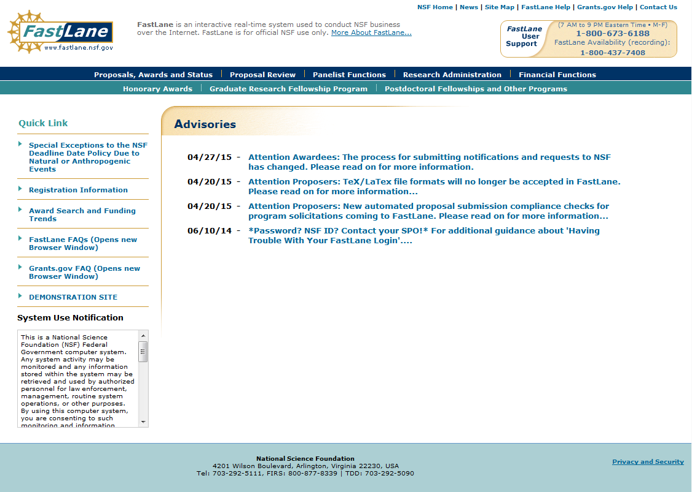
Fastlane
HELP
Notes:
All proposals to the NSF are submitted through Fastlane or Grants.gov. If you have not used NSF FastLane before, start early to be become accustomed to the interface and the use of the system. If you run into problems the FastLane Help line is very responsive and very good at helping those unfamiliar with FastLane use. Be sure to work with your Sponsored Research Office.

Slide 8
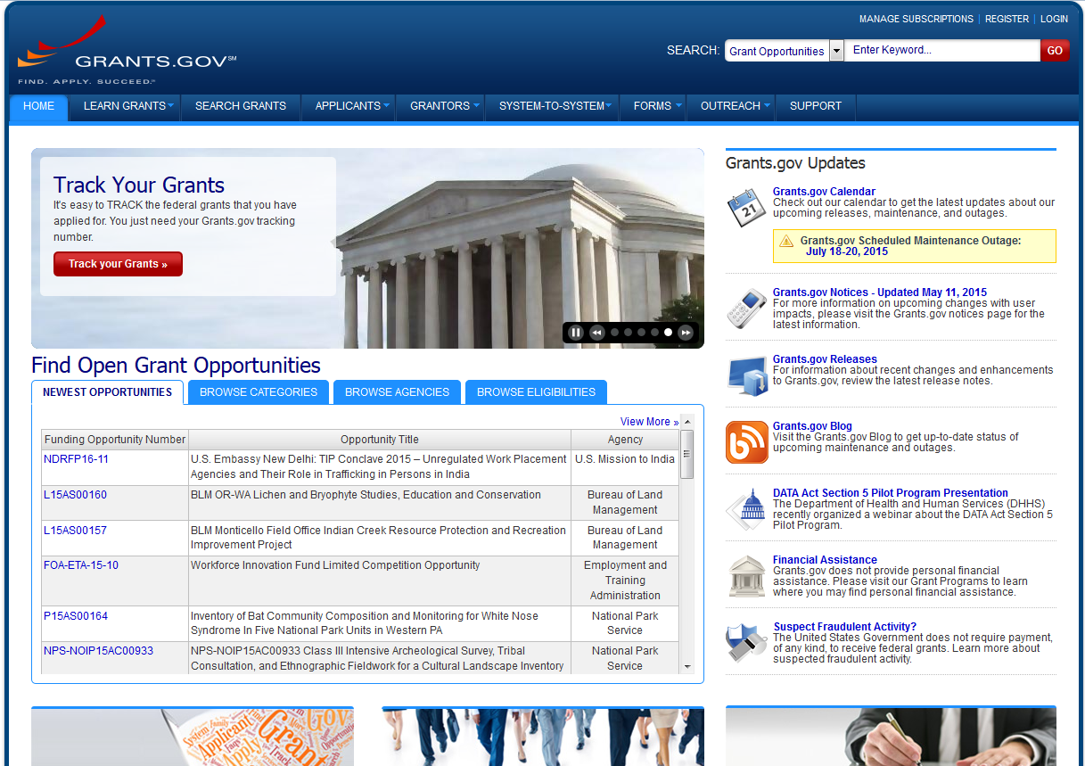
Grants.gov
HELP
Notes:
This is another way to submit proposals to NSF. Start early and get acquainted with the submission process. For assistance with Grants.gov click the dropdown menu labeled “support.” Be sure to work with your Sponsored Research Office.

Slide 9

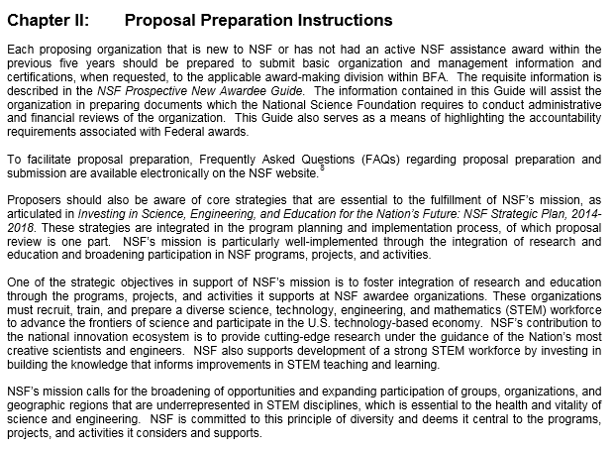
NSF Proposal & Award Policies & Procedures Guide (PAPPG)
https://www.nsf.gov/pubs/policydocs/pappg17_1/nsf17_1.pdf
Notes:
A good general source of information that is useful for new PIs is the NSF Proposal & Award Policies & Procedures Guide, NSF 17-1. Within the PAPPG is a description of each required section of an NSF proposal. A quick review of this can help you with the basic contents of what goes into an NSF proposal. There is a lot of detail in the PAPPG, and you do not need to know all of it to get started writing, but knowing what is in the PAPPG can help answer questions that come up and save you time. You are responsible for following the PAPPG and the program solicitation.

Slide 10
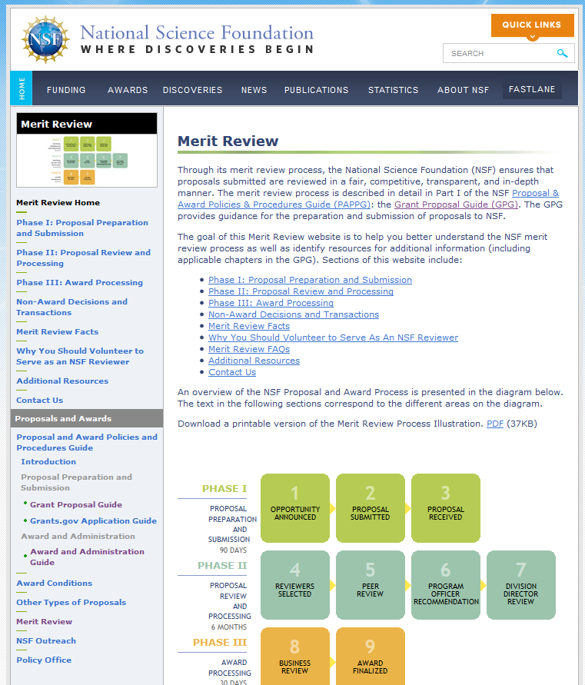
Review Process
http://nsf.gov/bfa/dias/policy/merit_review/
Notes:
It might be helpful to include a word here about the review process. Merit review of SSTEM proposals is addressed in detail in a separate presentation. Here we will mention the basics. Proposals received by NSF are assigned to the appropriate NSF program for acknowledgement and, if they meet NSF requirements, for review. All proposals are carefully reviewed by a scientist, engineer, or educator serving as an NSF Program Officer, and usually by three to ten other persons outside NSF either as ad hoc reviewers, panelists, or both, who are experts in the particular fields represented by the proposal. These reviewers are selected for their expertise by Program Officers charged with oversight of the review process. Senior NSF staff further review recommendations for awards.
A comprehensive description of the Foundation's merit review process is available on the NSF website shown. http://nsf.gov/bfa/dias/policy/merit_review/

Slide 11
S-STEM Presentation 5 Program-Specific Topics
Notes:
The next part of this presentation will turn to topics particular to the S-STEM Program

Slide 12
S-STEM Activities – Flexibility Needed
S-STEM is a program that supports scholarships for low-income academically talented students with demonstrated financial need
S-STEM projects often include activities such as
seminars,
field trips,
social activities,
student-faculty interaction outside classes
These activities may be required.
Requirements should be designed so that students who have other responsibilities can reasonably participate.
Flexible enough to allow reasonable absences.
Notes:
Use caution when making activities required.
In addition to scholarships for low-income academically talented students with demonstrated financial need, S-STEM projects often include activities such as seminars, field trips, social activities, student-faculty interaction outside classes, and other enrichment activities. These are valuable parts of programs. These activities may be required, as part of the scholarship program, but the requirements should be designed so that students who have other responsibilities can reasonably participate, and the requirements should be flexible enough to allow reasonable absences.

Slide 13
S-STEM Scholarships
Establishment of eligibility
S-STEM program criteria
Project criteria
Selection of project activities to meet institutional needs
Draw on literature on effective practices
Draw on needs assessment or institutional scan
Application and selection of S-STEM Scholars
Notes:
Project leadership teams need to establish eligibility for applicants and plans to recruit and select S-STEM Scholars (this could include working Officers of Admission, Financial Aid, Institutional Research, and Student Support.
The leadership teams need to decide what types of effective curricular and co-curricular activities to implement and investigate.
The leadership team needs to establish the recruitment, application, and selection process to review applications, check that applicants meet eligibility criteria, and select S-STEM Scholars.

Slide 14
Research and Internships – Optional!
Projects may offer research opportunities and internships for scholarship recipients.
These activities can enhance the student experience.
Research participation and internships MUST be optional components of the S-STEM project.
The reason for this is S-STEM scholarships may not be, nor appear to be, payment for services.
Research and internship opportunities are valuable components of S-STEM projects, as long as they are clearly optional for the student.
Notes:
Projects may offer research opportunities and internships for scholarship recipients. While these are excellent activities that can enhance the student experience, research participation and internships MUST be optional components of the S-STEM project. S-STEM scholarships may not be, nor appear to be, payment for services. Research and internship opportunities are valuable components of SSTEM projects as long as they are clearly optional for the student. Note this limitation on required research does NOT apply for graduate students doing research as part of their thesis or dissertation.

Slide 15
Cohorts and Faculty Mentors Required
All S-STEM projects must include plans to provide faculty mentors for S-STEM Scholars
All S-STEM projects must include plans to develop a cohort experience for the scholarship recipients.
Experience shows that the most successful S-STEM scholarship projects involve faculty mentors and a group of students who form a cohort.
A cohort is a group of student who in some way naturally associate.
The project plan should include activities to establish a cohort of students who receive scholarships.
Notes:
All S-STEM projects must include plans to develop a cohort experience for the scholarship recipients. Experience shows that the most successful S-STEM scholarship projects involve a group of students who form a cohort. A cohort is a group of students who in some way naturally associate, whether as majors in the same department, or sharing classes, or participating together in activities of common interest. The project plan should include activities to establish a cohort of students who receive scholarships.

Slide 16
Data determines average scholarship
Many students may not be eligible for the maximum scholarship of $10,000 per year.
The proposal budget requires an estimate of both the number of scholarships to be awarded and the total amount of funds that would be required.
The proposal should include an explanation of how these estimates were determined.
The number and total amount should be based on actual institutional financial aid data (FAFSA and GAANN).
Notes:
Many students may not be eligible for the maximum scholarship of $10,000 per year, depending on the student’s expected family contribution and the amount of the institution’s cost of attendance. The proposal budget requires an estimate of both the number of scholarships to be awarded and the total amount of funds that would be required. The proposal should include an explanation of how these estimates were determined. It is suggested that estimates of the average scholarship amounts expected should be based on actual institutional financial aid data.
FAFSA is the Free Application for Federal Student Aid
GAANN is Graduate Assistance in Areas of National Need

Slide 17
Flexibility after award is made.
NSF recognizes that the proposal includes a reasonable estimate of the average scholarship amounts to be awarded.
While there is flexibility within a project budget after a grant is made, the size of the budget request must be closely related in the proposal to a realistic estimate of student need.
Notes:
NSF recognizes that the proposal includes a reasonable estimate of the average scholarship amounts to be awarded.
While there is flexibility within a project budget after a grant is made, the size of the budget request must be closely related in the proposal to a realistic estimate of student need.

Slide 18
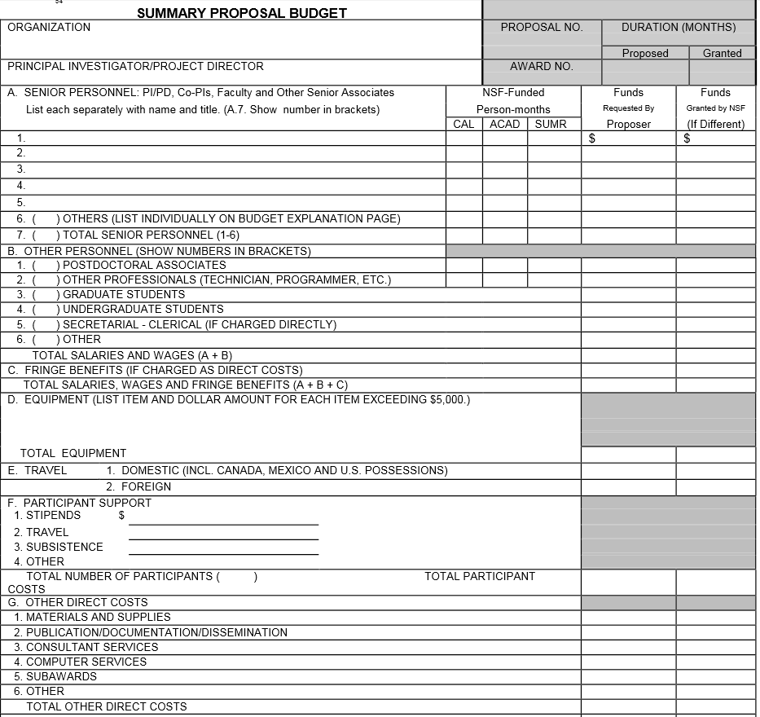
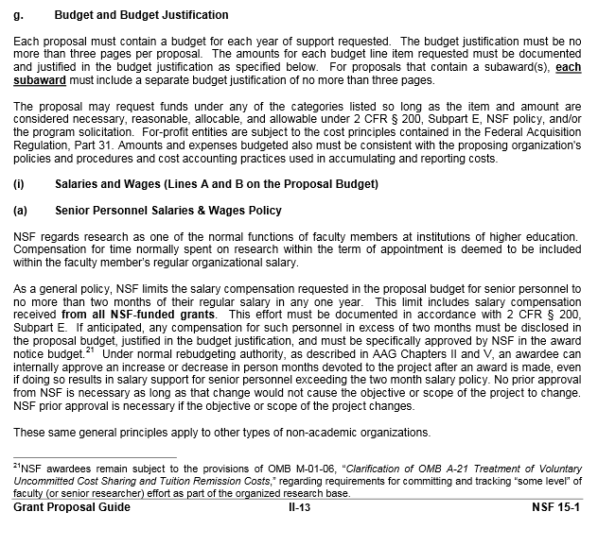
Budget
Notes:
It is generally helpful for new PIs to become familiar with the NSF standard budget form early in the process of planning the project budget. All budget items must be entered in appropriate locations on the standard budget form on FastLane. The PAPPG (NSF 17-1) has useful information about the contents of a proposal budget for those unfamiliar with the process
Check to see if there is institutional support for developing a budget and request assistance. A good place to start is the Sponsored Research Office, Department Chair, or Dean.

Slide 19
Important S-STEM Budget Facts
Notes:
The solicitation describes details about developing a project budget (Section V.8). Please note that earlier S-STEM solicitations had restrictions related to including monetary support on lines F.4 and G.6 – those are no longer in effect for solicitation 17-527.
A couple of budgetary issues are worthy of clarification:
S-STEM requires that at least 60% of a budget be spent on scholarship stipends. This is the only element that should be in field F.1. Program officers will check to make sure that the F.1 amount on the budget summary is at least 60% of the total “Amount of this Request” L.
If your project will be making summer research stipends available to students (which must be optional), these should be placed in field F.4. If there are other items in F.4, please clearly describe them separately and in sum in the budget justification. Travel and Subsistence budget items for participants also do not enter into the required 60% for scholarships.

Slide 20
Faculty Salary
Requesting funds for faculty summer salary is allowed in S-STEM Budgets.
Salary requests must be accompanied by an appropriate indication of the fraction of academic or summer months to be paid by the grant and justification for the support.
If no salary is requested from the grant, then:
The fraction of NSF funded academic and summer months should be listed on the budget form as zero
The Facilities, Equipment, and Resources document should include for each of these persons their name and the estimated person months they will spend on the project.
Notes:
Requesting funds for faculty summer salary is allowed in the S-STEM solicitation.
However salary requests must be accompanied by an appropriate indication of the fraction of academic or summer months to be paid by the grant and justification for the support. If there is any PI, co-PI or other senior personnel for whom no salary is requested from the grant, then the fraction of NSF funded academic and summer months should be listed on the budget form as zero. Also, the Facilities, Equipment, and Resources document should include for each of these persons, their name and the estimated person months they will spend on the project. There are some NSF-wide conditions regarding faculty salary, these can be found in the PAPPG (NSF 17-1).

Slide 21
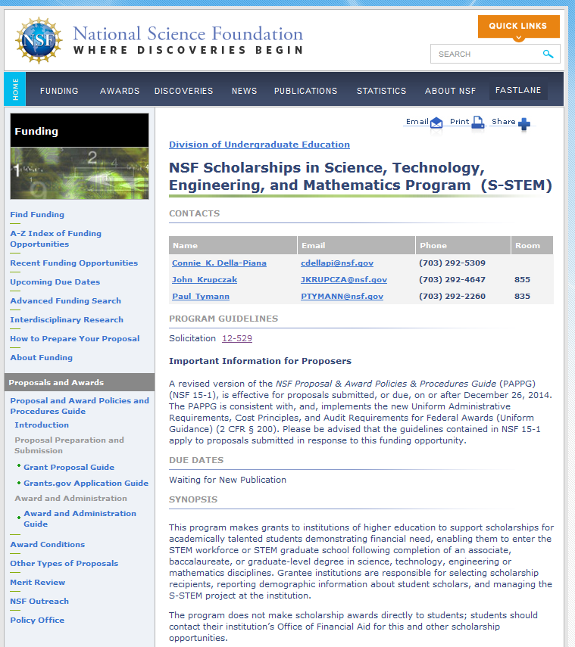
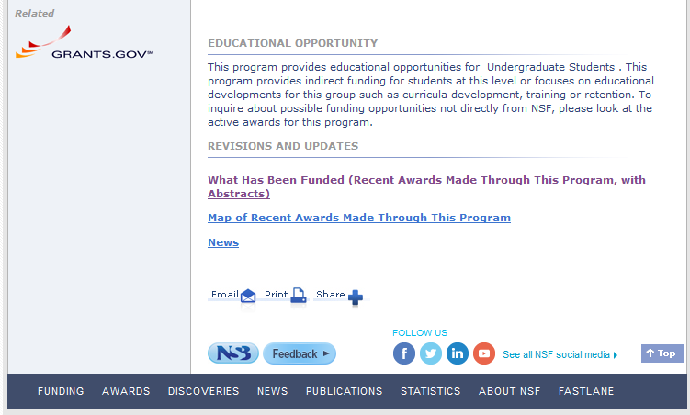
Prior S-STEM award to your institution
What Has Been Funded (Recent Awards Made Through This Program with Abstracts)
Notes:
Prior S-STEM awards to your institution.
The S-STEM solicitation asks proposers to discuss the results of prior S-STEM, CSEMS, or STEP awards to their institution. There is a NSF website that allows searching for awards made under a given program. This search feature can be used to find prior awards about which a project team might not be aware.
Results from prior and relevant NSF support to the PI or coPIs must be described.
S-STEM: Scholarships in Science, Technology, Engineering, and Mathematics
CSEMS: Computer Science, Engineering, and Mathematics Scholarships
STEP: Science, Technology, Engineering, and Mathematics Talent Expansion Program

Slide 22
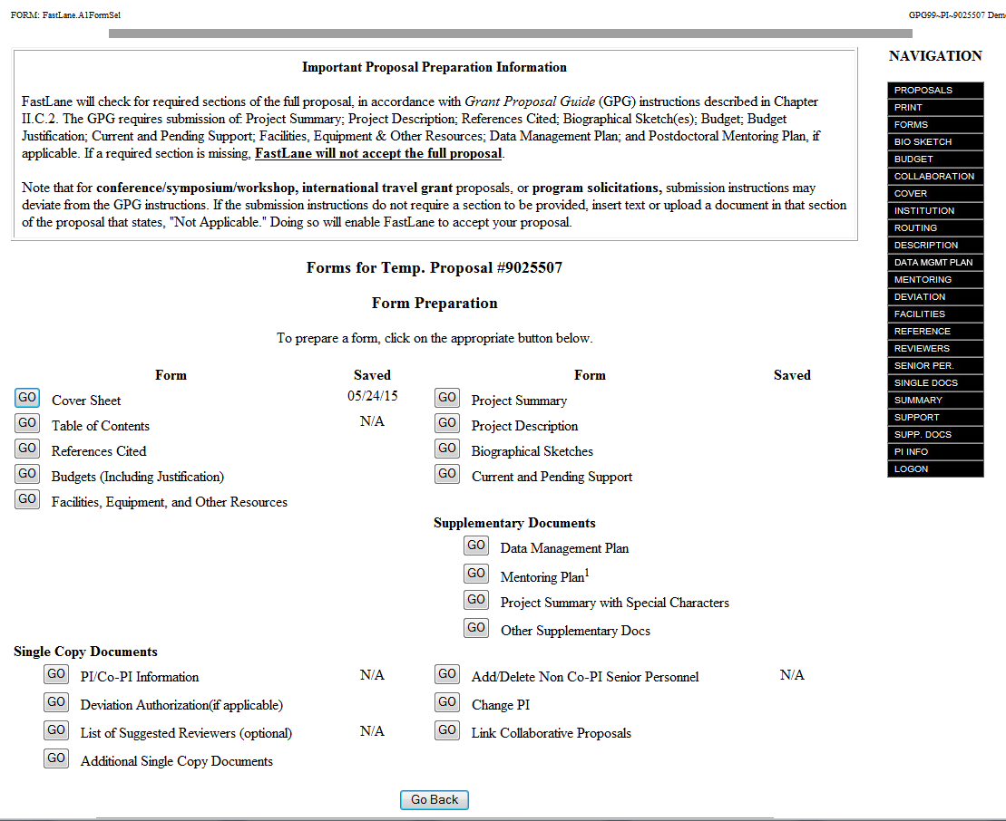
Supplementary Docs 10 pg limit
Notes:
The slide shows a screenshot of how FastLane appears when entering the parts of a proposal. It is important to note that S-STEM restricts the number of supplementary documents that can be submitted.
S-STEM limits supplementary documents to 10 pages. Do not submit more than 10 pages of supplementary documents. If more than 10 pages of supplementary documents are submitted, the proposal will be “returned without review.”
See the solicitation for a description of admissible documents.

Slide 23
Quick Summary
NSF – Generic Topics
S-STEM – Specific Issues
PAPPG (NSF 17-1)
FastLane/Grants.gov
Merit Review Process
NSF Budget Format
Flexibility for attendance
Research – optional
Cohorts and Faculty Mentors
At least 60% of the total budget on scholarship stipends
Scholarship amount from data
Flexibility after award made.
Salary allowable
Supplementary Docs = 10 pgs
Notes:
To finish here is a quick summary of some of the topics we addressed in this presentation for new proposers.
Concerning topics related to NSF proposals, the PAPPG (NSF 17-1) was described as a useful resource about the components of an NSF proposal. We mentioned NSF FastLane or Grants.gov as the means by which proposals are submitted and the need to start early working in FastLane or Grants.gov, especially if you are not familiar with the interface. The presentation touched on the merit review process and provided some references for more detailed information. The NSF-standard budget form was introduced and proposers were advised to start thinking about their budget in terms of the categories that appear on the NSF budget form.
The presentation described some common problems that trouble investigators new to the S-STEM program. It was noted that while S-STEM scholars can be required to participate in student support and enrichment activities, some flexibility in attendance policy must be included. Participation in research and internships, while beneficial, must be optional for S-STEM scholars. S-STEM scholars are expected to have faculty mentors and to participate in some type of cohort. The amount requested for scholarships must be based on relevant institutional data on average financial need of the expected S-STEM student population and at least 60% of the total budget must be allotted to scholarship stipends. There is some flexibility to make adjustments within the S-STEM budget after an award is made.
It is possible to request salary stipends for faculty who are involved in S-STEM projects and the requests must be in line with NSF policy as described in the PAPPG. As a final note, do not submit more than 10 pages of supplementary documents.

Slide 24
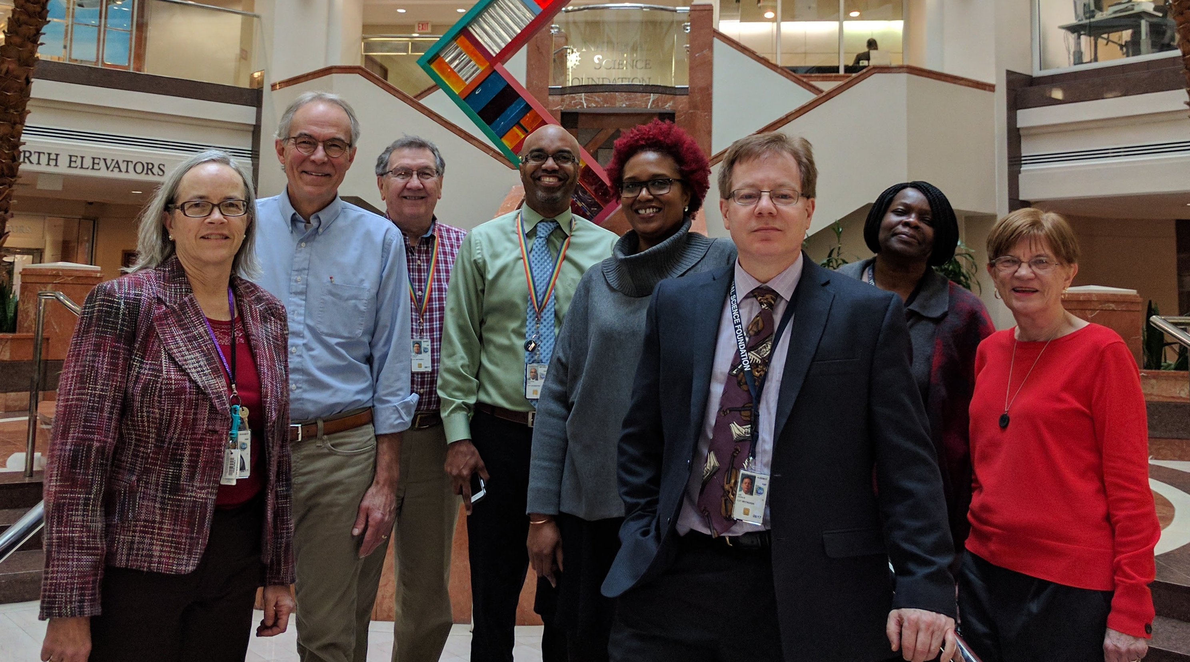
Thank you
NSF S-STEM Team
Stephanie August, Chuck Sullivan, John Haddock, Ron Buckmire
Karen Crosby, Kevin Lee, Abby Ilumoka, Liz Teles
Not Pictured: Jaimia Goodwin, Nabriya Horton, Ellen Carpenter, Connie Della-Piana, Tom Higgins, Ece Yaprak
Notes:
We hope this presentation has been useful in helping you to plan your SSTEM proposal. On behalf of the NSF and the entire S-STEM team we thank you for time and interest. For more information, please consult the S-STEM solicitation or the links on the next slide.

Slide 25
Additional Information
NSF Proposal & Award Policies & Procedures Guide
https://www.nsf.gov/pubs/policydocs/pappg17_1/
Common Guidelines for Education Research and Development
http://www.nsf.gov/pubs/2013/nsf13126/nsf13126.pdf
NSF Merit Review Overview
http://nsf.gov/bfa/dias/policy/merit_review/
Solicitation, FAQs, and Webinar Resources on the S-STEM program website:
https://www.nsf.gov/funding/pgm_summ.jsp?pims_id=5257
Notes:
Here are links to a collection of resources on NSF proposal submission and the S-STEM program in particular.

