Slide 1


S-STEM (NSF 17-527)
NSF Scholarships for Science, Technology, Engineering, & Mathematics
Information Materials
7
Merit Review
Notes:
Welcome! This is the seventh in a series of presentations on the new S-STEM solicitation. This presentation will address the merit review process for S-STEM proposals.

Slide 2
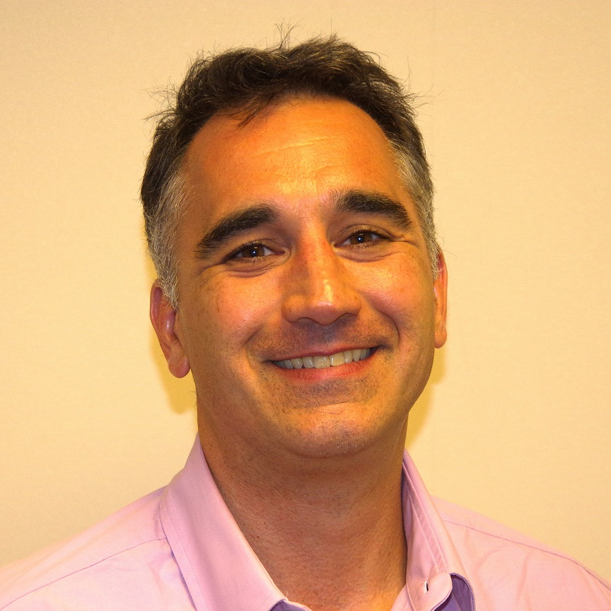
S-STEM Presentation
Thomas Higgins
Notes:
Hi, this is Tom Higgins. I am also Program Officer working on the S-STEM program. My background is in Chemistry. I am in the NSF Division of Undergraduate Education from the City Colleges of Chicago. I am rotator finishing my second year in DUE.
We will be conducting this presentation on some aspects of the S-STEM program. The presentation describes material that appears in NSF 17-527, the S-STEM solicitation and NSF 17-1, the NSF Proposal & Award Policies & Procedures Guide.

Slide 3
Agenda
This presentation will address the review criteria that will be used to evaluate S-STEM proposals
Two main criteria are used to evaluate NSF proposals.
How the review criteria are applied in the context of the S-STEM program.
Notes:
This presentation will address the review criteria that will be used to evaluate S-STEM proposals
The major topics of this presentation will be an explanation of the two main criteria used to evaluate NSF proposals and how the review criteria are applied in the context of the S-STEM program.

Slide 4
S-STEM Review Criteria
All proposals, from all strands reviewed based on NSF standard review criteria:
Intellectual Merit:
  the potential to advance knowledge
Broader Impacts:
  the potential to benefit society and contribute to the achievement of specific, desired societal outcomes.
Notes:
Proposals to the S-STEM program are reviewed using the same criteria that are applied to all proposals to the National Science Foundation.
These two NSF-standard review criteria are Intellectual Merit and Broader impacts. Reviewers are asked to judge the intellectual merit and broader impacts of submitted proposals.
Intellectual merit is the potential of the work to advance knowledge within its own field and across different fields, while broader impacts describes the potential to benefit society and contribute to the achievement of desired societal outcomes.

Slide 5
NSF Review Criteria
Questions for Intellectual Merit & Broader Impact
What is the potential for the proposed activity to:
  Advance knowledge and understanding within its own field or across different fields (Intellectual Merit); and
  Benefit society or advance desired societal outcomes (Broader Impacts)?
To what extent do the proposed activities suggest and explore creative, original, or potentially transformative concepts?
Is the plan for carrying out the proposed activities well-reasoned, well-organized, and based on a sound rationale? Does the plan incorporate a mechanism to assess success?
How well qualified is the individual, team, or organization to conduct the proposed activities?
Are there adequate resources available to the PI (either at the home organization or through collaborations) to carry out the proposed activities?
Notes:
For all proposals submitted to NSF, reviewers are asked to use a series of questions to help discern the intellectual merit and broader impacts of a proposal.
These standard questions are:
To what extent do the proposed activities suggest and explore creative, original, or potentially transformative concepts?
Is the plan for carrying out the proposed activities well-reasoned, well-organized, and based on a sound rationale? Does the plan incorporate a mechanism to assess success?
How well qualified is the individual, team, or organization to conduct the proposed activities?
Are there adequate resources available to the Principal Investigator (either at the home organization or through collaborations) to carry out the proposed activities?
As you prepare your proposal keep in mind that these are the questions the reviewers will be using to guide their reviews.

Slide 6
S-STEM Specific Review Criteria
Results of previous S-STEM, CSEMS, or STEP awards;
Student-support infrastructure for the successful graduation of scholarship recipients;
Management plan that is effective and clearly articulated;
Evidence of broad faculty participation and support from the appropriate academic, financial aid, and student services personnel;
Notes:
As described in the solicitation, the S-STEM program has review criteria that are specific to the S-STEM program. These are criteria that are used in reviewing S-STEM proposals in addition to the standard NSF-wide criteria that were just described.
What are these S-STEM specific criteria?
First consideration will be given to the results of previous SSTEM, CSEMS, or STEP awards. Results from any prior awards from these programs to either the PI or the institution should be described in the proposal.
Reviewers are asked to evaluate the student-support infrastructure. Is there the structure in place to support the successful completion of degrees by the scholarship recipients?
What about the management plan? Is the plan to manage all aspects of the proposed work clear? Is the plan likely to be effective?
Is there evidence of broad faculty participation? Is there evidence of support from the appropriate personnel in the offices of financial aid, academic support, and student services?

Slide 7
S-STEM Specific Review Criteria
Justification of the number and amount of scholarships requested based on current student demographics;
Details describing methods for documenting, testing, and understanding the implementation and effects of project activities;
Educational program of high quality; and
Evaluation design that is aligned with project goals.
Notes:
There are four additional S-STEM specific criteria used in evaluating proposals.
Does the proposal have strong justification for the number and amount of the scholarships? Is this justification based on data for the current students expected to be in the cohort? In other words, is there some basis for the expected average scholarship rather than numbers picked out of the air?
Funded S-STEM awards will be implementing a variety of project activities. Are the details described concerning how the effects of these project activities will be tested, documented, and understood?
Is the educational program involved of high quality?
Finally, is the design of the project evaluation aligned with the project goals?

Slide 8
Intellectual Merit
Intellectual Merit: The Intellectual Merit criterion encompasses the potential to advance knowledge;
What is the potential for the proposed activity to advance knowledge and understanding within its own field or across different fields?
What will we learn from this project?
Notes:
We have described the S-STEM specific review criteria so lets go back and review the big-picture overarching review criteria so we do not lose sight of the two key considerations. The first is intellectual merit.
Intellectual merit is the potential of the proposed work to advance knowledge. Advancing knowledge is a major goal of all NSF work.
One way to evaluate the potential to advance knowledge is to ask: “what will we learn from this project?”

Slide 9
Broader Impacts
Broader Impacts: the potential to benefit society and contribute to the achievement of specific, desired societal outcomes.
Broader impacts includes more than broadening participation, increasing number of underrepresented minorities in STEM.
Notes:
Broader impacts is the other NSF-wide criteria applied to all proposals submitted to the NSF in all programs.
Broader impacts is the potential of the project to contribute to the achievement of desirable societal outcomes.
Or, what is the benefit to society from this project?
It is important to note that broader impacts includes more than increasing number of underrepresented minorities in STEM.

Slide 10
Broader Impact Details
Broader impacts may be accomplished through the research itself, through the activities that are directly related to outcomes.
Including but are not limited to:
  full participation of women, persons with disabilities, and underrepresented minorities in science, technology, engineering, and mathematics (STEM);
  improved STEM education and educator development at any level;
  increased public scientific literacy and public engagement with science and technology
  improved well-being of individuals in society;
  development of a diverse, globally competitive STEM workforce;
  increased partnerships between academia, industry, and others;
  improved national security;
  increased economic competitiveness of the United States;
  enhanced infrastructure for research and education.
Notes:
Broader impacts may be accomplished through the research itself, or through the activities that are directly related to outcomes.
Some examples of broader impacts Include (but are not limited to)
full participation of women, persons with disabilities, and underrepresented minorities in science, technology, engineering, and mathematics (STEM);
improved STEM education and educator development at any level;
increased public scientific literacy and public engagement with science and technology;
improved well-being of individuals in society;
development of a diverse, globally competitive STEM workforce;
increased partnerships between academia, industry, and others;
improved national security;
increased economic competitiveness of the United States;
And enhanced infrastructure for research and education.

Slide 11
Summary
S-STEM reviews proposals based standard NSF procedures.
Intellectual Merit
  What will we learn from this project?
Broader Impacts
  What is the potential to benefit society?
S-STEM-specific criteria, including:
  Results of previous S-STEM, CSEMS, or STEP awards
  Student-support infrastructure
  Management plan
  Evidence of broad faculty participation
  Justification of award amount
  Details of project activities
  Educational programs of high quality
  Evaluation aligned with goals?
Notes:
We hope this webinar has provided you with an overview of how proposals are reviewed. Let’s summarize.
The proposals are reviewed in the following way. Reviewers are asked what is the intellectual merit and broader impacts or what will we learn from this and how will it benefit society?
The following elements should be considered in the review for both criteria:
do the proposed activities suggest and explore creative, original, or potentially transformative concepts?
Is the plan for carrying out the proposed activities well-reasoned, well-organized, and based on a sound rationale?
Does the plan incorporate a mechanism to assess success?
How well qualified is the individual, team, or organization to conduct the proposed activities?
Are there adequate resources available to the team to carry out the proposed activities?
What will we learn from this project? What is the potential to benefit society?
Criteria specific to S-STEM will be applied.
If there were prior S-STEM, CSEMS, or STEP awards, what were the results?
How strong is the student-support infrastructure to support the successful completion of degrees by the scholarship recipients?
Is there a clear and effective management plan?
Is there evidence of broad faculty participation? Is there evidence of support from the appropriate personnel in the offices of financial aid, academic support, and student services?
Does the proposal have strong justification for the number and amount of the scholarships?
Are the details described, concerning how the effects of these project activities will be tested, documented and understood?
Are the educational programs involved of a high quality?
Finally, is the design of the project evaluation aligned with the project goals?

Slide 12
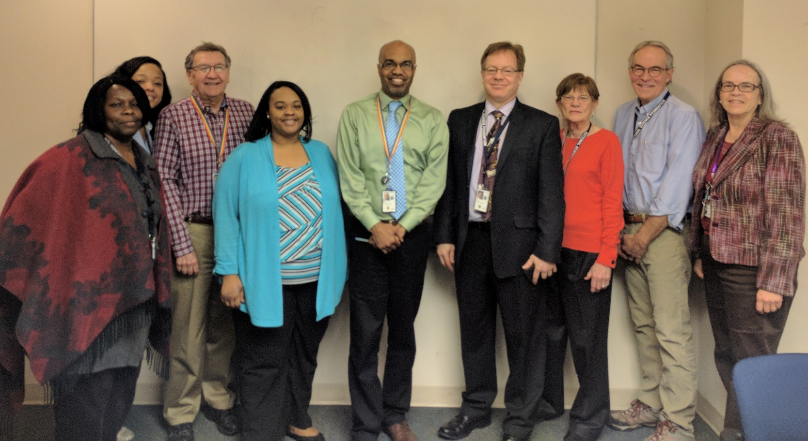
Thank you
NSF S-STEM Team
Abby Ilumoka, Jaimia Goodwin, John Haddock, Nabriya Horton, Ron Buckmire
Kevin Lee, Liz Teles, Chuck Sullivan, Stephanie August
Not Pictured: Ellen Carpenter, Karen Crosby, Connie Della-Piana, Tom Higgins, Ece Yaprak
Notes:
We hope this presentation has been useful in helping you plan your SSTEM proposal. On behalf of the NSF and the entire S-STEM team we thank you for your time and interest. For more information, please consult the S-STEM solicitation or the links on the next slides.

Slide 13
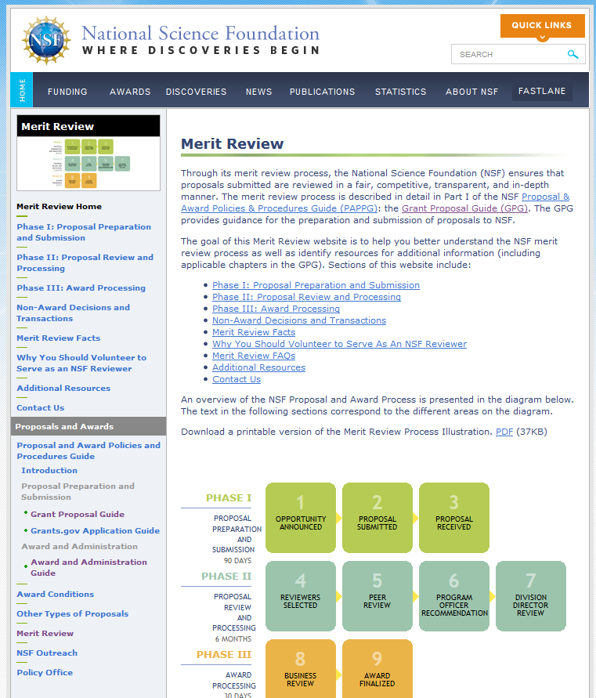
Review Process
http://nsf.gov/bfa/dias/policy/merit_review/
Notes:
For those interested in more information about the review process a comprehensive description of the merit review process is available on the NSF website shown. http://nsf.gov/bfa/dias/policy/merit_review/

Slide 14
Additional Information
NSF Proposal & Award Policies & Procedures Guide
https://www.nsf.gov/pubs/policydocs/pappg17_1/
Common Guidelines for Education Research and Development
http://www.nsf.gov/pubs/2013/nsf13126/nsf13126.pdf
NSF Merit Review Overview
http://nsf.gov/bfa/dias/policy/merit_review/
Solicitation, FAQs, and Webinar Resources on the S-STEM program website:
https://www.nsf.gov/funding/pgm_summ.jsp?pims_id=5257
Notes:
Here are links to a collection of resources on NSF proposal submission and the S-STEM program in particular.

