Slide 1

S-STEM (15-581)
NSF Scholarships in Science, Technology, Engineering, & Mathematics
Information Materials
“Flipped” Webinar
Education and Human Resources Directorate
Division of Undergraduate Education
July 15, 2015
7/15/15
Notes:
Welcome! This is the first in a series of presentations on the S-STEM solicitation that was released in June. These presentations will cover long standing characteristics of the S-STEM program as well as a few details that have changed since the last solicitation. Each presentation will be hosted by a different program officer on the S-STEM team..

Slide 2
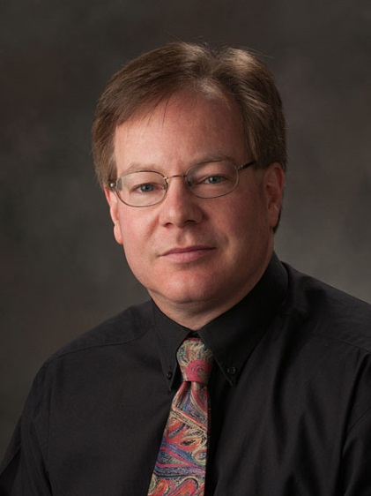
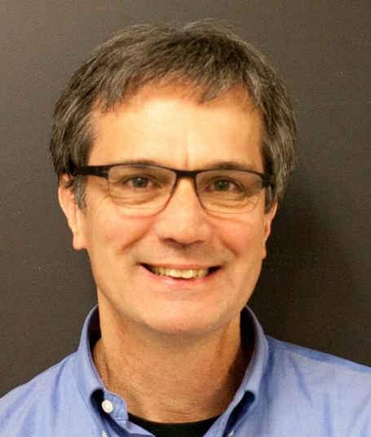
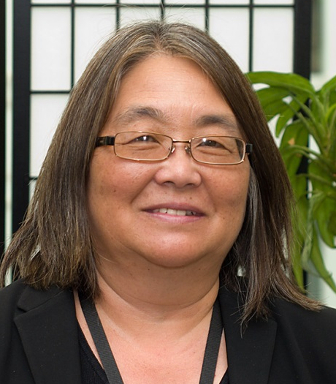
S-STEM Flipped Webinar Presenters
Kevin Lee
John Krupczak
Connie Della-Piana

Slide 3
S-STEM NSF 15-581
Flipped Webinar Agenda
Goals of Flipped Webinar
Help you create strong proposals.
Gain “big picture” view of S-STEM.
Flipped Format
7 Presentations provided beforehand.
Not delving into every possible detail.
Q & A – answer your specific questions.
Expect to post FAQs soon.
Notes:
Here is agenda for our webinar today
Goals
Create strongest competitive proposals
Gain big picture intent and spirit of the program
Answer specific questions
Flipped format
Detailed powerpoints available before hand – will not repeat
Focus on major points in brief intro overview
Bulk of webinar Q&A
Expect to post Q&A soon
Expect to post recording of at least 1 webinar

Slide 4
Goals of the Program
1. To increase the recruitment, retention, student success, and graduation (and transfer) of low-income academically talented students in STEM.
2. To implement and study models, effective practices, and/or strategies that contribute to success in STEM.
3. To contribute to the implementation and sustainability of effective curricular and co-curricular activities in STEM education.
Notes:
There are three major goals for the S-STEM program:
To increase the recruitment, retention, student success, and graduation (including student transfer) of low-income academically talented students with demonstrated financial need who are pursuing associate, baccalaureate, graduate degrees in STEM, and subsequently enter the STEM workforce or graduate study.
2. To implement and study models, effective practices, and/or strategies that contribute to understanding the factors of supportive curricular and co-curricular activities that affect recruitment, retention, student success, academic/career pathways, and/or degree attainment (including student transfer) in STEM of low-income academically talented students with demonstrated financial need.
3. To contribute to the implementation and sustainability of effective curricular and co-curricular activities (e.g. curriculum, professional, and workforce development activities) for low-income academically talented students with demonstrated financial need, pursuing undergraduate or graduate STEM education.

Slide 5
S-STEM Program: Core Purpose
Improve the STEM workforce by increasing
  # of students who graduate with STEM degrees
  # of students entering the STEM workforce
Provide Scholarships
  Academically Talented
  Low-income students with demonstrated financial need
Inform STEM education community
Notes:
Improve Nations STEM workforce by increasing
Number of graduates with stem degrees AS, BA, Graduate
Join and contribute to workforce
Does this by
Providing scholarship and other support
Academically talents
Low income demonstrated financial need
Inform the STEM ed community about what works, what doesn’t and why

Slide 6
S-STEM Program Key Themes
STEM Degree completion
Eventual Contribution to Workforce
Academic talent, promise, potential
Low income, demonstrated need
Evidence based / evidence generating
Notes:
Key themes
Degree completion
Eventual workforce contributions
Academic talent, promise, potential
Low income demonstrated need
Based on use of the best available evidence, other results and awards then inform the community

Slide 7
S-STEM Proposal Categories
Strand 1 – S-STEM Institutional Capacity Building
  $650k max for maximum duration of 5 years
Strand 2 – S-STEM Design and Development
  Type I – Single Institution
    $1M max for maximum duration of 5 years
  Type II – Multi-Institution
    $5M max for maximum duration of 5 years
Notes:
The new solicitation specifies three different kinds of proposals that can be submitted.
Strand 1 is entitled S-STEM Institutional Capacity Building.
Capacity building – institutions new to NSF funding, bringing in new Principal investigators, not quite the scope of Strand 2
Strand 2 is entitled S-STEM Design and Development.
$1M single institution, 5yr max
$5M multi instittion, 5 yr
Two types of projects may be funded in this strand. Single institution or Type 1 projects are capped at 1M for a maximum duration of 5 years and should implement and test effective high quality extant curricular and co-curricular activities. Activities are expected to increase the recruitment, retention, student success, and graduation (including student transfer) of low-income academically talented students with demonstrated financial need who are pursuing associate, baccalaureate, graduate degrees in STEM. It is expected that these projects will study attempts to address a well-documented institutional need or concern (in a manner consistent with what is already known from educational research).
Multi-Institutional or Type 2 projects are capped at 5M for a maximum duration of 5 years. It is expected to involve several institutions implementing scholarship programs and collaborating on the implementation and study of a common set of academic or student support services. The actual amount of funding requested should reflect the number of schools involved, the number of scholarships awarded, and the complexity of the academic and student support service questions explored.

Slide 8
The New S-STEM Program
Funding
  At least 60% of the funds must be used for scholarships
  Up to 40% of funds may be used for other things – support structures, research, recruitment, etc.
Why 60/40?
Scholarships are not enough
  Student support structures are possible
  A more systematic determination of what support structures are effective and will benefit the STEM education community.
Notes:
In the new solicitation at least 60% of the funds must be used for student scholarships. This allows more funds to go into supporting high quality extant curricular and co-curricular activities and studies on the recruitment and retention of students and the effectiveness of support structures.
Providing students with scholarship support helps then overcome financial obstacles in their path to obtaining a STEM degree. However research has shown that scholarships alone are not sufficient to ensure that low-income academically talented students with demonstrated financial need complete degrees. It has become clear that scholarships along with participation in academic and student support activities result in retention and graduation in STEM fields. The additional funds now available allow PIs to provide more academic and student services support. They also will enable S-STEM awardees to gather systematic information and disseminate the “lessons learned” about how and what support structures or factors affect student outcomes in different circumstances.
The S-STEM program makes it possible for PIs to implement and adapt high-quality and effective extant curricular and co-curricular activities for recruiting and support structures to tackle unique challenges at their schools. It allows for the adaptation of effective programmatic elements and encourages PIs to study the effects of their implementation and disseminate that information to the broader community.

Slide 9
Expected Student Outcomes
1) Receive a degree in one of the STEM disciplines supported by the S-STEM program;
2) Transfer from an associate to a baccalaureate degree program or from an undergraduate to a graduate program; or
3) Successfully overcome one or more of an institution's self-identified attrition points
Notes:
The expected outcomes that scholarship recipients are expected to achieve by the end of the S-STEM scholarship award period include:
Receive an associate, baccalaureate, or graduate degree in one of the STEM disciplines supported by the SSTEM program;
Transfer from an associate degree program to a baccalaureate degree program or from an undergraduate
program to a graduate program in one of the STEM disciplines supported by the S-STEM program; or
Successfully overcome one or more of an institution's self-identified attrition points which have been described in the institution's proposal.

Slide 10
Cohorts and Faculty Mentors
Required
Provide faculty mentors for S-STEM Scholars
Develop a cohort experience for the scholarship recipients.
Most successful S-STEM scholarship projects involve faculty mentors and a group of students who form a cohort.
  A cohort is a group of students who in some way naturally associate.
  The project plan should include activities to establish a cohort of students who receive scholarships.
Notes:
Cohorts
All S-STEM projects must include plans to develop a cohort experience for the scholarship recipients. Experience show that the most successful S-STEM scholarship projects involve a group of students who form a cohort. A cohort is a group of student who in some way naturally associate, whether as majors in the same department, or sharing classes, or participating together in activities of common interest. The project plan should include activities to establish a cohort of students who receive scholarships.

Slide 11
Institutional needs
Encourage efforts that are focused on well-documented institutional needs or concerns.
Strongly encourages proposals to build on completed needs analyses or institutional scans.
Base your proposal on your local circumstances and opportunities.
Notes:
In this track, NSF encourages efforts that are focused on documented institutional needs or concerns. The SSTEM program encourages Strand 2, Type 1 proposals to build on completed institutional needs analyses or institutional needs assessments.

Slide 12
Evidence Based / Evidence Generating
Implement / adapt and study
  Effective high quality curricular and co-curricular activities and professional development.
  Activities tailored to students, STEM faculty, and different types of institutional contexts
Know what has been done!
Use it!
Inform the community of your results!

Slide 13
Management
Project teams composed of:
Faculty member currently teaching in one of the S-STEM disciplines,
(STEM disciplinary expertise)
STEM Administrator
(Communicate across functional units of institution)
An institutional, educational, discipline-based educational, or social science researcher at the institution or from another institution or research organization.
(Education, DBER, social science, change expertise)
Notes:
For SSTEM Strand 1 Type 1 proposals, the project management team should consist of at least these three individuals. The Principal Investigator should be a faculty member currently teaching in one of the SSTEM disciplines. The team should also include a STEM administrator as a co-Principal Investigator. This could be an administrator whose responsibilities include STEM subjects in addition to other duties. An example would be a Director of Admissions, or a Director of Student Services.
The third required member of the management team should be a co-Principal Investigator with a background in institutional research, education, social science or discipline-based education research. This person does not need to be from the same institution as the PI and the STEM administrator. The education research coPI can be from an institution or organization that is different from the institution that is submitting the proposal. The education research coPI can be from the same institution as the PI and STEM administrator OR they can be from a different institution.

Slide 14
Deadlines
September 22, 2015
  All Strands!
May 16, 2016
  All Strands!
Expect to complete review process on Sept 22 submission in advance of May 16

Slide 15
Research Participation Stipends
S-STEM NSF 15-581 Allows stipends for research participation.
Research participation stipends are considered student support not scholarships.
If the project includes research participation stipends they should be paid from the 40% non-scholarship portion of budget.
Enter on line F.1 (see example next slide)

Slide 16
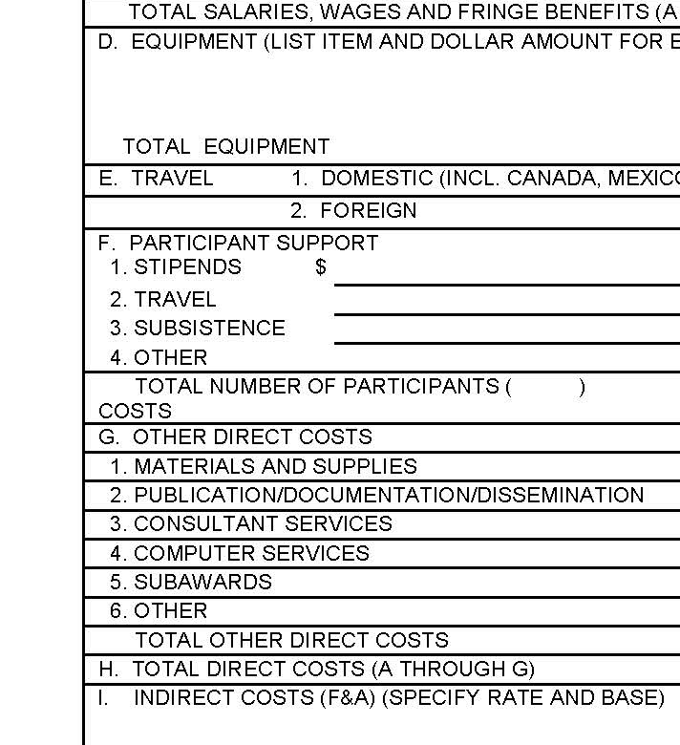
Ex: Scholarship & Stipends – Fastlane line F.1.
$100,000
Counts toward 60% of funds allocated to scholarships
$120,000
Assume
$100,000 scholarships
$20,000 in stipends
100K+20K = 120K line F.1
$20,000
Counts toward 40% of funds allocated to non-scholarship
Budget justification should clearly show that all non-scholarship expenses sum to 40% of total or less

Slide 17
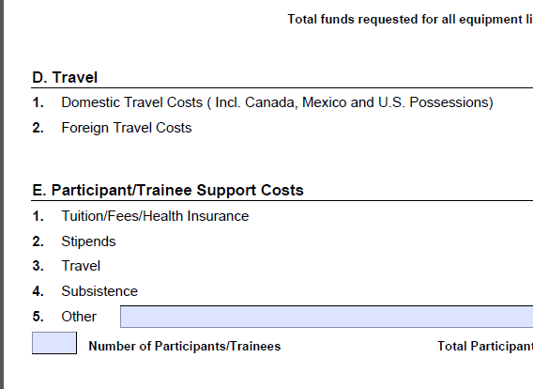
Ex: Scholarship & Stipends – Grants.gov line E.2.
Grants.gov Budget page
Assume
$100,000 scholarships
$20,000 in stipends
$120,000
100K+20K = 120K line E.2

Slide 18
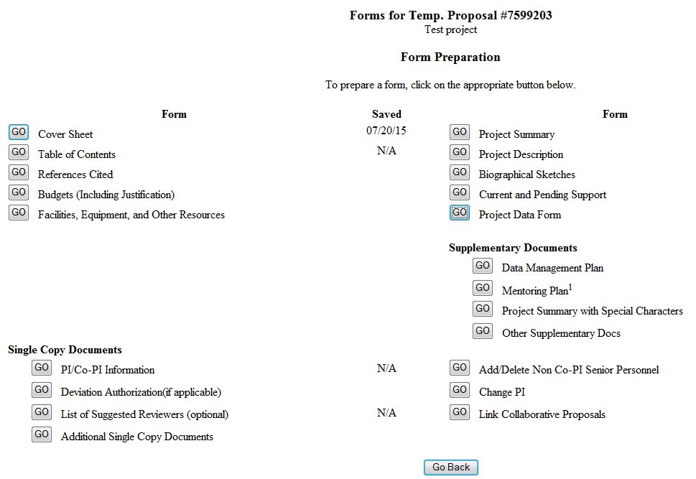
Identifying Strand and Type :Fastlane
Select Project Data Form

Slide 19
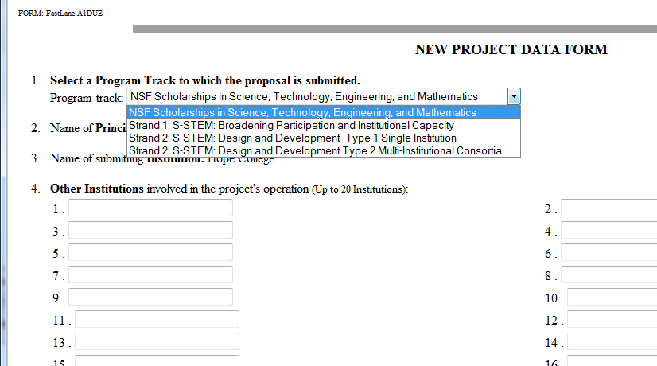
Identifying Strand and Type: Fastlane
Select Strand and Type in Project Data Form

Slide 20
Identifying Strand and Type: Grants.gov
After submit in Grants.gov must go to Fastlane and fillout project data form

Slide 21
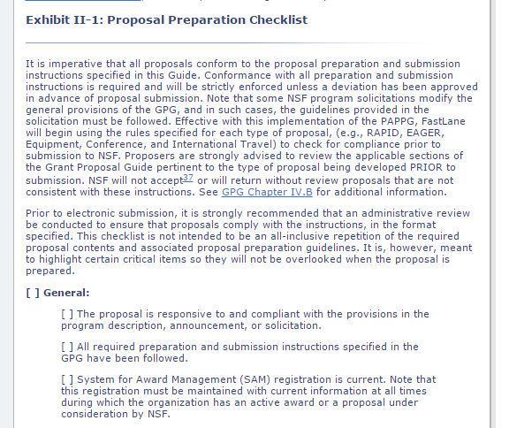
NSF Generic Proposal Preparation Checklist
http://www.nsf.gov/pubs/policydocs/pappguide/nsf15001/gpg_2.jsp#IIex1
Notes:
New Resource

Slide 22
Summary
Key Themes
  STEM Degree completion
  Eventual contribution to Workforce
  Academic talent, promise, potential
  Low income, demonstrated need
  Evidence based / evidence generating

Slide 23
Final Thoughts…
Multitude of requirements but…
  Encourage innovative implementations that work.
  Innovation – use, adapt, combine, adjust existing work to solve your students problems in creative and imaginative ways.
  Inspiring solutions that other people will emulate.
  Publicize and get the word out!

Slide 24
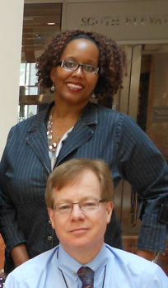
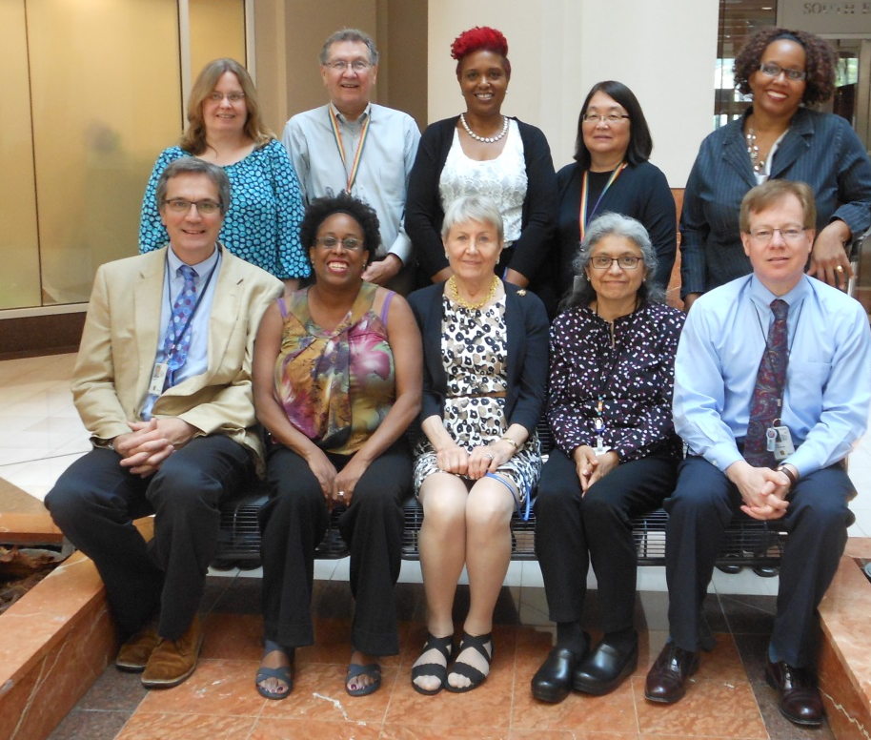

Thank you
NSF S-STEM Team
Front Row L to R: John Krupczak, Nicole Bennett, Joyce Evans, Lidia Yoshida, Kevin Lee
Second Row: Dawn Rickey, John Haddock, Karen Crosby, Connie Della-Piana, Yvette Weatherton,
Not Pictured: Brent Driscoll, Kate Denniston, Alyssa Jones, Nabriya Horton, Liz Teles
Notes:
We hope this presentation has been useful in helping you to plan your SSTEM proposal. On behalf of the NSF and the entire S-STEM team we thank you for time and interest. For more information, please consult the S-STEM solicitation or the links on the next slide.

Slide 25
Questions ?

Slide 26
S-STEM Program Officer
Contact Information
Connie K. Della-Piana, CDELLAPI@nsf.gov
John Krupczak, JKRUPCZA@nsf.gov
Kevin Lee, KELEE@nsf.gov
Paul Tymann, PTYMANN@nsf.gov
Yvette Weatherton, YWEATHER@nsf.gov
Notes:
NOTE: Be on the look-out for a set of FAQs on the S-STEM program page.

