Slide 1
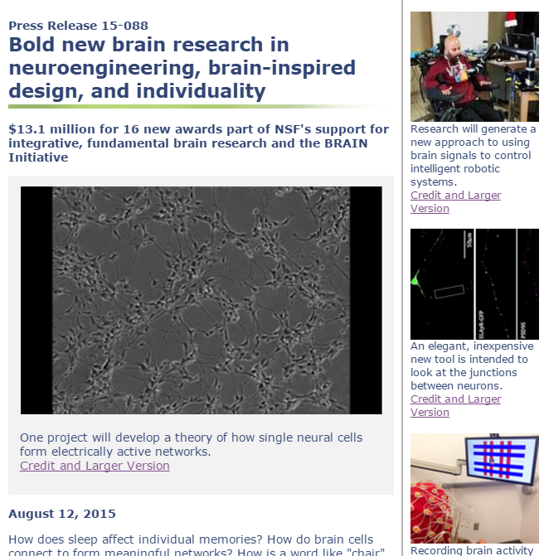
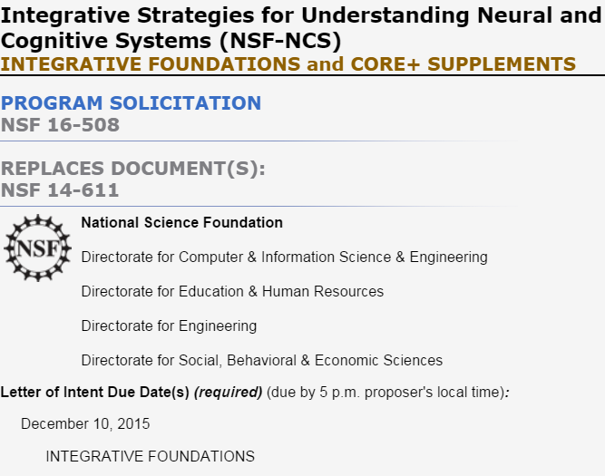
NSF-NCS 2016 Proposers’ Webinar
http://www.nsf.gov/ncs/
Submit your questions by e-mail to ncs@nsf.gov

Slide 2
NSF-NCS 2016 Proposers’ Webinar
Program Context and Scope
  Integrative Research Themes
Important Emphases and Limitations
  Integrative; Transformative; High-risk, high-payoff
  1 per PI; Participating directorates
Proposal Classes and How to Apply
  INTEGRATIVE FRONTIERS
  CORE+ SUPPLEMENTS
Review Criteria
Your Questions
http://www.nsf.gov/ncs/
Submit your questions by e-mail to ncs@nsf.gov

Slide 3
please read the solicitation nsf.gov/ncs and the NSF Grant Proposal Guide
(recently revised) nsf.gov/publications/pub_summ.jsp?ods_key=gpg nsf.gov/pubs/policydocs/pappguide/nsf15001/sigchanges.jsp nsf.gov/pubs/policydocs/pappguide/nsf16001/sigchanges.jsp
Be sure to read up on “Failure to submit by 5 p.m.” and “Broader Impacts of the Proposed Work”
Submit your questions by e-mail to ncs@nsf.gov

Slide 4
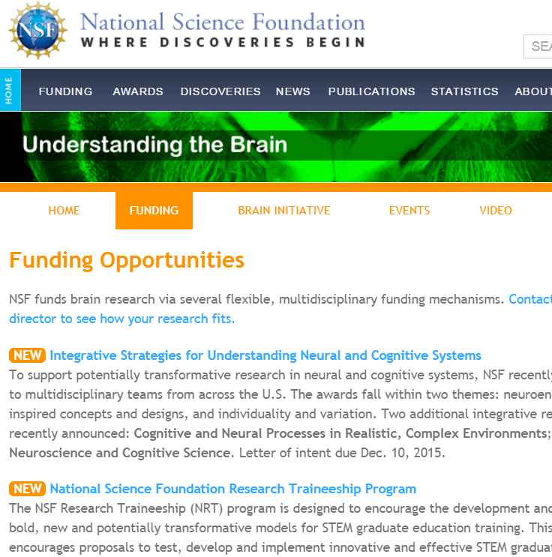

Program Context and Scope
nsf.gov/brain
INTEGRATIVE THEMES
Neuroengineering
and Brain-Inspired Concepts and Designs
Individuality
and
Variation
Cognitive and Neural Processes in Realistic, Complex Environments
Data-Intensive Neuroscience and Cognitive Science
update this
http://www.nsf.gov/ncs/
Submit your questions by e-mail to ncs@nsf.gov

Slide 5
Program Context and Scope
nsf.gov/brain
INTEGRATIVE THEMES
Neuroengineering
and Brain-Inspired Concepts and Designs
Individuality
and
Variation
Cognitive and Neural Processes in Realistic, Complex Environments
Data-Intensive Neuroscience and Cognitive Science
update this
http://www.nsf.gov/ncs/
Submit your questions by e-mail to ncs@nsf.gov

Slide 6
Program Context and Scope
INTEGRATIVE THEMES
transformative, integrative, bold, risky, beyond single-discipline; tackle previously intractable challenges
bridge across scales, levels of abstraction/analysis, approaches
build on leading edges, bridge critical gaps, challenge prevailing paradigms
connected portfolio of transformative, integrative projects
Neuroengineering
and Brain-Inspired Concepts and Designs
Individuality
and
Variation
Cognitive and Neural Processes in Realistic, Complex Environments
Data-Intensive Neuroscience and Cognitive Science
http://www.nsf.gov/ncs/
Submit your questions by e-mail to ncs@nsf.gov

Slide 7
INTEGRATIVE THEMES
Neuroengineering and Brain-Inspired Concepts and Designs
technologies for imaging, sensing, recording, or affecting real-time brain activity and behavior
computing paradigms
brain-computer interfaces
augmented and adaptive systems (e.g., for communication, learning, performance)
other computational and bioengineered systems
insights from neuroscience and cognitive science
insights from rapidly changing technologies
significant innovations inspired by or directed toward the brain
+
→
Submit your questions by e-mail to ncs@nsf.gov

Slide 8
INTEGRATIVE THEMES
Individuality and Variation
characteristic of all neural and cognitive processes at all scales:
biological/machine systems signaling/communication representations learning/adaptation development resilience ability cultural/social processes group differences
functionally important individuality and variation
role of noise
domain-general statistical and modeling challenges
explore, describe, and understand the role of naturally occurring variability
Submit your questions by e-mail to ncs@nsf.gov

Slide 9


INTEGRATIVE THEMES
Cognitive and Neural Processes in
Realistic, Complex Environments
naturally occurring complexity and interactions
beyond static, artificial experimental settings
• adaptive processes during physical, social, and educational interactions • flexibility and contextual aspects of learning (biological, cognitive, machine) • experimental paradigms leveraging immersive environments (e.g., virtual reality) or other simulation or synthesis methods • mobile technologies for cognitive and neural processing and data gathering
• cyber-human interactions such as human-robot symbiosis
Images: Snežana Trifunović, Groink, CC BY-SA 3.0
Submit your questions by e-mail to ncs@nsf.gov

Slide 10
INTEGRATIVE THEMES
Data-Intensive Neuroscience and Cognitive Science
New methods and technologies for gathering and analyzing vast amounts of data are rapidly changing how neural and cognitive processes can be explored, modeled, and understood.
Specific challenges of scale, heterogeneity, throughput; behavioral, cognitive, and biological richness; experimental limitations; multi instruments, investigators, or communities; wide variety of contexts
Analysis
Modeling
Aggregation
Sharing
Open Science
Integrative discovery goals
Large-scale data
Submit your questions by e-mail to ncs@nsf.gov

Slide 11
INTEGRATIVE THEMES
Across all themes:
Advances in theory and methods
Technological innovation
Education and workforce
Research infrastructure
Neuroengineering
and Brain-Inspired Concepts and Designs
Individuality
and
Variation
Cognitive and Neural Processes in Realistic, Complex Environments
Data-Intensive Neuroscience and Cognitive Science
Build on associated infrastructure projects, leverage existing standards, frameworks, platforms, resources as appropriate
Submit your questions by e-mail to ncs@nsf.gov

Slide 12
Important Emphases
transformative advances in one or more of the integrative thematic areas
transformative advance, one or more integrative theme
Neuroengineering
and Brain-Inspired Concepts and Designs
Individuality
and
Variation
Cognitive and Neural Processes in Realistic, Complex Environments
Data-Intensive Neuroscience and Cognitive Science
Submit your questions by e-mail to ncs@nsf.gov

Slide 13
Important Emphases
transformative advances in one or more of the integrative thematic areas
transformative advance, one or more integrative theme
high-risk, high payoff approaches are expected
Submit your questions by e-mail to ncs@nsf.gov

Slide 14
Important Emphases
transformative advances in one or more of the integrative thematic areas
transformative advance, one or more integrative theme
high-risk, high payoff approaches are expected
integrative approach, integrative outcomes
Submit your questions by e-mail to ncs@nsf.gov

Slide 15
Limitations
transformative advances in one or more of the integrative thematic areas
Limit one per PI/Co-PI/Senior Personnel (including INTEGRATIVE FOUNDATIONS and CORE+ SUPPLEMENTS)
Consistent with the missions of the participating directorates (CISE, EHR, ENG, SBE)
Minimum two collaborating investigators with complementary expertise for INTEGRATIVE FOUNDATIONS
Submit your questions by e-mail to ncs@nsf.gov

Slide 16
Proposal Classes
transformative advances in one or more of the integrative thematic areas
CORE+ SUPPLEMENTS
INTEGRATIVE FOUNDATIONS
Anticipated Future Activities:
subject to availability of funds
INTEGRATIVE FRONTIERS
Submit your questions by e-mail to ncs@nsf.gov

Slide 17
Letter of Intent (REQUIRED):
December 10, 2015
Proposal Deadline:
January 26, 2016
INTEGRATIVE FOUNDATIONS
foundational advances that are deeply connected to a broad scope of questions in cognitive and neural systems
transformative advance in one or more thematic area
two or more investigators with distinct but complementary expertise
$500,000 to $1,000,000* over 2 to 4 years
*cumulative total costs
Submit your questions by e-mail to ncs@nsf.gov

Slide 18
Letter of Intent (REQUIRED):
December 10, 2015
Proposal Deadline:
January 26, 2016
INTEGRATIVE FOUNDATIONS
foundational advances that are deeply connected to a broad scope of questions in cognitive and neural systems
transformative advance in one or more thematic area
two or more investigators with distinct but complementary expertise
$500,000 to $1,000,000 over 2 to 4 years
may build on an associated project
Submit your questions by e-mail to ncs@nsf.gov

Slide 19
Letter of Intent (REQUIRED):
December 10, 2015
must include on the FastLane form:
names and institutional affiliations
synopsis conveying innovative, integrative nature of the project
research theme or themes
participating directorate(s) to which the proposal is relevant (CISE, EHR, ENG, SBE)
why not suitable for an NSF core program?
distinct areas of expertise, research approaches, or disciplines represented by the investigators
No feedback on Letters of Intent
INTEGRATIVE FOUNDATIONS
foundational advances that are deeply connected to a broad scope of questions in cognitive and neural systems
transformative advance in one or more thematic area
two or more investigators with distinct but complementary expertise
$500,000 to $1,000,000 over 2 to 4 years
may build on an associated project
Submit your questions by e-mail to ncs@nsf.gov

Slide 20
INTEGRATIVE FOUNDATIONS
Proposal Deadline:
January 26, 2016
Project Summary must separately address Integrative Value and Transformative Potential
Project Description must separately address
  Integrative Strategy
  Risk, Reward, and Risk Management
Please see instructions for additional solicitation requirements.
foundational advances that are deeply connected to a broad scope of questions in cognitive and neural systems
transformative advance in one or more thematic area
two or more investigators with distinct but complementary expertise
$500,000 to $1,000,000 over 2 to 4 years
may build on an associated project
Submit your questions by e-mail to ncs@nsf.gov

Slide 21
Major advances in understanding the brain have depended on fundamental contributions from many
different disciplinary communities, often engaging with neural and cognitive questions in creative and
surprising ways.
CORE+ SUPPLEMENTS
Major advances in understanding the brain have depended on fundamental contributions from many different disciplinary communities, often engaging with neural and cognitive questions in creative and surprising ways.
additional support for new or existing projects in CISE, EHR, or ENG, but not SBE
for additional activities that connect those projects to significant new integrative opportunities in neural and cognitive systems (not straightforward extension of current work)
up to $200,000 in additional funds, or 20% of an existing award, whichever is less
No Letter of Intent
Contact your cognizant program officer or directorate contact
Submit your questions by e-mail to ncs@nsf.gov

Slide 22
Major advances in understanding the brain have depended on fundamental contributions from many
different disciplinary communities, often engaging with neural and cognitive questions in creative and
surprising ways.
CORE+ SUPPLEMENTS
Major advances in understanding the brain have depended on fundamental contributions from many different disciplinary communities, often engaging with neural and cognitive questions in creative and surprising ways.
with a new CISE/EHR/ENG proposal:
embedded as a supplementary document
for an existing CISE/EHR/ENG project:
as a separate supplemental funding request after discussing with program officer
consider:
relation to base project; what is the new direction?
relation to one or more solicitation theme(s)
high-risk, high-payoff?
budget needs
Contact program officer before submitting; notify nsf-ncs-coreplus@nsf.gov after submitting
additional support for new or existing projects in CISE, EHR, or ENG, but not SBE
for additional activities that connect those projects to significant new integrative opportunities in neural and cognitive systems (not straightforward extension of current work)
up to $200,000 in additional funds, or 20% of an existing award, whichever is less
Submit your questions by e-mail to ncs@nsf.gov

Slide 23
Merit Review Criteria
Intellectual Merit Broader Impacts
potential to advance knowledge • potential to benefit society
Integrative Value and Transformative Potential
bold, potentially risky, well beyond typical disciplinary approach?
advance foundations of one or more integrative research theme?
deep, complementary, synergistic expertise; build on/contribute to broader intellectual context?
cross temporal/spatial scales, levels of abstraction/analysis, disciplinary/methodological/technological approaches?
advances in theory or methods, technological innovations?
broadly accessible, high-quality resources?
educational approaches, interdisciplinary workforce?
Submit your questions by e-mail to ncs@nsf.gov

Slide 24
NSF-NCS 2016 Proposers’ Webinar
http://www.nsf.gov/ncs/
Submit your questions by e-mail to ncs@nsf.gov

Slide 26
ask yourself
innovative/integrative?
high-risk, high-payoff?
advance the integrative research theme(s)?
bring together, and build on distinct expertise/approaches/ disciplines?
consistent with the missions of the participating directorates (CISE, EHR, ENG, SBE)
http://www.nsf.gov/ncs/
Submit your questions by e-mail to ncs@nsf.gov

