Slide 1
Lightening Talks
National Science Foundation
Large Facilities Workshop
May 24, 2016

Slide 2

Regional Class Research Vessel NSF Large Facilities Workshop
24 May 2016

Slide 3
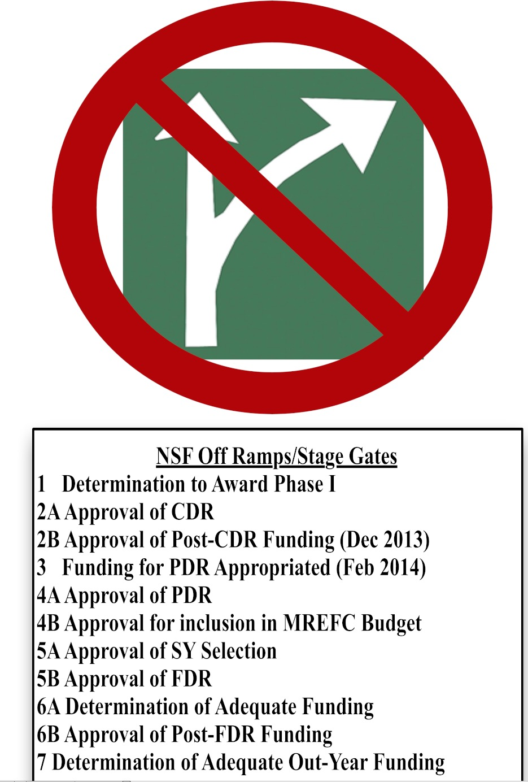
Status Update✔
Passed CDR/PDR/BSR/Acquisition Review
FDR in October
NSB recommended 2 vessels based on Decadal Survey. NSF has $106M in FY17 Pres Bud.
✔
✔
✔
✔
✔
✔

Slide 4
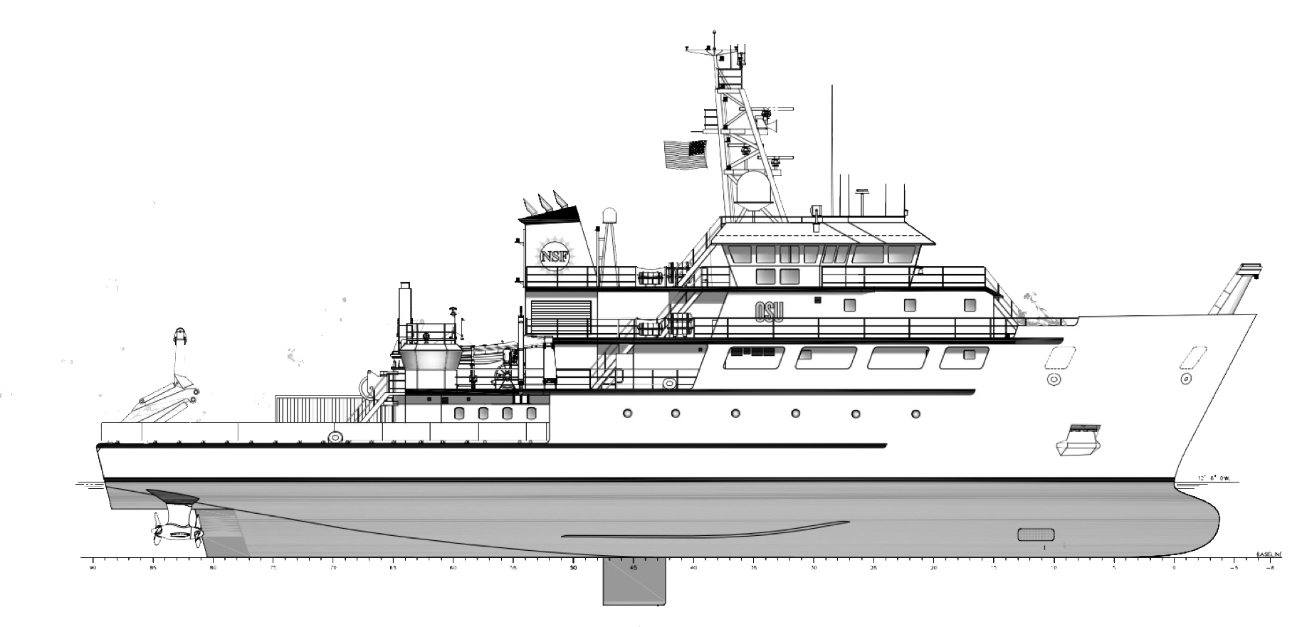
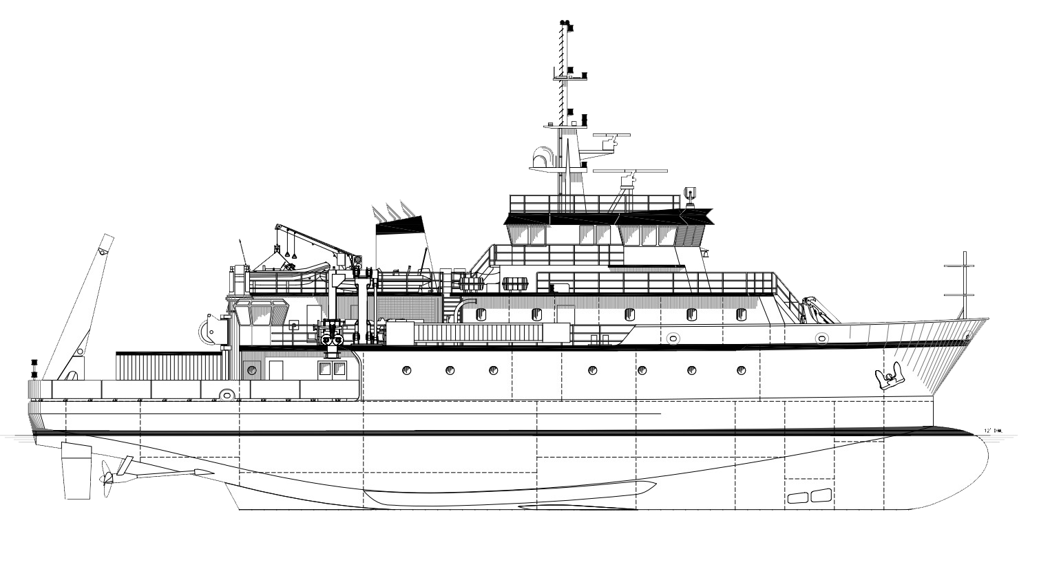
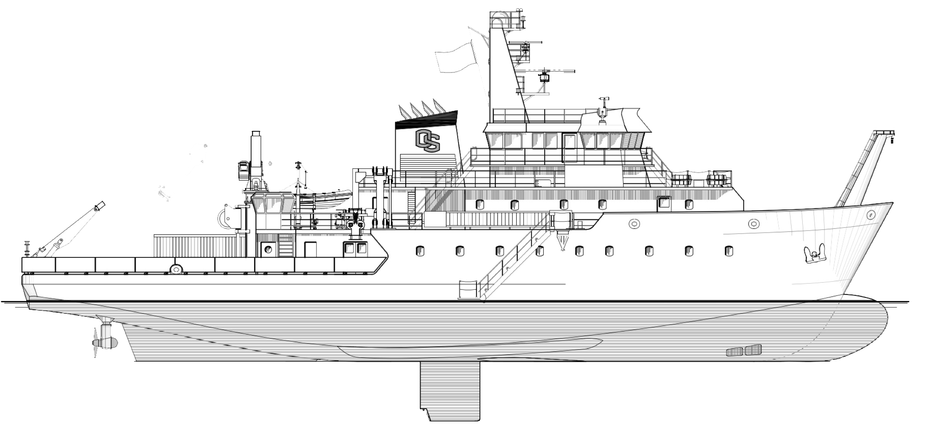
Establishing Scope: RCRV Over Time
Challenge and Achievement #1
(i.e the mixed blessing of “design refresh”)
2009: 155’
2012: 175’
2016: 193’

Slide 5


RCRV Scenario Development
Challenge and Achievement #2
Science Community
Senate CJS Markup
CDR
PDR
FDR?
PDR
Decadal Survey
‘17 Pres.
Budget
FDR-Ready PEP
FDR?
CDR
CDR
PDR
FDR?
House CJS Markup
FDR?
2013
2014
2015
2016

Slide 6
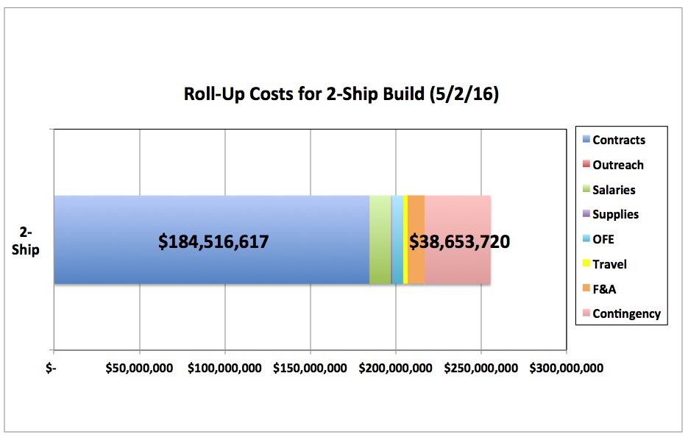
Budget Progression
PDR Budget
FDR Budget
$255,500,000

Slide 7

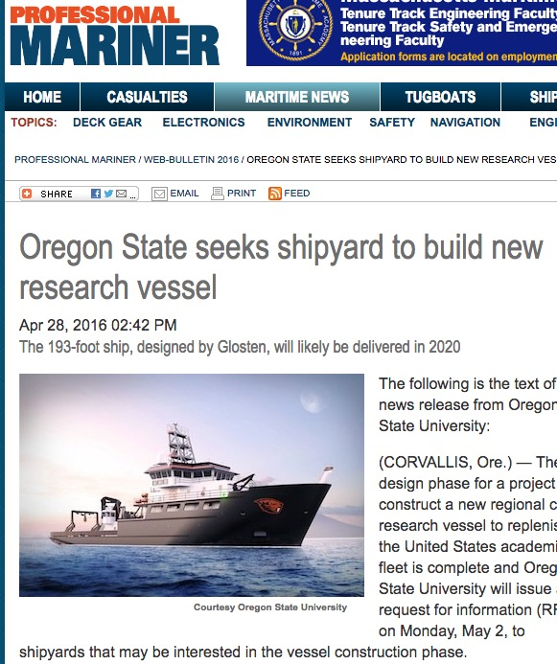
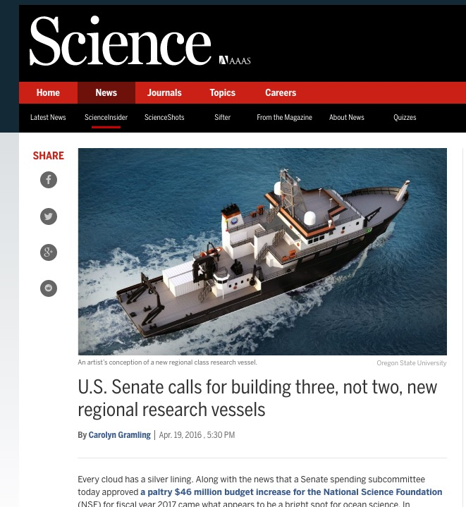
Senate Added $56M
RFI
Released May 2nd

Slide 8
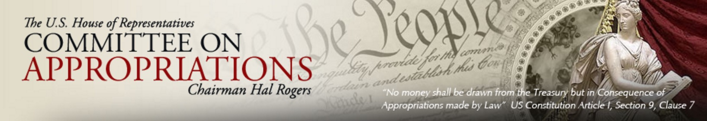
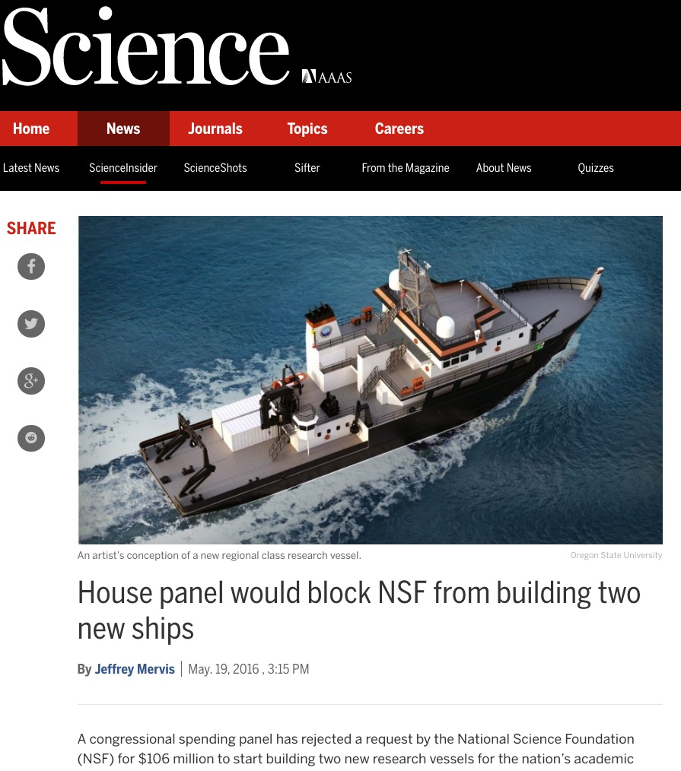
House Removes $159M

Slide 9
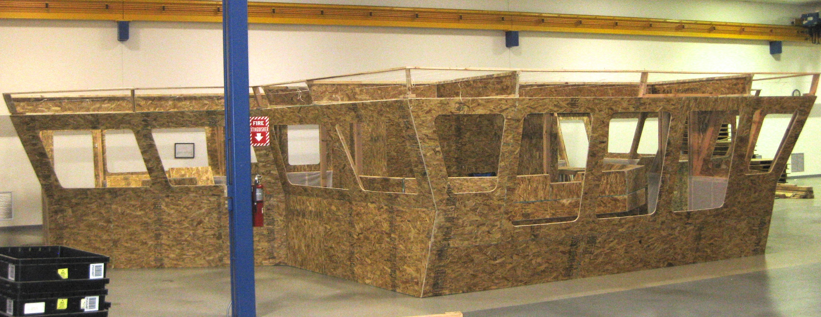
Bridge Mock Up

Slide 10
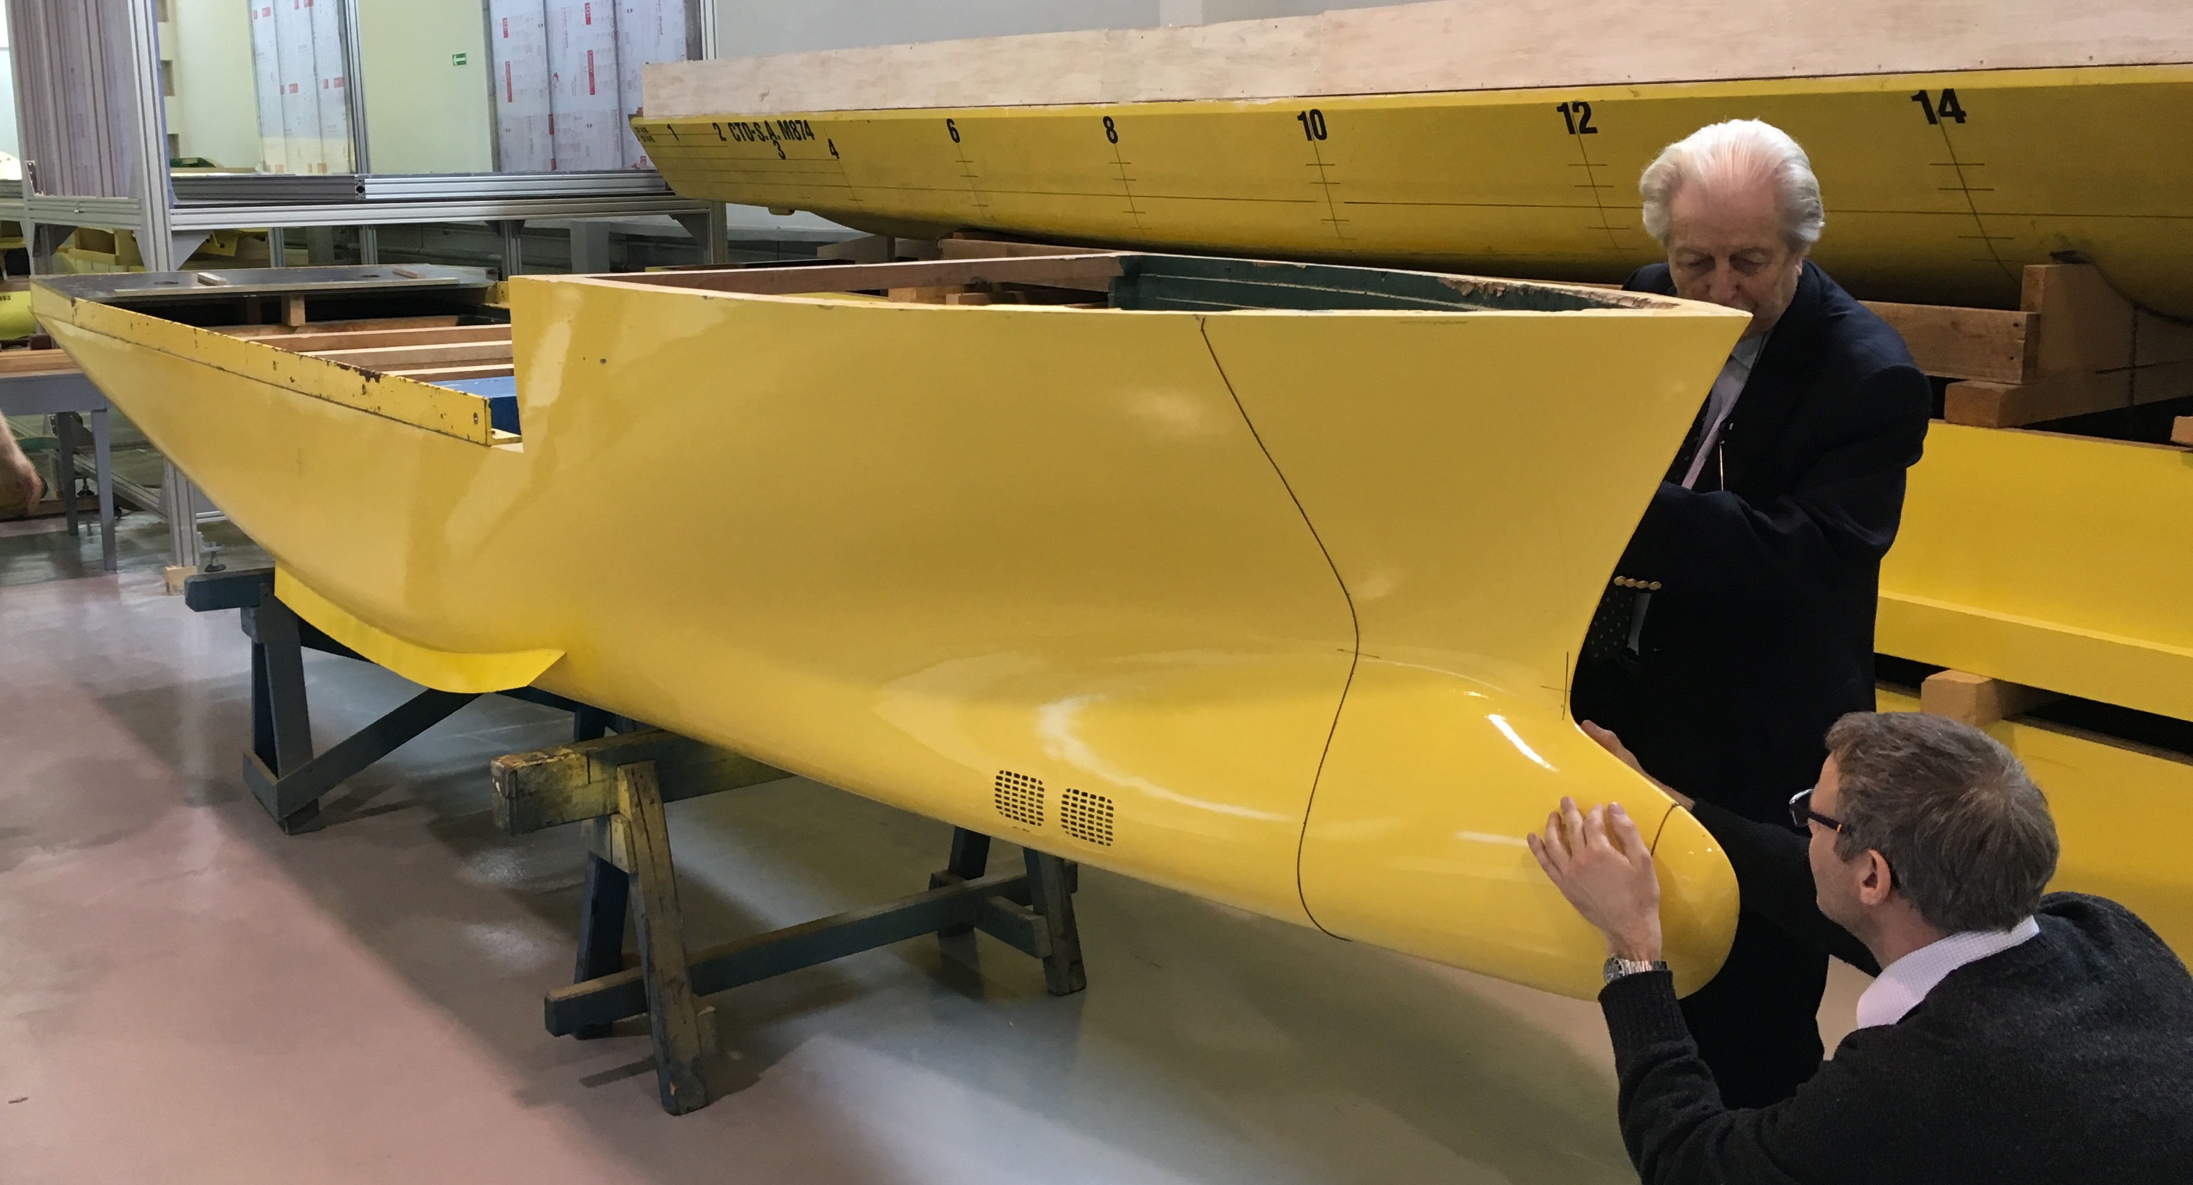
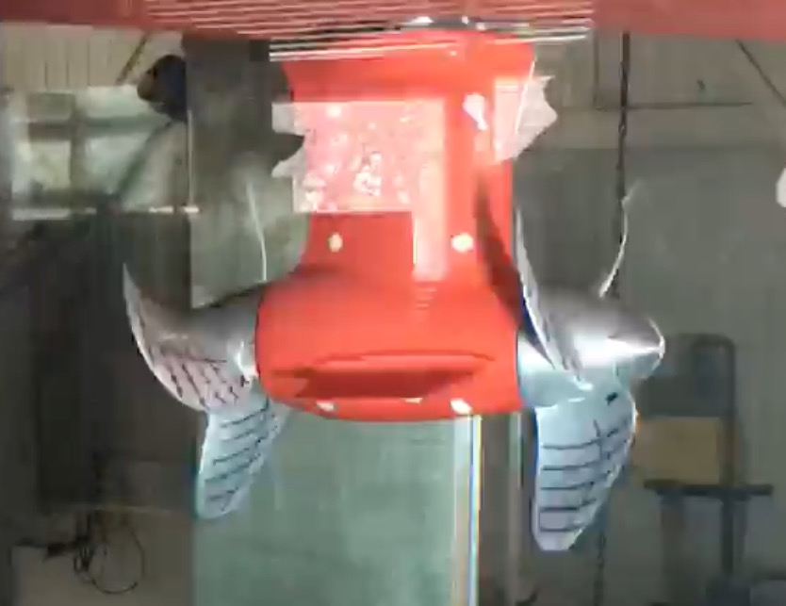
Model Testing
Cavitation-free to 11 kts
No evidence of bubble sweep down under simulated survey conditions

Slide 11
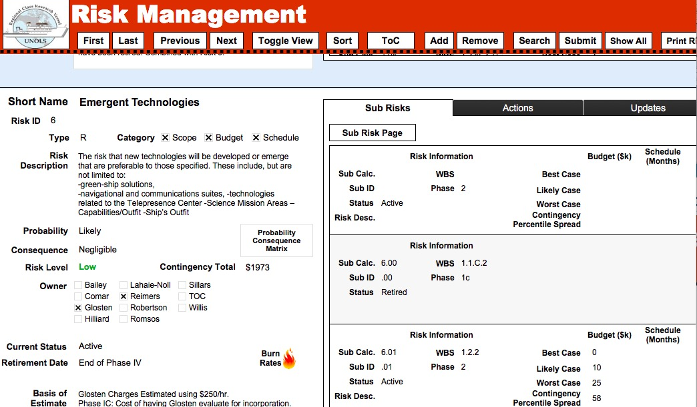

Slide 12




Gemini Observatory operations, science & development
Andy Adamson
Associate Director of Operations, Gemini
Scot Kleinman
Associate Director of Development, Gemini
Markus Kissler-Patig - Gemini Board meeting May 2016

Slide 13

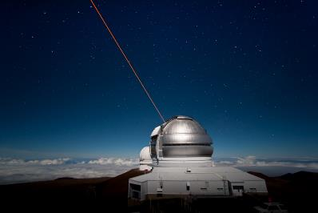
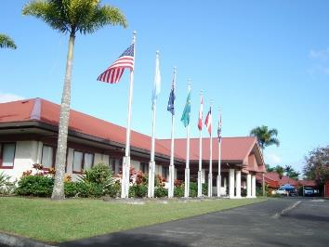
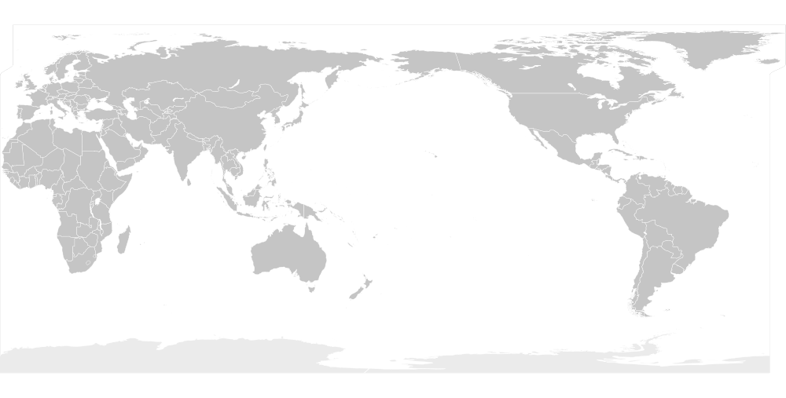

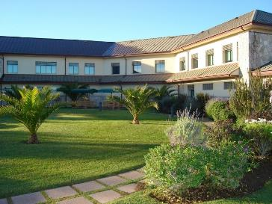
Mauna Kea
since 1999
Gemini Observatory: Operating twin 8m telescopes on Mauna Kea and Cerro Pachon: providing access to the entire sky
Hilo, Hawaii
We are Here
We are Here
We are Here
We are Here
We are Here
We are Here
We are Here
Cerro Pachon
since 2000
La Serena, Chile

Slide 14
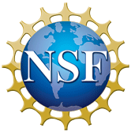
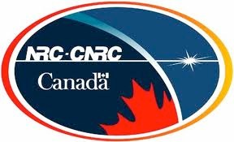

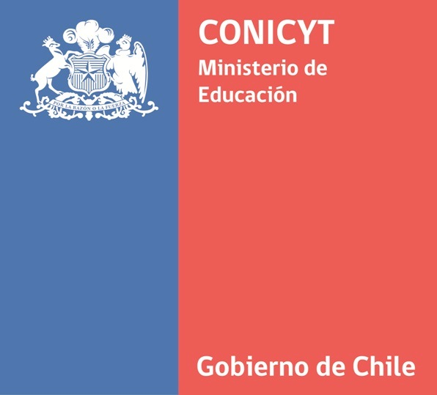

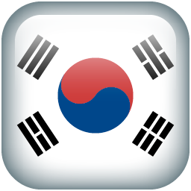

The International Partnership
International Agreement 2016-2021 includes as partners: USA, Canada, Brazil, Argentina, and Chile
US 70 %
CA 20 %
BR 7 %
AR 3%
AUS+KOR +x%
Shares 2016-2021:
(Budget ~27+x $M/year)
KASI (Korea) is a limited-term partner since 2015, aspiring to become a full partner
Australia did not remain a full partner beyond 2015, but is continuing in 2016 as limited-term partner
Andy Adamson NSFLFW May 2016

Slide 15
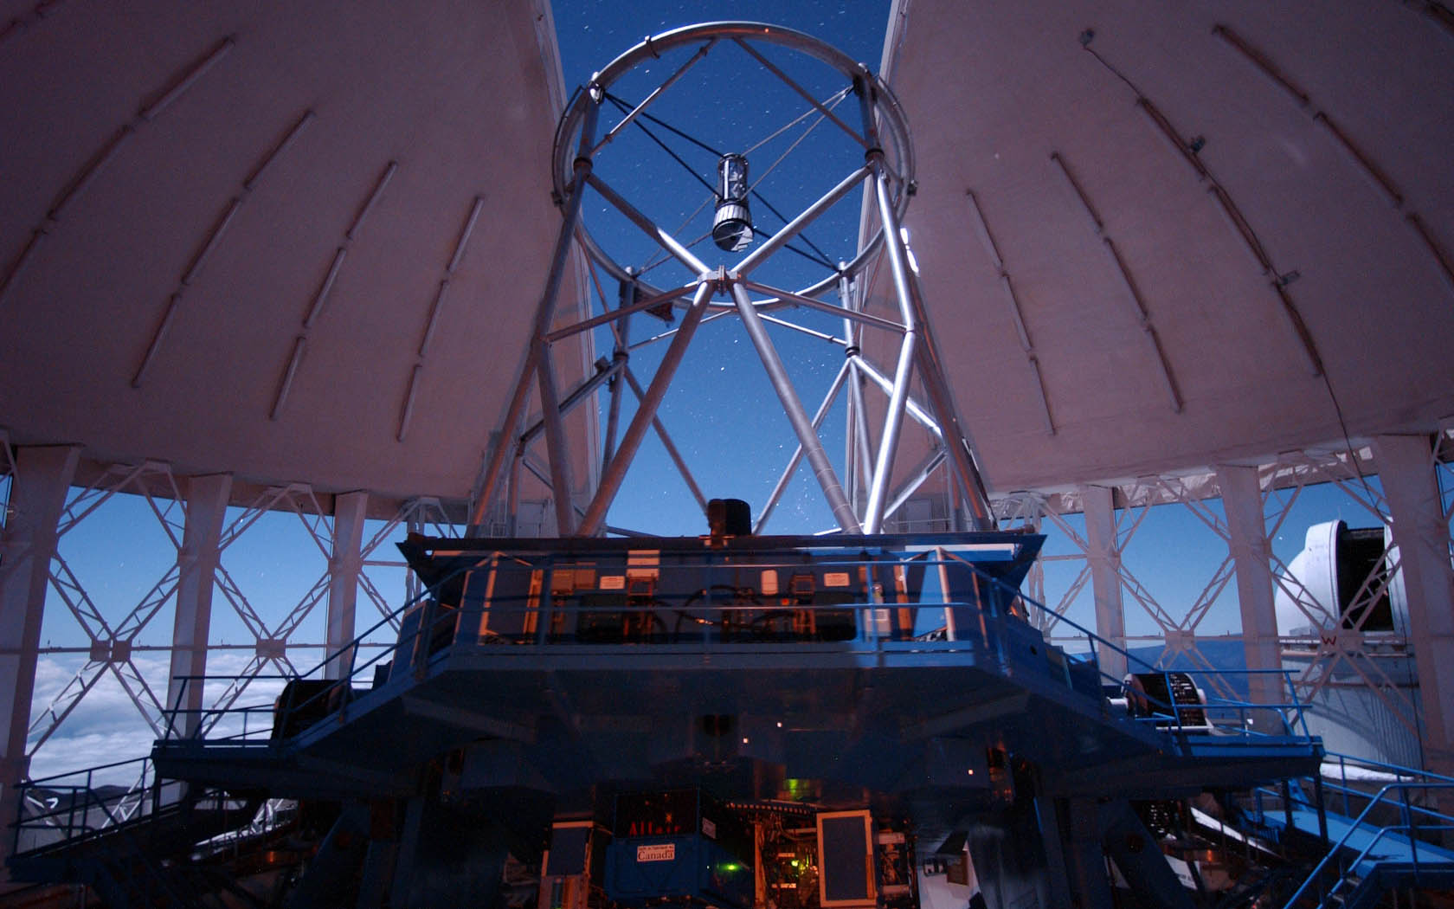
Markus Kissler-Patig - Gemini Board meeting May 2016

Slide 16
Proposing for time at Gemini
The regular proposal: once per semester, through the national Time Allocation Committees (TAC)
for regular proposals
Large & Long Programs: once per year, through the Large Program TAC
for large and/or long ambitious proposals
Fast turnaround programs: once per month, 'peer reviewed', no TAC
for short, rapid, immediate and/or follow-up proposals
70%
20%
10%
Andy Adamson & Scot Kleinman NSFLFW May 2016

Slide 17
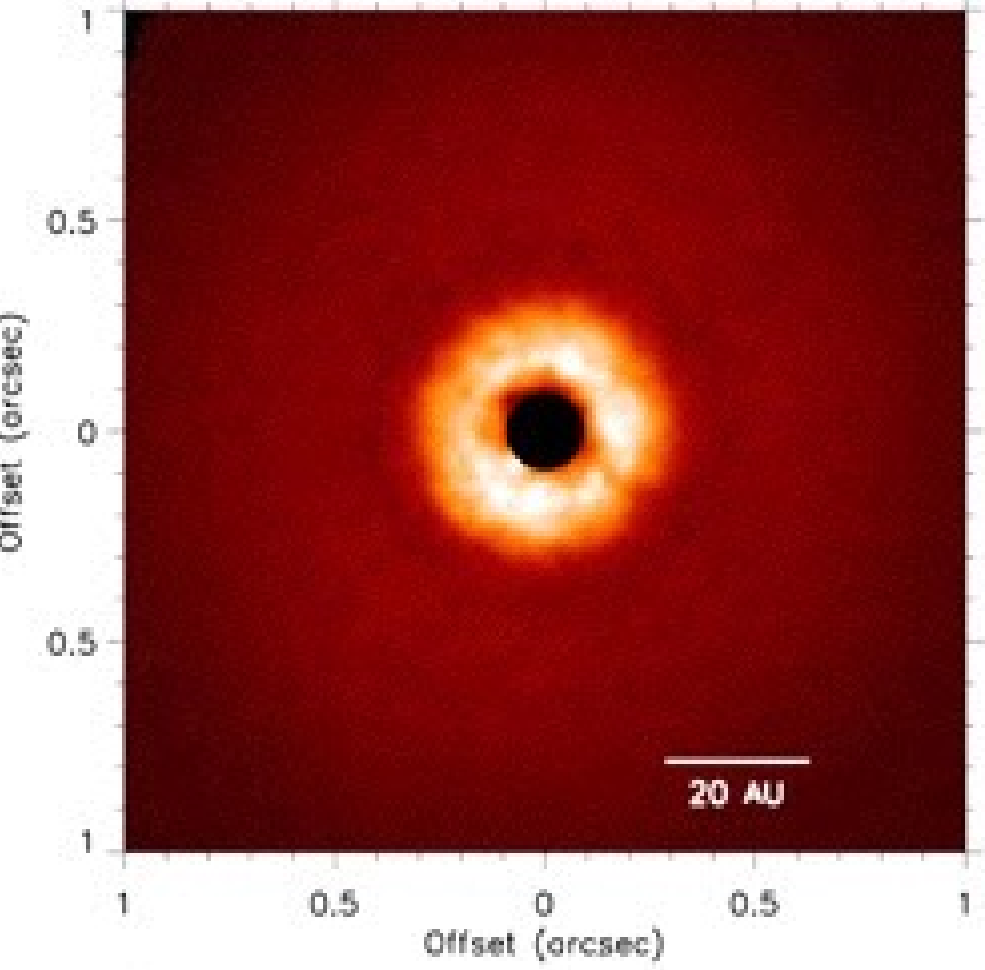
Recent Science Highlights
TW Hydrae
1.2 micron (near-infrared)
Polarized intensity image from GPI
Rapson et al. 2016
• GPI probes w/in 10AU of TW Hydrae
• Comparison with simulations suggests 0.2M Jupiter planet at 21A

Slide 18
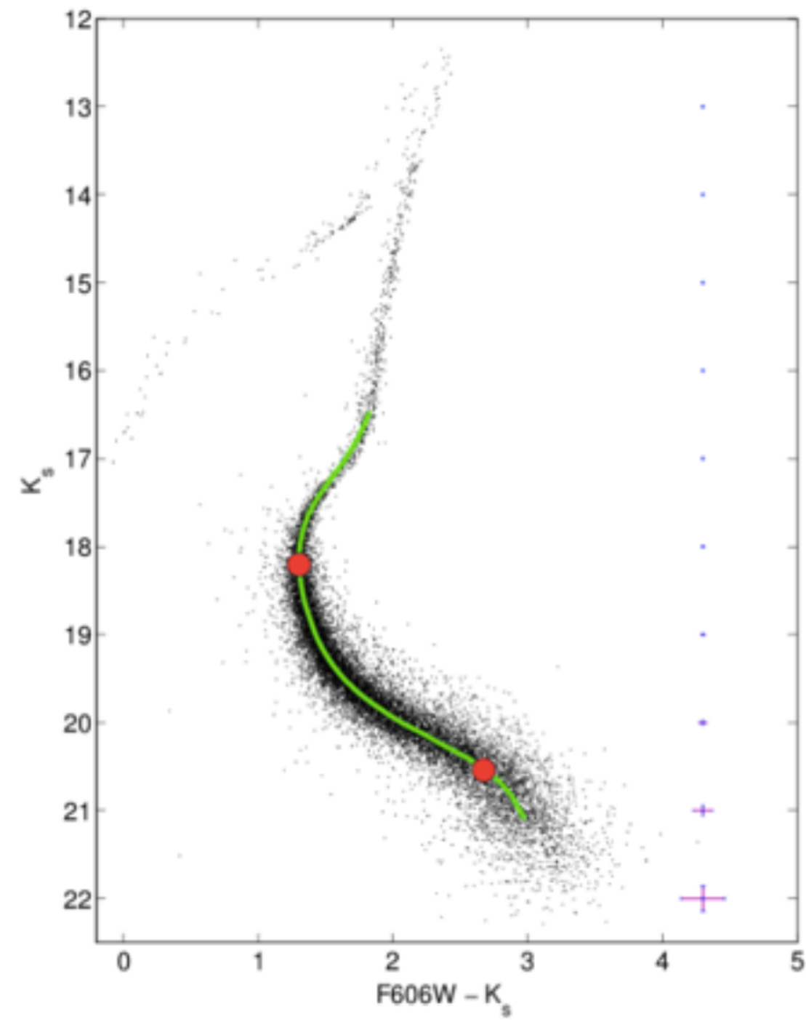
Recent Science Highlights
Turri et al. 2015
• Globular cluster NGC 1851
• Around 16,000 stars
• Depth and precision allow combination with HST
• Double subgiant branch
• Main sequence “knee” reddening- and distance-independent age
GeMS/GSAOI
Multiconjugate, laser-supported AO

Slide 19
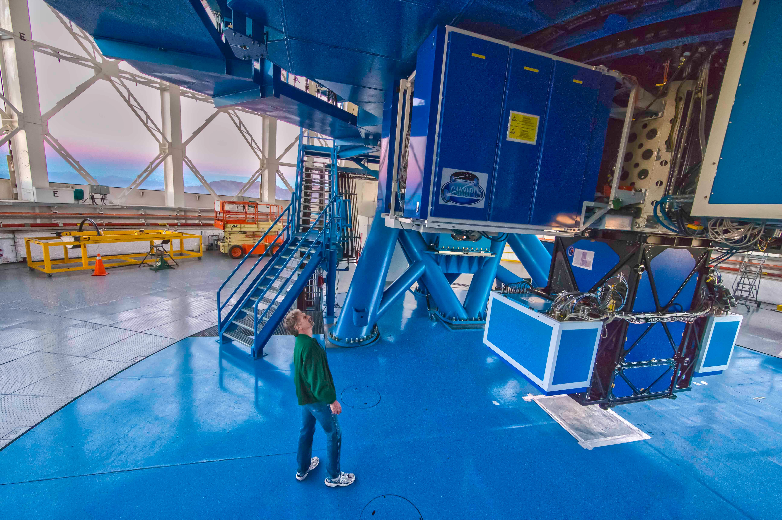
Gemini Instruments
Markus Kissler-Patig - Gemini Board meeting May 2016

Slide 20
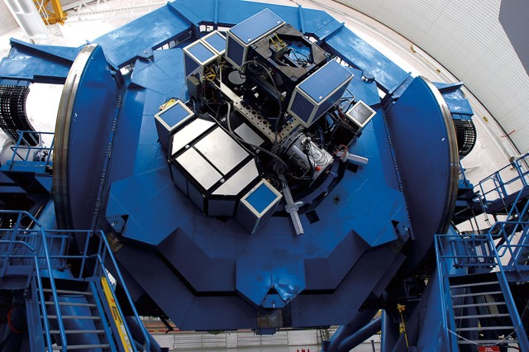
Gemini Instruments

Slide 21
Engaging the Community
Bring your Projects
Apply for Long and Large, Fast Turnaround, or standard TAC; Upgrade a current instrument, or build part or all of a new one
Bring your Instrument
Contact us if you would like to bring a Visiting Instrument or propose for our new projects and initiatives
Bring yourself
Rediscover the advantages of classical observing and mitigate weather loss with Priority Visiting Observing
Bring your Student
Give your student the extra boost of motivation by taking her/him along and we’ll chip in to pay for it!
Bring your Code
Share your reduction/analysis code or just expertise on our new User Forum. Win observing time.
20

Slide 22
Contracting Issues
Negotiations typically drag on longer than hoped
Approval process through oversight and NSF takes a long time
Sometimes difficult to take advantage of opportunities while adhering to procurement requirements
Reserves, contingency, risk mitigation funds: a moving target in policy, but critical for projects
Typical university teams still used to grad students and duct tape; hard to move to more rigorous project management and systems engineering approaches

Slide 23
… and one more thing
Very interested in how you do resource planning for both current and future operations and projects in your organizations.

Slide 24
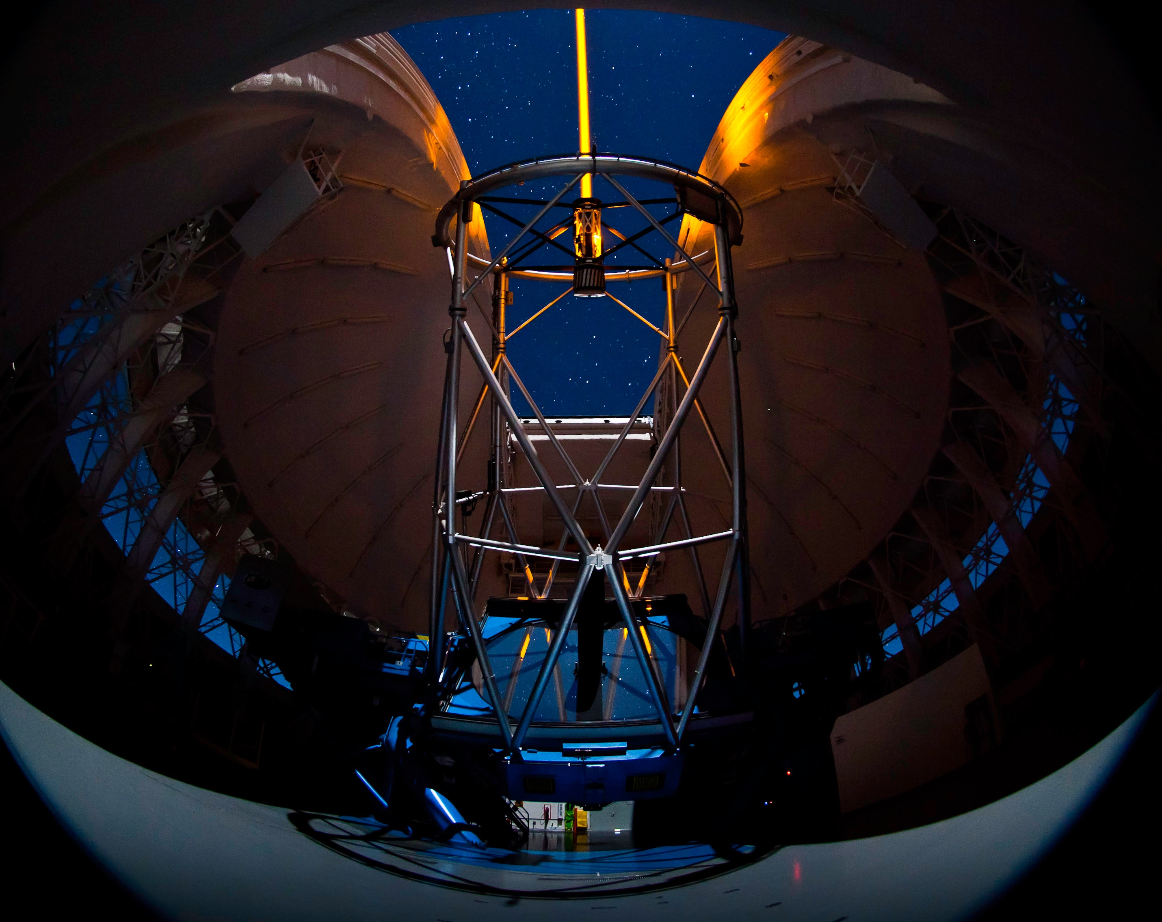
Thank You
Markus Kissler-Patig - Gemini Board meeting May 2016

Slide 26
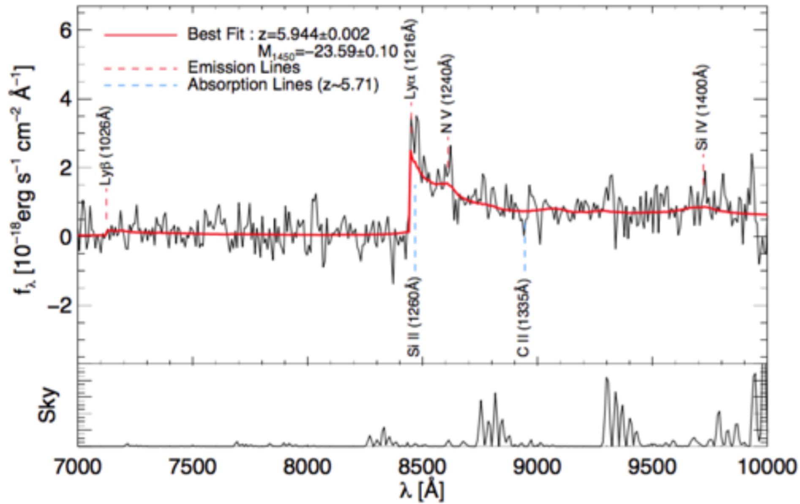
Recent Science Highlights
Kim et al. 2015 • first publication from Korean participation in Gemini partnership • GMOS-S spectroscopy confirm source as quasar, and redshift • sample from Infrared Medium-Deep Survey • not enough quasars for cosmic reionization, even considering candidates as well as confirmed quasars in the survey

Slide 27
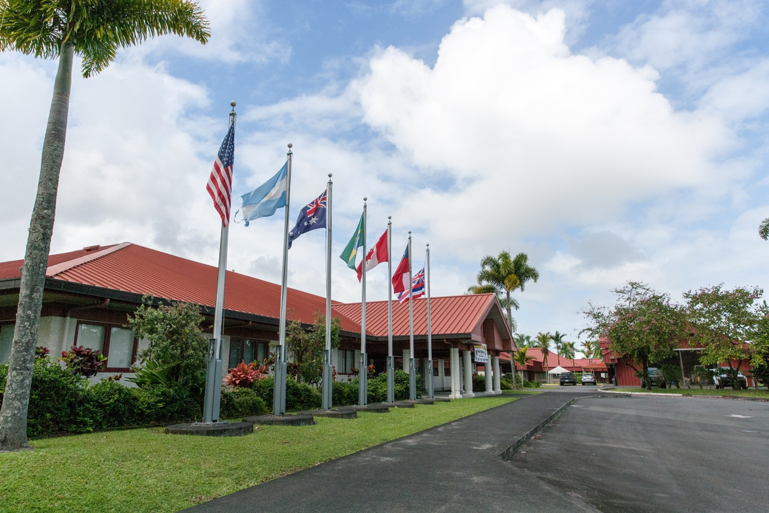
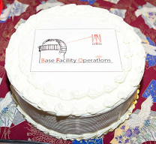
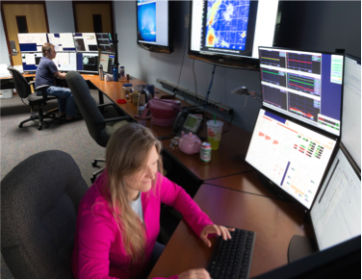
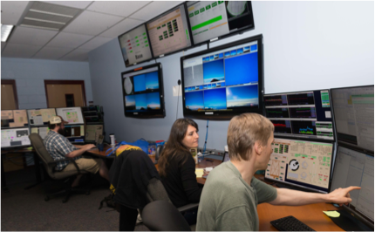
Gemini North runs from Hilo since November
Markus Kissler-Patig - Gemini Board meeting May 2016

Slide 28
UK withdrawal: 25% budget reduction
Andy Adamson NSFLFW May 2016

Slide 29



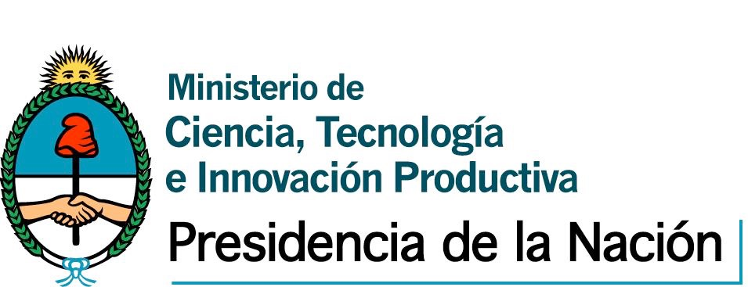
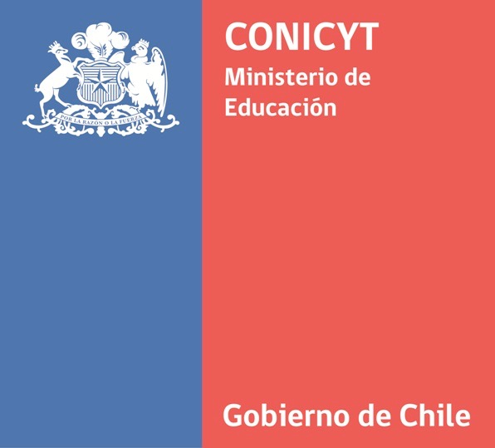
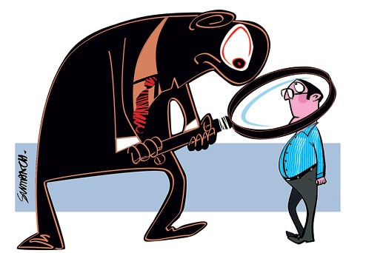


The Governance
International
Partner countries
GFC
Board
Community
STAC
Executive Agency
US Government
Managing Agency
AURA members
AOC-G
Shared services
with UH and AURA-O
CAS/HRS
Observatory
Users’ Committee
NOAO-S
National Gemini
Offices
Community
MKSS
Partner countries

Slide 30

Integrated Cost-Schedule Risk Analysis
Lightning Talk
Integrated
Cost-Schedule
Risk Analysis
Mike Carrancho, P.E.
Smithsonian Institution
NSF Large Project Workshop 24 May 2016

Slide 31
National Air & Space Museum
Very Large, complex, renovation project
Complete HVAC replacement
Complete stone envelope and primary weather barrier replacement
Museum to remain open and operational during project
“Like rebuilding a 747 while in flight” Ret. Gen J. Dailey

Slide 32
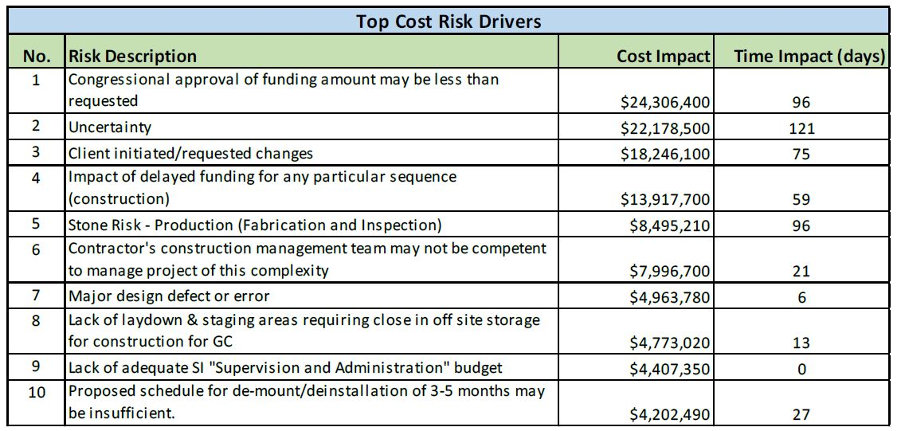
Cost Risks & Impacts

Slide 33
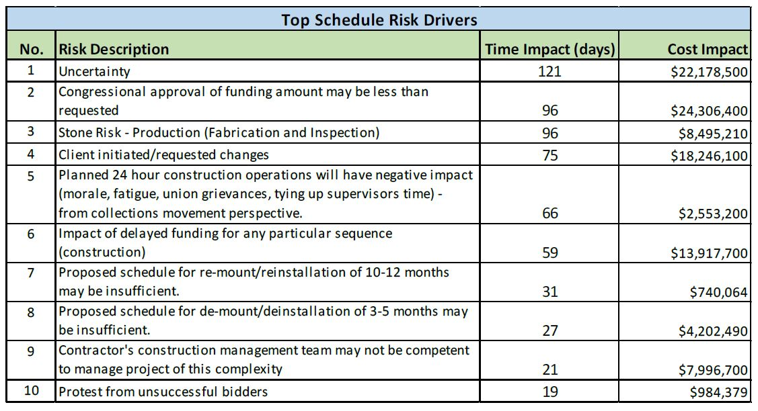
Schedule Risks & Impacts

Slide 34
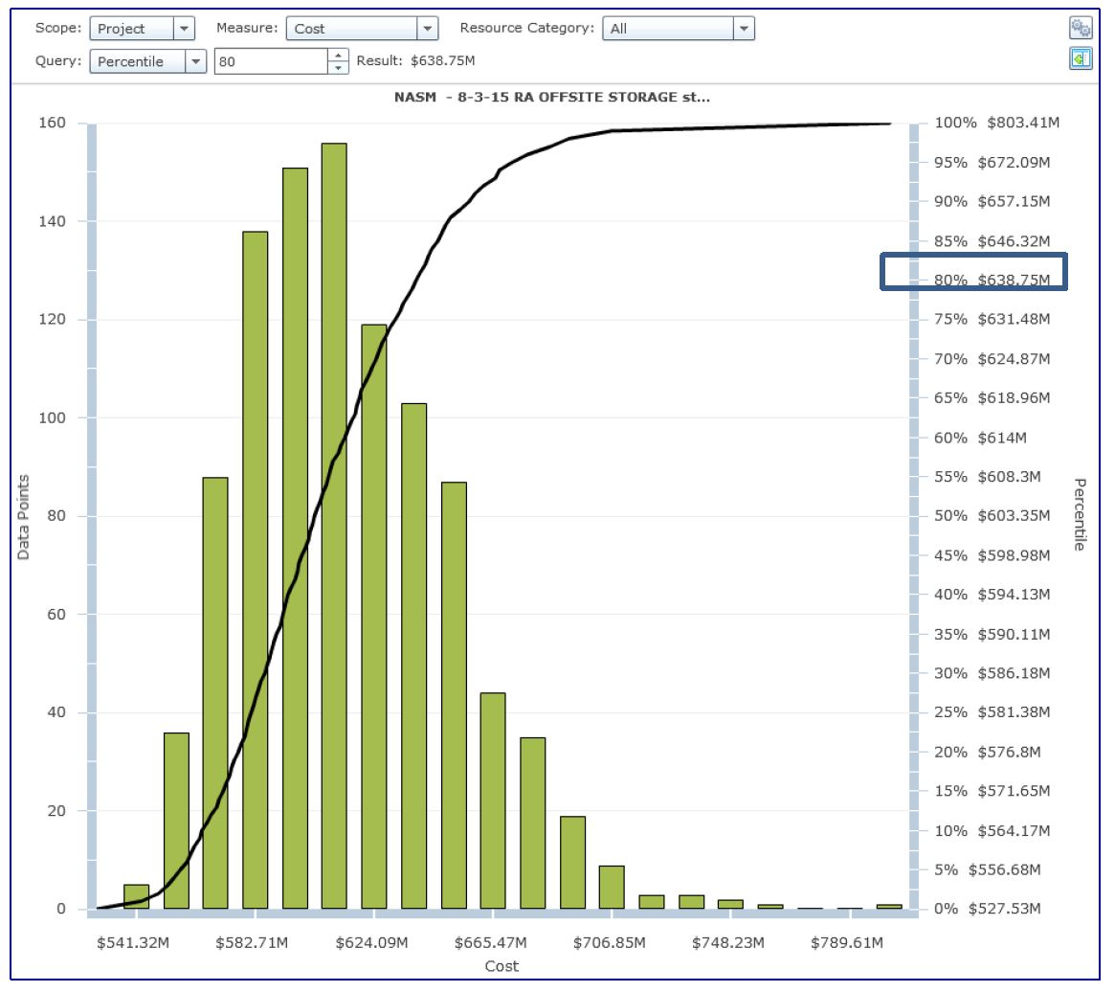
Cost Probabilities

Slide 35
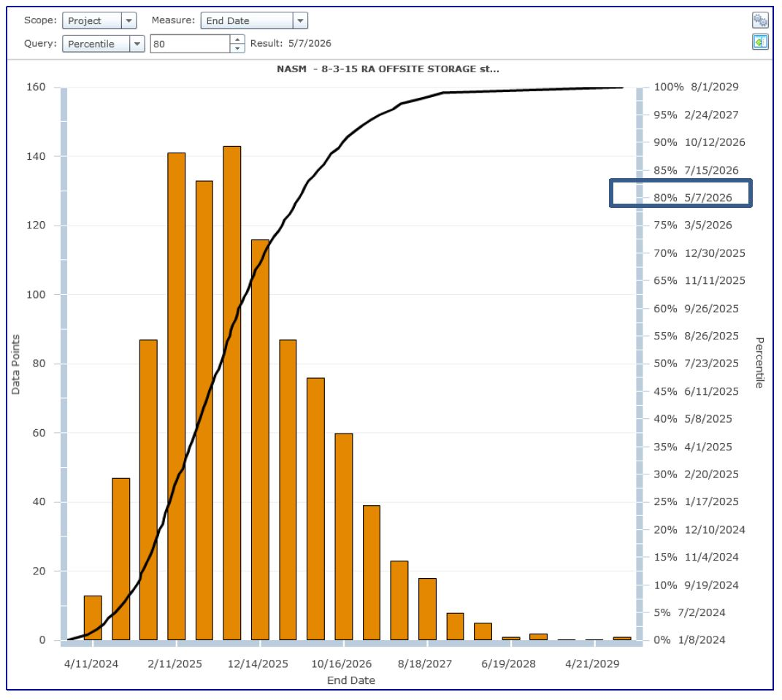
Schedule Probabilities

Slide 36
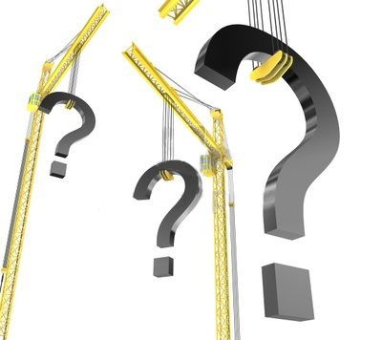
Questions
Mike Carrancho, PE
Smithsonian Institution
Deputy Director, Office of Planning, Design and Construction
CarranchoM@si.edu

Slide 37

CHESS Highlights
Joel D. Brock, Director
Cornell High Energy Synchrotron Source (CHESS)
joel.brock@cornell.edu
CHESS is supported by the NSF and the NIH/NIGMS under NSF award DMR-1332208
Notes:
Open University environment

Slide 38
CHESS at a Glance
NSF stewarded, national user facility providing synchrotron x-ray facilities to an international, multidisciplinary user community.
Located on central campus of Cornell University, Ithaca, New York
Our X-ray facilities are optimized for high-flux, high-energy applications in: Materials Research, Life Science, Engineering, Biology, Physical Sciences, and Cultural Heritage.
Over 1,300 user visits, 800 unique visitors each year
11 experimental stations
> 3600 hours per year of x-ray operations.
>$20M/year in funding
~75 FTEs, ~150 people on payroll
60 undergraduates per year participate in laboratory research.
X-ray Beam time awarded via competitive proposal process
Proposals rated by (domain science) experts
~ 60% success rate
~1 publication / day of operations

Slide 39
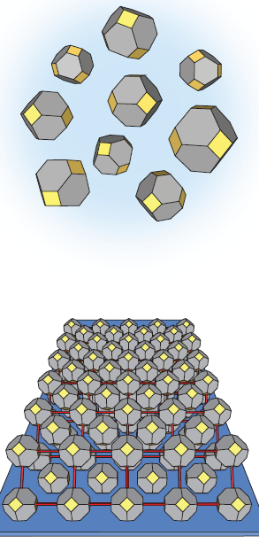
Nanocrystal self-assembly sheds its secrets:
a new approach gives a real-time look Tisdale (MIT) DMR-1332208
The transformation of simple colloidal particles — bits of matter suspended in solution — into tightly packed, beautiful lace-like meshes, or superlattices, has puzzled researchers for decades. Pretty pictures in themselves, these tiny superlattices, also called quantum dots, are being used to create more vivid display screens as well as arrays of optical sensory devices. The ultimate potential of quantum dots to make any surface into a smart screen or energy source hinges, in part, on understanding how they form.
Through a combination of techniques including controlled solvent evaporation and synchrotron X-ray scattering, the real time self-assembly of nanocrystal structures has now become observable in-situ. The findings were reported in the journal Nature Materials in a paper by Assistant Professor William A. Tisdale and grad student Mark C. Weidman, both at MIT’s Department of Chemical Engineering, and Detlef-M. Smilgies at the Cornell High Energy Synchrotron Source (CHESS) [1].
To make the nanoscale movies (see third page), the group took advantage of a CHESS-developed experimental chamber and a recently developed dual detector setup with two fast area detectors, while environmental conditions were changed during the formation of superlattices. Using lead sulfide nanocrystals, they were able to conduct simultaneous small-angle X-ray scattering (capturing the structure of the superlattice) and wide-angle X-ray scattering (capturing atomic scale orientation and alignment of single particles) observations during the evaporation of a solvent.
“We believe this was the first experiment that has allowed us to watch in real time and in a native environment how self-assembly occurs,” Tisdale says. “These experiments would not have been possible without the experimental capabilities developed by Detlef and the CHESS team.” [2]
(top)
Illustration of randomly oriented nanocrystals in solution.
(bottom)
Illustration of two layers of the atomically aligned bcc nanocrystal superlattice on the substrate,
where the bcc (110)SL plane is parallel to the substrate
[1] Mark C. Weidman, Detlef- M. Smilgies, and William A. Tisdale, "Kinetics of the self-assembly of nanocrystal superlattices measured by real-time in situ X-ray scattering," Nat Mater advance online publication (2016).
[2] Text quoting an MIT report by Michael Patrick Rutter; https://mitei.mit.edu/news/nanocrystal-self-assembly-sheds-its-secrets

Slide 40
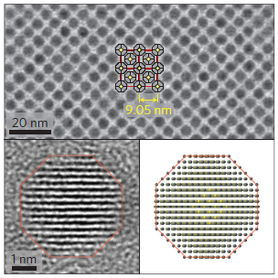
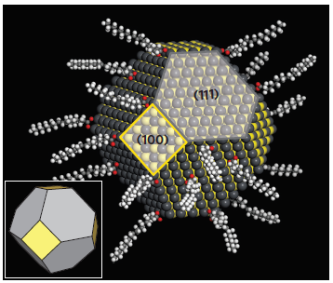
Nanocrystal self-assembly sheds its secrets:
a new approach gives a real-time look Tisdale (MIT) DMR-1332208
Science - What was found? What is new?
Demonstrated the first experiment to view in real time and in a native environment how self-assembly occurs
Developed a new method to observe self-assembly of nanocrystals using controlled solvent evaporation and synchrotron X-ray scattering
The discovery will lead to refined models for self-assembly of a wide range of organic soft materials.
Impact - Why is it important?
The broader adoption of nanocrystals into energy conversion technologies has been limited by the lack of knowledge about how they self-assemble
These tiny superlattices, also called quantum dots, are being used to create more vivid display screens as well as arrays of optical sensory devices.
The ultimate potential of quantum dots to make any surface into a smart screen or energy source hinges, in part, on understanding how they form
This new findings will enable direct manipulation of resulting superlattices, with the possibility of on-demand fabrication and the potential to control the formation of related soft materials such as proteins and polymers and materials needed for new technologies
Why did this research need CHESS?
CHESS-developed experimental chamber and a recently developed dual detector setup with two fast area detectors was needed to control environmental conditions during the formation of superlattices.
The CHESS D1 experimental station has high-flux, wide energy-bandpass x-ray optics and can support multiple simultaneous fast 2D detectors and a fast data-acquisition compute farm to capture time-resolved kinetics of the in-plane and out-of-plane molecular ordering
Work supported by an Energy Frontier Research Center (DOE-BES), made use of MRSEC Shared Experimental Facilities at MIT (NSF DMR-08-19762), a NSF Graduate Research Fellowship (1122374), and CHESS (DMR-1332208).
(top)
TEM image of a bcc superlattice of the nanocrystals with a superimposed [100]SL view of four unit cells with a lattice constant of 9.05 nm. Inset (left)
shows a high-resolution TEM image of a single nanocrystal in which the atomic planes are visible and the corresponding nanocrystal model (right) that
leads to this pattern.
(bottom)
Atomic model of the nanocrystals used in this study highlighting a hexagonal (111)NC face and a square (100)NC face. The ligand
coverage density has been decreased for the image to better show the nanocrystal core.
[1] Mark C. Weidman, Detlef- M. Smilgies, and William A. Tisdale, "Kinetics of the self-assembly of nanocrystal superlattices measured by real-time in situ X-ray scattering," Nat Mater advance online publication (2016).
[2] Text quoting an MIT report by Michael Patrick Rutter; https://mitei.mit.edu/news/nanocrystal-self-assembly-sheds-its-secrets

Slide 41
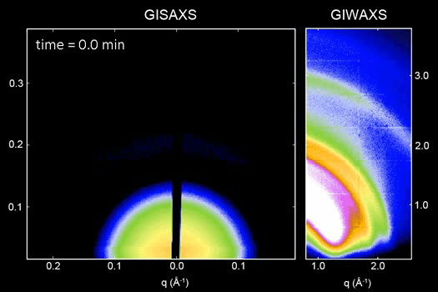
Nanocrystal self-assembly sheds its secrets:
a new approach gives a real-time look Tisdale (MIT) DMR-1332208
Time-resolved X-ray scattering reveals the transition from a disordered colloid to a highly ordered superlattice. a–h, Temporal evolution of
GISAXS (square panels) and GIWAXS (vertical panels) patterns during the in situ measurement of nanocrystal self-assembly. The GISAXS patterns show
the transition from a colloidal suspension to an fcc superlattice to a bcc superlattice via contraction of the c axis. The white circles on the left halves of the
GISAXS patterns are the predicted scattering locations for the superlattice parameters indicated above each image. The GIWAXS patterns show the early
onset of orientational alignment as well as the shape transformation of the 200NC scattering peak.

Slide 42
The Future: optimizing for high-flux, high-energy x-rays CHESS-U
Funding (awaiting public announcement by Governor Cuomo)
New York State’s Upstate Revitalization Initiative (URI)
$15M over 3 years (completion 12/31/2018)
Goal is regional economic development (job creation and retention in Southern Tier) – public/private partnerships
Capital Project – optimize for high-flux, high-energy x-rays
Single particle beam operation
Increase storage ring energy from 5.3 → 6.0 GeV
Increase storage ring current from 100 → 200 mA
Decrease storage ring emittance
Increase number of undulator sources from 2 to 10
(re)build/upgrade 6 x-ray beamlines and experimental stations

Slide 43
end

Slide 44

International Ocean Discovery Program
JOIDES Resolution facility
Texas A&M University as
Science Operator
Notes:
Entering the 21st Century we face the challenges of the uncertainty of
A changing climate
Resources
materials
energy
water
natural hazards – with a growing percentage of the world’s population living within a few miles of the coast, we are increasing vulnerable to tsunamis and changing sea levels.
To face these challenges, it is imperative that we understand how our planet functions. And to do that we have to understand the world that is hidden beneath the sea.
Water hides the seafloor and what lies beneath.
The only way to directly find out what lies beneath the top few meters of the seafloor is with a drilling vessel.
IODP is the only program that provides research drilling vessels to operate in deep waters

Slide 45
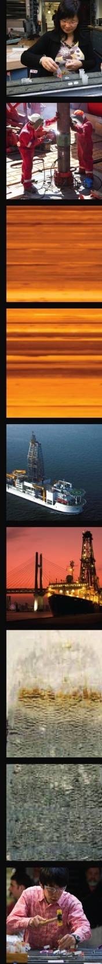
Scientific Ocean Drilling
Largest and longest running international research program dedicated to exploring Earth’s history and structure
Project Mohole: 1958-1966
Deep Sea Drilling Project (DSDP): 1968-1983
Ocean Drilling Program (ODP): 1985-2003
Integrated Ocean Drilling Program (IODP): 2003-2013
International Ocean Discovery Program (IODP): 2013-2023

Slide 46


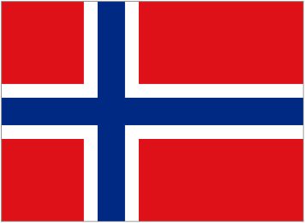





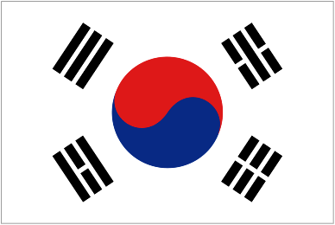


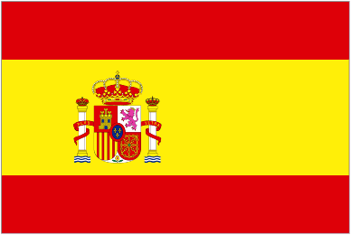






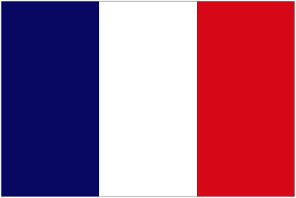
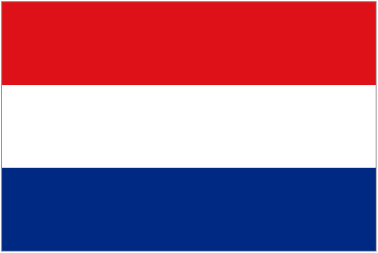




IODP Member Countries
Australia
Germany
Norway
Austria
Iceland
Portugal
Belgium
India
South Korea
Canada
Ireland
Spain
China
Italy
Sweden
Denmark
Japan
Switzerland
France
Netherlands
United Kingdom
Finland
New Zealand
United States

Slide 47



The International Ocean Discovery Program: Multiple Platforms
JOIDES Resolution
Chikyu
Mission Specific Platforms
Notes:
Over 2500 scientists have sailed on the JOIDES Resolution since 1985 (ODP and IODP)
Representing more than 27 member countries
Citizenship representing 60 countries
27% of scientists are students

Slide 48

Notes:
North Pond operated in water depth equal to ~15 Empire State Buildings.

Slide 49
Notes:
Core Sampling

Slide 50

Notes:
Splitting Core

Slide 51







The JOIDES Resolution is a 1300m² floating laboratory…
Notes:
The cores are processed in an assembly-line like manner through the ship’s laboratories. On some expeditions, cores come on deck every twenty minutes. The labs run twenty four hours a day. the scientists, technicians and ships’ crew work 12 hour shifts, seven days a week for the two-month expedition.

Slide 52







…and a floating university
Notes:
We nominally staff a science party of 25-30. Importance of international collaboration… One of the few environments in which groups of experts in field focus on the same problem, at the same time. This mode of collaboration is unique, and provides an important incubator for new ideas and creative approaches to problems.

Slide 53
Major Accomplishments of Scientific Ocean Drilling
Confirmation of the Seafloor Spreading Hypothesis
Discovered that the Mediterranean Sea completely dried repeatedly ~5 million years ago
Recovered direct evidence that a bolide impact caused the mass extinction that killed off the dinosaurs
Recovered an intact section of the upper oceanic crust
Recovered first samples of gas hydrates from continental margins
Discovered that deep ocean waters flow vigorously through the crust (world’s largest aquifer)
Discovered that the deep seafloor hosts abundant microbial life.

Slide 54

JR Facts
Owned: Overseas Drilling Limited, Inc.
Built 1978 as exploration vessel Sedco/BP 471
Converted to science research in 1985
Rebuilt 2009; facility is reliable- breakdown contract rate 0-2% 2009 -2016
Length: 143 m (471 ft)
Drill pipe: 5” and 5.5” tapered string
Drill string capacity: >9 km (~30,000 ft)
Deepest hole penetration: 2111 m (6924 ft)
Shallowest water: 35.5 m (123 ft)
Deepest water: 5980 m (19,614 ft)
Most core on single cruise: 8003 m (26,250 ft)
Total core recovered: >230 km (>146 miles)

Slide 55


Slide 56

JOIDES Resolution Recent and Upcoming Expeditions

Slide 57
Battelle/NEON
Richard Farnsworth PhD PMP
Senior Program Manager
March 3, 2016

Slide 58

National Ecological Observatory Network
Battelle was recently selected by the National Science Foundation (NSF) to assume management of the construction and initial operations of the NEON observatory
Battelle began transition in Mid-March
Transitioning key staff to Battelle Ecology Inc.
Ensuring smooth transition of permitting, contracts, etc.
Continuing construction and Operations
Expect to complete transition of Observatory by June 2016
NEON is a continental-scale observation system for examining ecological change over time.

Slide 59

Battelle Mission and Purpose
Our mission: To translate scientific
discovery and technology advances
into societal benefits
Nonprofit, charitable trust formed in 1925
Profits reinvested in science & technology and in charitable causes, making the world better for generations to come
Gordon Battelle, Founder

Slide 60
Project Sikuliaq
NSF Builds a Ship With Capabilities Like No Other!

Slide 61
Schedule Change Highlights
Following Final Design Review there were five major areas that could potentially cause Project schedule changes
Funding to continue the project – Accelerated from FDR because the Project was “shovel ready” when American Recovery and Reinvestment Act of 2009 funding became available, no impact on Project schedule.
Shipyard Contract Award – Accelerated from FDR because of availability of ARRA funding, no impact on Project schedule.
Delivery of Owner Furnished Z-Drives to the Shipyard – Accelerated from FDR because of shortened lead time for gear sets, no impact on Project schedule.
Shipyard Execution and Ship Delivery Date
Post-delivery trials

Slide 62
Shipyard Execution and Ship Delivery Date
Original contract delivery date – 22 January 2013
Actual delivery date – 06 June 2014
Two shipyard contract modifications that contractually extended delivery a total of 197 days:
Mod 34 added 185 days due to lengthening of the ship – 26 July 2013
Mod 50 added 12 days due to OFE Z-drive issue – 07 August 2013
Shipyard was 303 days late with delivery of the ship:
Significantly protracted shipyard tests and trials
Shipyard paid $2,250,000 in liquidated damages (maximum allowed by the contract) for late delivery

Slide 63
Change Orders
Decided to:
Increase length to 6 feet to increase reserve buoyancy
Change from Steel to Aluminum structure above 02 deck
Eliminate elevator service above 01 deck
Other weight savings: light-weight joinery, steel reductions
VCG is below the line, including full icing and science loads

Slide 64
Post-Delivery Trials
Late delivery and two funded science cruises in late 2014 reduced time for warm water trials and pushed piston coring trials off until 2016.
Plan for post-delivery shipyard availability was reduced in scope necessitating a second post-delivery shipyard availability in late 2015:
Timeline for original post-delivery shipyard period was too early
Funded science cruises in the Arctic in summer/fall 2015 didn’t allow for extending the post-delivery shipyard period
Complexity of the ship required more time for fully testing the systems than originally planned.
Replacement A-frame schedule and timeline for discovery of post-delivery issues from trials necessitated second post-delivery shipyard period.

Slide 65
The Greening of R/V Sikuliaq
Bottom Coating
Waste Incinerator
Integrated Power Plant
Waste Heat Recovery System
Biodegradable Lubricants
Double Bottom Hull
State of the Art MSD
Ballast Water Management System
Specialized Hull Configuration and Propulsion
The Greening of R/V Sikuliaq
Shrinking a Ship’s Environmental Footprint

Slide 66

THE END
The National Science Foundation

