Slide 1
Introducing the National User Facility Organization
Susan White-DePace
NUFO Executive Administrator
NSF Large Facilities Workshop
May 24-26, 2016
Washington, DC

Slide 2
Overview
Introduction to NUFO
What is NUFO’s role?
What does NUFO do?
How is NUFO changing?
What’s in it for you?

Slide 3
Introduction to NUFO
1997 first formal meeting of user administrators to share best practices
2003 user representatives were included in meeting
2006 formally became NUFO
Currently has 47 member facilities (materials science, astrophysics, computing, high-energy, nuclear energy, neutron, etc.)
Two-branch organization: user administrators and user representatives
Primary mission is to provide a unified message at a national level on issues for science done at federally-funded user facilities
  Current NSF-funded facilities are: NSCL, NOAO, NRAO, Maglab, & CHESS
  Love to have broader NSF membership and participation

Slide 4
NUFO’s Unique Role
Only professional association dedicated to the user science community
Provides a forum for multiple communities of practice
Only unified voice for the user science community in Washington, DC
BUT: NUFO is not a lobbying organization

Slide 5
NUFO Activities
Annual Membership Meetings
Science Expositions on Capital Hill
Congressional Testimony
Expert input to federal agencies (e.g., DOE Order on Foreign Visits, Immigration)
Public outreach (e.g. Science & Engineering Expo)
Share Benchmarking

Slide 6
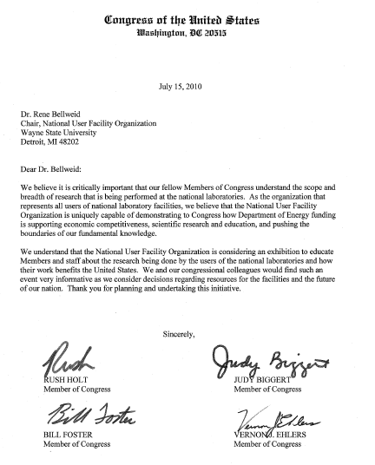
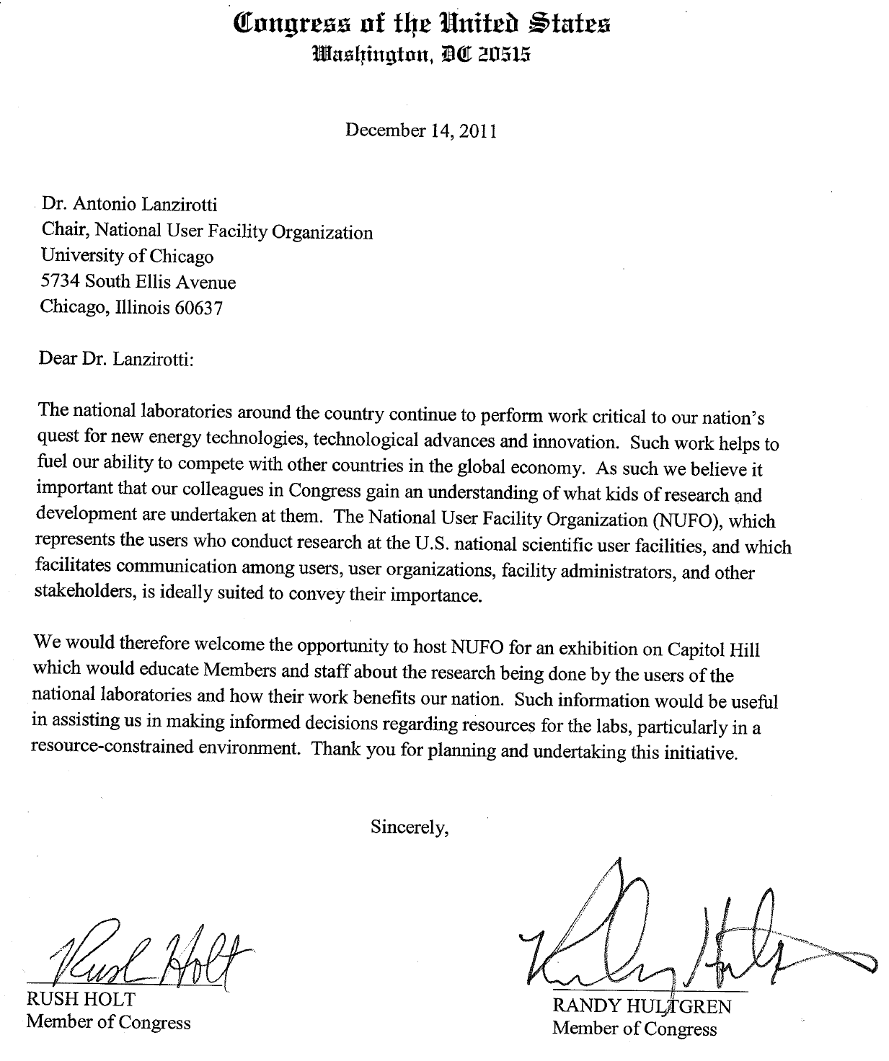
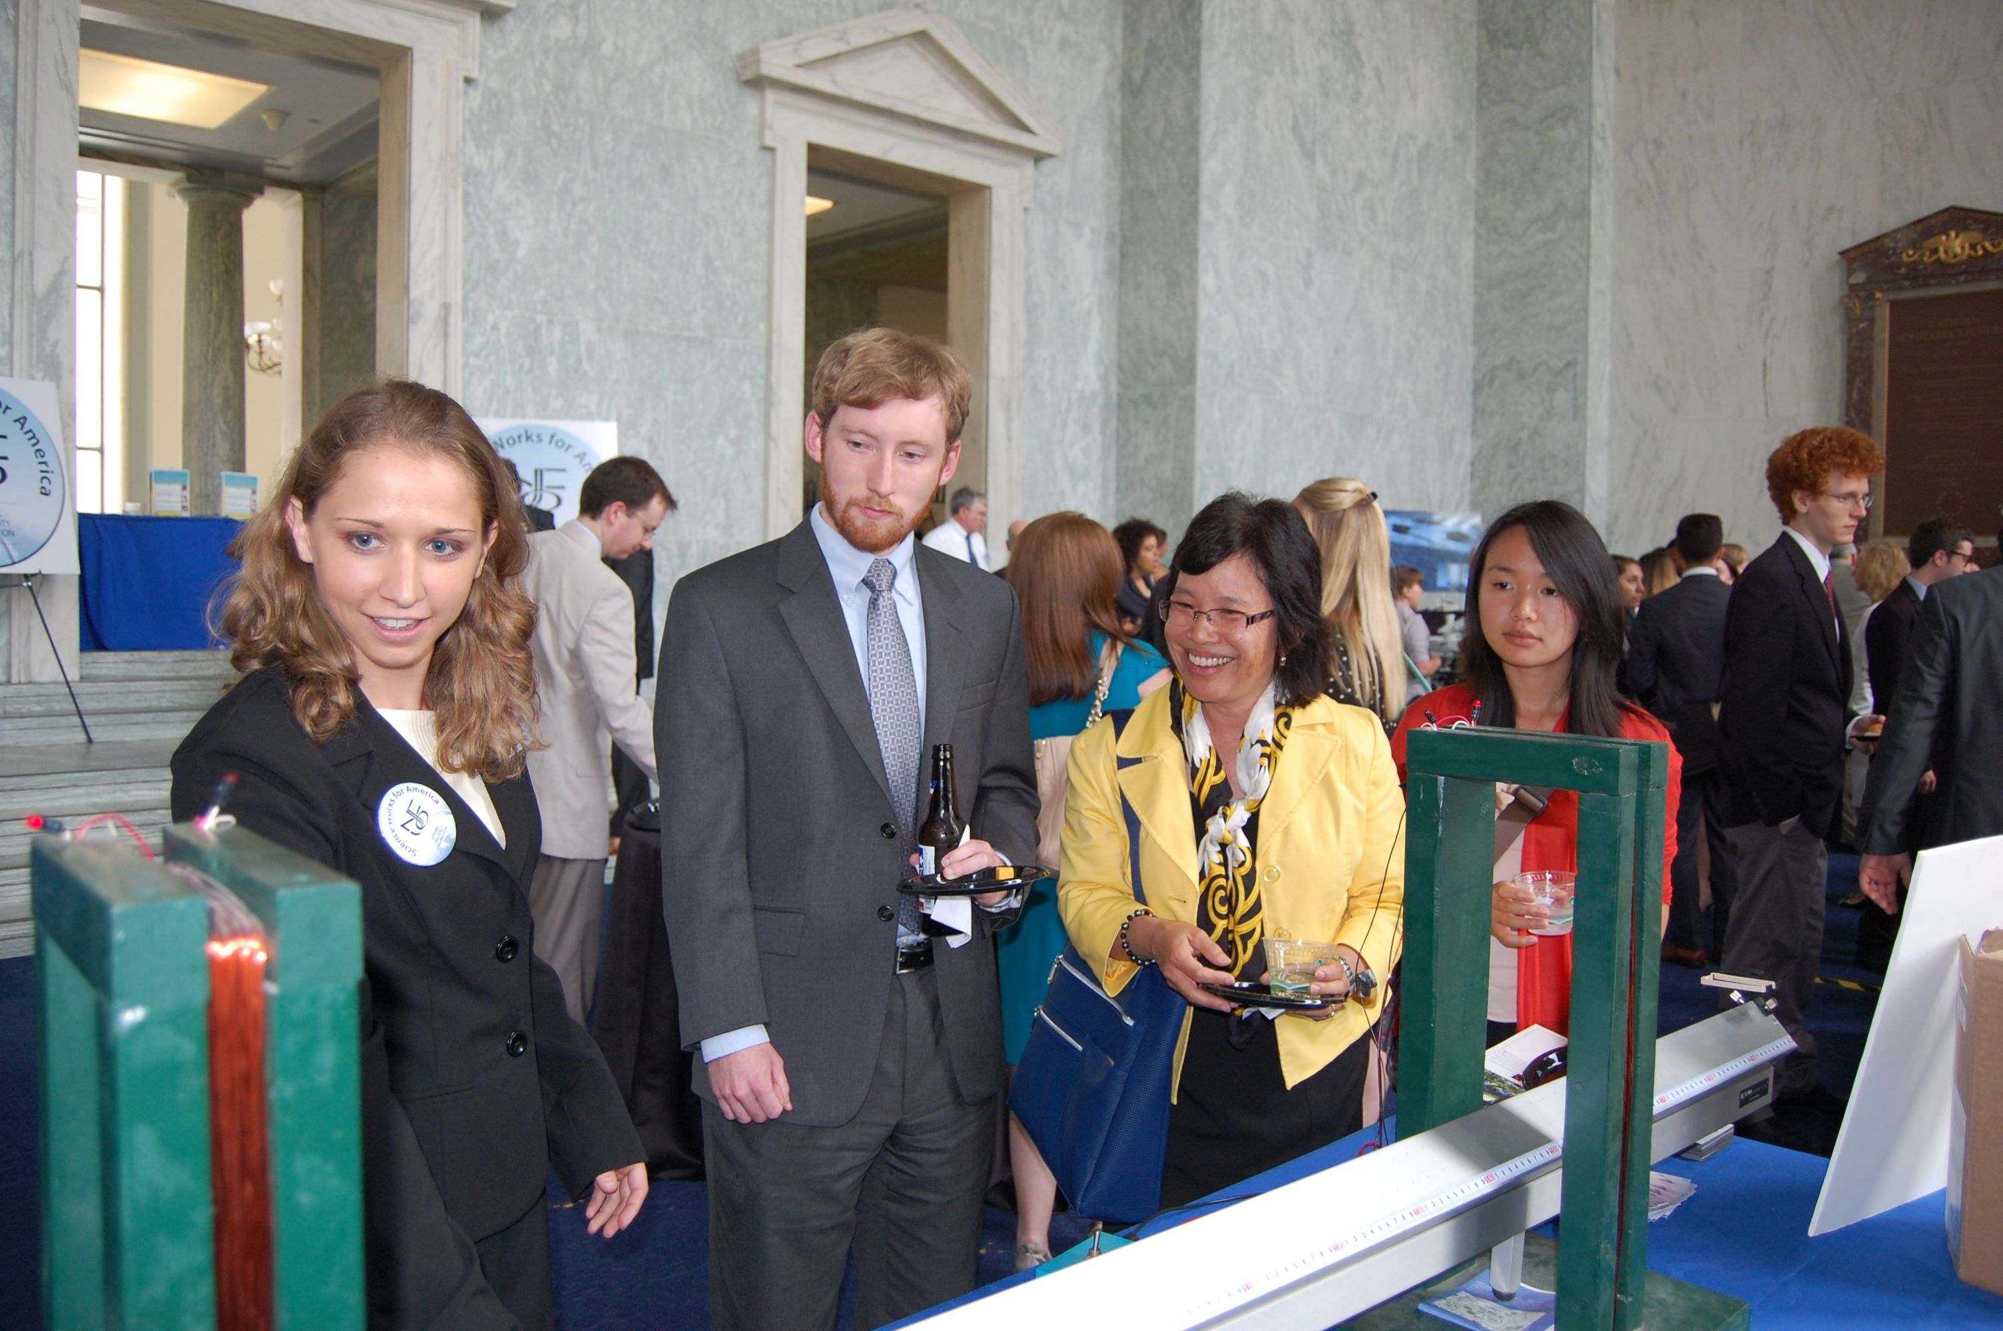
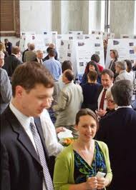
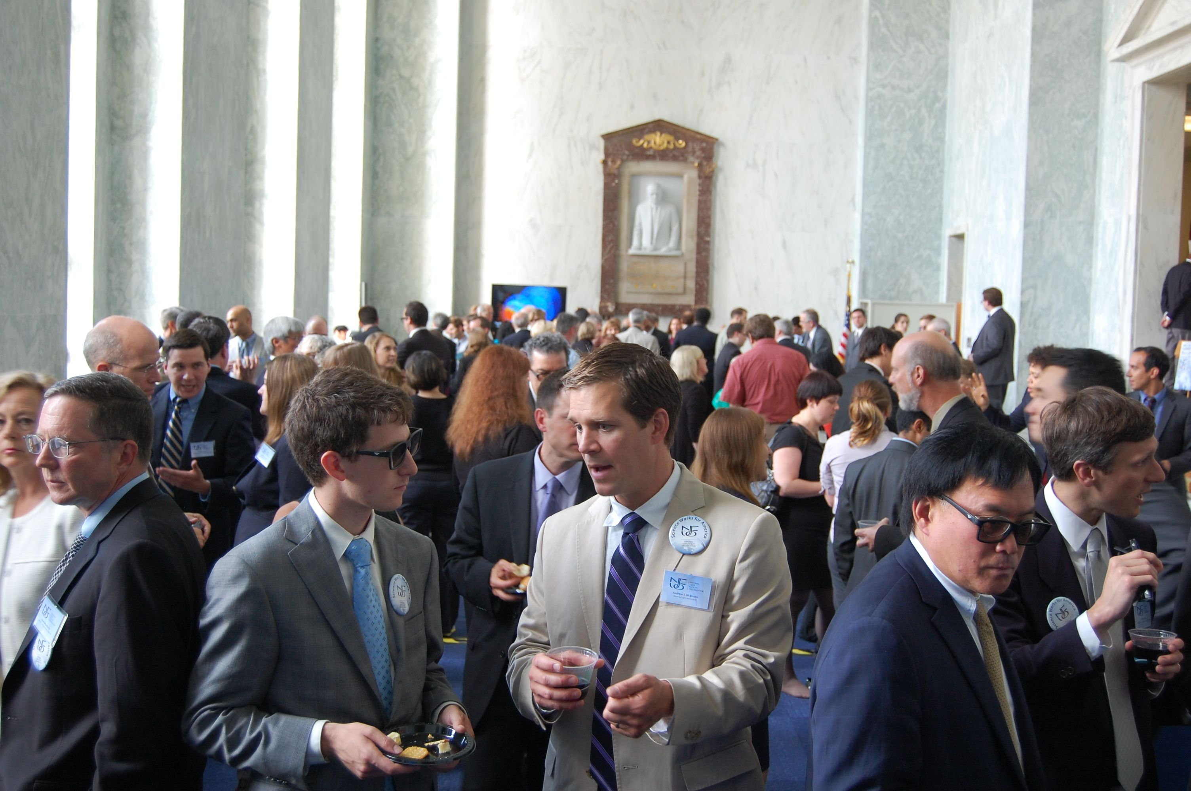
NUFO on Capital Hill
Providing a unified message at the national level…
Congress invites NUFO to hold yearly Exhibitions on Capital Hill about User Facility science

Slide 7
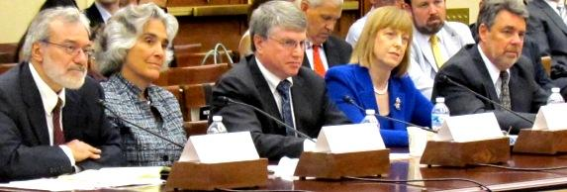
NUFO Testifies to Congress
Providing a unified message at the national level…
  As a direct result of the 2012 User Science Exhibition, NUFO was invited to testify to Congress about User Facility science
The U.S House of Representatives Science Space & Technology Committee, Subcommittee on Energy & Environment hearing on Utilizing the Tools of Science to Drive Innovation through Fundamental Research” was held on June 21, 2012, discussing:
  The role that the Department of Energy’s (DOE) national scientific user facilities play in enabling basic research that drives innovation and economic growth.
  Challenges and opportunities associated with user facility planning and management.
Dr. Tony Lanzirotti (U. of Chicago) testified as Chair of NUFO. Also on the panel were
  Dr. Stephen Wasserman from Eli Lilly
  Dr. Persis Drell (director of SLAC),
  Dr. Suzy Tichenor (ORNL), and
  Dr. Ernest Hall (GE Global).

Slide 8
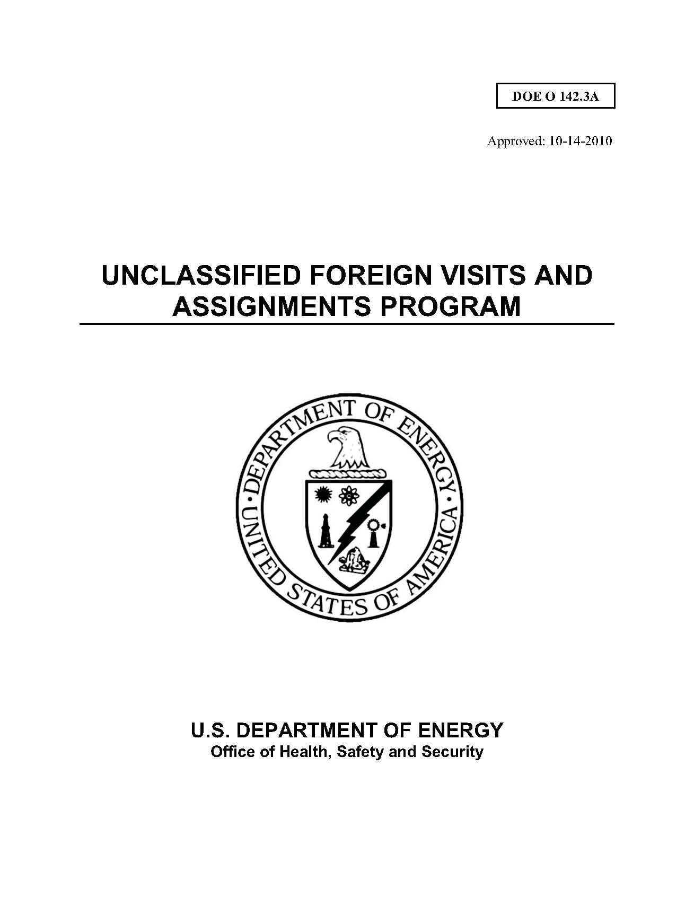
NUFO Support the DOE
Providing a unified message at the national level…
NUFO involvement led to modification of DOE Order 142.3: Foreign Visits and Assignments – facilitating access for non‐US citizen users
  Enhances accountability within the security function
  Removed requirements that did not advance national interest or laboratory security
  Improved efficiency in administering processing
  Minimized administrative barriers to scientific research

Slide 9

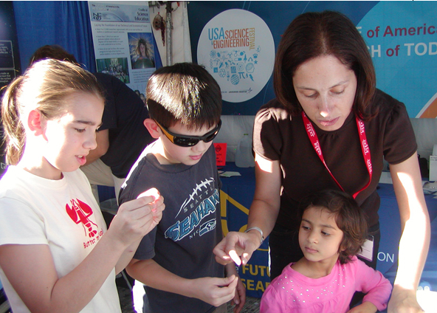
NUFO
Promoting science to the public…
USA Science & Engineering Festival in Washington, DC
  NUFO conducted hands-on demonstrations to stimulate interest in science.
  children, parents, high school students, and teachers participated in activities at the NUFO booth

Slide 10
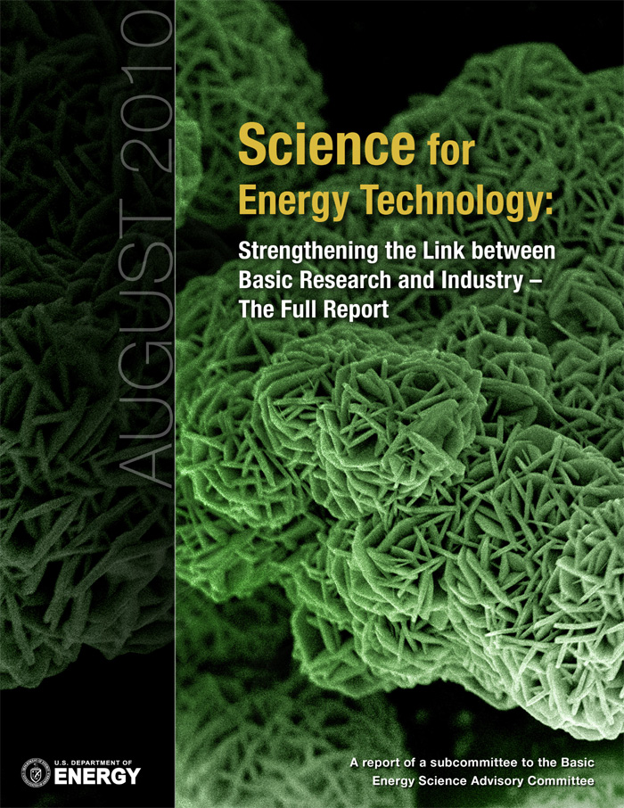
NUFO Supports Industry
Providing a unified message on industrial user access….
NUFO advances and promotes industry access to User Facilities
  NUFO 2009 workshop focused on industrial use of national user facilities
  NUFO Report led to a BESAC study
  BESAC report recommended changes that directly tracked NUFO recommendations
  This has the direct potential to increase “industrial friendliness” of the facilities

Slide 11
Enhancing Immigration Procedures for International Users
Supporting a unified message on international collaborations…
Discussions with the Democratic Counsel on the Judiciary Committee and private law firms
NUFO conducted two surveys on the immigration experiences of international users
Based on the survey results, NUFO sent formal communications to Dept. of State, Dept. of Homeland Security, and Bureau of Immigration and Customs Enforcement, seeking to improve access to U.S. user facilities to better meet the needs of international scientists.

Slide 12
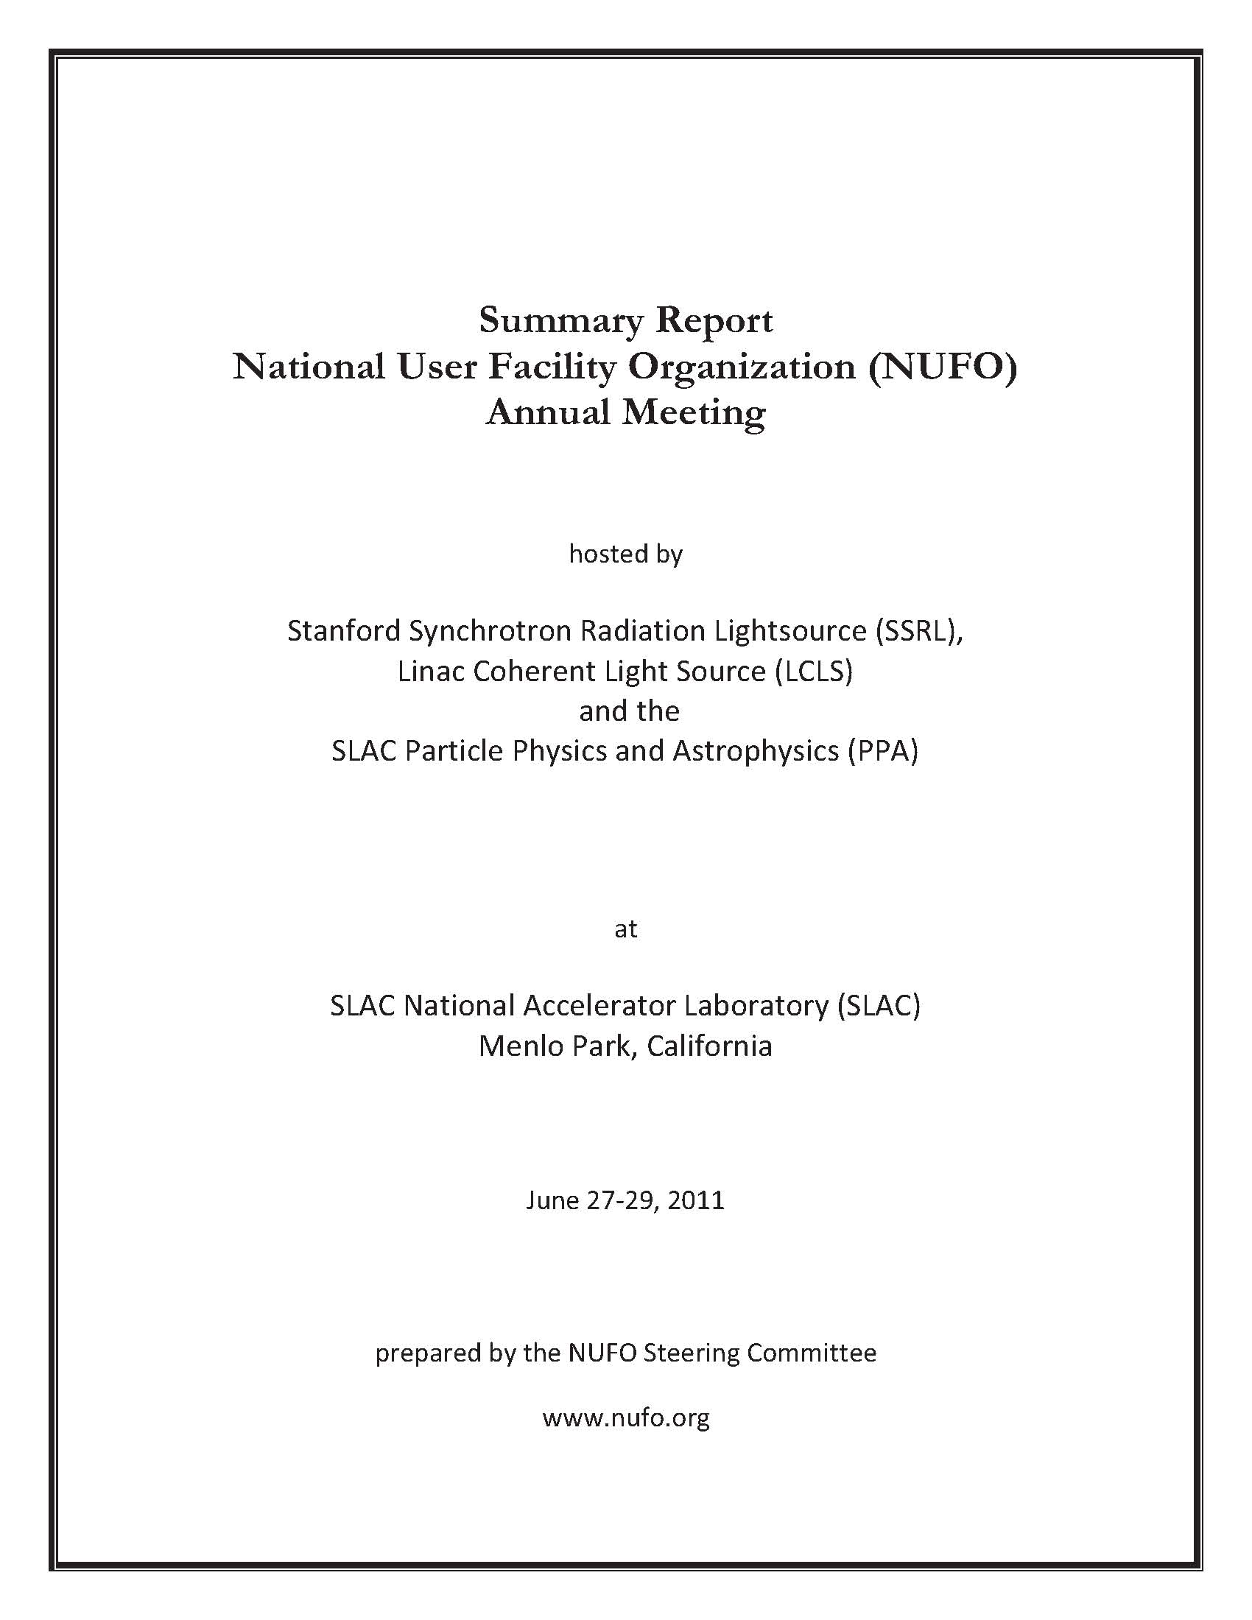
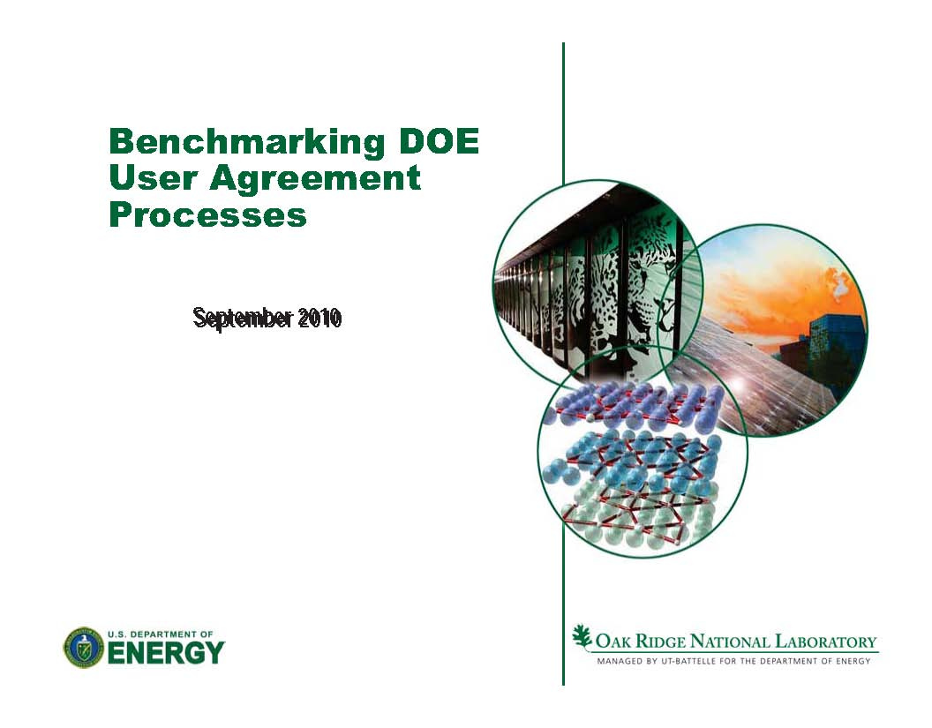
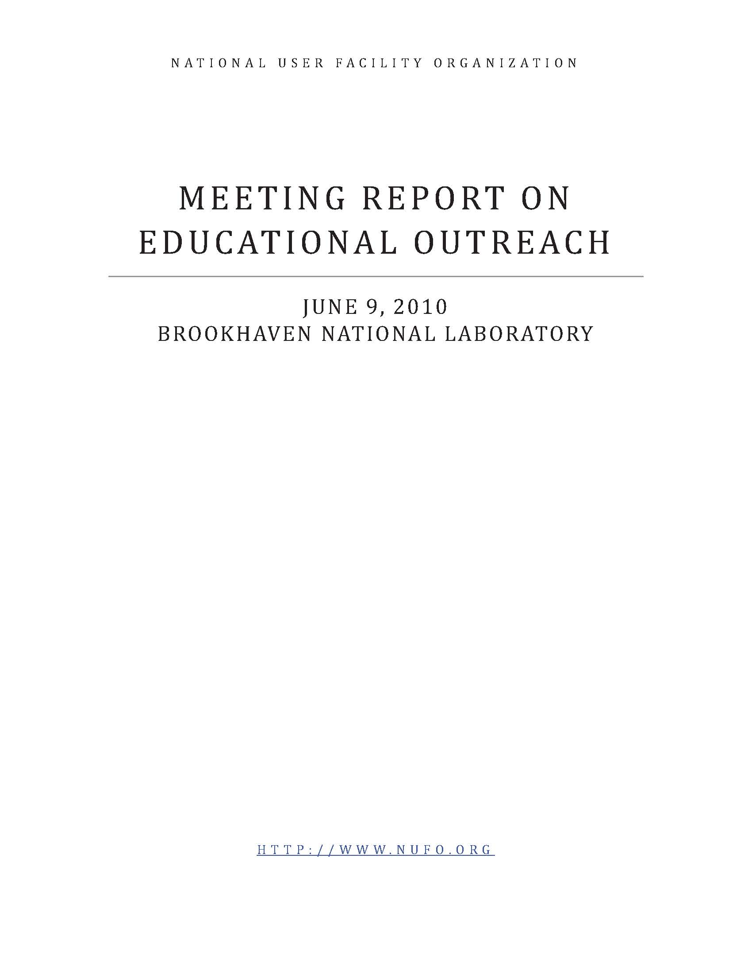
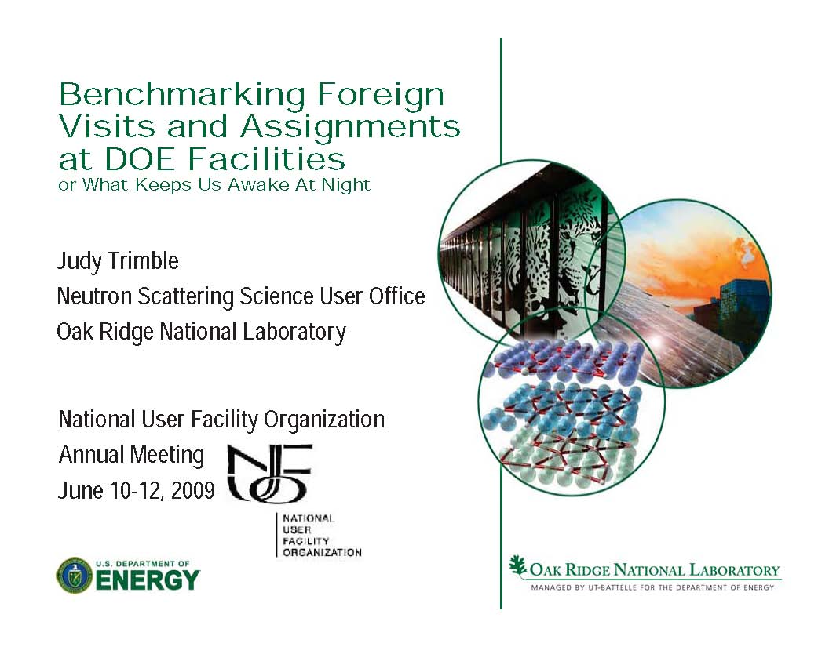
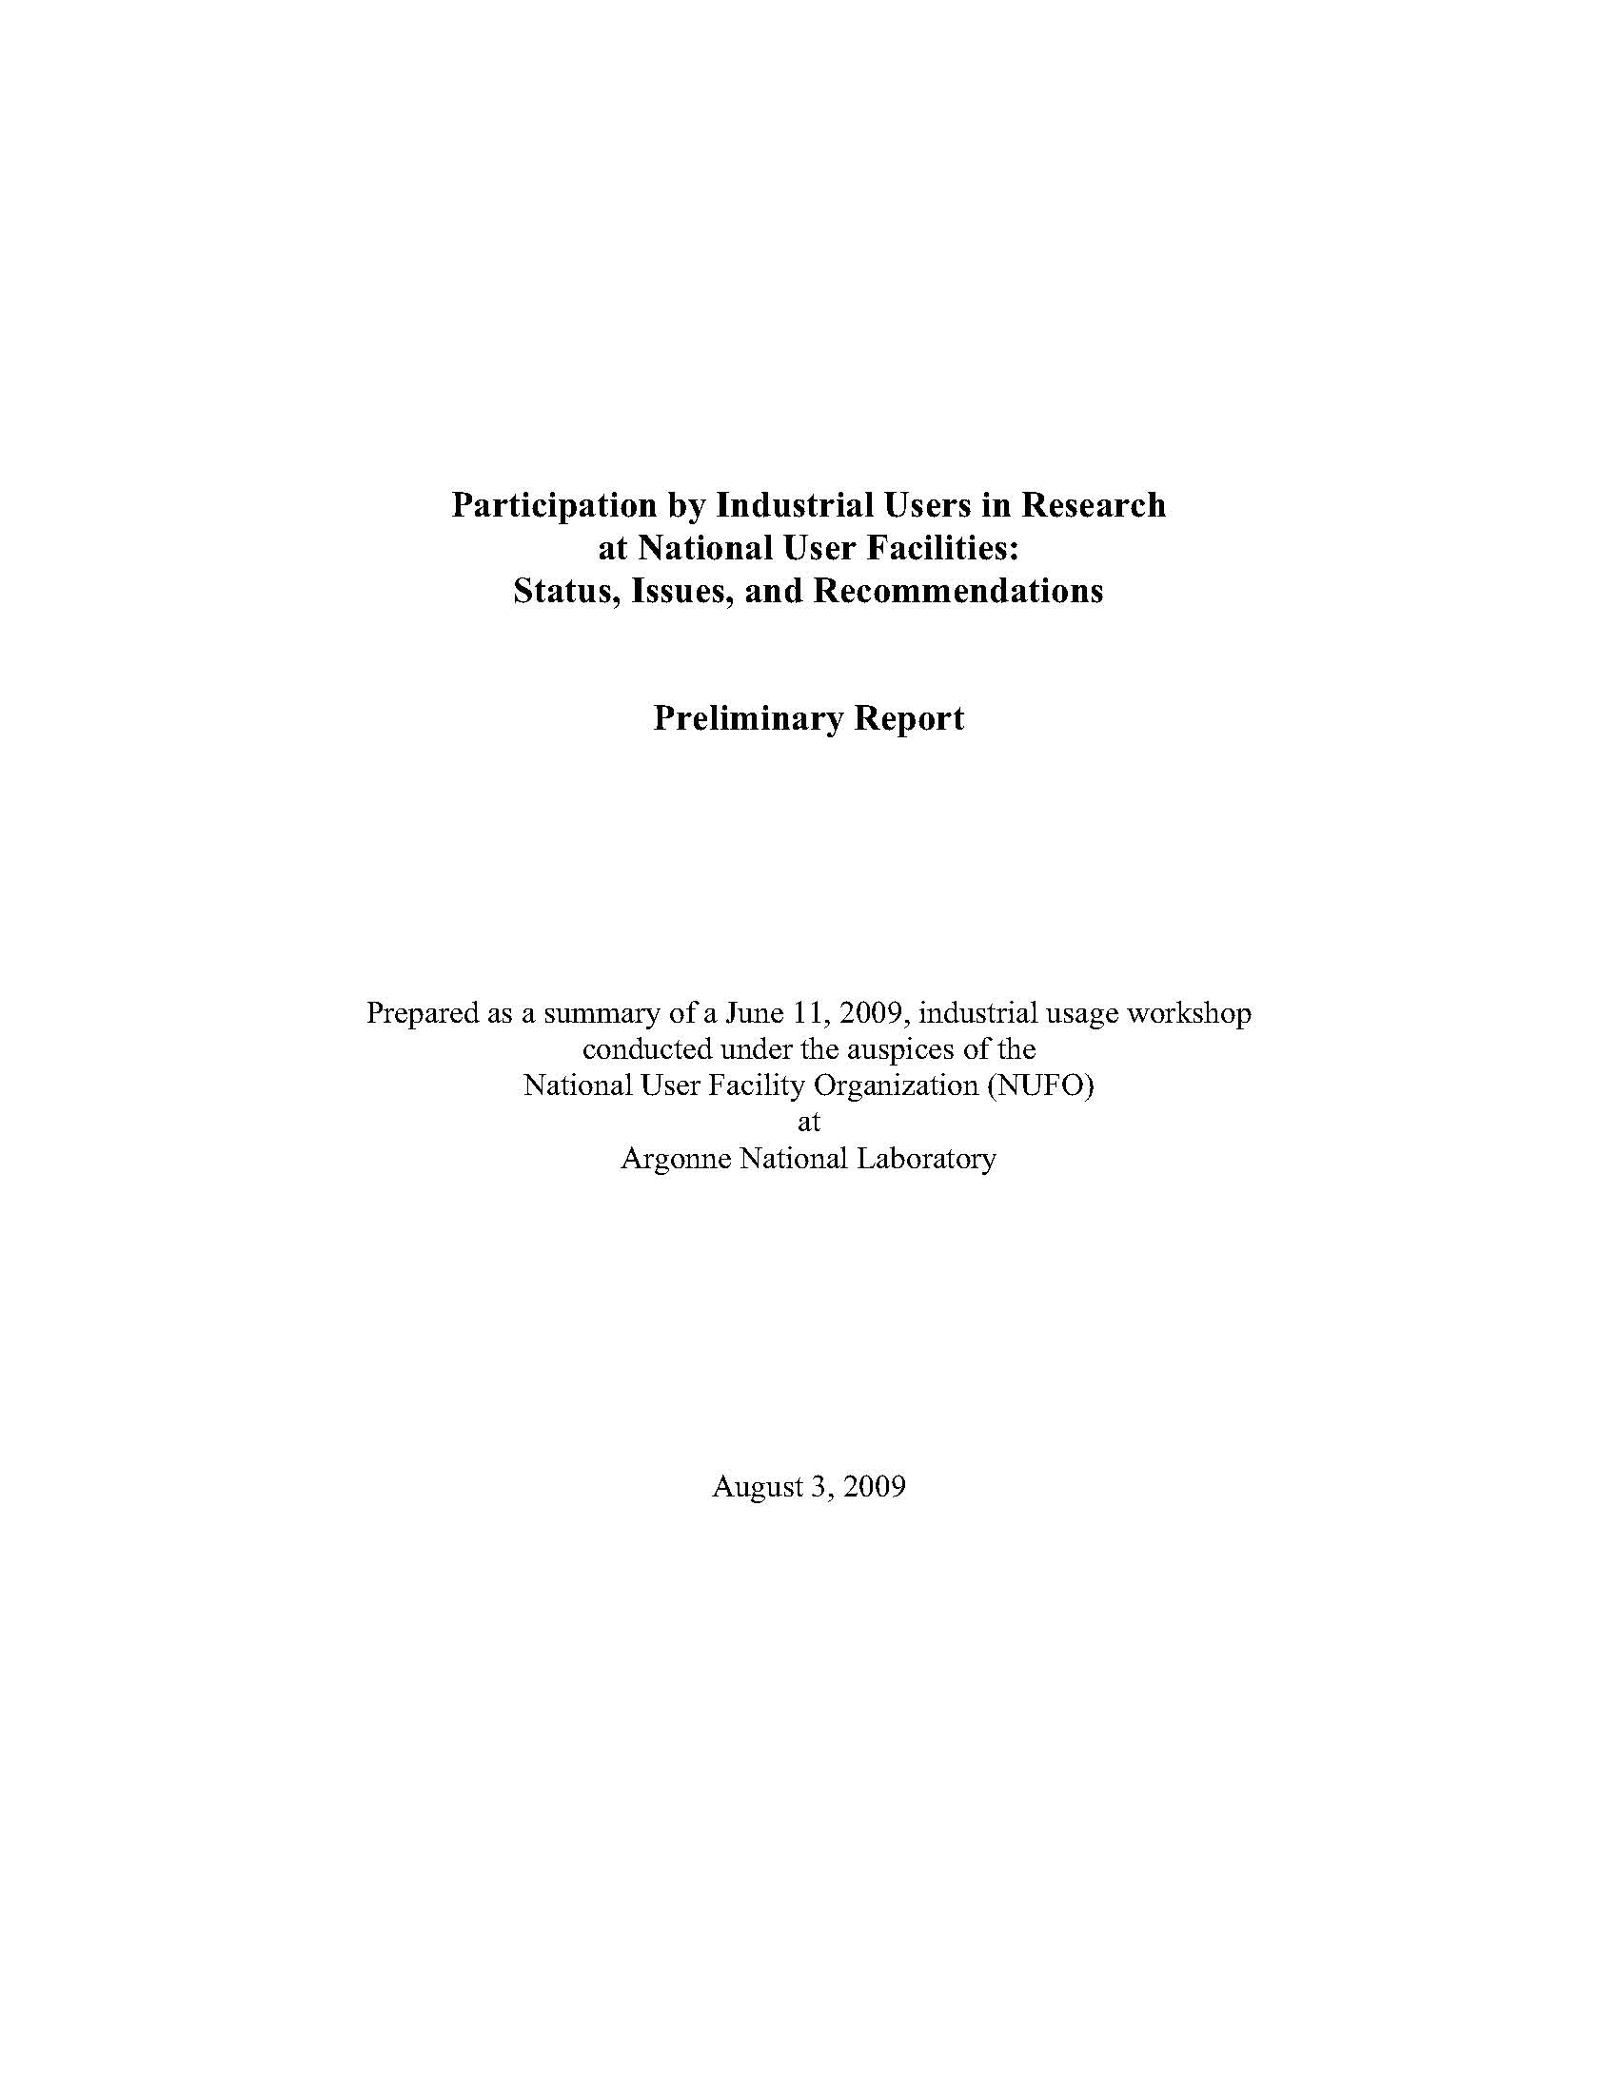
NUFO Benchmarking
Communities support communities
NUFO conducts benchmarking studies to enable facilities to adopt best practices
  DOE User Agreements
  Calls for Proposals
  Shipping Policies and Procedures
  Multilingual Websites
  Housing for Users
  Multi-facility proposals – APS/ATR, APS/CNM
  Complementary research by users at two different facilities with different capabilities
Planned benchmarking
  Federated Systems
  Training Programs

Slide 13
NUFO’s Future
NUFO will soon become the Society for Science at User Research Facilities (SSURF)
SSURF will be a 501c3 non-profit corporation
SSURF will be a member-oriented, professional society dedicated to all aspects of user facility research
More inclusive membership categories with membership benefits
Incorporation will allow growth, programmatic expansion, fundraising opportunities, employees

Slide 14
SSURF’s Mission
Advance the science performed at user research facilities by (1) supporting their professional communities and research networks through the sharing of best practices and facilitation of professional development, and (2) promoting public awareness about the benefits and significance of the facilities and their research

Slide 15

Building a Larger Community of Practice
In December 2015, the National Academy of Public Administration recommended:
“NSF formally establish communities of practice to share best practices and implement a “lessons learned” requirement for all MREFC projects.”
NUFO can help you;
please join us in our mission.

Slide 16
What’s in it for you?
SSURF plans to:
Host annual meetings on topics of importance to it membership
  “Power in Numbers: Building Partnerships and Common Standards across User Facilities” will challenge attendees to develop shared practices for improving users’ experience, and create community performance standards to facilitate easier multi-facility use and collaboration.
  Examples of previous meeting themes: Industrial Usage, Educational Outreach, Bridging Science Across User Facilities, Big Data
  Community-determined parallel workshops and breakout sessions are always welcome

Slide 17
What’s in it for you?
Continue the Annual Science Exhibitions on Capital Hill
Coordinate Congressional staff visits to facilities
Organize Congressional home district office visits
Facility adoption of unique identifiers for all users to enable data sharing
Training reciprocity
Other plans as staff and resources allow (e.g., speaker series, or professional societies forums)
What would you need, what do you want, what can we help you with?

Slide 18
Questions and Comments
www.nufo.org
info@nufo.org
Susan.white-depace@nufo.org
Paul.runci@pnnl.gov

Slide 19
National Superconducting Cyclotron Laboratory – Interactions with Users
David J. Morrissey
NSCL Associate Director for Operations

Slide 20
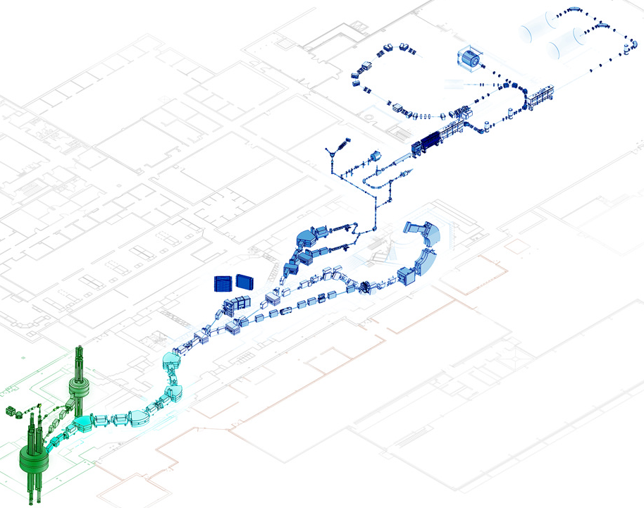
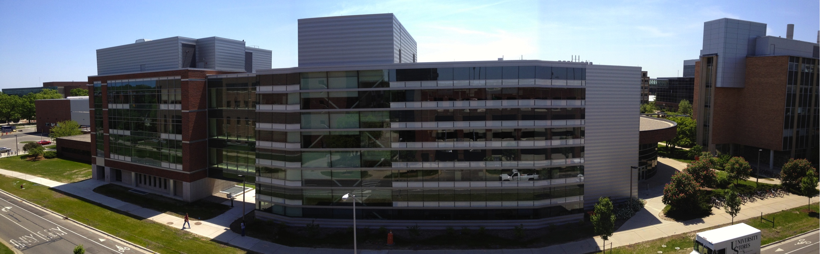
The NSCL is Operated to
Facilitate Nuclear Science
Originally an NSF sponsored laboratory on a university campus that evolved into a national user facility.
NSCL produces and provides beams of “rare isotopes” for nuclear science research (present incarnation ~1990)
As a national user facility the NSCL supports a broad scientific community:
  The user group of NSCL has approximately 1350 members (98 U.S. colleges and universities represented)
  Past 4 years 359 publications,
    79 were letter-like, 4 in Nature
  Including a local research group,
    41 faculty
    73 graduate students
    100 undergraduates
NSCL Facility
Operation of NSCL user facility is supported by NSF Physics Division

Slide 21
External Program Advisory Committee
Statistics (April 2016)
Written Proposals Submitted to PAC40 (no oral presentations)
  44 Proposals, for a total of 7515 hrs
    33 proposals led by an Outside Spokesperson
    365 Proposers from 75 institutions in 17 countries
    118 Students
Proposals Approved at PAC40
  19 Proposals (43%), for a total of 2744 hrs (37%) [468 hrs on reserve]
    8 GRETINA, 2 ReA3, 3 Low Energy Area, 6 Other
    16 proposals led by an Outside Spokesperson
    233 Experimenters from 52 institutions in 14 countries
    70 Students
PAC41 is expected to take place in Spring, 2017

Slide 22
Scheduled NSCL User Program during last ~4 years
From October 1, 2011 – October 1, 2015:
68 scheduled experiments
  41 (60%) were led by Outside Spokespersons
  63 (93%) involved collaborations between outside groups and NSCL faculty and staff.
  61 (90%) required secondary beams from the A1900 fragment separator
  35 (51%) used the S800 spectrometer
  23 (34%) were part of the 2012/13 campaign with the S800+GRETINA
  33 (49%) experiments formed part of a Ph.D. Thesis
Involved 413 scientists from 81 institutions in 16 countries
  300 (73%) scientists from outside institutions
  131 students were involved (117 graduate students, 54 of those from NSCL)

Slide 23
Communication with Users is Critical
Web Presence and Single Point of Contact at Lab
nscl.msu.edu
Dr. Jill Berryman, Manager for User Relations reports directly to NSCL Director handles all user interactions, coordinates experiment schedule, collects statistics

Slide 24
External User Organization
Jill Berryman (Manager for User Relations) is the point of contact with NSCL users
FRIB (nee NSCL) Users Organization (FRIBUO) www.fribusers.org
  1354 members from 98 US Universities/Colleges, 12 National Labs, in 50 countries
  Quarterly newsletters “FRIB Laboratory Update for Users”
  Announcements of important conferences, workshops, Call for Proposals
Executive Committee of the FRIBUO contains an Operations Subcommittee, with three members focused on operations at NSCL
  NSCL Laboratory Management has quarterly conference calls with Operations Subcommittee and chair of Executive Committee
  One member of the Operations subcommittee attends the PAC meeting and records his/her observations. http://www.nscl.msu.edu/users/PAC39-Crawford-Signed2.pdf
Annual Low Energy Community Meeting
  Opportunity for users to come together annually, next at Notre Dame, Aug 11-13, 2016 http://2016.lecmeeting.org/
  NSCL receives and acts on “Consensus Statements” on scientific thrusts and equipment or facility development plans created at these meetings
User survey for feedback at the completion of each experiment

Slide 25
Experiment Feedback
As part of the dedication to delivering world-class beams of rare isotopes to enable our users to achieve their scientific objectives the NSCL has a quality management system that was registered as compliant with the ISO 9001 standard and continues with external audits. Part of that quality management system is getting feedback from our users.
Experiment Feedback survey is on-line the NSCL website (here).
Since 2012, the response rate to survey has been 100%

Slide 26
Summary
The NSCL is a national user facility that provides RIB’s for nuclear science experiments proposed by users.
PAC-approved beam time is scheduled and run by the NSCL in close coordination with the experiment spokesperson. ~Twenty experiments per year with several hundred (unique) experimenters.
Large user community with various forms of engagement:
  User Manager (scientist)
  Large web utilization
  User oversight of PAC and Operations
  Annual meeting
  Feedback on completed experiments

