Slide 1
2016 NSF Large Facilities Workshop
Making Sense of Audits and Reviews
Business Roundtable I
May 24, 2016
Anna-Lee Misiano, (amisiano@nsf.gov) Division of Acquisition and Cooperative Support
Florence Rabanal (frabanal@nsf.gov), Large Facilities Office
Eddie Whitehurst, (ewhitehu@nsf.gov) Division of Acquisition and Cooperative Support
Charlie Zeigler, (czeigler@nsf.gov) Division of Institute and Award Support
2016 NSF Large Facilities Workshop

Slide 2
Presentation Goal, Objectives and Agenda
GOAL: TO IMPROVE OUTCOME of REVIEWS/AUDITS
OBJECTIVES:
Outline various types of Audits/Reviews
Explain the overall purpose of each [Audit/Review]
Identify the Business Owners associated with [Audit/Review]
Highlight key interactions amongst Business Owners
Engage stakeholders to gather input and ideas
2016 NSF Large Facilities Workshop

Slide 3
PRESENTATION SCOPE and Content
Defines Audits/Reviews broadly as “a careful/methodical check or review of something”;
Recognizes the necessity of [audits/reviews] and fiduciary responsibilities inherent to the stewardship of Federal funds.
Covers administrative business of audits/reviews of NSF Large Facility Portfolio, and NOT audits/reviews associated with project management (e.g., EVM, contingency) or scientific/technical components
Presents an overview of “what, why and who”, NOT the details of “how”
Complements related (more detailed) held in Business Roundtable II and III discussions.
2016 NSF Large Facilities Workshop

Slide 4
Engaging Stakeholders
How could NSF’s communication and documentation strategies be adjusted to improve [external stakeholder] understanding of the variety of audits/reviews?
    Importance
    NSF Resources for Questions and Guidance
    NSF Coordination
What are major challenges to employing suggested strategies for audit/review interactions?
What steps could NSF take to further facilitate Recipient-implementation of the suggested improvement strategies for audits/review?
2016 NSF Large Facilities Workshop

Slide 5
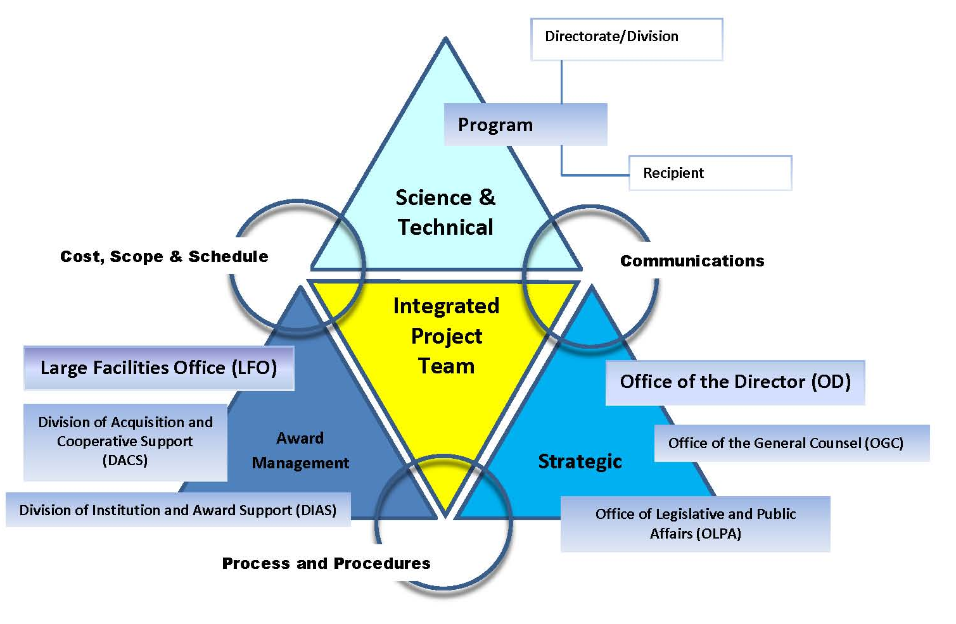
KEY [NSF] ASSURANCE MEMBERS/ AWARD MANAGEMENT: Division of Acquisition and Contract Support, the Division of Institution and Award Support, and the Large Facilities Office
2016 NSF Large Facilities Workshop

Slide 6
AUDITS/REVIEWS: OVERVIEW BY TYPE
AUDIT/REVIEW TYPE | SIMPLIED DESCRIPTION | BUSINESS OWNER
STATUTORY
Single Audit (A-133) | ANNUALLY, to provide assurance to the US federal government as to the management and use of such funds by recipients such as states, cities, universities, and non-profit organizations | Independent certified public accountant (CPA)
OIG-led/contracted | RISK-BASED, to promote efficiency and effectiveness, through assessment of internal controls, financial management, information technology, and other systems that affect the operation of Agency programs. To investigate fraud, misuse of funds, and other violations of laws and regulations. | NSF Office of Inspector (OIG)
Improper Payments | ANNUALLY, to identify for reducing improper payments | NSF Division of Financial Management (DFM)
POST-AWARD MONITORING
ADVANCED: focus on developing a reasonable assurance that institutions managing the higher-risk awards possess adequate policies, processes, and systems to properly manage federal awards
Business Systems Review | RISK-BASED, to provide oversight/assurance of the suite of business systems (people, processes, and technologies) that supports the administrative management of a Facility (http://www.nsf.gov/pubs/2013/nsf13100/nsf13100.pdf) | NSF Large Facilities Office (LFO)
2016 NSF Large Facilities Workshop

Slide 7
AUDITS/REVIEWS: OVERVIEW BY TYPE
AUDIT/REVIEW TYPE | SIMPLIED DESCRIPTION | BUSINESS OWNER
POST AWARD MONITORING, Cont.
ADVANCED: focus on developing a reasonable assurance that institutions managing the higher-risk awards possess adequate policies, processes, and systems to properly manage federal awards
Advanced Monitoring Desk Review & Site Visit | RISK-BASED, to assess the extent that an awardee maintains a control environment within which awards are likely to be administered in compliance with Federal financial and administrative regulations and NSF agreement provisions (http://www.nsf.gov/bfa/dias/caar/docs/factsheet_desk.pdf) | NSF Division of Institution and Award Support (DIAS)
BASELINE: focus on post-award actions and financial transactions for most awards and verify that awardee institutions implement awards in compliance with federal regulations and the terms and conditions of NSF award agreements
Award Expenditure Transaction Testing | RISK-BASED, reveal potential financial anomalies, inaccurate expenditure reporting, or evidence of a possible misunderstanding of, or non-compliance with, federal cash management requirements and/or NSF guidelines. | NSF Division of Financial Management (DFM)
Grants and Agreements Monitoring | ONGOING, reveal a misunderstanding of, or non-compliance with, federal regulations and the terms and conditions of NSF awards | NSF Division of Grants and Agreements (DGA)
Active Payment/ACM$ Screening | ONGOING, focused on daily, monthly, quarterly, and annual transactional activity. | NSF Division of Financial Management (DFM)
Program Income | ONGOING, to verify that awardee institutions are properly reporting program income in accordance with NSF’s policies. | NSF Division of Financial Management (DFM)
2016 NSF Large Facilities Workshop

Slide 8
AUDITS/REVIEWS: OVERVIEW BY TYPE
AUDIT/REVIEW TYPE | SIMPLIED DESCRIPTION | BUSINESS OWNER
MREFC LIFE-CYCLE BASED
PRECONSTRUCTION STAGES: to assess whether [costs] they are reasonable and realistic as the design matures in preparation for the eventual construction award and subsequent operations awards
High-Level Cost Analysis #1 | Post CDR…to only frame the initial parametric cost estimate, ensure coordination with the other NSF assurance divisions and offices, and identify areas of further refinements with the cost book and PEP that are necessary during the Preliminary Design Phase… “ | Division of Acquisition and Cooperative Support (DACS)
Cost Analysis #2 | POST PDR, “…to give confidence in the Not-To-Exceed estimated Total Project Cost (TPC)… also identify areas of further refinement with the cost book and PEP that are necessary during the Final Design Phase.” | Division of Acquisition and Cooperative Support (DACS)
Cost Analysis #3 | ~90-180 DAYS PRIOR to PLANNED AWARD DATE, “…to give confidence in making the actual award for construction based on the best-available cost information, including updated cost proposal information received during the Final Design Phase.” | Division of Acquisition and Cooperative Support (DACS)
Independent Cost Estimate Review/s | AD HOC, To assess, through independent mechanisms, the credibility of the [Large Facility’s] cost estimate. | Large Facility Office (LFO)
Accounting System | PRIOR TO MAKING CONST AWARD, “…to assess and determine if awardee and subawardee accounting systems are adequate for use with cost reimbursement type agreements .” | Division of Acquisition and Cooperative Support (DACS)
2016 NSF Large Facilities Workshop

Slide 9
AUDITS/REVIEWS: OVERVIEW BY TYPE
AUDIT/REVIEW TYPE | SIMPLIED DESCRIPTION | BUSINESS OWNER
MREFC LIFE-CYCLE BASED, Cont.
CONSTRUCTION AND OPERATION STAGES: to assess whether [costs] they are reasonable and realistic as the design matures in preparation for the construction award and subsequent operations awards
Business Systems Review | RISK-BASED, to provide oversight/assurance of the suite of business systems (people, processes, and technologies) that supports the administrative management of a Facility (http://www.nsf.gov/pubs/2013/nsf13100/nsf13100.pdf) | NSF Large Facilities Office (LFO)
Accounting System, Other Business Systems | PRIOR TO MAKING CONST/OPS AWARD, “…to assess and determine if awardee and subawardee accounting systems are adequate for use with cost reimbursement type agreements .” | Division of Acquisition and Cooperative Support (DACS)
Cost Incurred Audit | AT LEAST ANNUALLY, AWARD [>$100M], “to assure the existence of adequate controls which will prevent or avoid waste, fraud, and abuse and inefficient practices.” | Division of Acquisition and Cooperative Support (DACS)
Budget Review | ALL AWARD ACTIONS> $10M, over all award years funded at that time. Ensure budgeted costs are reasonable and realistic to accomplish project scope. | Division of Institution and Award Support (DIAS)
Indirect Cost Rate Negotiation | GENERALLY ANNUALLY, with provisional to final indirect cost rates. Where NSF acts as cognizant Federal agency, review of indirect cost pool expenses may include transaction testing. | Division of Institution and Award Support (DIAS)
2016 NSF Large Facilities Workshop
Notes:
a

Slide 10
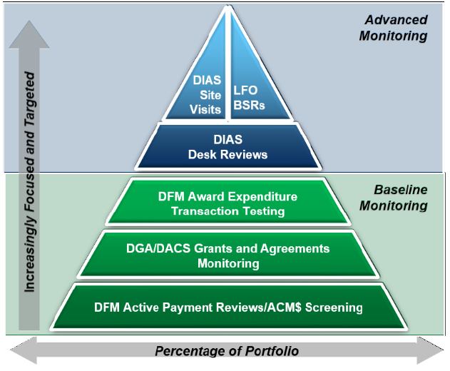
NSF Post Award Monitoring
Baseline monitoring, executed in the course of post-award administration, seeks to verify that awardee institutions implement awards in compliance with federal regulations and the terms and conditions of NSF award agreements.
NSF’s advanced monitoring activities focus on developing a reasonable assurance that institutions managing the higher-risk awards possess adequate policies, processes, and systems to properly manage federal awards.
2016 NSF Large Facilities Workshop

Slide 11
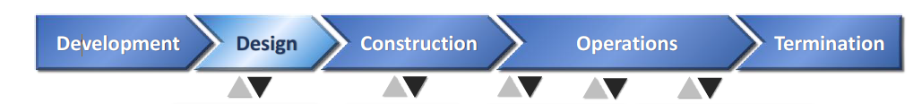
MREFC Life-Cycle Based View:
[NSF-coordinated] Audits/Reviews
COST ANALYSES, immediately following Conceptual Design Review, Preliminary Design Review and Final Design Reviews.
REVIEW OF INDEPENDENT COST ESTIMATE , prior to completion of second cost analysis. Other internal NSF cost analyses may be used.
BUSINESS SYSTEMS REVIEW, ideally conducted during CDR phase and prior to PDR, if employed
BUSINESS SYSTEMS REVIEW, ideally prior to transition to Operations, in addition to periodically Operations Phase, if employed
ACCOUNTING SYSTEM and OTHER BUSINESS SYSTEMS, prior to entering any large facility Construction or Operations [>$100M] Cooperative Agreements
COST INCURRED AUDIT, at least annually for award [>$100M], “to assure the existence of adequate controls which will prevent or avoid waste, fraud, and abuse and inefficient practices.”
BUDGET REVIEW, ALL AWARD ACTIONS> $10M, over all award years funded at that time. Ensure budgeted costs are reasonable and realistic to accomplish project scope.
INDIRECT COST RATE NEGOTIATION, GENERALLY ANNUALLY, with provisional to final indirect cost rates. Where NSF acts as cognizant Federal agency, review of indirect cost pool expenses may include transaction testing.
2016 NSF Large Facilities Workshop

Slide 12
Strategies for Improving Audit and Review Interactions and Outcomes
ROLES AND RESPONSIBLITIES
  Identify single point of contact/dedicated person, in appropriate organizational role
  Coordinate, coordinate, coordinate Organization-wide
  Maintain routine and open communication with your auditors/reviewers
PLANNING
  Plan ahead, don’t wing it
  Create deliberate internal and external communication strategies, include routine interactions
  Provide staff training
DOCUMENTATION
  Organize well packaged and externally-oriented materials
  Avoid the extremes, “too much, too little”
  Provide easy and timely access
  Assure underlying systems are robust
2016 NSF Large Facilities Workshop

Slide 13
Engaging Stakeholders
How could NSF’s communication and documentation strategies be adjusted to improve [external stakeholder] understanding of the variety of audits/reviews?
    Importance
    NSF Resources for Questions and Guidance
    NSF Coordination
What are major challenges to employing suggested strategies for audit/review interactions?
What steps could NSF take to further facilitate Recipient-implementation of the suggested improvement strategies for audits/review?
2016 NSF Large Facilities Workshop

