Slide 1

Communities of Practice & Lessons Learned
Budget, Finance, and Award Management
Large Facilities Office
May 2016
Large Facilities Workshop 2016
S. Dillon Ripley Center
Washington, D.C.

Slide 2
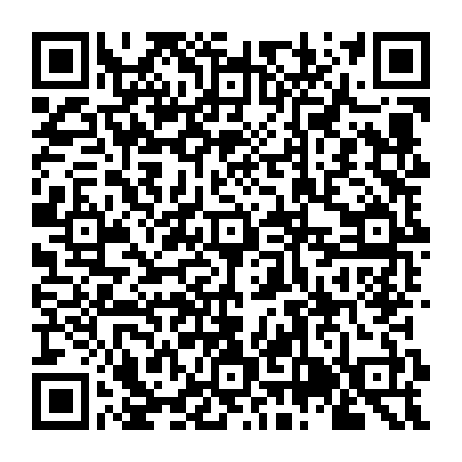
NATIONAL ACADEMY OF PUBLIC ADMINISTRATION Use of Cooperative Agreements to Support Large Scale Investment in Research December 17, 2015
RECOMMENDATION 6.9
Notes:
Find the report here: http://www.napawash.org/reports-publications/1785-national-science-foundation-use-of-cooperative-agreements-to-support-large-scale-investment-in-research.html

Slide 3
Recommendation 6.9
KNOWLEDGE SHARING
“To facilitate project management knowledge sharing across the agency and with award recipients . . . .”
“The NSF Academy should promote the formation of communities of practices and encourage staff participation.”
INTERNAL
“NSF should formally establish communities of practice to share best practices and implement a “lessons learned” requirement for all MREFC projects.”
“The LFO should develop a lessons learned process and template to capture instructive experiences from projects and to inform policies and practices to strengthen the management of future projects.”
EXTERNAL
Focus Today

Slide 4
NAPA Likes & Dislikes & NSF PLANS
Likes - | Dislikes - | NSF Plans to -
LFM tasks LFO with sharing Lessons Learned (LL).¹ | No collection or distribution guidance provided | Introduce a means to collect and distribute LL.
DOE and NASA have LL policy and databases. |  | Review DOE and NASA systems.
DOE and NASA collect both positive and negative lessons. |  | Collect both positive and negative lessons Inform agency policy with LLs
1. LFM NSF 15-89, Sec. 2.1.6

Slide 5
Questions
What kinds of lessons learned would assist a project at each of its various stages?
What elements should a lessons learned template include?
How might NSF motivate projects to share both positive and negative lessons learned?
Who should input lessons learned and how often?
Who should have access to the lessons learned and under what circumstances would these groups have access?

Slide 6








Who in Government has Lessons Learned Systems?
Notes:
NASA Lessons Learned Database
http://llis.nasa.gov/
DOT Lessons Learned Database
http://www.itslessons.its.dot.gov/
DOE Lessons Learned Database
http://energy.gov/ehss/policy-guidance-reports/databases/lessons-learned-database
Other agencies (DoD)
http://www.acqnotes.com/acqnote/tools/lessons-learned

Slide 7
Advice on Lessons Learned
“Structure by lifecycle stage or role, not by project.”
“Collect lessons in a form.”
“Input lessons throughout the project.”
“Review lessons before posting.”
“Associate an action with each lesson.”
Repeatable or adaptable
Preventative measure or response
“Turn lessons into policy.”
“Open access as widely as possible.”
“Enable filter and free text searching.”
“Prompt for inputs and notify following posts.”
“Track usage metrics.”
“Archive closed or obsolete lessons.”
What else?

Slide 8
Elements for a Template
Category or Categories
Lifecycle stage or role
Name
Title representative of the problem or success
Description
Explanation of the problem or success in two to three sentences
Root Cause(s)
Brief summary of what created the issue or opportunity
Impact(s)
Costs the problem or benefits the success introduced
Action(s)
What a project or the sponsor could do to prevent the problem or claim the success
What else?

Slide 9
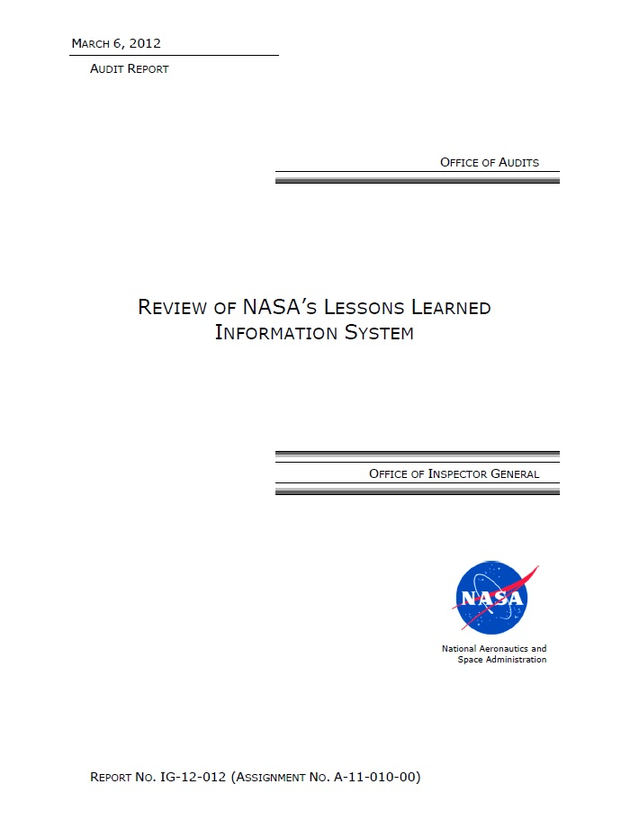
Findings
Infrequent entries
Low usage
Policies not encouraging entries or usage
Minimal monitoring
Action
Broadened policy on lessons learned to create a “Chief Knowledge Officer” and assign other responsibilities
Notes:
The OIG recommended that NASA develop and implement a cohesive strategic plan for knowledge management and sharing, particularly with respect to lessons learned. As part of this plan, we recommended that the Agency determine if or how LLIS fits into this overall plan. In addition, we recommended that NASA revise applicable policies to align with NASA's strategic vision for institutional knowledge management and improve the collection and dissemination of lessons learned Agency-wide. NASA concurred with the OIG's recommendations.
The full report can be found on the OIG's website at http://oig.nasa.gov/ under "Reading Room" or at the following link: http://oig.nasa.gov/audits/reports/FY12/IG-12-012.pdf
Resulted in a revision to the NPD on Lessons Learned. See: http://nodis3.gsfc.nasa.gov/displayDir.cfm?t=NPD&c=7120&s=6
Note that management’s response cited the challenge of assigning a dollar value to lessons learned. NASA found it hard to correlate presumed cost avoidance and applications of knowledge gained on previous projects.

Slide 10
Barriers to Recording Lessons Learned
Costs (time) to . . .
Fear of . . .
Initiate and maintain the system
Embarrassment
Harm to reputation
Prompt recipients for submissions
Reduced responsibilities or funding
Prepare, edit, and approve entries
Review and archive past submissions
Administrative
Culture
Trust
Policy changes
What else?

Slide 11
Institutionalizing Lessons Learned
Reduce the stigma -
Minimize who at NSF knows what each project has submitted.
Anonymize listings of lessons learned.
Broaden submissions – accept from:
Project and facility personnel
NSF program officers, grants and agreement officers, etc.
Reviewers and other stakeholders
Require submissions in conjunction with reviews
Report annually including
Submission and access counts
Lessons that changed policies or procedures
What else?

Slide 12
Selecting a Medium
 | Spreadsheet | Database
Pros | Quick implementation Low maintenance Low first cost | Accommodates multiple roles User-friendly searches and outputs
Cons | Time consuming compiling Querying not user friendly Low security Usage metrics not available | High initial investment Learning curve Routine maintenance
What else?

Slide 13

Access to the Lessons Learned
Who?
National Science Foundation
Program officers and Grants and agreements officers?
Large Facilities Office?
Office of the Director?
Office of Legislative and Public Affairs?
Office of General Counsel?
Office of the Inspector General?
Projects
. . . in development or design?
. . . in construction?
. . . in operations or divestment?
Office of Management and Budget?
Public?
How much access?
Read some?
Read all?
Comment?
Write?
Edit others?

Slide 14
Next steps
Slides posted on the workshop Web page
Notes from the session included in the workshop proceedings
Large Facilities Office (LFO) will pilot test a collection tool in fiscal year 2017
The Large Facilities Manual (18-XX) will identify recipient requirements with options and approaches –
NSF will publish a public comment draft in April 2017 with comments accepted for three months
NSF will publish the final Large Facilities Manual in October 2017 to take effect in January 2018.
LFO will issue its first report on its lessons learned system in March 2018.
For more information:
Ivan Graff
Large Facilities Advisor
(703) 292-4416
igraff@nsf.gov

Slide 15
Backup
U. S. Department of Energy Lessons Learned System Screen Shots

Slide 16
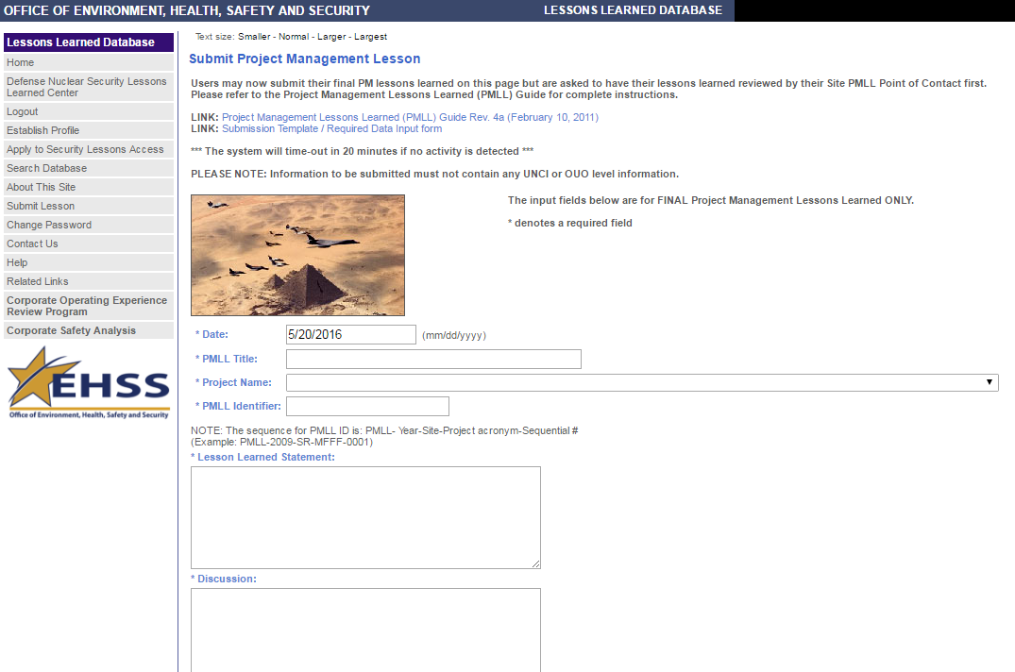
Input Screen, 1 of 3

Slide 17
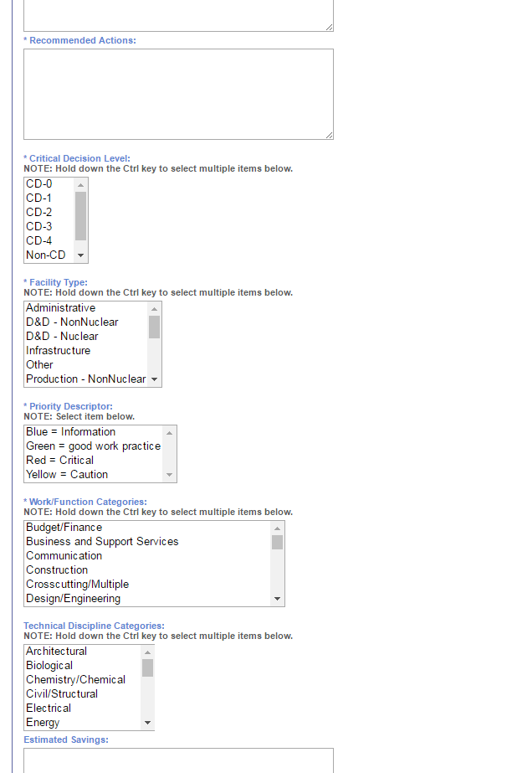
Input Screen, 2 of 3

Slide 18
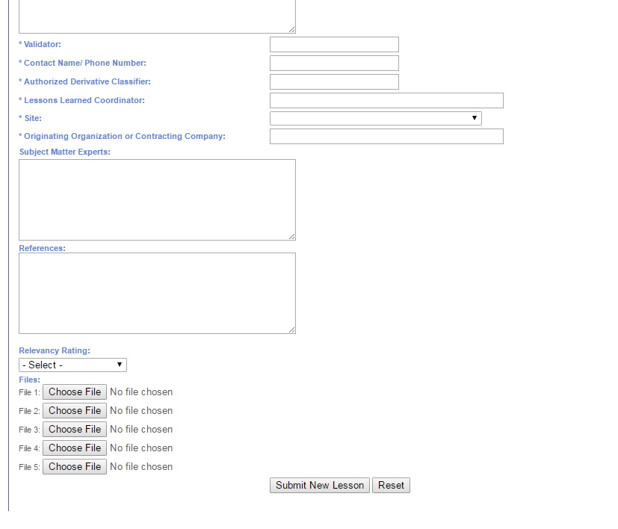
Input Screen, 3 of 3

Slide 19
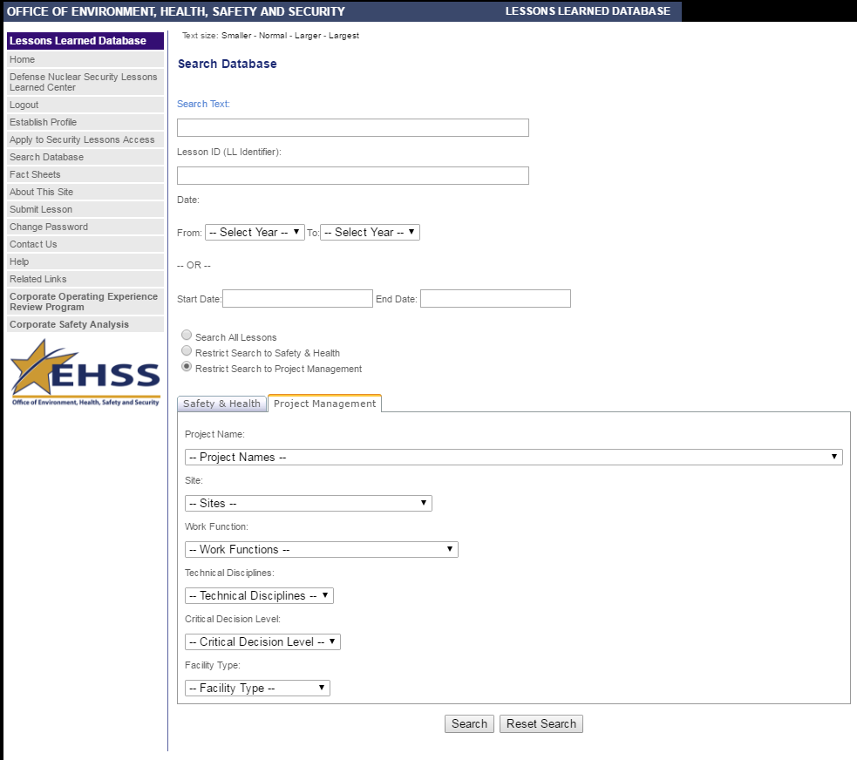
Search Screen

