Slide 1
GAO’s Cost and Schedule Assessment Guides
U.S. Government Accountability Office
Applied Research and Methods
Cost Engineering Sciences
Jason T Lee, Assistant Director
May 2016

Slide 2
Agenda
The role of GAO
GAO Cost Guide and the characteristics of a reliable cost estimate
GAO Schedule Guide and the characteristics of a reliable schedule
How is the government performing?
Proposed updates to the Cost Guide
Reliability assessment example for a large-scale infrastructure project

Slide 3
The Role of GAO in Government
Known as the investigative arm of Congress, GAO exists to support Congress in meeting its constitutional responsibilities. To that end, GAO works to
  Help improve the performance of federal government
  Ensure government agencies and programs are accountable to the American people
  Examine the use of public funds, and
  Evaluate federal programs by providing analyses and recommendations to help Congress make informed oversight and funding decisions

Slide 4
Cost Estimating and Assessment Guide
Drafted 2005-2007, published in 2009
Outlines GAO’s criteria for assessing cost estimates during audits
Contains 20 chapters with supporting appendixes
Chapters 1-17: developing credible cost estimates and the 12-step cost estimating process for developing high quality cost estimates
Chapters 18-20 address managing program costs once a contract has been awarded and discuss Earned Value and risk management
Also provides case studies of prior GAO audits to show typical findings related to the cost estimating process

Slide 5
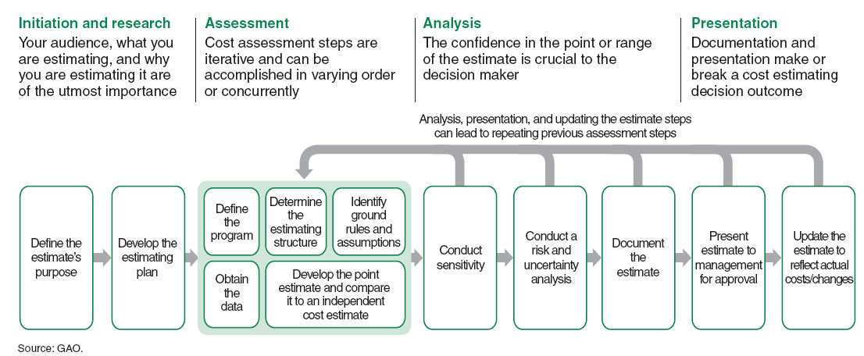
A Reliable Process for Developing Credible Cost Estimates

Slide 6
Characteristics of Reliable Cost Estimates
Are all costs included?
Is the estimate unbiased?
What is the uncertainty?
Can the estimate be recreated?
Define the program
Identify ground rules and assumptions
Obtain data
Document the estimate
Present estimate to management
Comprehensive
Develop the estimating plan
Well Documented
Determine the estimating approach
Accurate
Develop the point estimate
Compare the point estimate to an independent estimate
Update the estimate with actual costs
Credible
Create an independent cost estimate
Conduct sensitivity analysis
Conduct risk and uncertainty analysis

Slide 7
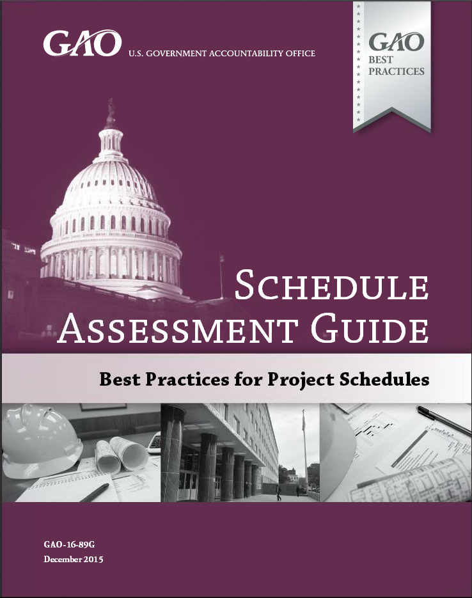
Schedule Assessment Guide
Drafted 2010-2015, exposure draft published May 2012
Final publication December 2015
Outlines GAO’s criteria for assessing master schedules
Contains chapters for each of the 10 best practices plus supporting appendixes
Also provides case studies of prior GAO audits to show typical findings related to the scheduling process

Slide 8
Four Characteristics of a Reliable Schedule
Is all effort included?
Is the network logical?
What is the uncertainty?
Is progress measured?
Update the schedule with progress
Maintain a schedule baseline
Comprehensive
Capture all activities
Controlled
Assign resources to all activities
Well Constructed
Sequence all activities
Confirm the critical path
Confirm reasonable float (slack)
Credible
Confirm vertical and horizontal traceability
Establish durations for all activities
Conduct a schedule risk analysis

Slide 9
How Is the Government Performing?
The extent to which agencies are adhering
to cost and schedule best practices

Slide 10
How is the government performing in developing cost estimates?
 | Comprehensive | Well Documented | Accurate | Credible
Veterans Affairs (VA)
DOT
DOD
Missile Defense (MDA)
IRS
DHS
DOE
Agriculture
Commerce
Fully Met | Substantially | Partially | Minimally | Not Met
Data based on agencies and departments with three or more GAO cost estimate assessments
Notes:
In general, government program offices
Exclude all program life cycle costs and do not break out costs into sufficient detail
Rarely use standardized product-oriented work breakdown structures with common support elements
Do not reflect historic or risk data and do not assess the risk impacts if major assumptions fail
Do not document the cost estimate to a level that would allow a cost analyst unfamiliar with the program to replicate the results
Conduct limited sensitivity analyses based on engineering judgment rather than historic data
Do not perform cost risk and uncertainty analysis and fail to document the risks associated with assumptions
Cannot show that their estimates are unbiased (i.e., do not identify a level of confidence along with contingency)
Fail to crosscheck estimating methodologies or reconcile with an independent cost estimate
Cannot demonstrate that management has understood and approved all facets of the cost estimate
Fail to update the cost estimate to reflect actual costs and reasons for variances
Many government program offices lack effective internal controls
Program offices generally have no:
Centralized cost estimating organization that includes experienced and trained cost analysts to develop high-quality cost estimates
Policy or guidance for developing high-quality cost estimates that include steps to follow, time that is needed, and how estimates will be updated
Infrastructure or staff for collecting and storing historic cost and technical data
Independent cost estimating organization that can test whether the cost estimate is accurate and realistic
Program offices generally do not
Link cost and schedule variances to risks in the cost uncertainty analysis
Update cost estimates regularly (e.g., monthly)
with actual cost data from an earned value management system,
to capture the reasons for variances with links to risks identified in the risk register,
at major milestones.

Slide 11
How is the government performing in developing and maintaining schedules?
 | BP 1 All effort | BP 2 Logic | BP 3 Resources | BP 4 Durations | BP 5 Traceable | BP 6 Critical Path | BP 7 Float | BP 8 Risk | BP 9 Statusing
Veterans Affairs (VA)
DOT
DOD
Missile Defense (MDA)
DHS
DOE
NASA
Fully Met | Substantially | Partially | Minimally | Not Met
Results reflect agencies and departments with three or more GAO schedule assessments
Notes:
In general, government program offices fail to
Include all effort in the IMS for the entire program or provide traceability of activities to the statement of work
Set a schedule baseline (or track against one)
Properly sequence activities using correct logic to ensure the schedule is dynamically networked (e.g., missing relationships and dangling activities)
Use constraints and lags moderately and force activities to occur on predetermined dates
Document their justification
Include activities of long duration that are difficult to objectively status and manage
Perform schedule risk analysis
Further, government program offices
Appreciate the concept of a critical path but not the consequences of unrealistic float
Assume unlimited resources by failing to resource load their schedules
Do not consistently update schedules or record a status/data date
Miss distinct start and finish milestones.
Contractor schedules are usually more reliable than government program office schedules
Many contract deliverables require an integrated network schedule
Government program offices typically have a 1-page IMS developed in PowerPoint
Program offices resource-load schedules only at the prime and subcontractor levels, believing that resource loading a schedule is overkill
Government program office IMSs usually fail to span an entire program, regardless of how many increments, steps, blocks, contracts, or milestones the program is divided into
Activity names in government programs tend to be too general, causing problems when filtering the schedule to look for missing logic or status issues
Schedules are not created by the critical path method and therefore cannot be
Used to conduct schedule risk analysis
Relied on by management to evaluate progress and make decisions
Schedulers -- rather than the program manager -- are too often held responsible for updating and managing schedules.

Slide 12
Some Proposed Cost Guide Updates
Integration with and references to the
  GAO Schedule Assessment Guide (GAO-16-89G)
  GAO Standards for Internal Control (GAO-14-704G)
  GAO Technology Readiness Assessment Guide (expected summer 2016)
  GAO Federal Agile Software Guide (issue date TBD)
Improved definitions and descriptions of several best practices and their mappings to the 12 steps and 4 characteristics
Applicability of best practices to all types of capital programs
Appendixes: risk breakdown structures, spreading contingency dollars through the WBS; updated laws and guidance
Notes:
Improved descriptions and definitions of several best practices
Application beyond capital programs and major weapons systems
Definition of life cycle (e.g. FOC + 10 years)
Explanation of management briefings and sign-off
Explanation of optimistic and pessimistic estimates relative to Monte Carlo S curves

Slide 13
Invitation to Participate in Further Updates and Discussion about Best Practices
GAO invites interested parties to meet with us and other experts to discuss further updates to the cost and schedule guides so that the guides continually reflect best practices.
If interested, please e-mail your contact information to:
    Jason T Lee – leejt1@gao.gov
    Karen Richey - richeyk@gao.gov

Slide 14
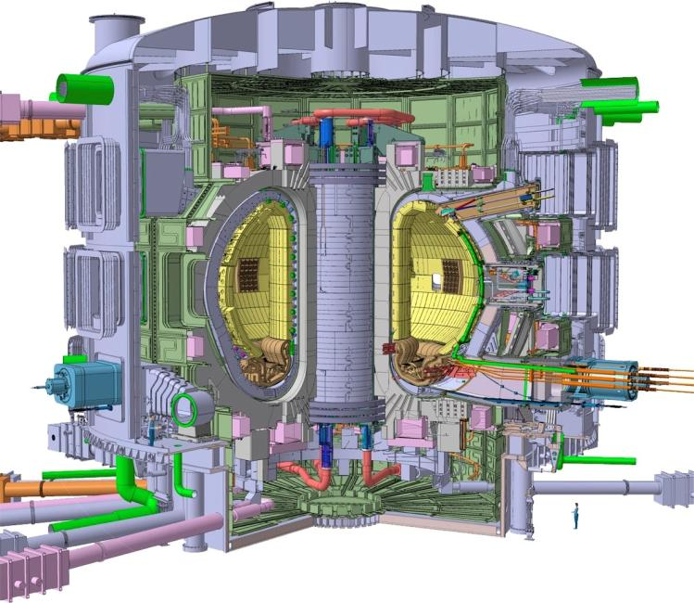
International Thermonuclear Experimental Reactor (ITER) Project: Background
ITER is an international research facility being built in France to demonstrate the feasibility of fusion energy.
Other countries involved in ITER include Russian Federation, Japan, European Union, People’s Republic of China, Republic of Korea, and India.
The United States has committed to providing about 9 percent of ITER's construction costs through contributions of hardware, personnel, and cash, and DOE is responsible for managing those contributions, as well as the overall U.S. fusion program.
GAO reviewed costs and schedules in 2014 (GAO-14-499)

Slide 15
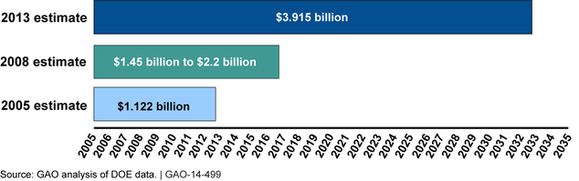
ITER: Cost estimates of U.S. Contribution

Slide 16
ITER: Key Findings
Cost: Estimate of U.S. contribution has grown by almost $3 billion
Schedule: Estimated completion date has slipped by 20 years
Causes: 1) refined design and requirements of U.S. hardware; 2) changes to the international schedule; 3) changes to ITER design; 4) U.S. funding constraints and associated inflation; 5) increased ITER construction costs
Assessment:
  U.S. schedule estimates substantially meet best practices
  U.S. cost estimates substantially meet best practices, but only partially meet Credible because they did not develop a sensitivity analysis or independent cost estimate
  DOE has been unable to set a cost and schedule baseline in part because the international schedule has not been set

Slide 17
ITER: Recommendations
Revise U.S. ITER Project Office to develop a sensitivity analysis for the cost estimate and compare to an independent cost estimate
Develop proposal describing what actions are necessary to create a reliable international schedule and improve ITER Organization program management
Once ITER Organization creates a reliable master schedule, use that schedule to update the U.S. schedule
Develop strategic plan to address DOE’s fusion program priorities

Slide 18
Conclusion
The GAO Cost Guide and Schedule Guides provide criteria to evaluate many types projects
The GAO Cost Guide and Schedule Guides can serve as the basis for agency project control guidance
GAO recommendations have been aimed at improving oversight to keep projects on cost and schedule.

Slide 19
Thank you- Any Questions?
Guides Available Online:
GAO Cost Estimating and Assessment Guide: http://www.gao.gov/products/GAO-09-3SP
GAO Schedule Assessment Guide: http://www.gao.gov/products/GAO-16-89G

