Slide 1
Organizational Climate Studies and Other Evaluation Strategies: Experience from NSF’s Advanced Cyberinfrastructure Projects
Lizanne DeStefano, Georgia Institute of Technology
Lorna Rivera, University of Illinois at Urbana-Champaign

Slide 2
Three Evaluation Strategies
Climate Study
Dashboard Display of KPIs and area metrics
Logic Models

Slide 3
Annual Climate Study
Lizanne DeStefano, Georgia Institute of Technology
Lorna Rivera, University of Illinois at Urbana-Champaign

Slide 4
Purpose of the Climate Study
Support XSEDE’s organizational health by providing data over time to:
Better understand current working conditions
Recognize successes and areas of concern
Develop responses to improve working conditions
Improve workplace efficiency and satisfaction

Slide 5
Method
Annual on-line Survey to all XSEDE staff and leadership
  Core items
  XSEDE specific items
  May/June administration
Disaggregation by Level 2, 3, site, FTE, length of employment
  Special requests by L2 and L3 managers
EXTENSIVE dissemination and interaction around results
Documentation of XSEDE response to results
  Quarterly Meetings

Slide 6
Six Climate Indices
Responsiveness
Leadership
Communication Tools
Values and Satisfaction
Communication and Decision-making
Resources and Support
Equity

Slide 7
Index Scores Over Time (Scale 1 – 5)

Slide 8
2015 Respondent Demographics
FTE (Sciforma)
Staff Level (Self Report)
Length of Employment (Self Report)
Gender (Self Report)
Notes:
49% former TeraGrid Staff (N=149), 38% no affiliation

Slide 9
2015 Respondent Demographics Continued
Racial/ethnic diversity: Note that totals may not equal 100% since respondents could select more than one category.

Slide 10
2013 Recommendation: Promote staff directory on main XSEDE staff wiki page. Consider adopting a universal online document storage and collaboration solution.
2014-2015 XSEDE Response: Complete reorganization of wiki. Retirement and replacement of Sciforma in XSEDE2.0. Expansion of Communication Tools dimension in 2015 Climate Study.
Climate Study Results
Survey Item | Mean 2013 | Mean 2014 | Mean 2015
Q1A. The XSEDE staff wiki helps me find information across the project. | - | 3.26* | 3.58**
Q1C. The XSEDE staff wiki contains information that is useful to me and my work. | - | - | 3.82
Q1E. The XSEDE staff wiki helps me to communicate effectively with other XSEDE staff. | 3.04 | 2.99 | 3.18
    “The wiki reorganization has helped me find things outside my level 3 WBS area”
“…It would also help to expand the use of good collaborative tools to a more complete integrated tool suite, e.g., integrated wiki/issue system/source control/code review system.
Scale: Strongly Disagree (1) to Strongly Agree (5)
* p < .05, ** p < .01, *** p < .001
Range of comparable projects 2.83 to 3.74
Notes:
Q1A, 2014 & 2015, t(277) = -2.66, p = .008
Q1E not significant

Slide 11
2013 Recommendation: Maintain detailed FTE assignments, coordinate with local supervisors, and regularly recognize outstanding work.
2014-2015 XSEDE Response: Detailed FTE assignments included in PY5 and XSEDE2.0 planning budgets. Internal newsletter highlights of staff work.
Climate Study Results
Survey Item | Mean 2013 | Mean 2014 | Mean 2015
Q7A. I am satisfied with the balance between my work for XSEDE and my work on other projects. | 3.33* | 3.54 | 3.59*
Q7D. I am satisfied with how my program area is managed. | 3.57** | 3.75 | 3.93**
    “I work for an XSEDE partner. I feel that my interactions with XSEDE staff are very good.”
    “…Perhaps there should be annual performance reviews, and the Level 3's could shift funds between people and institutions based on who is actually delivering.”
Scale: Strongly Disagree (1) to Strongly Agree (5)
* p < .05, ** p < .01, *** p < .001
Range of comparable projects 2.83 to 3.74
Notes:
Q7a, 2013 & 2015, t(252)=-2.80, p=.023
Q7d, 2013 & 2015, t(256)=-3.053, p=.003

Slide 12
2013 Recommendation: Establish explicit procedures including time limits for XSEDE decision making.
2014-2015 XSEDE Response: Expanded communication & decision making dimension in 2014 Climate Study and again in 2015. All hands meetings implemented at sites. Retirement of projects lacking desired outcomes.
Climate Study Results
Survey Item | Mean 2013 | Mean 2014 | Mean 2015
Q3A. XSEDE’s decision making process is efficient. | - | 2.93 | 2.96
Q3B. I understand how decisions are made within the organization. | - | - | 3.04
Q3C. I have input in decision making that relates to my work. | - | - | 3.77
Q3D. When decisions are made, they are effectively communicated back to me. | - | - | 3.55
    “ “Communication during and after decision making by senior leadership is better than before, but overall still not nearly good enough…However, I have confidence that the senior leadership is addressing this problem and headed in the right direction.”
Scale: Strongly Disagree (1) to Strongly Agree (5)
Range of comparable projects 2.83 – 3.74

Slide 13
2014 Recommendation: Conduct deeper investigations of organizational climate as it relates to equity with staff from all groups.
2014-2015 XSEDE Response: Expanded equity dimension in 2015 Climate Study. Diversity speaker at June 2015 quarterly meeting.
Climate Study Results
Survey Item | Mean 2013 | Mean 2014 | Mean 2015
Q2b. I feel that XSEDE staff treat each other equally regardless of gender. | - | 4.41 | 4.38
Q9. How often do you experience discrimination by other XSEDE staff?† | - | 4.83 | 4.80
“I'm sure that there is unconscious bias like with any human enterprise. I haven't personally seen anything I could point to as a clear case of discrimination, but different people can interpret the same event differently.”
Scale: Strongly Disagree (1) to Strongly Agree (5)
†Note Q9 has been reverse coded as 1 (Almost Always) to 5 (Never).
Range of comparable projects not available

Slide 14
Pilot TEOS Area Metrics Tableau Dashboard Demonstration
Lizanne DeStefano, lizanne.destefano@ceismc.gatech.edu
Lorna Rivera, lirivera@Illinois.edu

Slide 15
XSEDE has a complex system of KPIs and area metrics
Dashboard was developed to provide real time access to metrics for L1, L2, and L3 and program managers.
  Easy quarterly and annual reporting
  Consistent definitions and data pulls
  Promotes longitudinal analysis
  Better understand user base
  Promote data based decision-making and transparency

Slide 16
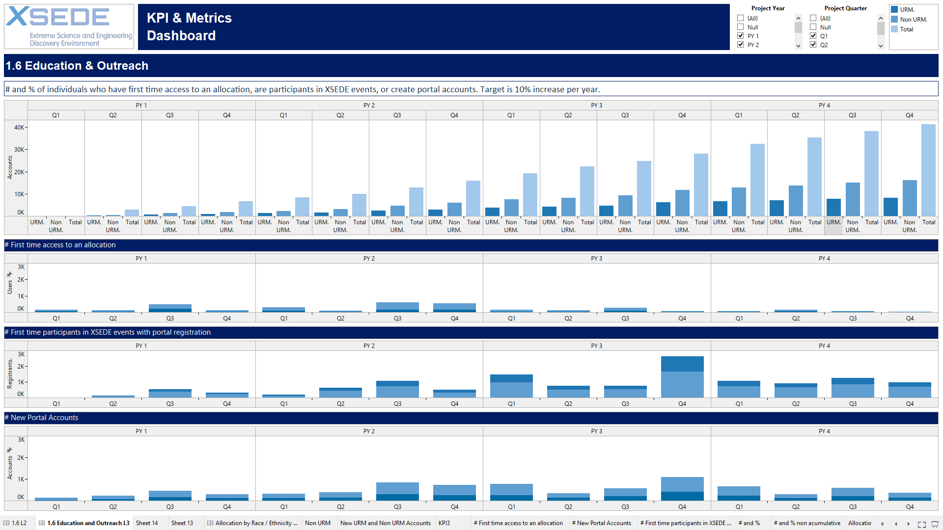
L2 Area Metrics Sample
Cumulative and Quarterly Data

Slide 17
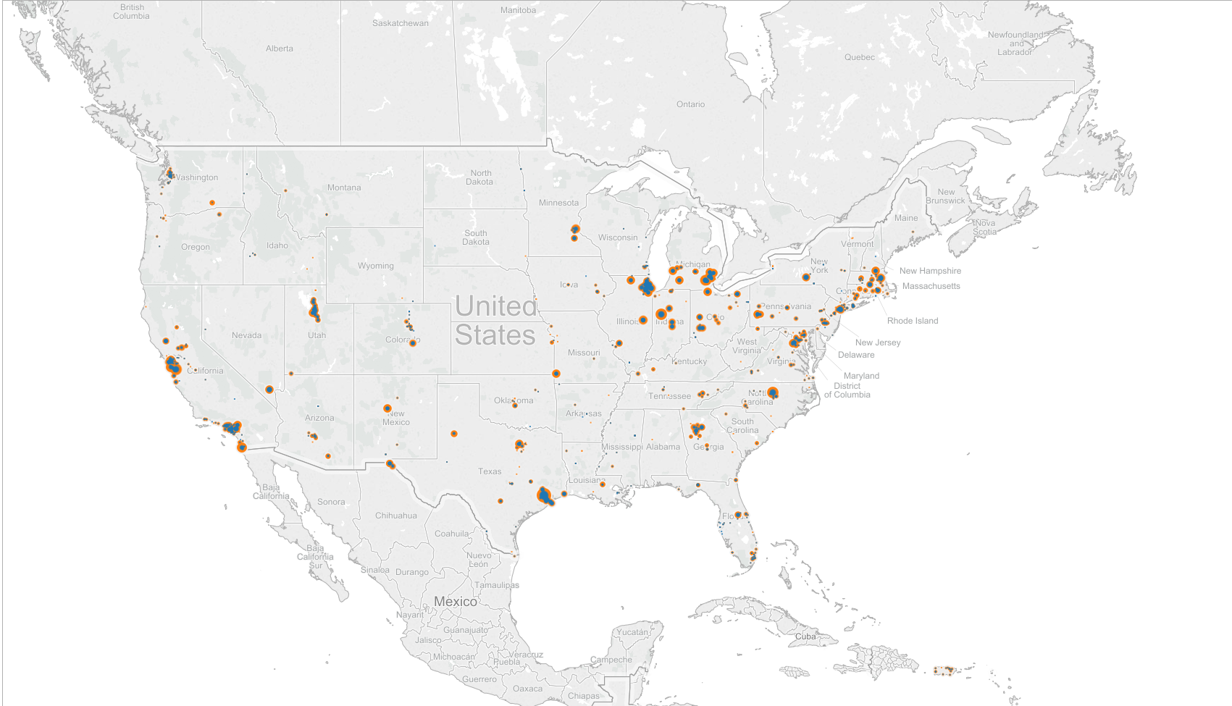
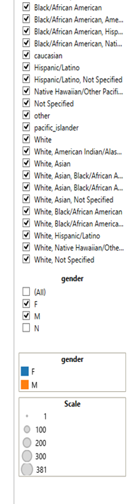
Spatial Distribution

Slide 18
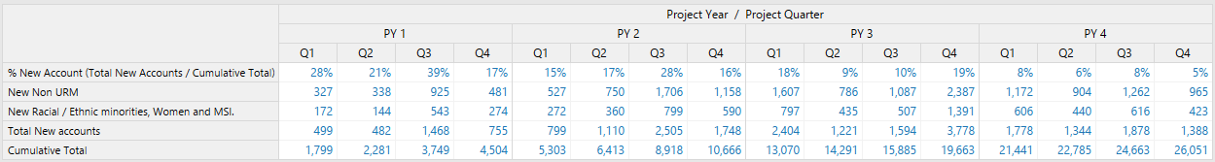
L2: Area Metrics
Cumulative and Quarterly Data

Slide 19
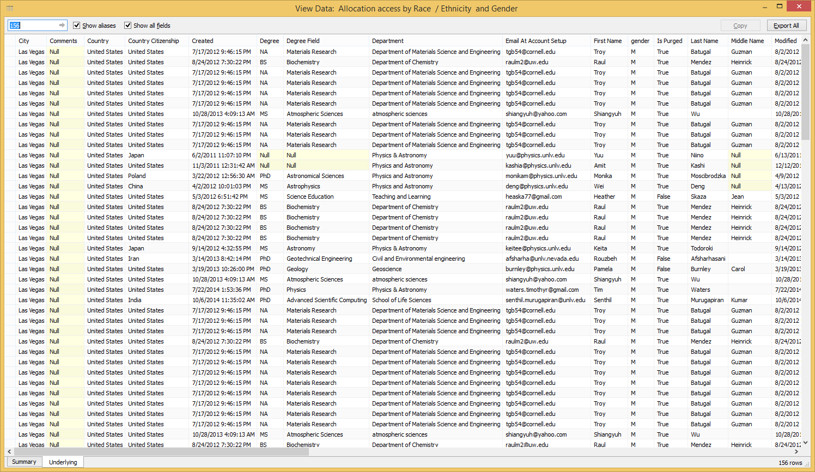
Underlying Data
Removed to preserve participant privacy.

Slide 20
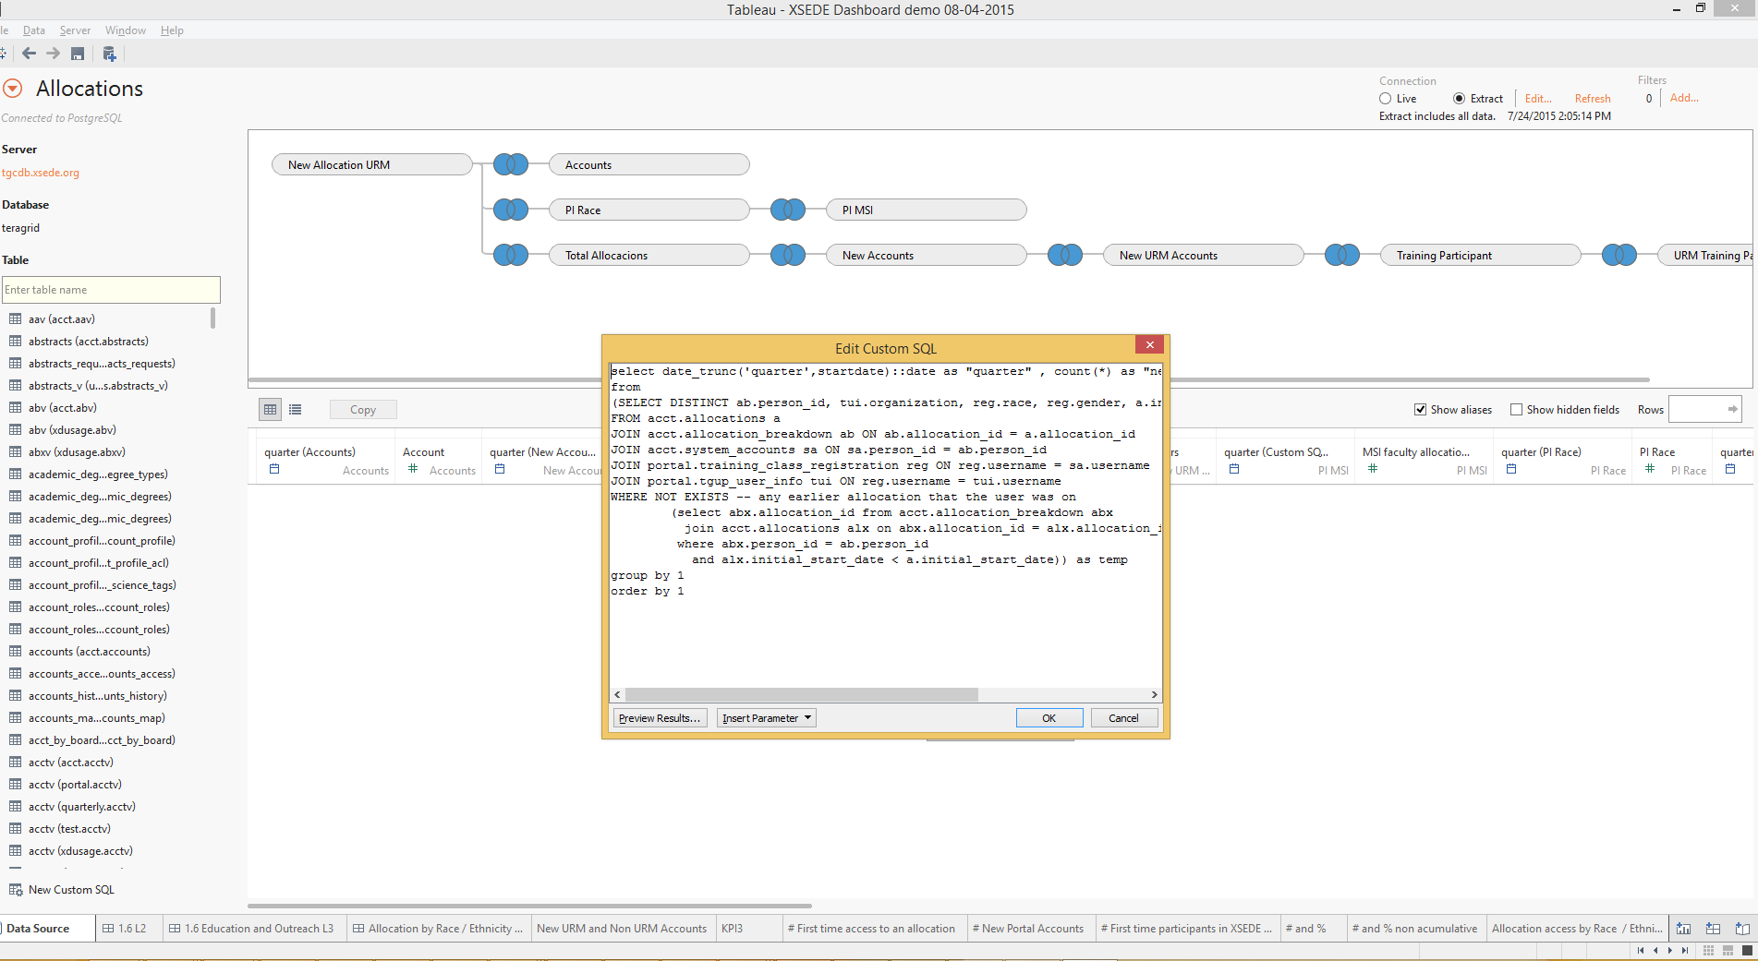
Underlying Queries

Slide 21
Logic Models
Lizanne DeStefano, I-STEM, UIUC
Lorna Rivera, I-STEM, UIUC
Michael Culbertson, I-STEM, UIUC

Slide 22
Logic Models represent intended program operation
Make program components and processes explicit
Identify different understandings and promote consensus
Clarify points for intervention and evaluation

Slide 23
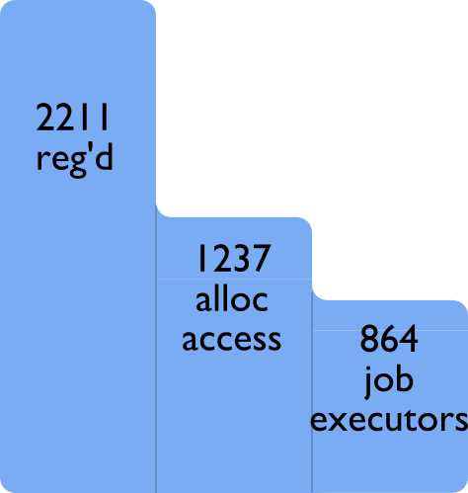
Allocations are an important metric in XSEDE
Figure 1. Training Registrants as of February 2013

Slide 24
Allocations Logic Model
Allocation access survey
Outcomes
Time
Resources used
Publications
Awards/grants
Career impact
Value added
Awarded
-Plans and timeline
-Resources requested
Exit survey
Submission
-Satisfaction
-Time and effort
-Support needed
POPS Post submission survey
XRAS Reviewer survey
Experienced Users
-Previous allocation
Intake surveys
Pre-allocation
-How heard
-Information needs
-Support needs
-Purpose
Declined
Reasons why
Plans and timeline
Resources needed
Post decline survey
New Users
-Discipline
-Institution
-URM
No Submission
Reasons why
Support/training needs
Outcomes
Later submission
Other resources
Abandon project

Slide 25
Surveys
Table 1. Survey suite related to allocations
Items on… | Intake | POPS Post Submission | XRAS Reviewer | Allocation Access | Exit | Declined
Computational experience | X | X |  | X | X | X
Training needs | X |  |  | X | X | X
Access/use of other computational resources | X |  |  | X | X | X
Champion interaction | X |  |  | X | X | X
Demographics | X | X |  | X | X | X
Submission process |  | X
Review process |  |  | X |  |  | X
New portal account | X
Allocation plans |  |  |  | X
Allocation achievements |  |  |  |  | X
Alternative plans |  |  |  |  |  | X

Slide 26
Discussion
Are the annual Climate Study and other strategies useful for promoting continuous improvement and a positive working environment within XSEDE?
Are these findings useful or applicable to other large NSF investments?
  Communication & decision making in virtual organizations
  New staff orientation needs
  Less than .50 FTE

Slide 27
Discussion
Contact Information:
Lizanne DeStefano, ldestefano6@gatech.edu
Lorna Rivera, lirivera@Illinois.edu

