Slide 1
Goddard Space Flight Center
Transforming Concepts Into Reality: Project Management Insights from NASA’s Goddard Space Flight Center
David Mitchell
Director of Flight Projects Directorate
Presentation to the National Science Foundation and Smithsonian Institution at the 2016 Large Facilities Office Workshop
May 24, 2016

Slide 2
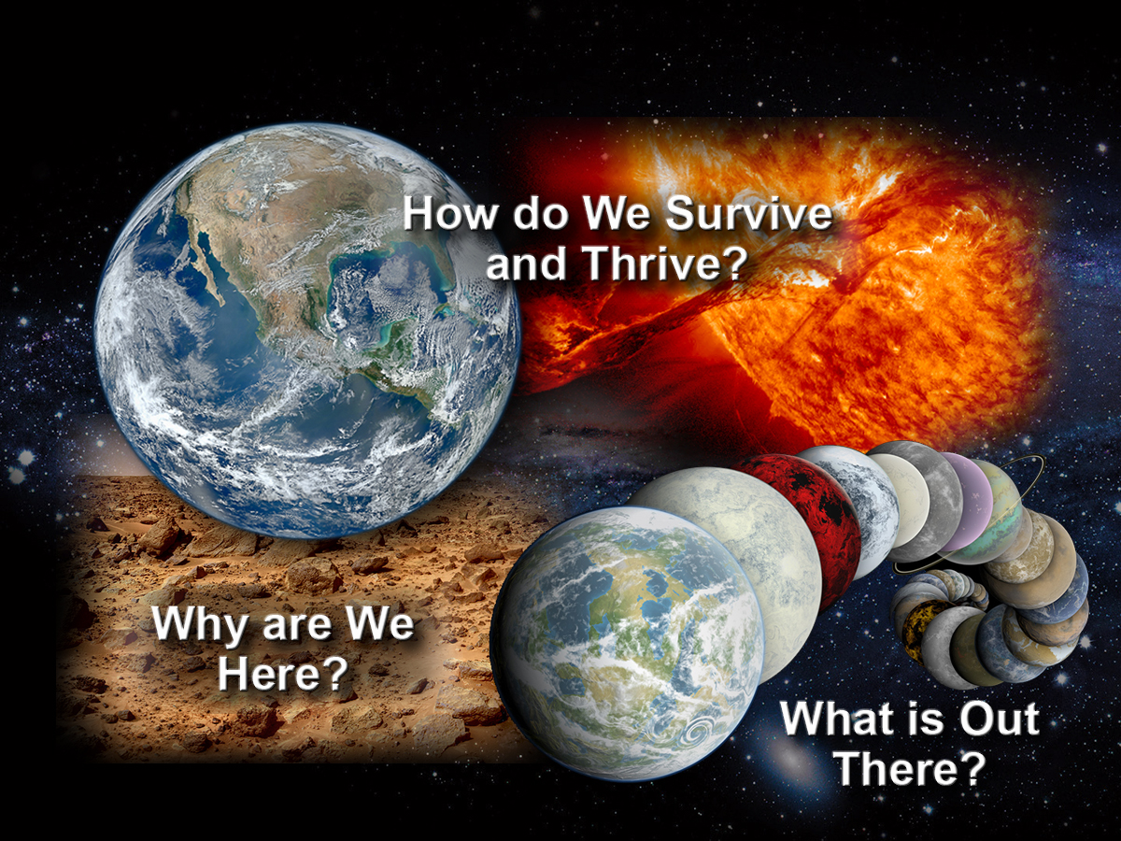

Humanity’s Big Questions
Translate the knowledge and technologies derived from these areas of exploration to practical applications today.

Slide 3

NASA GSFC Installations
GSFC Greenbelt, MD
GSFC Wallops Flight Facility, VA
IV&V Facility, WV
Goddard Institute for Space Studies, NY
Ground Stations at White Sands Complex, NM
Wallops Flight Facility
White Sands Complex
Independent Verification and
Validation Facility
Greenbelt
Campus
Goddard Institute for
Space Studies
3
Notes:
3

Slide 4
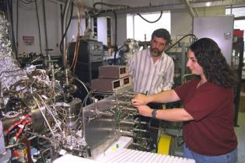
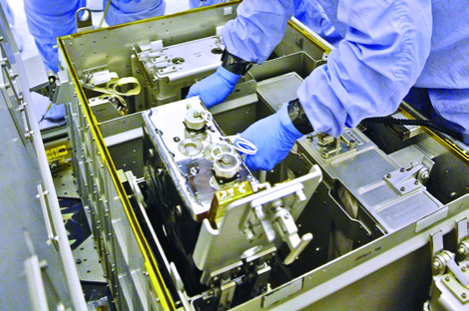
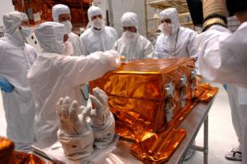
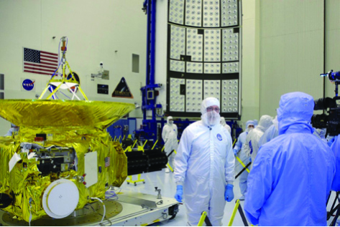

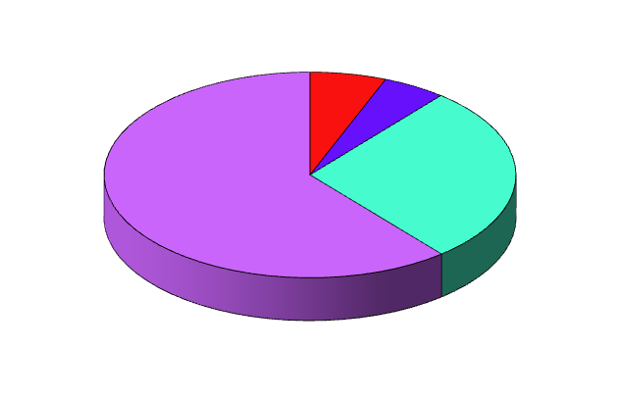
Our People
Technicians/Other
6%
Clerical
5%
Scientists &
Engineers
61%
Professional/
Administrative
28%
GSFC Workforce
Total Civil Servants: 3,400
Total Contractors : 6,400
Total Workforce: 9,800
4

Slide 5
Flight Projects’ FY 2015 Annual Portfolio
As of March 2016
Earth Science – 15%
FY16 NOA $479.9M
Missions in Development: 5
Total in Operations: 13
Earth Science
Reimbursable – 42%
FY16 NOA: $1,376.3M
Missions in Development: 7
Total in Operations: 1
Funded $3.5B annual NOA
Communications & Navigation –10%
FY16 NOA: $316.0M
Missions in Development: 1
Total in Operations: 10
Astrophysics – 23%
FY16 NOA: $750.0M
Missions in Development: 5
Total in Operations: 5
Heliophysics – 5%
FY16 NOA: $148.9M
Missions in Development: 5
Total in Operations: 15
Planetary – 3%
FY16 NOA: $155.9M
Missions in Development: 2
Total in Operations: 2
FPD Workforce (FY 2016)
399 Civil Service Employees
2,224 contractors
2,623 Total Employees
Cross-cutting Technologies – 2%
FY16 NOA: $69.1
Missions in Development: 4
Total in Operations: 1
5

Slide 6
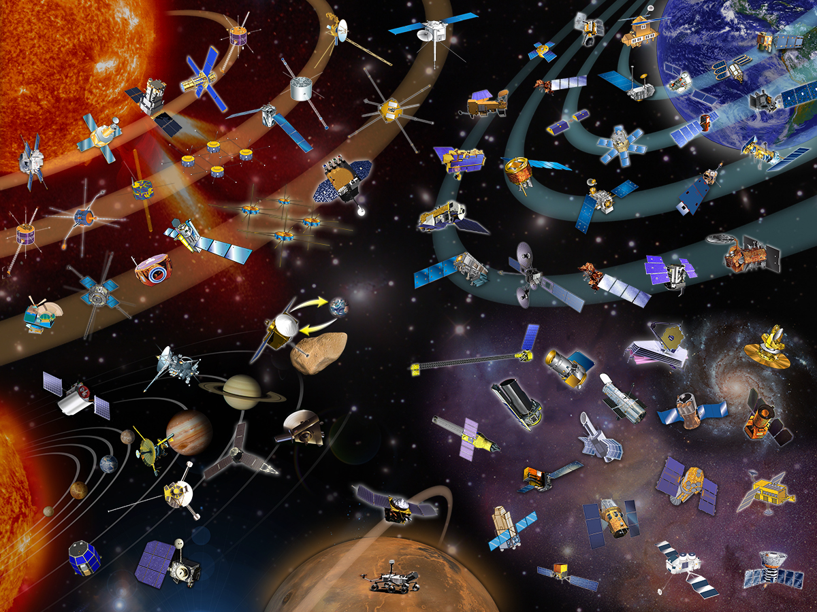
GSFC: A Diverse Mission Portfolio
Wind
Voyager
QuikSCAT
EO-1
Stereo
ACRIMSAT
ERBS
RHESSI
TRMM
TOMS
SOHO
Geotail
Aqua
ICESat-2
TIMED
THEMIS
TRACE
Landsat 7
TOPEX
CALIPSO
ACE
Terra
GRACE
Cluster
SORCE
POES
IMAGE
SDO
Aura
AIM
FAST
GPM
GOES
Polar
Solar-B
MMS
IBEX
NPP
Aquarius
Osiris-Rex
(Sample Return)
TDRSS
LDCM
CloudSat
TWINS
(Instrument)
RBSP
WMAP
Cassini
NuSTAR
JWST
WISE
HST
GALEX
New Horizons
Messenger
Spitzer
SWAS
Galileo
Astro-H
IUE
RXTE
Juno
MAVEN
Integral
Pioneer
EUVE
Mars Science
Laboratory
FUSE
Swift
COBE
Fermi
Compton
GRO
LADEE
LRO
6
Notes:
6

Slide 7
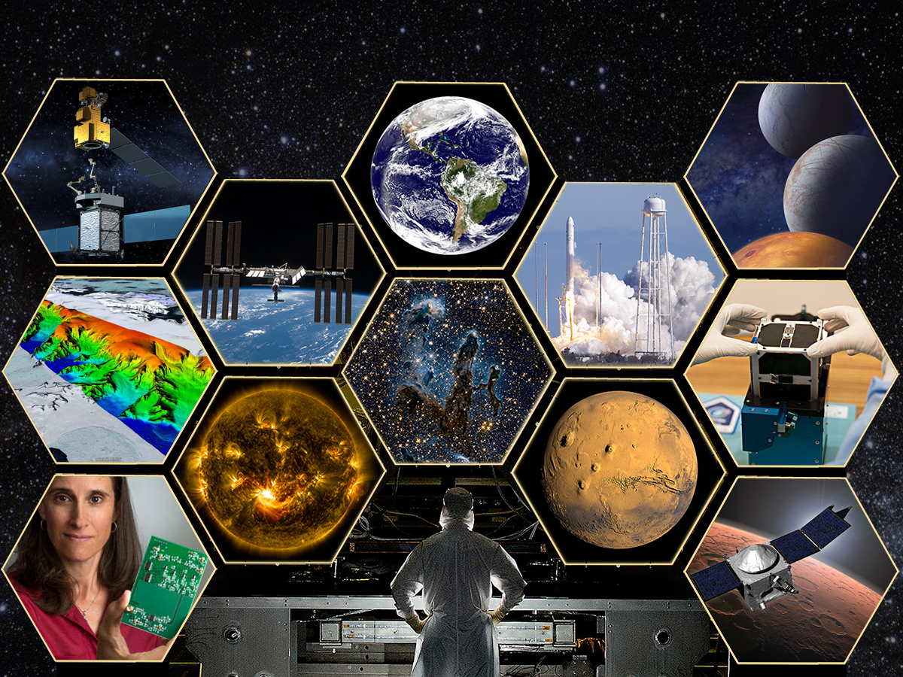

Looking to the Future

Slide 8

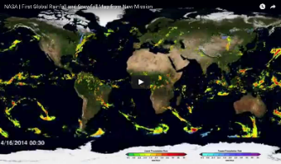
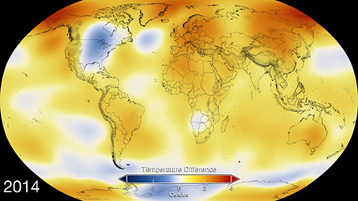

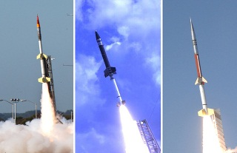
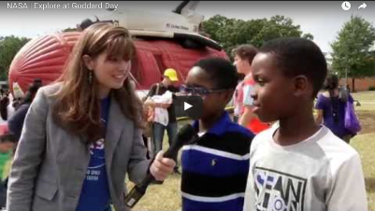
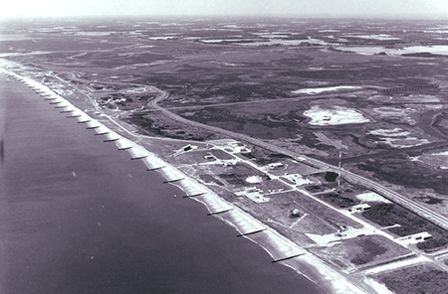
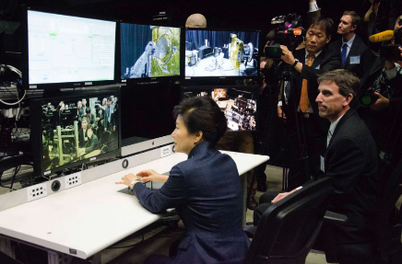

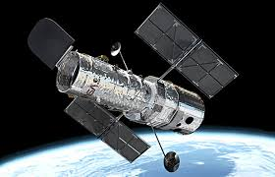
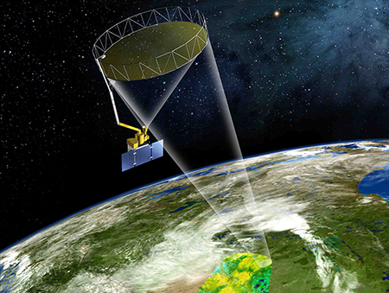
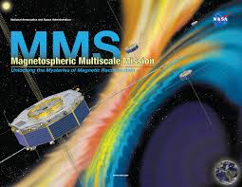
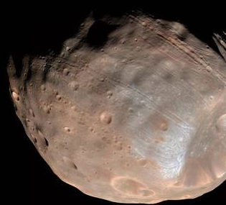
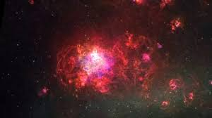
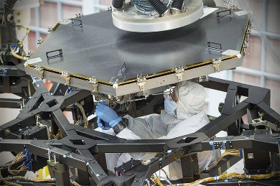

2015 Accomplishments
MAVEN Mission Reveals Speed of Solar Wind Stripping Martian Atmosphere
First Global Precipitation Maps from GPM
NASA, NOAA Find 2014 Warmest Year in Modern Record
DSCOVR Discovers Moon Photo-bombing Earth
Sounding Rocket Launches
Goddard Open House Attracts Record Crowd of 20,000
Wallops Flight Facility Marks 70 Years
President Park Geun-hye Visits NASA Goddard
Celebrating 25 Years of Hubble
Liftoff for MMS Mission’s Quadruplet Satellites
Mars’ Moon Phobos is Slowly Falling Apart
Fermi Satellite Detects First Gamma-ray Pulsar in Another Galaxy
Webb Telescope Mirror Assembly Begins at Goddard
SMAP Launches January 2015

Slide 9
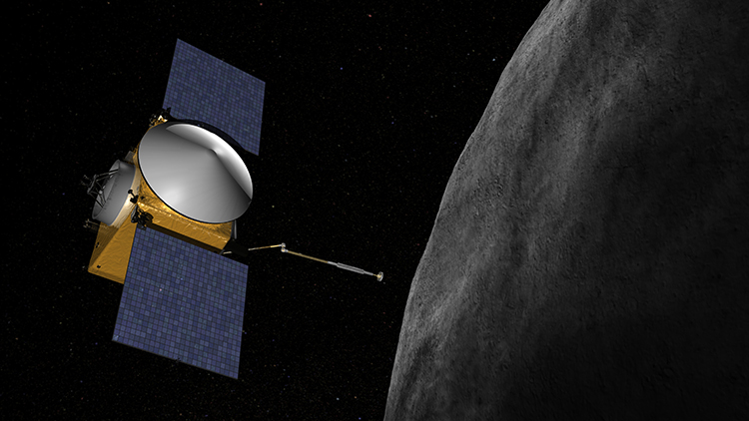
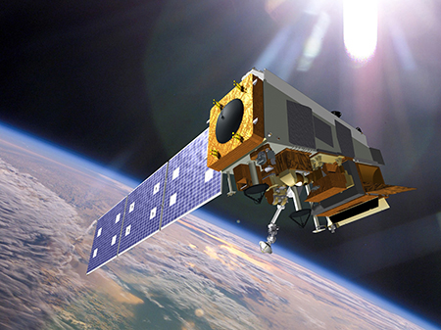
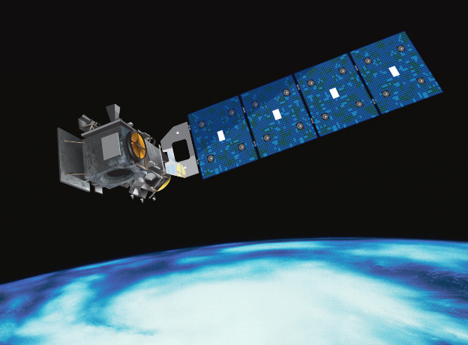
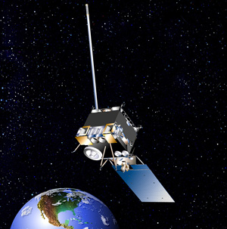
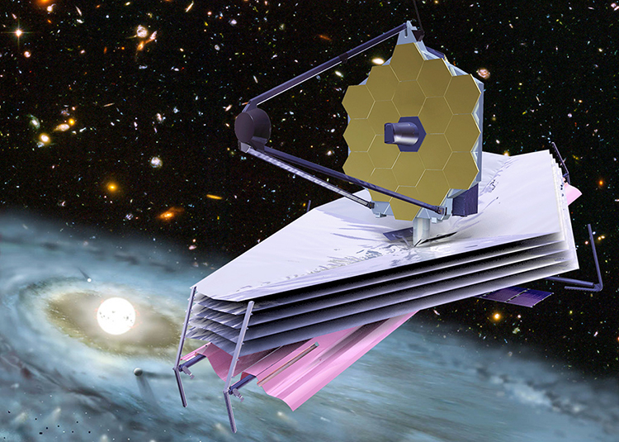

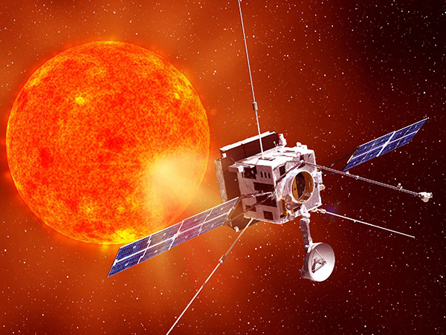
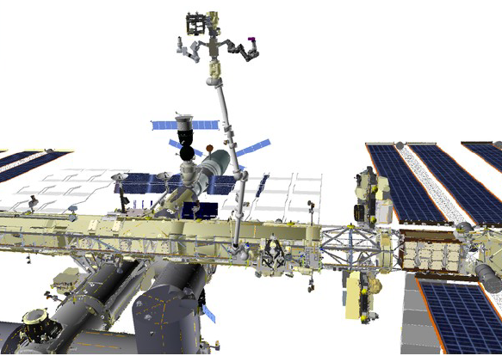
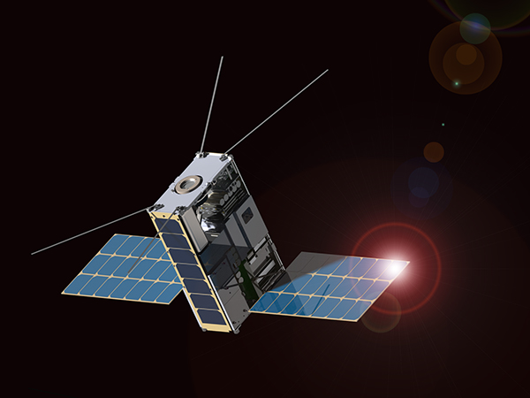
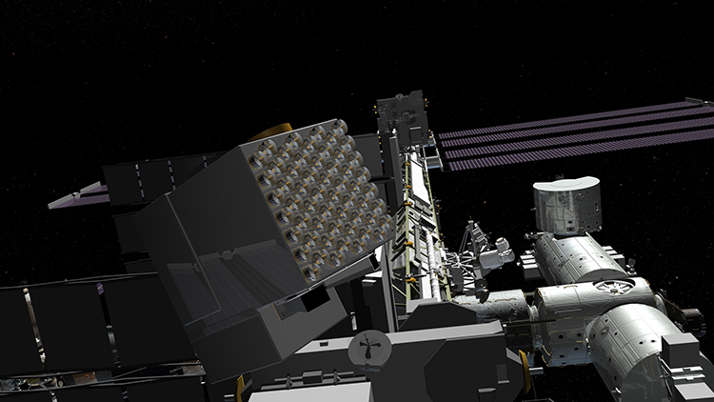
Upcoming Launches and Future Missions
OSIRIS-REx
JPSS-1
ICESat-2
GOES-R
GEDI
Solar Orbiter
JWST
Cubesats
NICER
Ammonia Leak Locator Tool on ISS
Notes:
9

Slide 10
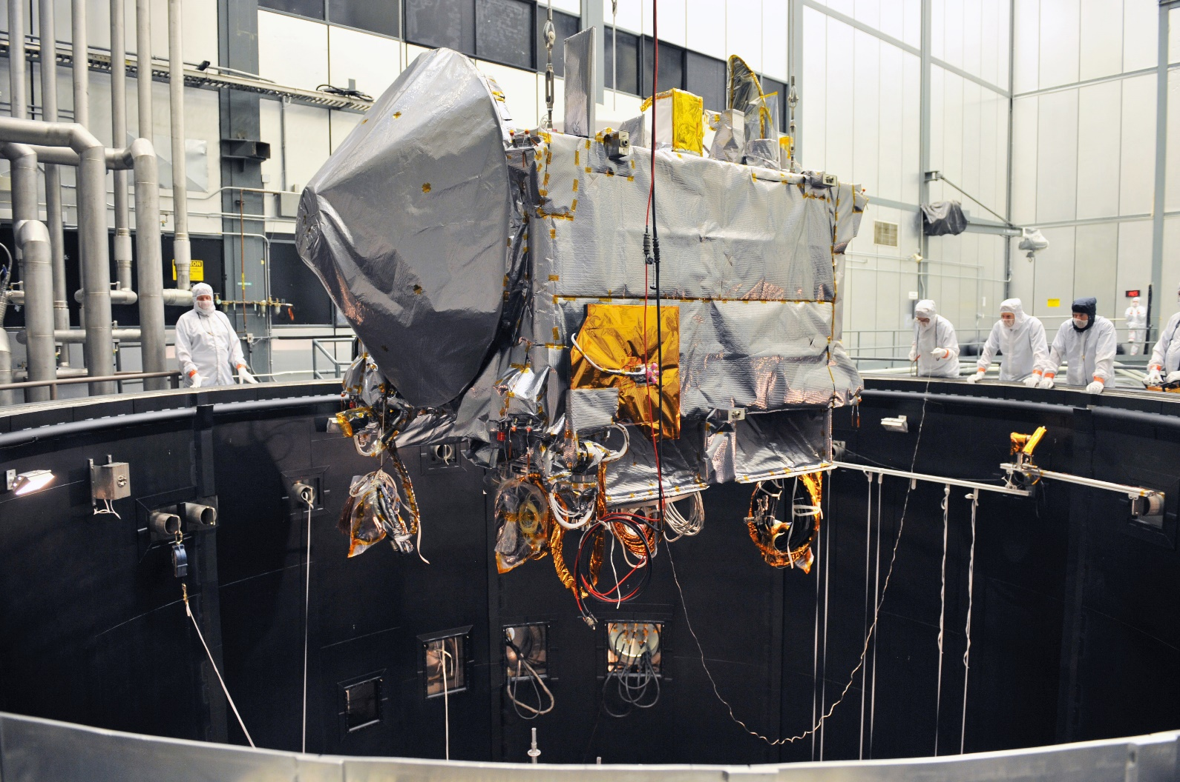
Accomplishments - OSIRIS REx
Origins, Spectral Interpretation, Resource Identification, Security-Regolith Explorer (OSIRIS REx) asteroid sample return mission completing environmental testing
  Launch in September 2016

Slide 11
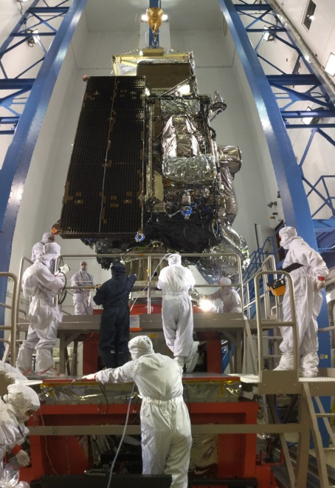
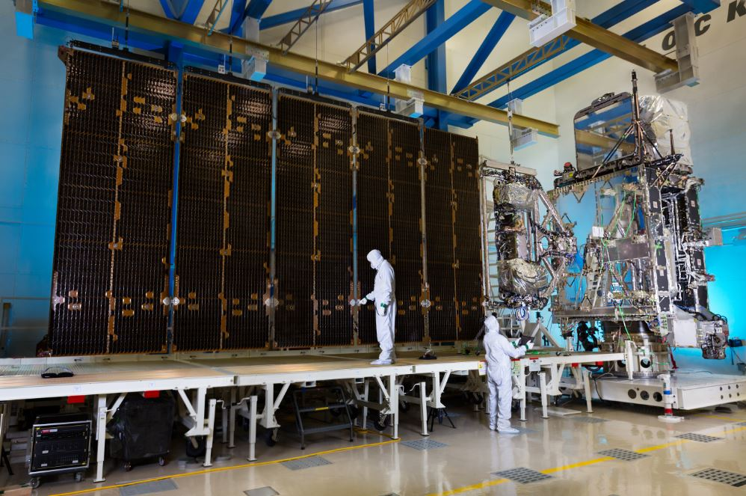
Accomplishments - GOES-R Satellite
Geostationary Operational Environmental Satellite “R” Series (GOES-R) is a collaborative program between NOAA and NASA to develop the next generation GOES environmental satellites (follow-on to GOES-N/O/P)
GOES-R completed mass properties, sine vibe, shock, dynamic interaction test, and launch vehicle adapter match mate
November 2016 Launch
GOES-R in Sine Vibe at LMSSC in Littleton, CO

Slide 12
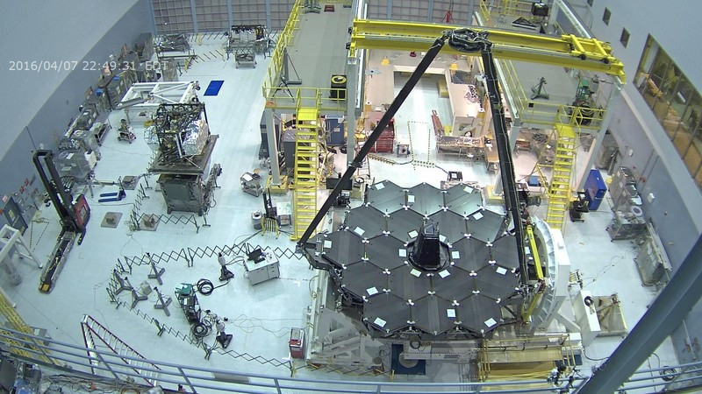
Accomplishments - JWST
James Webb Space Telescope (JWST) is a deployable infrared telescope, passively cooled, with 6.5 meter diameter segmented adjustable primary mirror designed to study the origin and evolution of galaxies, stars, and planetary systems
Primary mirror installation is complete
Integrated Science Instrument Module underwent third and final cryogenic test.
Side portions of the backplane structure successfully deployed
Launch: October 2018

Slide 13
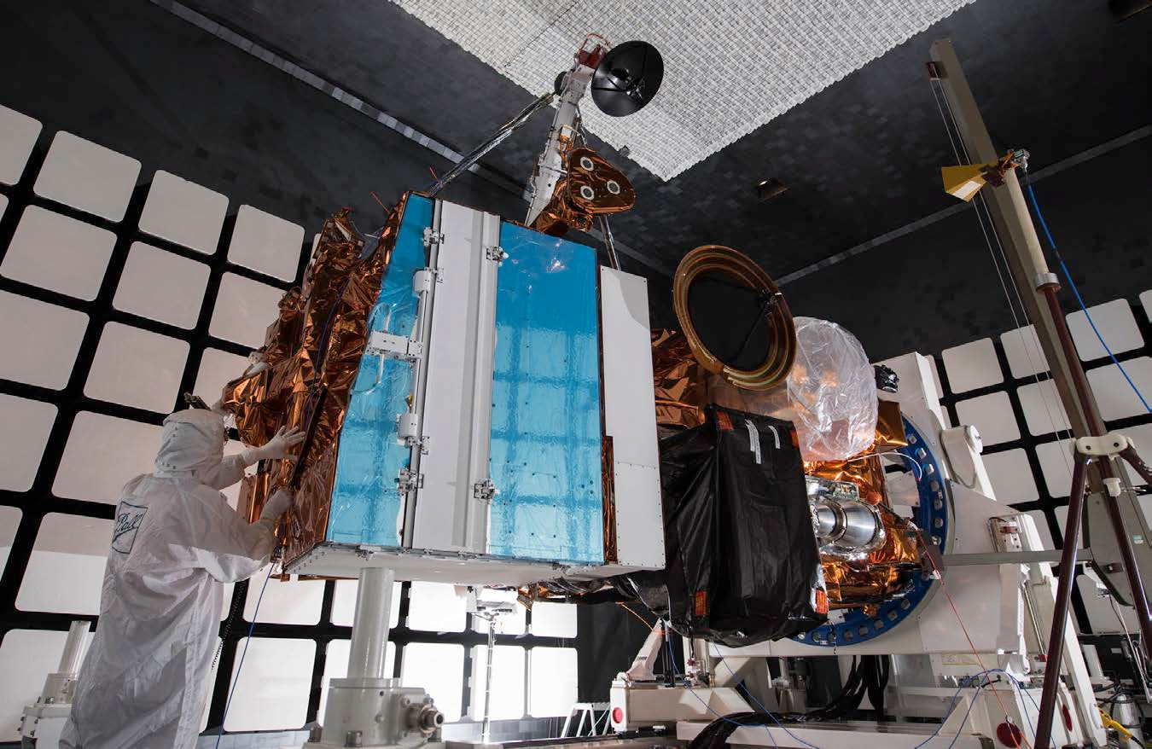
Accomplishments – JPSS
Joint Polar Satellite System 1 (JPSS 1) spacecraft will sustain continuity of and enhance NOAA’s Earth observation analysis and forecasting capabilities from global polar-orbiting observations
Pre-Environmental Review successfully completed on March 30, 2016
  On track for January 2017 launch

Slide 14
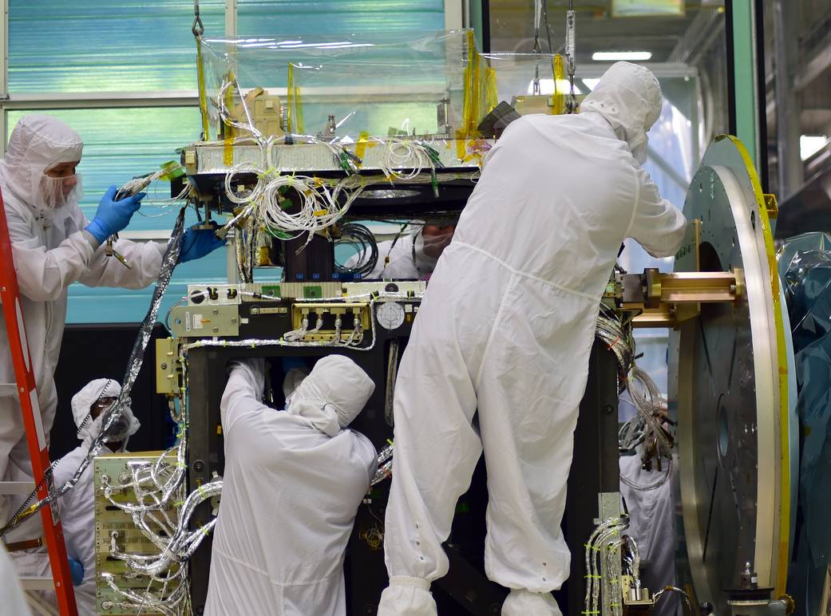
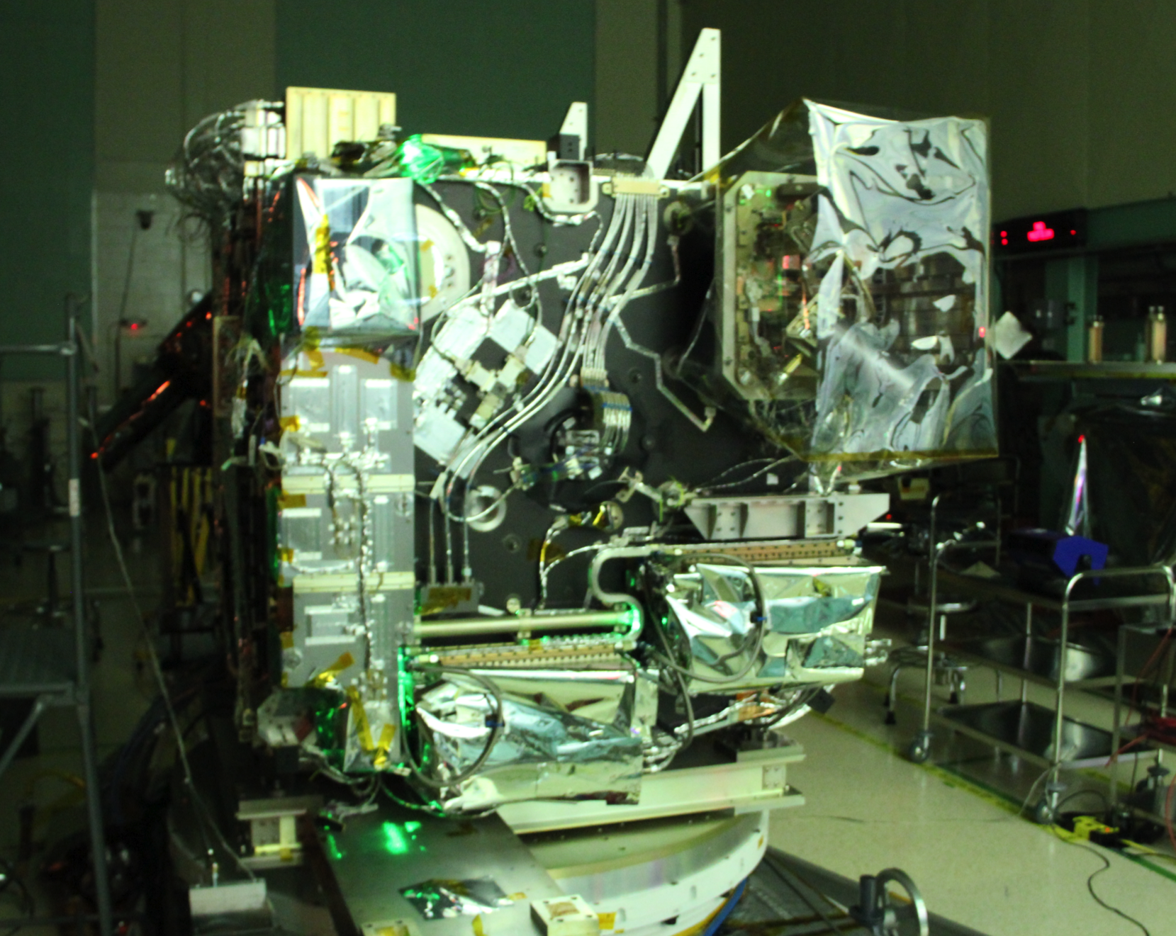
Accomplishments – ICESat-2
Ice, Cloud, and Land Elevation Satellite (ICESat-2) is designed to collect altimetric measurements of the Earth’s surface, optimized to measure the heights and freeboard of polar ice and global vegetation canopy.
Project undergoing integration and test
Launch: October 2017
ATLAS Instrument

Slide 15
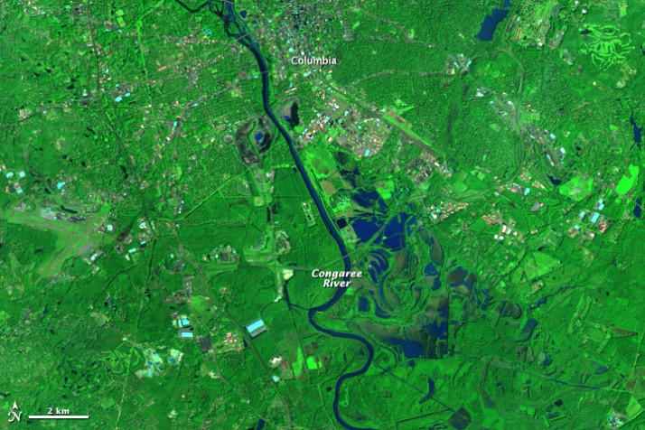
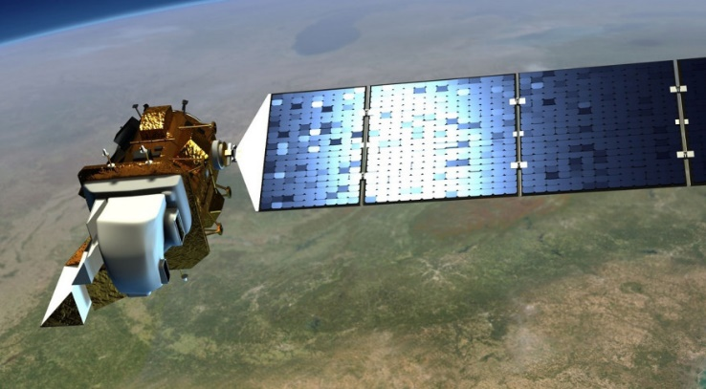
New Missions for GSFC – LANDSAT 9
LANDSAT 9 is in Phase A
Designed to provide continuity in the multi­‐ decadal land surface observations to study, predict, and understand the consequences of land surface dynamics
  Mission Definition Review scheduled for May 2016
Flooding Near Columbia, South Carolina

Slide 16
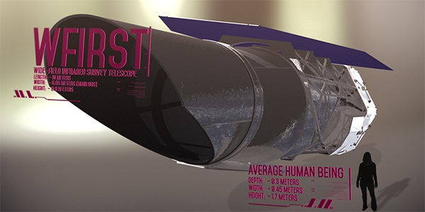
New Missions for GSFC - WFIRST
Wide Field Infrared Survey Telescope (WFIRST) is a NASA observatory designed to settle essential questions in the areas of dark energy, exoplanets, and infrared astrophysics
WFIRST Mission Concept Review successfully completed in December 2015
Key Decision Point A was held in January 2016
Baseline WFIRST Image

Slide 17
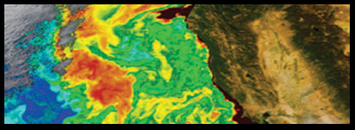
New Missions for GSFC - PACE
Pre-Aerosol, Clouds, and Ocean Ecosystem (PACE) mission will make global ocean color measurements to provide extended data records on ocean ecology and global biogeochemistry (e.g., carbon cycle) along with polarimetry measurements to provide extended data records on clouds and aerosols
PACE completed Mission Concept Review in March 2016

Slide 18
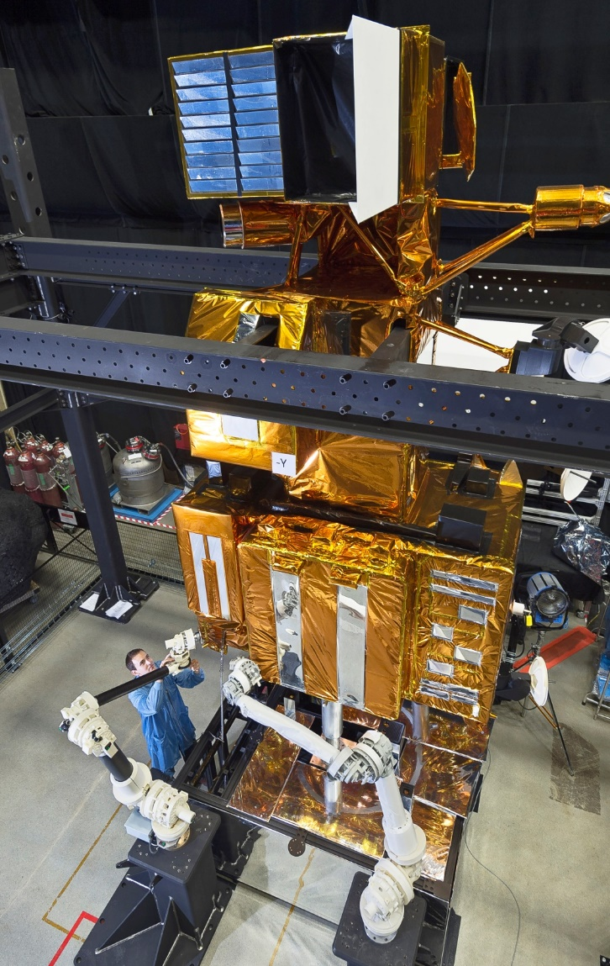
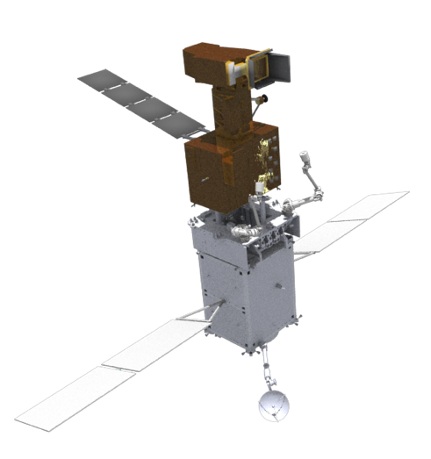
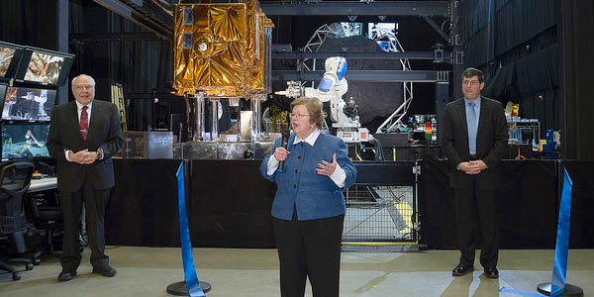
New Missions for GSFC – Restore-L
Restore-L will robotically refuel a Government-­‐owned satellite in low Earth orbit (LEO)
Restore-L Satellite Mission Preliminary Design Review held in December 2016
Restore-L Mission Concept Review held April 7-8, 2016
Restore Servicing Vehicle (RSV) (bottom, with conceptual Bus shown) mated to notional client (top)
Development work at GSFC with Landsat 7 as case study
Sen. Barbara Mikulski Officially Opens New Robotic Operations Center

Slide 19
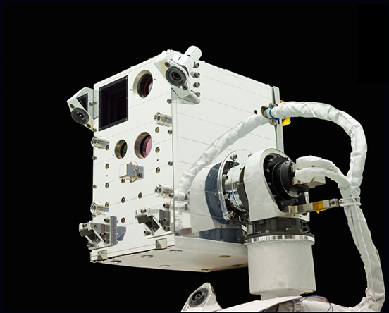
International Space Station Utilization
Neutron star Interior Composition ExploreR (NICER) study of neutron stars through soft X-ray timing
Completed Pre-Environmental Review and is in integration and test
Launch in January 2017
Raven (relative navigation tech demo) launches to the International Space Station in November 2016

Slide 20
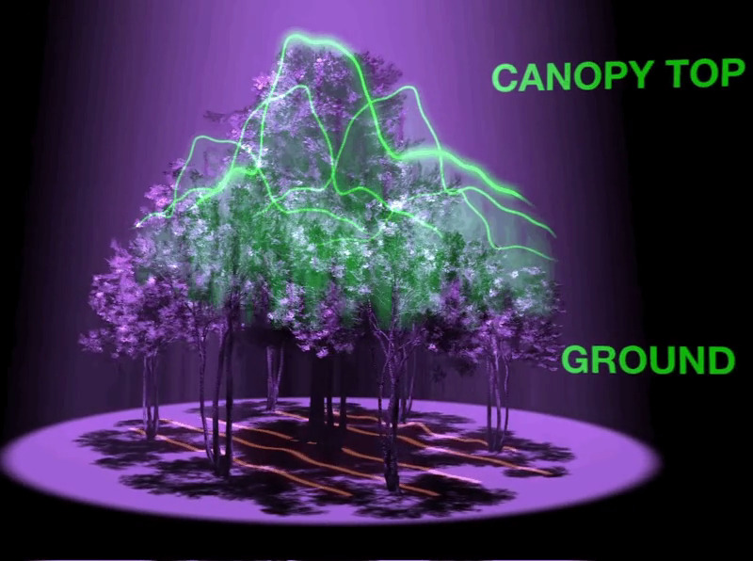
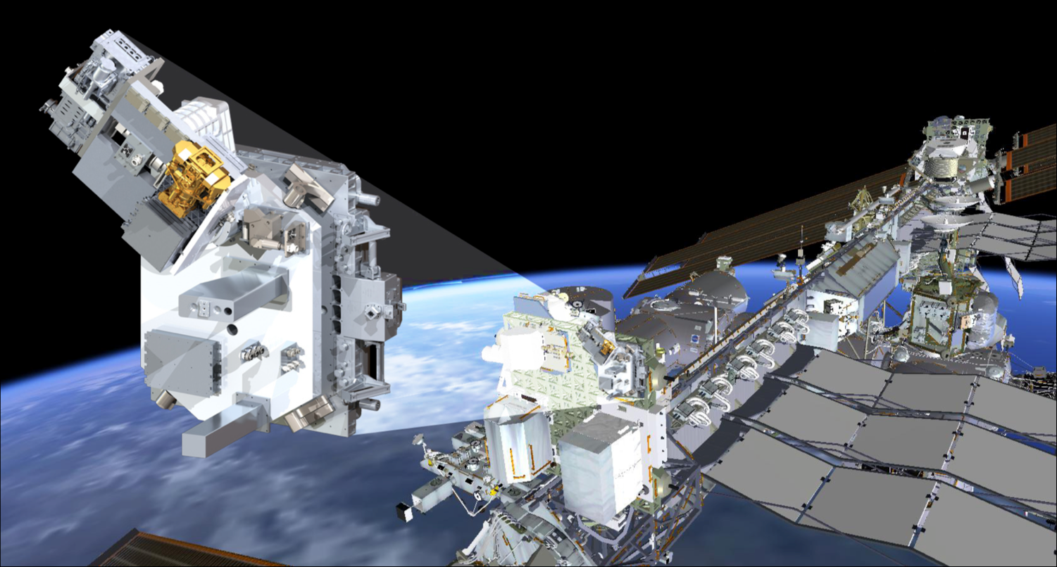
International Space Station Utilization
The scientific goal of the Global Ecosystem Dynamics Investigation Lidar (GEDI) is to characterize the effects of changing climate and land use on ecosystem structure and dynamics to enable radically improved quantification and understanding of the Earth's carbon cycle and biodiversity
Global Ecosystems Dynamics Investigation (GEDI) is in Phase B Preliminary Design Review held in March 2016
The Total and Spectral Solar Irradiance Sensor (TSIS-1) mission will provide absolute measurements of the total solar irradiance (TSI) and spectral solar irradiance (SSI), important for accurate scientific models of climate change and solar variability

Slide 21
Project Unique Challenges

Slide 22
Unique Flight Project Challenges
Problems and challenges arise even on the most well planned projects
Need both schedule and budget reserve to address unknown unknowns
    Need reserves to actively manage issues and concerns to minimize cost and schedule impacts
    Need reserves to mitigate risks
  Need to manage technical reserves and design margins
    Exceeding technical reserves and design margins may force
    re-designs, affect mission performance requirements, and/or deplete cost and schedule reserves

Slide 23
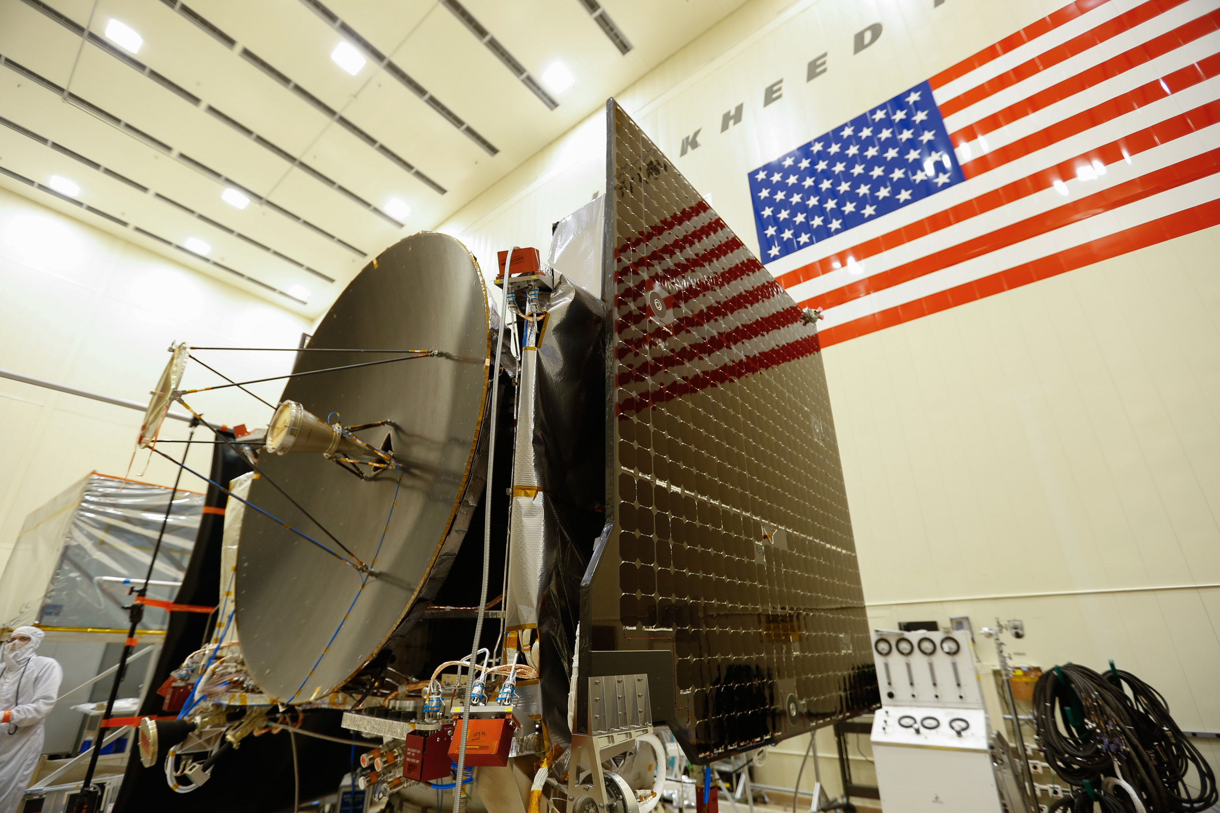
Challenges - Schedule
Meeting planetary windows bring hard deadlines
  May need to wait months or years for next launch opportunity
Origins, Spectral Interpretation, Resource Identification, Security-Regolith Explorer (OSIRIS Rex) completing environmental testing – Shipped to Cape Canaveral on May 20, 2016 – Launch window September 3 – October 12, 2016

Slide 24
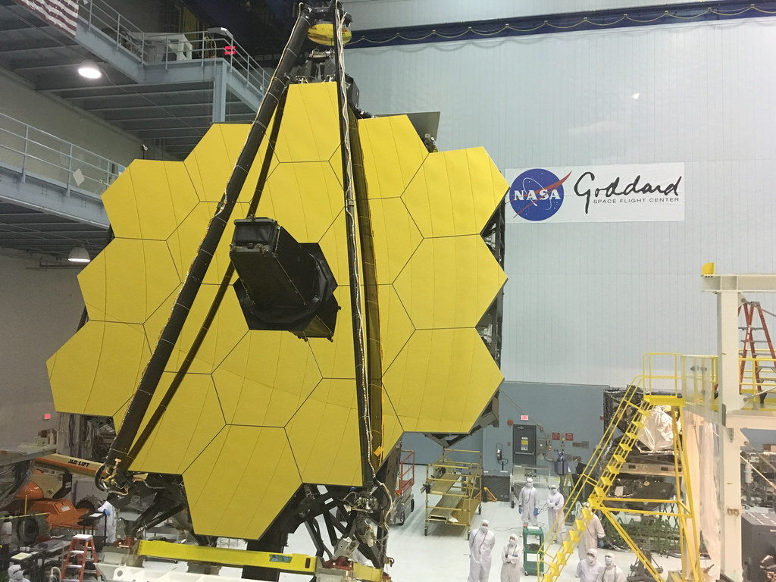
Challenge – Complex Design (1 of 2)
Satellites with complex designs and/or large scale pose unique challenges
  Drives schedule and cost
James Webb Space Telescope (JWST)

Slide 25
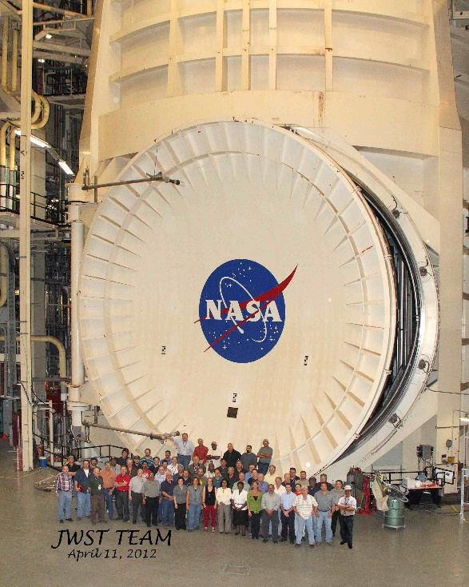
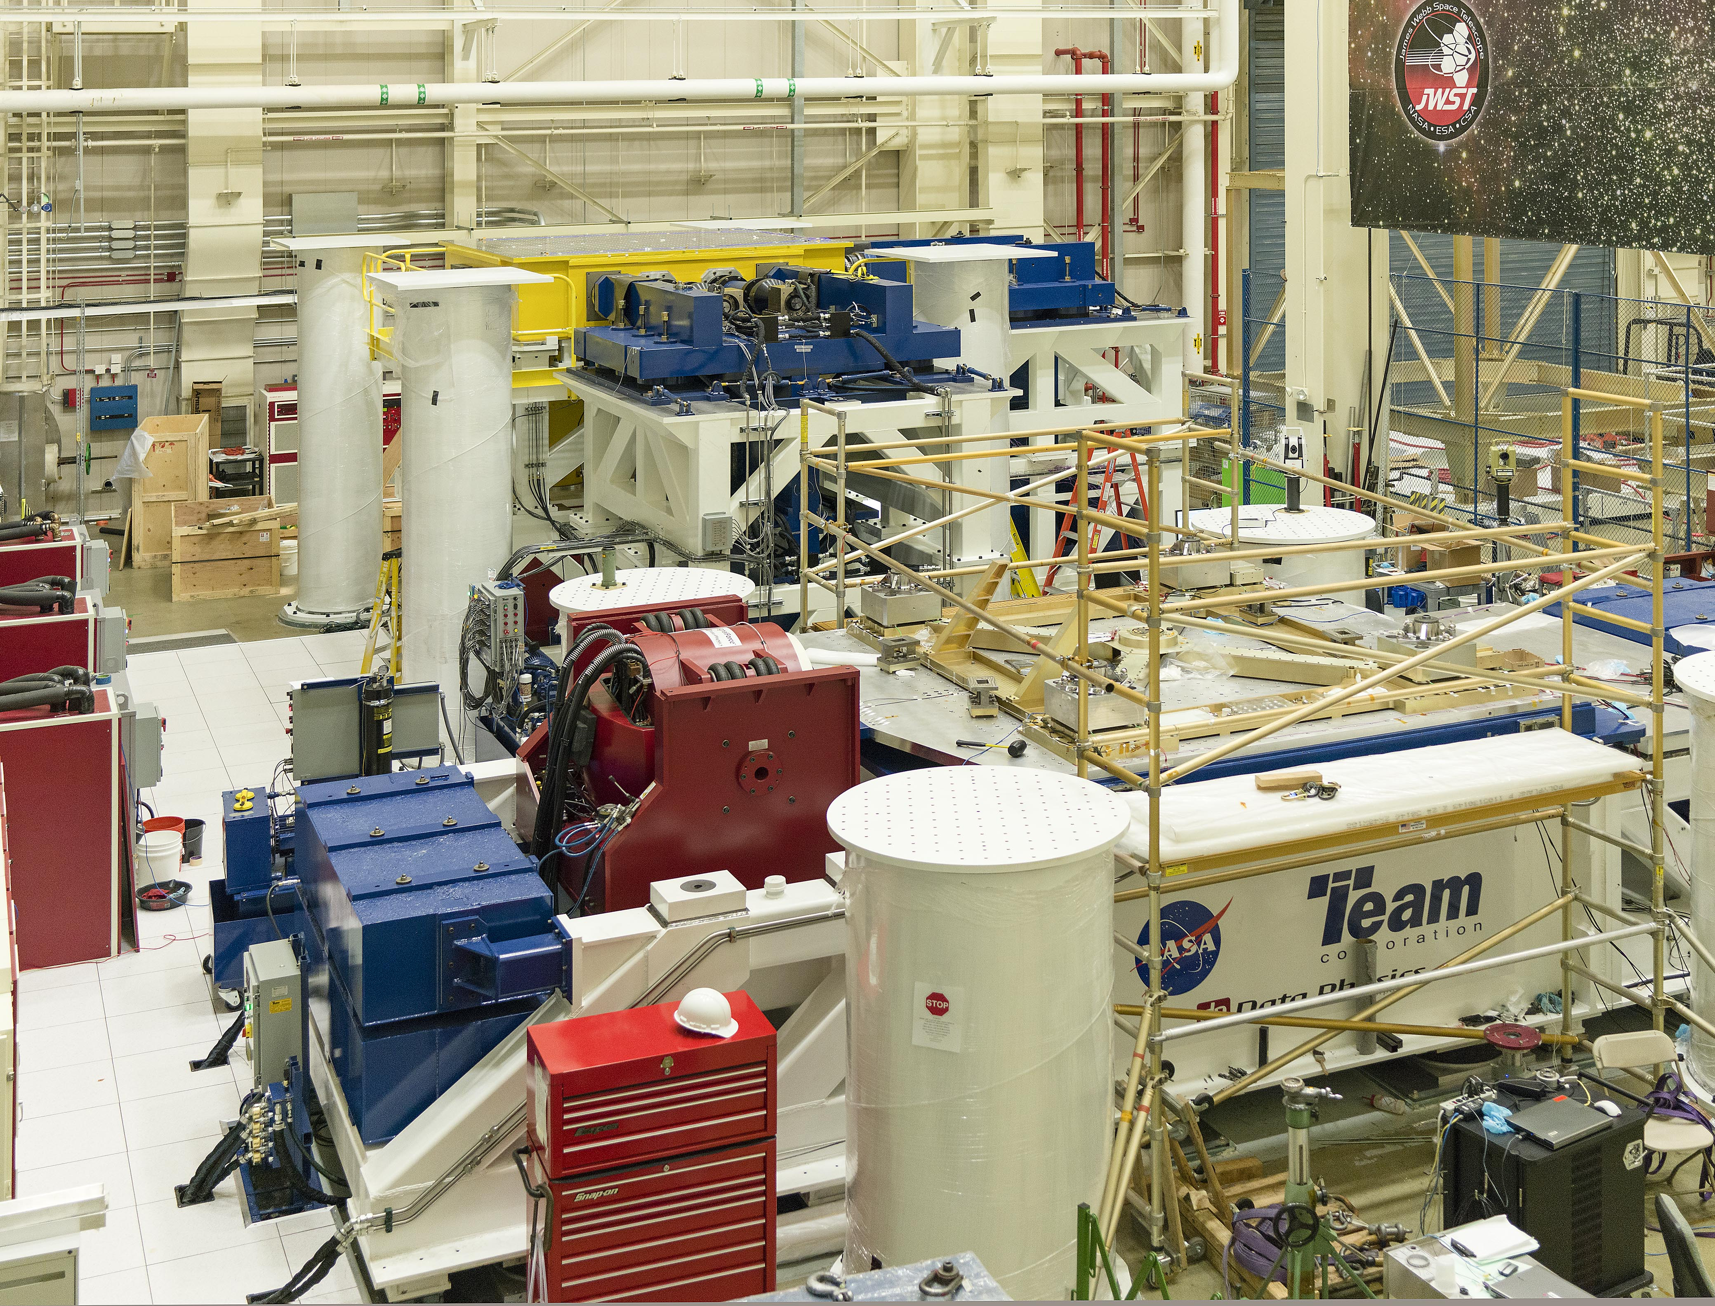
Challenge – Complex Design (2 of 2)
Satellites with complex designs may need unique or one-of-a-kind facilities and support equipment
Ground systems can also have complex designs and/or unique challenges
New vibration facility for James Webb Space Telescope (JWST)
JWST thermal vacuum testing to occur at JSC

Slide 26

Challenges – Mishaps
Major unplanned events often requiring a project “stand-down” and re-plan
Spacecraft mishap during integration

Slide 27


Challenges – Facility Conflicts
Schedule conflicts between projects using integration and test facilities
  May require building new facilities
  May require taking hardware to outside facilities
MMS conflict with JWST required MMS to go to Naval Research Laboratory for Thermal Vacuum testing
Facility conflicts also drove MMS to build their own cleanroom facility
JWST Integrated Science Instrument Module being lowered into the GSFC Space Environment Simulator Thermal Vacuum chamber

Slide 28
Challenges – Outside Partnerships
Partnerships with outside organizations can drive funding and schedule beyond the control of the GSFC project manager
Partners can also back-out of agreements
GSFC contribution to European ExoMars mission: Mars Organic Molecule Analyzer Mass Spectrometer (MOMA-MS)
ExoMars mission recently slipped launch 2 years from 2018 to 2020

Slide 29
Challenges – Procurement Delays
Delays in awarding procurements can increase cost, as well as decrease schedule margins
JPSS 2, 3, and 4 spacecraft experienced a delayed start as a result of a procurement protest

Slide 30
Challenges – Hardware Issues
Hardware issues can cause cost increases, schedule delays, re-designs, and re-plans
  Parts issues
    Parts not available
    Long lead items don’t meet mission schedule
    Parts may require test program
  Hardware issues
    Poor workmanship
    Failure during testing
    Behind schedule
    Exceeded budget
    Unexplained test results
    Late deliveries
Late hardware deliveries from suppliers

Slide 31


Challenges – Changing Requirements
There will be reasons to change requirements after they are baselined — budget cuts, changes in funding profiles, system upgrades, unplanned changes in an interface, or changes in a regulation or a standard, etc.
Requirements creep, both in the science and engineering areas must be minimized to stay on schedule and within budget
Landsat Data Continuity Mission (LDCM) - The Thermal Infrared Sensor (TIRS) instrument drove schedule

Slide 32


Challenges – Launch Vehicle Schedule
Delays in launch vehicle schedules use up funding and schedule reserves
Project manager needs to incorporate schedule and cost margin in budget for normal launch delays of a few weeks or months
    May need to re-plan and request more funding from Headquarters for longer delays
  Launch vehicle failures tend to cause long launch delays, as well as, backlogs in the manifest
MAVEN Launch on ATLAS V on November 18, 2013
DSCOVR launch on Falcon 9 rocket from Kennedy Space Center on February 11, 2015

Slide 33

Challenges – On Orbit Events
Orbital events can cause a loss of mission
STEREO mission experienced problems in October 2014
  Lost communications with one of the two spacecraft while in extended operations
Defense Meteorological Satellite Program (DMSP 19) broke up in orbit in February 2015
  Exploded while in a sun-synchronous polar orbit leaving a large debris field
Micrometeoroid impact to the MMS 4 spacecraft but all instruments and the spacecraft are still functioning
NASA monitors space debris and performs collision risk conjunction assessments (CARA)
  Routinely needs to move satellites to avoid collisions
STEREO Satellites during Spin Test

Slide 34

Challenges – Stakeholders
Key stakeholders often drive launch dates and funding, as well as ownership of mission between agencies
Stakeholders include Congress, Office of Management and Budget, science communities, and other agencies
Outcomes are often out of the control of the center and project manager
Deep Space Climate Observatory
Triana mission originally scheduled to launch in 2003
(NASA mission)
Storage from 2001 to 2013
Several attempts to revive mission
DSCOVR mission (formerly Triana) confirmation in 2013 with launch in 2015
(joint NASA/NOAA mission)
Landsat 9: Stakeholders driving launch readiness date
Same instruments/measurements – different prime mission focus (earth science to solar storm warning)

Slide 35


Mars Atmosphere and Volatile EvolutioN (MAVEN) Mission
MAVEN’s Lessons Learned

Slide 36



The MAVEN Project’s Journey
From proposal days…
Image Credit: Corby Waste, NASA-JPL
… to Science at Mars
SIR/ATLO Start
Extended
Mission
All major milestones, including launch, achieved on the schedule originally proposed in 2008 – and under budget!

Slide 37
Historical Perspective
The concept which became MAVEN was hatched in 2003 by one scientist from the University of Colorado/Boulder (eventual Principal Investigator [PI]) and two scientists from the University of California/Berkeley
The MAVEN PI asked Goddard to join the team in 2005. The MAVEN proposal was submitted in response to NASA Headquarters’ Scout II Announcement of Opportunity in 2006
MAVEN was one of 20 Step-1 proposals. Two were selected for a more-detailed feasibility or Phase A study
Following the competitive Phase A study, MAVEN was selected to move forward to flight in 2008
After a 1-year “risk reduction phase,” MAVEN transitioned to a 4-year development phase for launch. MAVEN was confirmed in 2010
MAVEN was included in the government shutdown in October 2013, less than 7 weeks from launch. Launch-preparation activities were restarted after 2 days
MAVEN launched on November 18, 2013. This was the first day of its 3-week launch period, and it launched at the first opportunity at the start of its 2-hour firing window that day. MAVEN entered Mars orbit on September 21, 2014
MAVEN launched on schedule, under budget, and with the full technical capability that was intended

Slide 38

Project Organization at Launch
Project resides within GSFC’s Flight Projects Directorate, Planetary Science Projects Division
Support from GSFC internal organizations, as well as NASA Headquarters, Jet Propulsion Laboratory, Kennedy Space Center, and industry partners is key
Note that MAVEN is a University of Colorado at Boulder-Laboratory for Atmospheric and Space Physics PI-led mission, with project management coming from GSFC
38

Slide 39






Major Partner Institutions
Berkeley,
CA
Boulder, CO
Littleton, CO
GSFC
Greenbelt, MD
Pasadena, CA
39

Slide 40
Project Management: Principles to Success
1. Establish a clear and compelling vision
  Create a clearly defined vision of the future that serves to inspire and motivate the project team which in turn provides an important first step in paving the road toward project success
2. Secure sustained support “from the top”
  Develop effective working relationships with key stakeholders at all levels
3. Exercise strong leadership and management
  Identify and develop other leaders and technical staff within the organization, define clear lines of authority and demand accountability
4. Facilitate wide open communication
  Listen and share the good, the bad and the ugly
5. Develop a strong organization
  Design and align culture, rewards, and structure
6. Manage risk/seek opportunities
  Employ a continuous and evolving risk-management process
  Look forward then exploit opportunities to reduce cost or schedule requirements through agile principles
7. Establish, maintain, and implement an executable baseline
  Develop clear, stable objectives/requirements from the outset; establish clean interfaces; track changes, implement corrective actions when necessary; and maintain effective configuration control
40

Slide 41



Lessons Learned from the MAVEN Journey
Rigorous tracking of metrics (cost, schedule, technical) is critical to keeping leadership aware of negative trends in order to react early
Verification Status (L1 & 2 Burndown)

Slide 42

Lessons Learned: Planning and Scheduling
From Phase A, top-level schedules established key milestones (Preliminary Design review, Critical Design Review, System Integration Review, Launch Readiness Date, etc.) that all organizations could use for lower level planning and pricing purposes
It is critically important to get out of the starting blocks quickly with proper project staffing. Brought the schedule lead, financial manager, and Earned Value Management (EVM) lead onboard at the beginning of the project to design a Work Breakdown Structure (WBS)-based schedule and EVM system – costs and schedule were monitored together
Held early face-to-face meetings with organizations supplying schedule and EVM data to set expectations and assess institutional capabilities. This created a collaborative environment

Slide 43

Lessons Learned: Schedule Execution
All schedules were reviewed 30, 60, and 90 days ahead
During each shift of key integration and test events, the product lead met with the team, quality control representatives, and the scheduler to review planned and completed activities and status
During mission integration and test
  At the beginning and end of every shift, team reviewed the daily and hourly schedule to prepare and execute assignments
  Daily schedule briefings were held. The team focused on tasks scheduled for the coming days and weeks. Problems were addressed, identifying workarounds to save schedule
  The project team acted with the mindset of “schedule is king” during every phase of the mission. The team had to, given the constrained planetary launch period
November 18, 2013

Slide 44

Lessons Learned from the MAVEN Journey
Stability of leadership through the project lifecycle is critical
Push to get front line managers in the project office that have strong hardware development experience
Maintain a sense of urgency throughout the project lifecycle even if your mission does not have a constrained planetary launch period. Time is money
Communicate, communicate, communicate with the project office, the PI, partner institutions, program office and NASA HQ; regular face-to-face interactions are critical. You/your team have to be road warriors
Transparency and openness with your team is critical. You want to hear about concerns early, not days before or after launch

Slide 45


Lessons Learned from the MAVEN Journey
Fight for sufficient cost reserves at the outset of the mission (and sufficient up-front funding and carryout). These cost reserves will be needed to address many of the unknowns during development
  Pressure to cut bid price during the competitive phase was rebuffed by the Principal Investigator and the Project Manager
  Descoped two instruments shortly before final proposal submission to ensure proper reserves
  Execution is much more efficient when the project remains green throughout development rather than going yellow or red
Resist requirements creep, both in the science and engineering areas
  A solid mission was proposed and we stuck to it even under pressure from various corners (e.g., add a camera, add a student instrument, add a “free” foreign instrument)

Slide 46
Lessons Learned from the MAVEN Journey
Transition into integration, test, and on-orbit operations (Phase CDE) on a project is a large effort. For a planetary project, any loss of schedule is critical. In an effort to expedite the CDE proposal process, the spacecraft contractor opened the lower level internal subsystem reviews to the Project prior to submittal of the Phase CDE proposal. The result was a delivered proposal that contained no surprises
Negotiate partner institution Phase C-E contracts before the Confirmation Review - MAVEN retired a significant cost growth risk and bounded the overall scope of effort
The spacecraft contractor and Project Office personnel traveled extensively together to kickoff meetings at vendor facilities. These meetings set expectations on how we wanted the vendors to operate
Heritage systems help but just as importantly you need the matching “heritage people” building the hardware (this isn’t always possible)
  In one case, a technician who built circuit boards for previous instruments retired and the replacement tech did not implement the correct high-voltage workmanship techniques because they hadn’t been documented

Slide 47


Lessons Learned from the MAVEN Journey
Spending money early to retire risk significantly reduced late surprises and overruns
There was a large amount of interest from external parties that impacted "normal" work. Be prepared for significant data requests, questions, audits. Staff accordingly
Brought the Joint Cost/Schedule Confidence Level (JCL) independent review team into the mix with the project 6 months before the Preliminary Design Review (PDR). This was significant in relieving any disconnects in the run up to Mission PDR and Confirmation Review

Slide 48
Lessons Learned from the MAVEN Journey
The first lesson in planning is that you can’t plan for everything.
We encountered plenty of issues on MAVEN that required us to assess the impacts and move forward with Plan B. Surprises along the way:
  Two instruments were delivered months late, during the year of launch
  Application of a new material in a heritage system (MetGlas) and impacts in I&T. Must fully evaluate new materials and their application prior to use
  Sequestration, with imposition of a travel cap in FY 2012 that threatened MAVEN’s approach to conducting business
  FY 2014 furlough beginning 7 weeks before scheduled launch and how we preserved MAVEN’s full launch period
  Removal of an instrument at the launch site for rework back at Goddard (the “Cannot Duplicate Problem” that surfaced again during launch preparations at KSC, and forced a late, tough decision)
  Comet Siding Spring – truly an “unknown unknown” when we bid the mission in 2008. This comet was discovered in January 2013 and drove a significant amount of analysis and mitigation planning and implementation for the October 2014 encounter
  Find opportunities to team build at frequent intervals and schedule in lessons learned opportunities during every phase of development

Slide 49

It is difficult to say what is impossible…
for the dream of yesterday
is the hope of today
And the reality of Tomorrow.
- Robert H. Goddard (1882 - 1945)

Slide 50
Questions?

