Slide 1
NSF and the Federal Budget
Michael Sieverts
Division Director, Budget Division
Office of Budget, Finance, and Award Management
U.S. National Science Foundation

Slide 2
Main Topics
Federal Budget: Some Basics
NSF Budget Process
NSF Appropriations
Current Events

Slide 3
Spending America’s Income
Broad revenue and spending categories in President Obama’s fiscal 2017 budget:
Where it comes from (receipts)
$3.6 Trillion
How it would be spent (outlays)
$4.1 Trillion
$608 billion: Defense
(Discretionary)
Individual income tax:
$1,788 billion
$625 billion: Non-Defense
(Discretionary)
Corporate income tax:
$419 billion
$967 billion: Social Security
$4.1 Trillion
Payroll tax:
$1,141 billion
$598 billion: Medicare
$303 billion: Interest on debt
Excise tax: $110 billion
Estate and gift tax: $22 billion
$386 billion: Medicaid
Customs duties: $40 billion
Other: $124 billion
$661 billion: Other
Deficit: $502 billion
Totals may not add due to rounding.

Slide 4
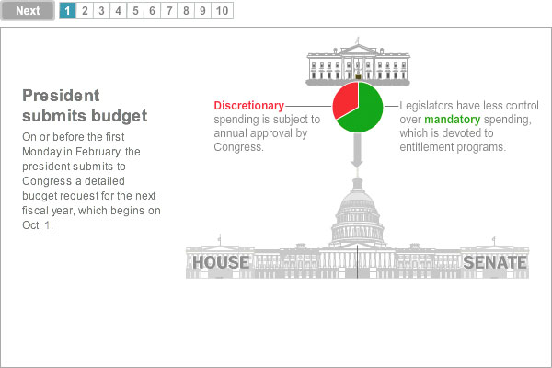
Source: Washington Post:
http://www.washingtonpost.com/wp-srv/special/politics/federal-budget-process/noFlash.jpg

Slide 5
Fields of Science and Executive and Legislative Decision Units
Connecting lines show location of budget decisions, but not decision sequences
Fields of Science
Departments & Agencies
House and Senate Appropriations Subcommittees
With significant R&D $
Defense
Engineering
Agency for International Development
Defense
Veterans Affairs
Physical Sciences
State & Foreign Operations
Energy
NRC
Military Construction & Veterans Affairs
Math & Computer Science
NASA
Energy & Water Development
NSF
Commerce, Justice & Science
Environmental Sciences
Agriculture
EPA
Agriculture & Related Agencies
Interior
Interior & Environment
Life Sciences
Transportation
Transportation & Related Agencies
Homeland Security
Psychology
Homeland Security
Justice
Housing & Urban Development
Financial Services & General Gov’t.
Social Sciences
Treasury
Labor, Health & Human Services, & Education
Commerce
Other Sciences
Health & Human Services
Education
Labor

Slide 6
Overview of Budget Process
Community Input
Prior Year Performance
Performance Reports
Committee of Visitors
Financial Audits
Strategic Plan
Internal Budget Development
Submission to OMB
Request to Congress
Develop Internal Allocations
Commit, Obligate, and Expend Funds
Evaluation
Planning
Execution
Formulation

Slide 7
Budget Planning Timeline
FY 2016
FY 2017
Dec 15
Jan 16
Feb 16
Mar 16
Apr 16
May 16
Jun 16
Jul 16
Aug 16
Sep 16
Oct 16
Nov 16
Dec 16
Jan 17
Feb 17
Mar 17
Commit, Obligate and Spend FY16 Funds
Financial Audit
FY 16
Budget
Cycle
Received FY16 Appropriation
Publish FY16 AFR
Develop FY17 Interim Operating Plan
Commit, Obligate and Spend FY17 Funds
Develop & Submit FY17 CP
FY 17
Budget
Cycle
Congressional Action on FY17
Receive FY17 Appropriation?
Submitted FY17 Budget to Congress
Develop underlying information
Develop FY18 Budget to Congress
NSB
Meeting
FY 18
Budget
Cycle
Leadership Retreat
NSB
Meeting
NSB
Meeting
Submit FY18
high level estimates to OMB
Election
Inauguration
Budget Formulation
Budget Execution
External Milestones/ Actions
Internal Milestones
Note: Timing of internal deadlines and appropriations fluctuates from year-to-year

Slide 8
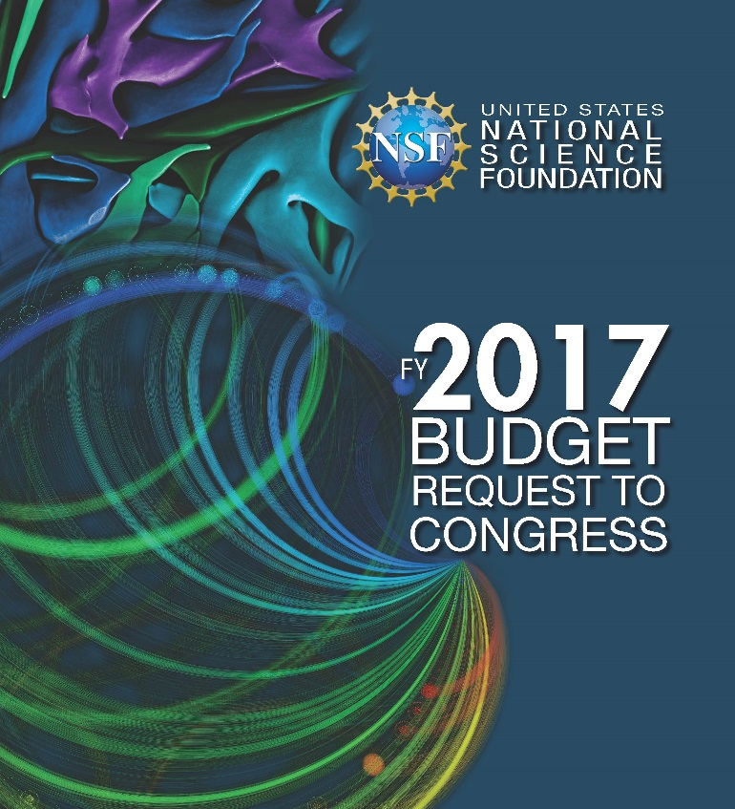
What is the “budget”?
Congressional Justification
Justification of Estimates of Appropriations to the Congress
NSF:
2 pages of appropriations language
~570 pages of “justification”
Know your pages
http://www.nsf.gov/about/budget/

Slide 9
NSF Budget
NSF Total Budget (FY 2016): $7.463 billion
NSF receives funding in six appropriations to finance its mission
Research and Related Activities (R&RA)
Education and Human Resources (EHR)
Major Research Equipment and Facilities
Construction (MREFC)
Agency Operations and Award Management (AOAM)
National Science Board (NSB)
Office of Inspector General (OIG)
Programmatic
Activities
Administrative
& Management
Activities

Slide 11
Program Accounts
R&RA & EHR:
Major Directorates and Offices.
~93% of Total Appropriation for NSF
MREFC:
Major facility projects
~3% of Total Appropriation for NSF

Slide 12
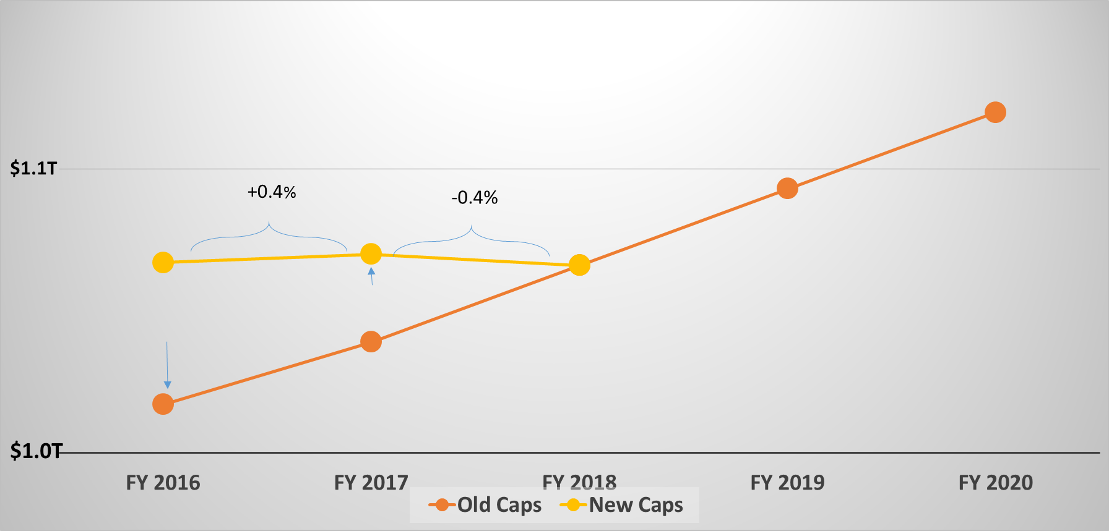
Current Events: Bipartisan Budget Act of 2015 (P.L. 114-74)
Discretionary Budget Caps
+3%
+5%

Slide 14
What is meant by mandatory funding?
Different category of Federal spending than NSF typically sees
Also known as “direct spending”
GAO Definition: budget authority that is provided in laws other than appropriations acts
Most commonly associated with entitlement programs (Social Security, Medicare, etc.) but also supports R&D
Not subject to discretionary caps
In FY 2017, the Administration is seeking legislation to provide mandatory funding for NSF on a one-time basis
Notes:
Slide 4: Michael

Slide 15
Congressional Action to Date
FY 2017 Budget Hearings in the House
House Appropriations, Subcommittee Commerce, Science, Justice March 16, 2016
House Committee on Science, Space & Technology March 22, 2016
Senate markup on April 21, 2016
House subcommittee markup on May 17, 2016
Congress not considering Administration’s proposal for new mandatory funding

Slide 16
Senate Mark-up

Slide 17
House Mark-up

Slide 18
Appropriations: Noteworthy Items
SENATE
Third Regional Class Research Vessel
GAO review of projects funded via MREFC account
Based on GAO review of NASA projects
NSB report re: facilities O&M
AOAM funding insufficient to cover relocation to Alexandria
HOUSE
No details yet
No Regional Class Research Vessel funding

Slide 19
Outlook
Uncertainty – Potential Outcomes….
Appropriations enacted by Oct. 1
-- OR --
Continuing resolution until after election or inauguration

Slide 21
For More Information
NSF Budgets – Budget and Performance link at bottom of nsf.gov
http://www.nsf.gov/about/budget/
http://www.nsf.gov/about/performance/
NSF Budget Primer - http://collaboration.inside.nsf.gov/bfa/Budget/Budget%20Process%20Primer/01_Primer_Introduction.aspx
NSF Budget Internet Information System (BIIS) - http://dellweb.bfa.nsf.gov/
NSF Enterprise Information System (EIS) –
http://budg-eis-01/eisportal/default.aspx
NSF Program and Financial Coding Manual FY 2016
https://inside.nsf.gov/tools/toolsdocuments/Inside%20NSF%20Documents/NSF%20Manual%2021.pdf

