Slide 1

Project Management Personnel
Certification
Budget, Finance, and Award Management
Large Facilities Office
May, 26 2016
Large Facilities Workshop 2016
S. Dillon Ripley Center
Washington, D.C.

Slide 2
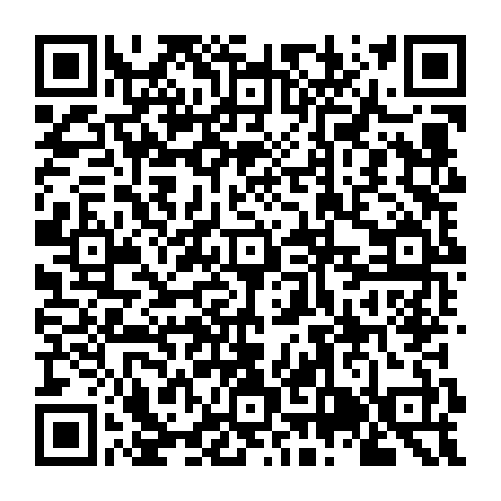
NATIONAL ACADEMY OF PUBLIC ADMINISTRATION
Use of Cooperative Agreements to Support
Large Scale Investment in Research
December 17, 2015
RECOMMENDATION 6.8
Notes:
Find the report here: http://www.napawash.org/reports-publications/1785-national-science-foundation-use-of-cooperative-agreements-to-support-large-scale-investment-in-research.html

Slide 3
Recommendation 6.8
KEY PERSONNEL
“To ensure that award recipients have the requisite project management experience and knowledge to successfully lead a MREFC project . . . .”
“NSF POs and G/AOs should work together to include project management certification and requisite experience requirements in cooperative agreements for MREFC projects.”
“NSF should require award recipient project managers to be certified in project management. NSF should also specify minimum project management experience thresholds for project positions.”

Slide 4
NAPA Likes and Dislikes and NSF PLANS
Likes - | Dislikes - | NSF Plans -
 | Agreements do not include certification requirements | Include qualifications requirements in agreements
PO and G/AO review key personnel |  | NSF would confirm qualifications

Slide 5
Questions
How do training (i.e., certificates) and certification differ in terms of costs and benefits?
Which roles on a project should demonstrate adequate qualifications?
  Project manager only?
  Others?
When would NSF require experience above and beyond that required by certifications?
What approach should NSF take to establishing equivalence?

Slide 6

Certificates vs. Certification
Certificates
  Documentation of completion of a short course in a particular subject
  Number of classes prescribed
    Core &
    Elective
  Offered through universities
  Online or in person
  High first costs but no ongoing costs
Certification
  Designation earned by an individual demonstrating attainment of a standard level of expertise, experience, and skills within the subject field.
  Applicants must have certain experience or other qualifications.
  Typically require passing an examination.
  Variable first and ongoing costs
    Prep class?
    Continuing professional development?

Slide 7
Certificates vs. Certification
 | Certificates | Certification
Pros | University-based Customizable Online or in person | Uniform requirements Recognizable 2 – 4 months
Cons | No experience needed Not standardized Not recognizable 6 months – 2 years | General experience accepted Passing a standardized test Test preparation
What else?
Note: The Uniform Guidance (2 CFR § 200.472 Training and education costs) states:
“The cost of training and education provided for employee development is allowable.”

Slide 8

Certificates
What must coursework include?
  Fundamentals
    Scoping
    Scheduling
    Budgeting
  Accounting
  Law
  Managing teams
  Cost control
  Risk
  Performance measurement
NOTE
NSF will not endorse specific providers
What else?
Notes:
NSF will not pick winners, but how should NSF prioritize establishing criteria for accepting certain certifications?

Slide 9

Certification
What should NSF consider in setting minimum standards?
  Knowledge Base
  Experience (quantity not quality)
  Cost (to obtain and maintain)
  Time (to obtain and maintain)
  Reputation and Notoriety
What else?
NOTE
NSF will not endorse specific providers

Slide 10
Certification
Prioritization Exercise
 | Knowledge Base | Experience | Cost | Time to obtain | Reputation
Knowledge Base | -- | : | : | : | : | : | :
Experience | : | -- | : | : | : | : | :
Cost | : | : | -- | : | : | : | :
Time to obtain | : | : | : | -- | : | : | :
Reputation | : | : | : | : | -- | : | :
 | : | : | : | : | : | -- | :
 | : | : | : | : | : | : | --

Slide 11


Who? Project managers & others?
- OR -
Project manager only
Project manager
Schedulers
Cost estimators
Systems engineers
Project controllers
Quality managers
Risk managers
Others?

Slide 12
Experience and certification
Rest assured . . . projects will remain responsible for personnel actions -
  Selections
  Releases
For this slide’s discussion, assume that NSF sets a certification requirement without a certificate option.
Would an analogous experience requirement over and above the experience required by a certification help projects?

Slide 13
Equivalence
Certifications
No equivalence issue. Certification requirements meet NSF requirements or not.
Certificates
No equivalence issue. Classes taken meet NSF requirements or not.
Experience
Equivalence issue. How will NSF establish equivalence?
By whom?
By when?
Program Officer?
Stage gate reviews?
Professional judgement by -
NSF Internal Panel?
Routine reviews?
External Panel?
As needed?

Slide 14
Next steps
Slides posted on the workshop Web page
Notes from the session included in the workshop proceedings
NSF will hold internal discussions and may follow up with the community
The Large Facilities Manual (18-XX) will identify options and criteria –
  NSF will publish a public comment draft in April 2017 with comments accepted for three months
  NSF will publish the final Large Facilities Manual in October 2017 to take effect in January 2018.
For more information:
Ivan Graff
Large Facilities Advisor
(703) 292-4416
igraff@nsf.gov

Slide 15
Backup
Certification Providers

Slide 16






Project Management Certifications
Project Management Professional
Certified Project Manager
Professional in Project Management
Master Project Manager
Certified Project Manager
Certified Construction Manager
Notes:
Project Management
http://www.pmi.org/certification/project-management-professional-pmp.aspx
http://www.ipma.world/certification/
http://projectmanagementcertification.org/masterprojectmanager.html
http://www.iappm.org/cpm.htm
http://www.gaqm.org:8080/gaqm/certifications/showcertcontent?autopk=2
http://cmaanet.org/certified-construction-manager-ccm

Slide 17



Cost Estimating and Engineering
Certified Cost Estimator/ Analyst
Certified Estimating Professional
Certified Cost Professional
Certified Professional Estimator
Notes:
Cost Estimating and Engineering
http://www.iceaaonline.com/certification-matters/the-certification-program/
CCP: http://www.aacei.org/cert/whatCertOffers.shtml
CEP: http://www.aacei.org/cert/whatCertOffers.shtml
https://www.aspenational.org/?page=AppsBrochures

Slide 18

Project Controls (Scheduling & EV)
Scheduling Professional
Project Scheduling Professional
Earned Value Professional
Certified Project Control Officer
Earned Value Management Professional
Notes:
Project Controls (EVMS & Scheduling)
http://www.evmi.com/cpco
http://www.pmi.org/certification/scheduling-professional-sp.aspx
EVP: http://www.aacei.org/cert/whatCertOffers.shtml
PSP: http://www.aacei.org/cert/whatCertOffers.shtml

Slide 19

System engineering Certification
Certified System Engineering Professional
Notes:
Systems Engineering
http://www.incose.org/certification

Slide 20

Quality Assurance and control
ISO 9001 Certified Internal Auditor
Certified Manager of Quality
Certified Quality Engineer
Notes:
Quality Assurance and Control
http://www.gaqm.org:8080/gaqm/certifications/iso-90012008-certified-internal-auditor
http://asq.org/cert/manager-of-quality/right-for-you
http://asq.org/cert/quality-engineer/right-for-you

Slide 21

Risk Management Certifications
Risk Management Professional
Certified Risk and Crisis Manager
Notes:
Risk Management
http://www.pmi.org/certification/risk-management-professional-rmp.aspx
http://www.gaqm.org:8080/gaqm/certifications/showsubcontent?subcategoryid=10

