Slide 1
SMITHSONIAN LESSONS LEARNED PROGRAM
Si-NSF large facilities workshop
May 25, 2016
Notes:
Good morning! I’m Jim Yuengert from Program Management, and we’ll be talking with you for the next hour about the lessons learned program.

Slide 2
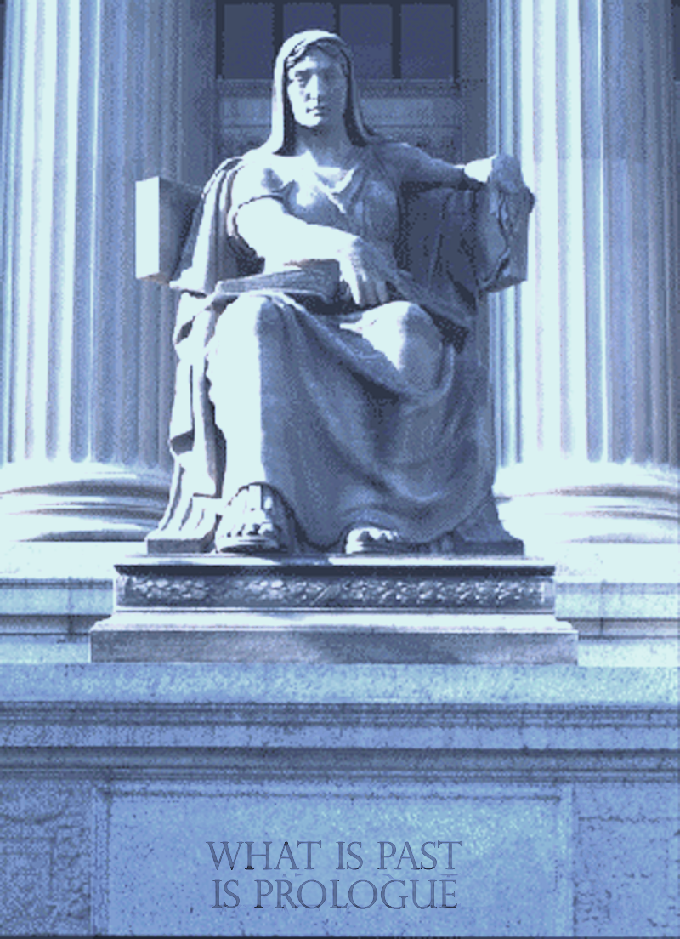
Lessons of History
“What is
past is
prologue.”
Notes:
National Archives photo

Slide 3
“Those who do not learn from history are doomed to repeat it.”
- Santayana
CAN YOU AFFORD NOT TO LEARN FROM PAST EXPERIENCE?
“Insanity is doing the same thing over and over and expecting different results.”
- Ben Franklin
Notes:
Can your organization afford not to learn from past experiences?
Ben Franklin quote: Insanity is doing the same thing over and over and expecting different results.
Lessons Learned can help you bring value to your changing global landscape/organization?

Slide 4
SMITHSONIAN LESSONS LEARNED PROGRAM
AGENDA
Program Evolution
Lessons Learned Process
Lessons
Comments/Questions
Notes:
I’m going to spend a few minutes updating you on the development of the process. I’m working together with Evi Oehler, Karen Swanson, Sylvia Kendra and lots of others to put together a process that will be useful to us in learning lessons.
We’re then going to try out a couple of different techniques to get the work out on lessons learned. Terry Hatchett will debrief you on a project he’s completed in the Quad. Then the NPM team is going to tell you the results of process we used to learn lessons on the Postal Museum gallery expansion.
I’ll finish by giving you a chance to comment and letting you know next steps in the development of the process.

Slide 5
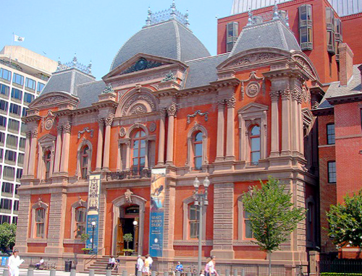
SMITHSONIAN LESSONS LEARNED PROGRAM
PROGRAM EVOLUTION
CII – 2007 Research Team Co-Chair
  State of the industry
  Jump-start guide
Facilities Unit Goal - 2013
  Form Task Force
  Survey
  Develop plan
Notes:
Simple slide – we can either collect lessons as a team, or can input lessons as individuals. We’ve chosen projects to do a formal collection program, but that doesn’t mean we aren’t learning lessons on other projects.

Slide 6
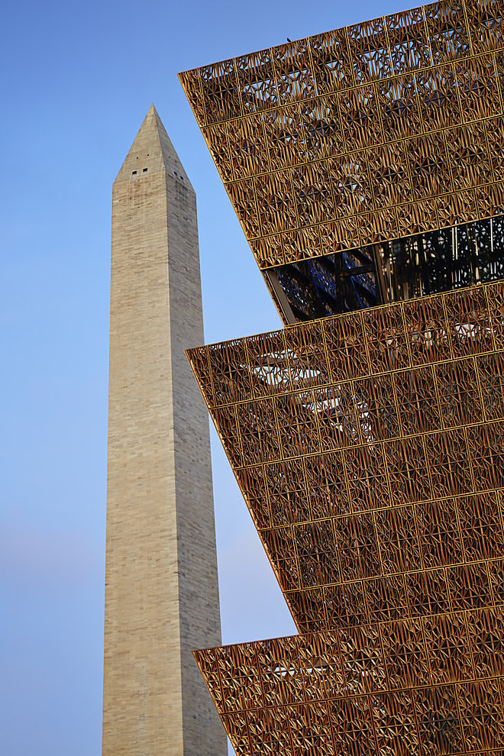
SMITHSONIAN LESSONS LEARNED PROGRAM
PROGRAM EVOLUTION
  Lessons Learned Process Elements
    Leadership
    Culture
    Lesson Collection
    Lesson Analysis
    Lesson Implementation
    Resources
    Maintenance and Improvement
Notes:
Here are the 7 elements of our process. We have the direction and vision from our director, and the active interest and participation from our deputy and associate directors. Culture is critical – identifying lessons and doing something with them as a matter of course. We’ll talk more about collection, analysis and implementation next. We’re developing a program without adding resources. Using Geospatial’s Dbase coordinator to help us, but the collection, analysis and implementation are all on us. Once we get a program up and running, we’ll worry about maintenance.

Slide 7
SMITHSONIAN LESSONS LEARNED PROGRAM
PROGRAM EVOLUTION
2014 Pilot Program
  Data Base Selection and Development
  ID Pilot Projects
  Collections Templates and Methods
Notes:
Simple slide – we can either collect lessons as a team, or can input lessons as individuals. We’ve chosen projects to do a formal collection program, but that doesn’t mean we aren’t learning lessons on other projects.

Slide 8
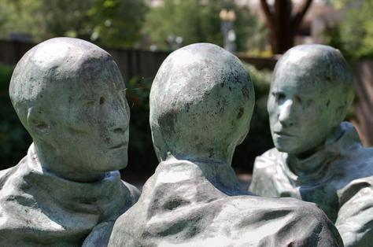
SMITHSONIAN LESSONS LEARNED PROGRAM
COLLECTION
Collection Template
  Lesson Learned
  Background
  Executive Action
  Admin Info
Data Base
  Existing Document Locator DB
  BIM Wiki Site
  Searchable
Notes:
Simple slide – we can either collect lessons as a team, or can input lessons as individuals. We’ve chosen projects to do a formal collection program, but that doesn’t mean we aren’t learning lessons on other projects.

Slide 9
SMITHSONIAN LESSONS LEARNED PROGRAM
COLLECTION
Collection Process
  Specific Projects
    From Integrated Facilities Teams
    Project Type and Phase
    Museum Input
    Contractor and Consultant Input
  Individual collection
Notes:
Simple slide – we can either collect lessons as a team, or can input lessons as individuals. We’ve chosen projects to do a formal collection program, but that doesn’t mean we aren’t learning lessons on other projects.

Slide 10
SMITHSONIAN LESSONS LEARNED PROGRAM
ANALYSIS
Analysis teams
  5-6 volunteers from SI Facilities staff
  Review 20 lessons
  Sort into action folders
  Develop suggested Executive Action
Notes:
We don’t want to just collect lessons – we want to do something with them. We’re going to ask for volunteers to participate in reviewing the lessons once we populate the data base. Every quarter we will look at lessons and decide what to do with them. What are the trends? What lessons are so important that we need to act immediately? What changes do we need to make in our project management processes?

Slide 11

SMITHSONIAN LESSONS LEARNED PROGRAM
ANALYSIS
Action Folders
  Review Panel
  External Action
  Change to tech requirements
  Change to Process
  Pre-project Checklist
  Newsletter
  Return/Rewrite
  No Action - Archive
Notes:
We don’t want to just collect lessons – we want to do something with them. We’re going to ask for volunteers to participate in reviewing the lessons once we populate the data base. Every quarter we will look at lessons and decide what to do with them. What are the trends? What lessons are so important that we need to act immediately? What changes do we need to make in our project management processes?

Slide 12
SMITHSONIAN LESSONS LEARNED PROGRAM
IMPLEMENTATION
Implementation Presentations
  Senior Leadership Briefings
  12 lessons
  Document decisions
  Track actions
SI Facilities Quarterly Newsletter
  Three lessons
  Credit submitters!
Notes:
We’re debuting a couple of ways to publicize lessons today, with a project debrief and a summary of what we learned on the Postal Museum project. Part of developing the culture is talking about lessons every chance we get.
Part of the process will be identifying the most important lessons and putting them in a newsletter or technical bulletin to distribute to all hands.
A third way is to develop a list of lessons that a project team should review at the beginning of a project. Maybe the checklist is specific to a particular type of project, or to a building.
We want to ID lessons that need to go into the next version of our design guide, or into the PM handbook.

Slide 13
SMITHSONIAN LESSONS LEARNED PROGRAM
ACCOMPLISHMENTS
  270 lessons collected
  210 lessons analyzed
  27 lessons presented for implementation
Notes:
We’re debuting a couple of ways to publicize lessons today, with a project debrief and a summary of what we learned on the Postal Museum project. Part of developing the culture is talking about lessons every chance we get.
Part of the process will be identifying the most important lessons and putting them in a newsletter or technical bulletin to distribute to all hands.
A third way is to develop a list of lessons that a project team should review at the beginning of a project. Maybe the checklist is specific to a particular type of project, or to a building.
We want to ID lessons that need to go into the next version of our design guide, or into the PM handbook.

Slide 14
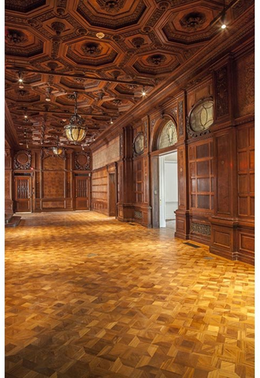
SMITHSONIAN LESSONS LEARNED PROGRAM
LESSONS
Cooper Hewitt Museum Renovation
  Design exhibits concurrently
  with infrastructure
  Install stand-alone temporary
  fire alarm system
  Closely coordinate museum
  re-opening dates
Notes:
We’re debuting a couple of ways to publicize lessons today, with a project debrief and a summary of what we learned on the Postal Museum project. Part of developing the culture is talking about lessons every chance we get.
Part of the process will be identifying the most important lessons and putting them in a newsletter or technical bulletin to distribute to all hands.
A third way is to develop a list of lessons that a project team should review at the beginning of a project. Maybe the checklist is specific to a particular type of project, or to a building.
We want to ID lessons that need to go into the next version of our design guide, or into the PM handbook.

Slide 15
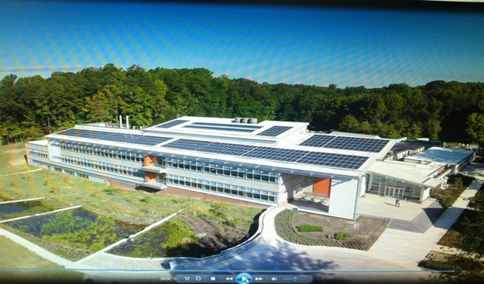
SMITHSONIAN LESSONS LEARNED PROGRAM
LESSONS
Mathias Lab Construction
Coordination of drawings; more attention required
Never assume that all
previous HAZMAT
abatement has been
completed. Cheaper
to test and confirm.
Sustainability initiatives don’t necessarily lead to customer satisfaction.
Notes:
We’re debuting a couple of ways to publicize lessons today, with a project debrief and a summary of what we learned on the Postal Museum project. Part of developing the culture is talking about lessons every chance we get.
Part of the process will be identifying the most important lessons and putting them in a newsletter or technical bulletin to distribute to all hands.
A third way is to develop a list of lessons that a project team should review at the beginning of a project. Maybe the checklist is specific to a particular type of project, or to a building.
We want to ID lessons that need to go into the next version of our design guide, or into the PM handbook.

Slide 16
SMITHSONIAN LESSONS LEARNED PROGRAM
LESSONS
    Questions?
Notes:
We’re debuting a couple of ways to publicize lessons today, with a project debrief and a summary of what we learned on the Postal Museum project. Part of developing the culture is talking about lessons every chance we get.
Part of the process will be identifying the most important lessons and putting them in a newsletter or technical bulletin to distribute to all hands.
A third way is to develop a list of lessons that a project team should review at the beginning of a project. Maybe the checklist is specific to a particular type of project, or to a building.
We want to ID lessons that need to go into the next version of our design guide, or into the PM handbook.

