Slide 1
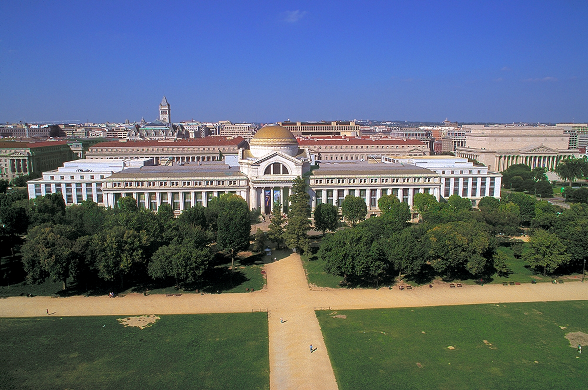
Notes:
Built in 1910, the National Museum of Natural History is the most visited museum in the world with more than 7 million visitors annually and an additional 10 million visitors to our web site. There are over 600 staff members including research curators and collections managers in 6 departments- paleobiology, botany, zoology, anthropology, entomology, mineral science.
The Museum maintains more than 145 million natural science specimens and cultural artifacts. Approximately 3.5 million artifacts are on loan to other cultural institutions each year.
Our mission is to inspire curiosity, discovery and learning about nature and culture through outstanding research, collections, exhibits and education.

Slide 2
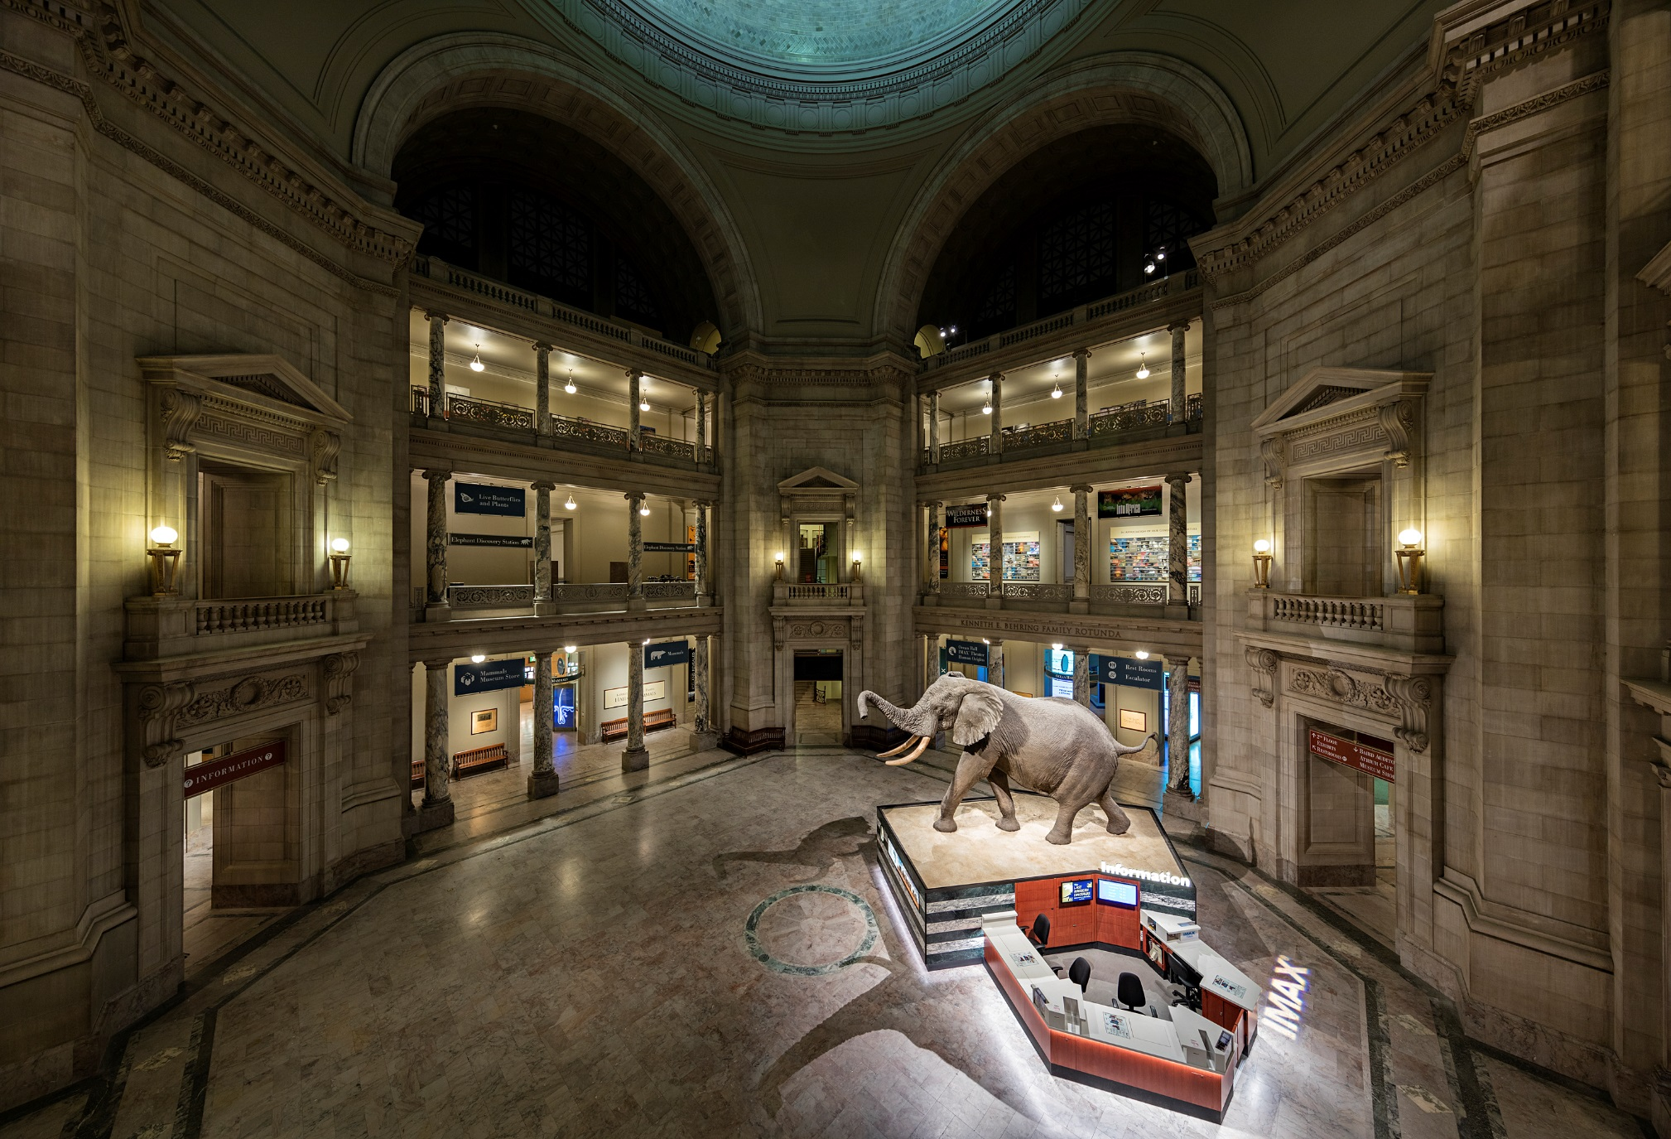
Notes:
Educational Foundation
Our visitors come here, for the most part, voluntarily and at their leisure seeking entertainment.
Our challenge is to create enjoyable experiences that will capture their interest long enough for reflection, dialogue, and learning to take place.
At the Museum an exhibit is a functional educational tool that has a well‑defined audience in mind, and a clear intention to change that audience's knowledge, feelings, beliefs, and attitudes in very particular ways.
It is this commitment to engaging and changing, and not just distracting or entertaining people, that distinguishes us as an educational and scholarly collections‑based institution.

Slide 3
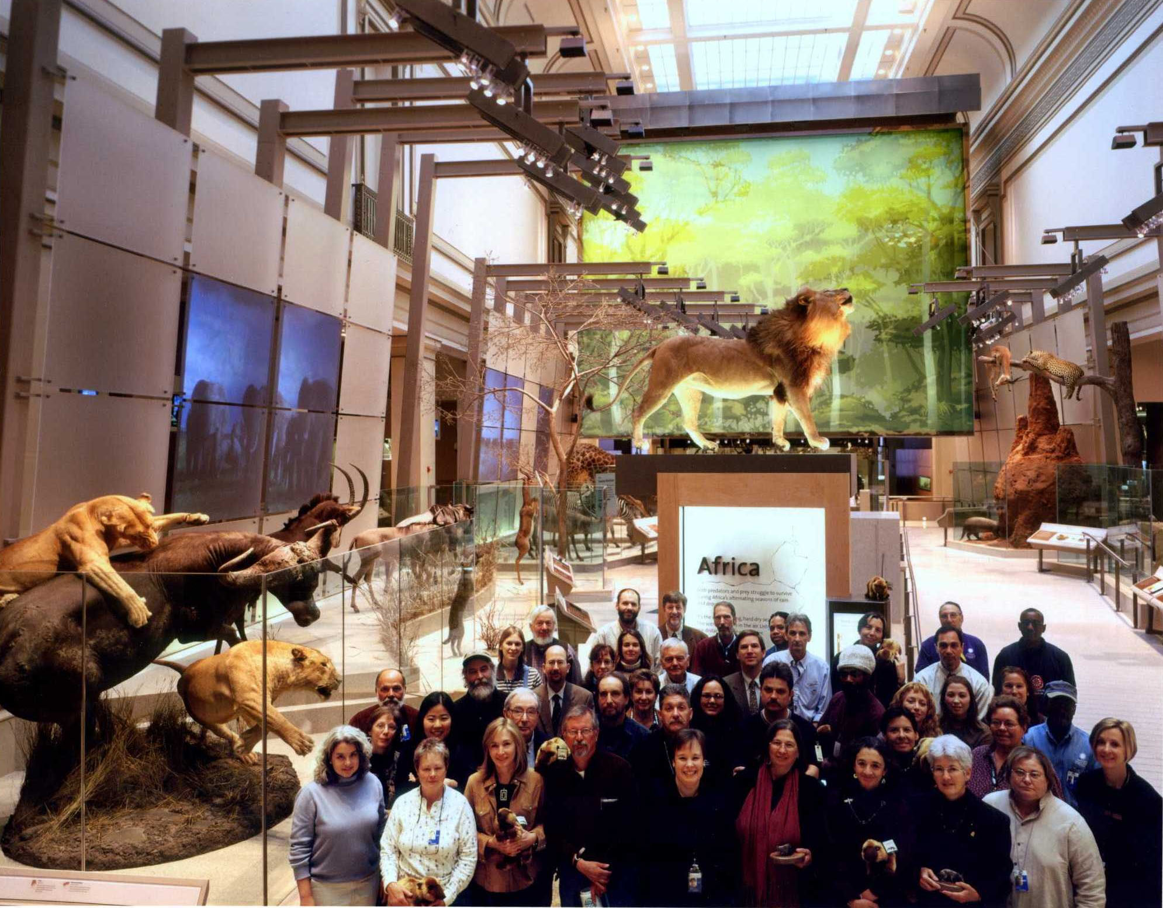
Notes:
DEVELOPING EXHIBITS
There are several guiding principles we use in planning exhibits.
We believe exhibits must be relevant. They must address idea and issues relevant to the museum’s mission and lives of our visitors
They must be accurate, authentic and current providing direct contact with real objects
They must be respectful and balanced. Recognizing different points of view and acknowledging the many ways of knowing and explaining the world
They must be scholarly and detailed motivating visitors to discover, understand and preserve the natural and cultural world
They must be engaging- both visually and verbally- an exhibit’s look, feel, words, and techniques‑‑must attract and hold the visitor’s attention and strive to inspire further inquiry or influence individual beliefs or behavior. Elegantly designed and compellingly written, exhibits are potent educators
They must be accessible, physically and intellectually. The exhibit design and content must recognize the varying physical needs and intellectual experience of visitors. Exhibits should also recognize and take advantage of different learning styles and employ experiential approaches. All of our exhibits are written to the level of popular newspapers.
They must be proven effective with sound evaluation and measurement of outcomes Our exhibit process is characterized by persistent interactions with community groups, scholars, audience members, and staff to be certain relevant ideas, views, and attitudes are actively included in both the process and end‑products of the Museum

Slide 4
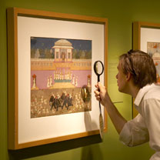


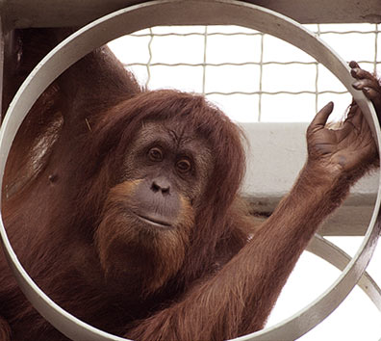
Classifying the Exhibit
From “Exhibitions and their Audiences: Actual and Potential”, SI Office of Policy and Analysis, September 2002
Exhibition as Artifact Display
Exhibition as Visitor Activity
Exhibition as Communicator of Ideas
Exhibition as Environment
Smithsonian Institution
National Museum of Natural History
Notes:
Large Exhibition, Large Audience
Should encompass universal themes with widespread relevance
Topic should be clear and quickly recognizable
Topic should tap into broad base of prior interest and commonality of experience
Topic should afford ample personal connections and past/present comparisons
Exhibits can contain all these models in varying degrees.

Slide 5
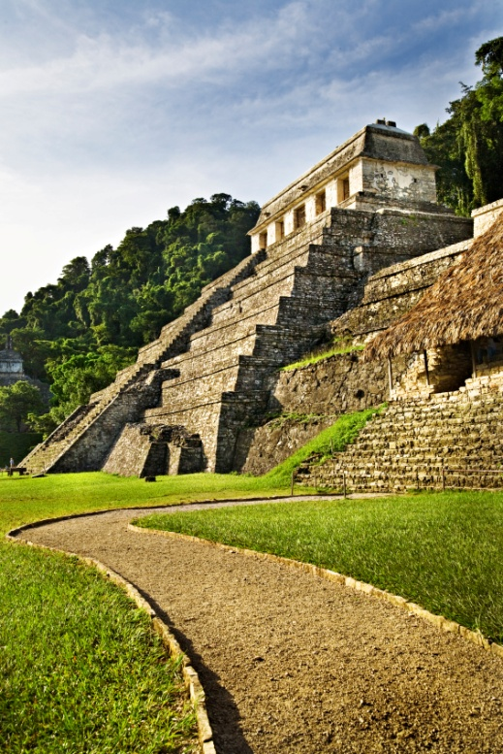

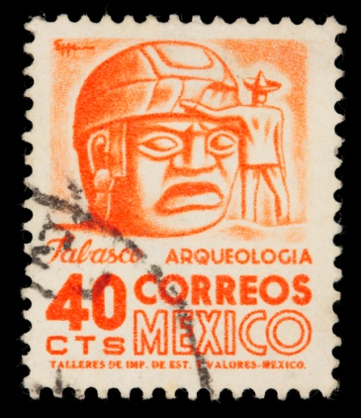

Classifying the Exhibit
Chronological
Hybrid
Thematic
Smithsonian Institution
National Museum of Natural History
Notes:
During the exhibit planning process, we address national educational standards for scientific literacy; cultural and gender equity; and ecological education.
We have a commitment to be in close touch with our visitors' educational needs, expectations, and learning styles
One of our educational goals is to create a responsible citizenry and to encourage and nurture creative future scientists.
Our exhibits MUST have impact that affects broad‑based and diverse audiences.

Slide 6
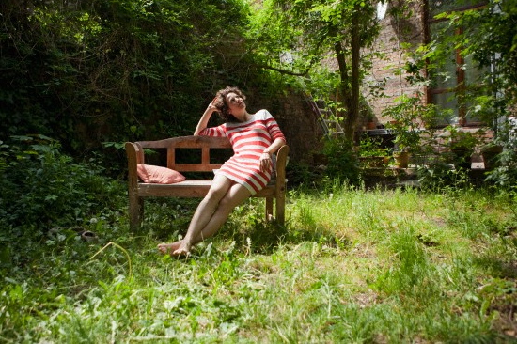
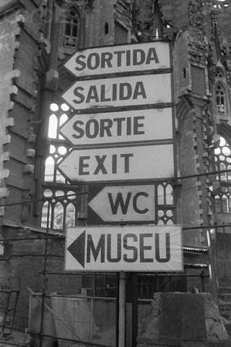

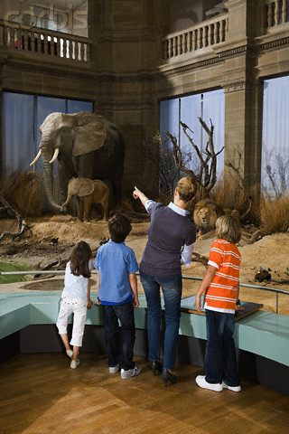
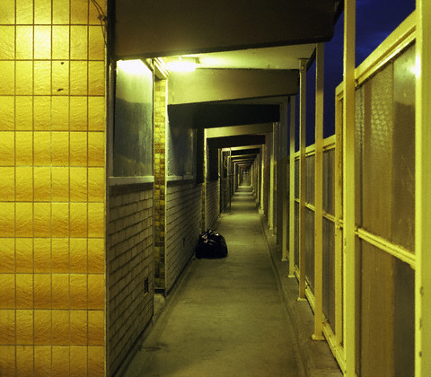
Accommodating visitor needs and wants
Fostering shared experiences
Learning from Architecture and Urbanism
Smithsonian Institution
National Museum of Natural History

Slide 7
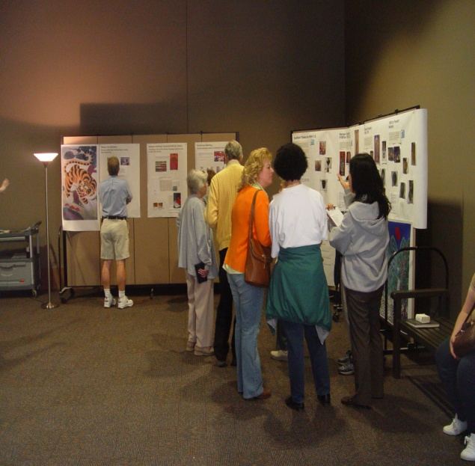
Determining Target Audiences
Families, teens, tourists, connoisseurs?
What are their needs, wants, interests?
Smithsonian Institution
National Museum of Natural History
Notes:
Before we begin developing an exhibit and during the development process, we utilize visitor testing to determine more effective ways of delivering content. We try to anticipate and answer visitor questions, and most importantly we alter the content and the approach to exhibits if visitors just don’t seem to understand.
The process begins with the development of a Statement of Purpose- the document that will identify the primary and secondary audiences for the exhibit, primary attitudes, feelings , beliefs and/or knowledge that the exhibit will change for that audience.
Important because it frames the specific intent of the exhibit and provides the criteria for judging the effectiveness of the eventual script and design of the exhibit.

Slide 8
Appropriate Design
Associative words & images
Thought-Provoking
elegant
PATRIOTIC
authoritative
Historically Correct
Inviting
Dynamic
Kid-friendly
Definitive
Exotic
Sociable
Smithsonian Institution
National Museum of Natural History
Notes:
Certain basic functions have to be fulfilled in the course of developing any exhibit.
They are
1) managing content and story line,
2) creating design,
3) effectively communicating ideas,
4) managing and administering the exhibit project to coordinate and maintain progress on the first three and deliver the exhibition on time and within budget.
In order to do this effectively, we work in teams.

Slide 9
Developing Thematic Zones
Allocating areas
Content/Theme
Zone 3
Content/Theme
Zone 1
[transition]
Content/Theme
Zone 4
Content/Theme
Zone 2
Introduction
Conclusion
Smithsonian Institution
National Museum of Natural History
Notes:
A core team of exhibit planners and producers collaborate directly with scientists and curators of the museum ensuring that story line, content, and communication goals meet our high intellectual and educational standards. Consultants may play a crucial part in creating the most effective exhibit, providing missing skills, brainstorming new approaches, bringing alternative points‑of‑view to temper the focus of the core team.
The core team is made up primarily of six members.
The project manager who might be described as the "nerve center" of the core team and is responsible for maintaining positive, cooperative interaction among all team members.
The exhibit developer who acts as the "bridge" between scientific expertise and the rest of the team, and "educates" the other team members about the subject. On smaller scaled projects, the exhibit developer may also act as the project manager.
The designer has authority over all visual aspects of an exhibit. On larger projects, a lead designer may supervise and coordinate a design team
The writer, has authority over all creative and stylistic aspects of the exhibit's verbal message. As a professional creative writer, the writer works with content specialists to ensure that every exhibit has a "voice" and compelling story line as distinctive as its "look."
The curator/scientist is responsible for the scholarly standards and content of the exhibition. Depending on the scope and scale of the exhibit, there may be several curators, or a single curator who represents not only her/his content area but the interests of colleagues involved in the content of the exhibition
The museum evaluator acts as the audience advocate and develops techniques for assessing the effectiveness of proposed content, design, and story line.

Slide 10
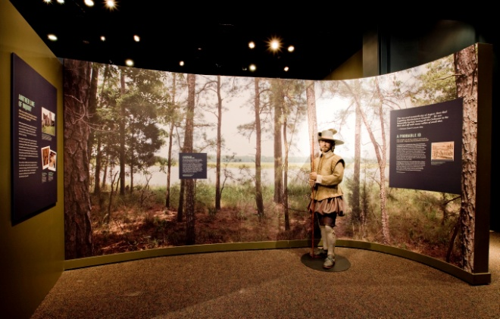
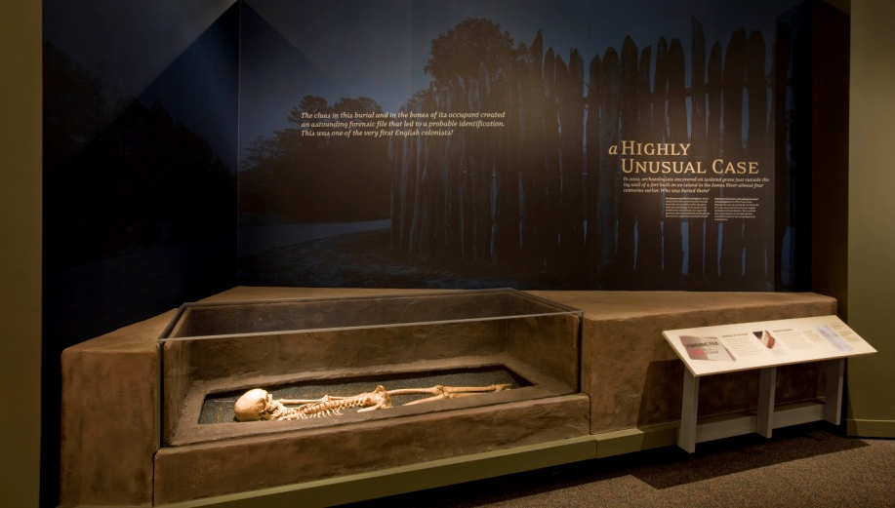
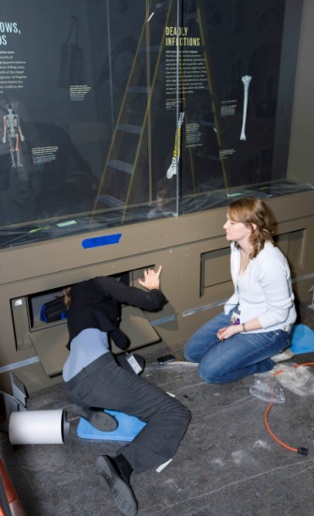
Design & Display Issues
Design Input into the Artifact Selection Process
Designer in conversation with curator & developer/project manager to determine:
Key artifacts (landmarks) with strongest stories
Variety
Environmental concerns: case interiors, lighting, need for rotation
Budget impact
Smithsonian Institution
National Museum of Natural History
Notes:
Design Responsibilities
Collaborate with the Exhibit Team in the conceptualization, development and realization of a comprehensive visitor experience for targeted audiences.
Advise the curatorial team in the selection of artifacts and specimens for display, and design highly effective settings for them.
Collaborate with the content developer/writer on the presentation of information, and design graphics to foster enquiry and promote interaction.
Collaborate with educators to develop a multi-sensory experience incorporating hands-on and multi-media learning as integral components.
Develop complete exhibit documentation in compliance with regulations and client requirements for durability and ease of service.
Maintain assigned budget and schedule.
Advise Exhibit Team during bidding; review drawings and submittals during fabrication
Observe (or participate in) installation and help maintain quality control.

Slide 11
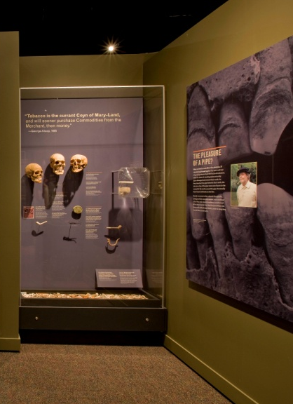
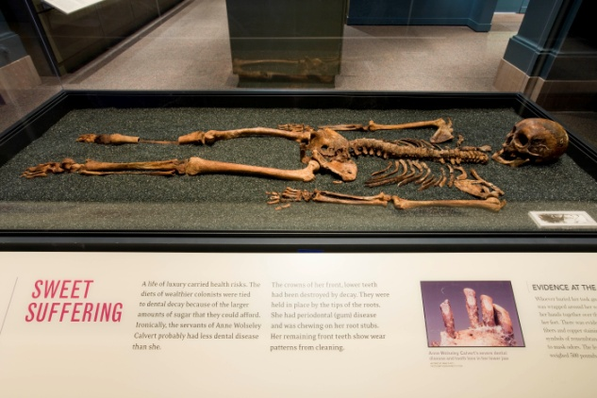
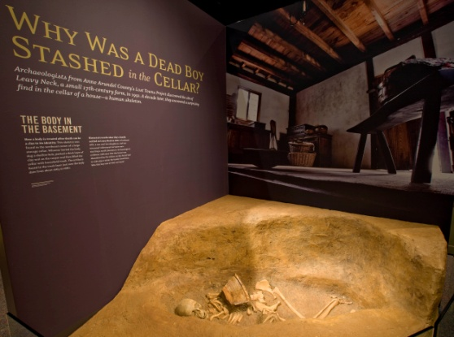
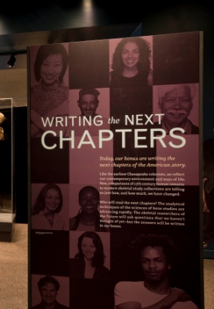
Design & Display Issues
The Importance of Visitor Perceptions
Act as visitor advocate:
Can I locate myself in the stories? (audience relevance)
How much is enough, and too much?
How am I made to feel in relation to the objects? (point of view, voice)
Am I inspired, moved, informed?
Smithsonian Institution
National Museum of Natural History
Notes:
Everyone involved should be able to answer specific questions as they relate to their discipline.

Slide 12

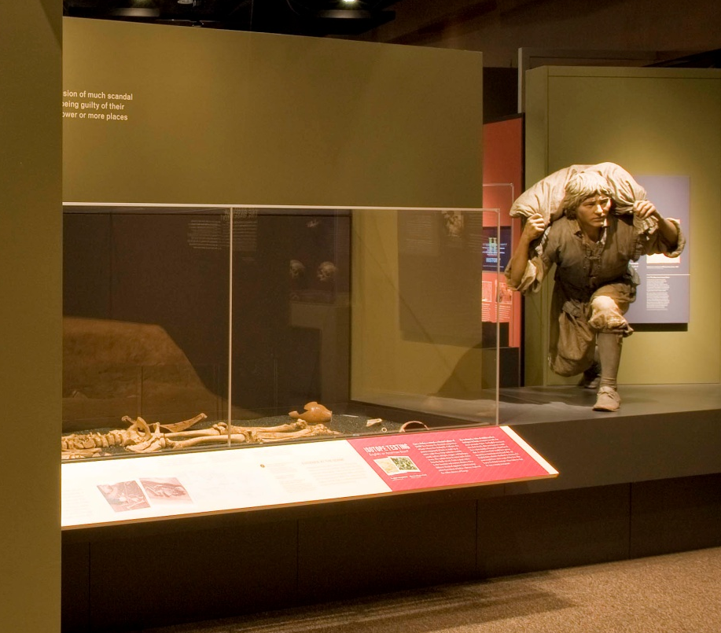
Accessible 3D and 2D Design
Smithsonian Institution
National Museum of Natural History
Notes:
as museums recognize the diversity within their audiences, they realize that exhibitions must do more: exhibitions must teach to different learning styles, respond to issues of cultural and gender equity, and offer multiple levels of information. The resulting changes in exhibitions have made these presentations more understandable, enjoyable, and connected to visitors’ lives
Accessible design must be a part of this new philosophy of exhibition development because people with disabilities are a part of museums’ diverse audience. Discovering exciting, attractive ways to make exhibitions accessible will most directly serve people with disabilities and older adults. But to name an audience who will not benefit by these designs is impossible. Accessibility begins as a mandate to serve people who have been discriminated against for centuries; it prevails as a tool that serves diverse audiences for a lifetime
(from Smithsonian Guidelines for Accessible design)

Slide 13

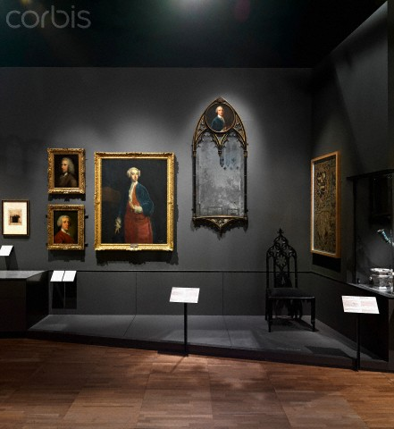
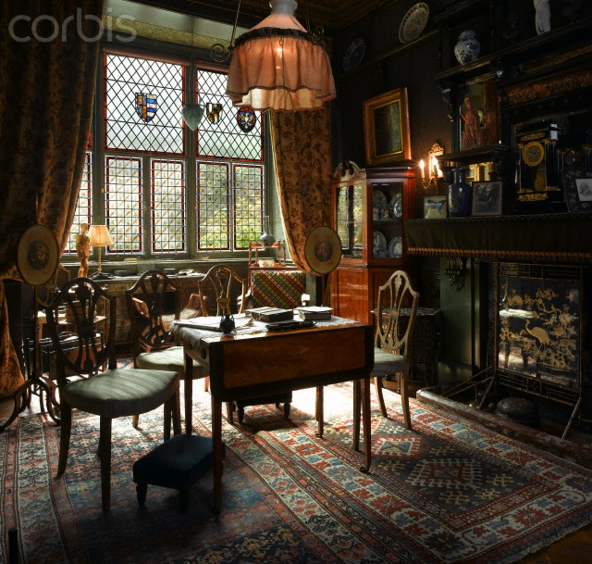
Lighting
Accessible 3D and 2D Design
Smithsonian Institution
National Museum of Natural History
Notes:
Lighting Challenges
Human eye can discern highly subtle variations in intensity and color.
Importance of gradual transitions:
light and visitor comfort
Light as magnet: daylight and artificial
Life-giving - and destructive

Slide 14

CONTRAST
1. Legibility
2. Legibility
3. Legibility
4. Legibility
5. Legibility
6. Legibility
7. Legibility
8. Legibility
1.
5.
CONTRAST
2.
6.
CONTRAST
3.
7.
CONTRAST
4.
8.
Accessible 3D and 2D Design
Smithsonian Institution
National Museum of Natural History
Notes:
Readability: The Ekarv Method
Use simple language to express complex ideas
Use normal spoken word order
One main idea per line, the end of the line coinciding with the natural end of the phrase
Lines of about 45 letters; text broken into short paragraphs of four to five lines
Use the active form of verbs and state the subject early in the sentence.

Slide 15

Readability
Unlike in the North, where ample resources and established arms factories (such as the Whitney Armory in Connecticut) produced a steady stream of high-quality arms during the War, Confederate arms were less numerous and more difficult to produce; this pistol, for example, made in Georgia before the conflict began, has a brass frame – later brass frames may have come from melted church bells.
Confederate Pistol with Brass Frame
ca. 1860
Griswold & Gunnison, Macon, GA
Accessible 3D and 2D Design
Smithsonian Institution
National Museum of Natural History

Slide 16
Readability
This pistol with brass frame was made in Georgia before war. During the conflict brass frames may have come from melted church bells.
It was difficult for the Confederate armories to produce weapons due to the lack of resources and established factories.
Confederate Pistol with Brass Frame
ca. 1860
Griswold & Gunnison, Macon, GA
Accessible 3D and 2D Design
Smithsonian Institution
National Museum of Natural History

Slide 17
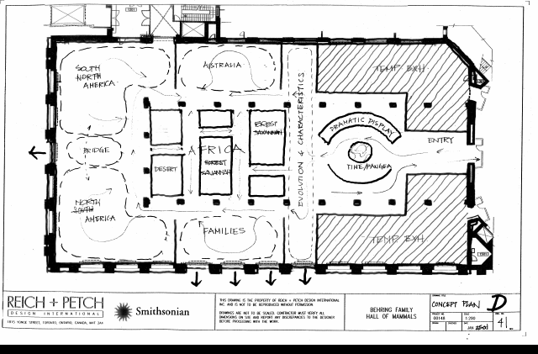
Concept Development Phase
Script gives narrative description of major units
Bubble Diagram gives impression of look and feel of the exhibit
Notes:
We spend about 2/3 of schedule on exhibition development, 1/3 on actual fabrication
The first stage in the development of the exhibition is the concept design phase.
This phase produces the concept script and bubble diagram.
The script at this phase is a narrative description of all the major units and sub‑units and acts as an intellectual road map for the project explaining what the content of each of the major elements of the project will be.
The bubble diagram gives the first impressions of the look and feel of the exhibit and some of the recommended methods to deliver its content.
As the concept script progresses the design develops into a more detailed floorplan with space assigned to individual elements within each section.

Slide 18
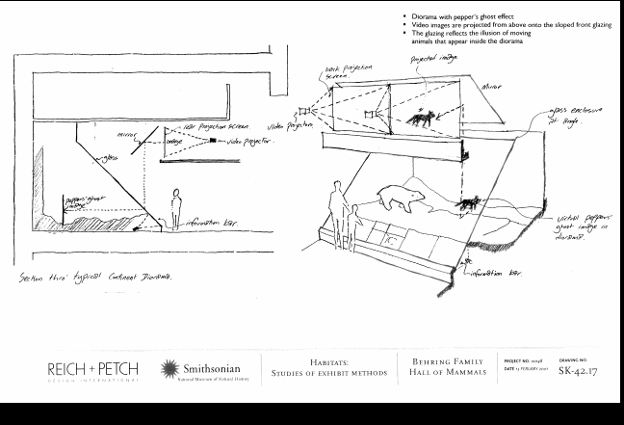
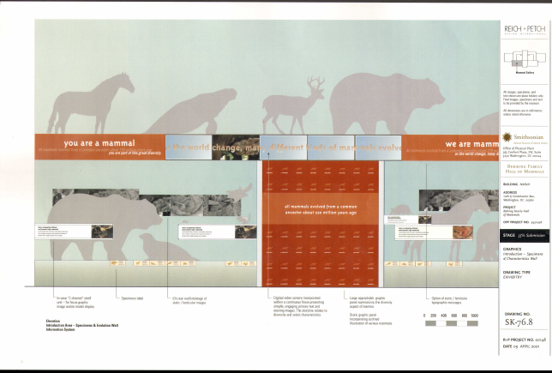
Draft Design Phase
Script is an attempt at actual words intended for the wall
Object and graphic inventory approximately 75% complete
Design of the exhibit is 65% complete, connected to the script with typical case designs and specimen layouts
Notes:
The next phase is the draft design phase.
In this phase, the script is in its first attempt to produce the actual words intended for the wall and the object and graphic inventory should be approximately 80% complete.
The design is 65% complete and is connected to the script showing the location and relative size of each of the major units and sub‑units as well as typical case designs and specimen layouts.
Both the graphic look and the methodology have been determined.
These documents are used to confirm the budget and time line for the exhibit.
This is often the most painful phase for the core team. The “blue sky” period has ended and the realities of the budget and spatial constraints set in. There is ALWAYS more content than money and space…

Slide 19
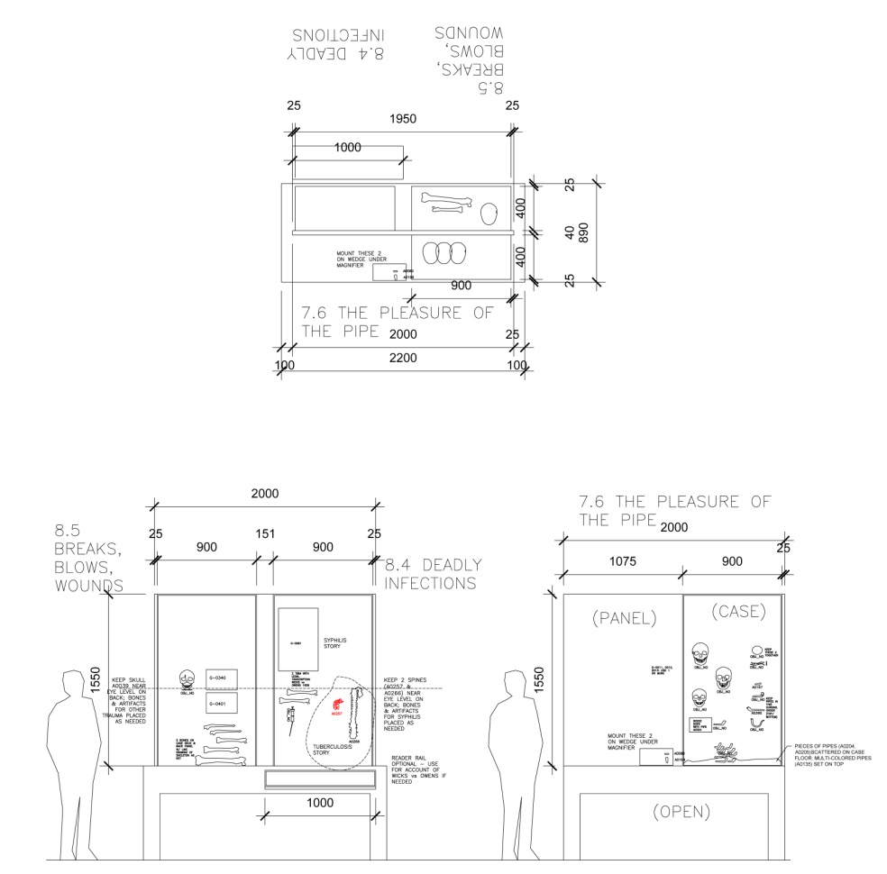
Final Design Phase
Script is final with actual words for the wall, captions and photo credits
Object and graphic inventory approximately 100% complete
Design of the exhibit is 95-100% complete, documents can be bid on and used as a base for production drawings
Notes:
Finally, we progress into the final script and detailed design.
The final script is the actual words to be screened on the "wall" and
The detailed design is the document upon which production drawings and decisions will be based.
Once approved by the Approval Team and the Director, the Core Team has completed its job.
The project manager and designer work closely with the production team led by the Chief of Production to bid and/or build the exhibit

Slide 20
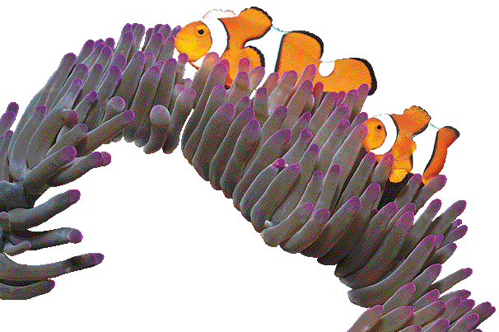
Exhibit Supplements
Using on-line and other technologies to make education engaging and interactive
On-line exhibits
Educational Resources
Research and Collections
Field Guides
Q?rius Programming
Notes:
Increasingly an exhibit is more than just a single presence in the building.

Slide 21
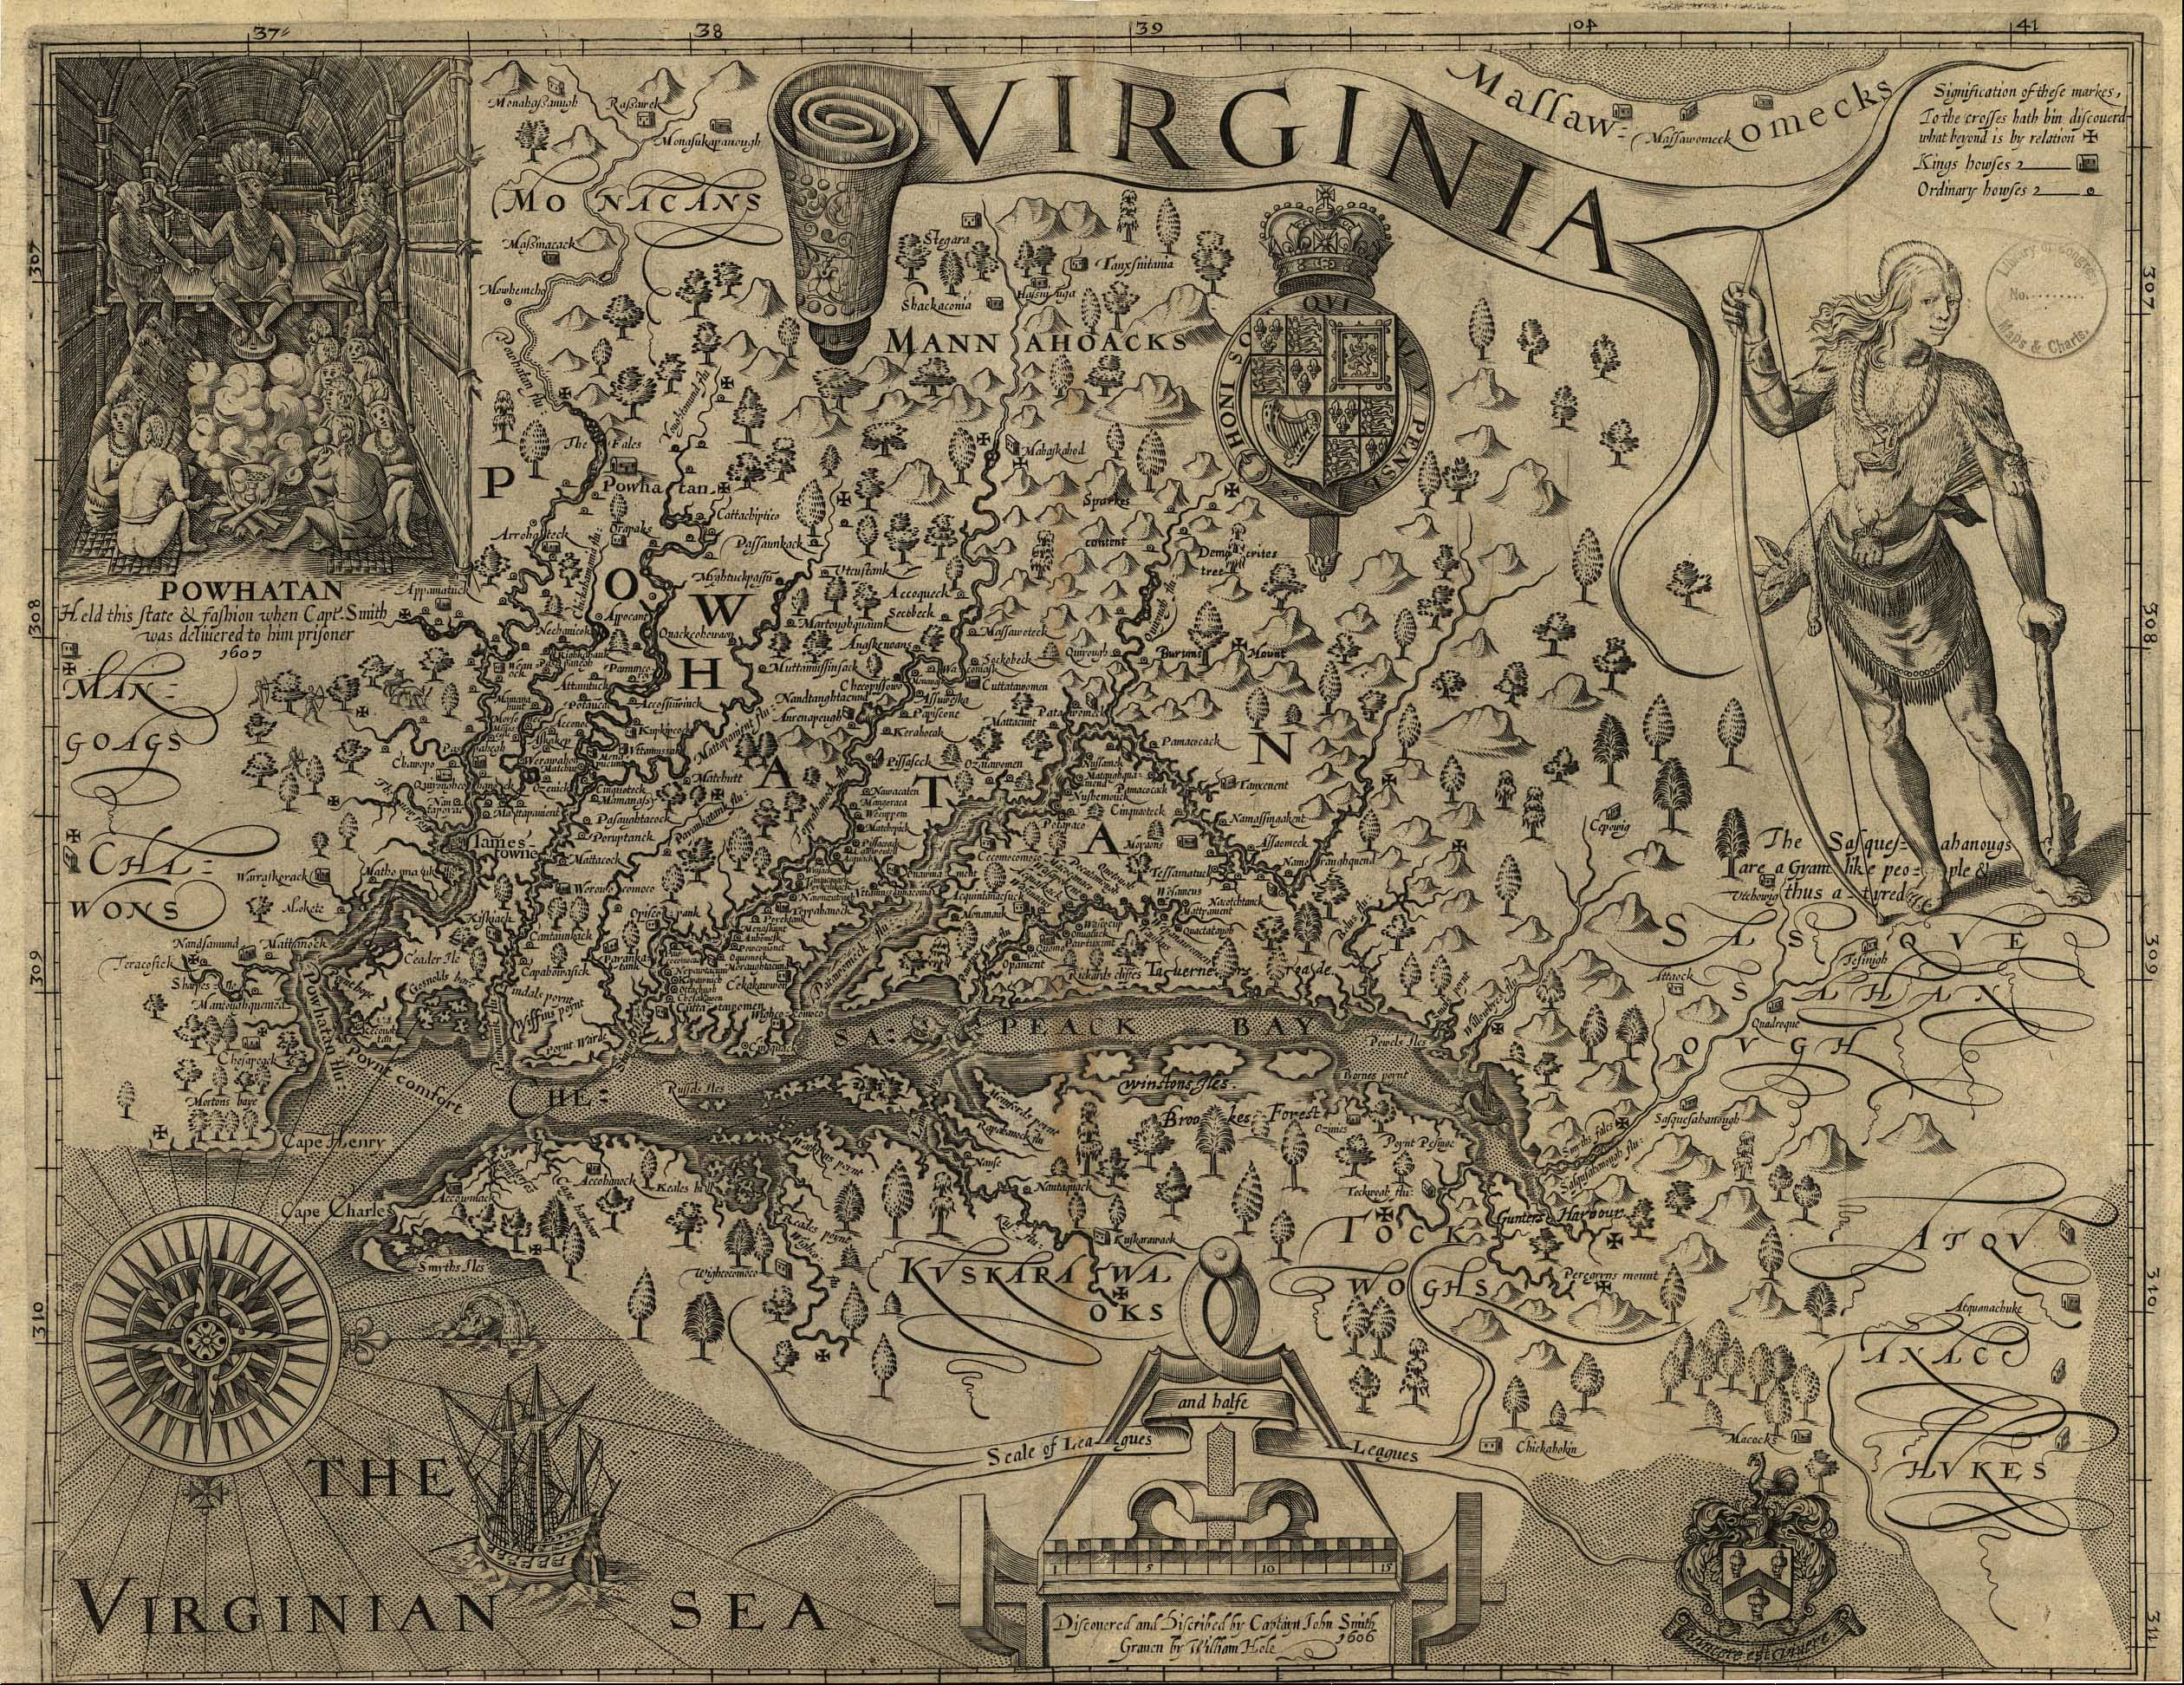

National Museum of Natural History
Smithsonian Institution, Washington, DC
CONCEPT DESIGN: 26 JUNE 2006

Slide 22

Goals of the Exhibit:
To develop a sense of wonder at the quantity and kinds of information that can be obtained from skeletal remains
To introduce the work of physical anthropologists, both as contemporary forensic detectives and as bioarchaeologists
To explain how forensic anthropology has enlarged our view of early colonization in the Chesapeake, the century that made Americans physically and culturally American
To convey the vital importance of scientifically studying human skeletal remains, because they can contain information unavailable from any other source or by any other means
Exhibit Goals:
CONCEPT DESIGN: 26 JUNE 2006

Slide 23
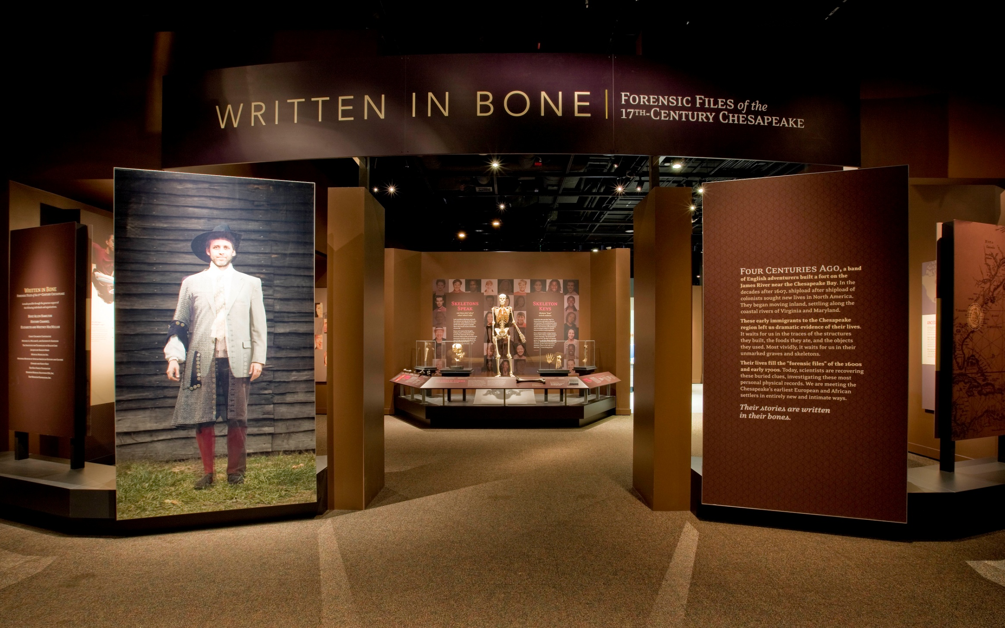
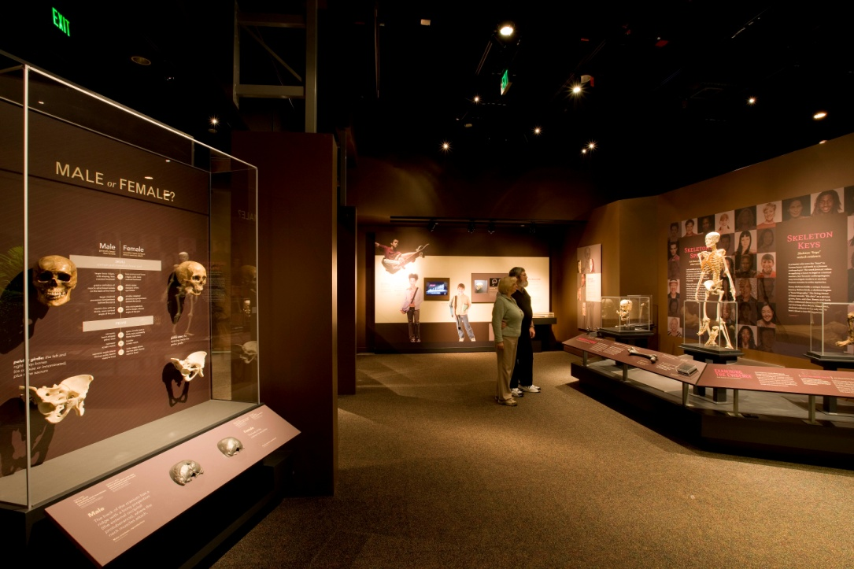
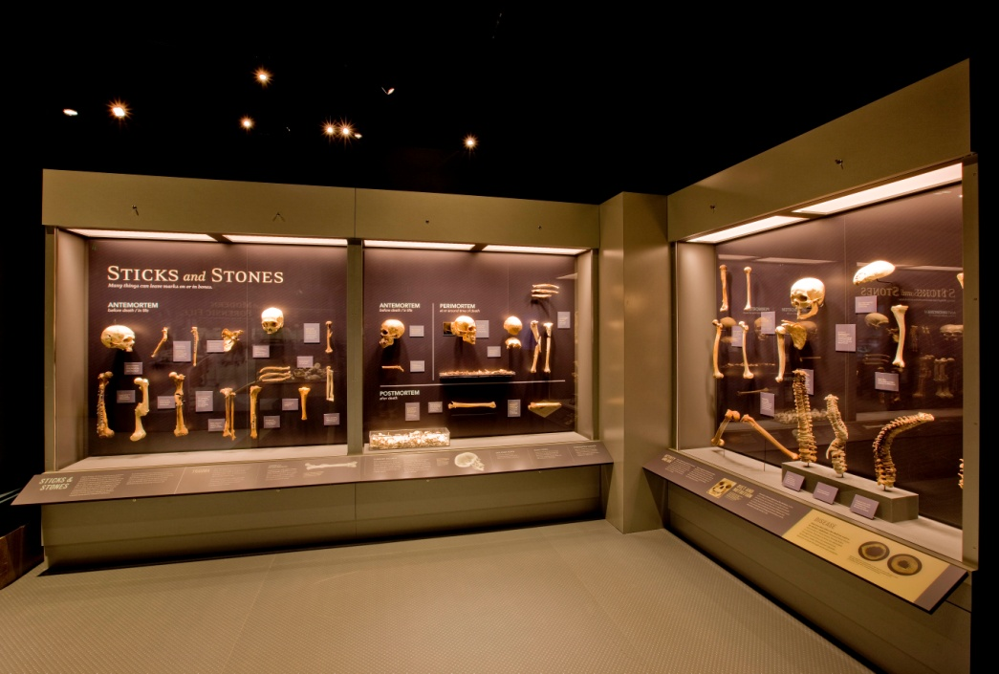
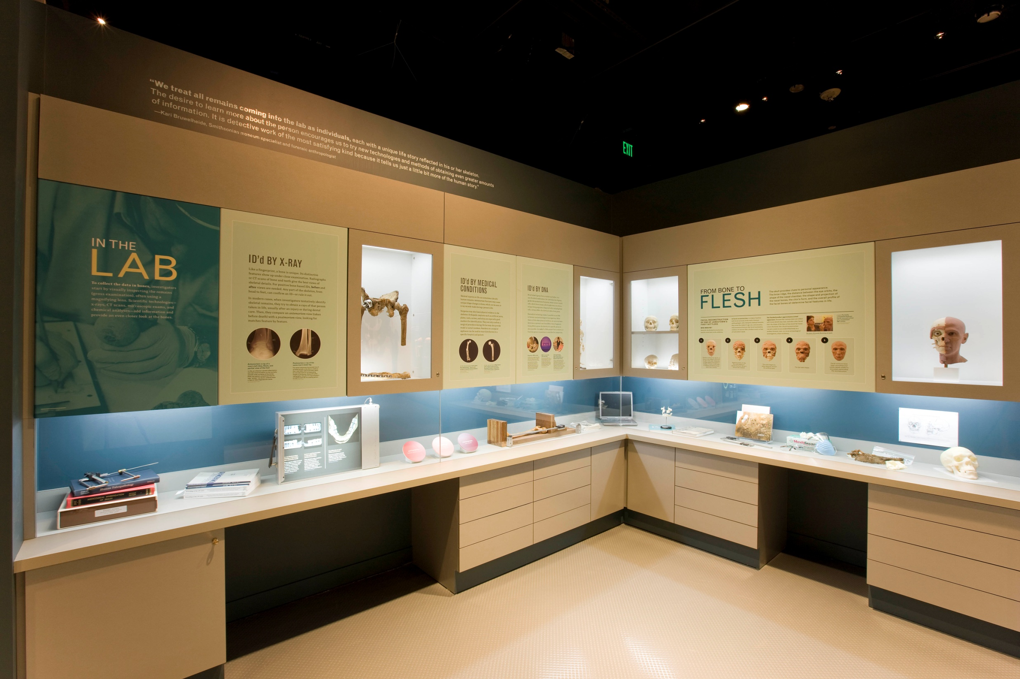
Written in Bone: Forensic Files of the 17th Century Chesapeake
Smithsonian Institution
National Museum of Natural History

Slide 24

A temporary exhibit, but built with “permanent” durability:
Museum receives 7 million visitors annually
Fragile items require solid substrates
Lighting and environmental concerns same as with permanent exhibit.
Opened early 2008, now extended to 2014
Written in Bone: Forensic Files of the 17th Century Chesapeake
Smithsonian Institution
National Museum of Natural History

Slide 25
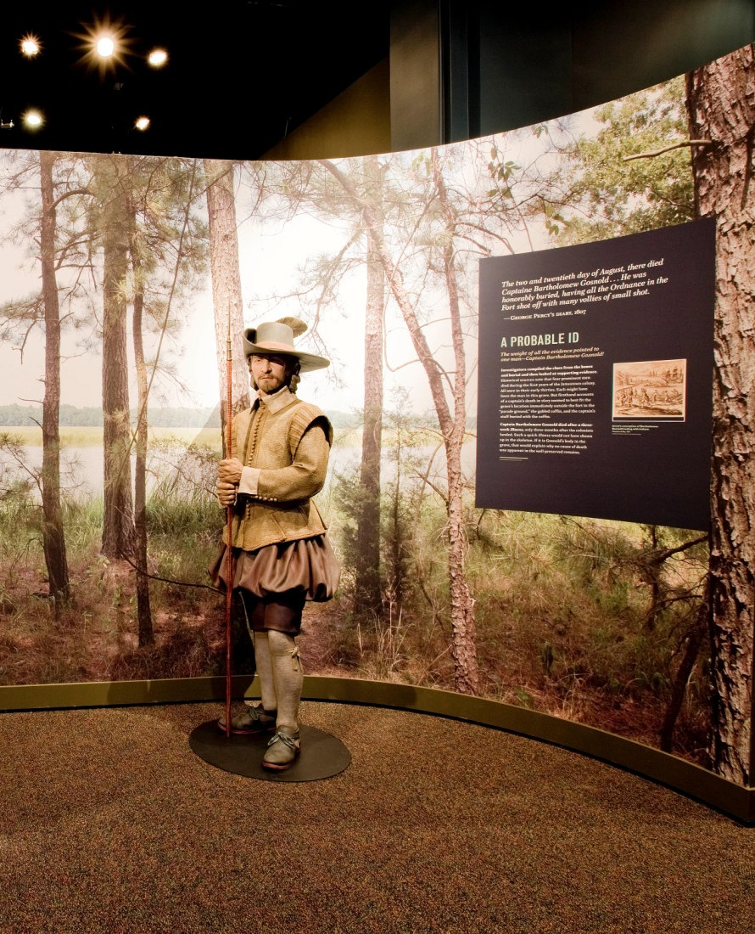

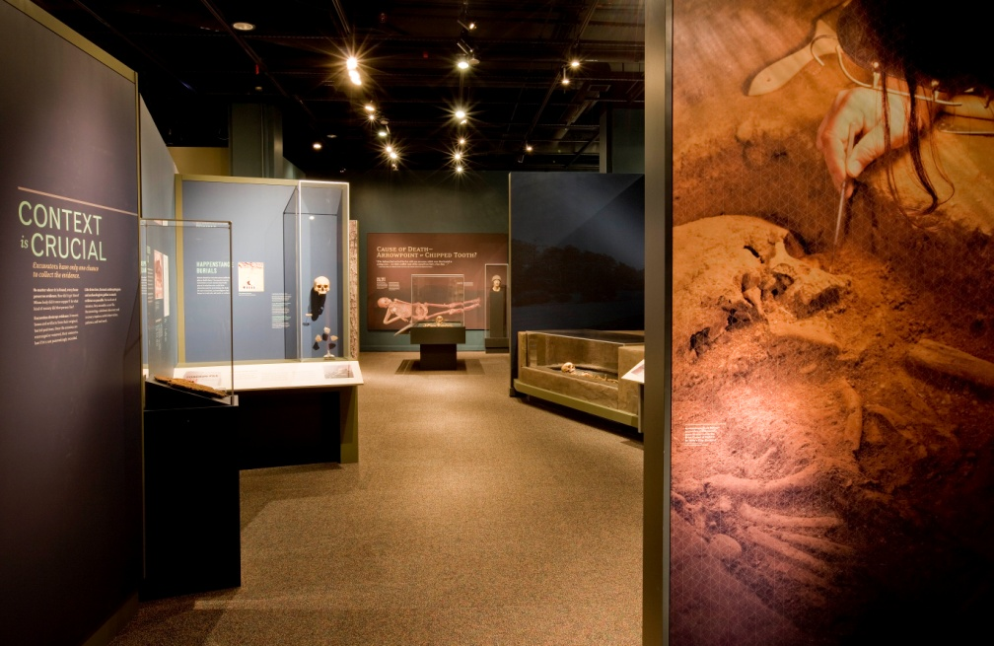
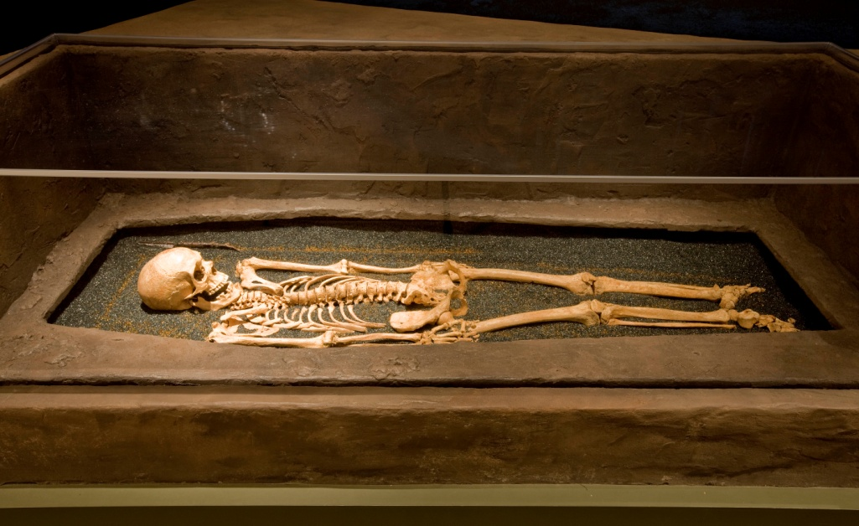
Painted sculpture and scenic units have been treated respectfully
“Shock absorber” cases for remains sustained no earthquake damage
Written in Bone: Forensic Files of the 17th Century Chesapeake
Smithsonian Institution
National Museum of Natural History
Notes:
In 2002, archaeologists uncovered an isolated grave just outside the log wall of a fort built on an island in the James River almost four centuries earlier.
European male, about 5 feet 3 inches tall, and 30 to 36 years old. Though his remains were well preserved, the cause of death was not apparent in the skeleton.
Historical sources note that four prominent men died during the first years of the Jamestown colony. All were in their early thirties. Each might have been the man in this grave. But firsthand accounts of a captain’s death in 1607 seemed to best fit the grave’s location immediately outside the fort in the “parade ground,” the gabled coffin, and the captain’s staff buried with the coffin.
Captain Bartholomew Gosnold died after a three-week illness, only three months after the colonists landed. Such a quick illness would not have shown up in the skeleton. If it is Gosnold’s body in the grave, that would explain why no cause of death was apparent in the well-preserved remains
Investigators hoped to make a positive ID of the skeleton in the James Fort “captain’s” burial by comparing its DNA to DNA of Captain Bartholomew Gosnold’s sister. In 2005, scientists sampled bones in an unmarked grave thought to be that of Elizabeth Gosnold. The DNA results did not match, but further analysis revealed the bones were not his sister’s remains.
Bartholomew Gosnold (1572–1607) was an enthusiastic promoter of colonization. An English lawyer and explorer, he first led an expedition to New England in 1602. He named Cape Cod for the teeming fish he encountered there, and Martha’s Vineyard for his daughter. Gosnold captained the Godspeed, one of three ships that sailed for Virginia in 1606. He was vice admiral of the expedition and helped design the fort at Jamestown.

Slide 26
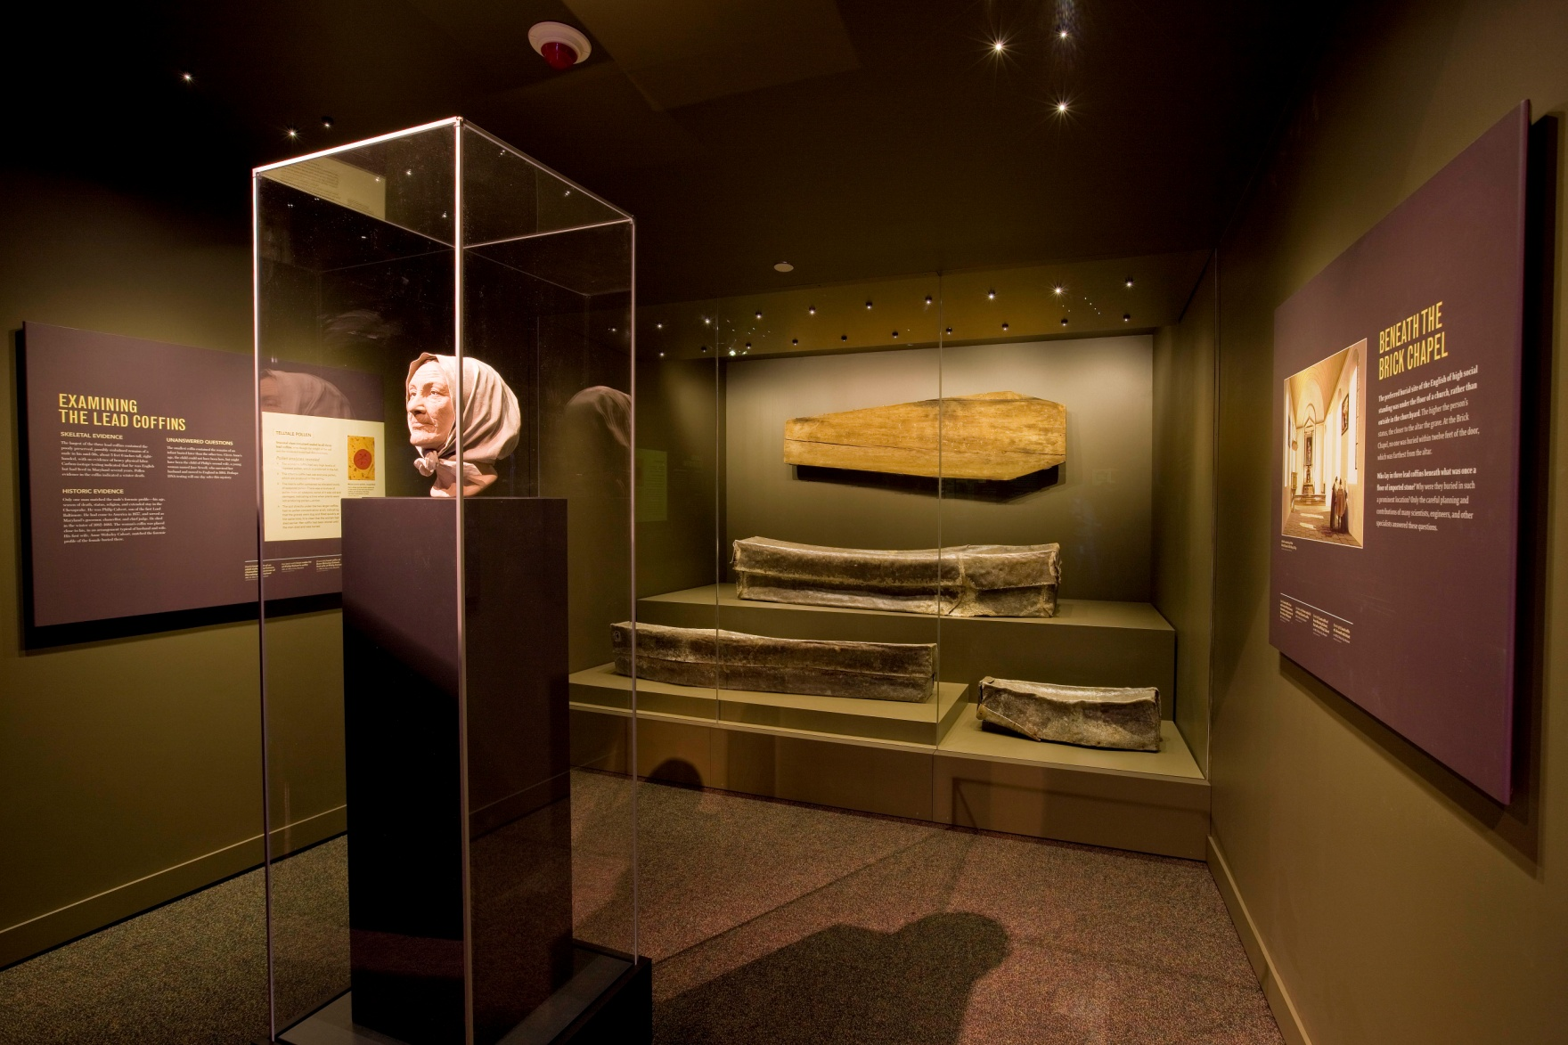
Frequent monitoring of case seals, interior conditions (temperature and Rh)
Written in Bone: Forensic Files of the 17th Century Chesapeake
Smithsonian Institution
National Museum of Natural History

Slide 27
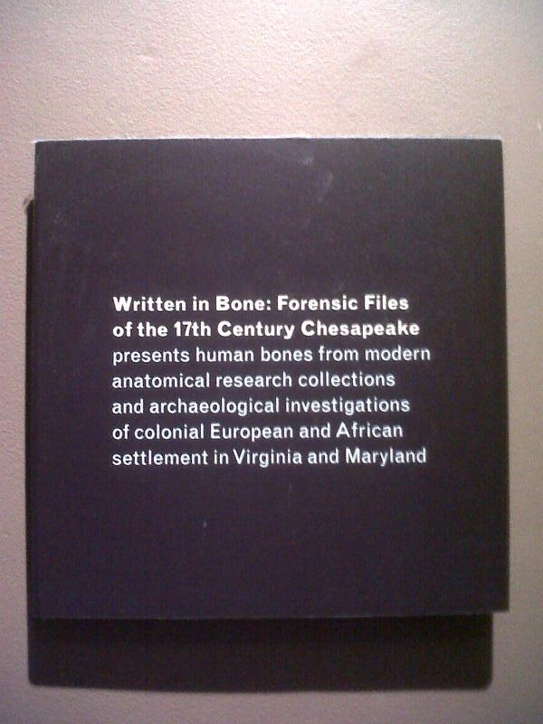
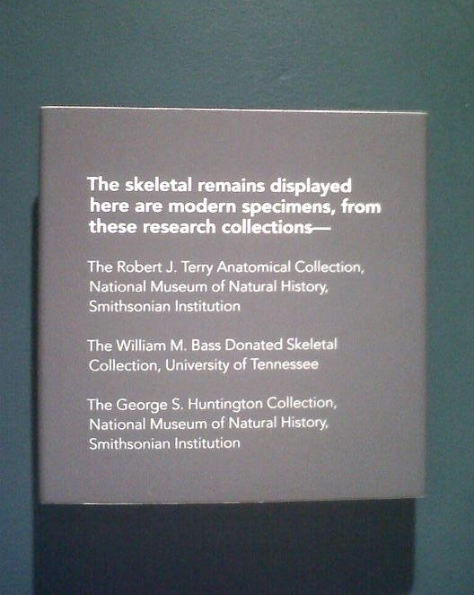
Smithsonian Institution
National Museum of Natural History

Slide 28


Written in Bone:
Forensic Files of the 17th Century Chesapeake
National Museum of Natural History
Smithsonian Institution
Washington, DC
Displaying Human Remains in a Museum Setting
Skeletons represent the most direct evidence of the biology of past populations: health, lifestyle, diet, trauma, disease, etc.
Most retrieved from unmarked graves, discovered by accident – professionals treat them with care and respect
Donated remains intended for teaching
When possible, identified remains returned to families if so desired
“The skeleton is a personal legacy. It is an individual’s life story – a gift to the present.”
-Douglas Owsley, curator
Smithsonian Institution
National Museum of Natural History

Slide 29
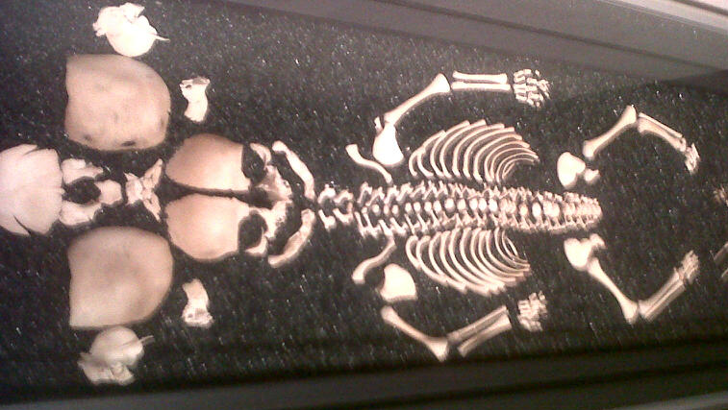
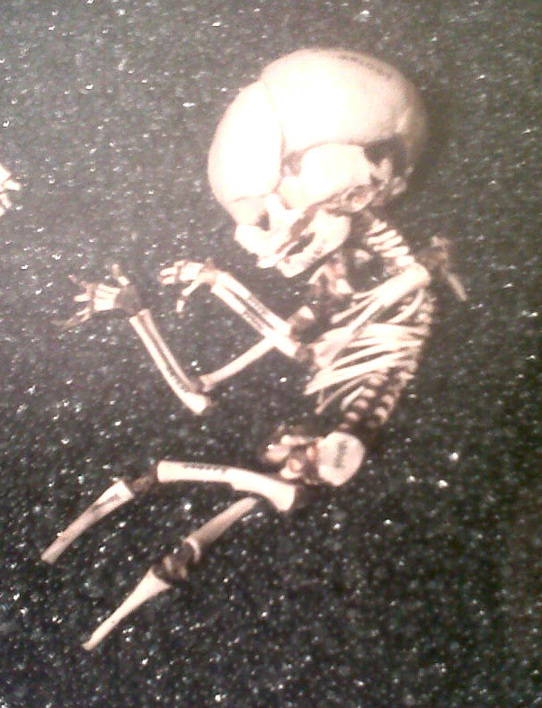
Full-term fetus (neonate), approximately 40 weeks
Fetus second trimester, approximately 22 weeks
Smithsonian Institution
National Museum of Natural History

Slide 30
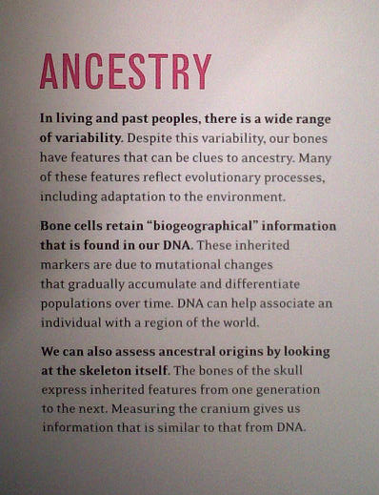
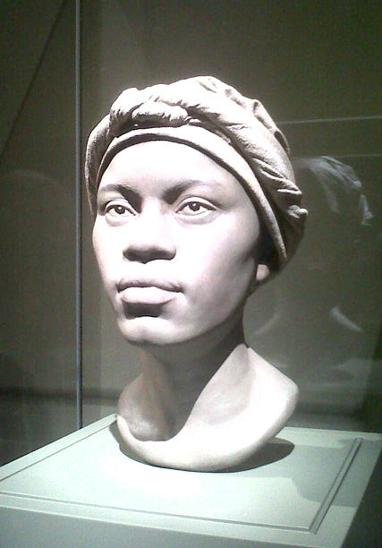
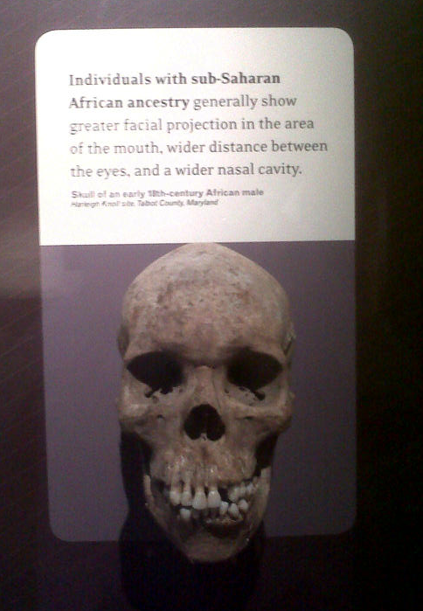
Smithsonian Institution
National Museum of Natural History

Slide 31
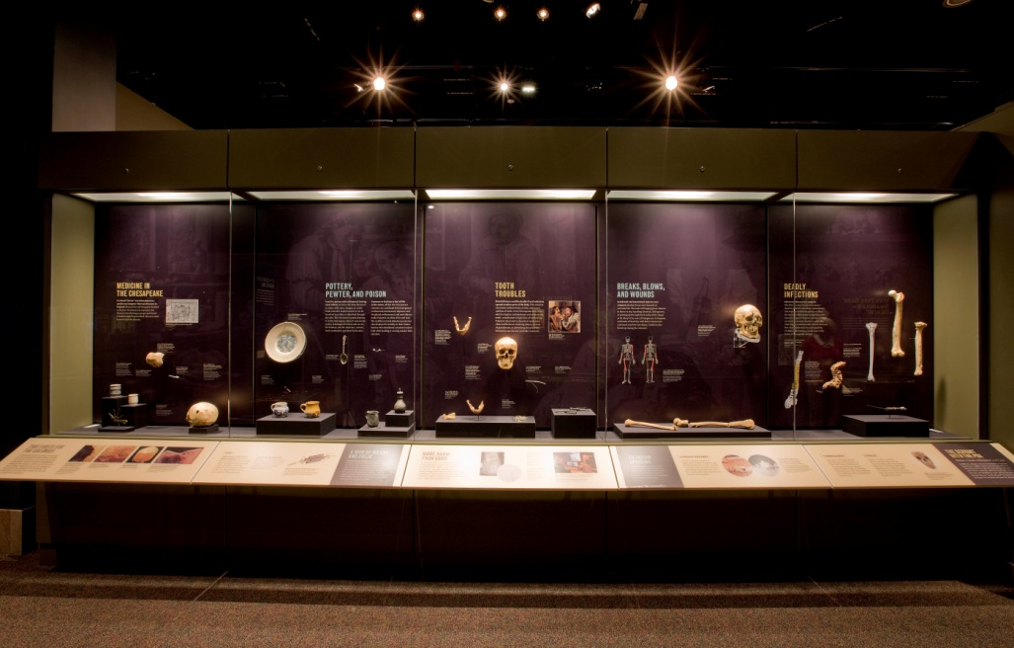
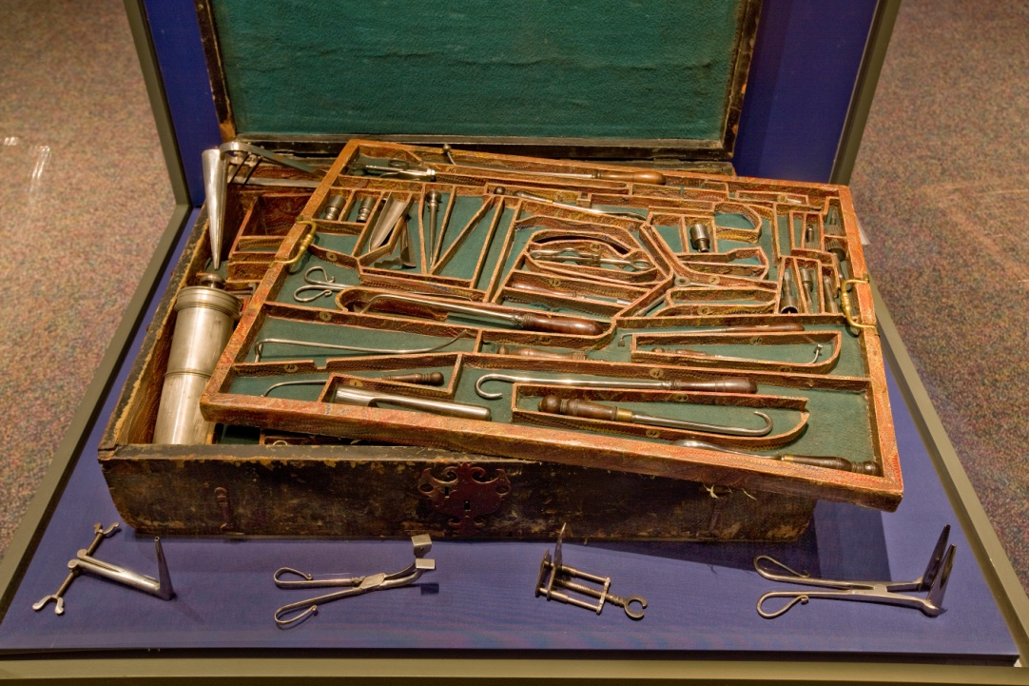
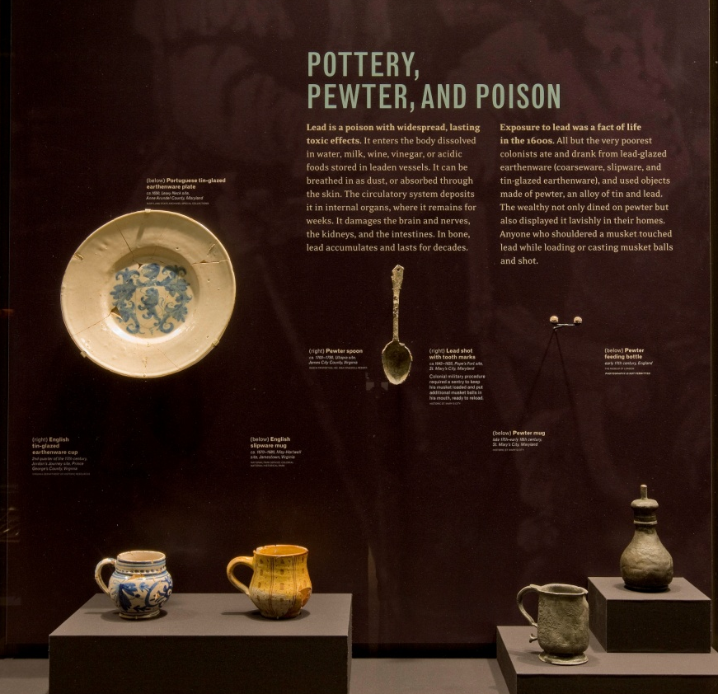
Few fragile items requiring trade-outs; removal of unique 17th c. surgeon’s chest required exhibit unit redesign
Written in Bone: Forensic Files of the 17th Century Chesapeake
Smithsonian Institution
National Museum of Natural History

Slide 32
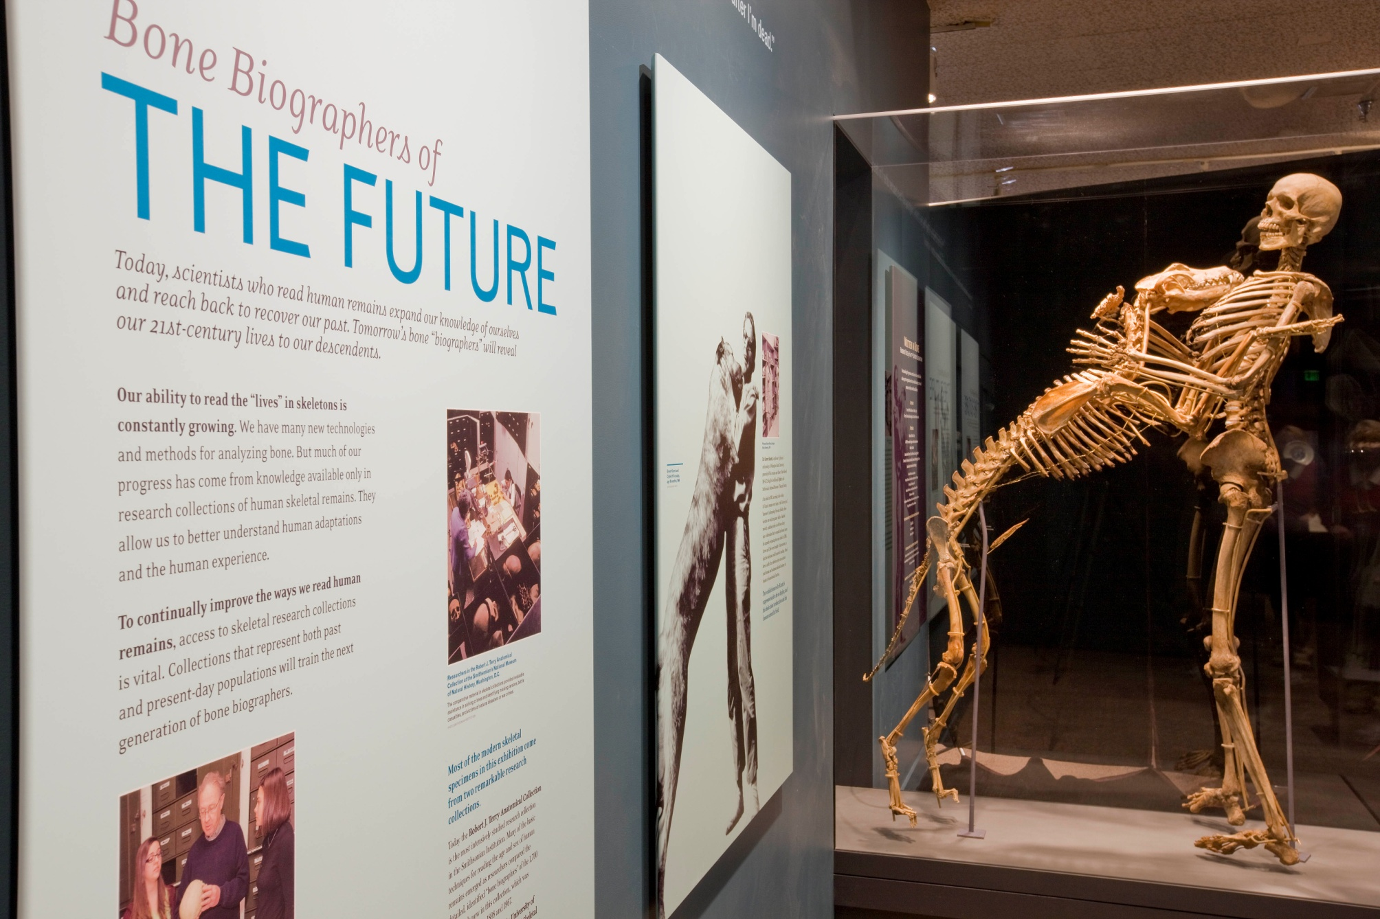
Smithsonian Institution
National Museum of Natural History

Slide 33
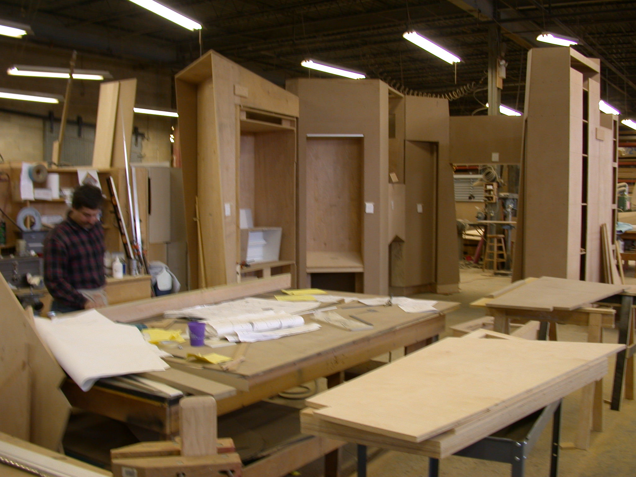
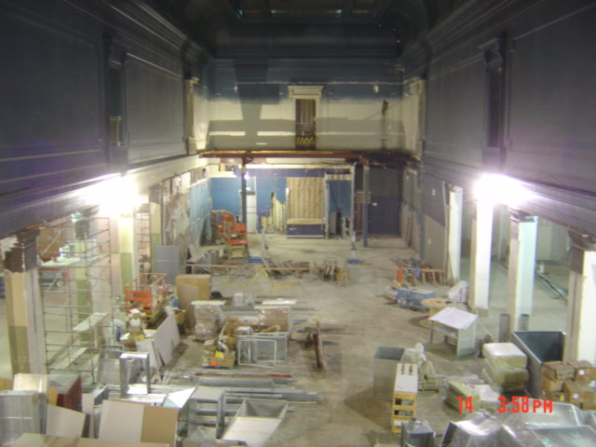
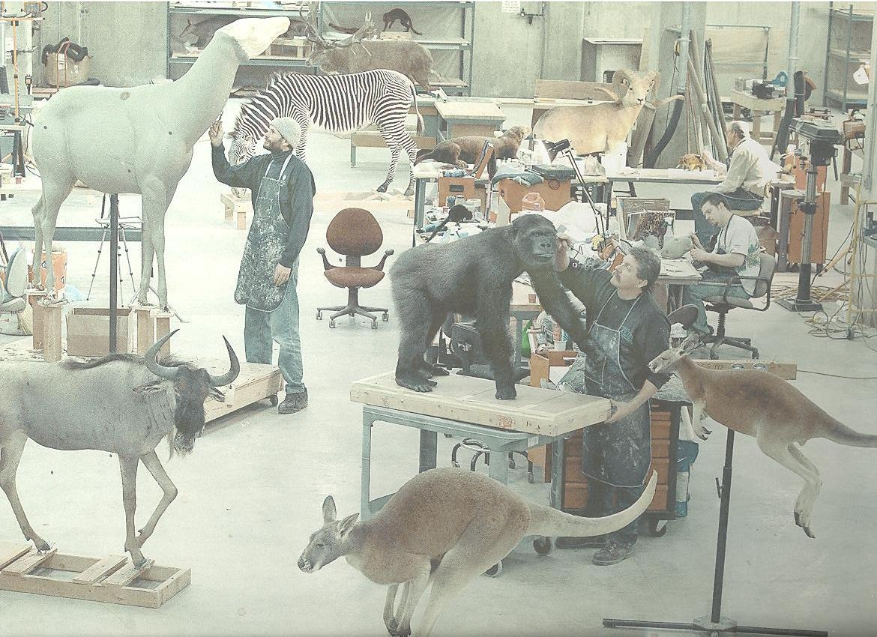
Construction and Installation
Notes:
Since our exhibits are installed within an existing structure that is nearly 100 years old, there is a lot of preliminary work that needs to happen before the exhibit can be installed.
The project manager work closely with teams of architects and engineers to plan the demolition and restoration of the exhibit halls while the exhibit is still in the development process.
Ideally, the architects and engineers can coordinate with the exhibit designers to incorporate electrical, mechanical, and structural systems needed by the exhibits that will be part of the building structure.
With good planning and some good luck, exhibit installation can begin as the building construction work is being completed.

Slide 34



Slide 35


Janet Annenberg Hooker
Hall of Geology Gems and Minerals, 1997
Notes:
So, if you’ve visited us in the last 10 years you’ve been seeing new exhibits like this…
the Janet Annenberg Hooker Hall of Geology, Gems and Minerals

Slide 36

Kenneth E. Behring Family Hall of Mammals, 2003
Notes:
We worked over 6 years, set up 3 outside facilities for specialized work and undertook the first major building renovation in the 95 year history of the Museum. 20,000 square feet of exhibit space and almost $40 million.

Slide 37


Slide 38



Slide 39



Notes:
I learned that the sewing skills my grandmother taught me REALLY WOULD come in handy one day although I doubt she thought I would use them on a giraffe skin.
I learned that Pert shampoo makes hair the fluffiest and Garnier Nutrisse has the perfect shade of orange to re-fresh a tiger’s faded fur.

Slide 40

Sant Ocean Hall, 2008
Notes:
The Sant Ocean Hall, which opened in September of this 2008, is aneffort to modernize the museum experience. This is not the natural history exhibit of your childhood, but we there’s still elements that inspire a sense of wonder and curiosity in our visitors that keep them coming back and cause them to discuss as a family or group what they saw and experienced.
Before the exhibit fabrication began, there was a major building renovation that included moving the escalators, upgrading systems and restoring the architecture. That work was done in conjunction with the exhibit design.
The Sant Ocean Hall took just over 5 years to develop, design and build.
Unique challenges– size, specimens, people

Slide 41


Notes:
I learned that it’s extremely difficult to convince Maryland and DC Depts. of Transportation and the National Park Service to close roads at rush hour and that they really don’t care how difficult and fragile a 2,200 lbs whale skull is.

Slide 42



Phoenix the North Atlantic Right Whale
Notes:
I’ve learned that everyone has a skill… and that a man can make a pretty good living making models of North Atlantic Right Whales and a welder can decided he wants to specialize in removing fossils.
That people who have what they think are ordinary jobs, can be called upon to do extraordinary things.

Slide 43


Giant Squid
Notes:
I’ve learned that while not as sparkly as diamonds or as soft as a leopard’s fur, marine specimens have their own special charm– really, what can compare to a 25 foot giant squid or a coelacanth- a prehistoric fish once thought extinct?

Slide 44



Notes:
squid

Slide 45



Raven Canoe
Notes:
canoe

Slide 46




Slide 47


