Slide 1

2016 NSF Large Facilities Workshop
Matthew J. Hawkins
Head, Large Facilities Office
May 24-26, 2016
Washington, DC

Slide 2
2016 NSF Large Facilities Workshop
Purpose & Vision
Two-Way & Open Exchange
  Formal & Informal
  Transparent
Best-Practices & Lessons-Learned
New Policy
Identify & Solve Challenges

Slide 3
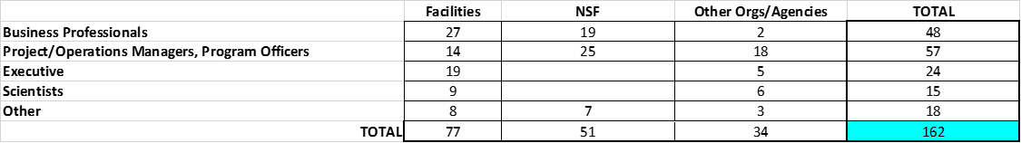
2016 NSF Large Facilities Workshop
Participants
Facilities Representatives: ~50%
NSF: ~ 30%
Other: ~20%

Slide 4
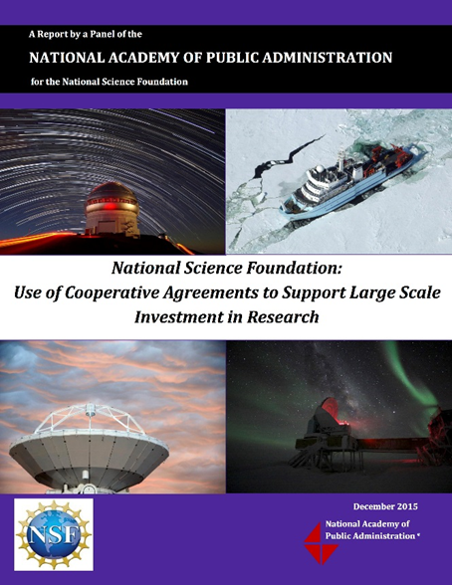
2016 NSF Large Facilities Workshop
NAPA Report
“It is clear, that in the past, NSF has prioritized the innovative scientific aspects of large facility construction projects; the agency now needs to apply equal emphasis on increased internal management of the business practices critical to enhanced oversight and project success.”
NAPA Report
Executive Summary, Page 6
December 17, 2015

Slide 5
2016 NSF Large Facilities Workshop
Breakouts
Speaker, Lead & Scribe
No formal sign-up (“first-come/first-serve”)
Open dialog & exchange of ideas
Summary Workshop Report

Slide 6
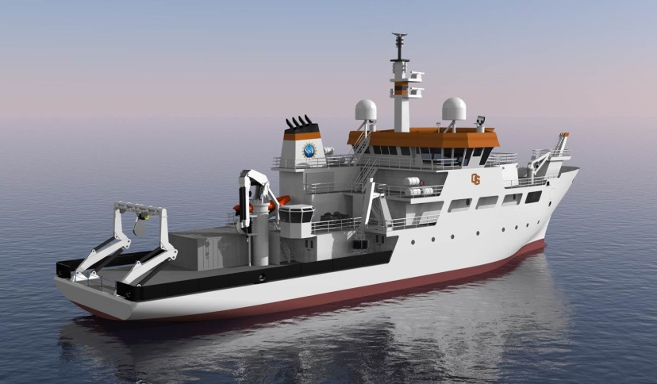
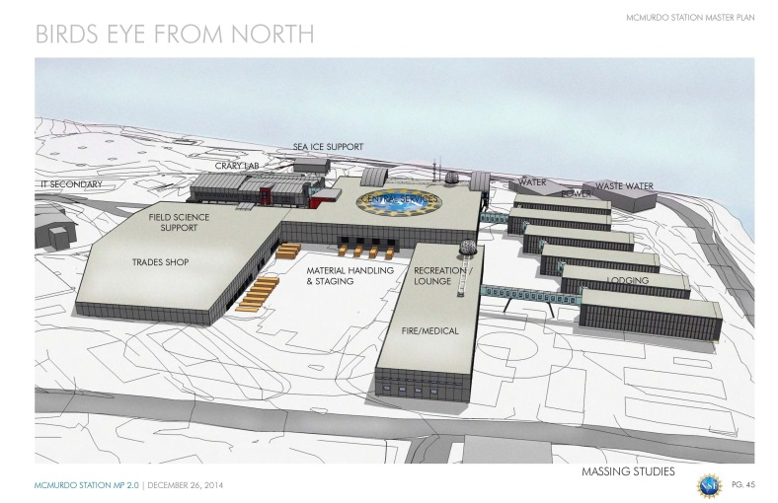
2016 NSF Large Facilities Workshop
Projects in the Design Stage
Regional Class Research Vessel (RCRV)
Antarctic Infrastructure Modernization for Science (AIMS)
Final Design Phase
2-Ship Build ($255.5M TPC)
FY17 Budget Request
Preliminary Design Phase
Refining Project Scope and Schedule
PDR - Fall 2016

Slide 7
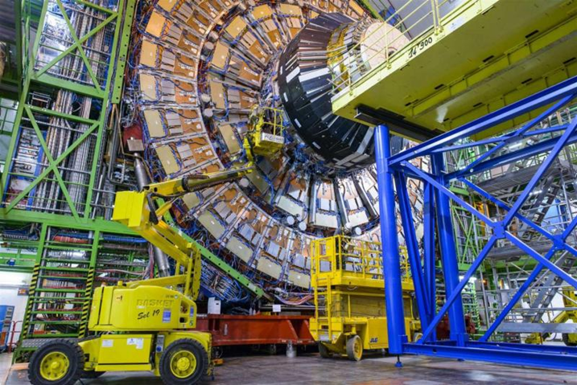
2016 NSF Large Facilities Workshop
Projects in the Design Stage
Large Hadron Collider – High Luminosity Upgrades (LHC-HL)
Conceptual Design Phase
CMS and ATLAS Detectors (CERN)
CDR – March 2016

Slide 8
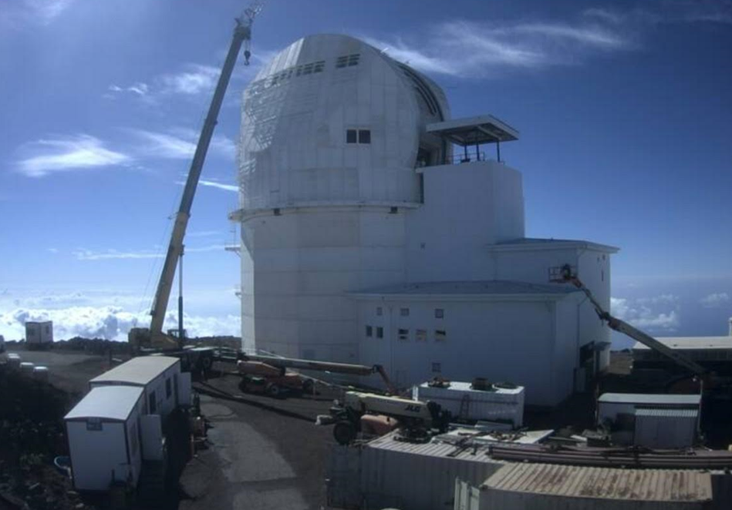
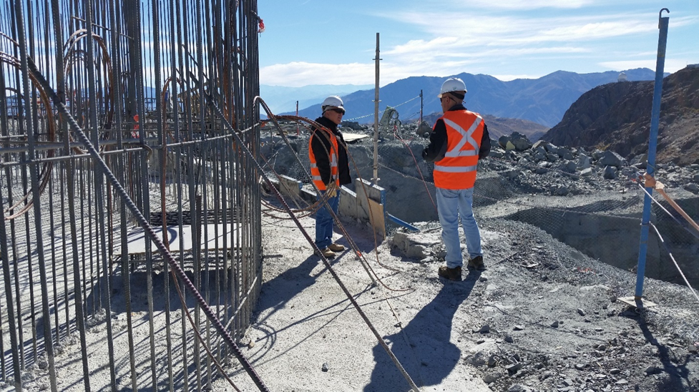
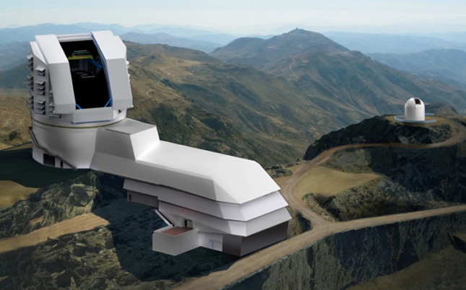
2016 NSF Large Facilities Workshop
Projects in the Construction Stage
Daniel K. Inouye Solar Telescope (DKIST)
Large Synoptic Survey Telescope (LSST)
~80% complete
Court decisions pending
Risks being evaluated
~20% complete
Partnership with DOE (Camera)
Fully compliant with latest NSF oversight policies in LFM

Slide 9
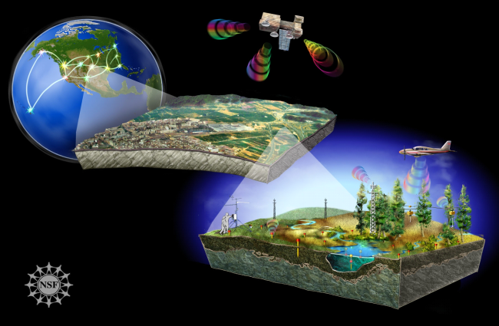
2016 NSF Large Facilities Workshop
Projects in the Construction Stage
National Environmental Observatory Network (NEON)
~75% Complete
Transition to operations at many sites
NSF “No Cost Overrun” Policy Implemented
Management Transition > Battelle

Slide 10
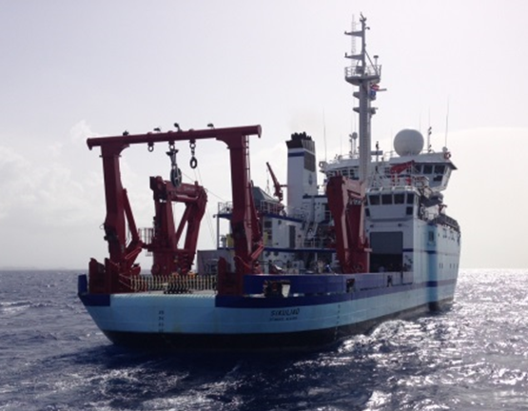
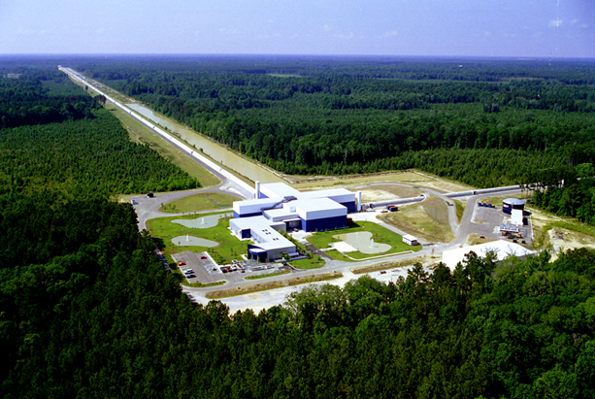
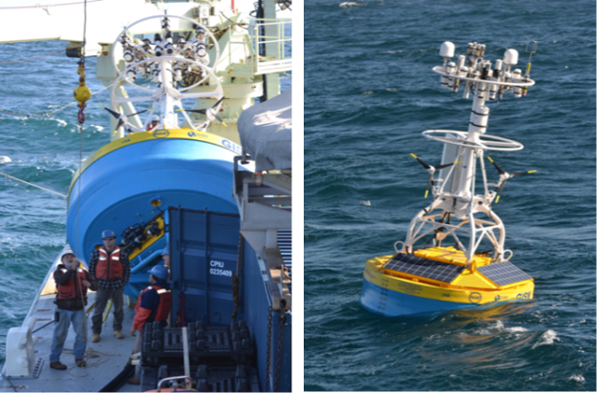
2016 NSF Large Facilities Workshop
Projects Transitioned to Operations Stage
Alaska Region Research Vessel(ARRV; R/V Sikuliaq)
Advanced Laser Interferometer Gravitational-wave Observatory (AdvLIGO)
Ocean Observatory Initiative (OOI)

Slide 11
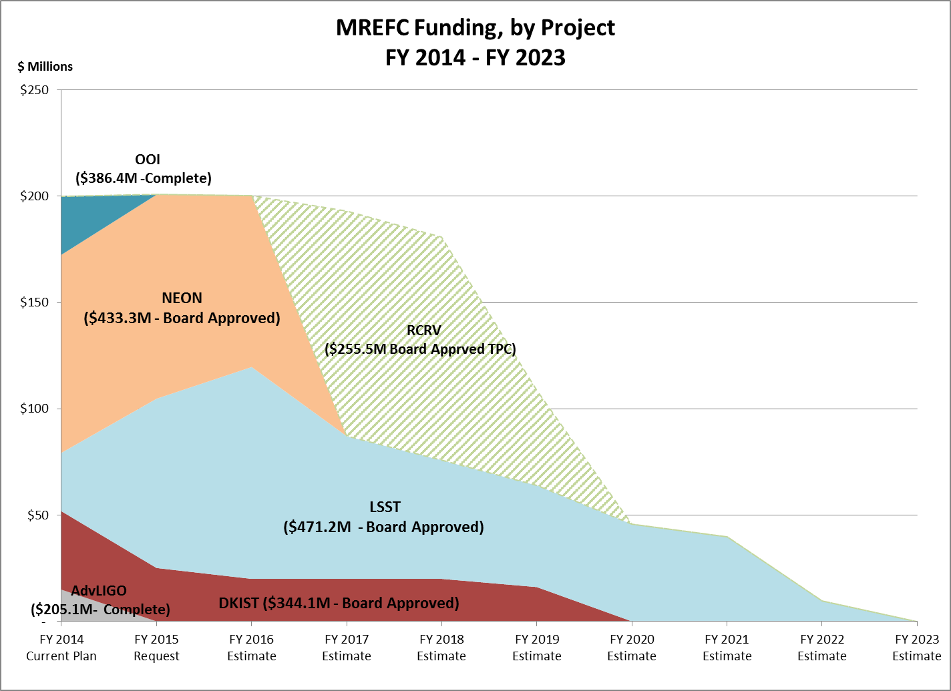
2016 NSF Large Facilities Workshop
MREFC Budget Profile
~ $200M Budget Planning “Target”
Notional Projects in the Development and Design Stages

Slide 12
2016 NSF Large Facilities Workshop
2017 Host Volunteers
UT Austin (NHERI-CI)
Jefferson Lab (Newport News, Virginia)
Gemini (Chile)
LIGO (Livingston Observatory, Louisiana)

