Slide 1
Empirical Modeling
R.V. Guha

Slide 2
Outline
Data Science → Empirical Modeling
Deep dives on some research topics
Web scale structured data
Teachable learning systems
The case for a `Data Commons’
Notes:
Thank you for inviting me here.
The term Data Science has become rather popular of late and is being used to refer to a range of very different things.
I’d like to start by offering one perspective on what it is.
There are a large number of super interesting research problems associated with Data Science. I will go into a bit of depth
On a couple of topics that I have been closely associated with.
Finally, I’d like to make a case for something I call a ‘Data Commons

Slide 3
Models
Engineering = Modeling
Models are essential for building, predicting &
controlling systems
Model = set of variables + constraints
capture behavior of the system
Notes:
Much of engineering is about building or controlling systems … bridges, planes or search results. And in order to do that we need a model of that system. A model is simply a set of variables together with constraints on the variables that tells us the possible states the system can be in and how it transitions between these states.

Slide 4
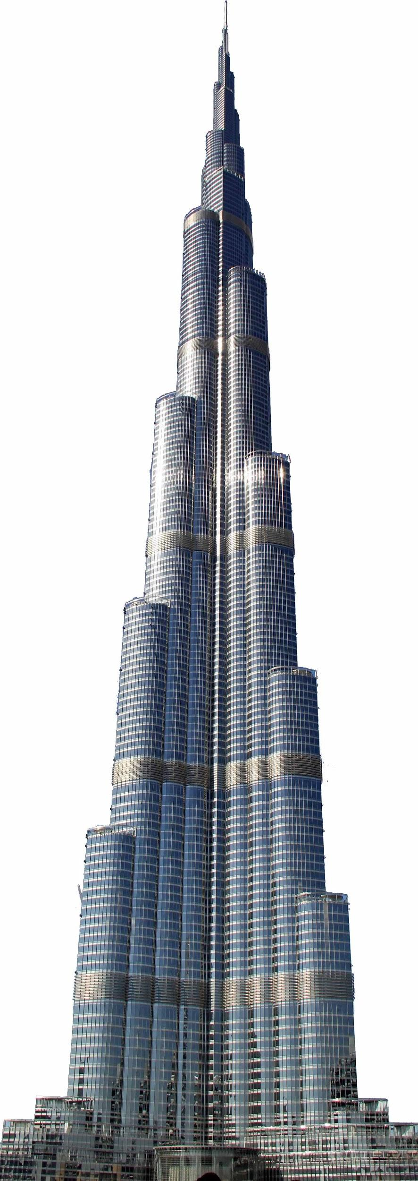
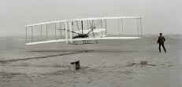

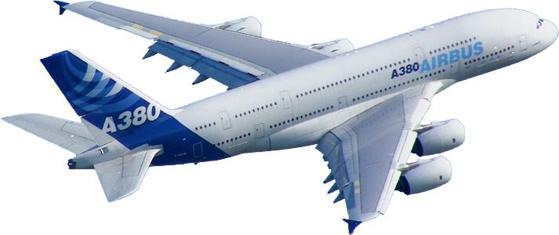
Evolution of Models
There was engineering before models, but ...
Notes:
Mathematical models have gotten widespread use only in the last 100 years or so, as our understanding of various physical phenomenon has improved. Yes, people did build St. Peters and the first plane without models, but the kind of structures built today can’t be done without models.

Slide 5
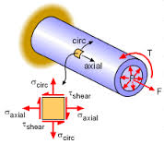


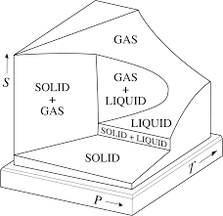
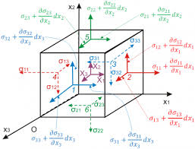
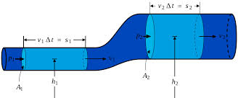
Analytic Models
Basic equations of continuum mechanics, materials, heat transfer, fluids, …. that capture the phenomenon in a mathematical form
System is modelled with these equations
Notes:
The kind of modelling that prevades engineering today, that is the backbone of building everything from this building to the dreamliner, is something I call analytic modelling.
We have the core equations of continuum mechanics, heat transfer, fluid motion, etc. And the system is modelled in terms of these equations. I estimate that a few dozen of these equations cover over 90% of the use cases.
The important point to note is that these equations capture the underlying causality of the phenomenon in a mathematical form

Slide 6
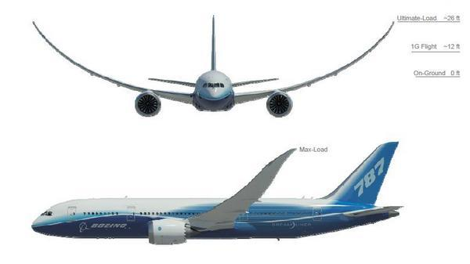
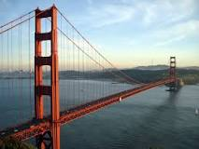

Complex engineering
Finite element methods for complex cases
26ft
Manually built models using small number of equations capturing underlying phenomenon
Notes:
This kind of modelling has been going on for a very long time. And the invention of the slide rule, about 400 years ago, was driven in large part by them.
In the last 40 years, we have seen the widespread use of finite element methods to do these calculations over much more complex engineering structures. So, when they need to compute that the maximum flapping allowed on a dreamliners wings is 26 feet, this is how they do it.
But at its core, the modelling approach has not changed. The models are manually built using a small number of equations that capture the underlying phenomenon.
Analytic modelling is behind the spectacular success of engineering over the last 150 years.

Slide 7
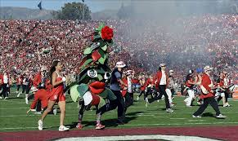
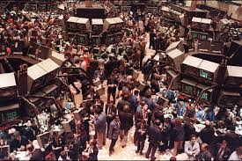
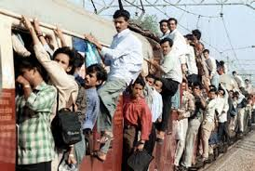

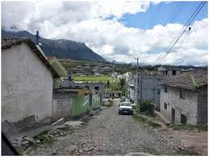
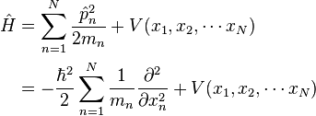

Limits of Analytic models
We don’t have ‘basic equations’ for social, medical, behavioral, economic and other complex phenomena
?
Notes:
The source of power of the analytic model, namely, these basic equations, are also its weakness.
We don’t and might never have succint equations capturing social, behavioral and economic phenomenon. And many of today problems, from city planning and energy planning to predicting the spread of epidemics are deeply intertwined with these phenomenon.
In fact, even something relatively mundane like predicting whether a particular user is likely to be interested in an ad on Kale chips is influenced by a surprising number of these phenomenon

Slide 8
Empirical Modelling
Take lots of data and fit the curve …
No causal equations required
Lots of data and compute power
Massively successful in the last 10 years
Notes:
One approach, which has had a lot of success in the last decade essentially steps around the problem of building causal models of the underlying phenomenon.
Instead, the approach is to use a lot of data, and fit the curve. And this approach has been massive success

Slide 9

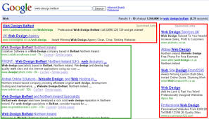
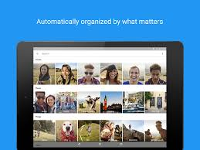
Success of Empirical Modelling
Spell Correction
Web search and advertising
News feed
Perception: Vision, speech
Mostly web-ecosystem products
Notes:
When Google introduce data driven spell correction in 2001, it was one of the highest profile success stories of this approach.
Now of course, it is the backbone of search and ads, not just at Google, but across the entire industry. Over the last couple of years, deep networks have produced remarkable breakthroughs in the area of machine perception.
So, one view of ‘Data science’ is that it is data driven modelling.

Slide 10

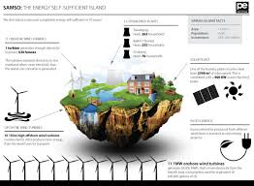
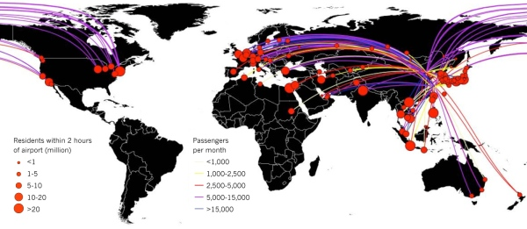
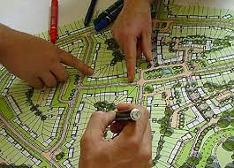
So much more can be done …
Empirical modeling is for complex systems what calculus is for classical engineering
Notes:
Most of today’s systems are built by CS folks to address CS problems: search, ads, …
The potential is much larger than that. Just like calculus is the basis for modelling engineering artifacts, data science is the basis for this new class of models that can handle complex phenomenon that have a significant social and behavioral component.
And a lot of the problems we have to solve today involve complex systems of this sort.

Slide 11
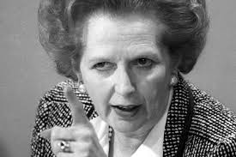
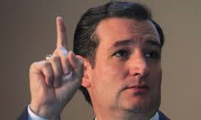
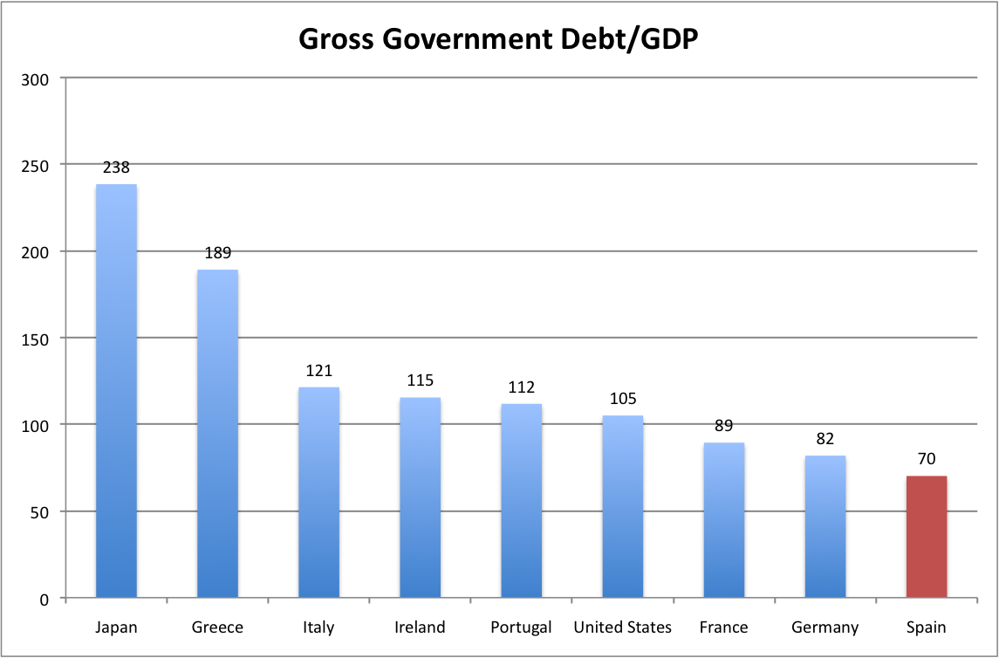
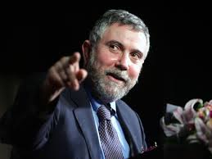
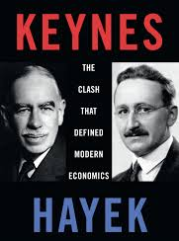
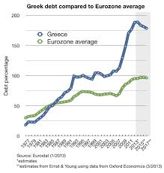
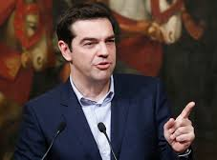
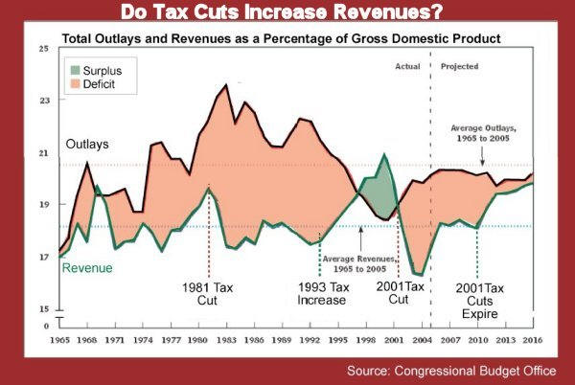
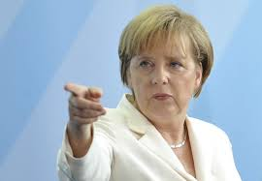
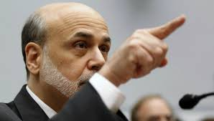
Challenge Problem
Simulate economic behavior of a population
Big juicy problem with huge impact
Notes:
picture with bernanke, krugman, angela merkel, ...

Slide 12
But ...
Building these systems is a black art
Data wrangling nightmares
Learning components brittle, unexplainable, unpredictable …
Systems complexity
...
Notes:
But the systems of today are very far from being mainline.
There are many scientific and engineering research issues.
Something about each of these issues

Slide 13
Deep dives
What is Empirical Modeling
Deep dives on some research topics
Web scale structured data
Teachable learning systems
The case for a `Data Commons’

Slide 14
Two projects on building datasets
Schema.org
  Structured data for the web, email, etc.
Reference by Description
  Towards a mathematical theory of communicating meaning
Notes:
I would like to get a bit deeper into a few projects that I have been personally associated with.
Building large information structures has been something of a fascination, I guess I got the bug from my days on Cyc.
When the web came along, the energies were channeled into building large distributed structured.
Schema.org is the latest chapter in this long journey. And somewhere along the line, I also got interested into the
Theoretical foundation of how one might go about stitching together the various pieces of data that we get
From different sources.
Our experiences in doing this are very appropos to empirical modeling. Given that a very substantial aspect
Of building such systems is in compiling an adequate data set.
I would like to spend the next 15 minutes telling you more about this journey.

Slide 15
Structured data and the web
The web was designed for humans but structured data was in the background
Many attempts to make
structured data a first class thing
Rise in form factors and alternate modalities makes structured data more important
Structured
Data
Web server
Notes:
Interest in enabling third party applications to have direct access to the databases behind
Websites started, to my knowledge, circa 1996.

Slide 16
The Goal
Actor
Ryan, Oklahama
type
birthplace
Chuck Norris
birthdate
March 10th 1940
Graph Data Model
  Common Vocabulary
Notes:
So, what did we really mean by giving applications access to the structured data?

Slide 17
Timeline of efforts
Many attempts: MCF, RDF, OWL, Microformats, OGP, Linked Data, …
Some successful, RSS, Vcard, but narrow in scope
Circa 2008, we were beginning to see some adoption, but straightforward copying of web architecture (let a million schemas bloom) was leading to chaos
Notes:
Long and tortous path. Many many standards, most too complicated.
2008 --- huge fragmentation. Adoption numbers still very small compared to web.

Slide 18
Schema.org
Work started in August 2010. Google, Microsoft, Yahoo … Now also Apple, W3C …
Provides core vocabulary for people, places, events, offers, actions, ... Understood by the search engines
Search (structured data in search) was driving application
Notes:
Key idea was to use the market influence of all the search engines together to get common markup.
Initial target was about 200 common terms. No one thought it would work and so we decided to put in formal structures etc. after we reached 1% coverage

Slide 21
Schema.org … the numbers
Approx. 1700 terms (classes + attributes)
In use by ~15 million sites
  Roughly 30% of pages in search index have markup
  ~25 ‘triples’ per page
  30% growth over last 12 months
~50% of US/EU ecommerce emails (sales confirmation, reservations, etc.) use schema.org markup

Slide 22
Schema.org: Major sites
News: Nytimes, guardian, bbc,
Movies: imdb, rottentomatoes, movies.com
Jobs / careers: careerjet, monster, indeed, simplyhired
People: linkedin.com, facebook
Products: ebay, alibaba, sears, cafepress, sulit, fotolia
Local: yelp, allmenus, urbanspoon
Events: wherevent, meetup, zillow, eventful
Music: last.fm, soundcloud
….

Slide 23
Schema.org: next steps
Now much more open … not restricted to sponsors. Lots of individuals participate
Extensions: GS1, Autos, Biblio … FIBO, Real Estate
More interesting applications
New modalities driving applications
Google Now, Cortana, Siri, Smart Pins, Gmail

Slide 24
Reservations ➔ Personal Assistant
Open Table → confirmation email → Now/Cortana Reminder

Slide 25
Web scale vertical search
Searching for Veteran friendly jobs

Slide 26
Why is Schema.org doing better?
Simplicity/value tradeoff
Incremental complexity
Invited everyone in
rNews, GoodRelations, …
Dropped some key Semantic Web/Linked Data Principles

Slide 27
The Game of the Name
Actor
Ryan, Oklahama
~1000s of terms like Actor, birthdate
  ~10s for most sites
  Common across sites
~1b-100b terms like Chuck Norris and Ryan, Oklahama
  Cannot expect agreement on these
  Reference by Description
  Consuming applications reconcile entity references
type
birthplace
Chuck Norris
citizenOf
birthdate
March 10th 1940
USA

Slide 28
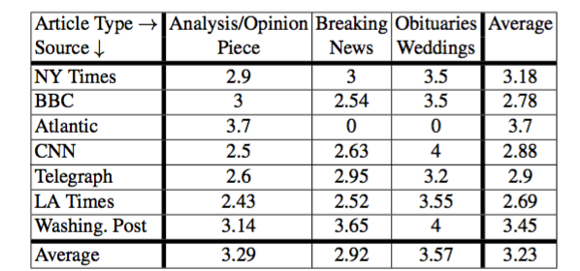
Reference by Description
We communicate about entities we don’t share unique names for: Lincoln, President vs Lincoln Nebraska vs …
This phenomenon is
ubiquitous in human
communication

Slide 29
Mathematical theory of Communication Semantics?
The fundamental problem of communication is that of reproducing at one point either exactly or approximately a message selected at another point. Frequently the messages have meaning; that is they refer to or are correlated according to some system with certain physical or conceptual entities. These semantic aspects of communication are irrelevant to the engineering problem. --- Shannon

Slide 30
Reference By Description
Could be basis for inter-program communication
Issues
How big does the description need to be?
    James Kohut, Neurosurgeon, Gilroy vs
    John Smith, Trader, New York
  Coping with wrong mutual knowledge
    George Bush, President
    How can we make the description easy to decode?

Slide 31
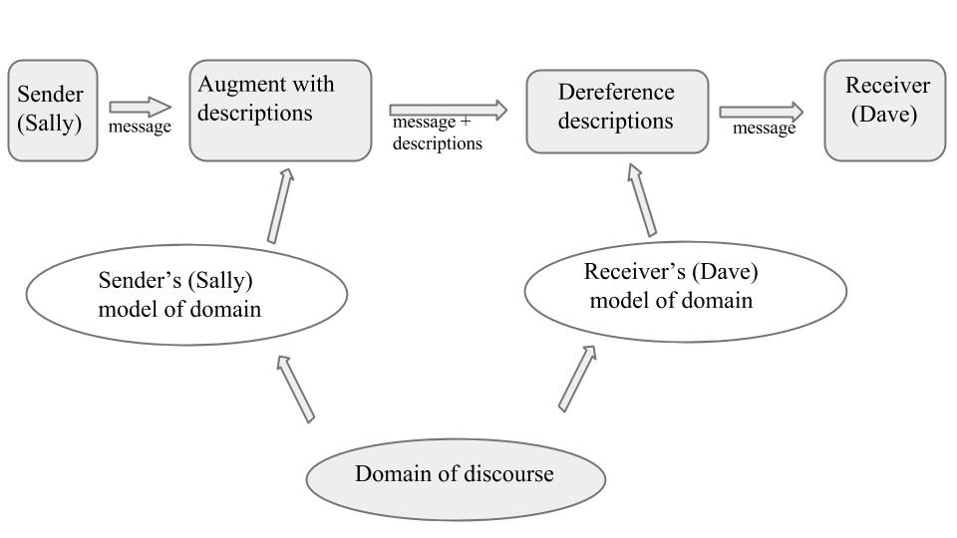
Communication Model

Slide 32
Questions for such a theory
  How do we measure shared knowledge and shared language?
  How big does the description need to be as a function of this?
  What is the minimum required sharing required?
  What are the computation and communication overheads?
  How much can be disclosed without revealing identity?
First steps towards such a theory
  http://arxiv.org/abs/1511.06341

Slide 33
Main Result
Ambiguity A = inverse of entropy of possible referents of symbols
Salience F = info. content rate of most discriminating descriptions
Description size in most general case
N = size of domain of discourse
Ax, Ad = Ambiguity of node being described, descriptor nodes
S = Number of candidate descriptions considered
bD = Number of relations between descriptor nodes
- Results empirically validated

Slide 34

Summary of results
Information content of description > ambiguity in language
Tradeoff between sharing language and computation
Sender computation can be traded for receiver computation
Humans use flat (easy to decode) descriptions
D = 2log(N)/F, bootstrap from no shared language, O(2^{log(N)}) computation
Non-identifying description size

Slide 35
Teachable Learning Systems
What is Empirical Modeling
Deep dives on some research topics
Web scale structured data
Teachable learning systems
The case for a `Data Commons’
Notes:
Thank you for inviting me here.
The term Data Science has become rather popular of late and is being used to refer to a range of very different things.
I’d like to start by offering one perspective on what it is.
There are a large number of super interesting research problems associated with Data Science. I will go into a bit of depth
On a couple of topics that I have been closely associated with.
Finally, I’d like to make a case for something I call a ‘Data Commons

Slide 36
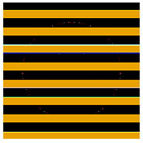
Todays learning systems
More art than engineering (hyper-parameters)
Brittle --- unpredictable failures
Don’t provide explanations
Tail performance is weak
Rare events are important!
Contrast with human learning
School bus?
Notes:
Hyper-parameter --- example of reducing beam search depth to get better answers
Many applications need explanations. Example of ad system freezing in 2008.
Example of learning to recognize an animal from just a couple of examples

Slide 37
Being taught vs discovering
Classical AI (Knowledge Based) systems
Just tell them, but have to tell them everything!
Extremely expressive, but run time is slow
Very predictable, explainable, but boring
Learning based systems
Can learn lots of simple generalizations
Mostly propositional representations
More complex things hard to express or learn

Slide 38
Teachable learning systems
Can we combine the two?
Given a set of training data + general constraints, learn function
Already done in most learning systems, in post processing layer
Goal is to incorporate constraints into learning to also improve tail performance

Slide 39
More expressive representations
Hard to express interesting generalities with feature vectors
Logic based KR hard to incorporate into learning
Need ‘differentiable knowledge representation’

Slide 40
Embedding logic into vector spaces
Classical logic based on set
of entities and N-tuples
Can be mapped to set of
points and vectors
KB (gafs + axioms) can be expressed
as a set of differentiable equations
Much work remains, but approach shows promise …
mother
mother
vector
Jane
Jill
mother
brother
fred

Slide 41
Outline
What is Empirical Modeling
Deep dives on some research topics
Web scale structured data
Teachable learning systems
The case for a `Data Commons’

Slide 42
Case for a Data Commons
Much work remains
Building these systems is a black art
On pulling together the data for an empirical model
On the learning components
On the systems problems
We need 100X more research systems!

Slide 43

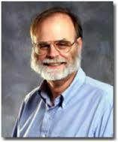
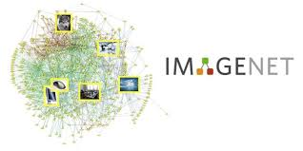

Data, Data, Data
Research is driven by large, interesting datasets
Datasets set research directions:
Genomics
Skyserver: Sloan Digital Sky Survey
ImageNet
Notes:
Datasets drive research.
Genomics is a field driven by data.
The work that Jim Gray did with Skyserver had a profound impact on astronomy.

Slide 44
Using Datasets: current model
Here is a dataset, download and have fun
High upfront costs: machines, storage
Sparse ecosystem, few tools, ...
Hello world is just too hard!
Notes:
There are an increasing number of datasets available on the web, but using them is still hard.
The biggest hurdle is that downloading something that is 100 terrabytes eliminates 99% of the researchers who want to dip their toe into the water.
And for the 1% who persevere, too much time is spent in data and systems wrangling

Slide 45
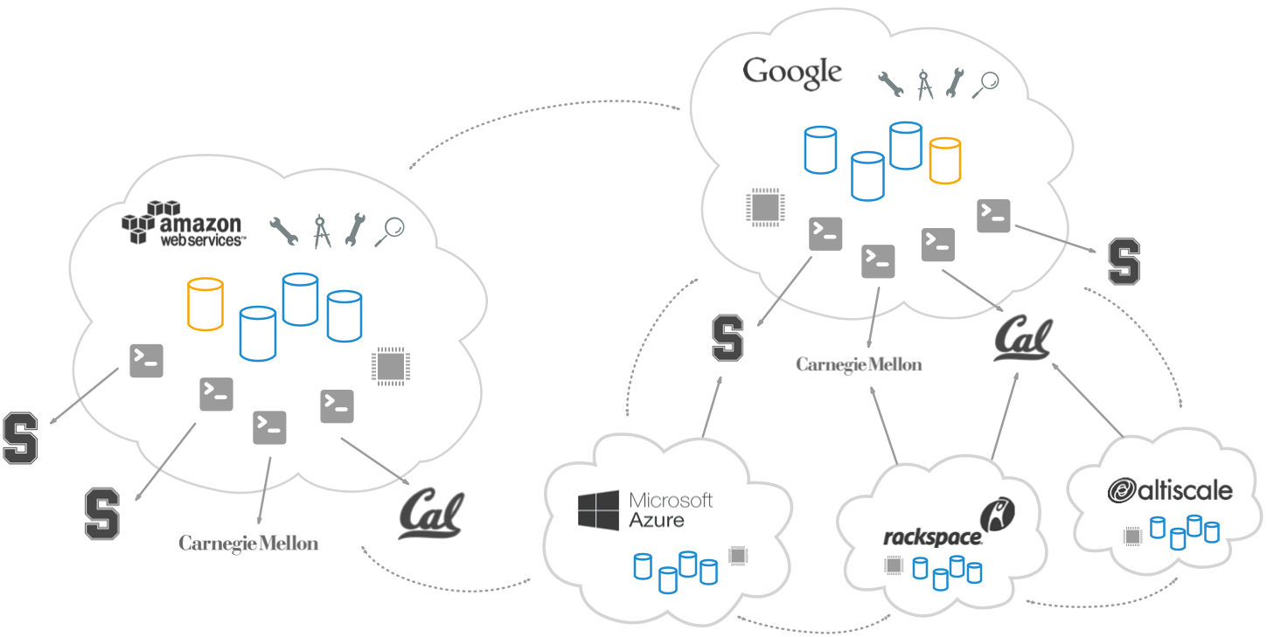
DataCommons.org
Notes:
I would like to propose datacommons.org.
The datasets are available to all in the public clouds.

Slide 46
Data Commons
Bring the code to the data
Make data science easier
Hello world → Trying something small should take < 30 min
Ecosystem of shared data sets, tools, applications …
Notes:
There are two important components of datacommons. The first is that by moving the computation to the data, we get rid of most of the systems burden. The second is that by enabling people to make small contributions, we should be able to get a much richer ecosystem of tools and such.
The hello world goal is that ...

Slide 47
Derivative works
Value of data commons has to be more than the sum of the input data (web analogy)
Ecosystem of derivative works that make data more useful
Build on each others data, not just code
2 examples of such derivative works

Slide 48
Schema.org as training data
The largest set of parallel corpura
Markup in English/German/… and structured data
But fewer than 5 papers over 4 years.
Why?

Slide 49
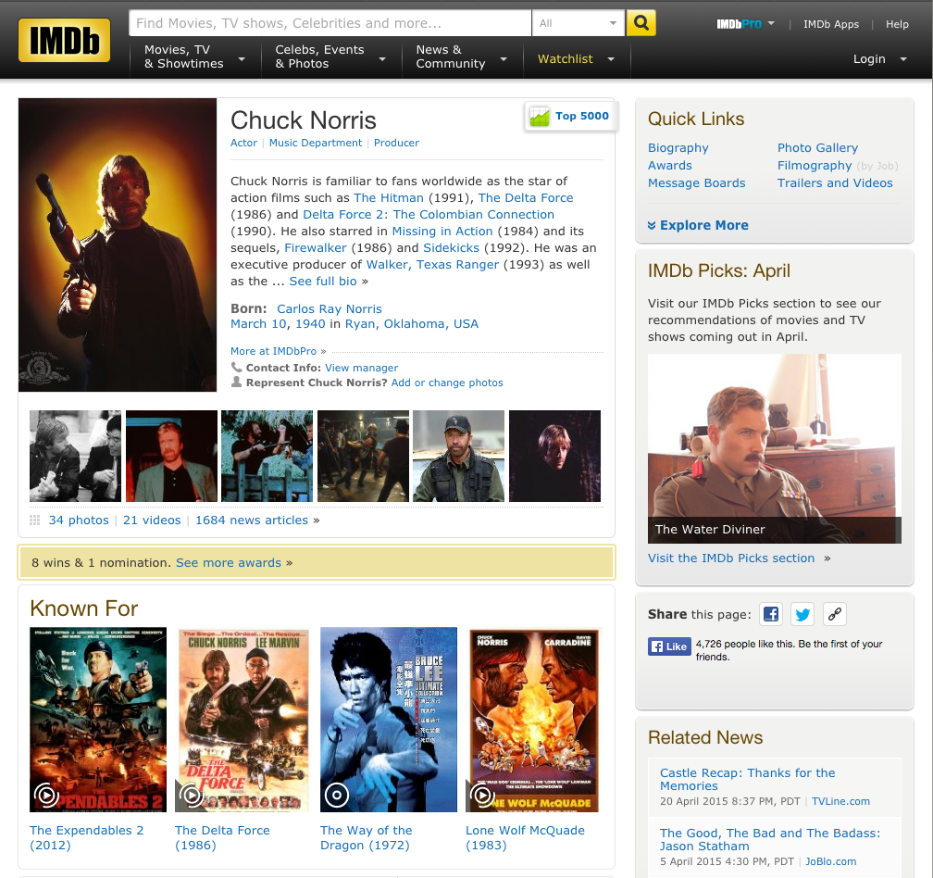
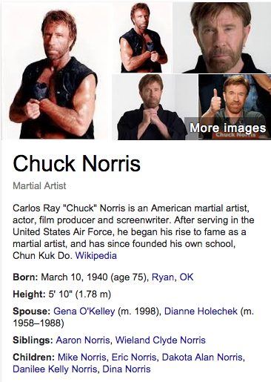
Dataset: Schema.org
Several sites make schema.org data dumps available
But it is in billions of small fragments
Chuck Norris/
nm0001569
type
Actor
<h1 itemprop="name">
Chuck Norris
</h1> ...
citizenOf
birthdate
USA
March 10, 1940
Wikidata
birthplace
Ryan, OK
<time
datetime="1940-3-10"
itemprop="birthDate">
Carlos Ray Norris/
Q2673
spouse
type
Actor
birthdate
Gena O’Kelley
March 10, 1940

Slide 50
Stitch
Wikidata
IMDb
Ryan, OK
Actor
Q2673
nm0001569
birthplace
type
+
citizenOf
type
Actor
birthdate
spouse
USA
March 10, 1940
birthDate
Q8392
March 10, 1940
Actor
Ryan, OK
type
=
birthplace
Chuck Norris
spouse
Gena O’Kelley
citizenOf
birthdate
USA
March 10, 1940

Slide 51
Building abstractions
We are generating huge amounts of raw data
GPS, browser history, …
Data is too low level and noisy for most apps to work with
Like networking and programs, data has abstraction layers

Slide 52
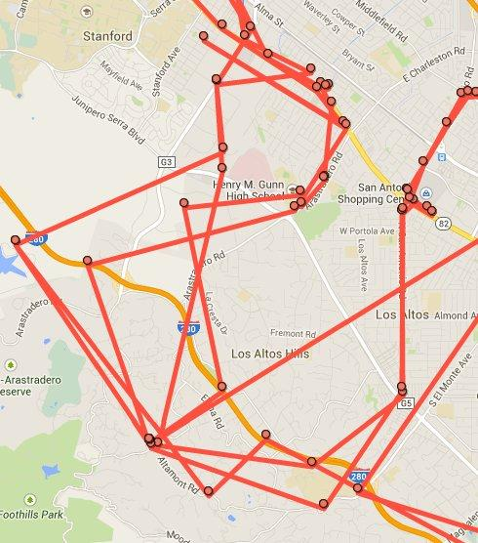
Dataset: Location History
GPS coords → Places → Intents
Need for intelligence:
Gunn school or
Alta Mesa cemetery?
Additional challenge: private data

Slide 53
Data Commons
Data is there … Open Science Data Cloud, NOAH, …
Cloud is there … Gcloud, Azure, ... many willing to help
How should we go about doing it?
Architectural/philosophical principles important

Slide 54
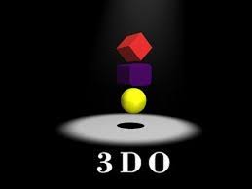



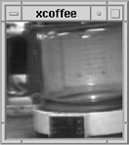
Lessons from the Web
1993: Web vs MSN, AOL, I-TV …
Full featured products + marketing + …
vs Grad students and coffee cams
Web was open, easy and built on simple primitives
Anyone could contribute
Optimized for flexibility/evolution
Very easy to start contributing

Slide 55
Internet → Data Commons
The Internet is more than just some formats and protocols
It embodied certain architectural principles
It grew up in academia
Data Commons has to come from academia
Like the Internet, Web, ...
Industry can provide the resources, but academia has to lead

Slide 56
Concluding
The story of Aldus
Empirical modelling: next step in engineering

Slide 57
Thank you

Slide 58
The Data Commons hope
Data for these and many more problems
Contributors of data
Developers of tools
Students experimenting
Research on learning, systems, ...

