Slide 1

Software Infrastructure for Sustained Innovation (SI²)
NSF 16-552
WEBINAR
March 3, 2016
Rajiv Ramnath
NSF CISE/ACI
Notes:
Hi. I’m Rajiv Ramnath from the NSF Division of Advanced Cyberinfrastructure or ACI. I’m the Program Director managing the Software Infrastructure for Sustained Innovation program, or SI2. In this webcast, I’ll give a brief overview of the SI2 program and describe some of the most important things you need to know about submitting a proposal.

Slide 2
Purpose of this webinar
Orient potential proposers for the SI² competition
Review the program and review criterion, and answer questions
Improve the quality of proposals
Notes:
This webinar in intended to orient the research community that is interested in the SI2 competition, review program and peer-review criterion, answer questions, and ultimately improve the quality of proposals.

Slide 3
Participating NSF Divisions and Program Officers
Directorate for Biological Sciences
Division of Biological Infrastructure
  Peter McCartney
Directorate for Computer & Information Science & Engineering
Division of Advanced Cyberinfrastructure
  Rajiv Ramnath
  Dan Katz (till 3/25)
Division of Computing and Communication Foundations
  Sol Greenspan
  Almadena Chtchelkanova
Directorate for Engineering
Division of Civil, Mechanical and Manufacturing Innovation (CMMI)
  Joanne D. Culbertson,
Division of Chemical, Bioengineering, Environmental, and Transport Systems (CBET)
  Dimitrios V. Papavassiliou
Division of Electrical, Communications and Cyber Systems (ECCS)
  Hao Ling
Directorate for Social, Behavioral & Economic Sciences
All divisions
  Cheryl Eavey
Directorate for Education & Human Resources
All divisions
  John C. Cherniavsky
Directorate for Geosciences
All divisions
  Eva Zanzerkia
Directorate for Mathematical & Physical Sciences
Division of Physics
  Bogdan Mihaila
Division of Materials Research
  Daryl W. Hess
Division of Mathematical Sciences
  Andrew Pollington
Division of Chemistry
  Evelyn Goldfield
Division of Astronomy
  Nigel Sharp
Notes:
Software Infrastructure for Sustained Innovation is a crosscutting program that involves program officers from every NSF Directorate. Participating program officers are listed here, and can be reviewed on solicitation web page at:
http://www.nsf.gov/pubs/2016/nsf16532/nsf16532.htm

Slide 4
Outline
SI² goals and implementation
Solicitation requirements
Review criteria
Notes:
Here is the agenda for today’s presentation. I’ll start by discussing the goals of the SI2 program and how SI2 is structured to achieve those goals. Next, I’ll briefly cover some important aspects of the solicitation including the types of awards to be made, submission requirements, and deadlines. I will then survey the review criteria, with a particular focus on those review criteria that are unique to the SI2 program. Finally, I’ll cover a few frequently asked questions, and invite further questions from you, the audience, that I will try to answer.

Slide 5
Goals and implementation
NSF SI²: a multi-year initiative
Notes:
First, goals and implementation strategies for SI2

Slide 6
Current SI2 Priorities - Towards a National Cyberinfrastructure Ecosystem
Robust and reliable multidisciplinary and omni-disciplinary software
That builds on other ongoing NSF-supported programs
Using techniques, tools and processes for rapid integration of software that reduces cost of custom solutions and custom integrations
Incorporation of software engineering processes that work for different communities
Balancing innovation and research into and along with the development, effectiveness, usability, adoption, and organizational aspects of the software and the project.
Serious considerations of security, trustworthiness and reproducibility.
Comprehensive, innovative approaches to sustainability (e.g. SAAS, incorporation into university offerings, commercialization)
Science-inspired education and LWD
Comprehensive metrics (ideally of impact)
Notes:
NSF program provides a framework for software development and support to advance NSF research in science and engineering via a national cyberinfrastructure ecosystem. Thus, its priorities are to support, encourage and incentivize:
The creation of robust and reliable multidisciplinary and omni-disciplinary software
That builds on other ongoing NSF-supported programs
Using techniques, tools and processes for rapid integration of software that reduces cost of custom solutions and custom integrations
Incorporation of software engineering processes that work for different communities
That includes balanced innovation and research on the development, effectiveness, usability, adoption, and organizational aspects of the software and the project, and embedded into the software development, deployment and support.
Serious considerations of security, trustworthiness and reproducibility,
Comprehensive, innovative approaches to sustainability (e.g. SAAS, incorporation into university offerings, commercialization),
Science-inspired education and LWD, all measured by
Comprehensive metrics (ideally of impact)

Slide 7
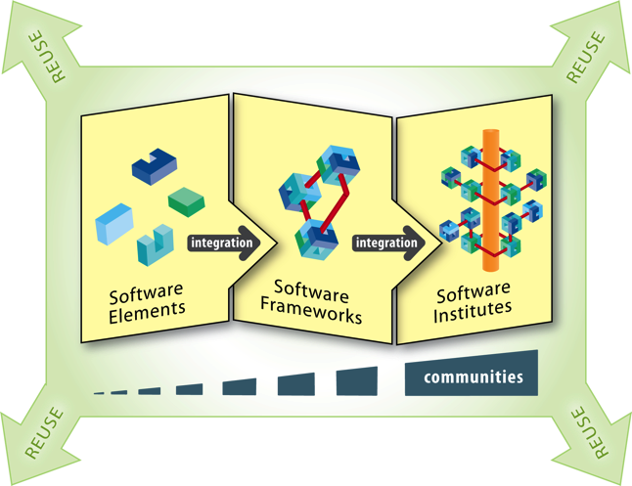
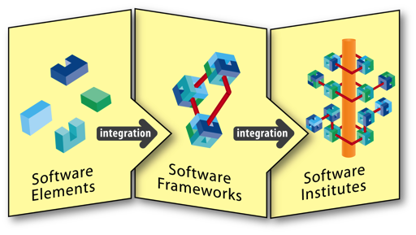
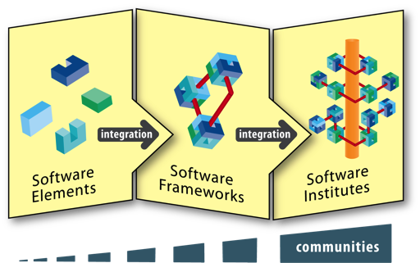
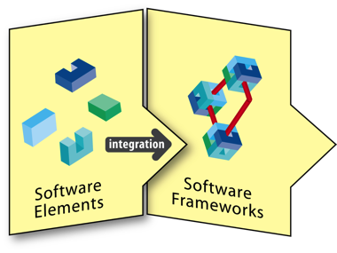
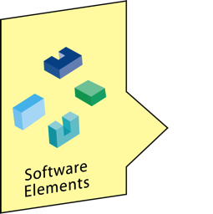
SI² Mechanisms
Create a software ecosystem that scales from individual or small groups of software innovators to large hubs of software excellence
3 interlocking levels of funding
Scientific Software Elements (SSE)
1–2 PIs, <$500k, 3 years
Scientific Software Integration (SSI)
For focused groups
$200k - $1M per year, 3–5 years
Notes:
Ultimately, NSF seeks to create a software ecosystem that scales from individual or small groups of software innovators to large hubs of software excellence. To create this ecosystem, we will use three interlocking levels of funding.
First is Software Elements, which map to SI2 Scientific Software Elements (SSEs), covered by this solicitation. SSE proposals focus on projects led by a small number of investigators, and can cost up to $500,000 over up to three years.
Next is Software Frameworks, which map to SI2 Scientific Software Integrations (SSIs) , covered by this solicitation. SSI Proposals are for focused groups, and can cost between $200,000 and $1,000,000 per year for three to five years. Software frameworks can integrate multiple Software Elements, whether funded by NSF or not.
As the research ecosystem grows to include entire communities, support will be provided for software institutes, which will work on issues that support software development at all levels.
Projects at all levels are expected to impact the research done by communities, and the impacted communities for SSIs should be larger than for SSEs.
NSF’s intent is that all the software developed under SI2 will be reusable outside the SI2 program as well as inside it.

Slide 8
FY16 SI² Competition: SSE & SSI
16-552 Solicitation
http://www.nsf.gov/pubs/2016/nsf16532/nsf16532.htm
Scientific Software Elements (SSE)
SSE awards target small groups that will create and deploy robust software elements for which there is a demonstrated need, encapsulating innovation in science and engineering.
Scientific Software Integration (SSI)
SSI awards target larger groups of PIs organized around common research problems as well as common software infrastructure, and will result in a sustainable community software framework.
Notes:
The current SI2 solicitation, NSF 16-552, can be found at http://www.nsf.gov/pubs/2016/nsf16532/nsf16532.htm. This solicitation includes information on SSE awards that target small groups that will create and deploy robust software elements for which there is a demonstrated need, encapsulating innovation in science and engineering. Information is also provided for SSI awards that target larger groups of principal investigators organized around common research problems as well as common software infrastructure, and that will result in a sustainable community software framework.
Note that as per the solicitation, each SSE award shall not exceed a total of $500,000 and 3 years duration. Each SSI award shall range from $200,000 to $1,000,000 per year, and shall be 3 to 5 years in duration. Projects in the upper portion of this range must be exceptional in terms of scientific impact, and as with all proposals, should be discussed with program officers from the divisions that fund the researchers that would be impacted.
It is strongly recommended that prospective PIs contact Cognizant Program Officers in the division(s) closest to the major disciplinary impact of the proposed work to ascertain whether the scientific focus and budget of the proposed work are appropriate for this solicitation.

Slide 9
FY16 SI² Competition: SSE & SSI
Changes from FY14
SSE due date for first year now in April
SSI due dates and start of decision process moved to September
Several solicitation specific review criteria added
Also note Grant Proposal Guide changes:
  Failure to submit by 5 p.m. submitter’s local time will result in the proposal not being accepted
  An Authorized Organizational Representative (AOR) must provide the proposal certifications concurrently with submission of the proposal.
  And others. See: http://www.nsf.gov/pubs/policydocs/pappguide/nsf16001/sigchanges.jsp
Notes:
Several changes from the fiscal year 2014 SI2 solicitation have been made to the SI2 solicitation for fiscal year 2016. Firstly, the SSE due date for 2016 is now in April (rather than February, as used to be the case). Note that this is for the first year of the solicitation only. Also, SSI due dates and start of decision process have been moved to September.
Also, several solicitation specific review criteria have been added, and existing criteria have been refined.
Please visit http://www.nsf.gov/pubs/2016/nsf16532/nsf16532.htm for more information on specific due dates and the revised solicitation review criteria.
Also note several important changes in the Grant Proposal Guide: http://www.nsf.gov/pubs/policydocs/pappguide/nsf16001/sigchanges.jsp. Two key changes are that failure to submit by 5 p.m. submitter’s local time will result in the proposal not being accepted. Also, an Authorized Organizational Representative (AOR) must provide the proposal certifications - concurrently with submission of the proposal.

Slide 10
FY16 SI² Competition: SSE & SSI
Eligibility
Proposals may only be submitted by:
  Universities and Colleges
  Non-profit, non-academic organizations
  FFRDCs may not receive funds directly from NSF under this solicitation
Limit on Number of Proposals per PI or Co-PI: 1
  An individual may participate as Principal Investigator, co-Principal Investigator or other Senior Personnel in at most one full proposal in the pair of SSE and SSI competitions that occurs in a given calendar year
  In the case of multiple proposals that include the same individual, all but the earliest will be returned without review
See solicitation for details
Notes:
The eligibility criteria for the SI2 program are as follows:
Proposals may only be submitted by universities and colleges or non-profit, non-academic organizations. Federally-funded research and development centers (FFRDCs) may not receive funds directly from NSF under this solicitation.
The number of proposals per principal investigator or co-principal investigator is limited to one. An individual may participate in a proposal as a principal investigator, co-principal investigator, or other senior personnel in at most one full proposal for each pair of SSE/SSE competitions that occurs in a given calendar year. In the case of multiple proposals that include the same individual, all but the earliest will be returned without review.
Please review the solicitation for details.

Slide 11
Solicitation requirementS
Context for meeting SI² goals
Notes:
Next, solicitation requirements

Slide 12
SI² Proposals Should
Identify the areas of science and engineering where the software is needed
Compare the proposed approach to alternative or existing approaches
Describe the process to design, develop, release and disseminate the software.
Describe the innovation and research that have been integrated into the project activities.
Describe how security, trustworthiness, reproducibility, and usability are addressed in the software
Describe the impact of previously funded software efforts (if any)
State which license(s) will be used – expectation is a standard open source license
Provide a project plan with milestones and tangible metrics
Discuss the software’s potential to impact science and engineering
Identify a concomitant outreach and education program
Propose a sustainability plan
Describe how the proposed software leverages and interoperates with widely used tools by the community, and NSF and national cyberinfrastructure investments, as appropriate.
Notes:
SI² Proposals should
Identify the areas of science and engineering where the software is needed
Compare the proposed approach to alternative or existing approaches
Describe the process to design, develop, release and disseminate the software.
Describe the innovation and research that have been integrated into the project activities.
Describe how security, trustworthiness, reproducibility, and usability are addressed in the software
Describe the impact of previously funded software efforts (if any)
State which license(s) will be used – expectation is a standard open source license
Provide a project plan with milestones and tangible metrics
Discuss the software’s potential to impact science and engineering
Identify a concomitant outreach and education program
Propose a sustainability plan
Describe how the proposed software leverages and interoperates with widely used tools by the community, and NSF and national cyberinfrastructure investments, as appropriate.
On a related point, note that the complete review criteria for SSE and SSI proposals are detailed and discussed later.

Slide 13
Additional Documents
Data Management Plan & Postdoctoral Trainee Mentoring Plan (if project includes such trainees)
  Standard NSF requirement
  SI2 reviewers pay close attention to data management plan, since software is data, and the goal of SI2 is to produce well-used software
For SSI proposals, Management and Coordination Plan:
  the specific roles of the PI, co-PIs, other senior personnel and paid consultants at all institutions involved
  how the project will be managed across institutions and disciplines
  identification of the specific coordination mechanisms that will enable cross-institution and/or cross-discipline scientific integration
  pointers to the budget line items that support these management and coordination mechanisms
Letters of collaboration, if any
List of Project Personnel
  List of all senior personnel (those with a biosketch in the proposal)
List of Conflicts
  For each senior person, all COIs (as defined by NSF in the GPG)
  Submitted through FastLane/Grants.gov
  Also as spreadsheet via email to si2@nsf.gov
Notes:
Additional documents include:
A data management plan and postdoctoral trainee mentoring plan (if the project includes such trainees). This is a standard NSF requirement. SI2 reviewers pay close attention to the data management plan since software is data and the goal of SI2 is to produce well-used software.
For SSI proposals, a management and coordination plan is also required. The specific roles of the principal investigators, co-principal investigators, other senior personnel, and paid consultants at all institutions involved must be outlined. Also, there must be a description of how the project will be managed across institutions and disciplines, identification of the specific coordination mechanisms that will enable cross-institution and/or cross-discipline scientific integration, and pointers to the budget line items that support these management and coordination mechanisms.
Letters of Collaboration (if any) should include documentation of funded or unfunded collaborative arrangements of significance to the proposal (see GPG Chapter II.C.2.d(iv) for details). Letters of collaboration should be limited to stating the intent to collaborate and should not contain endorsements or evaluation of the proposed project. The REQUIRED format for letters of collaboration is in the GPG.
A list of project personnel is required that includes all senior personnel, i.e. those with a biosketch in the proposal.
And finally, a list of conflicts must be included for each senior person that outlines all conflicts-of-interest (as defined by NSF in the Grants and Proposals Guide). This information is submitted through FastLane/Grants.gov and also as spreadsheet via email to si2@nsf.gov.

Slide 14
Review criteria
NSF standard and solicitation-specific criteria
Notes:
Now I will review the review criteria for SI2 proposals, with a specific focus on review criteria that are unique to this program.

Slide 15
SI² review criteria
Reviewers and panel will address:
Intellectual Merit,
Broader Impacts, and
SI² Additional Review Criteria
in their reviews, panel discussions, and panel summaries
SI²
Notes:
As for all proposals received by NSF, SI2 reviewers and panelists will be asked to consider the intellectual merit and broader impact for each proposal for their reviews, panel discussions, and panel summaries. In addition to these standard criteria, SI2 reviewers and panelists will also be asked to consider additional review criteria that are unique to the SI2 program. More on this in a few moments.

Slide 16
SI² review criteria
Please note that, since 14 January 2013, the Intellectual Merit and Broader Impacts elements have new guidance
When evaluating NSF proposals, reviewers will consider:
what the proposers want to do
why they want to do it
how they plan to do it
how they will know if they succeed
what benefits would accrue if the project is successful
These issues apply both to the technical aspects of the proposal (intellectual merit) and the way in which the project may make broader contributions (broader impacts)
Notes:
Since 14 January 2013, the intellectual merit and broader impacts review criteria for NSF proposals have been changed. When evaluating NSF proposals, reviewers are now asked to consider:
what the proposers want to do
why they want to do it
how they plan to do it
how they will know if they succeed
what benefits would accrue if the project is successful
These issues apply both to the technical aspects of the proposal (the intellectual merits) and the way in which the project may make broader contributions (the broader impacts).

Slide 17
SI² SSE & SSI specific criteria - 1
To what extent does the proposed software fill a recognized need and advance research capability within a significant area (or areas) of science and engineering?
To what extent does the project integrate innovation and research into the project activities?
How well does the proposal present and discuss the project plan and timeline, including proof-of-concept demonstrations of key software elements and the steps necessary to take the software from prototype to dissemination into the community as reusable software resources?
Does the proposal state the software license to be used and is the choice both suitably justified and appropriate, given the goals of the project?
If the proposers claim to have previously developed widely-used software, particularly if funded under an SSE or SSI award, how significant was the use and impact of the previously funded software, as shown by the quantifiable evidence in the proposal, and is the software properly listed in the appropriate proposers' biosketches?
Are tangible metrics described to measure the success of any software that may be developed? How appropriate are these metrics?
SI²
Not yes/no
Notes:
In addition to the Intellectual Merit and Broader Impacts criteria, there are review criteria that are specific to the SI2 program. Additional criteria and questions will be considered during peer-review. These have been broken up across two slides. The first set of criteria includes:
To what extent does the proposed software fill a recognized need and advance research capability within a significant area (or areas) of science and engineering?
To what extent does the project integrate innovation and research into the project activities?
How well does the proposal present and discuss the project plan and timeline, including proof-of-concept demonstrations of key software elements and the steps necessary to take the software from prototype to dissemination into the community as reusable software resources?
Does the proposal state the software license to be used and is the choice both suitably justified and appropriate, given the goals of the project?
If the proposers claim to have previously developed widely-used software, particularly if funded under an SSE or SSI award, how significant was the use and impact of the previously funded software, as shown by the quantifiable evidence in the proposal, and is the software properly listed in the appropriate proposers' biosketches?
Are tangible metrics described to measure the success of any software that may be developed? How appropriate are these metrics?
Note that reviewers will be asked to comment on all of these criteria, and to explain their opinions, not just say yes or no, the proposal does or does not address the criteria.

Slide 18
SI² SSE & SSI specific criteria - 2
How well does the software engineering and development plan include and/or enable the integration of relevant activities to ensure the software is responsive to new computing developments?
To what extent are issues of security, trustworthiness, reproducibility, and usability addressed and integrated into the proposed software?
To what extent is adaptability to new technologies and changing requirements addressed by the project and built into the proposed software system?
How well does the project plan include user interaction, a community-driven approach, and a timeline of new feature releases? Is there a strong plan to extend the work to additional user communities?
How well does the project address the sustainability of the developed software beyond the lifetime of the award?
To what extent does the proposed software leverage, and to what extent is it interoperable with, widely used tools by the community, and NSF and national cyberinfrastructure investments, as appropriate?
SI²
Not yes/no
Notes:
The second set of solicitation specific criteria includes:
How well does the software engineering and development plan include and/or enable the integration of relevant activities to ensure the software is responsive to new computing developments?
To what extent are issues of security, trustworthiness, reproducibility, and usability addressed and integrated into the proposed software?
To what extent is adaptability to new technologies and changing requirements addressed by the project and built into the proposed software system?
How well does the project plan include user interaction, a community-driven approach, and a timeline of new feature releases? Is there a strong plan to extend the work to additional user communities?
How well does the project address the sustainability of the developed software beyond the lifetime of the award?
To what extent does the proposed software leverage, and to what extent is it interoperable with, widely used tools by the community, and NSF and national cyberinfrastructure investments, as appropriate?
Once again note that the reviewers will be asked to comment on all of these criteria, and to explain their opinions, not just say yes or no, the proposal does or does not address the criteria.

Slide 19
Some Thoughts on Future directions
Notes:
I wanted to close the SI2 segment of the webinar with some thoughts on potential future directions that SI2, or an equivalent software program may take.

Slide 20
In 2026
Example societal grand challenges:
  Disaster scenarios imposed by climate change
  Sustainable provisioning of food, water and energy
  Economic shifts imposed by a decentralized world order
  Education for all
Research needs:
  Distributed, dynamic, multi-disciplinary collaborations
  Lots of research “in the wild” in situ with the object of research
  Data-driven, integrative over multiple scales, from “dual-use” sources
  A wide spectrum of stakeholders and participants – from scientists to citizens to industry organizations.
Research processes will need to be dynamic:
  Range from explorations to repeatable workflows and back.
  Research methods – ranging from quantitative to qualitative - will need to be drawn from across disciplines and then integrated.
  Participants will engage and disengage depending upon the stage of the research.
  Datasets, instruments and computation will be brought in and utilized as and when needed.
Notes:
Software will become extremely important in addressing societal grand challenges, such as:
Disaster scenarios imposed by climate change
Sustainable provisioning of food, water and energy
Economic shifts imposed by a decentralized world order
Education for all
Research will become:
Distributed, dynamic, multi-disciplinary collaborations, where
Lots of research is “in the wild” in situ with the objects of research, and is
Data-driven, integrative over multiple scales, with data and computation drawn from “dual-use” sources, and involving
A wide spectrum of stakeholders and participants – from scientists to citizens to industry organizations.
Thus the processes by which Research is done will need to be dynamic:
Ranging from explorations to repeatable workflows and back.
Using research methods ranging from quantitative to qualitative, drawn from across disciplines and then integrated.
Participants will engage and disengage depending upon the stage of the research, and
Datasets, instruments and computation will be brought in and utilized as and when needed.

Slide 21
Dynamic CI Processes on Interoperable, Configurable CI
Toolboxes of composable computational research methods
Workflows that adapt to data and humans-in-the-loop.
Use dynamically configurable systems, software and networks (software defined everything, software injection, parameterized components)
Need security, access, reproducibility and trustworthiness techniques for dynamic situations (human back in the loop?).
HCI that evolves
Business models for "on-demand negotiation”
Learning aimed towards “integrative synthesis” rather than disciplinary depth.
Notes:
Thus, cyber-infrastructure will need to support dynamic CI Processes on Interoperable, configurable CI, comprising:
Toolboxes of composable computational research methods
Workflows that adapt to data and humans-in-the-loop.
Dynamically configurable systems, software and networks (software defined everything, software injection, parameterized components)
That utilize security, access, reproducibility and trustworthiness techniques for dynamic situations (with the human back in the loop).
Interact with humans via Human Computer Interfaces that evolves
Business models may change from static models to models that are built on "on-demand negotiation”, such as through auctions.
Learning and workforce development may also have to change – and be aimed towards “integrative synthesis” rather than disciplinary depth.

Slide 22
On behalf of the National Science Foundation and the SI² team
THANK YOU!
These slides, an audio recording, and a script of this webinar are available at http://www.nsf.gov/events/
Questions? Now, rramnath@nsf.gov, or 703-292-4776.
Notes:
The slides and the script for this webcast, as well as an audio recording, will be available at http://www.nsf.gov/events/. On that page, you’ll need to look for this webcast among the list of events. I invite your questions now, via email to rramnath@nsf.gov, or via telephone to 703-292-4776. You can also find contact details for program officers from other NSF Directorates who are involved in the SI2 program on the solicitation web page http://www.nsf.gov/pubs/2016/nsf16532/nsf16532.htm.

