Slide 1

Introduction to Webinar on Upcoming ACI Solicitations
March 3, 2016
Amy Friedlander
Deputy Division Director
Division of Advanced Cyberinfrastructure/NSF
Notes:
Good morning. My name is Amy Friedlander, and I am delighted to welcome you to our webinar on ACI and upcoming solicitations that may be of interest to you. We will post the slides and the audio file on the Event Page so that if you miss any of the presentations or wish to refer back, the information will be available for you. The URL will be provided at the end of this presentation.

Slide 2
Goals for this presentation
Provide context for the programs
Call attention to several changes in NSF-wide policies and procedures
Point to resources that can help you prepare your proposals and understand the merit review process
Notes:
My colleagues in the programs are here to discuss specific opportunities in the areas we support. However, before we get to their presentations, the goals of my brief presentation are to: (1) tell you a little about NSF and ACI and to provide context for our programs; (2) call attention to several changes in NSF-wide policies and procedures that will affect the way you develop and submit your proposals; and (3) point you to some resources that can help you prepare your proposals.

Slide 3


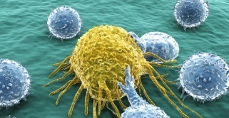
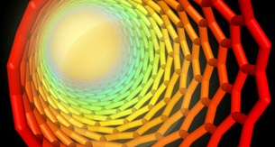
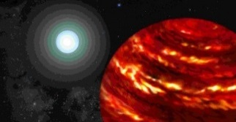
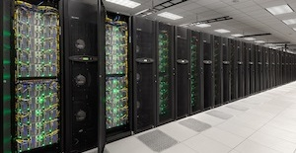
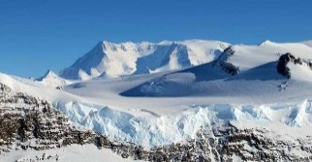




NSF Champions Research and Education Across All Fields of Science and Engineering
Biological
Sciences
Engineering
Mathematical & Physical Sciences
Computer & Information Science & Engineering
Geosciences
Integrative Activities
Education & Human Resources
Social, Behavioral & Economic Sciences
International Science and Engineering
Notes:
As many of you may know, NSF has a broad mission to advance basic research in science, technology, and engineering and the education. The foundation is organized into seven directorates and the Office of International Science and Engineering and the Office of Integrative Activities. The directorates correspond to the broad disciplinary areas of science, engineering, and education: Biological Sciences, Engineering, Mathematics and Physical Sciences, Computer and Information Science and Engineering, Geosciences, Education and Human Resources; Social, Behavioral, and Economic Sciences.
CREDITS:
Top row (left to right):
Cancer cell and lymphocytes;
Credit: Thinkstock
Stampede is a world-class supercomputer with comprehensive simulation and data analysis capabilities
Credit: TACC
Two students work on a research project as part of Rutgers' I³ effort. Rutgers' goal is to develop a model that will recruit, retain, mentor and educate graduate students to become leading scientists in the nation
Credit: Nick Romanenko
A carbon nanotube (shown in illustration) can produce a very rapid wave of power when it is coated by a layer of fuel and ignited, so that heat travels along the tube. The previously unknown phenomenon was discovered by a team of scientists at the Massachusetts Institute of Technology
Credit: Christine Daniloff
Bottom row (left to right):
Ice on the Ellsworth Range in Antarctica as seen from the IceBridge DC-8 on Oct. 22, 2012. NASA's Operation IceBridge is an airborne science mission to study Earth's polar ice Credit: James Yungel/NASA IceBridge, National Science Foundation
Artist's rendering of a possible exoplanetary system with a gas-giant planet orbiting close to his parent star which is more massive than our sun.
Credit: Artwork by Lynette Cook
Crowd of people
Credit: Thinkstock
Earth with stars, digitally generated image
Credit: iStock

Slide 4


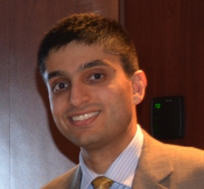
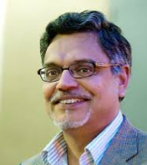

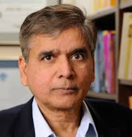

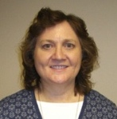
CISE Organization
Senior Advisor for
Research Cyberinfrastructure
Peter Arzberger
CISE Directorate
Jim Kurose, AD
Erwin Gianchandani, Acting DAD
Senior Advisor for
Data Science
Chaitan Baru
Advanced Cyberinfrastructure (ACI)
Irene Qualters, DD
Computing and Communications Foundations (CCF)
Rao Kosaraju, DD
Computer and Network Systems (CNS)
Peter Arzberger, Acting DD
Information and Intelligent Systems (IIS)
Lynne Parker, DD
Data
Algorithmic
Foundations
Computer Systems Research
Cyber Human Systems
High Performance Computing
Communication and Information Foundations
Networking Technology and Systems
Information Integration and Informatics
Networking/ Cybersecurity
Software and Hardware Foundations
CS Education and Workforce
Robust Intelligence
Software
Notes:
The Division of Advanced Cyberinfrastructure is located with the CISE directorate, and is one of four divisions: ACI, Computing and Communications Foundations, Computer and Network Systems, and Information and Intelligent Systems. Each of these divisions is further sub-divided into topical clusters or areas as you can see in this organization chart.

Slide 5
Snapshot of CISE FY 2015 Activities
 | CISE
Research Budget | $933M
Number of Proposals | 8,038
Number of Awards | 1,887
Success Rate | ~23%
Average Annualized Award | $187K
Number of Panels Held | 342
Number of People Supported | 17,868
 | CISE
Senior Researchers | 7,302
Other Professionals | 1,278
Postdoctoral Associates | 498
Graduate Students | 6,423
Undergraduate Students | 2,367
Notes:
This slide presents a little more detail on CISE, based on 2015 data. We made just under 1900 awards for a total of $933M. Most awards are made through competitive merit review, meaning that the directorate organized 342 panels. A total of 17,868 individuals are supported; the largest categories are senior researchers and graduate students. However, we are also pleased about the approximately 2,300 undergraduate students who are also supported.
Let’s look a little more closely at ACI.

Slide 6
ACI: Operational View
Supporting advance CI to accelerate discovery and innovation
Materials Genome
…
Facilities
Science Drivers
Constant exchange with NSF Directorates, Divisions and Programs
Understanding the Brain
INFEWS
High Performance
Computing
Data
ACI investments
Convergent investments in technologies and communities
to maximize impact
People
(LWD)
Networking and
Cybersecurity
Software
Leadership,
Coordination, Partnership
NSF Directorates, NSF-Wide Initiatives,
Industry, Agencies, International
Notes:
ACI is grouped into five thematic areas or clusters: High Performance Computing, Networking and Cybersecurity; Software; Data; and Learning and Workforce Development.
ACI both provisions the advanced research cyberinfrastructure on campuses and undertakes use-inspired research on the cyberinfrastructure itself. This means that we interact with all of the NSF directorates as well as other agencies, industry, and international partners and make investments that seek to build communities and maximize the impact of other investments as well as our own. In addition to the importance of supporting advanced research, what sets ACI apart from other NSF programs is the focus on integrated activities, interdisciplinary research and applications; and attention to sustainability and community development. This means we invest in the people who build, operate, and use the cyberinfrastructure together with high performance computing, advanced networking and cybersecurity, data, and software.
My colleagues will talk about their programs, so let me move on to some highlights of changes to the PAPPG.

Slide 7
Changes in NSF Policies
Proposal & Award Policies & Procedures Guide
  9 months review and comment beginning in April 2015
  Effective date, January 25, 2016
  Significant Changes and Clarifications to the PAPPG: http://www.nsf.gov/pubs/policydocs/pappguide/nsf16001/sigchanges.jsp
Notes:
Every year, NSF updates the Proposal and Award Policies and Procedures Guide through a public notification, comment, and review process published in the Federal Register. This process began in April, 2015 and was concluded in October. The effective date for these changes is January 25, 2016. For a summary of them, you should check the page entitled “Significant Changes and Clarifications to the PAPPG”; I have provided the URL.

Slide 8
Some of the notable changes
  5 p.m. submitter’s local time is standard for all submissions, including proposals submitted in response to solicitations.
  If the word “must” (rather than “should”) has been used, please note that this is a requirement. Proposals that do not have required elements may be returned without review. This includes use of special characters, formatting, and organization of documents uploaded separately as well as collaboration plans, data management plans, and other elements required by solicitation or the Grant Proposal Guide.
Notes:
You (or your sponsored research office) should become familiar with all of these changes, which affect both the submission of your proposal as well as the eventual management of the award, if your proposal is successful. For now, let me just highlight a couple of the changes for you:
5 p.m. submitter’s local time is standard for all submissions, including proposals submitted in response to solicitations.
If the word “must” (rather than “should”) has been used, please note that this is a requirement. Proposals that do not have required elements may be returned without review. This includes use of special characters, formatting, and organization of documents uploaded separately as well as collaboration plans, data management plans, and other elements required by solicitation or the Grant Proposal Guide.

Slide 9
Some of the notable changes, 2
  Broader impacts. “The Project Description must contain, as a separate section within the narrative, a section labeled "Broader Impacts". GPG II.C.2.d(i)
  Pay attention to changes in:
    Results from Prior NSF Support
    Biographical Sketches
    Current and Pending Support
  Public Access requirement will apply to peer-reviewed journal articles and juried conference papers resulting from awards made from proposals submitted after January 2016.
    NSF Public Access Repository (NSF-PAR), par.nsf.gov
    Voluntary deposit to NSF-PAR is possible.
Notes:
NSF employs two foundation-wide merit review criteria (in addition to any solicitation-specific criteria). These criteria are intellectual merit and broader impacts. Please pay attention to new requirements for broader impacts in your proposals: That is, “The Project Description must contain, as a separate section within the narrative, a section labeled "Broader Impacts".
Also pay attention to changes and new formatting requirements for:
Results from Prior NSF Support
Biographical Sketches
Current and Pending Support
Finally, a word about public access. NSF has had a data sharing policy for many years and a data management plan requirement since 2011. In March 2015, we released our public access plan (NSF 15-52), and the requirement has gone into effect for awards made for proposals submitted or due on or after January 25, 2016, the effective date of the PAPPG. Copies of journal articles and juried conference papers supported wholly or part from these awards must be deposited in the NSF Public Access Repository

Slide 10
NSF Public Access: Project Reporting
Reduce burden on PIs by automatically ingesting publication information submitted through NSF-PAR into annual and final project reports
Cumulative listing of all products
Simplify reporting of products
Automatic ingest will only happen for awards that must comply with the new Public Access policy
NSF has worked with a small group of PIs to voluntarily deposit publications in NSF PAR to test the automatic ingest process
Notes:
NSF-PAR has been up and running since December 2015, and over 100 individuals have voluntarily deposited papers, not including people who were part of the pilot. One of the goals of the system has been to minimize burden on the PI community by streamlining the way publications are reported. Data from the repository is automatically pre-populated in annual and final reports and the reports will provide a cumulative listing of all products.
Let me emphasize that the automatic pre-population of reports only applies to new awards that must comply with the public access requirement. Those of you who may have existing awards are not subject to the new requirement and will report the way you always have.

Slide 11
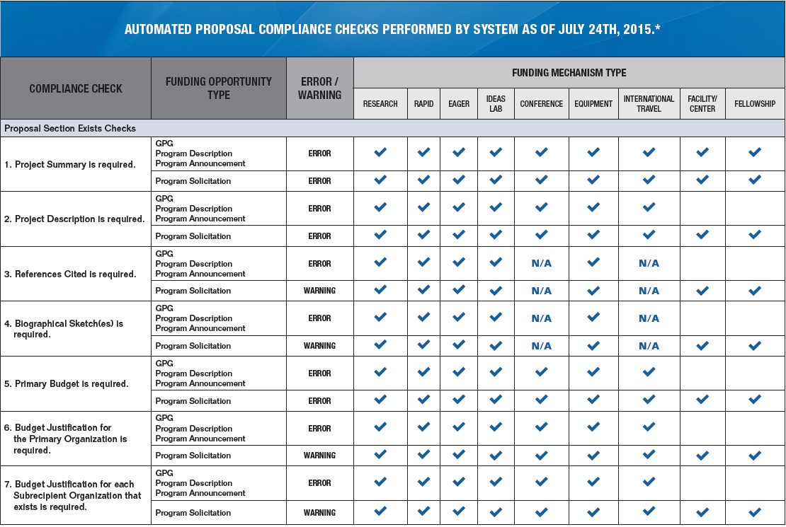
Automated Compliance Checking
http://www.nsf.gov/bfa/dias/policy/autocheck/compliancechecks_july15.pdf
Notes:
Another change concerns automated compliance checking.
The list specifies which checks are run depending on type of submission (GPG, Program Description, Program Announcement, or Program Solicitation) and funding mechanism (Research, RAPID, EAGER, Ideas Lab, Conference, Equipment, International Travel, Facility/Center, or Fellowship). It also specifies whether the check triggers a “warning” or “error” message for non-compliant proposals.
Grants.gov does not perform any of these checks and may allow a proposal to be submitted only for it to be returned without review once it hits NSF.

Slide 12
Key Documents
Proposal & Award Policies & Procedures Guide
  nsf.gov/publications/pub_summ.jsp?ods_key=papp
Fiscal Year 2016 Budget Request
  nsf.gov/about/budget/fy2016/index.jsp
NSF Strategic Plan for Fiscal Years 2014-2018
  nsf.gov/publications/pub_summ.jsp?ods_key=nsf14043
NSB Report on Merit Review
  nsf.gov/nsb/publications/pub_summ.jsp?ods_key=nsb1333
Public Access
  Plan (NSF 15-52)
    www.nsf.gov/news/special_reports/public_access/index.jsp
  Research.gov (www.research.gov), About Public Access
ACI website, www.nsf.gov/div/index.jsp?div=ACI
Notes:
So I will stop here with a few pointers to some key documents: The PAPPG; the budget request; the strategic plan; the NSB report on merit review; some pointers to Public Access resources; and of course, the division website.

Slide 13
Find our presentation at:
http://www.nsf.gov/events/event_summ.jsp?cntn_id=137798&org=CISE
Notes:
Finally, you can review this presentation at the Event page at this URL.

Slide 14
Thank you
Notes:
Thank you.

Slide 15
Credits
Copyrighted material used under Fair Use. If you are the copyright holder and believe your material has been used unfairly, or if you have any suggestions, feedback, or support, please contact: ciseitsupport@nsf.gov.
Except where otherwise indicated, permission is granted to copy, distribute, and/or modify all images in this document under the terms of the GNU Free Documentation license, Version 1.2 or any later version published by the Free Software Foundation; with no Invariant Sections, no Front-Cover Texts, and no Back-Cover Texts. A copy of the license is included in the section entitled “GNU Free Documentation license” at
http://commons.wikimedia.org/wiki/Commons:GNU_Free_Documentation_License.
The inclusion of a logo does not express or imply the endorsement by NSF of the entities' products, services, or enterprises.

