Slide 1
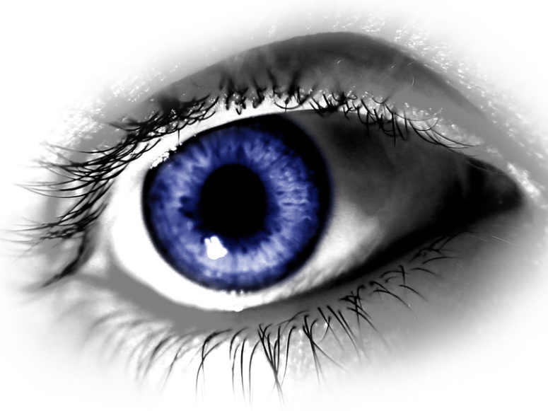
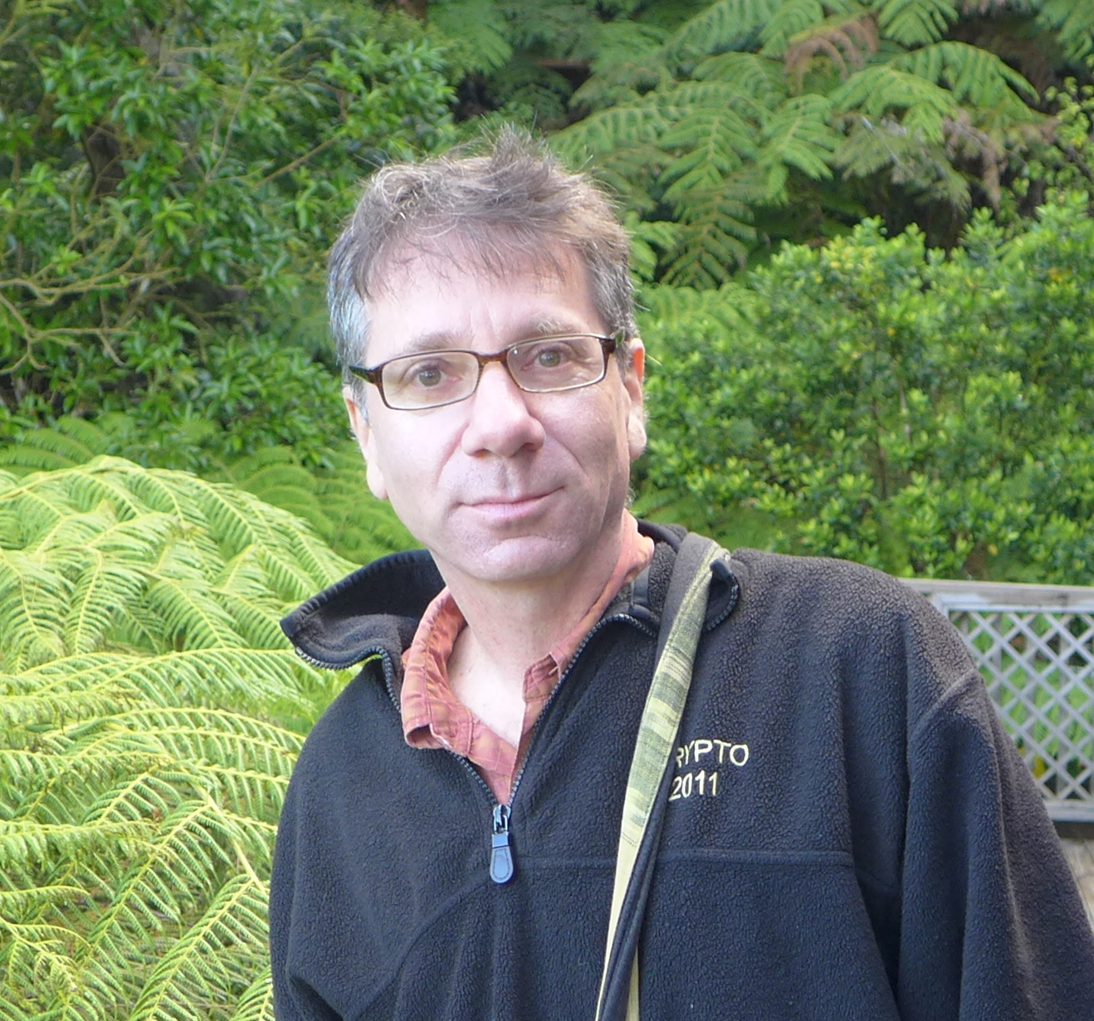
W ashington
A rea
T rustworthy
C omputing
H our
34th WATCH:
The Moral Character of Cryptographic Work
Phillip Rogaway
University of California, Davis
Thursday March 24, Noon, Room 110
Abstract
Cryptography rearranges power: it configures who can do
what, from what. This makes cryptography an inherently political tool,
and it confers on the field an intrinsically moral dimension. The Snowden
revelations motivate a reassessment of the political and moral positioning
of cryptography. They lead one to ask if my community's inability to effectively
address mass surveillance constitutes a failure of our field. I believe that
it does. I call for a community-wide effort to develop more effective means
to resist mass surveillance. I plead for a reinvention of our disciplinary
culture to attend not only to puzzles and math, but, also, to the societal
implications of our work.
Speaker
Phillip Rogaway studied cryptography at MIT (1991), then worked as a security
architect for IBM before joining the faculty at the University of California,
Davis in 1994. Co-inventor of “practice-oriented provable security,” Rogaway’s
work seeks to meld cryptographic theory and cryptographic practice in a
mutually beneficial way.
About the WATCH series:
Transforming today’s trusted but untrustworthy cyberinfrastructure into one that can meet society’s growing demands requires both technical advances and improved understanding of how people and organizations of many backgrounds perceive, decide to adopt, and actually use technology. WATCH aims to provide thought-provoking talks by innovative thinkers with ideas that illuminate these challenges and provide signposts toward solutions. The series is jointly organized by NSF’s Computer Science and Engineering (CISE) and Social, Behavioral, and Economic (SBE) Directorates and sponsored by the CISE Secure and Trustworthy Cyberspace (SaTC) Program. Talks will be recorded and made available over the Internet.
Thursday, Mar 24, 2016
Questions/comments about WATCH?
Contact Nina Amla (namla@nsf.gov)
NSF Stafford I Room 110, Noon
Public Invited

