Slide 1

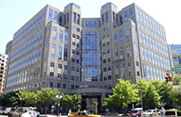


Innovative
Technology
Experiences for
Students and
Teachers
Reviewer Webinar
NSF 15-599

Slide 2
First, Thanks!
Your contributions of time and your insights are immensely important to us.
You have each been recruited for specific reasons; express yourself.
Our aim is (mostly) not consensus building; but to hear from a range of perspectives.
We do hope you’ll find the panel experience interesting and rewarding.

Slide 3
Overview of Webinar
FastLane & Arranging Travel
The panel process and preparing reviews
Avoiding implicit bias
Conflicts of Interests and Confidentiality
Some procedural details

Slide 4
Getting Set Up in FastLane
Log in and Change Password
Update Personal Information
Provide Banking information
Print-On-Demand Option
Access Your Proposals
Interactive Panel System

Slide 5
Remuneration and Travel Information
Travel Details:
Travel must be arranged through ADTRAV .
Those who drive should complete an auto travel form.
Federal employees must save receipts.
Electronic Funds Transfer (EFT):
Information is entered into FastLane by US panelists.
Ensures your remuneration.
Must be done before the meeting.
Not necessary for international panelists.
Remuneration will appear without notice to your specified financial institution and account (“U.S. Treasury”; does not reference NSF).
Remuneration is considered taxable.
NSF automatically sends a Form 1099 if $600 or greater is paid to a reviewer per calendar year.
Notes:
Should be modified for a fully virtual panel

Slide 6
Flat Rate Fee
Out of area: A flat rate of $480 for 2 meeting days attended and 1 travel day at $280 per day.
Local area and virtual panelists: $200 for each full meeting day attended.
This fee is meant to cover all expenses, and an IRS 1099 will be generated at the end of the year (so save your receipts for tax purposes).
All payments to panelists are made by direct deposit.

Slide 7
Lodging Accommodations
Please arrange lodging accommodations on your own, or contact Accommodations Unlimited at (703) 385-5680 or toll free (800) 201-4005.
NSF is located near the Ballston Metro Station in Arlington, VA, and there are five hotels in the immediate area.

Slide 8
Reminder
Sign NSF Form 1230P
COI
Confidentiality
We encourage you to indicate your race/ethnicity & gender on the confidential form
Please check and add/update your institution

Slide 9
Before You Review
If you haven’t yet done so,
please read the Solicitation!
ITEST Program Solicitation
NSF 15-599

Slide 10
Two Types of ITEST Projects Supported
Strategies projects that address the creation and implementation of innovative workforce-related activities or programs.
Awards for up to $1.2M for projects lasting up to 3 years.
Approximately 15-20 projects to be supported.
SPrEaD (Successful Project Expansion and Dissemination) projects that support the wider and broader dissemination and examination of innovative strategies.
Awards for up to $2M for projects lasting 3-5 years.
Approximately 5-10 projects to be supported.

Slide 11
Proposal Review Process and Timeline
DGA
Organization
submits
via
FastLane
Program
Officers
Ad hoc
ITEST
Program
Team
Advise
Recommend
Division
Director
Concur
Award
Panel
Decline
Organization
Proposal Receipt
at NSF
DGA
Award
DD Concur
6 Months
30 Days

Slide 12
What The PI Receives
NATIONAL SCIENCE FOUNDATION
4201 Wilson Boulevard
Arlington, Virginia 22230
Dear Dr. Doe,
The National Science Foundation hereby awards a grant of...
$
NATIONAL SCIENCE FOUNDATION
4201 Wilson Boulevard
Arlington, Virginia 22230
Dear Dr. Doe,
I regret to inform you that the National Science Foundation is unable to support your proposal referenced above...
Your reviews (verbatim & anonymous)
Panel Summary (verbatim & anonymous)
Context statement, award/declination letter, and Program Officer comments if declined

Slide 13
Roles of Panels:
Panels engage the broader communities of practice and research in the review process.
Panels provide a broad range of experiences, expertise, and perspectives in reviewing and rating proposals.
Panels prepare substantive reviews and summaries of panel discussions to inform the review process and feedback for researchers.
Panels advise ITEST Program Directors of the competitiveness of each proposal.
Panels do not make funding decisions.

Slide 14
Panel Organization
Panels were organized primarily according to the disciplinary content areas and target populations.
Most panels include either Strategies proposals or SPrEaD proposals, though a panel may have a blend of proposals to consider.

Slide 15
Reviewer Responsibilities
Primary panelists read and write reviews on assigned proposals. They introduce the proposals at the panel meeting, and they write the summaries of the panel discussions (Scribe).
Secondary panelists read and write reviews on assigned proposals and contribute to the panel discussions.
Panelists are encouraged to read all proposals, so long as there are no Conflicts of Interest, and may contribute to the panel discussions.

Slide 16
General Panel Procedure
For each proposal:
Primary panelist leads the discussion, summarizes, and then comments on the proposal.
Primary panelist represents ad hoc reviews (if any).
Secondary panelists discuss their comments in turn.
After all secondary panelists have finished sharing their perspectives, the floor is open for general panel discussion.
The primary panelist takes notes on the discussion and drafts a panel summary.
Everyone reviews all of the panel summaries.
The panel summaries are approved in turn.

Slide 17
National Science Board Report on Merit Review Criteria: Two Review Criteria
When evaluating NSF proposals, reviewers should consider what the proposers want to do, why they want to do it, how they plan to do it, how they will know if they succeed, and what benefits would accrue if the project is successful. These issues apply both to the technical aspects of the proposal and the way in which the project may make broader contributions. To that end, reviewers are asked to evaluate all proposals against two criteria:
Intellectual Merit: The intellectual Merit criterion encompasses the potential to advance knowledge; and
Broader Impacts: The Broader Impacts criterion encompasses the potential to benefit society and contribute to the achievement of specific, desired societal outcomes.

Slide 18
National Science Board Report on Merit Review Criteria: Five Review Elements
The following elements should be considered in the review for both criteria:
1. What is the potential for the proposed activity to:
a. advance knowledge and understanding within its own field or across different fields (Intellectual Merit); and
b. benefit society or advance desired societal outcomes (Broader Impacts)?
2. To what extent do the proposed activities suggest and explore creative, original, or potentially transformative concepts?
3. Is the plan for carrying out the proposed activities well-reasoned, well-organized, and based on a sound rationale? Does the plan incorporate a mechanism to assess success?
4. How well qualified is the individual, team, or institution to conduct the proposed activities?
5. Are there adequate resources available to the PI (either at the home institution or through collaborations) to carry out the proposed activities?
Notes:
The five review elements apply to both criteria, whereas, before they were separate elements.

Slide 19
Special Review Criteria
Does the proposal include explicit strategies for recruiting and selecting participants from identified groups currently underrepresented in STEM professions, careers, or education pathways?
Does the proposal identify the specific needs of the underrepresented groups to be served, and does it include specific plans or strategies for addressing or accommodating the particular needs of participants of the identified underrepresented groups?
Do the planned activities of the proposed project include explicit attention to strategies appropriate to participants’ experiences for promoting awareness, interest, or readiness for STEM careers or STEM education pathways?

Slide 20
Parts of an Individual Review
Rating
Intellectual Merit (Strengths & Weaknesses)
Should address research & evaluation plans
Prior NSF funding (nature & quality if applicable)
Broader Impacts (Strengths & Weaknesses)
Consider Post-Doctoral Mentoring Plan if applicable
Consider Data Management Plan
Special Review Criteria (3 questions relating to broadening participation)
Summary Statement

Slide 21
Your Reviews
Reviews are advisory to NSF, and to the PI, and we both want the best advice you can give.
Things to do in a review:
There is no need to summarize the proposal.
Detail the strengths and weaknesses, including why they are strengths or weaknesses.
Provide specific information that supports your rating, referring to each of the merit review criteria.
The summary statement should provide a justification for how you arrived at your overall rating based on how you weighted the two merit review criteria: intellectual merit and broader impacts.

Slide 22
Ratings – select only one
Excellent, Very Good, Good, Fair, Poor
Excellent - Outstanding proposal in all respects; deserves highest priority for support.
Very Good - High quality proposal in nearly all respects; should be supported if at all possible.
Good - A quality proposal, worthy of support.
Fair - Proposal lacking in one or more critical aspects; key issues need to be addressed.
Poor - Proposal has serious deficiencies.

Slide 23
Make Your Reviews Helpful
Less helpful reviews describe what the proposed work will be, but do not evaluate strengths or weaknesses and do not provide rationales for the evaluations.
Example: The PI will collect data from 25 students.
More helpful: The PI’s plan to collect data from 25 students is a strength because the power analysis suggests that 25 students is sufficient to detect an effect with reasonable assumptions.
Notes:
Could come up with different kinds of examples.

Slide 24
Be Explicit About Broader Impacts
You should attend to the Merit Review Elements for Broader Impacts explicitly in your reviews.
Example: The project will include students from underrepresented groups, in the sample.
More helpful: While the project will include students from underrepresented groups in the sample, there is no plan to specifically address the needs of these students, nor does the proposal cite the relevant literature on design of instructional materials that are relevant to the targeted groups. This is a weakness of the proposal.

Slide 25
Independent (“External”) Project Evaluation
A proposal must describe appropriate project-specific independent review and feedback processes to guide and gauge the success of the project in meeting its goals.
The review might include an external review panel or advisory board or a third-party evaluator.
The review must be independent and rigorous.
The proposal must
Describe the expertise of the external reviewer(s);
Explain how that expertise relates to the goals and objectives of the proposal;
specify how the PI will report and use results of the project's external, critical review process.
There can be different groups providing formative and summative evaluation.

Slide 26
Dissemination Plan
Proposals should include plans for creative and effective dissemination of findings to researchers, policymakers, practitioners, or other relevant constituency groups.
Applicants are encouraged to bring the same levels of insight and creativity to the dissemination aspect of their proposal as other activities.

Slide 27
Results of Prior Research
Does this project build on the results of related prior NSF-funded projects by the PI? The Grant Proposal Guide requires PIs to provide specific information about relevant prior NSF support.
If yes, is there evidence provided about the intellectual merit and broader impacts of the prior project(s)?
How has the prior project influenced this project?
Please include in your reviews any contributions of previously funded projects to the Intellectual Merit or Broader Impacts of proposals being reviewed.

Slide 28
Supplementary Documents
The only items required as Supplementary Documents are the Data Management Plan and, if applicable, the Postdoctoral Researcher Mentoring Plan. Please review these documents.
Letters of collaboration/commitment are allowed.
In the case of ITEST letters of commitment , you may indicate that additional letters of commitment should be obtained if negotiations go forward.

Slide 29
Data Management Plan
Address the strengths and weaknesses of the data management plan under intellectual merit and broader impacts, as appropriate
Types of data, software, curriculum materials, and other materials to be produced.
Standards to be used for data and metadata format and content.
Policies for access and sharing including provisions for appropriate protection of privacy, confidentiality, security, intellectual property, etc.
Policies and provisions for re-use, re-distribution, and the production of derivatives.
Plans for archiving data, samples, and other research products and for preservation of access to them.

Slide 30
Postdoctoral Mentoring Plan
Should be evaluated under broader impacts.
Should evaluate the plans for mentoring activities that will be provided to postdoctoral researchers, including but not limited to:
Career counseling
Training in preparation of grant proposals, publications, and presentations
Guidance on ways to improve teaching and mentoring skills
Guidance on how to effectively collaborate with researchers from diverse backgrounds and disciplinary areas
Training in responsible professional practices

Slide 31
Summary Statement of the Review
The summary should be a succinct statement of your overall analysis of the strengths and weaknesses of the intellectual merit and broader impacts of the proposal.
Do not omit this section.
Do not summarize the proposal itself in this section.
Do not add new information in this section.

Slide 32
Double Check Rating & Review
Make sure your rating is consistent with your written review.
You may change your rating and edit the written review anytime prior to the conclusion of the panel.
It is imperative that your ratings and reviews are entered into FastLane prior to the panel meeting. We strongly encourage you to upload your reviews at least two days prior to the panel meeting.

Slide 33
What makes a Good Review?
Analytic and not just descriptive.
Uses criteria consistent with the solicitation.
Adheres to the Merit Review criteria.
Uses grammatically correct form whether done in paragraphs or a bullet format.
Usually one to two pages; succinct but substantive.

Slide 34
Things to Avoid
Please do not indicate that a proposal should or should not be funded or supported.
Please do not say in the narrative of your review that a proposal is competitive, highly competitive, or not competitive.
Please do not mention any reviewer name in your reviews.

Slide 35
Review Submission Timeline
Reviewers submit reviews at least 1 day before the panel begins
Allows the Program Director to set the order of discussion on the panel, including proposals that are eligible to not be discussed.
Allows the Program Director to provide feedback on any potential problems in reviews.
Enables reviewers to ensure there are no hidden COIs to be addressed.

Slide 36
Common Guidelines for Education Research and Development
This solicitation incorporates language in the publication jointly developed and issued by the National Science Foundation and the Institute of Education Sciences in the U.S. Department of Education.
The Guidelines are just that, “guidelines.” They are intended to be helpful for PIs, but they are not to be used as review criteria. For purposes of the review process, awareness of the guidelines may help you judge the appropriateness of methodologies being proposed if the language of the guidelines is being used.

Slide 37
Research Described in the Guidelines
The Guidelines describe six types of research studies that can generate evidence about how to increase student learning or achieve other outcomes.
For each research type, there is a description of the purpose and the expected empirical or theoretical justifications, types of project outcomes, and quality of evidence.

Slide 38
Accessing The Common Guidelines
“Grant proposal writers and PIs are encouraged to familiarize themselves with both documents and use the information therein to help in the preparation of proposals to NSF.”
Guidelines NSF 13-126 http://www.nsf.gov/pubs/2013/nsf13126/nsf13126.pdf
FAQs NSF 13-127http://www.nsf.gov/pubs/2013/nsf13127/nsf13127.pdf
Notes:
These guidelines are not review criteria, but can be helpful in providing common vocabulary and in structuring comments about the proposed work, particularly for intellectual merit of the project.

Slide 39
Being Mindful of Bias
Hypotheses or stereotypes about a group, often about competence, may be implicit or unconscious.
Accumulation of disadvantage
Small bias in same direction has large effect over time.
Very small differences in treatment can have major consequences in salary, promotion and prestige. (Valian, 1998)

Slide 40
Sources of Implicit Bias
Widely culturally shared:
All people, even members of under-represented groups, hold implicit biases about these groups.
People are often not aware of their biases.
Applied more under circumstances of:
Lack of information.
Stress from competing tasks.
Time pressure.
Lack of critical mass.
Fiske (2002). Current Directions in Psychological Science, 11, 123-128

Slide 41
Minimizing Bias in Your Reviews
In your consideration of ITEST Proposals, try to:
Remain aware of how implicit biases might affect your review.
Decrease time pressure and distractions during the review process.
Rate on explicit criteria rather than global judgments. (Incorporate into your reviews)
Point to specific evidence supporting judgments. (Incorporate into your reviews)
Bauer & Baltes, 2002, Sex Roles, 47 (9/10), 465-476

Slide 42
Conflicts of Interest and Confidentiality
There is nothing wrong with having
conflicts of interests.

Slide 43
Conflicts of Interests
There are three types of conflicts of interests: Institutional, Individual & Appearance
By law, you may not work on an NSF matter that you know will affect your own financial interests, the interests of your spouse, minor children, or any organization for which you serve as an officer, director, employee, trustee, or are seeking employment.
COI policies exist to:
Remove or limit the influence (or appearance of influence) of ties to an applicant institution or investigator that could affect reviewer advice.
Preserve the trust of the scientific community, Congress, and the general public in the integrity, effectiveness, and evenhandedness of NSF’s peer review process.
Avoidance of conflicts of interest (including appearance of COI) is essential to the integrity of the review process.

Slide 44
Common Examples of COI With An Institution
You may have a conflict if you have/hold/are:
Current employment at the institution as a professor, adjunct professor, visiting professor, or similar position.
Other current employment with the institution (such as consulting or an advisory arrangement).
Previous employment with the institution within the last 12 months.
Being considered for employment at the institution.
Formal or informal reemployment arrangement with the institution.
Ownership of securities of firms involved in the proposal or application.
Current membership on a visiting committee or similar body at the institution. (This is a conflict only for proposals or applications that originate from the department, school, or facility that the visiting committee or similar body advises.)
Any office, governing board membership, or relevant committee chairpersonship in the institution. (Ordinary membership in a professional society or association is not considered an office.)
Current enrollment as a student. (Only a conflict for proposals or applications that originate from the department or school in which one is a student.)
Received and retained an honorarium or award from the institution within the last 12 months

Slide 45
Common Examples of COIs With Individuals
You may have a conflict if you have/hold/are:
Interests of the following persons are to be treated as if they were yours: Any affiliation or relationship of your spouse, of your minor child, of a relative living in your immediate household or of anyone who is legally your partner that you are aware of, that would be covered by any italicized items on previous slides.
Other relationship, such as close personal friendship, that you think might tend to affect your judgment or be seen as doing so by a reasonable person familiar with the relationship.

Slide 46
Specific Examples
You have a Conflict of Interests with
Your thesis advisor: lifetime COI
Your thesis student: lifetime COI
A co-author: within the last 48 months
A co-editor: within the last 24 months
Close personal friend
If you feel you cannot be impartial
Not sure? Check with your Program Director.

Slide 47
COI Policies
If determined by OGC or a COI official, a conflicted panelist must leave the room for the discussions of any proposals for which they have conflicts (**note** not every conflict can be managed by leaving the room)
You may not examine any documents (jackets or other matters) with which you have a known conflict-of-interest.
You may not participate in any discussion of documents with which you have a known conflict-of-interest.
You may not offer advice on any matter with which you have a known conflict-of-interest.
You should not even be present at any discussion of documents with which you have a known conflict-of-interest.
Every panelist must sign and turn in the 1230P Form

Slide 48
Not a COI
“Professional friends”
You may know many individuals identified in the proposals. In general, that is fine, and usually is not a COI. We need your expertise and knowledge of your field to review the proposals.

Slide 49
If you have a COI
Please check for COI’s when you receive the proposals.
Contact the Program Director in charge of your panel right away.
Do not read or review the proposal.
In FastLane check , “I am declining to review this proposal” on the review form, and
Enter a statement that you have a COI in the box at the bottom of the review form.

Slide 50
Confidentiality Overview
All panel discussions are confidential.
Other panels will be meeting. Keep discussions of proposals confidential within the panel room, and please: No Photos, Tweeting, Slideshare, Flickr or Facebook posts about the panel or proposals.
Take care when discussing with fellow panelists in case someone has a COI.
Leave all documents at NSF and destroy any you left at home.
Remember: Panels make recommendations. The final funding decision may be different than anticipated.
Identities of panelists and reviewers are confidential.

Slide 51
Avoid any discussion of:
Personalities of PIs or reviewers.
Charges of impropriety, fraud, plagiarism, academic misconduct, dishonesty, etc.
Non-professional inter-personal issues.
**Panelists should discuss issues of this type privately with a Program Officer**

Slide 52
Confidentiality of Information
All reviews, panel discussions, and proposal contents are confidential.
No use of “insider” information: If your panel participation gives you access to information not generally available to the public, you must not use that information for your personal benefit or make it available for the personal benefit of any other individual or organization. This is to be distinguished from the entirely appropriate general benefit of learning more about the Foundation, learning from other panel members, or becoming better acquainted with the state of a given discipline
Your Obligation to Maintain the Confidentiality of Proposals and Applicants: The Foundation receives proposals in confidence and protects the confidentiality of their contents. For this reason, you must not copy, quote, or otherwise use or disclose to anyone, including your graduate students or post-doctoral or research associates, any material from any proposal you are asked to review. If you believe a colleague can make a substantial contribution to the review, please obtain permission from the NSF program officer before disclosing either the contents of the proposal or the name of any applicant or principal investigator.

Slide 53
Confidentiality Checklist
As a reviewer, you must:
Not copy, distribute or quote from proposals.
Delete all electronic copies when the panel is over.
Not disclose identities of your fellow reviewers, or of people associated with proposals (PI, Co-PIs, Consultants, etc.)
Not discuss results or recommendations with other people.
Not use names of other reviewers in your review or Panel Summary (if you are the Scribe).
*You may certainly indicate (e.g., on a resume) that you served NSF on a review panel – but please do not identify the specific panel(s) or dates.

Slide 54

Getting Reviews into FastLane
All NSF grant proposals are submitted and reviewed using the FastLane system.
You have received an email with your access and log-in information.
A demonstration version of FastLane is available online.
Go to: www.FastLane.nsf.gov
Find menu button on lower left column.

Slide 55
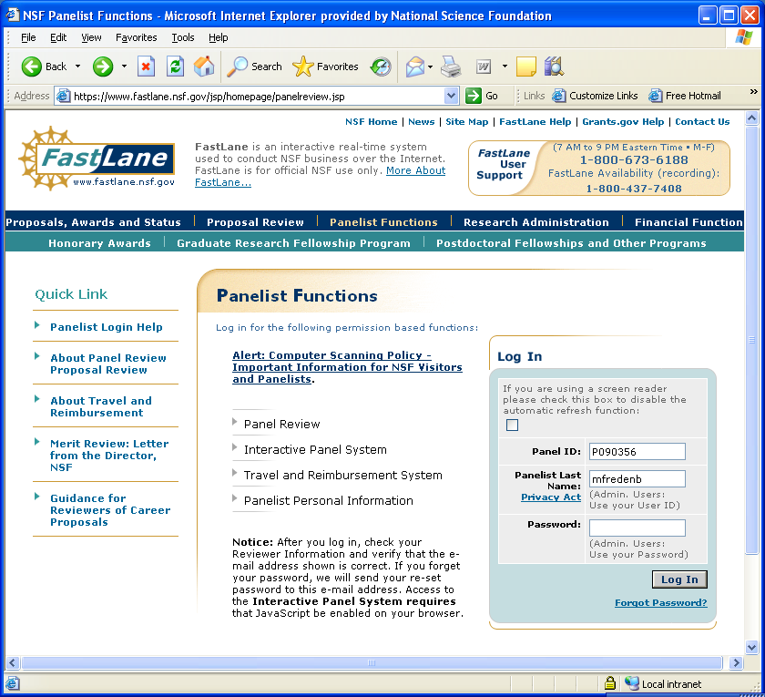

National Science Foundation
https://www.fastlane.nsf.gov/NSFHelp/flashhelp/fastlane/FastLane_Help/fastlane_help.htm#introduction_to_fastlane.htm

Slide 56

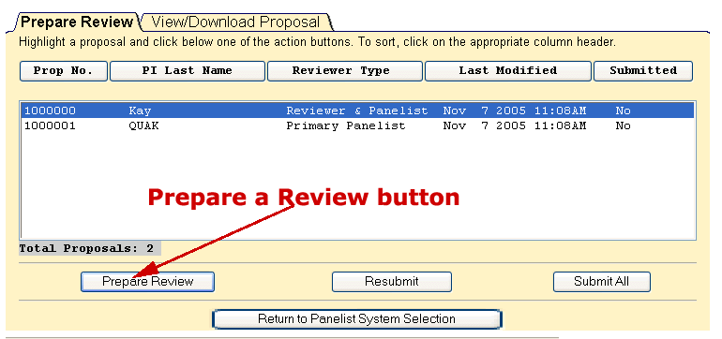
Panel Review System
National Science Foundation

Slide 57
Panel Summary Format
Intellectual Merit (Strengths & Weaknesses)
Broader Impact (Strengths & Weaknesses)
Special Review Criteria
Prior NSF support (if applicable)
Data Management Plan
Post-doctoral Mentoring Plan (if applicable) Summary
This summary was read by panel members, and they concurred that the summary reflects the panel discussion.

Slide 58
Thank You!
If you have more questions…….
Contact:
Your Panel Program Director

