Slide 1

Software Infrastructure for Sustained Innovation (SI²)
NSF 17-526
WEBINAR
December 13th, 2016
Rajiv Ramnath
NSF CISE/ACI
https://www.nsf.gov/pubs/2017/nsf17526/nsf17526.htm
Notes:
Hi. We’re Rajiv Ramnath and Vipin Chaudhary from the NSF Division of Advanced Cyberinfrastructure or ACI. We’re the Program Directors managing the Software Infrastructure for Sustained Innovation program, or SI2.
In this webcast, we’ll provide a brief overview of the SI2 program and describe some of the most important things you need to know about submitting a proposal.

Slide 2
Purpose of this webinar
Orient potential proposers for the SI² competition
Review the program and review criterion, and answer questions
Improve the quality of proposals
https://www.nsf.gov/pubs/2017/nsf17526/nsf17526.htm
Notes:
This webinar in intended to orient the research community for the SI2 competition, review the program and peer-review criteria, and answer questions, with the goal being to improve the quality of your proposals.

Slide 3
Outline
Participating directorates and divisions
SI² goals and implementation
Solicitation requirements
Review criteria
Q&A
https://www.nsf.gov/pubs/2017/nsf17526/nsf17526.htm
Notes:
Here is the outline of today’s presentation. We’ll start by discussing the goals of the SI2 program and how SI2 is structured to achieve those goals. Next, we’ll briefly cover some important aspects of the solicitation including the 3 types of awards, submission requirements, and deadlines. We will then survey the review criteria, with a particular focus on criteria specific to SI2. We’ll then take questions from you.

Slide 4
Participating NSF Divisions and Program Officers
Directorate for Biological Sciences
Division of Biological Infrastructure
  Peter McCartney
Directorate for Computer & Information Science & Engineering
Division of Advanced Cyberinfrastructure
  Rajiv Ramnath
  Vipin Chaudhary
Division of Computing and Communication Foundations
  Sol Greenspan
  Almadena Chtchelkanova
Directorate for Engineering
Division of Civil, Mechanical and Manufacturing Innovation (CMMI)
  Joanne D. Culbertson,
Division of Chemical, Bioengineering, Environmental, and Transport Systems (CBET)
  Ronald Joslin
Division of Electrical, Communications and Cyber Systems (ECCS)
  Hao Ling
Directorate for Social, Behavioral & Economic Sciences
Division of Social and Economic Sciences
  Cheryl Eavey
Directorate for Education & Human Resources
Division of Research on Learning in Formal and Informal Settings
  John C. Cherniavsky
Directorate for Geosciences
Division of Earth Sciences (GEO/EAR)
  Marc Stieglitz
Directorate for Mathematical & Physical Sciences
Division of Physics
  Bogdan Mihaila
Division of Materials Research
  Daryl W. Hess
Division of Mathematical Sciences
  Christopher Stark
  Yong Zheng
Division of Chemistry
  Evelyn Goldfield
Division of Astronomy
  Nigel Sharp
https://www.nsf.gov/pubs/2017/nsf17526/nsf17526.htm
Notes:
Software Infrastructure for Sustained Innovation is a crosscutting program that involves program officers from every NSF Directorate. Participating divisions and program officers are listed here, and can also be reviewed on solicitation web page at: https://www.nsf.gov/pubs/2017/nsf17526/nsf17526.htm

Slide 5
Program, priorities, Goals and implementation
NSF SI²: a multi-year initiative
https://www.nsf.gov/pubs/2017/nsf17526/nsf17526.htm
Notes:
We now will talk about the SI2 program, its priorities and goals and how we implement it.

Slide 6
SI² Program Goal – Innovative, Robust, Reliable Software
The SI² program supports the development and deployment of robust, reliable and sustainable software
That brings innovative capabilities towards sustained scientific innovation and discovery.
Through quality software development through a defined software engineering process
Includes software testing, analysis tools and capabilities
  Leverage resources, as needed, such as (see SWAMP, https://continuousassurance.org/), Software Carpentry (http://software-carpentry.org/) and the Center for Trustworthy Scientific Cyberinfrastructure (CTSC, http://trustedci.org/)
https://www.nsf.gov/pubs/2017/nsf17526/nsf17526.htm
Notes:
The SI² program focuses on supporting robust, reliable and sustainable software that will support and advance sustained scientific innovation and discovery. Thus, proposals are strongly encouraged to describe their approach to quality software development through a defined software engineering process that includes software testing, the appropriate use of analysis tools and capabilities such as those made available through the Software Assurance Marketplace (SWAMP, https://continuousassurance.org/), and collaborations with resources such as Software Carpentry (http://software-carpentry.org/) and the Center for Trustworthy Scientific Cyberinfrastructure (CTSC, http://trustedci.org/), in order to gain access to expertise where needed, such as in software design and engineering, as well as in cybersecurity.

Slide 7
Unique Criteria for the SI2 Program
This is a SOFTWARE program. Successful projects will:
Fill a recognized need (in the science community)
Create innovative, robust and reliable research capabilities in science and engineering for typically NSF-funded researchers
Embed research and innovation into the project activities
Use comprehensive user-engaged, dynamic, software engineering and management processes, w/ operational and success metrics
Be resourced by teams with credibility in software practice, and science
Build community through direct engagement
Progress towards sustainability after NSF funding has ended
https://www.nsf.gov/pubs/2017/nsf17526/nsf17526.htm
Notes:
The SI2 program is a software program with unique criteria, where successful projects will:
Fill a recognized need (in the science community)
Create innovative, robust and reliable research capabilities in science and engineering for (typical) NSF-funded researchers
Embed research and innovation into the project activities
Use a comprehensive user-engaged, dynamic, software engineering and management processes, w/ operational and success metrics
Resourced by teams with credibility in software practice, and science
Build community through direct engagement
Progress towards sustainability after NSF funding has ended
A question that we often get asked is: What does the SI2 program expect in terms of innovation. To assist you with answering that questions, we present several examples.

Slide 8
SSE: A plug-and-play software platform of robotics-inspired algorithms for modeling bio-molecular structures and motions
Award: 1440581
Current capabilities in
Modelling bio-molecular
structures and motions have
hit a saturation point in the
size of systems that can be
modeled and the length and
time scales of physics-based
simulations of these systems.
This project seeks to advance
algorithmic research in
molecular biology through a platform of plug-and-play software elements that adapt robot motion planning algorithms to modeling molecular structures and motions. These elements will incorporate modular sophisticated energetic models and molecular representations into robotics-inspired algorithms and provide cutting-edge benchmark metrics and tools for performance and other data analysis.
https://www.nsf.gov/pubs/2017/nsf17526/nsf17526.htm
Notes:
Current capabilities in modelling bio-molecular structures and motions have hit a saturation point in the size of systems that can be modeled and the length and time scales of physics-based simulations of these systems. This project seeks to advance algorithmic research in molecular biology through a platform of plug-and-play software elements that adapt robot motion planning algorithms to modeling molecular structures and motions. These elements will incorporate modular sophisticated energetic models and molecular representations into robotics-inspired algorithms and provide cutting-edge benchmark metrics and tools for performance and other data analysis.
In this case the innovation is that the software adds to the capabilities of a scientist in the molecular science domain - through computational techniques that seeks to increase the scale at which bio-molecular structures can be simulated, by bringing in algorithms from a different area - the area of robot motion planning techniques.

Slide 9
SSE: Adding Research Accounts to the ASSISTments' Platform: Helping Researchers Do Randomized Controlled Studies with Thousands of Students
Award: 1440753
ASSISTments is a free, platform for randomized controlled student-focused trials (RCTs) to help increase the quality, speed, and reliability of K-12 education while not compromising student learning. This project will add Researcher accounts to ASSISTments. Researchers will create their own experiments with IRB approval for release to teachers, and get anonymized data. Its long-term goal is to have a community of hundreds of scientists that use this tool to do their studies.
https://www.nsf.gov/pubs/2017/nsf17526/nsf17526.htm
Notes:
ASSISTments is a free, platform for randomized controlled student-focused trials (RCTs) to help increase the quality, speed, and reliability of K-12 education while not compromising student learning. This project will add Researcher accounts to ASSISTments. Researchers will create their own experiments with IRB approval for release to teachers, and get anonymized data. Its long-term goal is to have a community of hundreds of scientists that use this tool to do their studies.
The innovation here is a new capability provided to education researchers – the ability to easily create randomized controlled studies at scale -

Slide 10
SSE: Improving Vectorization
Award 1440749
Current vectorizing compilers realize only a small fraction of achievable performance. This project will make robust recent research on improving vectorization and incorporate the advances into the open-source LLVM/Clang. This work will advance the state-of-the art in automatic vectorization..
https://www.nsf.gov/pubs/2017/nsf17526/nsf17526.htm
Notes:
Current vectorizing compilers realize only a small fraction of achievable performance. This project will incorporate recent research advances in improving vectorization into the open-source LLVM/Clang, and make these available to users
Here the innovation is a software tools innovation, aimed at improving the scalability and performance of a popular compiler.

Slide 11
SI2-SSI: Distributed Workflow Management Research and Software in Support of Science
Award 1148515
In order to support a researcher’s productivity
and his/her focus on scientific questions rather
than on details of the underlining infrastructure,
planning and execution tools are needed. The
Pegasus Workflow Management System
provides tools that translate a high-level
description of the computation into a
detailed execution plan and reliably executes
that plan. Pegasus allows users to declaratively
describe their workflow definition, then makes
a plan that maps this description onto the available execution resources and executes the plans. This approach is scalable, reliable, and supports applications running on campus resources, clouds, and national cyberinfrastructure. Pegasus has been serving scientists from a broad range of disciplines: astronomy, bioinformatics, earthquake science, gravitational wave physics, limnology, and others.
https://www.nsf.gov/pubs/2017/nsf17526/nsf17526.htm
Notes:
SI2-SSI: Distributed Workflow Management Research and Software in Support of Science
In order to support a researcher’s productivity and his/her focus on scientific questions rather than on details of the underlining infrastructure, planning and execution tools are needed. The Pegasus Workflow Management System provides tools that translate a high-level description of the computation into a detailed execution plan and reliably executes that plan. Pegasus allows users to declaratively describe their workflow definition, then makes a plan that maps this description onto the available execution resources and executes the plans. This approach is scalable, reliable, and supports applications running on campus resources, clouds, and national cyberinfrastructure. Pegasus has been serving scientists from a broad range of disciplines: astronomy, bioinformatics, earthquake science, gravitational wave physics, limnology, and others.
The innovation in this project is the enhanced productivity it brings to scientists.

Slide 12
Key SI2 Priority - Towards a National Cyberinfrastructure Ecosystem
Robust and reliable multidisciplinary and omni-disciplinary software
Building on, leveraging and interoperating with other ongoing NSF-supported programs and widely used tools by the community (including commercial software) and national cyberinfrastructure investments.
  For example: Software Institutes: Science Gateways Community Institute (SGCI, http://www.sciencegateways.org) and the Molecular Science Software Institute (MolSSI - http://molssi.org/), Center for Trustworthy Scientific Cyberinfrastructure (CTSC - http://trustedci.org/), XSEDE (http://www.xsede.org)
Reducing cost of custom solutions and custom integrations
Comprehensively addressing sustainability post NSF-funding (using innovative approaches to sustainability - SAAS, incorporation into university offerings, commercialization etc.)
https://www.nsf.gov/pubs/2017/nsf17526/nsf17526.htm
Notes:
A Key SI2 Priority is making progress towards a National Cyberinfrastructure Ecosystem. Thus the SI2 program encourages proposals that seek to deliver:
Robust and reliable multidisciplinary and omni-disciplinary software
That builds on other ongoing NSF-supported programs by leveraging and being interoperable with widely used tools by the community (including commercial software), and with NSF and national cyberinfrastructure investments, as appropriate.
For example: Software Institutes: Science Gateways Community Institute (SGCI, http://www.sciencegateways.org) and the Molecular Science Software Institute (MolSSI - http://molssi.org/), Center for Trustworthy Scientific Cyberinfrastructure (CTSC - http://trustedci.org/), XSEDE (http://www.xsede.org)
Thus reducing the cost of custom solutions and custom integrations, with
Comprehensive, innovative approaches to sustainability (e.g. SAAS, incorporation into university offerings, commercialization)

Slide 13
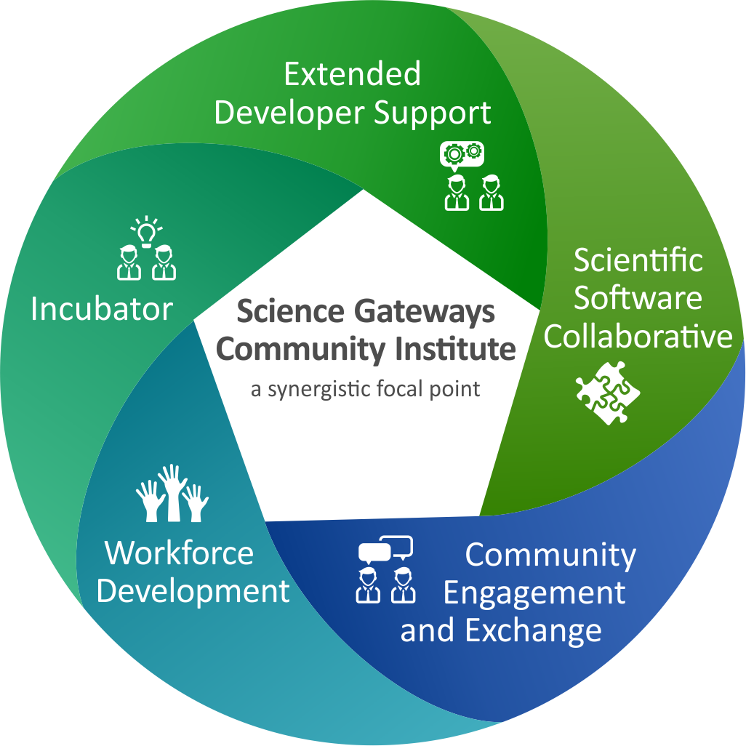
Science Gateways Community Institute
http://www.sciencegateways.org
Acknowledgement: Nancy Wilkins-Diehr, SGCI
https://www.nsf.gov/pubs/2017/nsf17526/nsf17526.htm
Notes:
The Science Gateways Community Institute will serve as a community hub to assist the gateway development and user community, across all science areas. It will provide business planning, hands-on technical support to research teams wishing to develop or enhance science gateways, and access to software frameworks that will be used to provide end-to-end software solutions for building gateways, as well as serving as a focal point for the gateway community, and as a science gateways training facility.

Slide 14

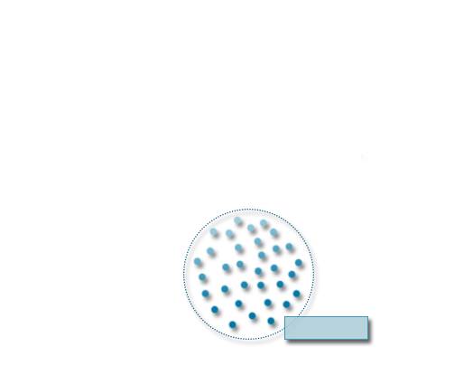
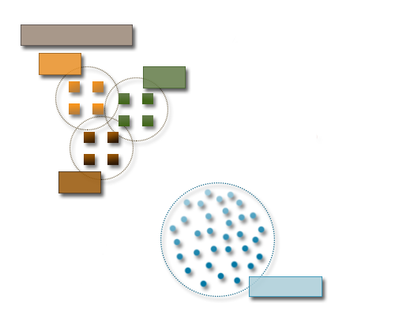
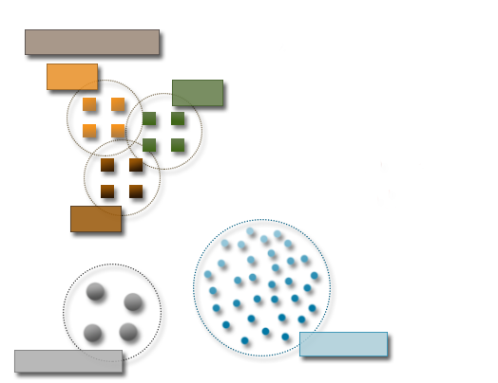
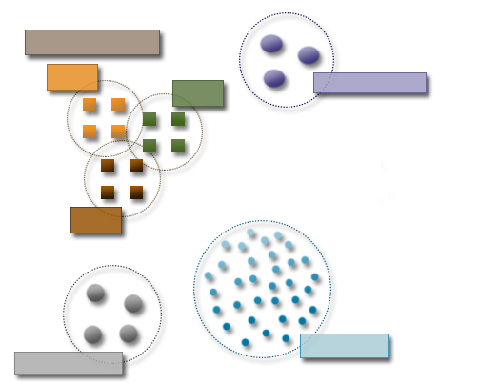
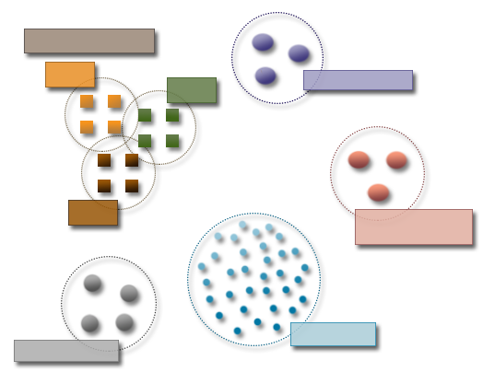

The Molecular Sciences Software Institute
http://molssi.org/
Software Scientists
Dev Team
#1
Board of Directors
Dev Team
#2
Dev Team
#3
Science & Software
Advisory Board
Community
Software Fellows
Acknowledgement: Daniel Crawford, MolSSI
Notes:
The Molecular Sciences Software Institute seeks to serve as a community software hub for the Molecular Sciences research community.
Software Scientists will serve as consultants, trainers, software developers
Software Fellows trained by MolSSI will seed community institutions
Educational programs will provide a path to sustainability

Slide 15





Center for Trustworthy Cyberinfrastructure
The mission of CTSC is to provide the NSF community with a coherent understanding of cybersecurity, its importance to computational science, and what is needed to achieve and maintain an appropriate cybersecurity program.
Notes:
The mission of CTSC is to provide the NSF community with a coherent understanding of cybersecurity, its importance to computational science, and what is needed to achieve and maintain an appropriate cybersecurity program.

Slide 16
Key SI2 Priority – Sustainability and Potential Sustainability Models
Community supported:
  Open source licensing (of various types)
  Supported by volunteer efforts by community
  “Club” i.e. consortium fees
  Institutes
Research Organizations (e.g. Universities):
  Direct support of research infrastructure (like any other infrastructure)
  Usage paid for via indirect costs on projects
  Incorporation into curriculum (and paid for by tuition $$)
NSF/Funding Agencies:
  Institutes
  CI line item on research projects
    E.g. Software “credits” to projects (like a computation allocation to HPC/XSEDE) coupled with long-term funding of foundation projects
    E.g. Direct budget line item
Commercialization
  License fees, royalties
Hybrids of the above
https://www.nsf.gov/pubs/2017/nsf17526/nsf17526.htm
Notes:
The open source community has excellent cultures of code reuse, where there is effectively low-friction collaboration through the use of repositories. This has generally not happened in scientific software. So with that, what are some potential models for sustainability?
Community supported:
Open source licensing (of various types)
Supported by volunteer efforts by community
“Club” i.e. consortium fees
Institutes
Research Organizations (e.g. Universities):
Direct support of research infrastructure (like any other infrastructure)
Usage paid for via indirect costs on projects
Incorporation into curriculum (and paid for by tuition $$)
NSF/Funding Agencies:
Institutes
Budgeted into research projects
E.g. Software “credits” to projects (like an XRAC allocation)
E.g. Direct budget line item
Commercialization
License fees, royalties
Hybrids of the above

Slide 17
Key SI2 Priority - NSCI
NSCI is an effort aimed at sustaining and enhancing the U.S. scientific, technological, and economic leadership position in high-performance computing (HPC) research, development, and deployment.
Proposals that advance the objectives of the NSCI are welcomed (in addition to other proposals)
Information about the NSCI are available at https://www.nsf.gov/nsci/.
Please review NSCI materials for priority areas.
https://www.nsf.gov/pubs/2017/nsf17526/nsf17526.htm
Notes:
This SI² solicitation welcomes proposals that advance the objectives of the National Strategic Computing Initiative (NSCI), an effort aimed at sustaining and enhancing the U.S. scientific, technological, and economic leadership position in high-performance computing (HPC) research, development, and deployment. Information about the NSCI together with the strategic plans, results of community workshops, background studies and other relevant resources, which suggest priority areas in both the domain sciences and the HPC and software infrastructure, are available at https://www.nsf.gov/nsci/. Proposers are encouraged to review these materials for priority areas identified by the research community.

Slide 18
Directorate Specific Priorities - ACI
Foundational infrastructure components.
Multidisciplinary and omnidisciplinary components.
NSCI objectives 2 and 4 – via an ecosystem architecture for future needs (https://www.nsf.gov/nsci/).
Leverage cyberinfrastructure projects in other ACI programs – XD (XSEDE), CC*DNI, CICI, DIBBs
Build on existing community CI services and software.
Enable new science and engineering not previously possible; and
Contain innovation and empirical research as an integral component of the project.
https://www.nsf.gov/pubs/2017/nsf17526/nsf17526.htm
Notes:
Some NSF directorates have additional specific information about their participation in this program, as follows:
Within the Directorate for Computer & Information Science & Engineering (CISE)
The Division of Advanced Cyberinfrastructure (ACI) manages the SI² program, and is especially interested in proposals that:
Seek to develop, deploy and sustain foundational infrastructure components, and multidisciplinary and omni-disciplinary computational tools and components.
Advance the objectives of the NSCI, particularly objectives 2 and 4, by situating the above-referenced tools and components within an ecosystem architecture that is positioned for future advancements in science and engineering;
Meaningfully leverage or complement other community cyberinfrastructure (CI) projects - such as the eXtreme Digital (XD) project (http://xsede.org) - and projects funded under NSF programs such as Campus Cyberinfrastructure - Data, Networking, and Innovation (CC*DNI), and Cyber-security Innovation for Cyberinfrastructure (CICI) and prior programs such as Data Infrastructure Building Blocks (DIBBs) – and build on existing community CI services and software, to enable new science and engineering not previously possible; and
Contain innovation and empirical research as an integral component of the project. Such research might encompass reproducibility, provenance, effectiveness, usability, and adoption of the software, its adaptability to new technologies and to changing requirements, and the software development lifecycle processes used in the project;

Slide 19
Directorate Specific Priorities – Science Domains – CISE
Primary CISE divisions: CCF, CNS, IIS
Creating software infrastructure in support of CISE research areas Integrating CISE research areas into new cyberinfrastucture
Advancing and adapting software engineering research through CI projects.
https://www.nsf.gov/pubs/2017/nsf17526/nsf17526.htm
Notes:
The Divisions of Computing and Communication Foundations (CCF), Computer and Network Systems (CNS), and Information and Intelligent Systems (IIS) are interested in supporting SSE and SSI proposals that advance software infrastructure in support of CISE research areas; integrate CISE research areas (e.g., programming languages and high-performance computing) into new cyberinfrastucture; or advance and adapt software engineering research to impact the software sustainability needs of scientific disciplines.

Slide 20
Directorate Specific Priorities – Science Domains – BIO, EHR, ENG, SBE
BIO: Proposals that impact a multi-disciplinary community that includes BIO-supported researchers.
EHR: Science, Technology, Engineering and Mathematics (STEM) learning and learning environments, workforce development, and broadening participation.
ENG: Computational tools for CBET, CMMI, and ECCS research. SSE proposals that become part of integrated software systems
SBE: SBE 2020 research priorities (https://www.nsf.gov/sbe/sbe_2020/), and projects aimed at SBE + one other directorate
https://www.nsf.gov/pubs/2017/nsf17526/nsf17526.htm
Notes:
The Directorate for Biological Sciences (BIO) is primarily interested in the SI² program as a means to collaborate with other NSF directorates to support proposals that impact a multi-disciplinary community that includes BIO-supported researchers. PIs wishing to submit software development projects that focus primarily on biological sciences should submit to Advances in Biological Informatics (ABI; NSF 15-582).
The Directorate for Education and Human Resources (EHR) is interested in proposals that focus on innovative software infrastructure that supports the directorate’s research areas, namely STEM learning and learning environments, STEM workforce development, and broadening participation in STEM. For example, EHR is interested in research studies on how software tools foster STEM learning.
The Directorate for Engineering (ENG) is primarily interested in proposals that focus on innovative computational tools that enable advances and scientific discovery in the research areas supported by its divisions of Chemical, Bioengineering, Environmental, and Transport Systems (CBET), Civil, Mechanical and Manufacturing Innovation (CMMI), and Electrical, Communications and Cyber Systems (ECCS). SSE proposals that are planned to become part of larger SSI-type integrated software systems, leading to increased community involvement, will be given priority in SSE funding decisions.
The Directorate for Social, Behavioral & Economic Sciences (SBE) is interested in proposals that focus on innovative software infrastructure that supports the directorate’s research priorities, such as those outlined in SBE 2020 (https://www.nsf.gov/sbe/sbe_2020/). In particular, SBE is interested in proposals that will further the goals of SBE and at least one of the other directorates participating in this solicitation.

Slide 21
Directorate Specific Priorities – Science Domains – GEO
Academic geosciences (atmospheric, geospatial, ocean, earth and polar sciences)
Strong connections with geosciences end-users.
Integration with GEO and/or NSF investments (EARTHCUBE), interaction between geo- and cyber/computer scientists
Contact and consult with both the SI² GEO Program Officer as well as Program Officers in the relevant geosciences domains.
https://www.nsf.gov/pubs/2017/nsf17526/nsf17526.htm
Notes:
The Directorate for Geosciences (GEO) is interested in software development projects that serve the academic geosciences (atmospheric, geospatial, ocean, earth and polar sciences). Projects must demonstrate strong connections with geosciences end-users and their research needs. Understanding of and integration with GEO and/or NSF investments in cyberinfrastructure, participation in EarthCube and interaction between geo- and cyber/computer scientists will be considered in prioritizing funding of SSI and SSE projects. PIs should contact and consult with both the SI² GEO Program Officer as well as Program Officers in the relevant geosciences domains.

Slide 22
Directorate Specific Priorities – Science Domains – MPS
  AST: Enabling progress on key questions in astronomy and astrophysics.
  CHE: Core research areas + interface of chemistry and other research domains, multiscale modeling, data-driven discovery in molecular science.
  DMR: Core research areas, interfaces of materials research with other research domains, Materials Genome Initiative – DMREF SusChEM
  DMS: Tools that have broad application
  PHY: Core research areas.
  All: Education and community development in cyberinfrastructure
https://www.nsf.gov/pubs/2017/nsf17526/nsf17526.htm
Notes:
Within the Directorate for Mathematics and Physical Sciences (MPS):
The Division of Astronomical Sciences (AST) is interested in proposals to support the development and dissemination of sustainable software that enables progress on key questions in astronomy and astrophysics.
The Division of Chemistry (CHE) encourages proposals that focus on innovative software tools that enable advances in the division’s research areas and at the interface of chemistry and other research domains, including software to enable scientific advances in NSF priority areas. This division encourages the development of software tools that support multiscale modeling of multiple and diverse interactions in complex chemical networks. It also encourages software that enables data-driven discovery in molecular science.
The Division of Materials Research (DMR) encourages proposals that focus on innovative software tools that enable advances in the division’s research areas and at the interfaces of materials research with other research domains. The division is particularly interested in projects that develop software tools to enable and support research under the Materials Genome Initiative, such as Designing Materials to Revolutionize and Engineer our Future (DMREF; NSF 16-613), and under Sustainable Chemistry, Engineering, and Materials (SusChEM; NSF 16-093).
The Division of Mathematical Sciences (DMS) welcomes proposals building computational tools that have broad application in mathematical sciences and related areas.
The Division of Physics (PHY) will consider proposals that focus on innovative computational tools that enable advances in the division's research areas.
MPS also supports education and community development in cyberinfrastructure, for example, through proposals that include visitor support (particularly for graduate students and postdoctoral researchers), postdoctoral opportunities, or short training courses that increase interactions of domain scientists and software and/or cyberinfrastructure specialists.

Slide 23
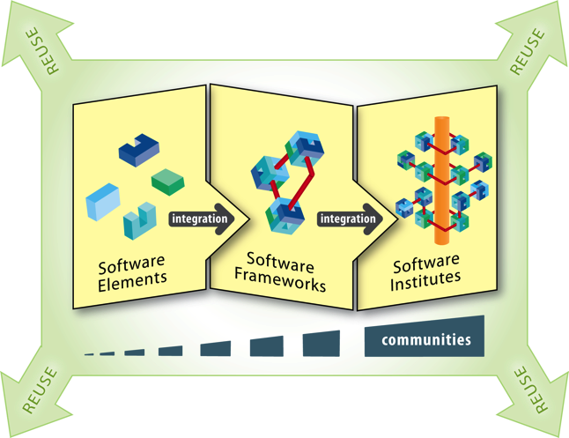
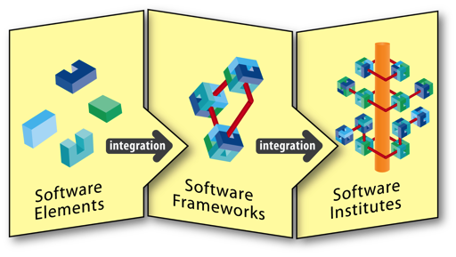
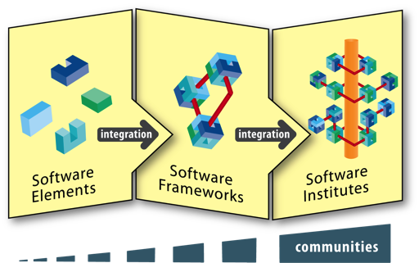
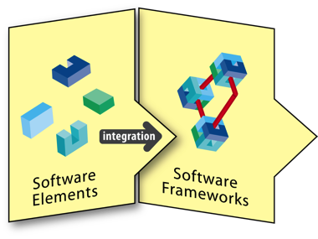
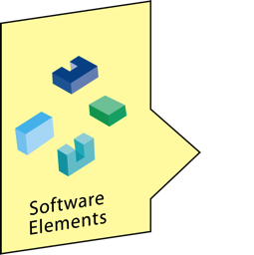
SI² Mechanisms
Create a software ecosystem that scales from individual or small groups of software innovators to large hubs of software excellence
3 interlocking levels of funding
Scientific Software Elements (SSE)
1–2 PIs, <$500k, 3 years
Scientific Software Integration (SSI)
For focused groups
$200k - $1M per year, 3–5 years
Software Institutes (S2I2) – Conceptualizations only
Long-term hubs of excellence in software infrastructure and technologies. $500K - 3 years
https://www.nsf.gov/pubs/2017/nsf17526/nsf17526.htm
Notes:
Ultimately, NSF seeks to create a software ecosystem that scales from individual or small groups of software innovators to large hubs of software excellence. To create this ecosystem, SI2 uses three types of elements, with “interlocking” levels of funding.
The first type is the SI2 Scientific Software Elements (SSEs). SSE proposals focus on projects led by a small number of investigators, and can cost up to $500,000 over up to three years.
The next type of element is SI2 Scientific Software Integrations (SSIs, also known as Software Frameworks). SSI Proposals are for focused groups, and can cost between $200,000 and $1,000,000 per year for three to five years. Software frameworks can integrate multiple Software Elements, whether funded by NSF or not. Software Frameworks are typically aimed at creating a comprehensive set of software tools or capabilities that can assist a researcher across his or her science workflow.
Projects at all levels are expected to impact the research done by communities. The impacted communities for SSIs should be larger than for SSEs.
As the research ecosystem grows to include entire communities, support will be provided for software institutes (S2I2) - long-term hubs of excellence in software infrastructure and technologies. Note: Only Conceptualization proposals for Software Institutes are open for this solicitation.

Slide 24
FY17 SI² Competition: Changes from FY16
SSE due date now in March
S2I2 Conceptualization proposals due in April
The Introduction section has been revised to state an interest in proposals that advance the National Strategic Computing Initiative (NSCI).
The paragraph on additional NSF unit-specific participation information within the section titled Synopsis of the Program has been revised to reflect the current priorities of these units, including, but not limited to, advancing the goals of the NSCI.
The section on solicitation-specific review criteria has been refined in the interest of greater clarity.
This solicitation now includes the option to submit S2I2 Conceptualization proposals.
Grant Proposal Guide (GPG) has been replaced with NSF Proposal & Award Policies & Procedures Guide (PAPPG), (NSF 17-1): https://www.nsf.gov/pubs/policydocs/pappg17_1/index.jsp. To be released January 30th 2017.
https://www.nsf.gov/pubs/2017/nsf17526/nsf17526.htm
Notes:
Several changes from the fiscal year 2016 SI2 solicitation have been made to the SI2 solicitation for fiscal year 2017.
The SSE due date is now in March. The SSI due date stays the same, and is in September.
The Introduction section has been revised to state an interest in proposals that advance the National Strategic Computing Initiative (NSCI).
The paragraph on additional NSF unit-specific participation information within the section titled Synopsis of the Program has been revised to reflect the current priorities of these units, including, but not limited to, advancing the goals of the NSCI.
The section on solicitation-specific review criteria has been refined in the interest of greater clarity.
This solicitation now includes the option to submit S²I² Conceptualization proposals. These proposals are due in April.
Please visit https://www.nsf.gov/pubs/2017/nsf17526/nsf17526.htm at the bottom of the slide for more information on specific due dates and the revised solicitation review criteria.
Finally note Grant Proposal Guide (GPG) has been replaced with NSF Proposal & Award Policies & Procedures Guide (PAPPG), (NSF 17-1) which has been issued at: https://www.nsf.gov/pubs/policydocs/pappg17_1/index.jsp

Slide 25
FY17 SI² Competition:
Eligibility
Proposals may only be submitted by:
  Universities and Colleges
  Non-profit, non-academic organizations
FFRDCs may not receive funds directly from NSF under this solicitation
Limit on Number of Proposals per PI or Co-PI: 1
  An individual may participate as Principal Investigator, co-Principal Investigator or other Senior Personnel in at most one full proposal in the pair of SSE and SSI competitions that occurs in a given calendar year
  In the case of multiple proposals that include the same individual, all but the earliest will be returned without review
See solicitation for details
https://www.nsf.gov/pubs/2017/nsf17526/nsf17526.htm
Notes:
The eligibility criteria for the SI2 program are as follows:
Proposals may only be submitted by universities and colleges or non-profit, non-academic organizations. Federally-funded research and development centers (FFRDCs) may not receive funds directly from NSF under this solicitation.
The number of proposals per principal investigator or co-principal investigator is limited to one. An individual may participate in a proposal as a principal investigator, co-principal investigator, or other senior personnel in at most one full proposal for each pair of SSE/SSE competitions that occurs in a given calendar year. In the case of multiple proposals that include the same individual, all but the earliest will be returned without review.
Please review the solicitation for details.

Slide 26
Solicitation requirementS
Context for meeting SI² goals
https://www.nsf.gov/pubs/2017/nsf17526/nsf17526.htm
Notes:
Next, solicitation requirements

Slide 27
SI² SSE and SSI Proposal Elements
How the proposed software will fill a recognized need and advance research capability within a significant area or areas of science and engineering. Provide a compelling discussion of the software's potential use by its intended and broader communities, preferably via use cases developed in concert with relevant domain scientists.
How the project integrates innovation and discovery into the project activities.
How the proposed software compares to alternative or existing elements (including other commercial and research solutions) and what are the limitations of these existing elements.
If PIs have been previously funded under an SSE or SSI award, they should show quantifiable evidence of the use, impact and sustainability of the previously funded software, and should also include a citation to the published software in their biographical sketches as one of their relevant products.
The architecture of the software and the software engineering process to be used for the design, development, documentation, testing, validation and release of the software, its deployment and associated outreach to the end user community, and an acceptance and evaluation plan that involves end users.
How security, trustworthiness, provenance, reproducibility, and usability will be addressed by the project and integrated into the proposed software system and the software engineering process.
https://www.nsf.gov/pubs/2017/nsf17526/nsf17526.htm
Notes:
SI² Proposals should identify:
How the proposed software will fill a recognized need and advance research capability within a significant area or areas of science and engineering. Provide a compelling discussion of the software's potential use by its intended and broader communities, preferably via use cases developed in concert with relevant domain scientists.
How the project integrates innovation and discovery into the project activities.
How the proposed software compares to alternative or existing elements (including other commercial and research solutions) and what are the limitations of these existing elements.
If PIs have been previously funded under an SSE or SSI award, quantifiable evidence of the use, impact and sustainability of the previously funded software, and a citation to the published software in their biographical sketches as one of their relevant products.
The architecture of the software and the software engineering process to be used for the design, development, documentation, testing, validation and release of the software, its deployment and associated outreach to the end user community, and an acceptance and evaluation plan that involves end users.
How security, trustworthiness, provenance, reproducibility, and usability will be addressed by the project and integrated into the proposed software system and the software engineering process.
Continued on the next slide

Slide 28
SI² SSE and SSI Proposal Elements (continued)
How adaptability to new technologies and changing requirements will be addressed by the project and built into the proposed software system.
Which software license will be used for the released software, and why this license has been chosen.
The project plan, including user interactions and a community-driven approach, and a timeline including a proof- of-concept demonstration of the key software components. The proposal must include a list of tangible metrics, with end user involvement, to be used to measure the success of the software element developed, especially the quantitative and qualitative definition of a "working prototype" against which that milestone will be judged, and the steps necessary to take the software element from prototype to dissemination into the community as reusable software resources.
The outreach and education plan for additional end user groups to take advantage of the proposed work, with the potential to have impact beyond the institution, including the possible adoption of approaches, curricula, and instructional material broadly within the relevant disciplines.
Sustainability of the developed software beyond the lifetime of the award.
How the proposed software will leverage and be interoperable with widely used tools by the community, and with NSF and national cyberinfrastructure investments, as appropriate.
How it advances the NSCI, in a clearly identifiable section (for proposals that seek to be considered as responsive to the NSCI).
https://www.nsf.gov/pubs/2017/nsf17526/nsf17526.htm
Notes:
SI² Proposals should identify:
How adaptability to new technologies and changing requirements will be addressed by the project and built into the proposed software system.
Which software license will be used for the released software, and why this license has been chosen.
The project plan, including user interactions and a community-driven approach, and a timeline including a proof- of-concept demonstration of the key software components. The proposal must include a list of tangible metrics, with end user involvement, to be used to measure the success of the software element developed, especially the quantitative and qualitative definition of a "working prototype" against which that milestone will be judged, and the steps necessary to take the software element from prototype to dissemination into the community as reusable software resources.
The outreach and education plan for additional end user groups to take advantage of the proposed work, with the potential to have impact beyond the institution, including the possible adoption of approaches, curricula, and instructional material broadly within the relevant disciplines.
Sustainability of the developed software beyond the lifetime of the award.
How the proposed software will leverage and be interoperable with widely used tools by the community, and with NSF and national cyberinfrastructure investments, as appropriate.
If the proposal seeks to be considered as responsive to the NSCI, how it advances this initiative.
On a related point, note that the complete review criteria for SSE and SSI proposals are detailed and discussed later.

Slide 29
S²I² Conceptualization Proposal Elements
The rationale for the envisioned institute, its mission and goals, and its responsiveness to community needs and to programmatic areas of interest to the SI² program and associated Dear Colleague Letters.
The scientific and engineering communities and software elements/frameworks targeted, and the specific software sustainability challenges that will be addressed.
Approaches for reaching out to the relevant communities and engaging them in the conceptual design process.
The anticipated impact to the scientific and engineering communities in terms of research, innovation and productivity.
The overarching approach as well as specific steps that will be taken towards the conceptual design of the envisioned institute.
The qualifications of the PIs to lead the conceptualization effort for the envisioned institute.
A steering committee comprising leading members of the targeted community that could assume key roles in the leadership and/or management of the envisioned institute. Brief biographies of the members of the steering committee and their role in the conceptualization process should be included.
How it advances the NSCI, in a clearly identifiable section (for proposals that seek to be considered as responsive to the NSCI).
https://www.nsf.gov/pubs/2017/nsf17526/nsf17526.htm
Notes:
S²I² Conceptualization Proposals Should Provide
The rationale for the envisioned institute, its mission and goals, and its responsiveness to community needs and to programmatic areas of interest to the SI² program and associated Dear Colleague Letters.
The scientific and engineering communities and software elements/frameworks targeted, and the specific software sustainability challenges that will be addressed.
Approaches for reaching out to the relevant communities and engaging them in the conceptual design process.
The anticipated impact to the scientific and engineering communities in terms of research, innovation and productivity.
The overarching approach as well as specific steps that will be taken towards the conceptual design of the envisioned institute.
The qualifications of the PIs to lead the conceptualization effort for the envisioned institute.
A steering committee comprising leading members of the targeted community that could assume key roles in the leadership and/or management of the envisioned institute. Brief biographies of the members of the steering committee and their role in the conceptualization process should be included.
If the proposal seeks to be considered as responsive to the NSCI, the relevance to this NSCI, in a clearly identifiable section.

Slide 30
Additional Documents
Data Management Plan & Postdoctoral Trainee Mentoring Plan (if project includes such trainees)
  Standard NSF requirement
  SI2 reviewers pay close attention to data management plan, since software is data, and the goal of SI2 is to produce well-used software
For SSI proposals, Management and Coordination Plan:
  the specific roles of the PI, co-PIs, other senior personnel and paid consultants at all institutions involved
  how the project will be managed across institutions and disciplines
  identification of the specific coordination mechanisms that will enable cross-institution and/or cross-discipline scientific integration
  pointers to the budget line items that support these management and coordination mechanisms
Letters of collaboration, if any
https://www.nsf.gov/pubs/2017/nsf17526/nsf17526.htm
Notes:
Additional documents include:
A data management plan and postdoctoral trainee mentoring plan (if the project includes such trainees). This is a standard NSF requirement. SI2 reviewers pay close attention to the data management plan since software is data and the goal of SI2 is to produce well-used software.
For SSI proposals, a management and coordination plan is also required. The specific roles of the principal investigators, co-principal investigators, other senior personnel, and paid consultants at all institutions involved must be outlined. Also, there must be a description of how the project will be managed across institutions and disciplines, identification of the specific coordination mechanisms that will enable cross-institution and/or cross-discipline scientific integration, and pointers to the budget line items that support these management and coordination mechanisms.
Letters of Collaboration (if any) should include documentation of funded or unfunded collaborative arrangements of significance to the proposal (see PAPPG Chapter II.C.2.d(iv) for details). Letters of collaboration should be limited to stating the intent to collaborate and should not contain endorsements or evaluation of the proposed project. The REQUIRED format for letters of collaboration is in the NSF Proposal & Award Policies & Procedures Guide (PAPPG).

Slide 31
Additional Documents – Project Personnel and Partner Institutions
Provide current, accurate information for all personnel and institutions involved in the project.
The list must include all PIs, Co-PIs, Senior Personnel, Consultants, Collaborators, Subawardees, Postdocs, advisory committee members, and writers of letters of collaboration.
NSF staff will use this information in the merit review process to manage conflicts of interest.
See details in the solicitation.
https://www.nsf.gov/pubs/2017/nsf17526/nsf17526.htm
Notes:
Additional documents include:
Project Personnel and Partner Institutions (required for all award categories): Provide current, accurate information for all personnel and institutions involved in the project. NSF staff will use this information in the merit review process to manage conflicts of interest. The list must include all PIs, Co-PIs, Senior Personnel, paid/unpaid Consultants or Collaborators, Subawardees, Postdocs, project-level advisory committee members, and writers of letters of support. See details in the solicitation.

Slide 32
Additional Documents – Collaborators and Other Affiliations
Collaborators & Other Affiliations information as specified in the PAPPG .
A completed spreadsheet for each PI, co-PI, or senior personnel .
NSF staff use this information in the merit review process to help manage reviewer selection.
Note the distinction from requirement on previous slide on Additional Documents
See details in the solicitation.
https://www.nsf.gov/pubs/2017/nsf17526/nsf17526.htm
Notes:
Additional documents - Collaborators and Other Affiliations Information:
Collaborators & Other Affiliations information specified in the PAPPG should be submitted using the spreadsheet template found at https://www.nsf.gov/cise/collab/. For each proposal, a completed spreadsheet for each PI, co-PI, or senior personnel must be uploaded directly into Fastlane in .xls or .xlsx format as a "Collaborator and Other Affiliations" Single Copy Document.
NSF staff use this information in the merit review process to help manage reviewer selection; the spreadsheet will ensure the Collaborator and Other Affiliations information has a common, searchable format.
Note the distinction to (2) above for Supplementary Documents: the listing of all project participants is collected by the project lead and entered as a Supplementary Document, which is then automatically included with all proposals in a project. The Collaborators and Other Affiliations (this document) are entered for each participant within each proposal and, as Single Copy Documents, are available only to NSF staff.
See details in the solicitation

Slide 33
Review criteria
NSF standard and solicitation-specific criteria
https://www.nsf.gov/pubs/2017/nsf17526/nsf17526.htm
Notes:
Now I will review the review criteria for SI2 proposals, with a specific focus on review criteria that are unique to this program.

Slide 34
SI² review criteria
Reviewers and panel will address:
Intellectual Merit,
Broader Impacts, and
SI² Additional Review Criteria
in their reviews, panel discussions, and panel summaries
SI²
https://www.nsf.gov/pubs/2017/nsf17526/nsf17526.htm
Notes:
As for all proposals received by NSF, SI2 reviewers and panelists will be asked to consider the intellectual merit and broader impact for each proposal for their reviews, panel discussions, and panel summaries. In addition to these standard criteria, SI2 reviewers and panelists will also be asked to consider additional review criteria that are unique to the SI2 program. More on this in a few moments.

Slide 35
SI² review criteria
When evaluating NSF proposals, reviewers will consider:
what the proposers want to do
why they want to do it
how they plan to do it
how they will know if they succeed
what benefits would accrue if the project is successful
These issues apply both to the technical aspects of the proposal (intellectual merit) and the way in which the project may make broader contributions (broader impacts)
https://www.nsf.gov/pubs/2017/nsf17526/nsf17526.htm
Notes:
When evaluating NSF proposals, reviewers are asked to consider:
what the proposers want to do
why they want to do it
how they plan to do it
how they will know if they succeed
what benefits would accrue if the project is successful
These issues apply both to the technical aspects of the proposal (the intellectual merits) and the way in which the project may make broader contributions (the broader impacts).

Slide 36
SI² SSE & SSI specific criteria - 1
To what extent does the proposed software fill a recognized need and advance research capability within a significant area (or areas) of science and engineering?
To what extent does the project integrate innovation and research into the project activities?
How well does the proposal present and discuss the project plan and timeline, including proof-of-concept demonstrations of key software elements and the steps necessary to take the software from prototype to dissemination into the community as reusable software resources?
Does the proposal state the software license to be used and is the choice both suitably justified and appropriate, given the goals of the project?
If the proposers claim to have previously developed widely-used software, particularly if funded under an SSE or SSI award, how significant was the use and impact of the previously funded software, as shown by the quantifiable evidence in the proposal, and is the software properly listed in the appropriate proposers' biosketches?
Are tangible metrics described to measure the success of any software that may be developed? How appropriate are these metrics?
Not yes/no
https://www.nsf.gov/pubs/2017/nsf17526/nsf17526.htm
Notes:
In addition to the Intellectual Merit and Broader Impacts criteria, there are review criteria that are specific to the SI2 program. Additional criteria and questions will be considered during peer-review. These have been broken up across two slides. The first set of criteria includes:
To what extent does the proposed software fill a recognized need and advance research capability within a significant area (or areas) of science and engineering?
To what extent does the project integrate innovation and research into the project activities?
How well does the proposal present and discuss the project plan and timeline, including proof-of-concept demonstrations of key software elements and the steps necessary to take the software from prototype to dissemination into the community as reusable software resources?
Does the proposal state the software license to be used and is the choice both suitably justified and appropriate, given the goals of the project?
If the proposers claim to have previously developed widely-used software, particularly if funded under an SSE or SSI award, how significant was the use and impact of the previously funded software, as shown by the quantifiable evidence in the proposal, and is the software properly listed in the appropriate proposers' biosketches?
Are tangible metrics described to measure the success of any software that may be developed? How appropriate are these metrics?
Note that reviewers will be asked to comment on all of these criteria, and to explain their opinions, not just say yes or no, the proposal does or does not address the criteria.

Slide 37
SI² SSE & SSI specific criteria - 2
How well does the software engineering and development plan include and/or enable the integration of relevant activities to ensure the software is responsive to new computing developments?
To what extent are issues of security, trustworthiness, reproducibility, and usability addressed and integrated into the proposed software?
To what extent is adaptability to new technologies and changing requirements addressed by the project and built into the proposed software system?
How well does the project plan include user interaction, a community-driven approach, and a timeline of new feature releases? Is there a strong plan to extend the work to additional user communities?
How well does the project address the sustainability of the developed software beyond the lifetime of the award?
To what extent does the proposed software leverage, and to what extent is it interoperable with, widely used tools by the community, and NSF and national cyberinfrastructure investments, as appropriate?
Not yes/no
https://www.nsf.gov/pubs/2017/nsf17526/nsf17526.htm
Notes:
The second set of solicitation specific criteria includes:
How well does the software engineering and development plan include and/or enable the integration of relevant activities to ensure the software is responsive to new computing developments?
To what extent are issues of security, trustworthiness, reproducibility, and usability addressed and integrated into the proposed software?
To what extent is adaptability to new technologies and changing requirements addressed by the project and built into the proposed software system?
How well does the project plan include user interaction, a community-driven approach, and a timeline of new feature releases? Is there a strong plan to extend the work to additional user communities?
How well does the project address the sustainability of the developed software beyond the lifetime of the award?
To what extent does the proposed software leverage, and to what extent is it interoperable with, widely used tools by the community, and NSF and national cyberinfrastructure investments, as appropriate?
Once again note that the reviewers will be asked to comment on all of these criteria, and to explain their opinions, not just say yes or no, the proposal does or does not address the criteria.

Slide 38
S²I² Conceptualization solicitation specific criteria
How compelling is the rationale for the envisioned institute, its mission and goals, and its responsiveness to community needs and to programmatic areas of interest to the SI² program and associated Dear Colleague Letters?
To what extent does the proposal describe the scientific and engineering communities and software elements/frameworks to be targeted, and the specific software sustainability challenges that will be addressed?
To what extent does the proposal describe approaches for reaching out to the relevant communities and engaging them in the conceptual design process?
To what extent does the proposal describe the anticipated impact to the scientific and engineering communities in terms of research, innovation and productivity?
To what extent does the proposal describe the overarching approach as well as specific steps that will be taken towards the conceptual design of the envisioned institute?
What qualifies the PIs to lead the conceptualization effort for the envisioned institute?
How qualified are the members of the steering committee in their ability to assume key roles in the leadership and/or management of the envisioned institute?
Not yes/no
https://www.nsf.gov/pubs/2017/nsf17526/nsf17526.htm
Notes:
S²I² Conceptualization solicitation specific criteria
How compelling is the rationale for the envisioned institute, its mission and goals, and its responsiveness to community needs and to programmatic areas of interest to the SI² program and associated Dear Colleague Letters?
To what extent does the proposal describe the scientific and engineering communities and software elements/frameworks to be targeted, and the specific software sustainability challenges that will be addressed?
To what extent does the proposal describe approaches for reaching out to the relevant communities and engaging them in the conceptual design process?
To what extent does the proposal describe the anticipated impact to the scientific and engineering communities in terms of research, innovation and productivity?
To what extent does the proposal describe the overarching approach as well as specific steps that will be taken towards the conceptual design of the envisioned institute?
What qualifies the PIs to lead the conceptualization effort for the envisioned institute?
How qualified are the members of the steering committee in their ability to assume key roles in the leadership and/or management of the envisioned institute?

Slide 39
On behalf of the National Science Foundation and the SI² team
THANK YOU!
Questions?
Now
rramnath@nsf.gov, or 703-292-4776
vipchaud@nsf.gov, or 703-292-2254
These slides, an audio recording, and a script of this webinar are available at http://www.nsf.gov/events/
https://www.nsf.gov/pubs/2017/nsf17526/nsf17526.htm
Notes:
The slides and the script for this webcast, as well as an audio recording, will be available at http://www.nsf.gov/events/. On that page, you’ll need to look for this webcast among the list of events. I invite your questions now, via email to rramnath@nsf.gov, or via telephone to 703-292-4776, and vipchaud@nsf.gov, or 703-292-2254. You can also find contact details for program officers from other NSF Directorates who are involved in the SI2 program on the solicitation web page https://www.nsf.gov/pubs/2017/nsf17526/nsf17526.htm.

